Slide 1
Unit 2 Review Biochemistry and Introduction to the Cell
AP Bio – Ch. 4-7

Slide 2
Unit 2 – Overview
Ch. 4 + 5
Carbon and the Molecular Diversity of Life
The Structure and Function of Large Biological Molecules
Ch. 6 – A Tour of the Cell
Ch. 7 – Membrane Structure and Function

Slide 3
Unit 2 – Overview
Ch. 4 + 5
Carbon and the Molecular Diversity of Life
The Structure and Function of Large Biological Molecules
Ch. 6 – A Tour of the Cell
Ch. 7 – Membrane Structure and Function

Slide 4
Ch. 4 + 5 – YOU MUST KNOW
The properties of carbon that make it so important.
The role of functional groups in determining molecular functions.
The role of dehydration reactions in the formation of organic compounds and hydrolysis in the digestion of organic compounds.
How the sequence and subcomponents of the four groups of organic compounds determine their properties.
The structures and functions of carbs, lipids, proteins, and nucleic acids.
The four structural levels of proteins and how changes at any level can affect their function (paper demonstration).
How proteins reach their final conformation (shape), the denaturing impact that heat and pH can have on protein structure, and how these changes may effect the organism.

Slide 5
Ch. 4 + 5 Overview
Carbon and molecular diversity
The major elements of life are CHON
ALL organic compounds contain carbon and must also contain hydrogen
Carbon is unparalleled in its ability to form molecules that are large and diverse. Why?
It has 4 valence electrons → it can form up to four covalent bonds (single, double, or even triple bonds)
It can form large molecules in the various shapes (chainz, ring-shaped, or branched).

Slide 6
Ch. 4 + 5 Overview
Carbon and molecular diversity (cont.)
Isomers are molecules that have the same molecular formula but differ in their arrangement of these atoms.
These differences can result in molecules that are very different in their biological activities. (e.g. glucose [C₆H₁₂O₆] and fructose [C₆H₁₂O₆])

Slide 7
Ch. 4 + 5 Overview
Carbon and molecular diversity (cont.)
The distinctive properties of an organic molecule depend not only on the arrangement of its carbon skeleton, but also on the various functional groups attached to the skeleton.
The functional groups attached to the carbon skeleton have diverse properties.
The behavior of organic molecules is dependent on the identity of their functional groups.

Slide 8
Ch. 4 + 5 Overview

Slide 9
Ch. 4 + 5 Overview
Macromolecules are polymers, built from monomers
Large carbohydrates (polysaccharides), proteins, and nucleic acids are polymers, which are chains of monomers.
The components of lipids vary.
Monomers form larger molecules by dehydration reactions, in which water molecules are released.
Polymers can disassemble by the reverse process, hydrolysis.
An immense variety of polymers can be built from a small set of monomers.

Slide 10
Summary of key concepts: carbohydrates
Notes:
Figure 5.UN03 Summary of key concepts: carbohydrates

Slide 11
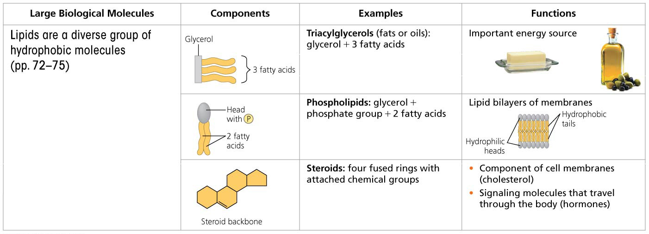
Summary of key concepts: lipids
Notes:
Figure 5.UN04 Summary of key concepts: lipids

Slide 12
Summary of key concepts: proteins
Notes:
Figure 5.UN05 Summary of key concepts: proteins

Slide 13
Summary of key concepts: nucleic acids
Notes:
Figure 5.UN06 Summary of key concepts: nucleic acids

Slide 14
Unit 2 – Overview
Ch. 4 + 5
Carbon and the Molecular Diversity of Life
The Structure and Function of Large Biological Molecules
Ch. 6 – A Tour of the Cell
Ch. 7 – Membrane Structure and Function

Slide 15
A Tour of the Cell – YOU MUST KNOW
At least three major differences between prokaryotic and eukaryotic cells.
How cell size and shape affect the overall functioning of cells.
The structure and function of eukaryotic organelles.
How internal membranes and organelles cohesively contribute to cellular functions.

Slide 16
A Tour of the Cell

Slide 17
A Tour of the Cell
Eukaryotic cells have internal membranes that compartmentalize their functions
All cells are bounded by a plasma membrane.
Prokaryotic cells lack nuclei and other membrane-enclosed organelles, while eukaryotic cells have internal membranes that compartmentalize cellular functions.
The surface-to-volume ratio is an important parameter affecting cell size and shape.
Plant and animal cells have most of the same organelles: a nucleus, endoplasmic reticulum, Golgi apparatus, and mitochondria.
Chloroplasts are present only in cells of photosynthetic eukaryotes.

Slide 18
Summary of key concepts: nucleus and ribosomes
Notes:
Figure 6.UN03 Summary of key concepts: nucleus and ribosomes

Slide 19
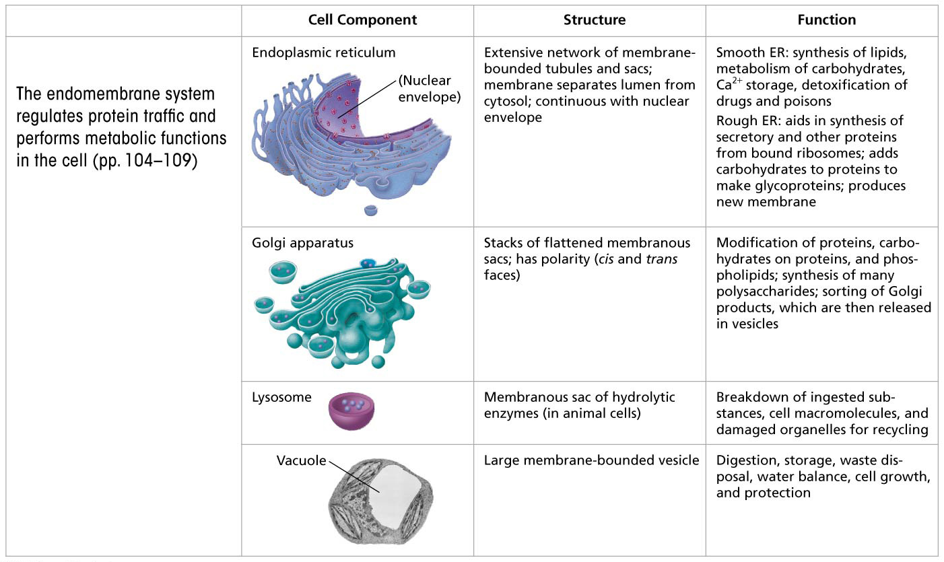
Summary of key concepts: endomembrane system
Notes:
Figure 6.UN04 Summary of key concepts: endomembrane system

Slide 20
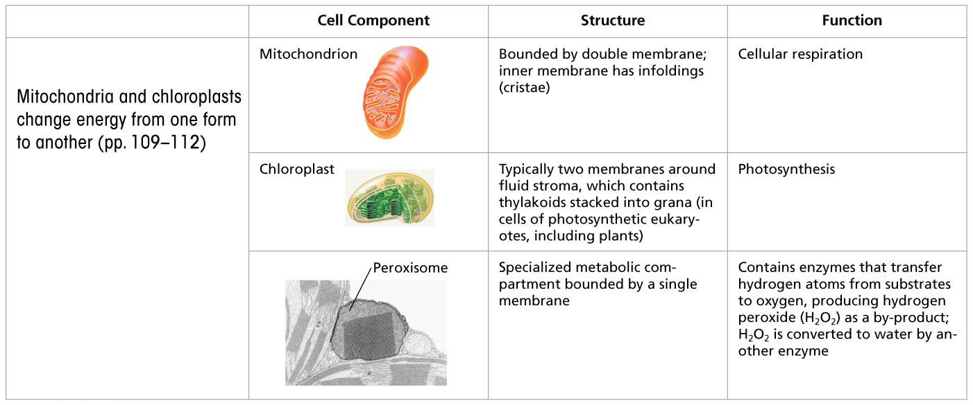
Summary of key concepts: mitochondria and chloroplasts
Notes:
Figure 6.UN05 Summary of key concepts: mitochondria, chloroplasts and peroxisomes

Slide 21
Unit 2 – Overview
Ch. 4 + 5
Carbon and the Molecular Diversity of Life
The Structure and Function of Large Biological Molecules
Ch. 6 – A Tour of the Cell
Ch. 7 – Membrane Structure and Function

Slide 22
Membrane Structure & Function – YOU MUST KNOW
Why membranes are selectively permeable.
The structural and functional roles of phospholipids, cholesterol, fatty acids, and carbs in membranes.
How water will move when a cell is in an isotonic, hypertonic, and hypotonic solution.
Be able to predict how the cell will be affected in these different environments.
How all the different forms of transport across the cell membrane work.

Slide 23
Membrane Structure & Function
Cellular membranes are fluid mosaics of lipids and proteins
In the fluid mosaic model, amphipathic proteins are embedded in the phospholipid bilayer. Proteins with related functions often cluster in patches.
Phospholipids and some proteins move laterally within the membrane.
The unsaturated hydrocarbon tails of some phospholipids keep membranes fluid at lower temperatures, while cholesterol helps membranes resist changes in fluidity caused by temperature changes.

Slide 24
Membrane Structure & Function
Cellular membranes are fluid mosaics of lipids and proteins
Integral proteins are embedded in the lipid bilayer; peripheral proteins are attached to the membrane surface.
Short chains of sugars linked to proteins (in glycoproteins) and lipids (in glycolipids) on the exterior side of the plasma membrane interact with surface molecules of other cells.
Membrane proteins and lipids are synthesized in the ER and modified in the ER and Golgi apparatus. The inside and outside faces of membranes differ in molecular composition.

Slide 25
Membrane Structure & Function
Diffusion is the spontaneous movement of a substance down its concentration gradient.
Water diffuses out through the permeable membrane of a cell (osmosis) if the solution outside has a higher solute concentration (hypertonic) than the cytosol; water enters the cell if the solution has a lower solute concentration (hypotonic). If the concentrations are equal (isotonic), no net osmosis occurs.
Cell survival depends on balancing water uptake and loss.
Cells lacking cell walls (as in animals) are isotonic with their environments or have adaptations for osmoregulation.
Plants have relatively inelastic cell walls, so the cells don’t burst in a hypotonic environment.

Slide 26
Membrane Structure & Function
In a type of passive transport called facilitated diffusion, a transport protein speeds the movement of water or a solute across a membrane down its concentration gradient.
Ion channels, some of which are gated channels, facilitate the diffusion of ions across a membrane.
Carrier proteins can undergo changes in shape that translocate bound solutes across the membrane.

Slide 27
Membrane Structure & Function
Active transport uses energy to move solutes against their gradients
Specific membrane proteins use energy, usually in the form of ATP, to do the work of active transport.
One example of such a protein is the sodium-potassium pump aka the Drake pump.

Slide 28
Membrane Structure & Function
Bulk transport across the plasma membrane occurs by exocytosis and endocytosis
In exocytosis, transport vesicles migrate to the plasma membrane, fuse with it, and release their contents.
In endocytosis, molecules enter cells within vesicles that pinch inward from the plasma membrane.
The three types of endocytosis are phagocytosis, pinocytosis, and receptor-mediated endocytosis.

Slide 29
Unit 2 – Overview
Ch. 4 + 5
Carbon and the Molecular Diversity of Life
The Structure and Function of Large Biological Molecules
Ch. 6 – A Tour of the Cell
Ch. 7 – Membrane Structure and Function

