Slide 1
Lecture 22- Batteries, corrosion, electrolysis

Slide 2
Batteries
Many types of batteries
Galvanic
Voltaic
Daniell
Grove
Lead-acid
Gravity
Leclanche
Dry cell (zinc-carbon)
Alkaline
Nickel hydrogen/nickel metal-hydride
Lithium

Slide 3
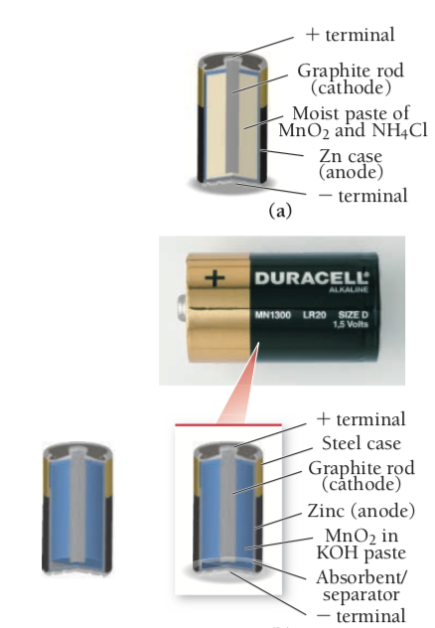
Dry-Cell Batteries
Common batteries
Do not contain large amounts of liquid water
Many types
Cheapest: zinc case which acts as anode
Oxidation (Anode): Zn (s) -> Zn 2+ (aq) + 2 e-
Reduction (Cathode): 2 MnO2 (s) + 2 NH4+ (aq) + 2 e- -> Mn2O3 (s) + 2 NH3 (g) + H2O (l)
Produce voltage of around 1.5 V
Batteries can be connected in a series to produce higher voltages
Alkaline Batteries
Oxidize zinc in basic environment (slightly different half reactions)
Oxidation (anode): Zn (s) + 2 OH- (aq) -> Zn(OH)2 (s) + 2 e-
Reduction (cathode): 2 MnO2 (s) + 2 H2O (l) + 2 e- -> 2MnO(OH) (s) + 2 OH- (aq)
Longer life than non alkaline batteries

Slide 4
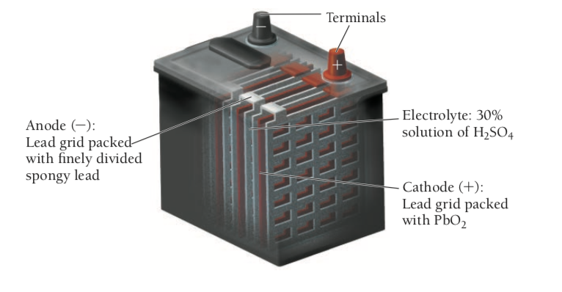
Lead-Acid Storage Batteries
Common in automobiles
6 electrochemical cells wired in a series
Each cell is 2 V (12 V total)
Each contains lead anode and lead(IV) oxide cathode
Oxidation (anode): Pb (s) + HSO4- (aq) -> PbSO4 (s) + H+ + 2e-
Reduction (cathode): PbO2 (s) + HSO4- (aq) + 3 H+ + 2 e- -> PbSO4 (s) + 2 H2O (l)
If run for a long time without recharging, too much PbSO4 (s) builds up on the surface of the electrodes
Battery dies
Can be recharged using electric current which reverses the reaction

Slide 5
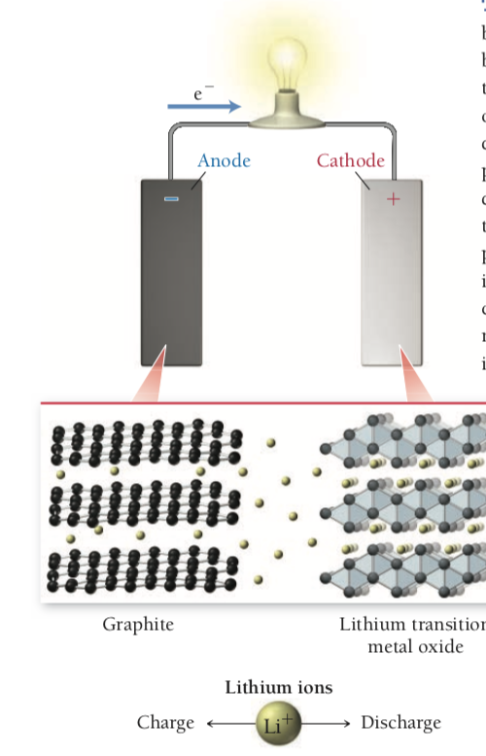
Other Rechargeable Batteries
Ex. Nickel-cadmium (NiCad) battery, nickel-metal hydride (NiMH) battery, lithium ion battery
NiCad
Oxidation (Anode): Cd (s) + 2 OH- (aq) -> Cd(OH)2 (s) + 2 e-
Reduction (Cathode): 2 NiO(OH) (s) + 2 H2O (l) + 2 e- -> 2 Ni(OH)2 (s) + 2 OH- (aq)
Electrolyte: KOH (aq)
Produces 1.30 V
Can be recharged, but overcharging is a problem as it causes electrolysis of water to form H2 and O2
NiMH
Oxidation (Anode): MH (s) + OH- (aq) -> M (s) + H2O (l) + e-
Reduction (Cathode: NiO(OH) (s) + H2O (l) + e- -> Ni(OH)2 (s) + OH- (aq)
Greater energy density than NiCad and are safer, commonly used for hybrid electric vehicles
Lithium Ion
High energy density since lithium is least dense metal
Works differently than other batteries
Lithium ions move from anode to cathode
Causes flow of electrons in external circuit
Anode is made of graphite while cathode is made up a lithium transition metal oxide (ex. LiCoO2 or LiMn2O4)
Recharging oxidizes the transition metal causing lithium to go back to the graphite
Commonly used in cell phones, laptops, and digital cameras

Slide 6
Fuel Cells
Similar to batteries
Need to be replenished from an outside source
Reactants constantly flow through from an external source
Generates electrical current
May be replacements for or work with centralized power grid electricity
May also be more efficient for vehicles
Most common: hydrogen-oxygen fuel cell
H2 flows past anode (screen coated in platinum)
Oxidation (Anode): 2 H2 (g) + 4 OH- (aq) -> 4 H2O (l) + 4 e-
Reduction (Cathode): O2 (g) + 2 H2O (l) + 4 e- -> 4 OH- (aq)
Used in space shuttles

Slide 7
Corrosion
Gradual oxidation of metals exposed to oxidizing agents
Can see the reduction of oxygen has a strong tendency to occur and can oxidize metals
O2 (g) + 2H2O (l) + 4 e- -> 4 OH- (aq)
E = 0.40 V
O2 (g) + 4 H+ (aq) + 4 e- -> 2 H2O (l)
E = 1.23 V
Oxidation of metals is spontaneous when paired with reduction of oxygen
Opposite process to extraction of metals from ores
Metals are usually protected by oxides
Al is easily oxidized (-1.66 V)
Al2O3 (corundrum) is inert and protects the aluminum from further corrosion by forming a protective coating
Oxides of iron are not stable
Fe (s) -> Fe2+ (aq) + 2 e-
E = -0.45 V

Slide 8
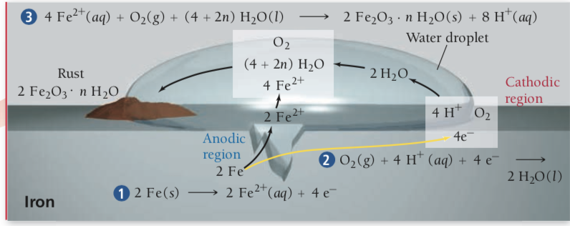
Corrosion
Overall reaction is very spontaneous
2 Fe (s) + O2 (g) + 4 H+ (aq) -> 2 H2O (l) + 2 Fe2+ (aq)
Ecell = 1.68 V
Fe2+ ions produced can migrated through moisture to cathodic regions to be further oxidized
4 Fe2+ (aq) + O2 (g) + (4 + 2n) H2O (l) -> 2 Fe2O3 x nH2O(s) + 8H+(aq)
Rust: 2 Fe2O3 x nH2O(s)
Conditions for rust to form
Moisture must be present
Allows charge to flow freely between anode and cathode
Electrolytes promote rusting
Ex. NaCl enhances current flow
Presence of acids promotes rusting
H+ ions enhance cathodic reaction
Rust can be prevented by using a sacrificial electrode
Composed o metal that oxidizes more easily than iron
Ex. Mg or Al
Can also be prevented by coating iron in a metal that oxidizes more easily
Ex. galvanized nails are coated with Zn

Slide 9
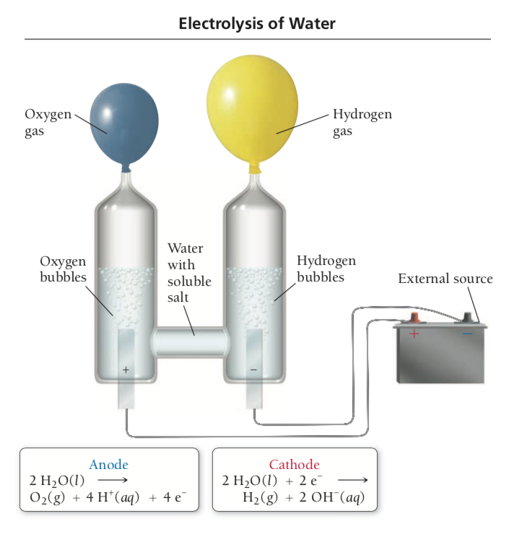
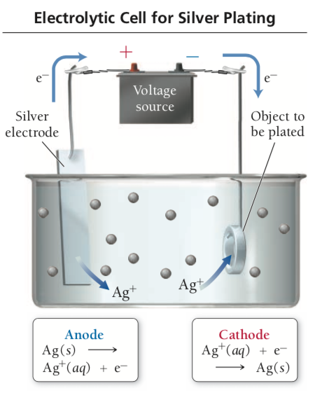
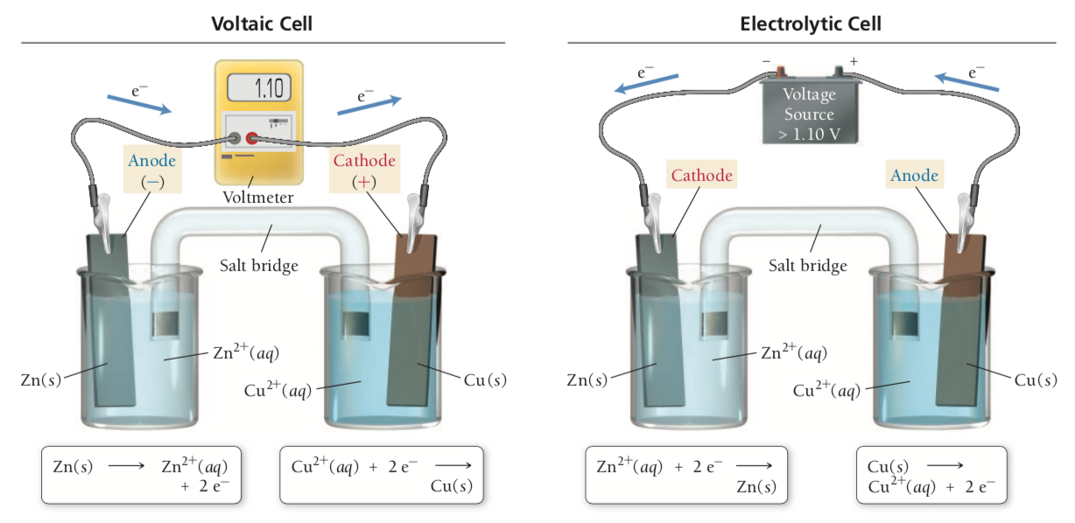
Electrolysis
Electrical current drives a nonspontaneous redox reaction
Spontaneous - voltaic
2H2 (g) + O2 (g) -> 2 H2O (l)
Nonspontaneous - electrolytic
2H2O (l) -> 2 H2 (g) + O2 (g)
Electrolysis can convert oxides to pure metals
Oxidation (anode): Ag (s) -> Ag+ (aq) + e-
Reduction (cathode): Ag+ (aq) + e- -> Ag (s)
Not spontaneous under standard conditions
Voltage required for electrolysis depends on specific half reactions (ex. Ox Zn Red Cu2+ produces 1.10 V)
If power source of over 1.10 V is inserted, electrons will be forced to flow the other way causing Zn2+ to be reduced and Cu to be oxidized

Slide 10
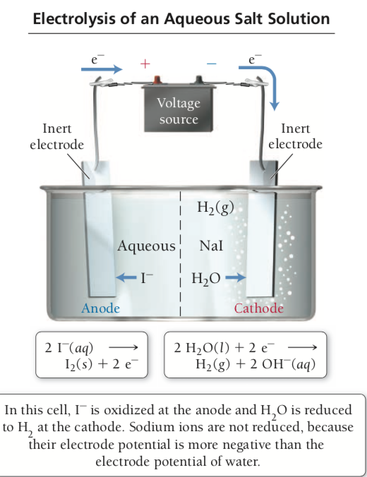
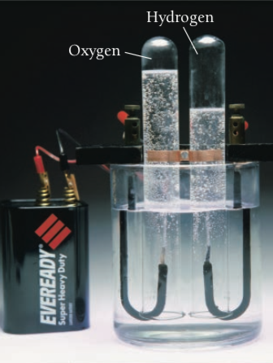
Electrolysis
In voltaic cell, anode is the source of electrons
In electrolytic cell, source of electrons is an external power source
Draws electrons away from the anode
Positive terminal of battery
Drives electrons toward the cathode
Negative terminal of battery
Predicting products of electrolysis can be simple and complex

Slide 11
Electrolysis
Pure Molten Salts
Ex. NaCl
Oxidation (anode): 2 Cl- (l) -> Cl2 (g) + 2 e-
Reduction (cathode): 2 Na+ (l) + 2 e- -> 2 Na (s)
In electrolysis of a molten salt, the anion is oxidized and the cation is reduced
Mixtures of Cations or Anions
Must determine which of the 2 cations is more easily reduced
Ex. Na and K
Na+ (aq) + e- -> Na (s)
E = -2.71 V (aq)
K+ (aq) + e- -> K (s)
E = -2.92 V (aq)
Na easier to reduce, so Na+ will be reduced at the cathode
2 anions
Ex. Cl- and Br-
2 Cl- (aq) -> Cl2 (g) + 2 e-
E = 1.36 V (aq)
2 Br- (aq) -> Br2 (l) + 2 e-
E = 1.09 V (aq)
Electrode potential for bromine half reaction is more negative so it will be more easily oxidized
Cation that is more easily reduced (more positive reduction potential) is reduced first
Antion that is more easily oxidized (more negative oxidation potential) is oxidized first

Slide 12
Electrolysis
Aqueous Solutions
Complicated by electrolysis of water itself
Oxidation (Anode): 2H2O (l) -> O2 (g) + 4 H+ (aq) + 4 e-
E = 1.23 V (standard)
E = 0.82 V ([H+] = 10^-7 M)
Reduction (Cathode): 2H2O (l) + 2 e- -> H2 (g) + 2 OH- (aq)
E = -0.83 V (standard)
E = -0.41 V ([OH-] = 10^-7 M)
E cell = Ecat - Ean = -0.41 V - 0.82 V = -1.23 V
Electrolyte needs to be added (ex. Na2SO4) for electrolysis to occur
Electrolysis of NaI
2 different oxidation reactions are possible
Oxidation: 2 I- (aq) -> I2 (s) + 2 e- (more negative oxidation potential so it occurs more readily)
E = 0.54 V
Oxidation: 2 H2O (l) -> O2 (g) + 4 H+ (aq) + 4 e-
E = 0.82 V ([H+] = 10^-7 M)
I- is oxidized at the anode and H2O is reduced to H2 at cathode
Na+ is not reduced because their reduction potential is more negative than the reduction potential of the water
2 different reduction half-reactions are possible
Reduction: 2 Na+ (aq) + 2 e- -> 2 Na (s)
E =-2.71 V
Reduction: 2 H2O (l) + 2 e- -> H2 (g) + 2 OH- (aq)
E = -0.41 V ([OH-] = 10^-7 M)
More negative positive reduction potential will be reduced
Iodide is oxidized at the anode and water is reduced at the cathode
Cations of active metals (ex. Li+, K+, Na+, Mg2+, Ca2+, and Al3+) cannot be easily reduced because water is more easily reduced

Slide 13
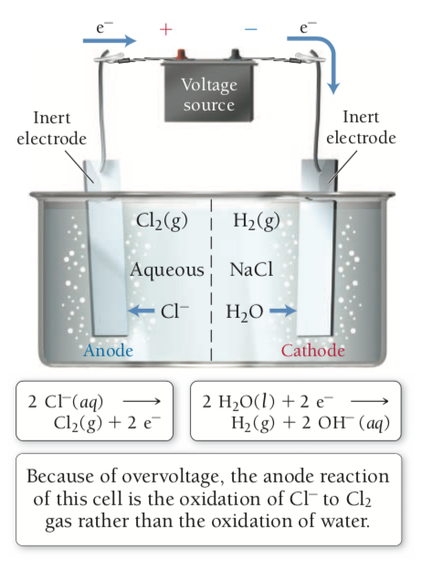
Electrolysis
Aqueous NaCl and Overvoltage
Overvoltage: additional voltage that must be applied to make non spontaneous reactions occur
Oxidation: 2 Cl- (aq) -> Cl2 (g) + 2 e-
E = 1.36 V
Oxidation: 2 H2O (l) -> O2 (g) + 4 H+ (aq) + 4 e-
E = 0.82 V ([H+] = 10^-7 M)
Reduction: 2 Na+ (aq) + 2 e- -> 2 Na (s)
E = -2.71 V
Reduction: 2 H2O (l) + 2 e- -> H2 (g) + 2 OH- (aq)
E = -0.41 V ([OH-] = 10^-7 M)
Since oxidation of water is more negative than oxidation of Cl-, easier to oxidize water
Reduction of water is more positive than reduction of Na, easier to reduce water
Should result in electrolysis of water
Oxidation of Cl- occurs
Water requires voltage greater than 0.82 which increases voltage required for oxidation of water to 1.4 V
Causes Cl2 to be oxidized

Slide 14
Electrolysis stoichiometry
Consider half reaction
Cu2+ (aq) + 2 e- -> Cu (s)
2 mol e-: 1 mol Cu (s)
1 A = 1 C/s
Current (C/s)*time (s) = charge ©
F = 96485 C/mol e-

