Slide 1
56
Conservation Biology and Global Change
Lecture Presentation by Nicole Tunbridge and
Kathleen Fitzpatrick

Slide 2
Biodiversity vs. Humans
Scientists have named and described 1.8 million species
Biologists estimate 10–100 million species exist on Earth
Tropical forests contain some of the greatest concentrations of species and are being DESTROYED at an alarming rate
HUMANS (that’s US) are rapidly pushing many species toward extinction

Slide 3
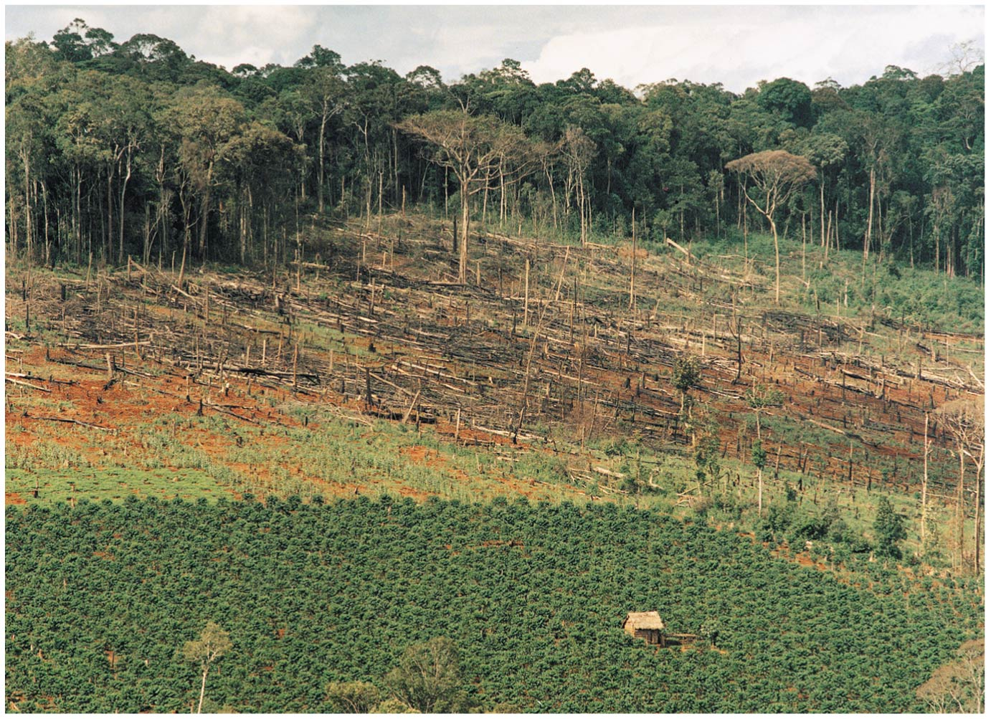
Tropical deforestation in Vietnam
Notes:
Figure 56.2 Tropical deforestation in Vietnam

Slide 4
Overview (don’t need to know 56.2 & 56.3)
Concept 56.1: Human activities threaten Earth’s biodiversity
Concept 56.2: Population conservation focuses on population size, genetic diversity, and critical habitat
Concept 56.3: Landscape and regional conservation help sustain biodiversity
Concept 56.4: Earth is changing rapidly as a result of human actions

Slide 5
Overview
Concept 56.1: Human activities threaten Earth’s biodiversity
Concept 56.4: Earth is changing rapidly as a result of human actions

Slide 6
Overview
Concept 56.1: Human activities threaten Earth’s biodiversity
Concept 56.4: Earth is changing rapidly as a result of human actions

Slide 7
Concept 56.1: Human activities threaten Earth’s biodiversity
Extinction events are natural…BUT the current RATE of species extinctions is unprecedented
Humans are CLEARLY threatening Earth’s biodiversity
Biodiversity has 3 main components:
Genetic diversity: genetic variation within and between populations
Species diversity: variety of species in an ecosystem or throughout the biosphere
Ecosystem diversity: variety of ecosystems in the biosphere

Slide 8
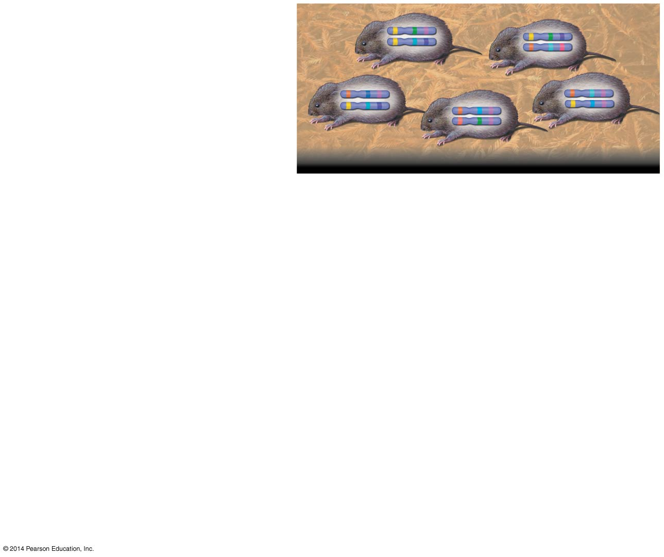
Figure 56.3-1
Genetic diversity in a vole population
Notes:
Figure 56.3-1 Three levels of biodiversity (step 1)

Slide 9
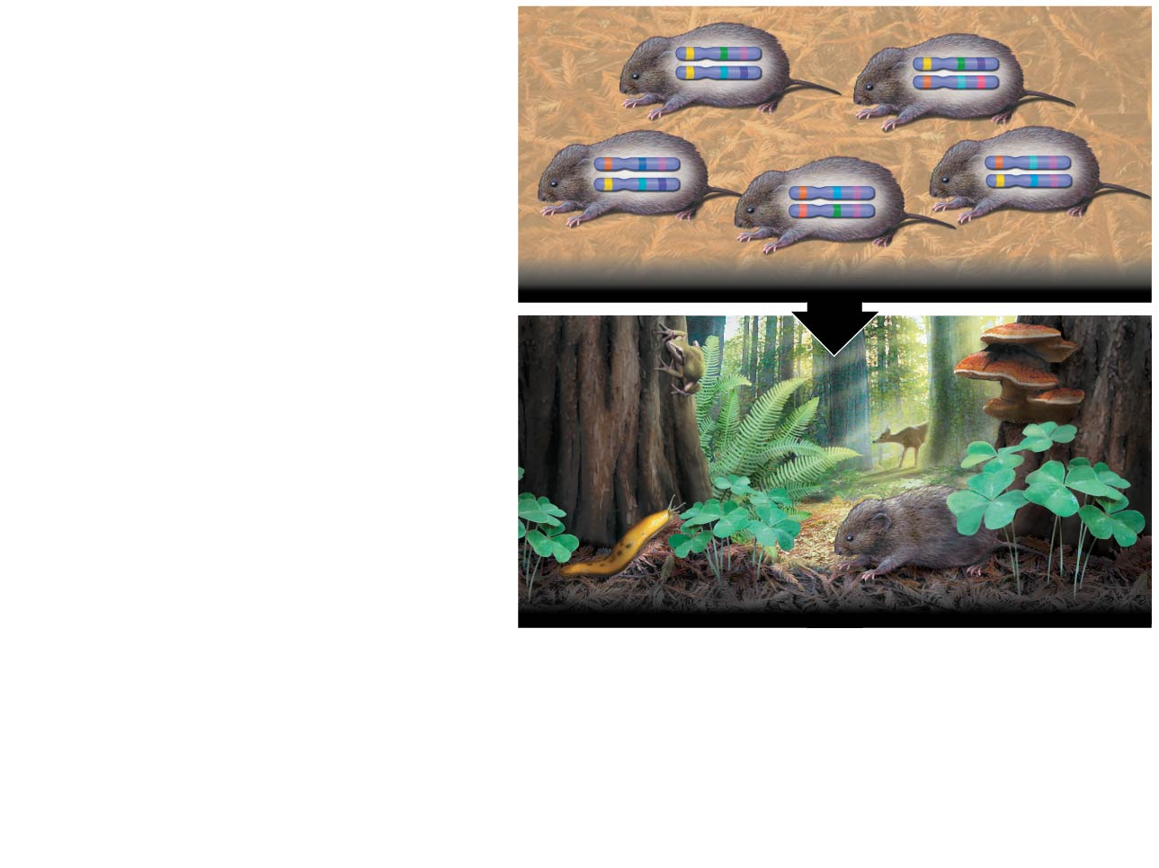
Figure 56.3-2
Genetic diversity in a vole population
Species diversity in a coastal redwood ecosystem
Notes:
Figure 56.3-2 Three levels of biodiversity (step 2)

Slide 10
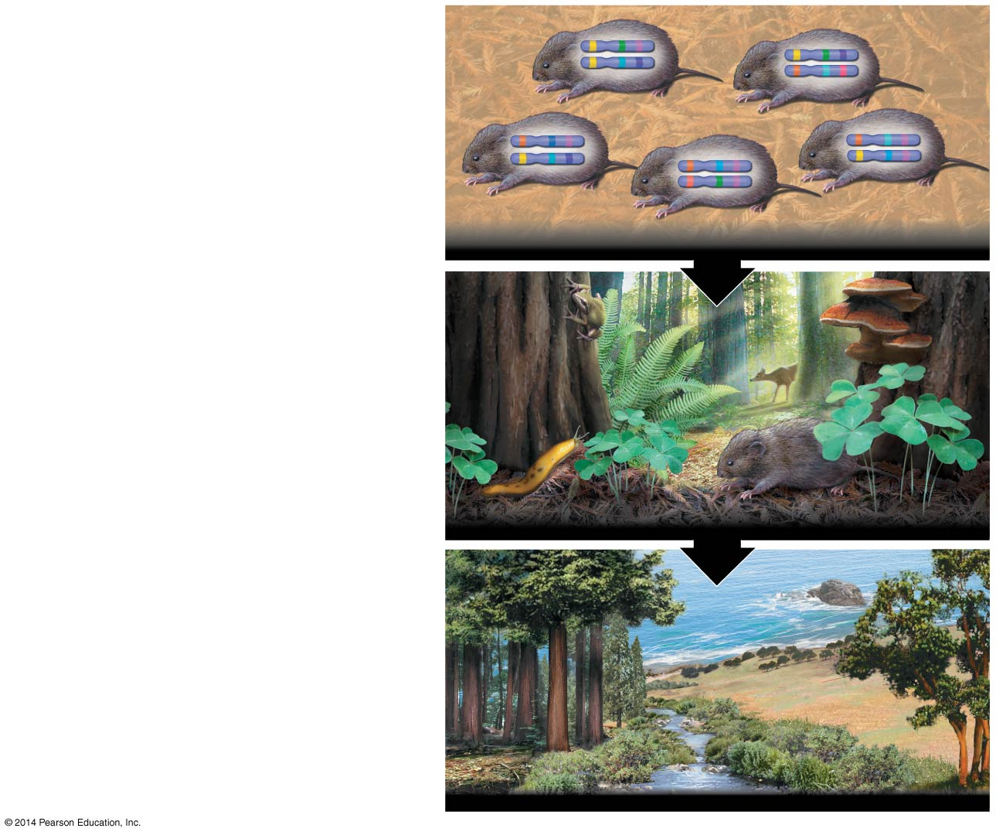
Figure 56.3-3
Genetic diversity in a vole population
Species diversity in a coastal redwood ecosystem
Community and ecosystem diversity across the landscape of an entire region
Notes:
Figure 56.3-3 Three levels of biodiversity (step 3)

Slide 11
Concept 56.1: Human activities threaten Earth’s biodiversity – Species Diversity
Species diversity is the variety of species in an ecosystem or throughout the biosphere
According to the U.S. Endangered Species Act:
Endangered species = in danger of becoming extinct throughout all or a significant portion of its range
Threatened species = likely to become endangered in the foreseeable future

Slide 12
Concept 56.1: Human activities threaten Earth’s biodiversity – Species Diversity
Conservation biologists are concerned about species loss because of alarming statistics regarding extinction and biodiversity
Globally, 12% of birds and 21% of mammals are threatened with extinction
Extinction may be local or global

Slide 13
Concept 56.1: Human activities threaten Earth’s biodiversity – Ecosystem Diversity
Human activity is REDUCING ecosystem diversity, the variety of ecosystems in the biosphere
More than 50% of wetlands in the contiguous United States have been drained and converted to other ecosystems
The local extinction of one species can have a negative impact on OTHER species in an ecosystem

Slide 14
Concept 56.1: Human activities threaten Earth’s biodiversity
Threats to Biodiversity
Most species loss can be traced to 4 major threats
Habitat loss
Introduced species
Overharvesting
Global change

Slide 15
Concept 56.1: Human activities threaten Earth’s biodiversity – 1. Habitat Loss
Human alteration of habitat is the GREATEST THREAT to biodiversity throughout the biosphere
In almost all cases, habitat fragmentation and destruction lead to loss of biodiversity
In Wisconsin, prairie occupies <0.1% of its original area!!!
<70% of coral reefs have been damaged by human activities!!!

Slide 16
Concept 56.1: Human activities threaten Earth’s biodiversity – 2. Introduced Species
Introduced species = those that humans move from native locations to new geographic regions
Without their native predators, parasites, and pathogens, introduced species may spread rapidly, disrupting their adopted community
Ex: the brown tree snake arrived in Guam as a cargo ship “stowaway” and led to extinction of some local species
Ex: kudzu was intentionally introduced to the southern United States

Slide 17
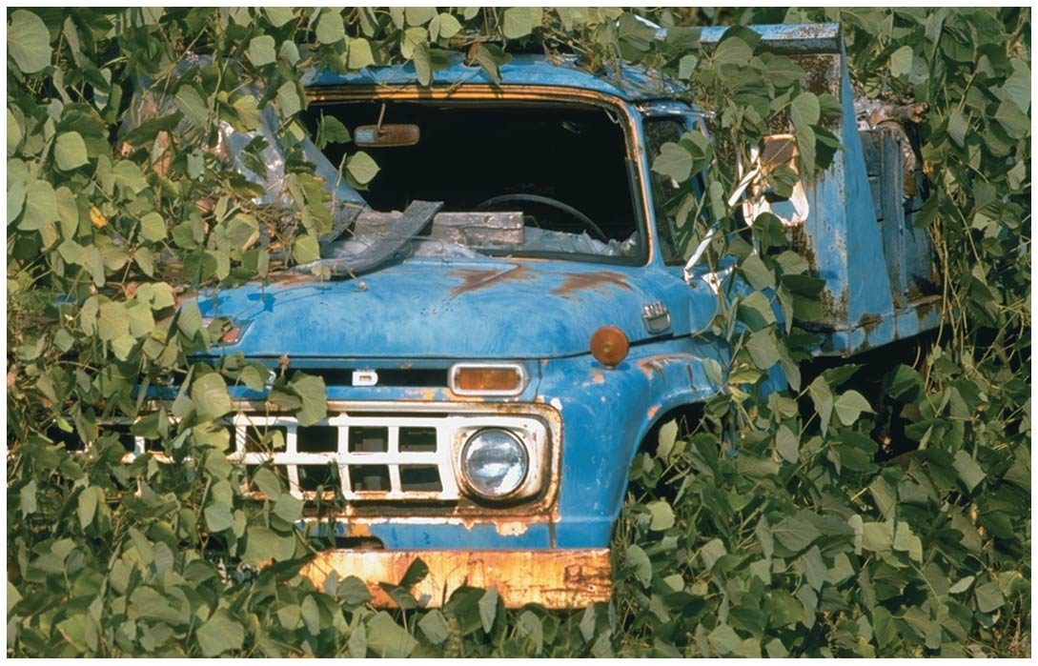
Kudzu, an introduced species, thriving (a little too much) in South Carolina
Notes:
Figure 56.8 Kudzu, an introduced species, thriving in South Carolina

Slide 18
Concept 56.1: Human activities threaten Earth’s biodiversity – 3. Overharvesting
Overharvesting = human harvesting of wild plants or animals at rates EXCEEDING the ability of populations of those species to rebound
Large organisms with low reproductive rates are especially vulnerable to overharvesting
Ex: elephant populations declined because of harvesting for ivory
Ex: the North Atlantic bluefin tuna population decreased by 80% in ten years

Slide 19
Concept 56.1: Human activities threaten Earth’s biodiversity – 4. Global Change
Global change = ALTERATIONS in climate, atmospheric chemistry, and broad ecological systems
Ex: Acid precipitation contains sulfuric acid and nitric acid from the burning of wood and fossil fuels
Environmental regulations have helped to decrease acid precipitation

Slide 20
Overview
Concept 56.1: Human activities threaten Earth’s biodiversity
Concept 56.4: Earth is changing rapidly as a result of human actions

Slide 21
Concept 56.4: Earth is changing rapidly as a result of human actions
Human-caused changes in the environment include…
Nutrient enrichment
Accumulation of toxins
Climate change
Ozone depletion

Slide 22
Concept 56.4: Earth is changing rapidly as a result of human actions – Nutrient Enrichment
Human activity often REMOVES nutrients from one part of the biosphere and ADDS them to another
Harvest of agricultural crops exports nutrients from the agricultural ecosystem
Agriculture leads to the depletion of nutrients in the soil
Fertilizers add nitrogen and other nutrients to the agricultural ecosystem

Slide 23
Concept 56.4: Earth is changing rapidly as a result of human actions – Toxin Accumulation
Humans release many toxic chemicals, including synthetics, previously unknown to nature
In some cases, harmful substances persist for long periods in an ecosystem
One reason toxins are harmful is that they become more concentrated in successive trophic levels
Biological magnification concentrates toxins at higher trophic levels, where biomass is lower

Slide 24
Concept 56.4: Earth is changing rapidly as a result of human actions – Climate Change
One pressing problem caused by human activities is the rising level of CO₂ and other greenhouse gases in the atmosphere
Due to burning of fossil fuels and other human activities, the concentration of atmospheric CO₂ has been steadily INCREASING

Slide 25
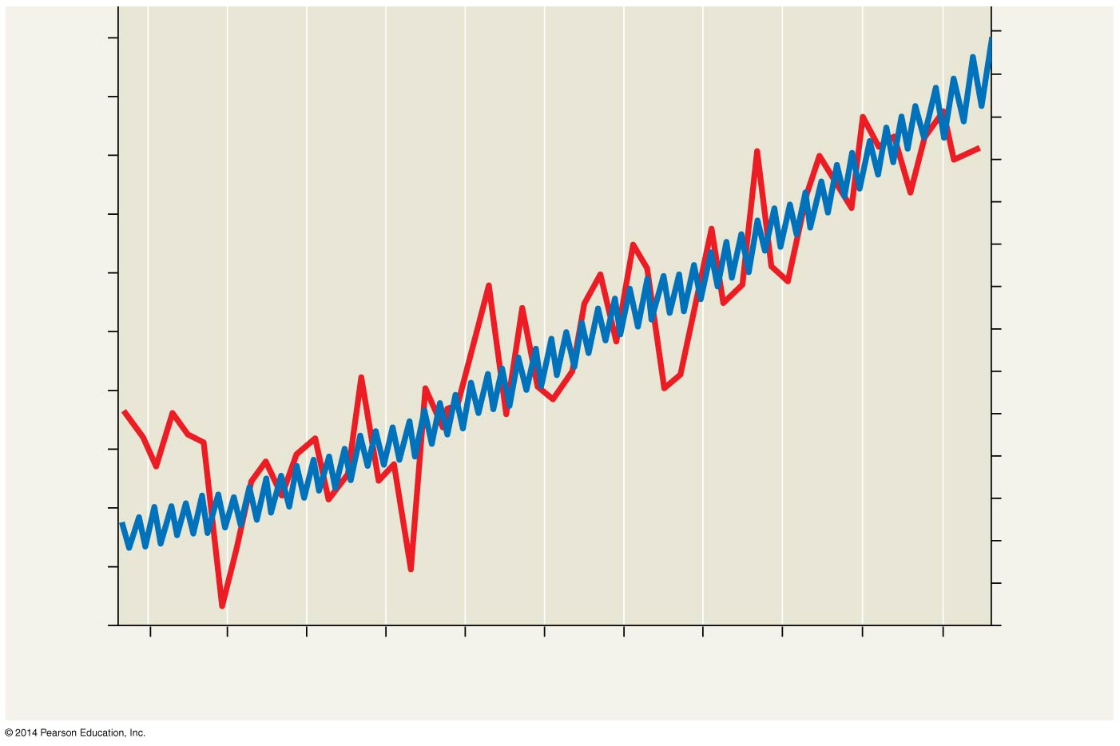
Figure 56.28
400
15.0
14.9
390
14.8
380
14.7
370
14.6
Temperature
14.5
360
14.4
CO₂ concentration (ppm)
Average global temperature (°C)
350
14.3
14.2
340
CO₂
14.1
330
14.0
320
13.9
13.8
310
13.7
300
13.6
1960 1965 1970 1975 1980 1985 1990 1995 2000 2005 2010
Year
Notes:
Figure 56.28 Increase in atmospheric carbon dioxide concentration at Mauna Loa, Hawaii, and average global temperatures

Slide 26
Concept 56.4: Earth is changing rapidly as a result of human actions – Climate Change
CO₂, water vapor, and other greenhouse gases REFLECT infrared radiation back toward Earth; this is the greenhouse effect
This effect is important for keeping Earth’s surface at a habitable temperature
Increasing concentration of atmospheric CO₂ is linked to INCREASING global temperature

Slide 27
Concept 56.4: Earth is changing rapidly as a result of human actions – Climate Change
Northern coniferous forests and tundra show the strongest effects of global warming
Ex: in 2012, the extent of Arctic sea ice was the smallest on record
A warming trend would also affect the geographic distribution of precipitation
Many organisms may not be able to survive such rapid climate change

Slide 28
Concept 56.4: Earth is changing rapidly as a result of human actions – Ozone Depletion
Life on Earth is protected from damaging effects of UV radiation by a PROTECTIVE layer of ozone molecules in the atmosphere
Satellite studies suggest that the ozone layer has been gradually THINNING since the mid-1970s
Destruction of atmospheric ozone results mainly from chlorofluorocarbons (CFCs) produced by human activity → DECREASES atmospheric ozone

Slide 29
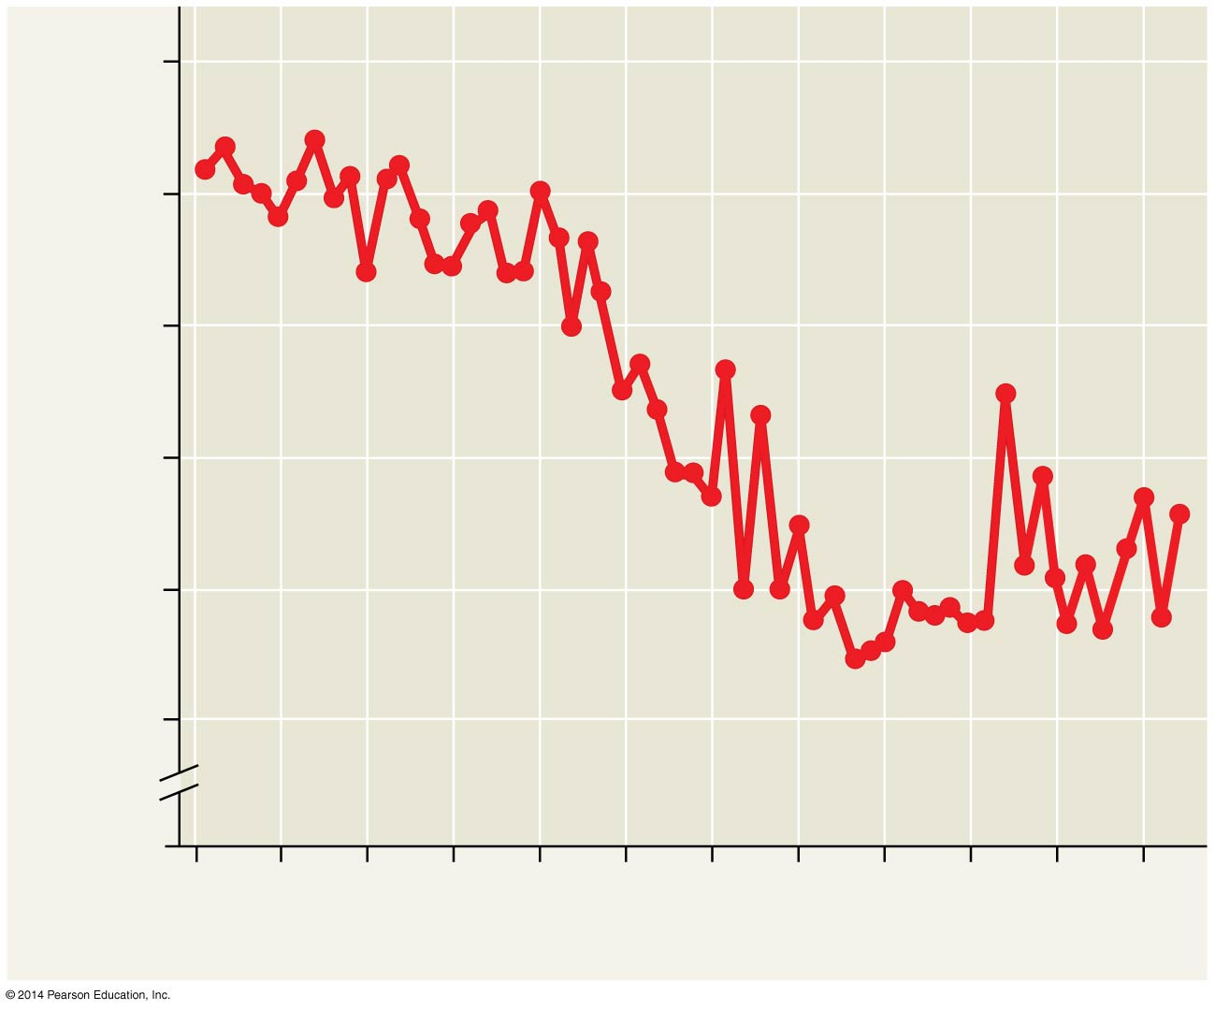
Figure 56.29
350
300
250
Ozone layer thickness (Dobsons)
200
150
100
0
1955 ’60 ’65 ’70 ’75 ’80 ’85 ’90 ’95 2000 ’05 ’10
Year
Notes:
Figure 56.29 Thickness of the October ozone layer over Antarctica in units called Dobsons

Slide 30
Concept 56.4: Earth is changing rapidly as a result of human actions – Ozone Depletion
Ozone depletion causes DNA damage in plants and poorer phytoplankton growth…this in turn may effect the whole biosphere!
An international agreement signed in 1987 has resulted in a decrease in ozone depletion
Chlorine molecules (from CFCs) already in the atmosphere will continue to influence ozone levels for at least another 50 years…

Slide 31
A final message in AP Bio!
Our behavior reflects remnants of our ancestral and seemingly innate attachment to nature and the diversity of life—the concept of biophilia
Our sense of CONNECTION to nature can motivate realignment of environmental priorities
People tend to appreciate what they understand, and since biology can often be so tough to understand, people have a tough time appreciating it…hopefully YOU have gained a greater appreciation for the study of life in AP Bio!

Slide 32
Overview
Concept 56.1: Human activities threaten Earth’s biodiversity
Concept 56.4: Earth is changing rapidly as a result of human actions

