Slide 1
55
Ecosystems and Restoration Ecology

Slide 2
Introduction
Ecosystem = all the organisms living in a community, as well as the ABIOTIC factors with which they interact
  Ecosystems range from a microcosm, such as the space under a fallen log, to a large area, such as a lake or island
Regardless of an ecosystem’s size, its dynamics involve two main processes: energy flow and chemical cycling
  Energy → flows through ecosystems
  Matter → cycles within ecosystems

Slide 3
Overview (don’t need to know 55.5)
Concept 55.1: Physical laws govern energy flow and chemical cycling in ecosystems
Concept 55.2: Energy and other limiting factors control primary production in ecosystems
Concept 55.3: Energy transfer between trophic levels is typically only 10% efficient
Concept 55.4: Biological and geochemical processes cycle nutrients and water in ecosystems
Concept 55.5: Restoration ecologists return degraded ecosystems to a more natural state

Slide 4
Overview
Concept 55.1: Physical laws govern energy flow and chemical cycling in ecosystems
Concept 55.2: Energy and other limiting factors control primary production in ecosystems
Concept 55.3: Energy transfer between trophic levels is typically only 10% efficient
Concept 55.4: Biological and geochemical processes cycle nutrients and water in ecosystems

Slide 5
Overview
Concept 55.1: Physical laws govern energy flow and chemical cycling in ecosystems
Concept 55.2: Energy and other limiting factors control primary production in ecosystems
Concept 55.3: Energy transfer between trophic levels is typically only 10% efficient
Concept 55.4: Biological and geochemical processes cycle nutrients and water in ecosystems

Slide 6
Concept 55.1: Physical laws govern energy flow and chemical cycling in ecosystems
Ecologists study the TRANSFORMATIONS of energy and matter within ecosystems
Laws of physics and chemistry apply to ecosystems, particularly energy flow

Slide 7
Concept 55.1: Physical laws govern energy flow and chemical cycling in ecosystems
Laws of Thermodynamics in Ecosystems
First law of thermodynamics = energy cannot be created or destroyed, only TRANSFORMED from one form to another
  Energy ENTERS an ecosystem as solar radiation, is CONSERVED, and is LOST from organisms as heat
Second law of thermodynamics = every exchange of energy INCREASES the entropy (disorder) of the universe
  In an ecosystem, energy conversions are NOT completely efficient, and some energy is ALWAYS LOST as heat (recall cell respiration equation!)

Slide 8
Concept 55.1: Physical laws govern energy flow and chemical cycling in ecosystems
Conservation of Mass in Ecosystems
Law of conservation of mass = matter CANNOT be created or destroyed
  Chemical elements (NOT ENERGY!) are continually RECYCLED within ecosystems
Ecosystems are OPEN systems (just like YOU), absorbing energy and mass and releasing heat and waste products

Slide 9
Concept 55.1: Physical laws govern energy flow and chemical cycling in ecosystems
Energy, Mass, and Trophic Levels
Autotrophs BUILD molecules themselves using photosynthesis or chemosynthesis as an energy source
Heterotrophs DEPEND on the biosynthetic output of other organisms
Energy and nutrients pass from primary producers (autotrophs) → primary consumers (herbivores) → secondary consumers (carnivores) → tertiary consumers (carnivores that feed on other carnivores)

Slide 10
Concept 55.1: Physical laws govern energy flow and chemical cycling in ecosystems
Energy, Mass, and Trophic Levels
Detritivores, or decomposers, are consumers that derive their energy from detritus, NONLIVING organic matter
  Prokaryotes and fungi are important detritivores
Decomposition connects ALL trophic levels

Slide 11
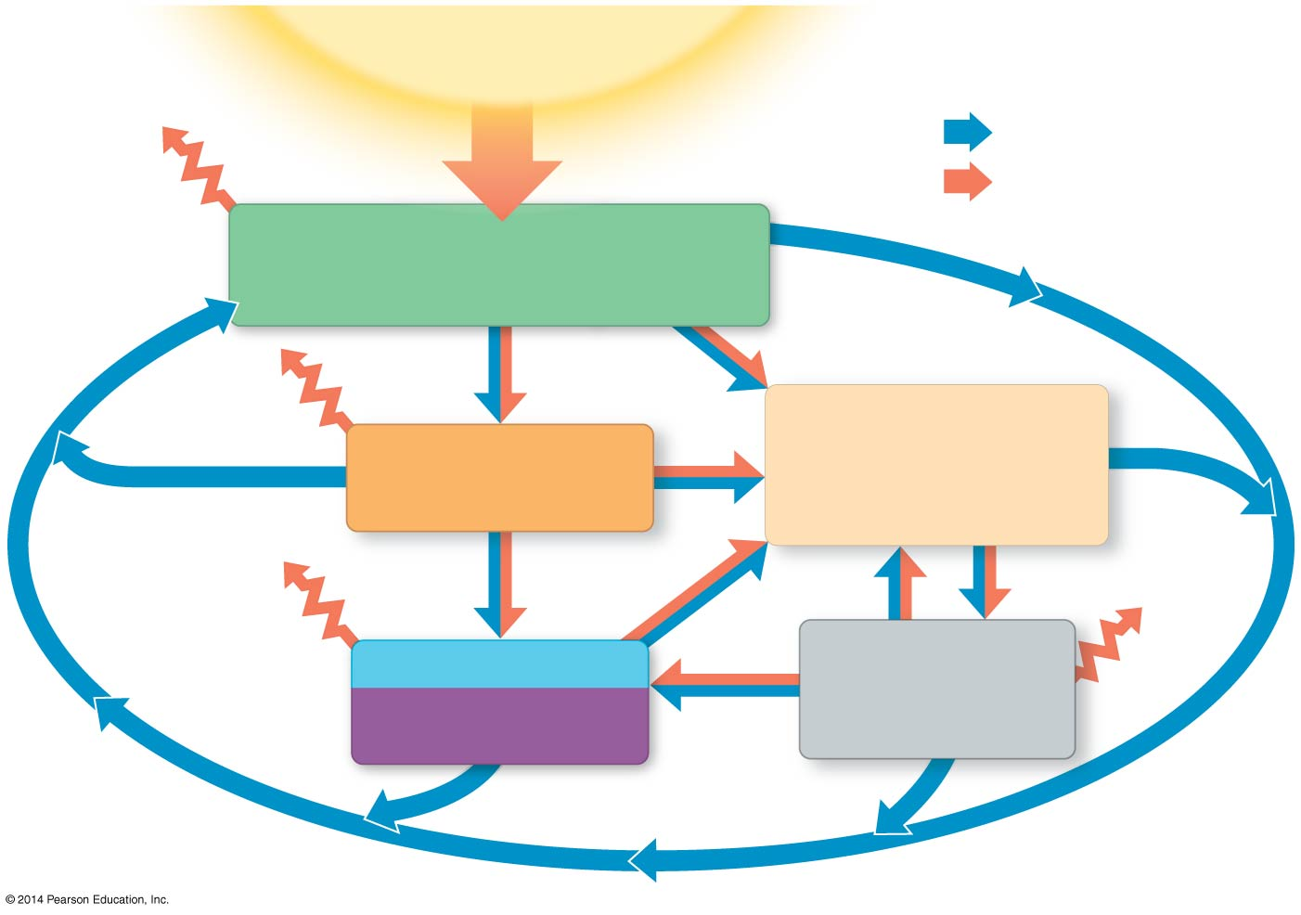
Figure 55.4
Sun
Key
Loss
of
heat
Chemical cycling
Energy flow
Primary producers
Primary
consumers
Detritus
Secondary and
Microorganisms
and other
detritivores
tertiary
consumers
Notes:
Figure 55.4 An overview of energy and nutrient dynamics in an ecosystem

Slide 12
Overview
Concept 55.1: Physical laws govern energy flow and chemical cycling in ecosystems
Concept 55.2: Energy and other limiting factors control primary production in ecosystems
Concept 55.3: Energy transfer between trophic levels is typically only 10% efficient
Concept 55.4: Biological and geochemical processes cycle nutrients and water in ecosystems

Slide 13
Concept 55.2: Energy and other limiting factors control primary production in ecosystems
Primary production = amount of light energy CONVERTED to chemical energy by AUTOTROPHS during a given time period
The extent of photosynthetic production sets the spending limit for an ecosystem’s energy “budget”
  The amount of solar radiation reaching Earth’s surface LIMITS the photosynthetic output of ecosystems
    Only a small fraction of solar energy actually strikes photosynthetic organisms, and even less is of a usable wavelength (recall P680 and P700!)

Slide 14
Concept 55.2: Energy and other limiting factors control primary production in ecosystems
Marine ecosystems are relatively unproductive per unit area but contribute greatly to global production because of their SIZE
  More than light, NUTRIENTS limit primary production in most oceans and lakes
  Limiting nutrient = element that must be ADDED for production to increase in an area
    Nitrogen and phosphorous are the nutrients that most often limit marine production

Slide 15
Concept 55.2: Energy and other limiting factors control primary production in ecosystems
In terrestrial ecosystems, temperature and moisture affect primary production on a large scale
  Primary production INCREASES with moisture
  Tropical rain forests, estuaries, and coral reefs are among the MOST productive ecosystems per unit area
On a more local scale, soil nutrients (ex: N and P) = limiting factor in primary production on land
  Land plant adaptations promote greater nutrient absorption from soil (ex: symbiosis with N-fixing bacteria)

Slide 16
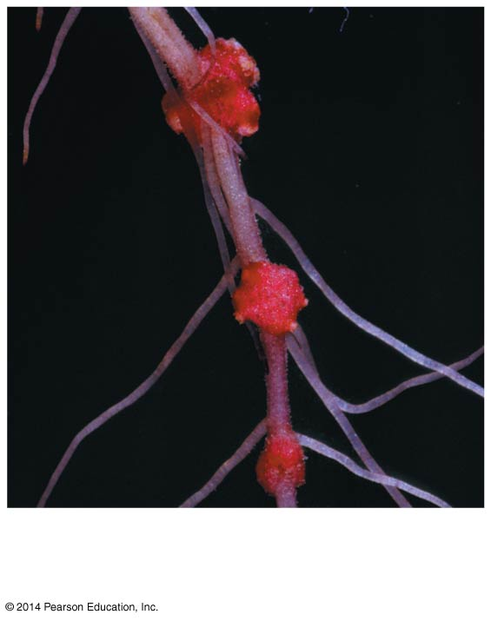
Figure 55.UN01
Root nodules containing
nitrogen-fixing bacteria
Notes:
Figure 55.UN01 In-text figure, root nodules, p. 1239

Slide 17
Overview
Concept 55.1: Physical laws govern energy flow and chemical cycling in ecosystems
Concept 55.2: Energy and other limiting factors control primary production in ecosystems
Concept 55.3: Energy transfer between trophic levels is typically only 10% efficient
Concept 55.4: Biological and geochemical processes cycle nutrients and water in ecosystems

Slide 18
Concept 55.3: Energy transfer between trophic levels is typically only 10% efficient
Trophic efficiency is the percentage of production transferred from one trophic level to the next
  It is usually about 10%, with a range of 5% to 20%
Trophic efficiency is multiplied over the length of a food chain
  Approximately 0.1% (!!!) of chemical energy fixed by photosynthesis reaches a tertiary consumer
  A pyramid of net production represents the LOSS OF ENERGY with each TRANSFER in a food chain

Slide 19
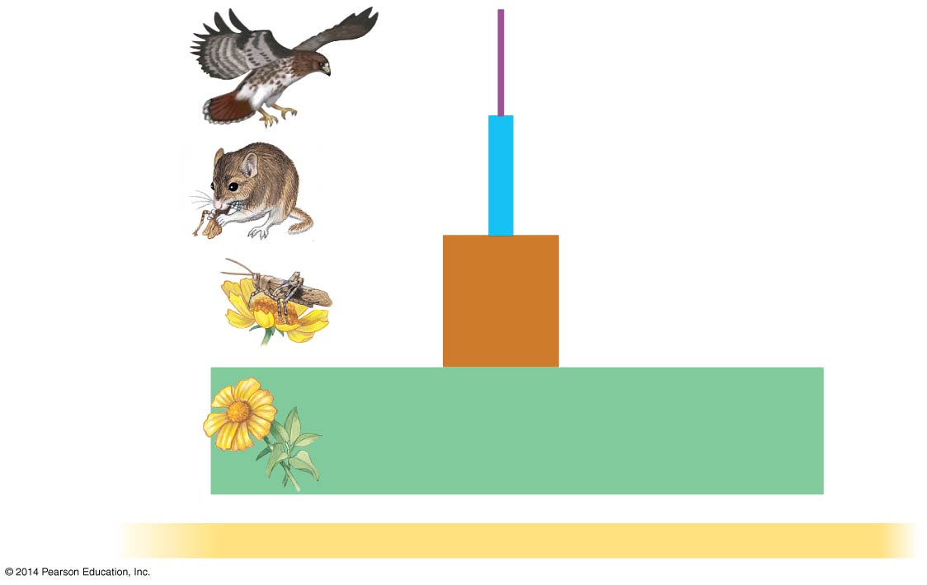
Figure 55.11
Tertiary
consumers
10 J
Secondary
consumers
100 J
Primary
consumers
1,000 J
Primary
producers
10,000 J
1,000,000 J of sunlight
Notes:
Figure 55.11 An idealized pyramid of net production

Slide 20
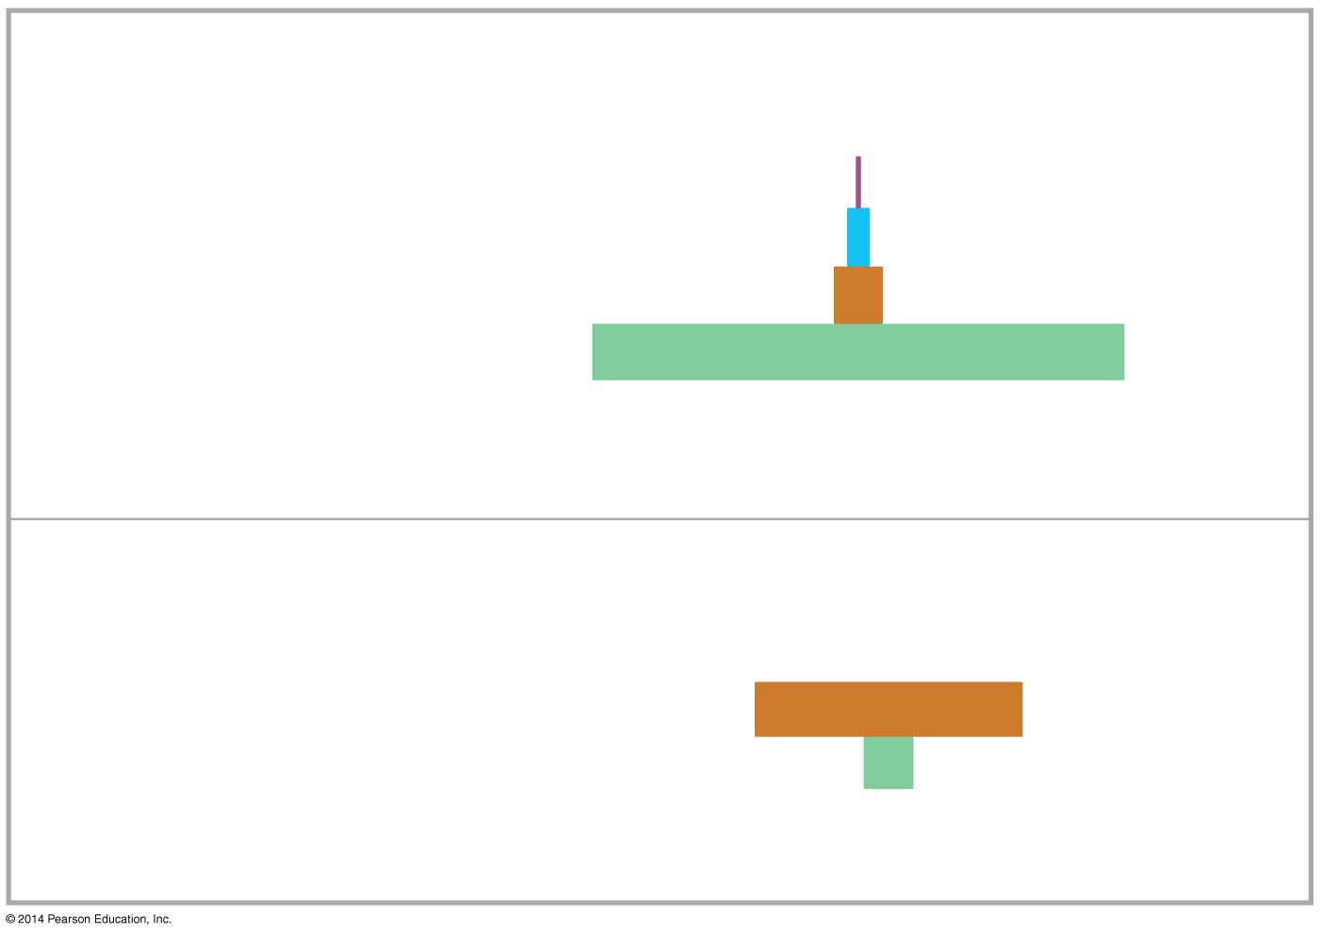
Pyramids of Biomass
Trophic level
Dry mass
(g/m²)
Tertiary consumers
Secondary consumers
Primary consumers
Primary producers
1.5
11
37
809
(a) Most ecosystems (data from a Florida bog)
Trophic level
Dry mass
(g/m²)
Primary consumers (zooplankton)
Primary producers (phytoplankton)
21
4
(b) Some aquatic ecosystems (data from the English Channel)
Notes:
Figure 55.12 Pyramids of biomass (standing crop)

Slide 21
Overview
Concept 55.1: Physical laws govern energy flow and chemical cycling in ecosystems
Concept 55.2: Energy and other limiting factors control primary production in ecosystems
Concept 55.3: Energy transfer between trophic levels is typically only 10% efficient
Concept 55.4: Biological and geochemical processes cycle nutrients and water in ecosystems

Slide 22
Concept 55.4: Biological and geochemical processes cycle nutrients and water in ecosystems
Life depends on RECYCLING chemical elements (NOT energy because remember, energy FLOWS)
Nutrient cycles in ecosystems involve biotic and abiotic components and are often called biogeochemical cycles
  Gaseous carbon, oxygen, sulfur, and nitrogen occur in the atmosphere and CYCLE globally
YOU DO NOT NEED TO KNOW EACH PART OF EACH CYCLE…just understand the big picture!

Slide 23
Concept 55.4: Biological and geochemical processes cycle nutrients and water in ecosystems
In studying cycling of water, carbon, nitrogen, and phosphorus, ecologists focus on four factors
  Each chemical’s biological importance
  Forms in which each chemical is available or used by organisms
  Major reservoirs for each chemical
  Key processes driving movement of each chemical through its cycle

Slide 24
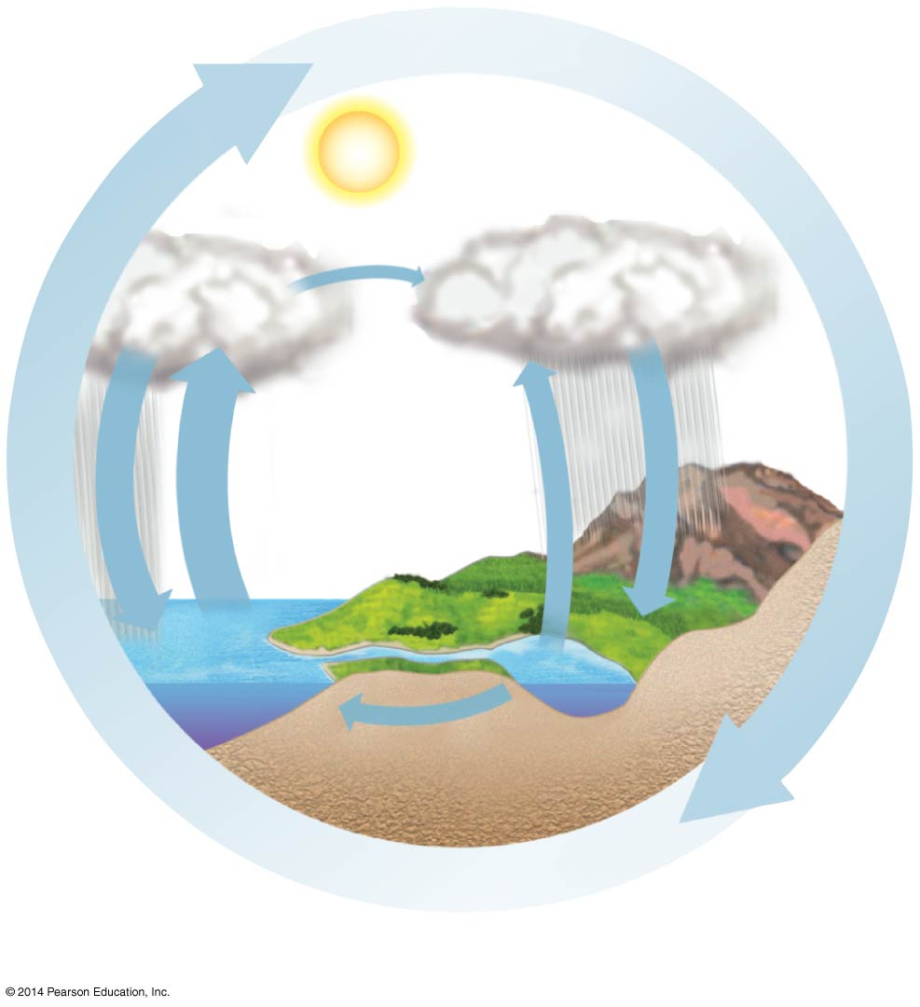
Figure 55.14a
Movement over
land by wind
Precipitation
over land
Precipitation
over ocean
Evaporation
from ocean
Evapo-
transpiration
from land
Percolation
through
soil
Runoff and
groundwater
The water cycle
Notes:
Figure 55.14a Exploring water and nutrient cycling (part 1: water)

Slide 25
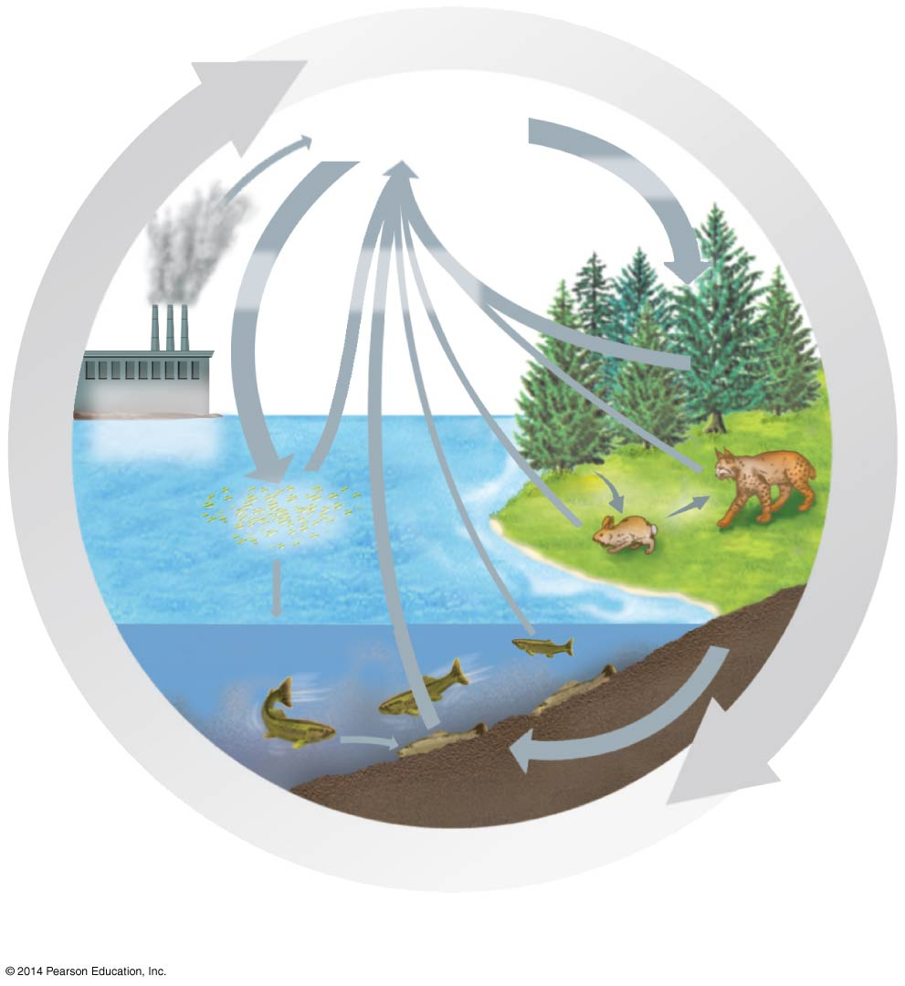
Figure 55.14b
CO₂ in
atmosphere
Photosynthesis
Photo-
synthesis
Cellular
respiration
Burning of
fossil fuels
and wood
Phyto-
plankton
Consumers
Consumers
Decomposition
The carbon cycle
Notes:
Figure 55.14b Exploring water and nutrient cycling (part 2: carbon)

Slide 26
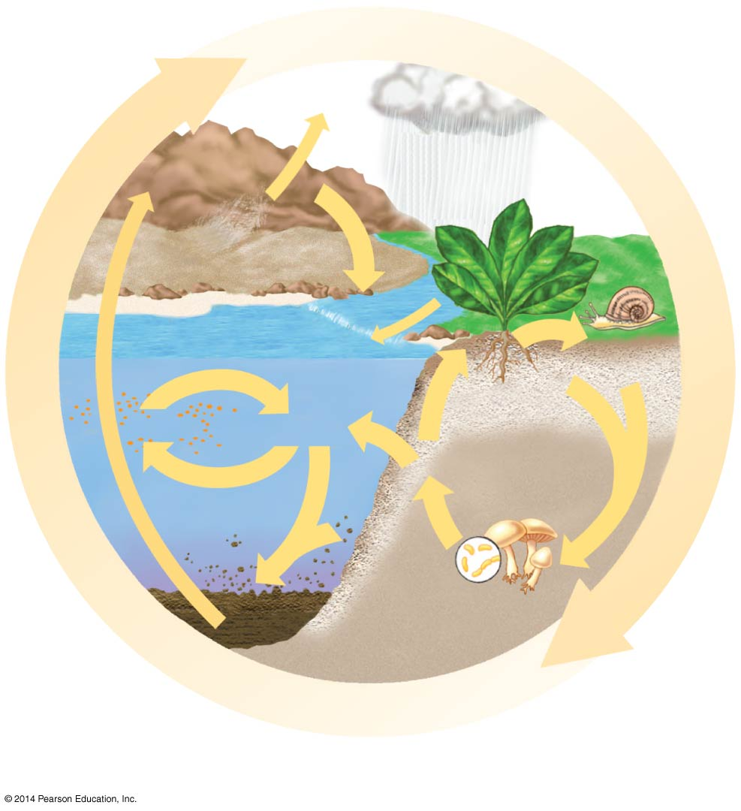
Figure 55.14c
Wind-blown
dust
Geologic
uplift
Weathering
of rocks
Runoff
Decomposition
Consumption
Plant
uptake
of PO₄^{3–}
Plankton
Dissolved
PO₄^{3–}
Uptake
Leaching
Sedimentation
Decomposition
The phosphorus cycle
Notes:
Figure 55.14c Exploring water and nutrient cycling (part 3: phosphorus)

Slide 27
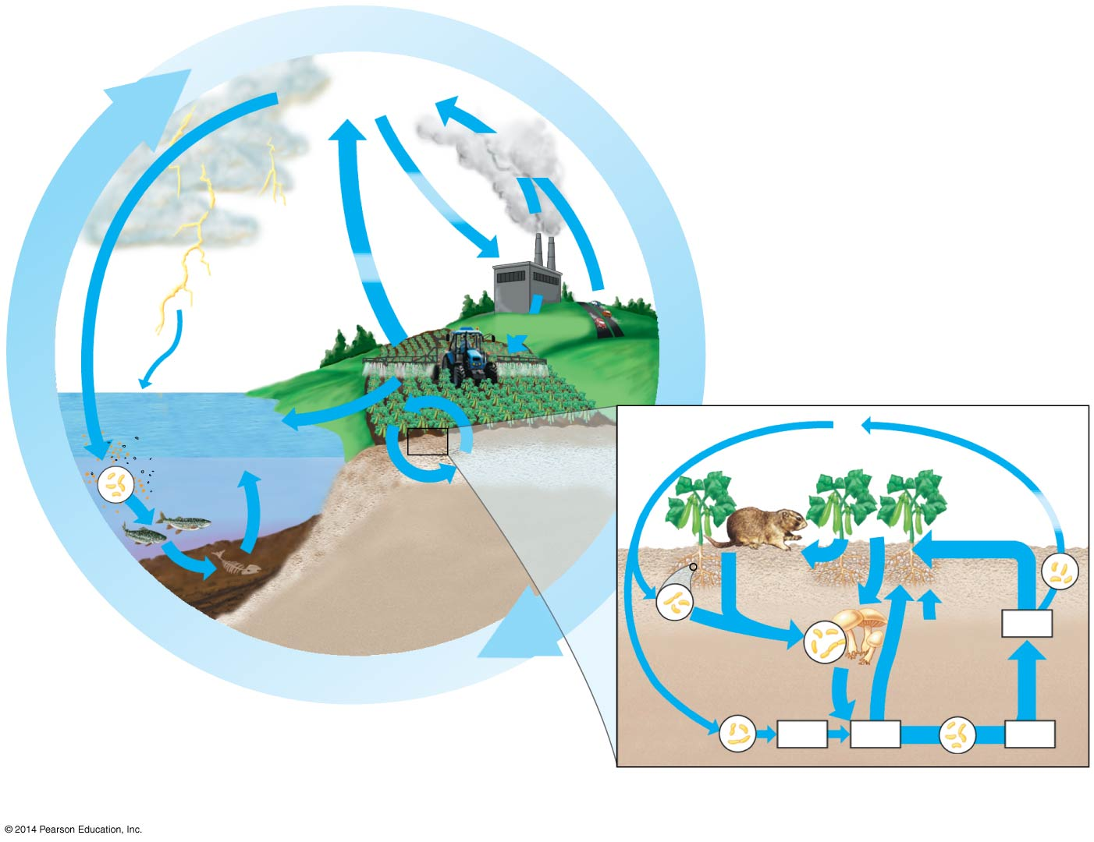
Figure 55.14d
N₂ in
atmosphere
Reactive N
gases
Industrial
fixation
Denitrification
N fertilizers
Fixation
Dissolved
organic N
Runoff
NO₃⁻
Terrestrial
cycling
N₂
NH₄+
NO₃⁻
Aquatic
cycling
Denitri-
fication
Decomposition
and
sedimentation
Assimilation
Decomposition
NO₃⁻
Fixation in
root nodules
Uptake of
amino acids
Ammonification
Nitrification
NH₃
NH₄⁺
NO₂⁻
The nitrogen cycle
Notes:
Figure 55.14d Exploring water and nutrient cycling (part 4: nitrogen)

Slide 28
Concept 55.4: Biological and geochemical processes cycle nutrients and water in ecosystems
Decomposers (detritivores) play a key role in the general pattern of chemical cycling
Rates at which nutrients cycle in different ecosystems vary greatly, mostly as a result of differing rates of decomposition
The rate of decomposition is controlled by temperature, moisture, and nutrient availability

Slide 29
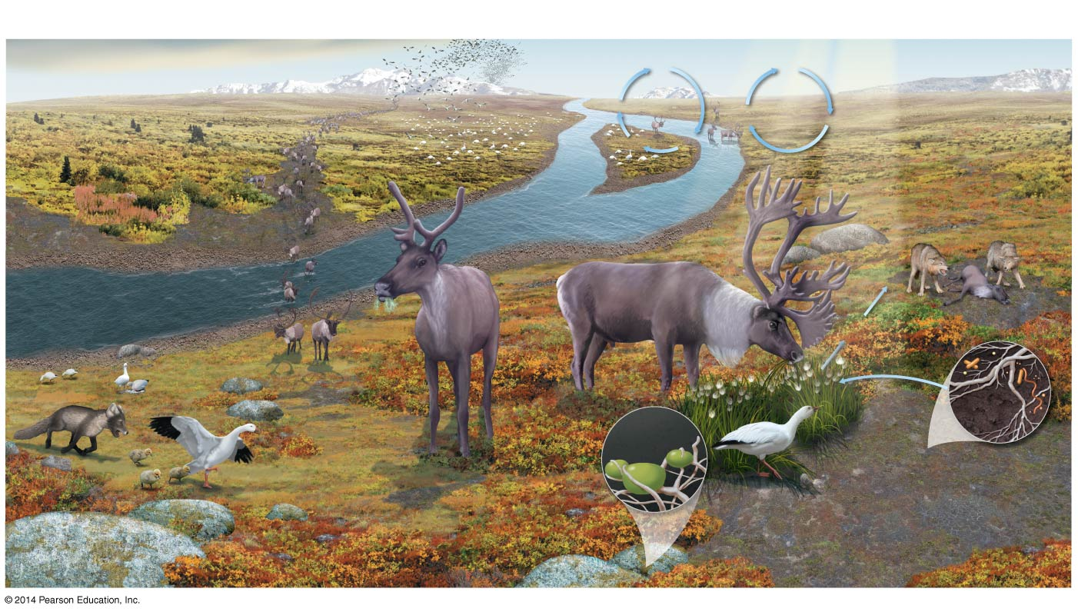
Figure 55.13
MAKE CONNECTIONS: The Working Ecosystem
Nitrogen cycle
Carbon cycle
Organisms
Transfer
Energy and
Matter in
Ecosystems
(Chapter 55)
N₂
CO₂
Denitrification
Cellular
respiration
Photosynthesis
Populations Are Dynamic
(Chapter 53)
Snow geese
Organisms
N fixation
1
Population size
12
Cycling of chemical elements
2
Migration
Caribou
Secondary
consumers
(wolves)
9
Food Chains
3
Population density
5
Primary
consumers
(caribou)
10
Transfer of energy
Herbivory
Species Interact in Diverse Ways
(Chapter 54)
8
Primary
producers
(plants and lichens)
Arctic fox
6
Symbiosis
7
Competition
11
Detritivores
(soil fungi and
prokaryotes)
Algal cell
Fungal
hyphae
Lichen
4
Predation
Snow goose
Notes:
Figure 55.13 Make connections: the working ecosystem

Slide 30
Overview
Concept 55.1: Physical laws govern energy flow and chemical cycling in ecosystems
Concept 55.2: Energy and other limiting factors control primary production in ecosystems
Concept 55.3: Energy transfer between trophic levels is typically only 10% efficient
Concept 55.4: Biological and geochemical processes cycle nutrients and water in ecosystems

