Slide 1
54
Community Ecology

Slide 2
Communities, Dynamically in Motion
A biological community is an assemblage of populations of VARIOUS species living close enough for potential INTERACTION
For example, the carrier crab carries a dangerous sea urchin on its back for protection against predators!

Slide 3
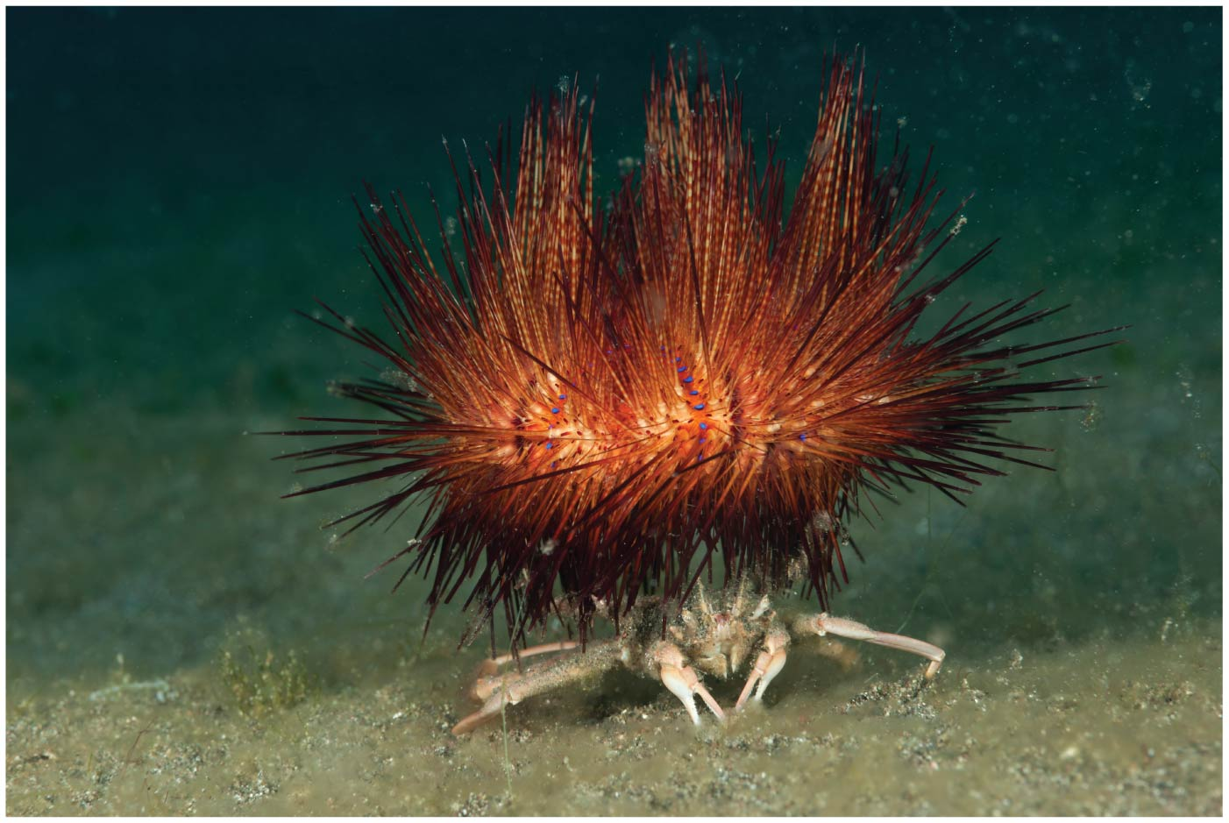
Figure 54.1
Corley & Mackenzie
Notes:
Figure 54.1 Which species benefits from this interaction?

Slide 4
Overview (don’t need to know 54.4 & 54.5)
Concept 54.1: Community interactions are classified by whether they help, harm, or have no effect on the species involved
Concept 54.2: Diversity and trophic structure characterize biological communities
Concept 54.3: Disturbance influences species diversity and composition
Concept 54.4: Biogeographic factors affect community diversity
Concept 54.5: Pathogens alter community structure locally and globally

Slide 5
Overview
Concept 54.1: Community interactions are classified by whether they help, harm, or have no effect on the species involved
Concept 54.2: Diversity and trophic structure characterize biological communities
Concept 54.3: Disturbance influences species diversity and composition

Slide 6
Overview
Concept 54.1: Community interactions are classified by whether they help, harm, or have no effect on the species involved
Concept 54.2: Diversity and trophic structure characterize biological communities
Concept 54.3: Disturbance influences species diversity and composition

Slide 7
Concept 54.1: Community interactions are classified by whether they help, harm, or have no effect on the species involved
INTERspecific interactions = relationships BETWEEN species in a community
INTERspecific interactions can affect the survival and reproduction (i.e. subject to evolution via NS!) of each species
Ex: competition, predation, herbivory, and symbiosis (parasitism, mutualism, and commensalism)
Positive (+), negative (−), or no effect (0)

Slide 8
Concept 54.1: Community interactions – Competition
Interspecific competition (−/− interaction) occurs when species COMPETE for a resource in short supply
Strong competition can lead to competitive exclusion, local elimination of a competing species
The competitive exclusion principle states that two species competing for the same limiting resources CANNOT coexist in the same place
Winners and losers in nature!

Slide 9
Concept 54.1: Community interactions – Competition leads to niches
Ecological Niches and Natural Selection
The sum of a species’ use of biotic and abiotic resources is called the species’ ecological niche
Think of a niche as the organism’s ecological role/job
Ecologically similar species CANNOT coexist in a community if their niches are exactly the same (via competitive exclusion principle)
Ecologically similar species CAN coexist in a community if there are one or more significant DIFFERENCES in their niches

Slide 10
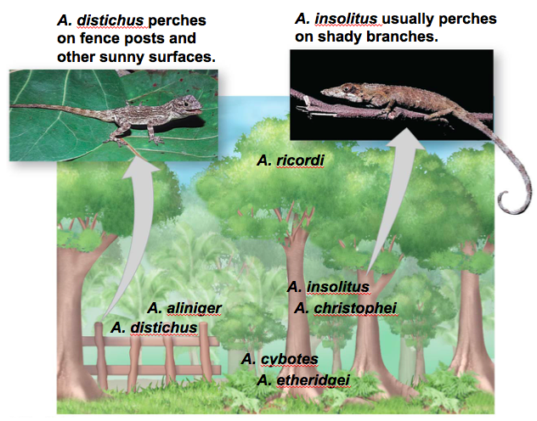
Concept 54.1: Community interactions – Competition leads to niches
Resource partitioning is differentiation of ecological niches, enabling similar species to COEXIST in a community (sharing is caring!)

Slide 11
Concept 54.1: Community interactions – Competition leads to niches
A species’ fundamental niche is the niche potentially occupied by that species
Ex: Human who potentially can be in the NBA
A species’ realized niche is the niche actually occupied by that species
Ex: Human who actually is in the town rec league
As a result of competition, a species’ fundamental niche may DIFFER from its realized niche
For example, the presence of one barnacle species limits the realized niche of another species

Slide 12
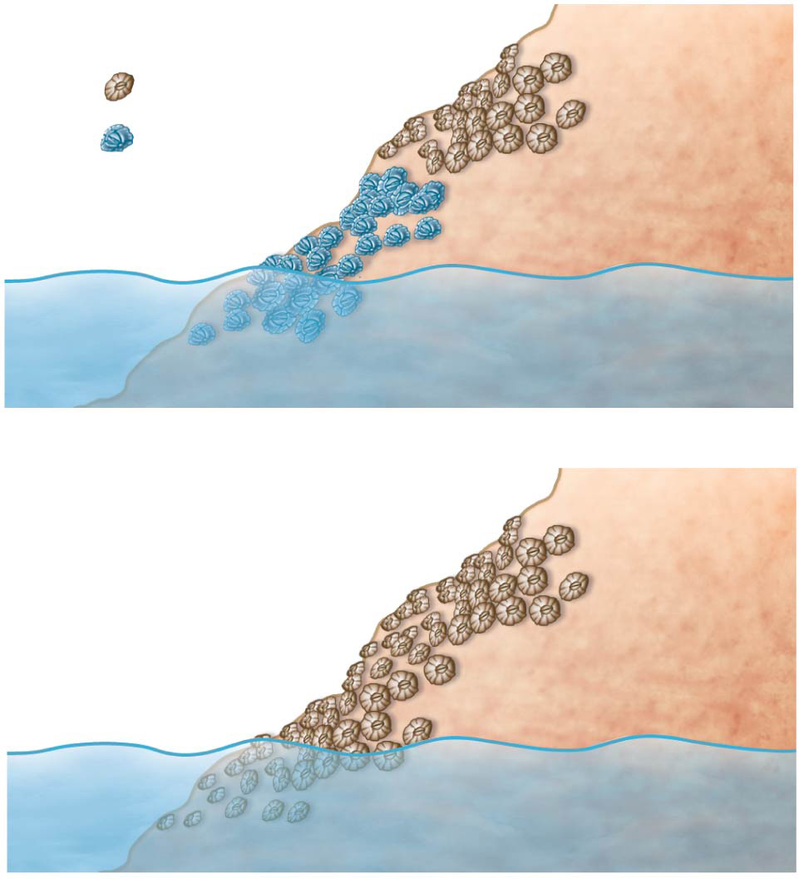
Figure 54.3
Experiment
High tide
Chthamalus
Chthamalus
Balanus
realized niche
Balanus
realized niche
Ocean
Low tide
Results
High tide
Chthamalus
fundamental niche
Ocean
Low tide
Notes:
Figure 54.3 Inquiry: Can a species’ niche be influenced by interspecific competition?

Slide 13
Concept 54.1: Community interactions – Predation
Predation (+/− interaction) refers to an interaction in which one species, the predator, KILLS and EATS the other, the prey
Some feeding adaptations of predators are claws, fangs, and poison
Prey display some AWESOME defensive adaptations…

Slide 14
Concept 54.1: Community interactions – Predation
Prey Defenses
Behavioral defenses include hiding, fleeing, forming herds or schools, self-defense, and alarm calls
Animals also have morphological and physiological defense adaptations
Mechanical and chemical defenses protect species such as porcupines and skunks

Slide 15
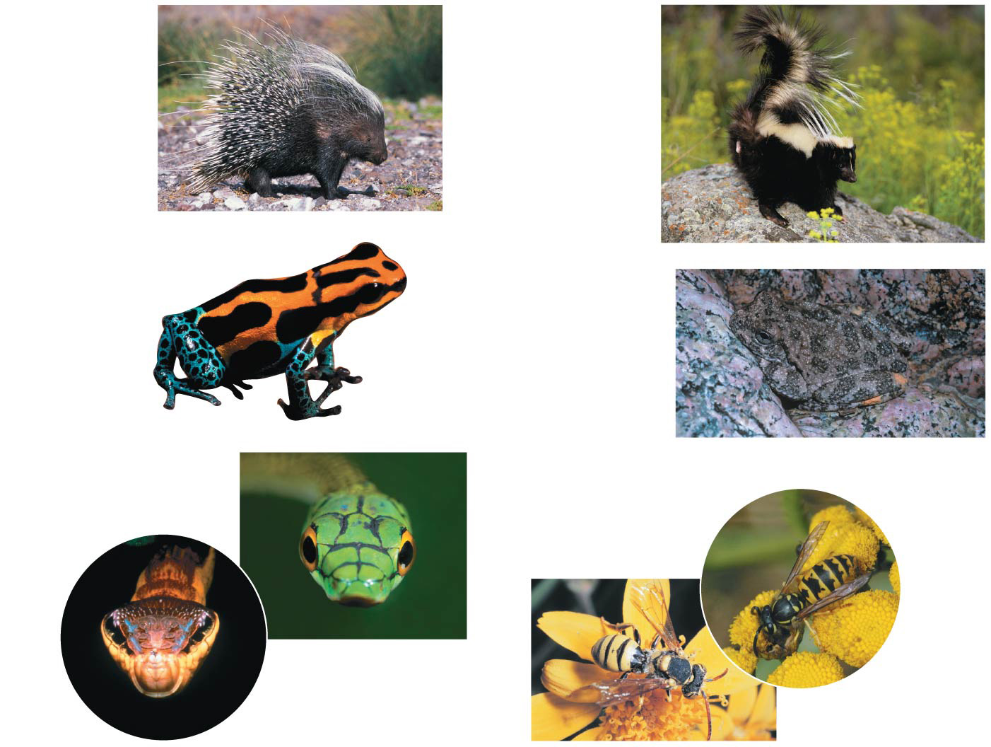
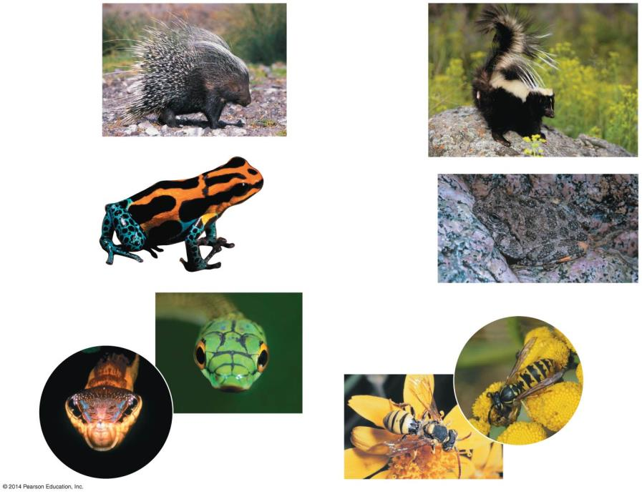
Figure 54.5
(a) Mechanical defense
(b) Chemical defense
▶ Porcupine
▶ Skunk
(c) Aposematic coloration:
warning coloration
(d) Cryptic coloration: camouflage
◀ Poison dart frog
▶ Canyon tree frog
(e) Batesian mimicry: A harmless species mimics a harmful one.
(f) Müllerian mimicry: Two unpalatable species mimic each other.
▲ Venomous green parrot snake
◀ Yellow jacket
◀ Nonvenomous hawkmoth larva
◀ Cuckoo bee
Notes:
Figure 54.5 Examples of defensive adaptations in animals

Slide 16
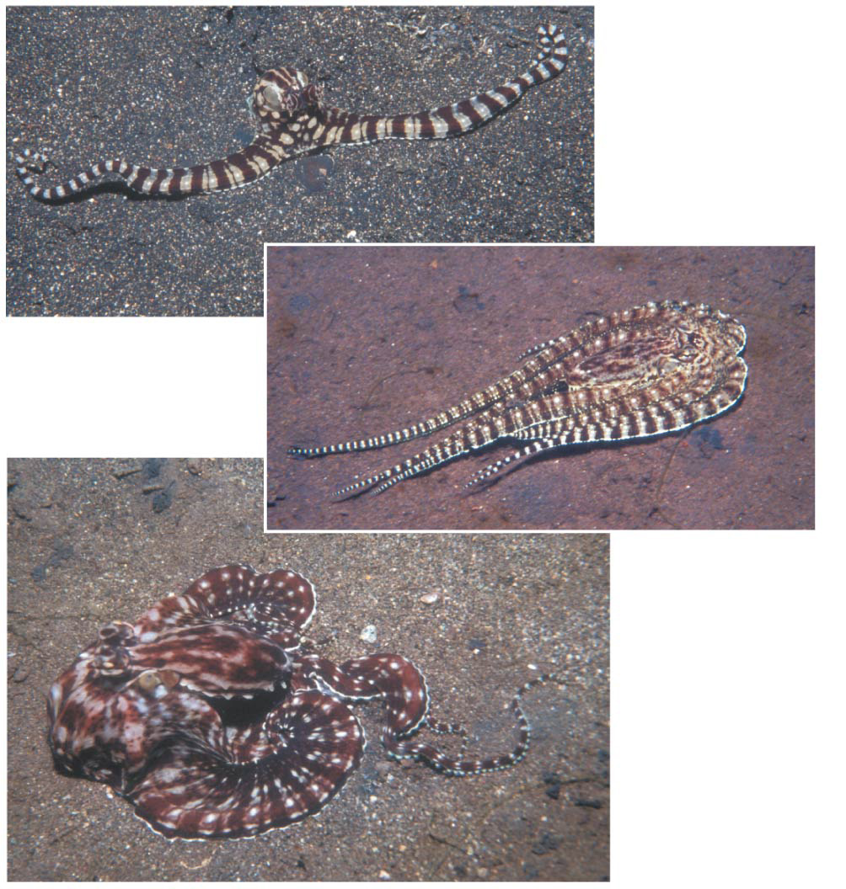
Figure 54.6
(a) Mimicking a sea snake
(b) Mimicking a flounder
(c) Mimicking a stingray
Notes:
Figure 54.6 The mimic octopus

Slide 17
Concept 54.1: Community interactions – Herbivory + Symbiosis
Herbivory (+/− interaction) refers to an interaction in which an herbivore eats parts of a plant or alga
Symbiosis is a relationship where two or more species live in DIRECT AND INTIMATE contact with one another…different TYPES of symbiosis include:
Parasitism (+/-)
Mutualism (+/+)
Commensalism (+/0)

Slide 18
Concept 54.1: Community interactions –Symbiosis (Parasitism)
In parasitism (+/− interaction), one organism, the parasite, derives nourishment from another organism, its host, which is harmed in the process
Parasites that live within the body of their host are called endoparasites
Parasites that live on the external surface of a host are ectoparasites

Slide 19
Concept 54.1: Community interactions –Symbiosis (Mutualism)
Mutualistic symbiosis, or mutualism (+/+ interaction), is an interspecific interaction that benefits both species
A mutualism can be
Obligate, where one species CANNOT survive without the other (Luv U 4evA)
Facultative, where both species can survive alone (let’s take a break)

Slide 20
Concept 54.1: Community interactions –Symbiosis (Commensalism)
In commensalism (+/0 interaction), one species benefits and the other is neither harmed nor helped
Commensal interactions are hard to document in nature because any close association likely affects BOTH species

Slide 21
Figure 54.UN07
Interspecific Interaction
Description
Interspecific competition (−/−)
Two or more species compete for a resource that is in short supply.
Predation (+/−)
One species, the predator, kills and eats the other, the prey. Predation has led to diverse adaptations, including mimicry.
Herbivory (+/−)
An herbivore eats part of a plant or alga.
Individuals of two or more species live in close contact with one another. Sym- biosis includes parasitism, mutualism and commensalism.
Symbiosis
Parasitism (+/−)
The parasite derives its nourishment from a second organism, its host, which is harmed.
Mutualism (+/+)
Both species benefit from the interaction.
Commensalism (+/0)
One species benefits from the interaction, while the other is unaffected by it.
Notes:
Figure 54.UN07 Summary of key concepts: interspecific interactions

Slide 22
Overview
Concept 54.1: Community interactions are classified by whether they help, harm, or have no effect on the species involved
Concept 54.2: Diversity and trophic structure characterize biological communities
Concept 54.3: Disturbance influences species diversity and composition

Slide 23
Concept 54.2: Diversity and trophic structure characterize biological communities
In general, a few species in a community exert strong control on that community’s structure as a whole
Two fundamental features of community structure are species diversity and feeding relationships

Slide 24
Concept 54.2: Diversity and trophic structure characterize biological communities
Species diversity of a community is the variety of organisms that make up the community
It has two components:
Species richness = the NUMBER of different species in the community
Relative abundance = the PROPORTION each species represents of all individuals in the community

Slide 25
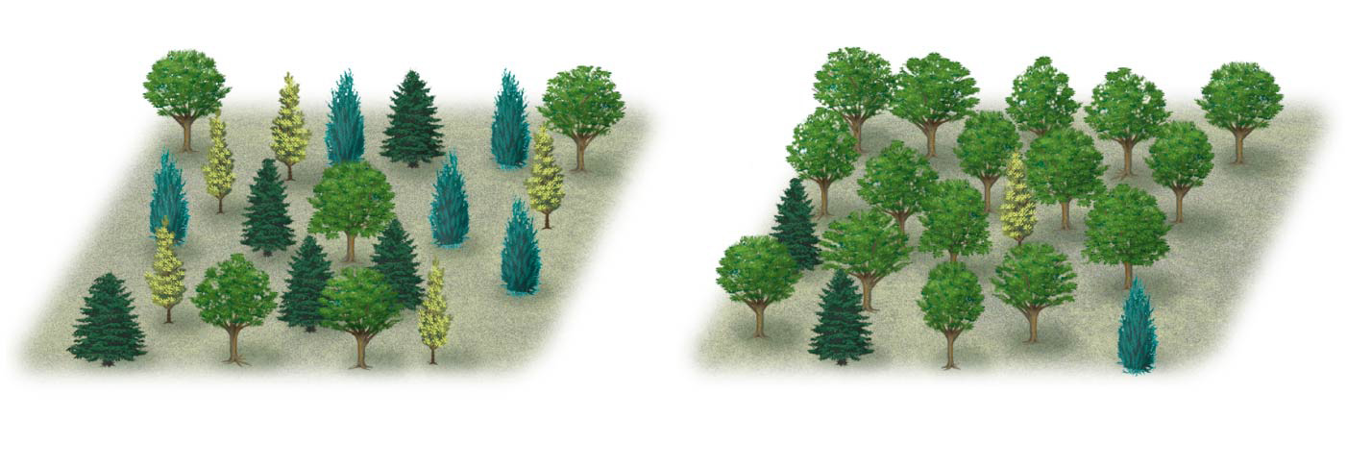
Which forest is more diverse?
A
B
C
D
Community 1
Community 2
A: 25% B: 25% C: 25% D: 25%
A: 80% B: 5% C: 5% D: 10%
Notes:
Figure 54.11 Which forest is more diverse?

Slide 26
Concept 54.2: Diversity and trophic structure characterize biological communities
Diversity and Community Stability
Communities with HIGHER diversity are…
More productive; they produce more biomass (the total mass of all organisms)
More stable in their productivity
Better able to withstand and recover from environmental stresses
More resistant to invasive species, organisms that become established outside their native range

Slide 27
Concept 54.2: Diversity and trophic structure characterize biological communities
Trophic structure is the feeding relationships between organisms in a community
It is a key factor in community dynamics
Food chains link trophic levels from producers to top carnivores
Species may play a role at more than one trophic level

Slide 28
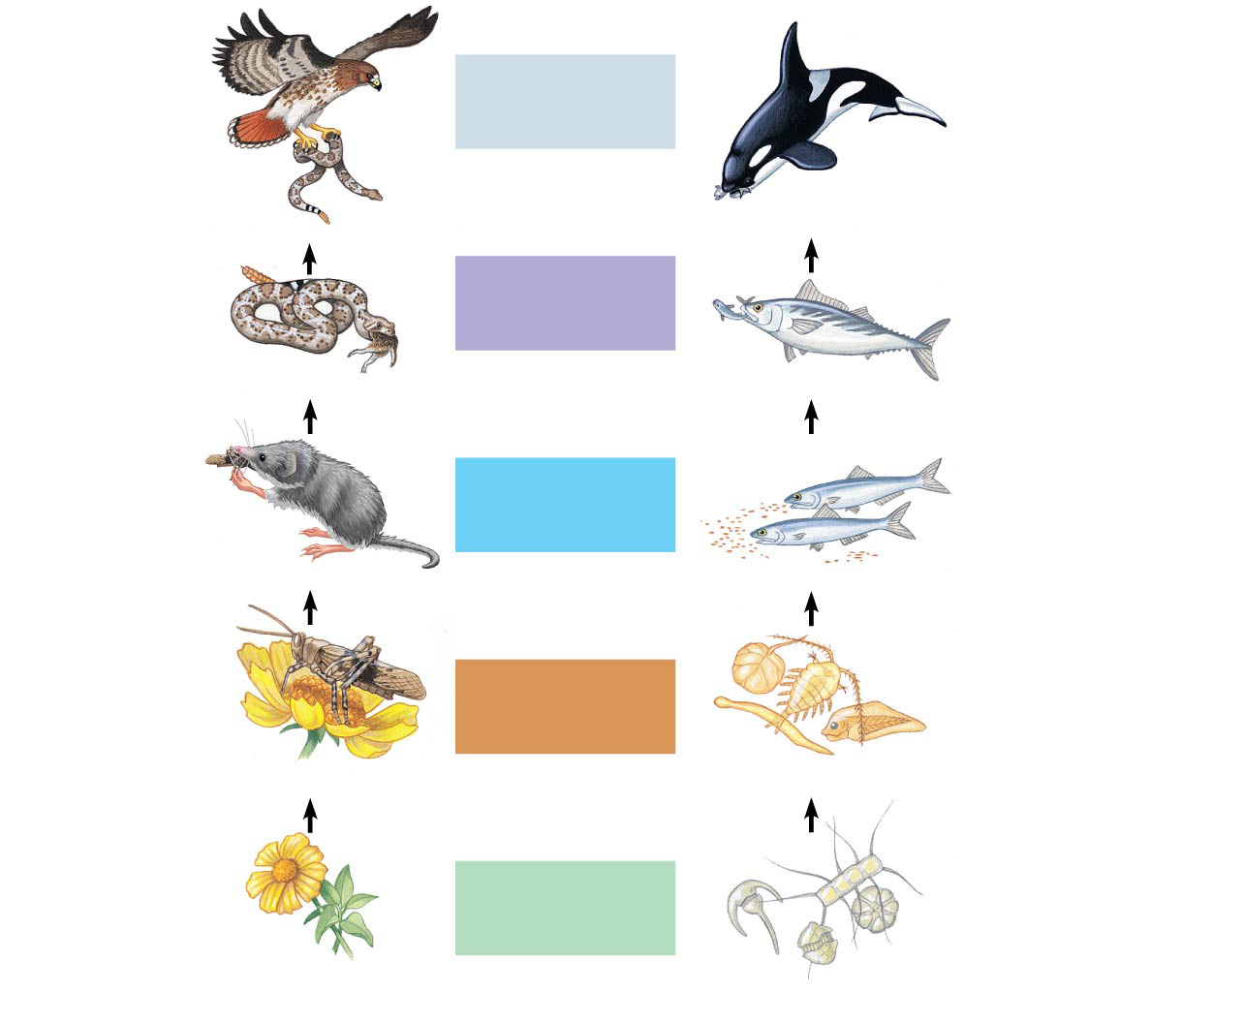
Figure 54.14
Carnivore
Quaternary consumers
Carnivore
Carnivore
Tertiary consumers
Carnivore
Carnivore
Secondary consumers
Carnivore
Herbivore
Primary consumers
Zooplankton
Plant
Primary producers
Phytoplankton
A terrestrial food chain
A marine food chain
Notes:
Figure 54.14 Examples of terrestrial and marine food chains

Slide 29
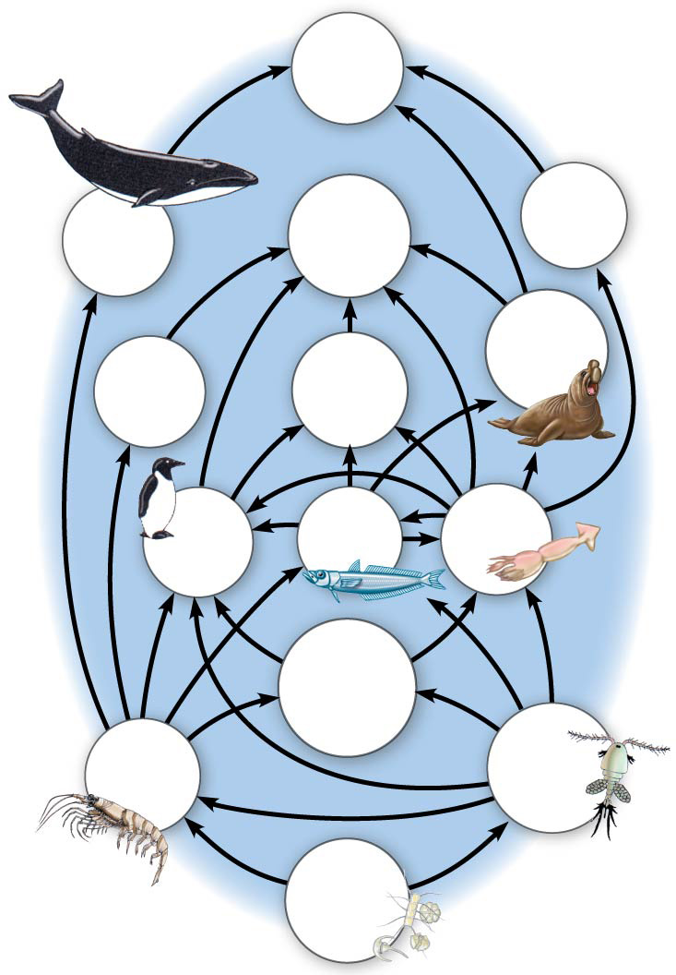
A food web is a branching food chain with complex trophic interactions
Humans
Smaller toothed whales
Sperm whales
Baleen whales
Elephant seals
Crab- eater seals
Leopard seals
Birds
Fishes
Squids
Carniv- orous plankton
Krill
Cope- pods
Phyto- plankton
Notes:
Figure 54.15 An Antarctic marine food web

Slide 30
Concept 54.2: Diversity and trophic structure characterize biological communities
Each food chain in a food web is usually only a few links long…why?
The energetic hypothesis suggests that length is LIMITED by inefficient energy transfer
Only about 10% of the energy stored in organic matter at each trophic level is converted to organic matter at the NEXT trophic level
For example, a producer level consisting of 100 kg of plant material can support about 10 kg of herbivore biomass and 1 kg of carnivore biomass

Slide 31
Concept 54.2: Diversity and trophic structure characterize biological communities
Species with Large Impacts
Certain species have a very large impact on community structure
Such species are classified as:
Dominant species = highly abundant in community
Keystone species = pivotal role in community dynamics

Slide 32
Concept 54.2: Diversity and trophic structure characterize biological communities
Species with Large Impacts
Dominant species = most abundant or have the highest biomass
One hypothesis suggests that dominant species are most competitive in exploiting resources, another hypothesis is that they are most successful at avoiding predators
Invasive species, typically introduced to a new environment by humans, may become dominant because they lack natural predators or disease in their new environments

Slide 33
Concept 54.2: Diversity and trophic structure characterize biological communities
Species with Large Impacts
Keystone species = exert STRONG CONTROL on a community by their ecological roles/niches
In contrast to dominant species, they are NOT necessarily abundant in a community
Field studies of sea stars illustrate their role as a keystone species in intertidal communities

Slide 34
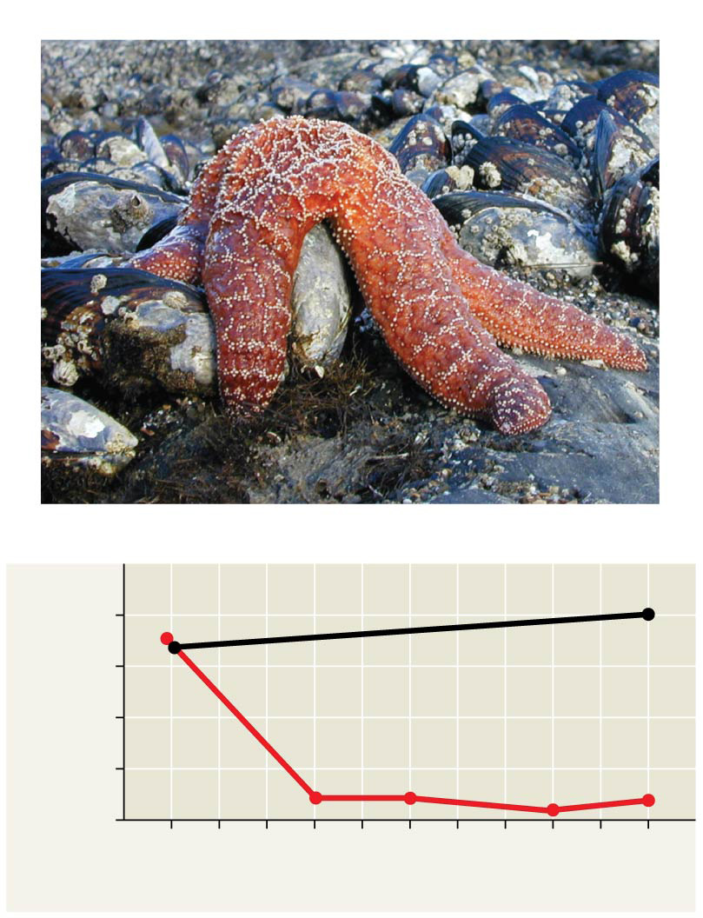
Pisaster ochraceus is a keystone predator
Experiment
Results
20
15
With Pisaster (control)
Number of species present
10
Without Pisaster (experimental)
5
0
1963 ′64 ′65 ′66 ′67 ′68 ′69 ′70 ′71 ′72 ′73
Year
Notes:
Figure 54.18 Inquiry: Is Pisaster ochraceus a keystone predator?

Slide 35
Overview
Concept 54.1: Community interactions are classified by whether they help, harm, or have no effect on the species involved
Concept 54.2: Diversity and trophic structure characterize biological communities
Concept 54.3: Disturbance influences species diversity and composition

Slide 36
Concept 54.3: Disturbance influences species diversity and composition
Decades ago, most ecologists favored the view that communities are in a state of “equilibrium” (MAJOR SMH)
The recent emphasis on the role of change has produced a nonequilibrium model, which describes communities as CONSTANTLY CHANGING after being buffeted by disturbances
Disturbance = an event that CHANGES a community, removes organisms from it, and alters resource availability

Slide 37
Concept 54.3: Disturbance influences species diversity and composition
Characterizing Disturbance
The types of disturbances and their frequency and severity vary among communities.
Storms and fire are significant sources of disturbance in many ecosystems
High level of disturbance = high intensity and high frequency of disturbance
Low level of disturbance = low frequency or low intensity of disturbance

Slide 38
Concept 54.3: Disturbance influences species diversity and composition
Intermediate disturbance hypothesis states:
MODERATE levels of disturbance can foster GREATER diversity than either high or low levels of disturbance (think Goldilocks)
High levels of disturbance exclude many slow-growing species
Low levels of disturbance allow dominant species to exclude less competitive species
Intermediate disturbance is juuuuusssssst right!

Slide 39
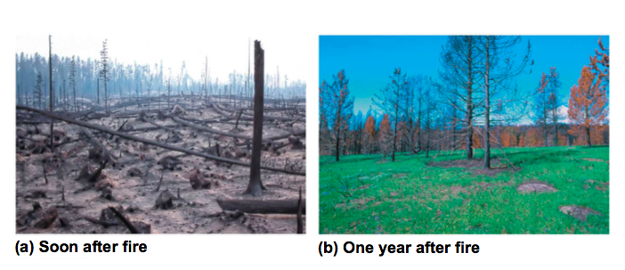
Concept 54.3: Disturbance influences species diversity and composition
The large-scale fire in Yellowstone National Park in 1988 demonstrated that communities can often respond VERY rapidly to a massive disturbance
The Yellowstone forest is an example of a nonequilibrium community

Slide 40
Concept 54.3: Disturbance influences species diversity and composition
Ecological succession = sequence of community changes after a disturbance
Primary succession occurs where no soil exists when succession begins
Secondary succession begins in an area where soil remains after a disturbance
For example, abandoned agricultural land may return to its original state through secondary succession

Slide 41
Concept 54.3: Disturbance influences species diversity and composition – Human Disturbance
Humans have the GREATEST impact on biological communities worldwide
Both terrestrial and marine ecosystems are subject to human disturbance
Human disturbance to communities usually REDUCES species diversity
More on human impact to come!

Slide 42
Overview
Concept 54.1: Community interactions are classified by whether they help, harm, or have no effect on the species involved
Concept 54.2: Diversity and trophic structure characterize biological communities
Concept 54.3: Disturbance influences species diversity and composition

