Slide 1
53
Population Ecology

Slide 2
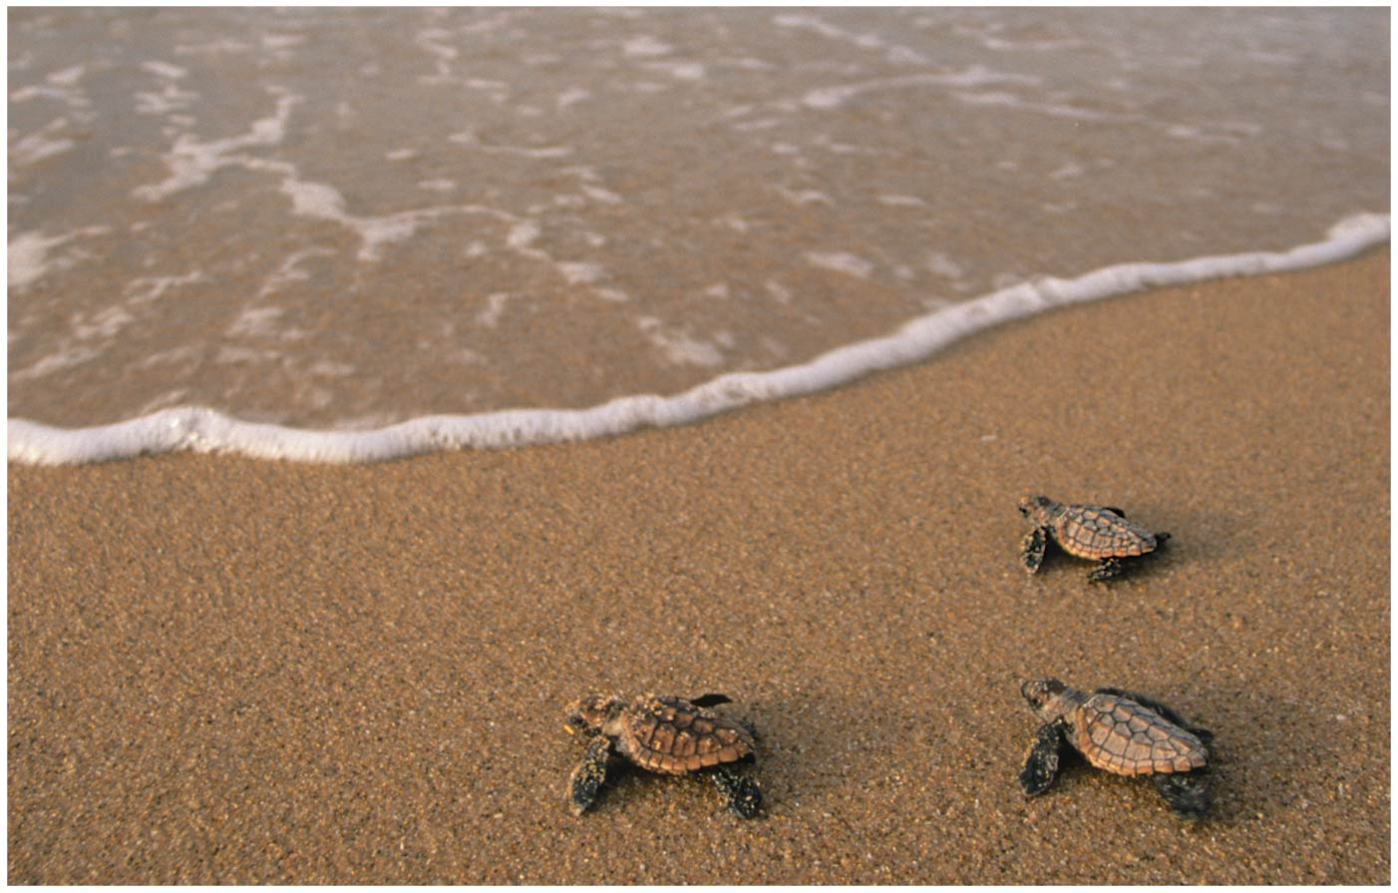
Figure 53.1
What causes the survival of
turtle hatchlings to vary each year?
Notes:
Figure 53.1 What causes the survival of turtle hatchlings to vary each year?

Slide 3
Turtle Tracks Exemplify PopEco
Population ecology explores how biotic AND abiotic factors influence density, distribution, size, and age structure of POPULATIONS
For example, the number of turtle hatchlings that survive their first journey to the ocean is affected by BOTH biotic and abiotic factors
Population dynamics focuses on the complex interactions between biotic and abiotic factors that cause VARIATION in population size

Slide 4
Overview
Concept 53.1: Biological processes influence population density, dispersion, and demographics
Concept 53.2: The exponential model describes population growth in an idealized, unlimited environment
Concept 53.3: The logistic model describes how a population grows more slowly as it nears its carrying capacity
Concept 53.4: Life history traits are products of natural selection
Concept 53.5: Many factors that regulate population growth are density dependent
Concept 53.6: The human population is no longer growing exponentially but is still increasing rapidly

Slide 5
Overview
Concept 53.1: Biological processes influence population density, dispersion, and demographics
Concept 53.2: The exponential model describes population growth in an idealized, unlimited environment
Concept 53.3: The logistic model describes how a population grows more slowly as it nears its carrying capacity
Concept 53.5: Many factors that regulate population growth are density dependent

Slide 6
Overview
Concept 53.1: Biological processes influence population density, dispersion, and demographics
Concept 53.2: The exponential model describes population growth in an idealized, unlimited environment
Concept 53.3: The logistic model describes how a population grows more slowly as it nears its carrying capacity
Concept 53.5: Many factors that regulate population growth are density dependent

Slide 7
Concept 53.1: Biological processes influence population density, dispersion, and demographics
Population = group of potentially interbreeding individuals within…
Same SPECIES…
Living in the same AREA…
At same general TIME
Populations are described by their boundaries and size

Slide 8
Concept 53.1: Biological processes influence population density, dispersion, and demographics
Density = number of individuals per unit area or volume, involves an interplay between…
Immigration = INFLUX of new individuals from other areas
Emigration = movement of individuals OUT of a population
Dispersion = pattern of SPACING among individuals within the boundaries of the population

Slide 9
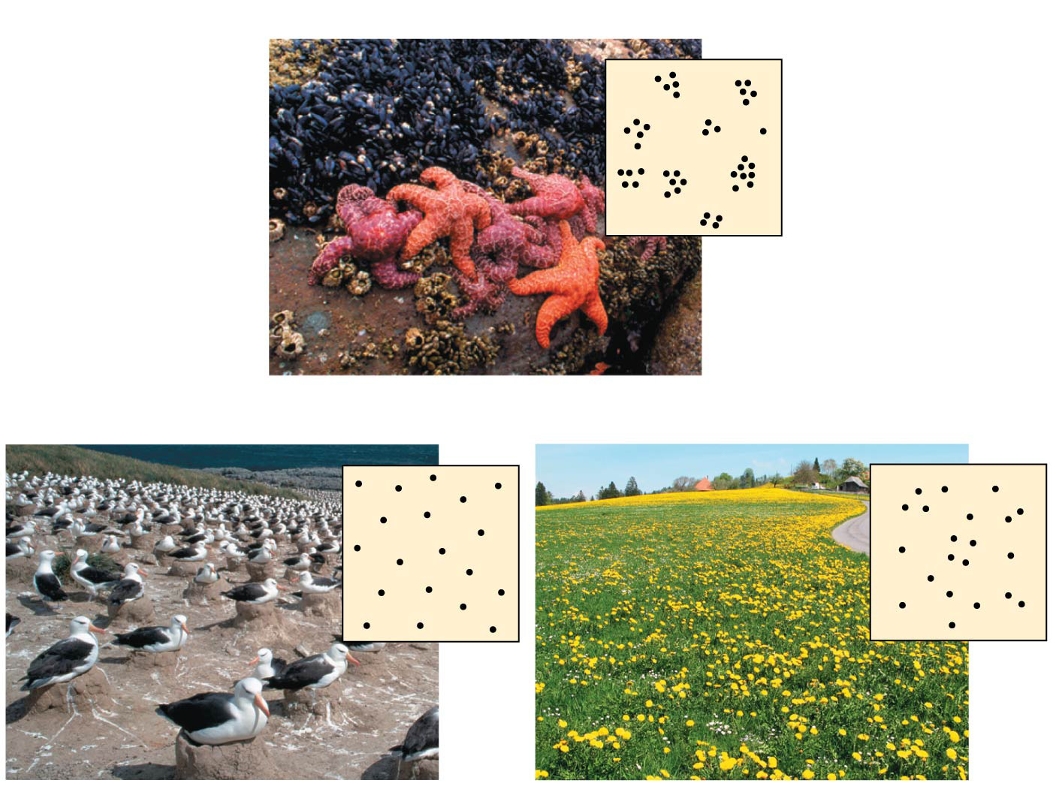
Patterns of dispersion within a population’s geographic range
(a) Clumped
(b) Uniform
(c) Random
Notes:
Figure 53.4 Patterns of dispersion within a population’s geographic range

Slide 10
Concept 53.1: Biological processes influence population density, dispersion, and demographics
Demography = study of the vital statistics of a population and how they CHANGE over time
Death rates and birth rates are of particular interest to demographers
Dynamic study! (just like all of ecology)

Slide 11
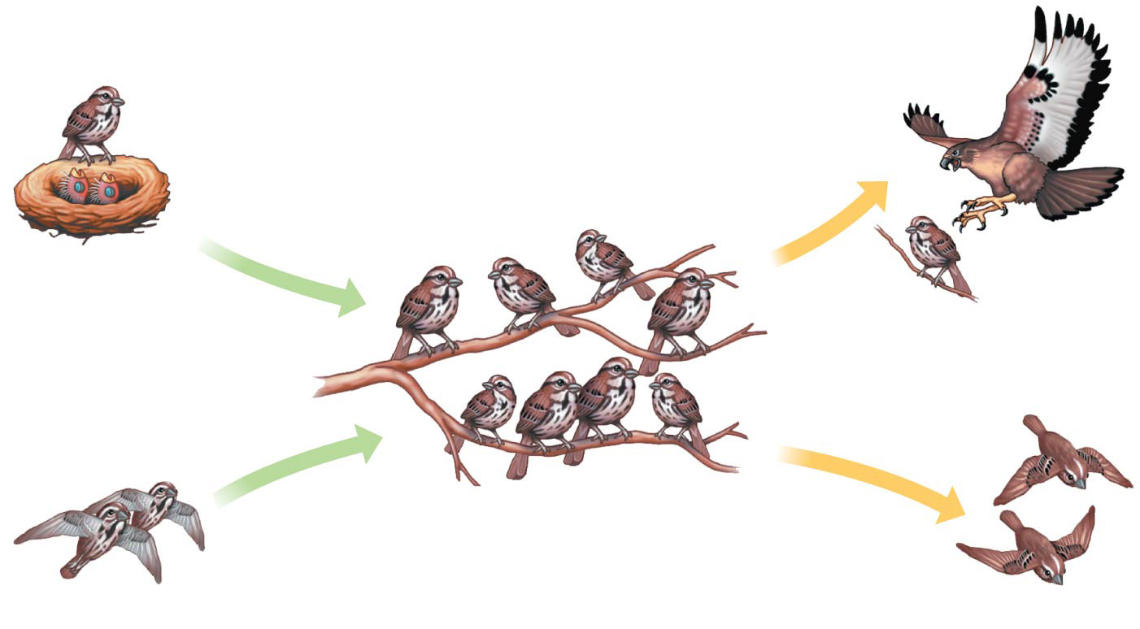
Population Dynamics
Births
Deaths
Deaths and emigration remove individuals from a population.
Births and immigration add individuals to a population.
Immigration
Emigration
Notes:
Figure 53.3 Population dynamics

Slide 12
Notes:
A population is correctly defined as having which of the following characteristics? I) inhabiting the same general area II) belonging to the same species III) possessing a constant and uniform density and dispersion
https://www.polleverywhere.com/multiple_choice_polls/50PjxQdeYpDON9O

Slide 13
Notes:
An ecologist recorded twelve white-tailed deer, Odocoileus virginianus, per square kilometer in one woodlot and twenty per square kilometer in another woodlot. What was the ecologist comparing?
https://www.polleverywhere.com/multiple_choice_polls/D7CawzVyYg3gDx9

Slide 14
Overview
Concept 53.1: Biological processes influence population density, dispersion, and demographics
Concept 53.2: The exponential model describes population growth in an idealized, unlimited environment
Concept 53.3: The logistic model describes how a population grows more slowly as it nears its carrying capacity
Concept 53.5: Many factors that regulate population growth are density dependent

Slide 15
Concept 53.2: The exponential model describes population growth in an idealized, unlimited environment
It is useful to study population GROWTH in an IDEALIZED situation…
Idealized situations help us understand the CAPACITY of species to increase and the conditions that may facilitate this growth

Slide 16
Concept 53.2: The exponential model describes population growth in an idealized, unlimited environment
Per Capita Rate of Increase
Change in
population
size
Immigrants
entering
population
Emigrants
leaving
population
=
Births
+
–
Deaths
–
If immigration and emigration are ignored, a population’s growth rate (per capita increase) equals birth rate minus death rate

Slide 17
Concept 53.2: The exponential model describes population growth in an idealized, unlimited environment
Exponential population growth = population INCREASE under IDEALIZED conditions
The rate of increase is CONSTANT and at its MAXIMUM
The population accumulates more new individuals per unit time when it is large as compared to when it is small
Exponential population growth = J-shaped curve

Slide 18
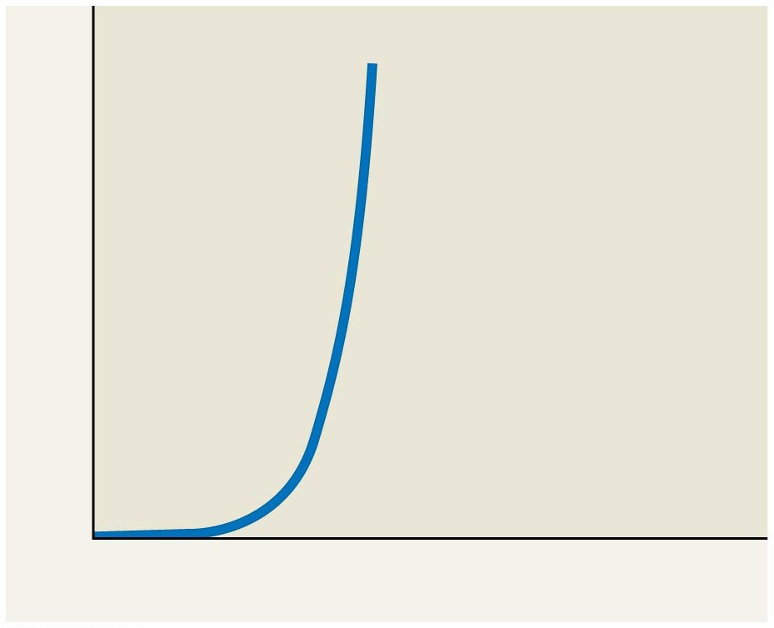
Exponential Model of Population Growth
Population size (N)
Number of generations
Notes:
Figure 53.UN03 Summary of key concepts: exponential model

Slide 19
Concept 53.2: The exponential model describes population growth in an idealized, unlimited environment
Exponential growth is NOT realistic in MOST populations! (idealized!)
There will always be limitations…
However, J-shaped curve of exponential growth characterizes some REBOUNDING populations
Ex: Elephant population in Kruger National Park, South Africa, grew exponentially after hunting was banned

Slide 20
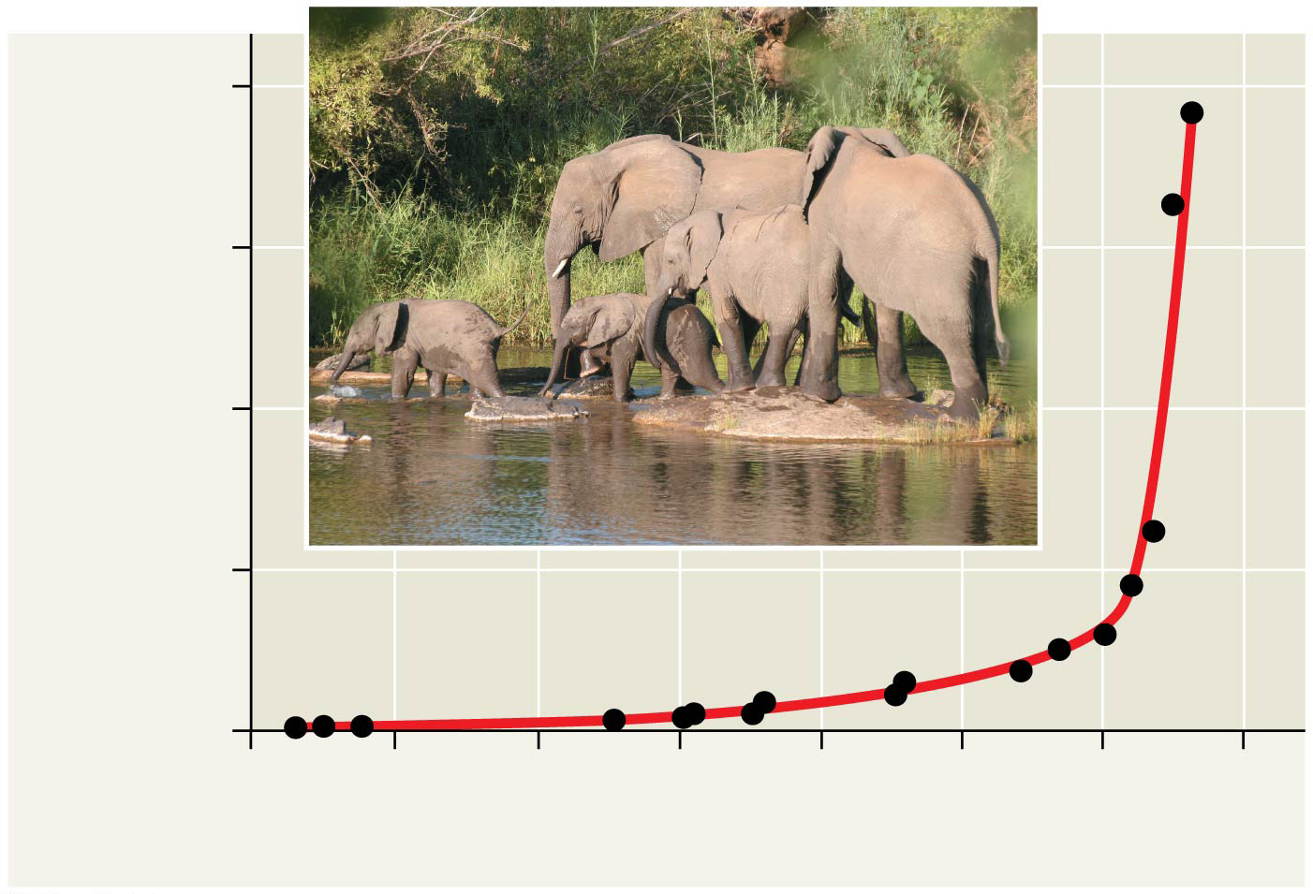
Figure 53.9
8,000
6,000
Elephant population
4,000
2,000
0
1900 1910 1920 1930 1940 1950 1960 1970
Year
Notes:
Figure 53.9 Exponential growth in the African elephant population of Kruger National Part, South Africa

Slide 21
Notes:
A population of ground squirrels has an annual per capita birth rate of 0.06 and an annual per capita death rate of 0.02. Calculate an estimate of the total number of individuals added to (or lost from) a population of 1000 individuals in one year.
https://www.polleverywhere.com/multiple_choice_polls/aJwYyTZtgsjmBQ8

Slide 22
Notes:
Consider two old-growth forests: one is undisturbed while the other is being logged. In which region are species likely to experience exponential growth, and why?
https://www.polleverywhere.com/multiple_choice_polls/NkcK3YrZzZXgL46

Slide 23
Overview
Concept 53.1: Biological processes influence population density, dispersion, and demographics
Concept 53.2: The exponential model describes population growth in an idealized, unlimited environment
Concept 53.3: The logistic model describes how a population grows more slowly as it nears its carrying capacity
Concept 53.5: Many factors that regulate population growth are density dependent

Slide 24
Concept 53.3: The logistic model describes how a population grows more slowly as it nears its carrying capacity
Exponential growth CANNOT be sustained for long in any population…
A more REALISTIC population model LIMITS GROWTH by incorporating carrying capacity
Carrying capacity (K) = the maximum population size the environment can support
K VARIES with the abundance of limiting resources
It is a dynamic value! (like ecology itself)

Slide 25
Concept 53.3: The logistic model describes how a population grows more slowly as it nears its carrying capacity
In the logistic population growth model, the per capita rate of increase declines as carrying capacity is reached
The population growth rate DECREASES as number of individuals within a population approaches K
When the number of individuals within a population EQUALS K → population STOPS growing
Logistic growth = sigmoid (S-shaped) curve

Slide 26
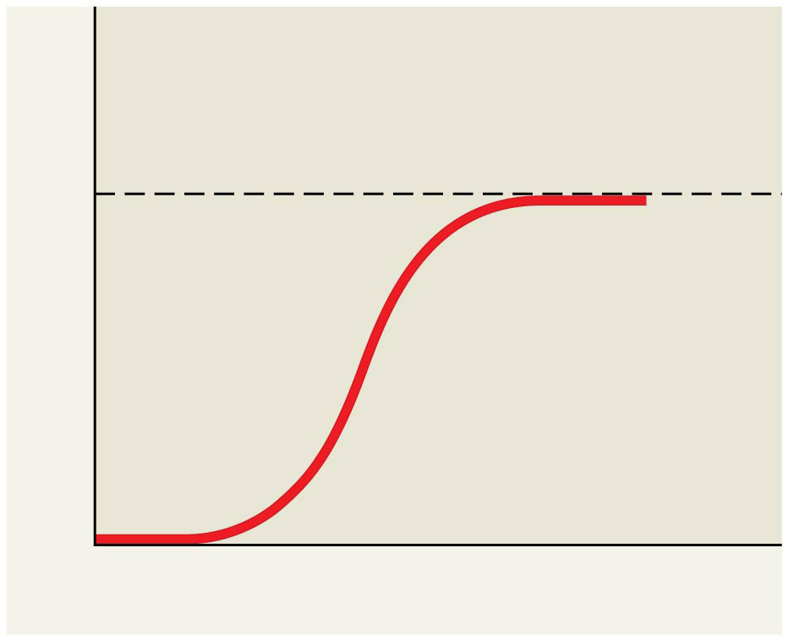
Logistic Model of Population Growth
K = carrying capacity
Population size (N)
Number of generations
Notes:
Figure 53.UN04 Summary of key concepts: logistic model

Slide 27
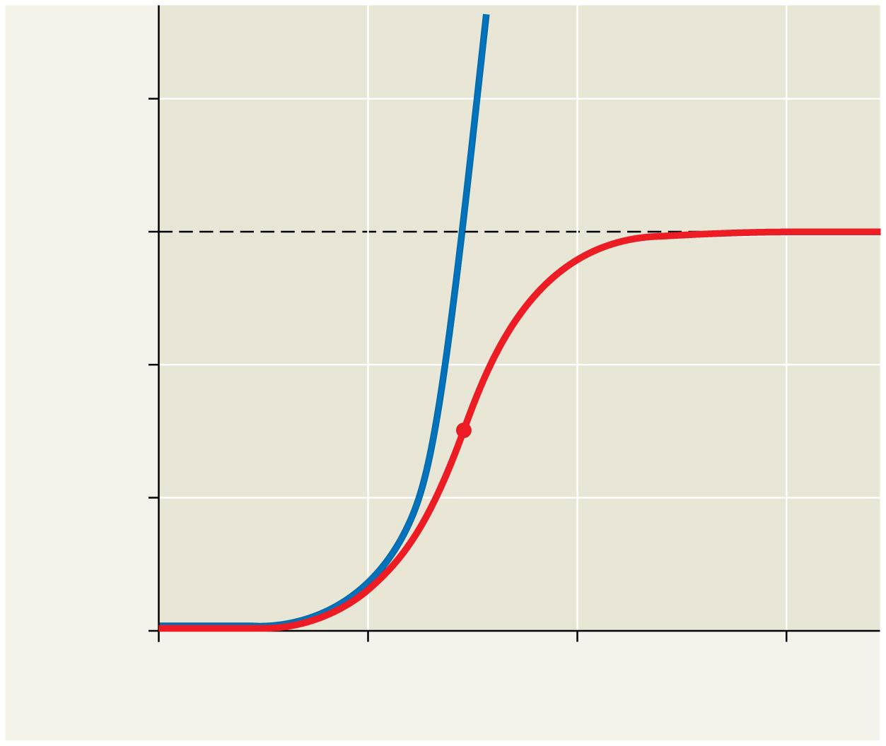
DON’T WORRY ABOUT THE MATH from the textbook...just compare the SHAPES of the growth curves
Exponential growth
2,000
1,500
K = 1,500
Logistic growth
Population size (N)
1,000
500
Population growth begins slowing here.
0
0
5
10
15
Number of generations
Notes:
Figure 53.10 Population growth predicted by the logistic model

Slide 28
Concept 53.3: The logistic model describes how a population grows more slowly as it nears its carrying capacity
The logistic model fits few real populations but is useful for estimating possible growth
Some populations overshoot K before settling down to a relatively stable density
Some populations fluctuate greatly and make it difficult to define K
BOTH the exponential and logistic models of growth are two ENDS OF A SPECTRUM…do not think of populations as simply either/or!

Slide 29
Notes:
Which statements about K are correct? I) K varies among populations. II) K varies in space. III) K varies in time. IV) K is constant for any given species.
https://www.polleverywhere.com/multiple_choice_polls/Cg2sadgGypbcNpz

Slide 30
Notes:
As N (total members of population) approaches K for a certain population, which of the following is predicted by the logistic equation?
https://www.polleverywhere.com/multiple_choice_polls/ehowzCGnOciUfEZ

Slide 31
Notes:
Which of the following causes populations to shift most quickly from an exponential to a logistic population growth?
https://www.polleverywhere.com/multiple_choice_polls/x6G9hmGGYrnR84B

Slide 32
Overview
Concept 53.1: Biological processes influence population density, dispersion, and demographics
Concept 53.2: The exponential model describes population growth in an idealized, unlimited environment
Concept 53.3: The logistic model describes how a population grows more slowly as it nears its carrying capacity
Concept 53.5: Many factors that regulate population growth are density dependent

Slide 33
Concept 53.5: Many factors that regulate population growth are density dependent
There are two general questions about REGULATION of population growth…
What environmental factors STOP a population from growing indefinitely?
Why do some populations show radical FLUCTUATIONS in size over time, while others remain STABLE?
Both questions are tied to the ever-so DYNAMIC nature of ecology itself!

Slide 34
Concept 53.5: Many factors that regulate population growth are density dependent
Population Change and Population Density
Density-independent populations = birth rate and death rate do NOT change with population density
Density-dependent populations = birth rates fall and death rates rise WITH population density
The large majority of factors that regulate population growth are density-DEPENDENT

Slide 35
Concept 53.5: Many factors that regulate population growth are density dependent
Density-independent regulators of population growth and size include:
Weather, natural disaster, random chance events
None of these factors are affected by the population density
Density-dependent birth and death rates are affected by density-dependent factors such as…
Competition for resources, territoriality, disease, predation, and toxic wastes

Slide 36
Concept 53.5: Many factors that regulate population growth are density dependent
Competition: In crowded populations, increasing population density intensifies competition for resources and results in a lower birth rate
Disease: In dense populations, pathogens can spread more rapidly
Predation: As a prey population builds up, predators may feed preferentially on that species
Territoriality: In many vertebrates and some invertebrates, competition for territory may limit density
Toxic Wastes: Accumulation of toxic wastes can contribute to density-dependent regulation of population size

Slide 37
Overview
Concept 53.1: Biological processes influence population density, dispersion, and demographics
Concept 53.2: The exponential model describes population growth in an idealized, unlimited environment
Concept 53.3: The logistic model describes how a population grows more slowly as it nears its carrying capacity
Concept 53.5: Many factors that regulate population growth are density dependent

