Slide 1
52
An Introduction to Ecology and the Biosphere

Slide 2
Discovering Ecology
Ecology = scientific study of the dynamic INTERACTIONS between organisms AND the environment
These INTERACTIONS determine the distribution of organisms and their abundance
Modern ecology includes observation and experimentation

Slide 3
Overview (only need to know 52.4)
Concept 52.1: Earth’s climate varies by latitude and season and is changing rapidly
Concept 52.2: The structure and distribution of terrestrial biomes are controlled by climate and disturbance
Concept 52.3: Aquatic biomes are diverse and dynamic systems that cover most of Earth
Concept 52.4: Interactions between organisms and the environment limit the distribution of species

Slide 4
Overview
Concept 52.1: Earth’s climate varies by latitude and season and is changing rapidly
Concept 52.2: The structure and distribution of terrestrial biomes are controlled by climate and disturbance
Concept 52.3: Aquatic biomes are diverse and dynamic systems that cover most of Earth
Concept 52.4: Interactions between organisms and the environment limit the distribution of species

Slide 5
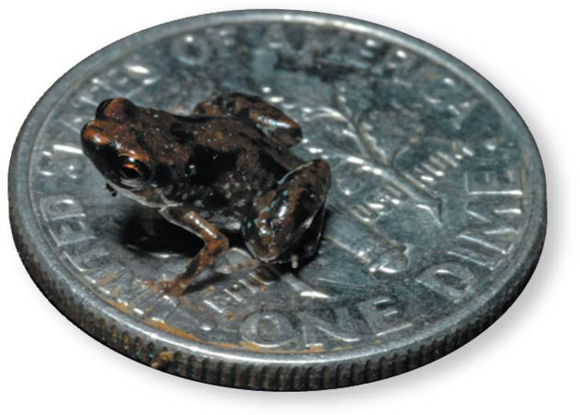
Figure 52.1a
What ecological factors limit the distribution of this tiny frog?
Notes:
Figure 52.1 What limits the distribution of this tiny frog? (part 1: frog on a dime)

Slide 6
Concept 52.4: Interactions between organisms and the environment limit the distribution of species
Both biotic (living) and abiotic (nonliving) factors influence species distribution
Species distributions are the result of ecological and evolutionary interactions through time
“Ecological time” = minute-to-minute time frame of interactions between organisms and the environment
“Evolutionary time” = spans MANY generations and captures adaptation through natural selection

Slide 7
Concept 52.4: Interactions between organisms and the environment limit the distribution of species
Events in ecological time can lead to evolution
Ex: Galápagos finches in a drought
Those with larger breaks were more likely to survive a drought as they could eat the available larger seeds
As a result, the average beak size was larger in the next generation
This resulted in an evolutionary change

Slide 8
Concept 52.4: Interactions between organisms and the environment limit the distribution of species
Dispersal = movement of individuals or gametes AWAY from centers of high population density or from their area of origin
Dispersal contributes to the global distribution of organisms
Ecologists ask questions about WHERE species occur and WHY species occur where they do…

Slide 9
Figure 52.16-1
Why is species X absent from an area?
Does dispersal limit its distribution?
Notes:
Figure 52.16-1 Flowchart of factors limiting geographic distribution (step 1)

Slide 10
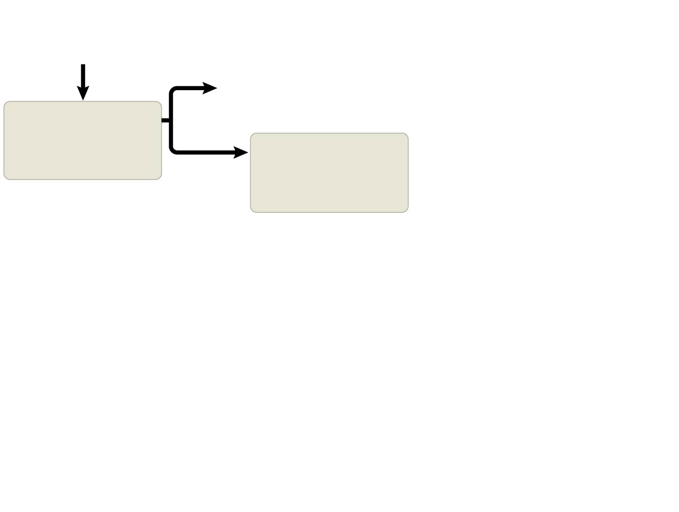
Figure 52.16-2
Why is species X absent from an area?
Yes
Area inaccessible or insufficient time
Does dispersal limit its distribution?
Does behavior limit its distribution?
No
Notes:
Figure 52.16-2 Flowchart of factors limiting geographic distribution (step 2)

Slide 11
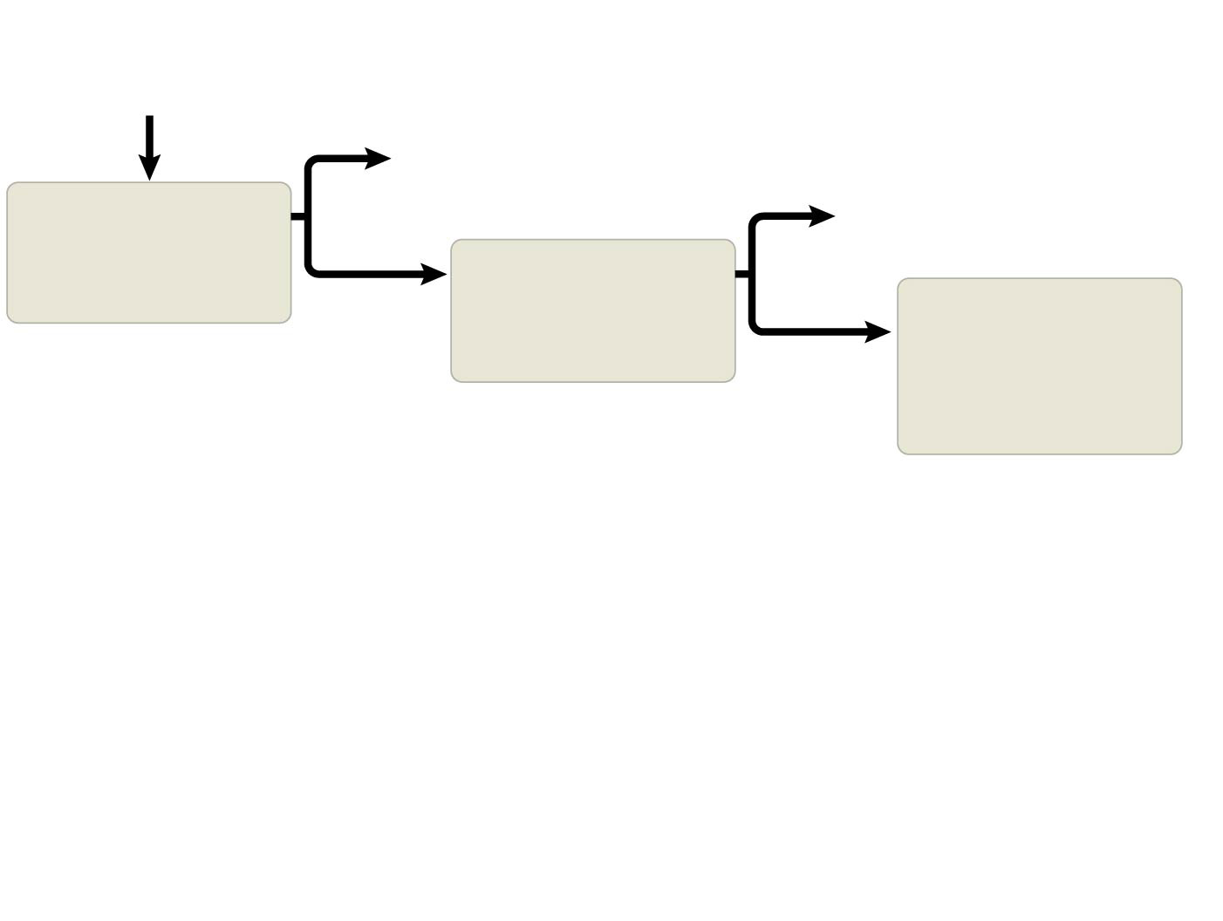
Figure 52.16-3
Why is species X absent from an area?
Yes
Area inaccessible or insufficient time
Yes
Does dispersal limit its distribution?
Habitat selection
Does behavior limit its distribution?
No
Do biotic factors (other species) limit its distribution?
No
Notes:
Figure 52.16-3 Flowchart of factors limiting geographic distribution (step 3)

Slide 12
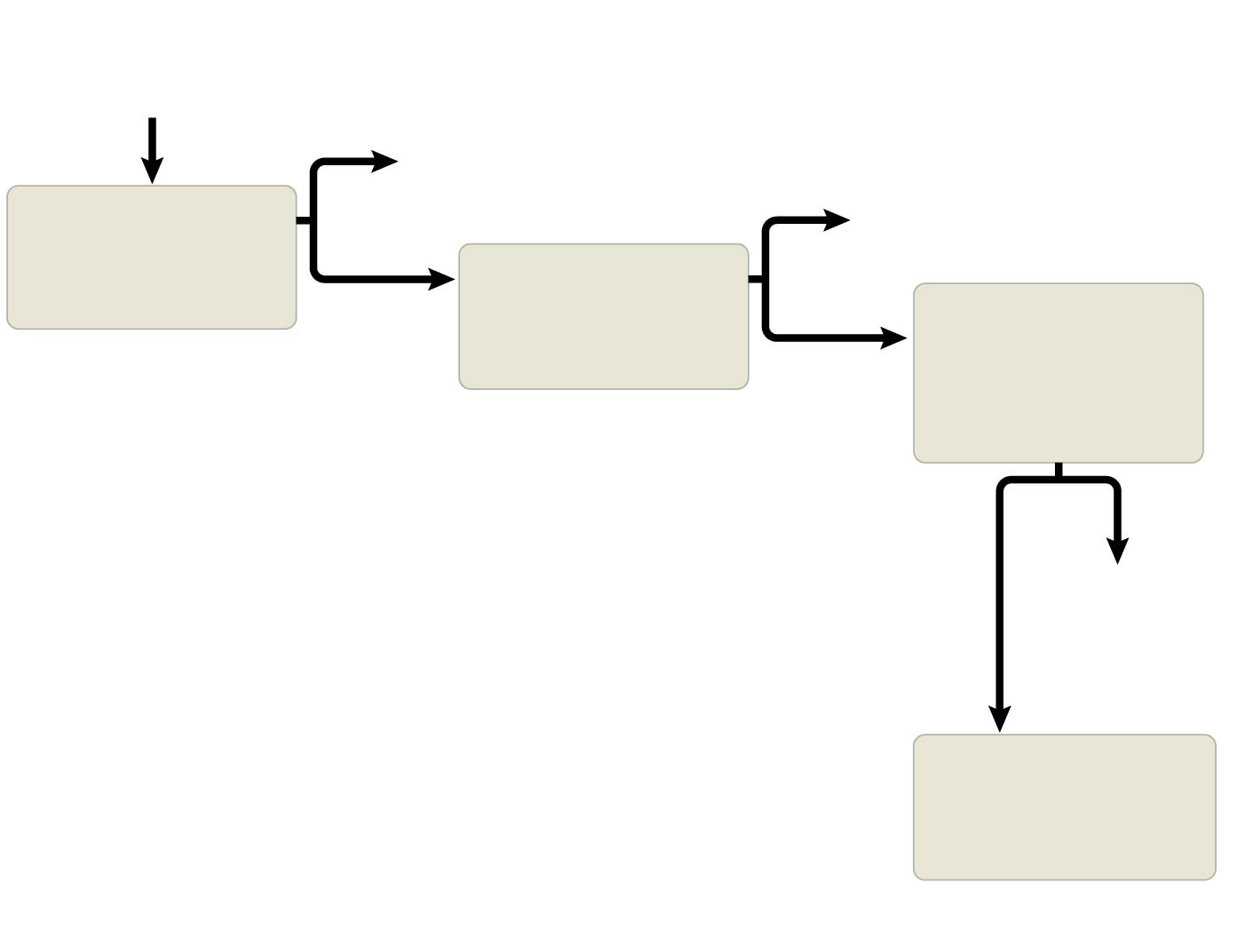
Figure 52.16-4
Why is species X absent from an area?
Yes
Area inaccessible or insufficient time
Yes
Does dispersal limit its distribution?
Habitat selection
Does behavior limit its distribution?
No
Do biotic factors (other species) limit its distribution?
No
Yes
No
Predation, parasitism, competition, disease
Do abiotic factors limit its distribution?
Notes:
Figure 52.16-4 Flowchart of factors limiting geographic distribution (step 4)

Slide 13
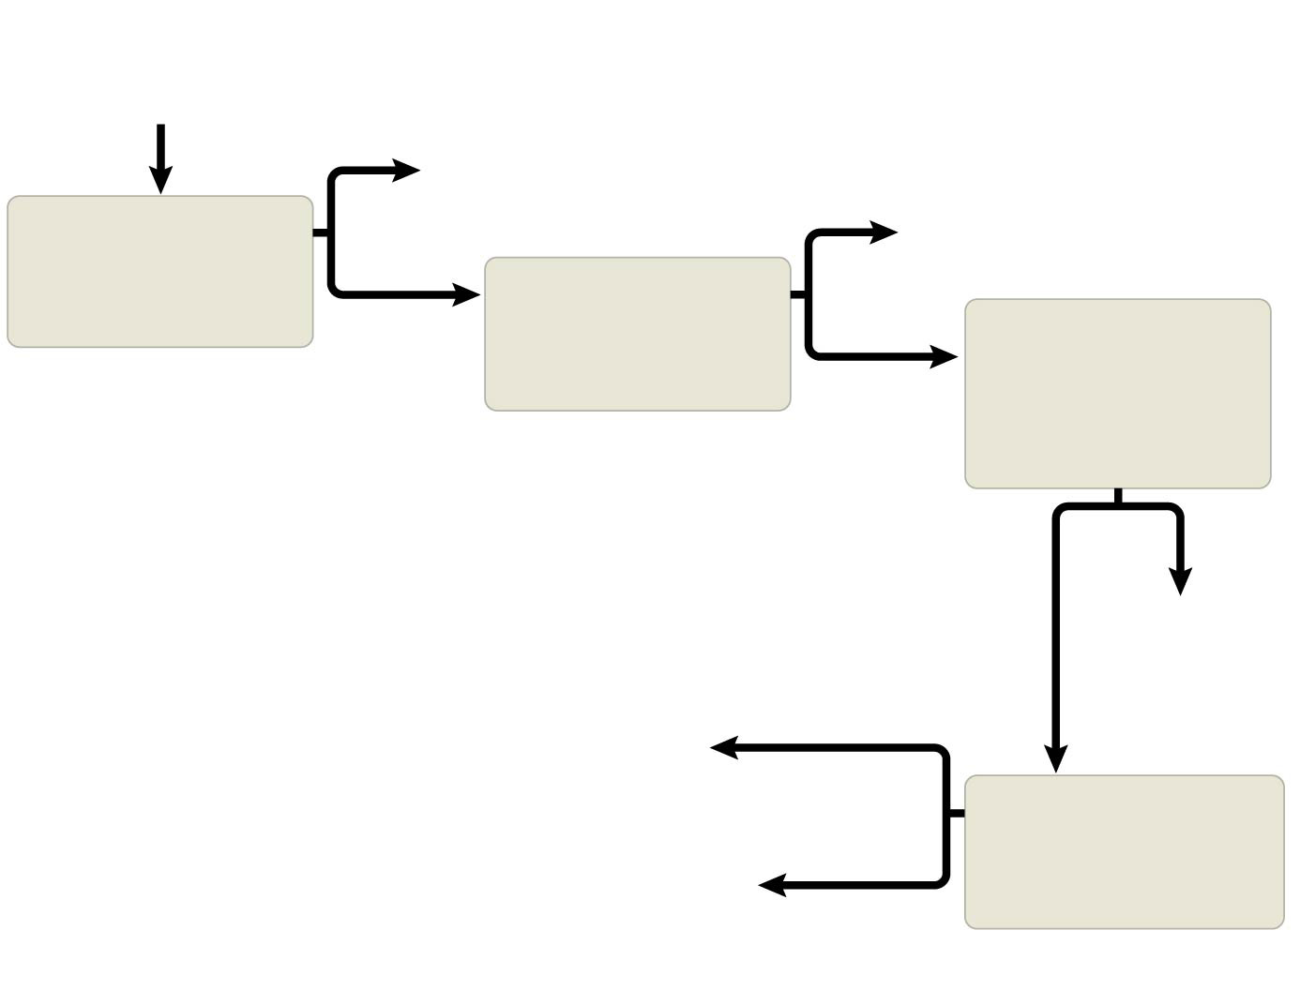
Figure 52.16-5
Why is species X absent from an area?
Yes
Area inaccessible or insufficient time
Yes
Does dispersal limit its distribution?
Habitat selection
Does behavior limit its distribution?
No
Do biotic factors (other species) limit its distribution?
No
Yes
No
Predation, parasitism, competition, disease
Chemical factors
Water, Oxygen, Salinity, pH, Soil nutrients, etc.
Do abiotic factors limit its distribution?
Temperature, Light, Soil structure, Fire, Moisture, etc.
Physical factors
Notes:
Figure 52.16-5 Flowchart of factors limiting geographic distribution (step 5)

Slide 14
Overview
Concept 52.1: Earth’s climate varies by latitude and season and is changing rapidly
Concept 52.2: The structure and distribution of terrestrial biomes are controlled by climate and disturbance
Concept 52.3: Aquatic biomes are diverse and dynamic systems that cover most of Earth
Concept 52.4: Interactions between organisms and the environment limit the distribution of species

Slide 15
Notes:
A certain species of pine tree survives only in scattered locations at elevations above 2800 meters in the western United States. To understand why this tree grows only in these specific places, an ecologist should _____.
https://www.polleverywhere.com/multiple_choice_polls/3HL4MWCMFy9Nlv1

Slide 16
Notes:
Which of the following examples of an ecological effect leading to an evolutionary effect is most correct?
https://www.polleverywhere.com/multiple_choice_polls/YQ7sDFYsBblZQYG

