Slide 1
51
Animal Behavior

Slide 2
The How and Why of Animal Activity
Fiddler crabs feed with their small claw and wave their large claw
WHY do male fiddler crabs engage in claw waving behavior → claw waving is used to repel other males and to attract females
A behavior is an action carried out by muscles under control of the nervous system
Behavior is subject to natural selection (duh)
Some behaviors will be selected, some won’t!

Slide 3
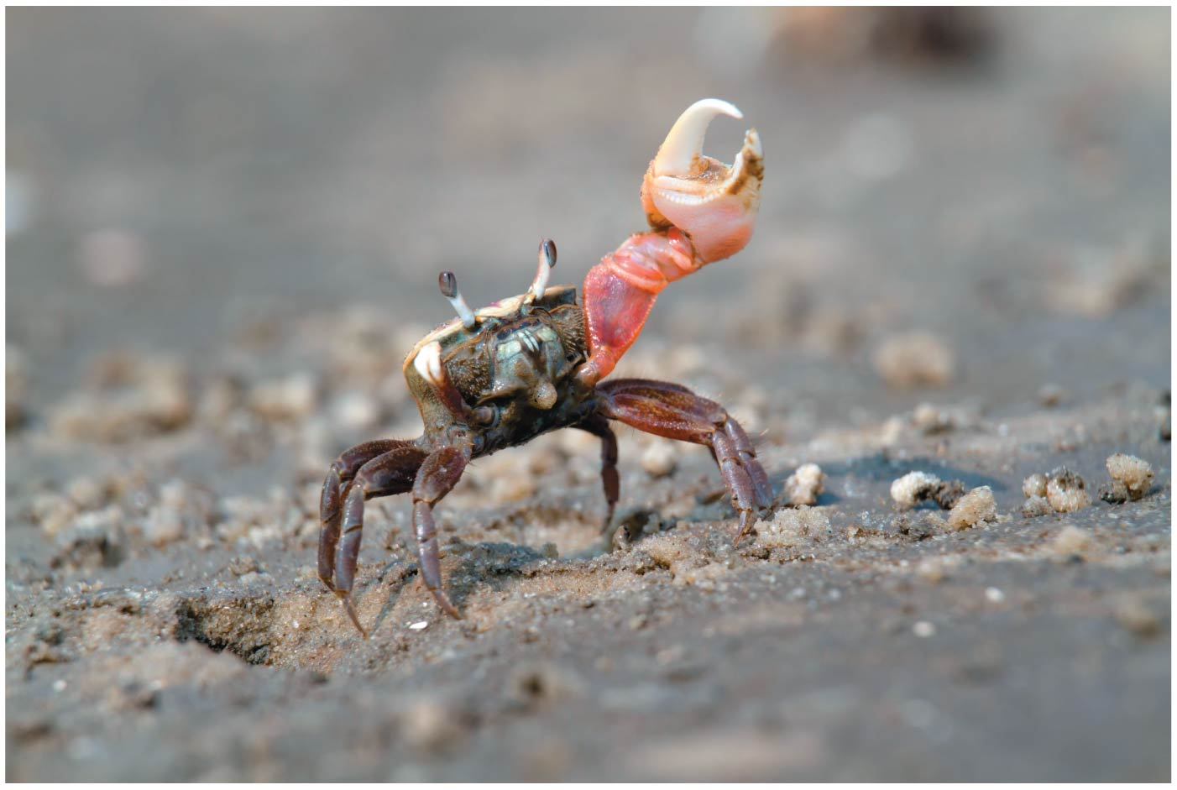
Figure 51.1a
Sup girl!
Notes:
Figure 51.1 What prompts a male fiddler crab to display its giant claw? (part 1: claw waving)

Slide 4
Overview
Concept 51.1: Discrete sensory inputs can stimulate both simple and complex behaviors
Concept 51.2: Learning establishes specific links between experience and behavior
Concept 51.3: Selection for individual survival and reproductive success can explain diverse behaviors
Concept 51.4: Genetic analyses and the concept of inclusive fitness provide a basis for studying the evolution of behavior

Slide 5
Overview
Concept 51.1: Discrete sensory inputs can stimulate both simple and complex behaviors
Concept 51.2: Learning establishes specific links between experience and behavior
Concept 51.3: Selection for individual survival and reproductive success can explain diverse behaviors
Concept 51.4: Genetic analyses and the concept of inclusive fitness provide a basis for studying the evolution of behavior

Slide 6
Concept 51.1: Discrete sensory inputs can stimulate both simple and complex behaviors
Niko Tinbergen (GOAT ethologist) identified 4 questions that should be asked about any animal behavior…
What stimulus elicits the behavior, and what physiological mechanisms mediate the response?
How does the animal’s experience during growth and development influence the response?
How does the behavior aid survival and reproduction?
What is the behavior’s evolutionary history?

Slide 7
Concept 51.1: Discrete sensory inputs can stimulate both simple and complex behaviors
Behavioral ecology = study of the ecological and evolutionary basis for animal behavior
Behavioral ecology integrates proximate and ultimate explanations for animal behavior
Proximate causation = “how” a behavior occurs or is modified (Tinbergen’s questions 1 and 2)
Ultimate causation = “why” a behavior occurs in the context of natural selection (Tinbergen’s questions 3 and 4)

Slide 8
Concept 51.1: Discrete sensory inputs can stimulate both simple and complex behaviors
Behavioral Rhythms
Some animal behavior is affected by the animal’s circadian rhythm, a daily cycle of rest and activity
Behaviors such as migration and reproduction are linked to changing seasons, or a circannual rhythm
Daylight and darkness are common seasonal cues
Some behaviors are linked to lunar cycles, which affect tidal movements (Ex: werewolves)

Slide 9
Concept 51.1: Discrete sensory inputs can stimulate both simple and complex behaviors
Migration = regular, long-distance change in location
Why: Environmental cues can trigger movement in a particular direction where conditions are favorable
How: Animals can orient themselves using…
The position of the sun and their circadian clock, an internal 24-hour clock that is an integral part of their nervous system
The position of the North Star
Earth’s magnetic field

Slide 10
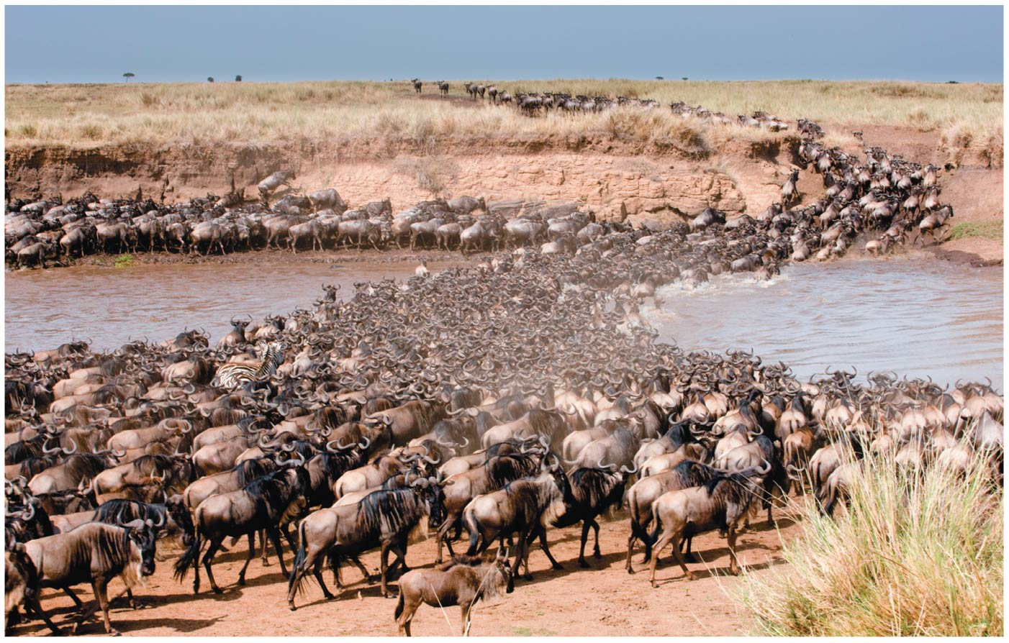
Figure 51.3
Notes:
Figure 51.3 Migration

Slide 11
Concept 51.1: Discrete sensory inputs can stimulate both simple and complex behaviors
Animal Signals and Communication
Signal = behavior that causes a CHANGE in another animal’s behavior
Communication = transmission AND reception of signals
Animals communicate using visual, chemical, tactile, and auditory signals
Ex: Fruit fly courtship (REPRODUCTION) and honeybee dancing related to food sources (SURVIVAL)

Slide 12
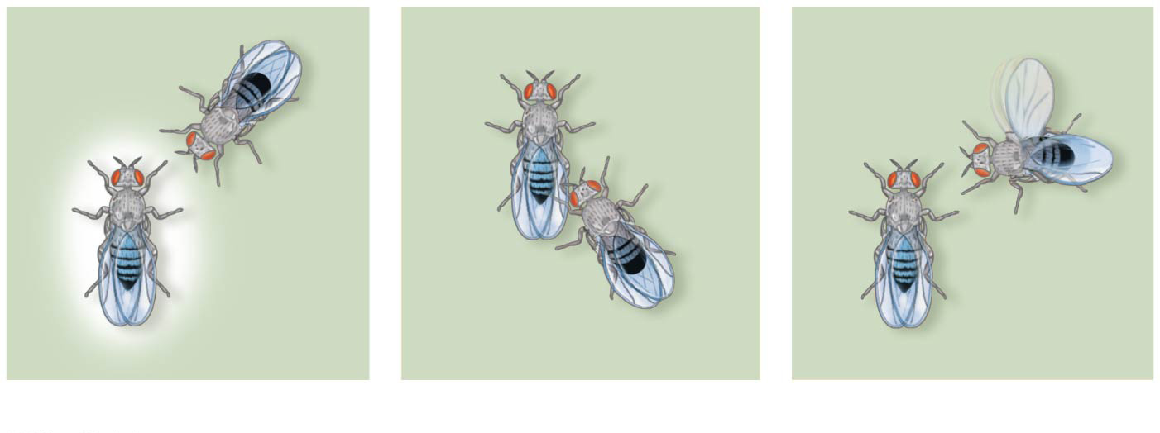
Figure 51.4
1
Orienting
2
Tapping
3
“Singing”
Notes:
Figure 51.4 Courtship behavior of the fruit fly

Slide 13
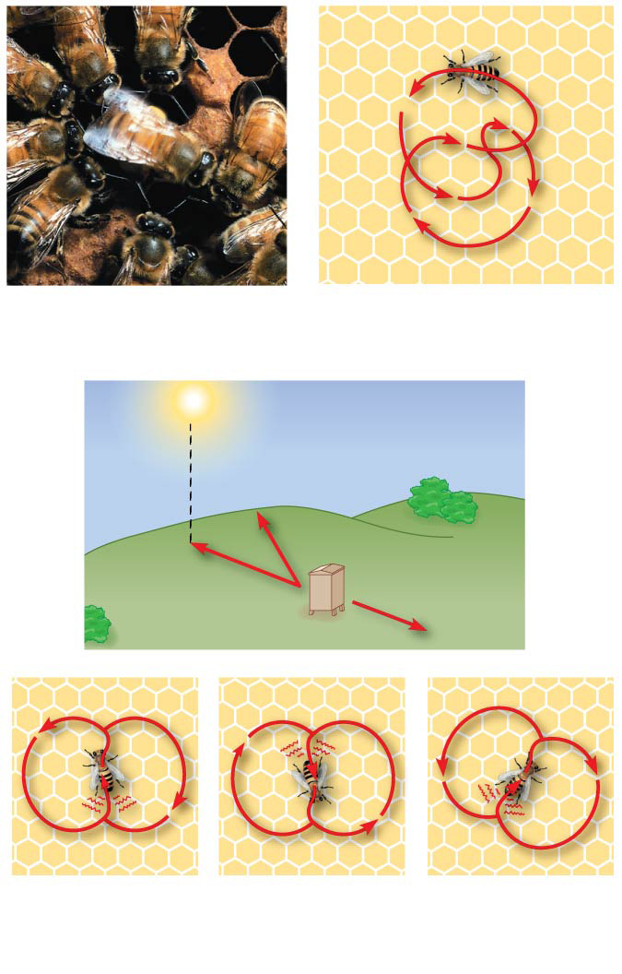
Figure 51.5
(a) Worker bees
(b) Round dance (food near)
C
A
30°
Beehive
B
30°
Location
A
Location
B
Location
C
(c) Waggle dance (food distant)
Notes:
Figure 51.5 Honeybee dance language

Slide 14
Concept 51.1: Discrete sensory inputs can stimulate both simple and complex behaviors
Animal Signals and Communication
Many animals that communicate through odors emit chemical substances called pheromones
Pheromones can be effective at very low concentrations
Nocturnal animals, such as most terrestrial mammals, depend on olfactory and auditory communication
Diurnal animals, such as humans and most birds, use visual and auditory communication

Slide 15
Overview
Concept 51.1: Discrete sensory inputs can stimulate both simple and complex behaviors
Concept 51.2: Learning establishes specific links between experience and behavior
Concept 51.3: Selection for individual survival and reproductive success can explain diverse behaviors
Concept 51.4: Genetic analyses and the concept of inclusive fitness provide a basis for studying the evolution of behavior

Slide 16
Notes:
Which of the following experiments best addresses the hypothesis that moths stop flying in response to high-intensity bat sounds?
https://www.polleverywhere.com/multiple_choice_polls/RQ9ka4pnvyy7ixh

Slide 17
Notes:
Which of the following examples describes a behavioral pattern that results from a proximate cause?
https://www.polleverywhere.com/multiple_choice_polls/XyOTeVG8GOXbznV

Slide 18
Notes:
The proximate causes of behavior are interactions with the environment, but behavior is ultimately shaped by _____.
https://www.polleverywhere.com/multiple_choice_polls/7zoVbPKZaMXLzIU

Slide 19
Concept 51.2: Learning establishes specific links between experience and behavior
Innate behavior = developmentally FIXED and does NOT vary among individuals
Learning = MODIFICATION of behavior based on specific EXPERIENCES
Research into learning seeks to understand the contributions of BOTH nature AND nurture in shaping learning (NO ONE IS “BORN SMART”)

Slide 20
Concept 51.2: Learning establishes specific links between experience and behavior
Imprinting = establishment of a long-lasting behavioral response to a particular individual or object
Involves both learning AND innate components and is generally irreversible
It is distinguished from other learning by a sensitive period
Limited-time developmental phase that is the ONLY time when certain behaviors can be learned

Slide 21
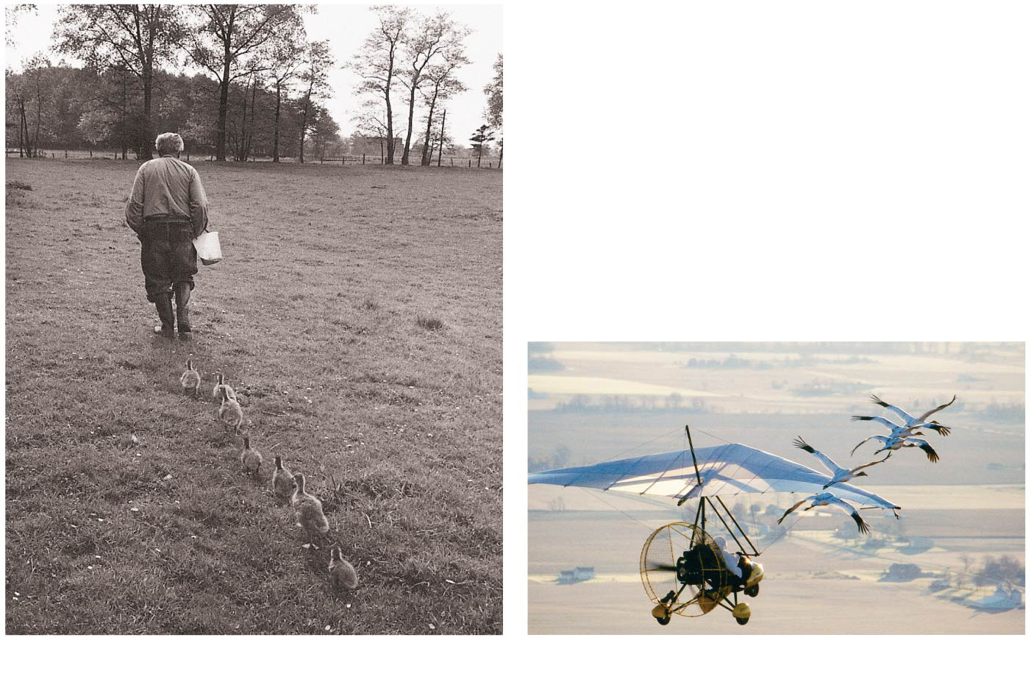
Figure 51.7
(a) Konrad Lorenz and geese
(b) Pilot and cranes
Notes:
Figure 51.7 Imprinting

Slide 22
Notes:
You observe a species of bird that, upon hatching, has contact with its parents only while being fed. You also never hear the parents sing during the feeding process. What would you propose about song learning in this species of bird?
https://www.polleverywhere.com/multiple_choice_polls/ailVHD1Xr7M02Am

Slide 23
Overview
Concept 51.1: Discrete sensory inputs can stimulate both simple and complex behaviors
Concept 51.2: Learning establishes specific links between experience and behavior
Concept 51.3: Selection for individual survival and reproductive success can explain diverse behaviors
Concept 51.4: Genetic analyses and the concept of inclusive fitness provide a basis for studying the evolution of behavior

Slide 24
Concept 51.3: Selection for individual SURVIVAL can explain diverse behaviors
Behavior may ENHANCE survival and reproductive success in a population over time (aka evolve!)
Natural selection may refine behaviors related to SURVIVAL
Ex: NS may enhance the efficiency of feeding
Foraging, or food-obtaining behavior, includes recognizing, searching for, capturing, and eating food items

Slide 25
Concept 51.3: Selection for individual SURVIVAL can explain diverse behaviors
Optimal foraging model → views foraging behavior as a COMPROMISE between benefits of nutrition and costs of obtaining food
The COSTS of obtaining food include energy expenditure and the RISK of being eaten while foraging
Natural selection should favor foraging behavior that MINIMIZES the costs/risks and MAXIMIZES the benefits

Slide 26
Concept 51.3: Selection for REPRODUCTIVE success can explain diverse behaviors
Behavior may ENHANCE survival and reproductive success in a population over time (aka evolve!)
Natural selection may refine behaviors related to REPRODUCTION
Mating behavior and mate choice determining reproductive success
Ex: seeking or attracting mates, choosing among potential mates, competing for mates, and caring for offspring

Slide 27
Concept 51.3: Selection for REPRODUCTIVE success can explain diverse behaviors
Sexual Selection and Mate Choice
Sexual dimorphism (two sexes look VERY DIFFERENT from one another) results from sexual selection, a form of natural selection
INTERsexual selection = members of one sex choosing mates on the basis of certain traits (shallow gals)
INTRAsexual selection = COMPETITION between members of the same sex for mates (knight-in-shining-armor)

Slide 28
Concept 51.3: Selection for REPRODUCTIVE success can explain diverse behaviors
Mate Choice by Females
Female choice = type of INTERsexual selection
Females can drive sexual selection by CHOOSING males with specific behaviors or features of anatomy
Ex: female stalk-eyed flies choose males with relatively long eyestalks
Ornaments, such as long eyestalks, often correlate with health and vitality (a good male can maintain and protect such an annoying and dangerous ornament!)

Slide 29
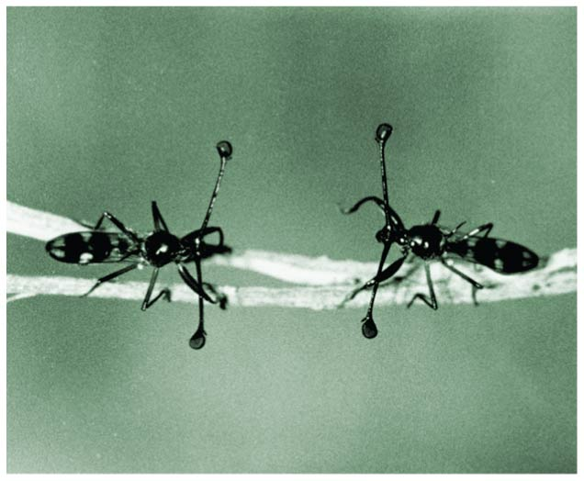
Figure 51.16
Looking good bro!
Right back at you!
Notes:
Figure 51.16 Male stalk-eyed flies face off for female attention

Slide 30
Concept 51.3: Selection for REPRODUCTIVE success can explain diverse behaviors
Male Competition for Mates
Male competition for mates = INTRAsexual selection
Such competition may involve agonistic behavior, an often ritualized contest that determines which competitor gains access to a resource (a good ol’ fashioned showdown)

Slide 31
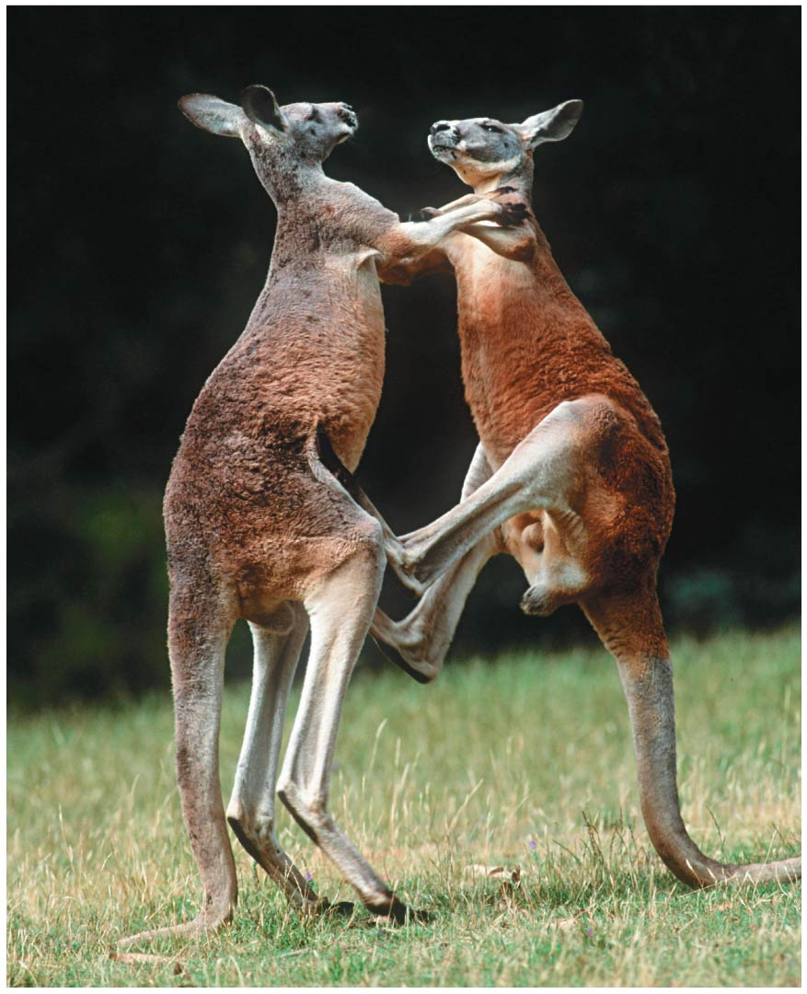
Figure 51.20
Catch these legs bro!
I saw her first!
Notes:
Figure 51.20 Agonistic interaction

Slide 32
Notes:
Fred and Joe, two unrelated, mature male gorillas, encounter one another. Fred is courting a female. Fred grunts as Joe comes near. As Joe continues to advance, Fred begins drumming (pounding his chest) and bares his teeth. Joe then rolls on the ground on his back, gets up, and quickly leaves. This behavioral pattern is repeated several times during the mating season. Choose the most specific behavior described by this example.
https://www.polleverywhere.com/multiple_choice_polls/DVoWAHHLIsI2Mtz

Slide 33
Notes:
Which of the following might affect the foraging behavior of an animal in the context of optimal foraging? I) risk of predation II) prey size III) prey defenses IV) prey density
https://www.polleverywhere.com/multiple_choice_polls/zJHAs8Zi07Xt8pu

Slide 34
Overview
Concept 51.1: Discrete sensory inputs can stimulate both simple and complex behaviors
Concept 51.2: Learning establishes specific links between experience and behavior
Concept 51.3: Selection for individual survival and reproductive success can explain diverse behaviors
Concept 51.4: Genetic analyses and the concept of inclusive fitness provide a basis for studying the evolution of behavior

Slide 35
Concept 51.4: Genetic analyses and the concept of inclusive fitness provide a basis for studying the evolution of behavior
Animal behavior is governed by complex interactions between genetic AND environmental factors
A master regulatory gene can control many behaviors (ex: single gene controls many behaviors of the male fruit fly courtship ritual)
Selfless/altruistic behavior can be explained by inclusive fitness

Slide 36
Concept 51.4: Inclusive fitness provides a basis for studying the evolution of behavior
Altruism
Natural selection favors behavior that maximizes an INDIVIDUAL’S survival and reproduction…right?
These behaviors are often selfish…
On occasion, some animals behave in ways that REDUCE (?!?!) their individual fitness BUT increase the fitness of others
This kind of behavior is called altruism

Slide 37
Concept 51.4: Inclusive fitness provides a basis for studying the evolution of behavior
Altruism
For example, under threat from a predator, an individual Belding’s ground squirrel will make an alarm call to warn others, even though calling increases the chances that the caller is killed
For example, in naked mole rat populations, nonreproductive individuals may sacrifice their lives protecting their reproductive queen and kings from predators
Squad goals

Slide 38
Concept 51.4: Inclusive fitness provides a basis for studying the evolution of behavior
Inclusive Fitness
How could such selfless behavior possibly happen under the concepts of evolution?
The evolution of altruistic behavior can be explained by inclusive fitness
Inclusive fitness = total effect individual has on proliferating its genes by producing offspring and HELPING CLOSE RELATIVES produce offspring

Slide 39
Concept 51.4: Inclusive fitness provides a basis for studying the evolution of behavior
Inclusive Fitness
Kin selection = natural selection that favors this kind of altruistic behavior by enhancing reproductive success of RELATIVES
An example of the relationship between kin selection and altruism is the warning behavior in Belding’s ground squirrels
In a group, most of the females are CLOSELY RELATED to each other…most alarm calls are given by females who are likely aiding CLOSE RELATIVES

Slide 40
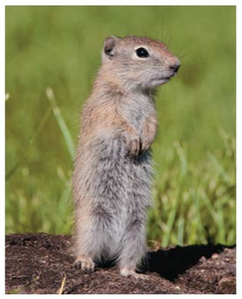
Figure 51.27a
Nice-guy Belding’s ground squirrel
Notes:
Figure 51.27a Kin selection and altruism in Belding’s ground squirrels (part 1: photo)

Slide 41
Notes:
Which of the following statements about evolution of behavior is correct?
https://www.polleverywhere.com/multiple_choice_polls/ISrtM27lc514fGQ

Slide 42
Notes:
The fru gene in fruit flies _____. I) controls sex-specific development in the fruit fly II) is a master regulatory gene that directs expression of many other genes III) can be genetically manipulated in females so that they will perform male sex behaviors IV) programs males for appropriate courtship behaviors
https://www.polleverywhere.com/multiple_choice_polls/ef08kMga8pbRffF

Slide 43
Notes:
How do altruistic behaviors arise through natural selection?
https://www.polleverywhere.com/multiple_choice_polls/omAEW5OLDuUWQBg

Slide 44
Overview
Concept 51.1: Discrete sensory inputs can stimulate both simple and complex behaviors
Concept 51.2: Learning establishes specific links between experience and behavior
Concept 51.3: Selection for individual survival and reproductive success can explain diverse behaviors
Concept 51.4: Genetic analyses and the concept of inclusive fitness provide a basis for studying the evolution of behavior

Slide 45
WATCH
https://www.youtube.com/watch?v=EyyDq19Mi3A
https://www.youtube.com/watch?v=6hREwakXmAo
https://www.youtube.com/watch?v=gwf5Xy5p_DI

