Slide 1
49
Nervous Systems

Slide 2
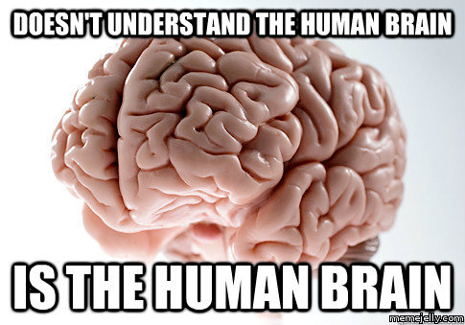

Slide 3
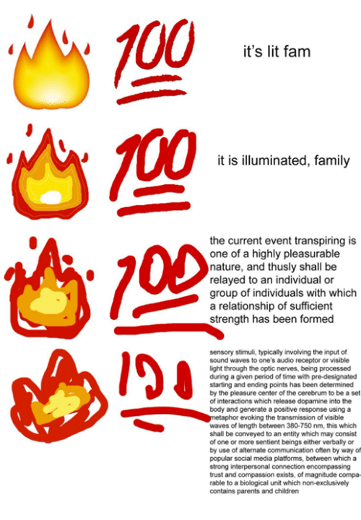

Slide 4
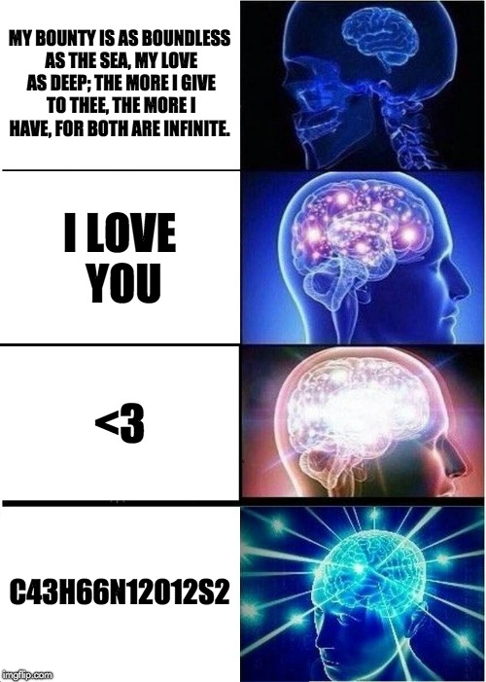

Slide 5
Command and Control Center
The human brain contains about 100 billion neurons, organized into circuits more complex than the most powerful supercomputers
Powerful imaging techniques allow researchers to monitor multiple areas of the brain while the subject performs various tasks
A recent advance uses expression of combinations of colored proteins in brain cells, a technique called “brainbow”

Slide 6
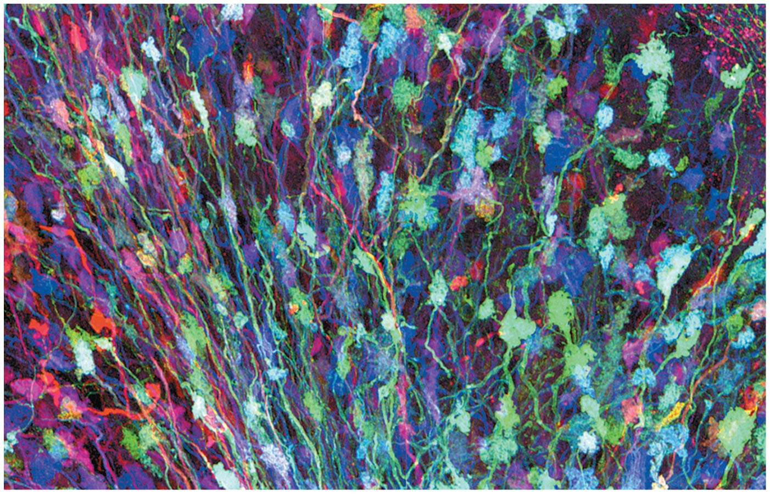
Figure 49.1
Notes:
Figure 49.1 How do scientists identify individual neurons in the brain?

Slide 7
Overview
Concept 49.1: Nervous systems consist of circuits of neurons and supporting cells
Concept 49.2: The vertebrate brain is regionally specialized
Concept 49.3: The cerebral cortex controls voluntary movement and cognitive functions
Concept 49.4: Changes in synaptic connections underlie memory and learning
Concept 49.5: Many nervous system disorders can be explained in molecular terms

Slide 8
Overview
Concept 49.2: The vertebrate brain is regionally specialized

Slide 9
Concept 49.2: The vertebrate brain is regionally specialized
Specific brain structures are particularly SPECIALIZED for diverse functions
The vertebrate brain has three major regions:
Forebrain (cerebrum): processing of olfactory input, regulation of sleep, learning, and any complex processing
Midbrain (brainstem): coordinates routing of sensory input
Hindbrain (cerebellum): controls involuntary activities and coordinates motor activities

Slide 10
Concept 49.2: The vertebrate brain is regionally specialized
Comparison of vertebrates shows that relative sizes of particular brain regions VARY
These size differences reflect the relative importance of the particular brain function
Evolution has resulted in a close match between structure and function

Slide 11
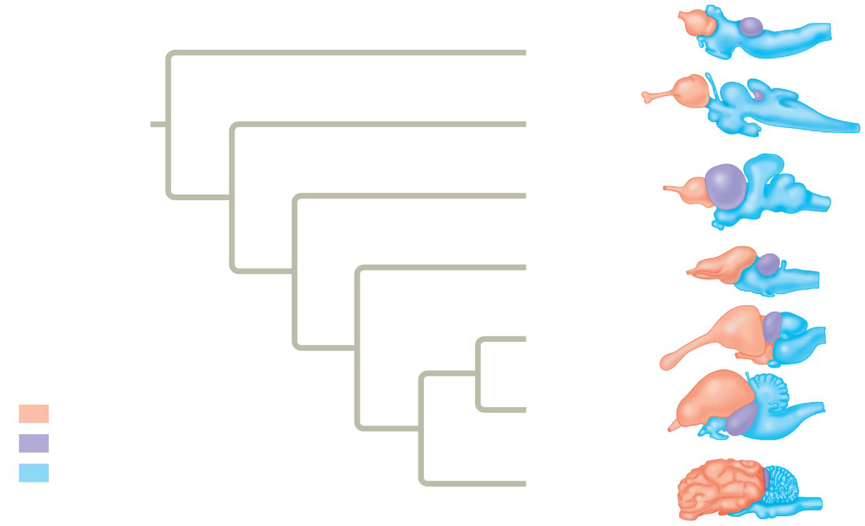
Figure 49.10
Lamprey
ANCESTRAL VERTEBRATE
Shark
Ray-finned fish
Amphibian
Crocodilian
Key
Forebrain
Bird
Midbrain
Hindbrain
Mammal
Notes:
Figure 49.10 Vertebrate brain structure and evolution

Slide 12
Concept 49.2: The vertebrate brain is regionally specialized
During embryonic development the anterior neural tube gives rise to the forebrain, midbrain, and hindbrain
The midbrain and part of the hindbrain form the brainstem, which joins with the spinal cord at the base of the brain
The rest of the hindbrain gives rise to the cerebellum
The forebrain divides into the diencephelon, which forms endocrine tissues in the brain, and the telencephalon, which becomes the cerebrum

Slide 13
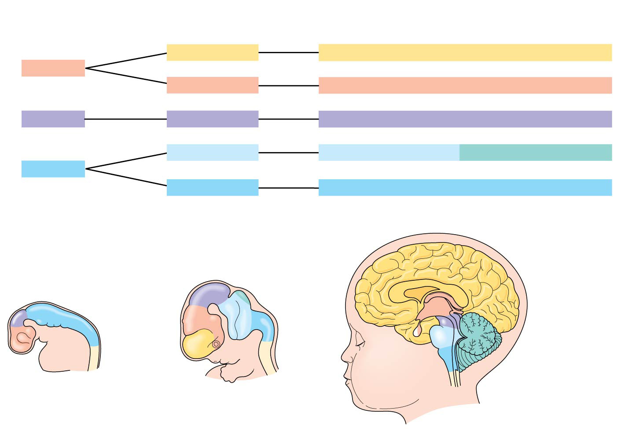
Figure 49.11b
Embryonic brain regions
Brain structures in child and adult
Telencephalon
Cerebrum (includes cerebral cortex, basal nuclei)
Forebrain
Diencephalon
Diencephalon (thalamus, hypothalamus, epithalamus)
Midbrain
Mesencephalon
Midbrain (part of brainstem)
Metencephalon
Pons (part of brainstem), cerebellum
Hindbrain
Myelencephalon
Medulla oblongata (part of brainstem)
Mesencephalon
Cerebrum
Diencephalon
Midbrain
Metencephalon
Diencephalon
Myelencephalon
Hindbrain
Midbrain
Pons
Medulla oblongata
Brainstem
Forebrain
Telencephalon
Cerebellum
Spinal cord
Spinal cord
Embryo at 1 month
Embryo at 5 weeks
Child
Notes:
Figure 49.11b Exploring the organization of the human brain (part 2: brain development)

Slide 14
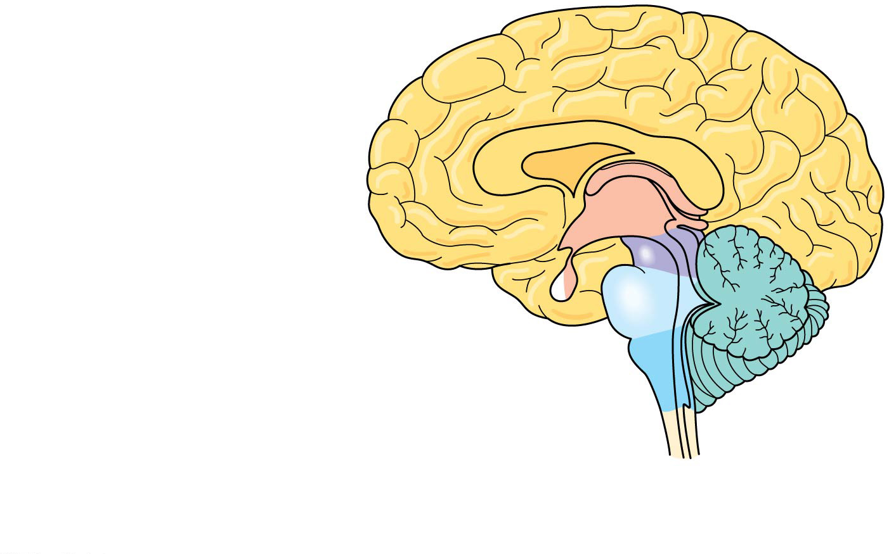
Figure 49.UN07
Cerebrum
Forebrain
Thalamus
Hypothalamus
Pituitary gland
Midbrain
Pons
Spinal cord
Hindbrain
Medulla oblongata
Cerebellum
Notes:
Figure 49.UN07 Summary of key concepts: vertebrate brain regions

Slide 15
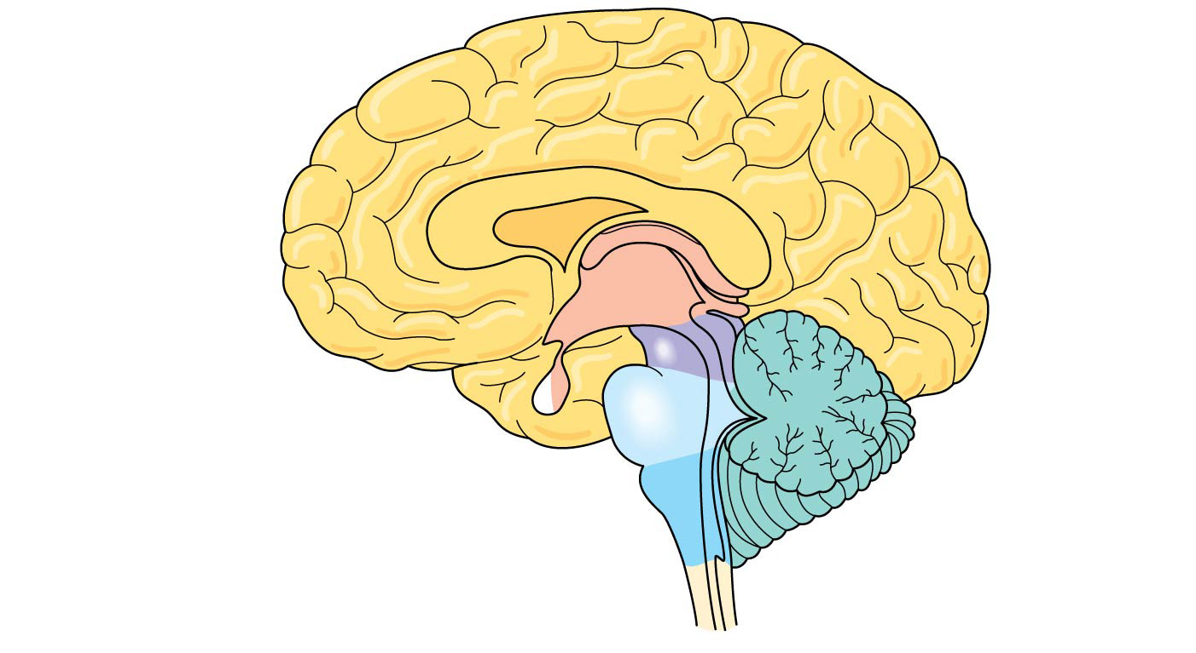
Figure 49.11d
Diencephalon
Thalamus
Pineal gland
Hypothalamus
Midbrain
Pituitary gland
Pons
Medulla oblongata
Spinal cord
Notes:
Figure 49.11d Exploring the organization of the human brain (part 4: diencephalon and brainstem)

Slide 16
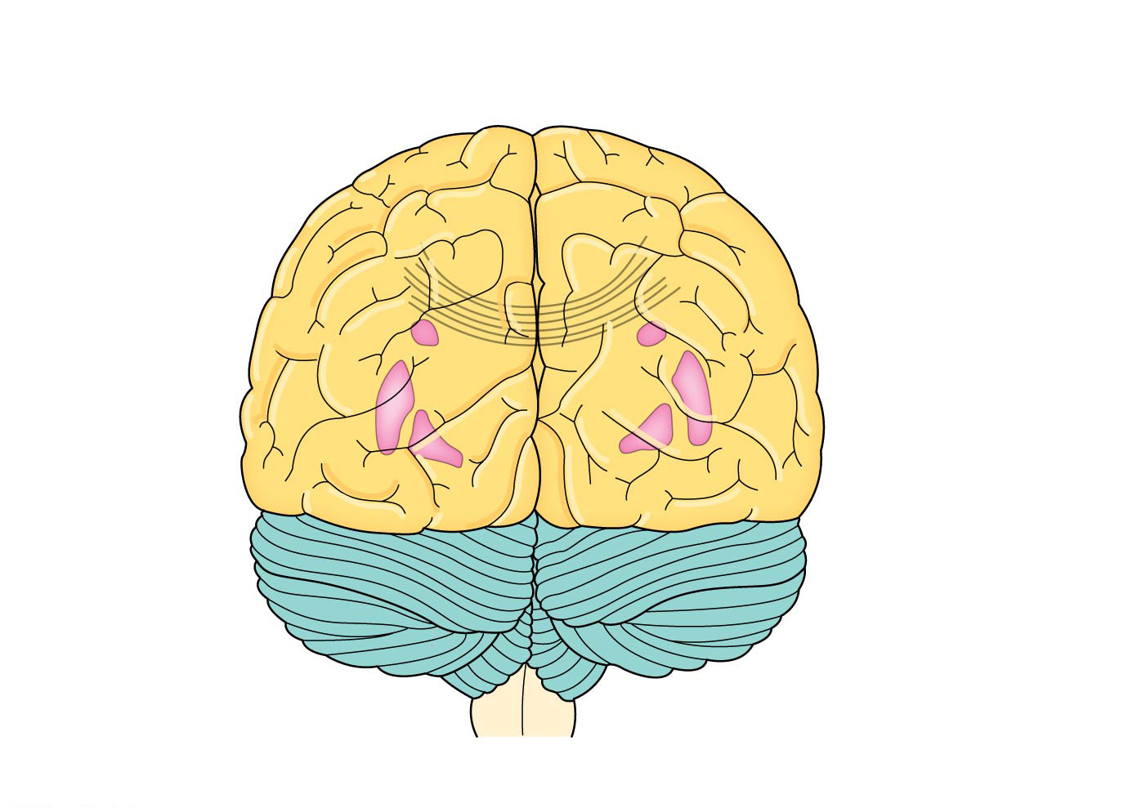
Figure 49.11c
Left cerebral hemisphere
Right cerebral hemisphere
Cerebral cortex
Corpus callosum
Cerebrum
Basal nuclei
Cerebellum
Adult brain viewed from the rear
Notes:
Figure 49.11c Exploring the organization of the human brain (part 3: cerebrum and cerebellum)

Slide 17
Concept 49.2: The vertebrate brain is regionally specialized – Sleep & Arousal
The brainstem and cerebrum control arousal and sleep
The core of the brainstem has a diffuse network of neurons called the reticular formation
These neurons control the timing of sleep periods characterized by rapid eye movements (REMs) and by vivid dreams
Sleep is also regulated by the biological clock and regions of the forebrain that regulate intensity and duration

Slide 18
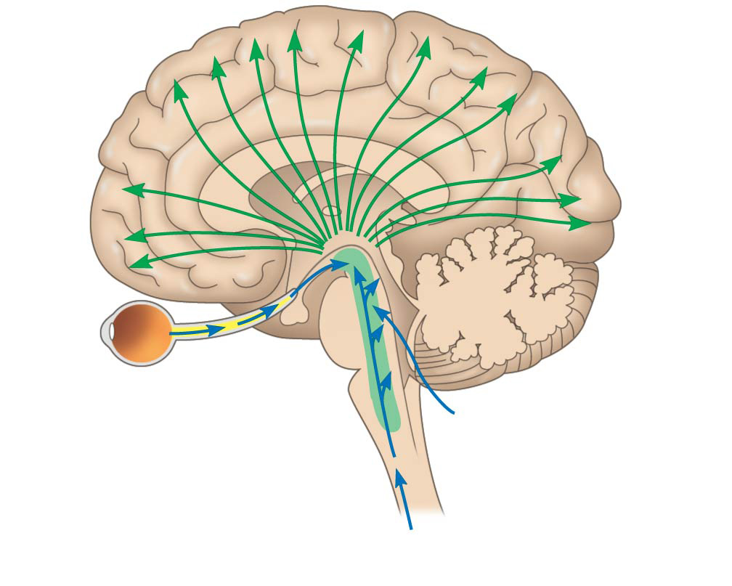
Figure 49.12
Eye
Input from nerves of ears
Reticular formation
Input from touch, pain, and temperature receptors
Notes:
Figure 49.12 The reticular formation

Slide 19
Concept 49.2: The vertebrate brain is regionally specialized – Sleep & Arousal
Sleep is essential and may play a role in the consolidation of learning and memory
Some animals have evolutionary adaptations allowing for substantial activity during sleep
Dolphins sleep with one brain hemisphere at a time and are therefore able to swim while “asleep” !!!

Slide 20
Concept 49.2: The vertebrate brain is regionally specialized – Emotions
Emotions
Generation and experience of emotions involve many brain structures, including the amygdala, hippocampus, and parts of the thalamus
These structures are grouped as the limbic system
The structure most important to the storage of emotion in the memory is the amygdala, a mass of nuclei near the base of the cerebrum

Slide 21
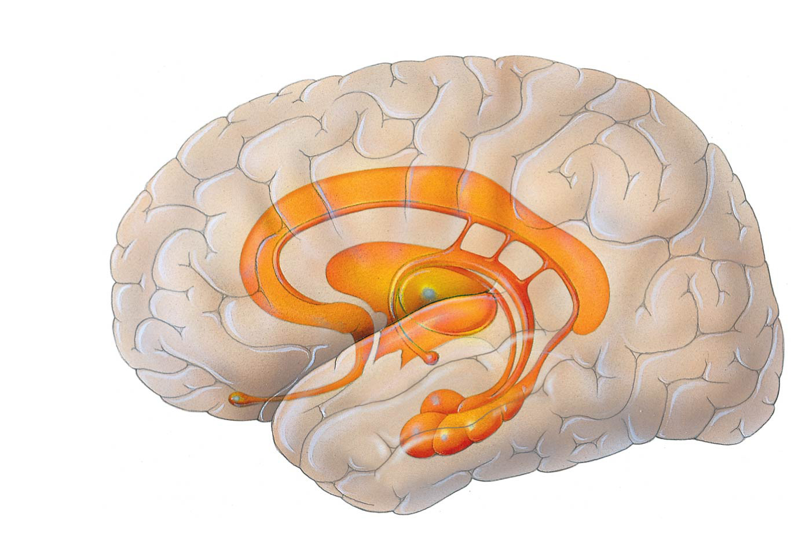
Figure 49.14
Thalamus
Hypothalamus
Olfactory bulb
Amygdala
Hippocampus
Notes:
Figure 49.14 The limbic system in the human brain

Slide 22
Overview
Concept 49.2: The vertebrate brain is regionally specialized

