Slide 1
48
Neurons, Synapses, and Signaling

Slide 2
The Body’s Headquarters (get it?)
Neurons are nerve cells that transfer information within the body
Neurons use two types of signals to communicate:
Electrical signals (long-distance)
Chemical signals (short-distance)
Interpreting signals in the nervous system involves sorting a complex set of paths and connections
Processing of information takes place in the complex organization of neurons called a brain

Slide 3
Overview
Concept 48.1: Neuron organization and structure reflect function in information transfer
Concept 48.2: Ion pumps and ion channels establish the resting potential of a neuron
Concept 48.3: Action potentials are the signals conducted by axons
Concept 48.4: Neurons communicate with other cells at synapses

Slide 4
Overview
Concept 48.1: Neuron organization and structure reflect function in information transfer
Concept 48.2: Ion pumps and ion channels establish the resting potential of a neuron
Concept 48.3: Action potentials are the signals conducted by axons
Concept 48.4: Neurons communicate with other cells at synapses

Slide 5
Concept 48.1: Neuron organization and structure reflect function in information transfer
The neuron is the functional UNIT of the nervous system and exemplifies form + function:
Most of a neuron’s organelles are in the cell body
Most neurons have dendrites, highly branched extensions that receive signals from other neurons
The axon is typically a much longer extension that transmits signals to other cells at synapses

Slide 6
Concept 48.1: Neuron organization and structure reflect function in information transfer
The neuron is the functional UNIT of the nervous system and exemplifies form + function (cont):
The cone-shaped base of an axon is called the axon hillock
A synapse is a junction (space) between an axon and another cell
The synaptic terminal of one axon passes information across the synapse in the form of chemical messengers called neurotransmitters

Slide 7
Concept 48.1: Neuron organization and structure reflect function in information transfer
The neuron is the functional UNIT of the nervous system and exemplifies form + function (cont):
Information is transmitted FROM a presynaptic cell (a neuron) TO a postsynaptic cell (a neuron, muscle, or gland cell)
Info transfer = presynaptic cell → postsynaptic cell
Most neurons are nourished or insulated by cells called glia or glial cells

Slide 8
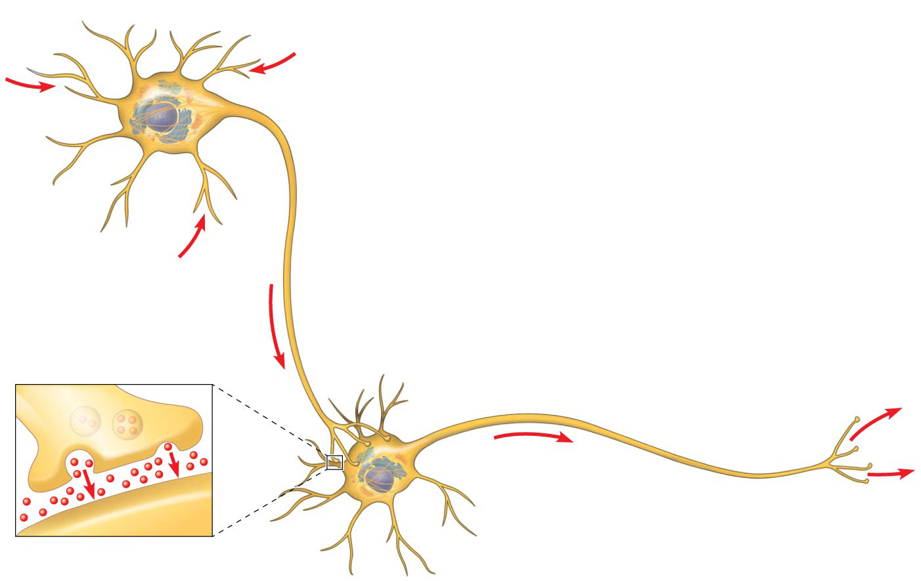
Figure 48.2
Dendrites
Axon
hillock
Nucleus
Cell
body
Presynaptic
cell
Axon
Synapse
Synaptic
terminals
Synaptic
terminals
Postsynaptic cell
Neurotransmitter
Notes:
Figure 48.2 Neuron structure

Slide 9
Notes:
The point of connection between two communicating neurons is called the _____.
https://www.polleverywhere.com/multiple_choice_polls/s51Tb6vCFmL1DaI

Slide 10
Notes:
In a simple synapse, neurotransmitter chemicals are released by _____.
https://www.polleverywhere.com/multiple_choice_polls/d3ICN2nNhyb3U7j

Slide 11
Notes:
In a simple synapse, neurotransmitter chemicals are received by _____.
https://www.polleverywhere.com/multiple_choice_polls/q5BImeXMp5yGLFn

Slide 12
Concept 48.1: Neuron organization and structure reflect function in information transfer
Information Processing
Nervous systems process information in three stages:
Sensory input: Sensors DETECT external stimuli and internal conditions and TRANSMIT information along sensory neurons
Integration: Sensory information is sent TO the brain, where interneurons INTEGRATE the information
Motor output: Motor output LEAVES the brain via motor neurons, which trigger muscle or gland activity

Slide 13
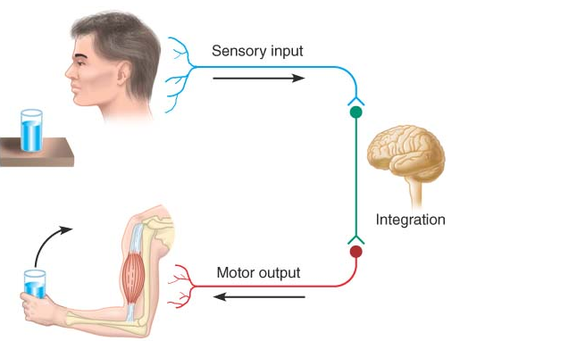
Summary of Info Processing
Notes:
Figure 48.4 Summary of information processing

Slide 14
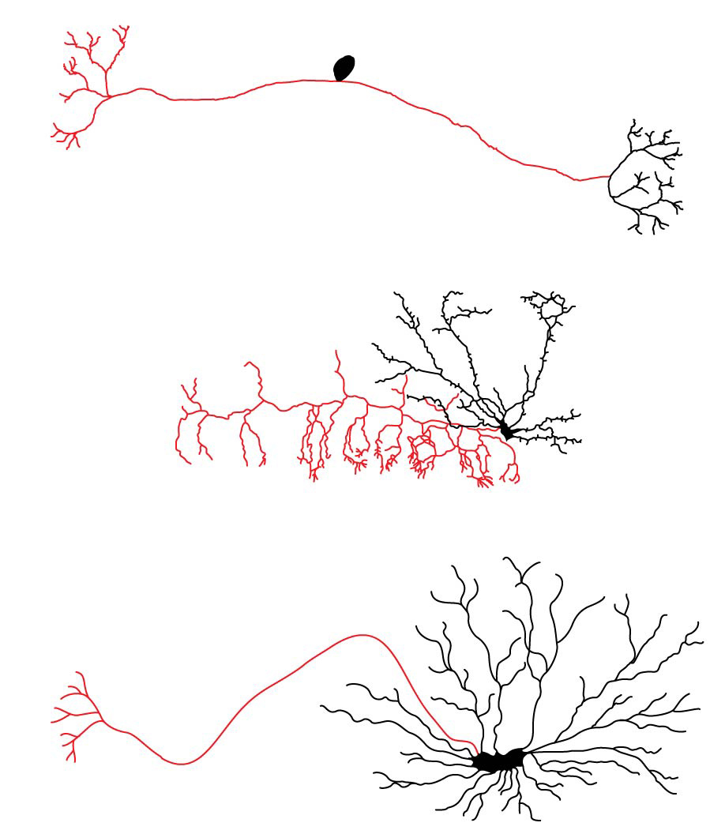
Structural diversity of neurons
Cell
body
Dendrites
Axon
Sensory neuron
Interneuron
Motor neuron
Notes:
Figure 48.5 Structural diversity of neurons

Slide 15
Overview
Concept 48.1: Neuron organization and structure reflect function in information transfer
Concept 48.2: Ion pumps and ion channels establish the resting potential of a neuron
Concept 48.3: Action potentials are the signals conducted by axons
Concept 48.4: Neurons communicate with other cells at synapses

Slide 16
Concept 48.2: Ion pumps and ion channels establish the resting potential of a neuron
Every cell has a voltage (difference in electrical charge) across its plasma membrane called a membrane potential
The resting potential is the membrane potential of a neuron NOT sending signals
CHANGES in membrane potential act as SIGNALS, transmitting and processing information
This is the whole purpose of the nervous system!
We’ll look at these CHANGES in Concept 48.3…for right now, let’s focus on what’s MAINTAINED

Slide 17
Concept 48.2: Ion pumps and ion channels establish the resting potential of a neuron
Formation of the Resting Potential
In a mammalian neuron at resting potential:
Concentration of K⁺ = [K⁺] = highest INSIDE cell
Concentration of Na⁺ = [Na⁺] = highest OUTSIDE cell
Sodium-potassium pumps use the energy of ATP to MAINTAIN these K⁺ and Na⁺ gradients across the plasma membrane
Why maintain this? …these “concentration gradients” represent chemical potential energy!

Slide 18
Concept 48.2: Ion pumps and ion channels establish the resting potential of a neuron
Formation of the Resting Potential
The opening of ion channels in the plasma membrane converts chemical potential to electrical potential
A neuron at resting potential contains many OPEN K⁺ channels and fewer open Na⁺ channels → K⁺ diffuses out of the cell
The resulting BUILD-UP of negative charge within the neuron is the major source of NEGATIVE membrane potential (-70 mV…more on this number later)

Slide 19
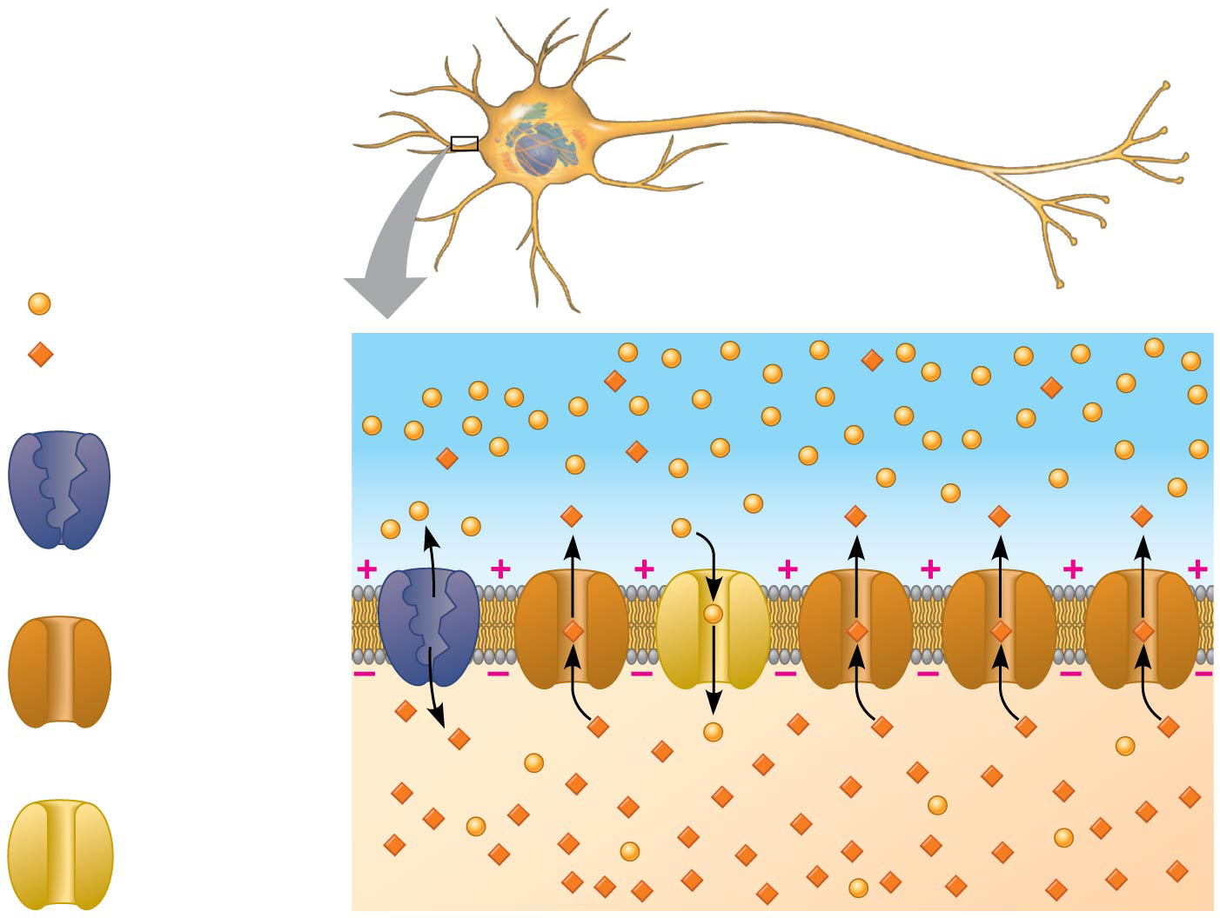
The basis of the membrane potential
Key
Na⁺
K⁺
OUTSIDE OF CELL
Sodium-
potassium
pump
Potassium
channel
Sodium
channel
INSIDE OF CELL
Notes:
Figure 48.6 The basis of the membrane potential

Slide 20
Notes:
In a resting potential, an example of a cation that is more abundant as a solute in the cytosol of a neuron than it is in the interstitial fluid outside the neuron is _____.
https://www.polleverywhere.com/multiple_choice_polls/tK2Zrot8CUpSZ0a

Slide 21
Notes:
The operation of the sodium-potassium "pump" moves _____.
https://www.polleverywhere.com/multiple_choice_polls/B8sDvNAZZudx8f7

Slide 22
Notes:
Two fundamental concepts about the ion channels of a "resting" neuron are that the channels _____.
https://www.polleverywhere.com/multiple_choice_polls/FNBgO8rlJ5mNW0h

Slide 23
WATCH
https://www.youtube.com/watch?v=v9THfG4ZoN4&t=8s
https://www.youtube.com/watch?v=rcacx09VODc

Slide 24
Overview
Concept 48.1: Neuron organization and structure reflect function in information transfer
Concept 48.2: Ion pumps and ion channels establish the resting potential of a neuron
Concept 48.3: Action potentials are the signals conducted by axons
Concept 48.4: Neurons communicate with other cells at synapses

Slide 25
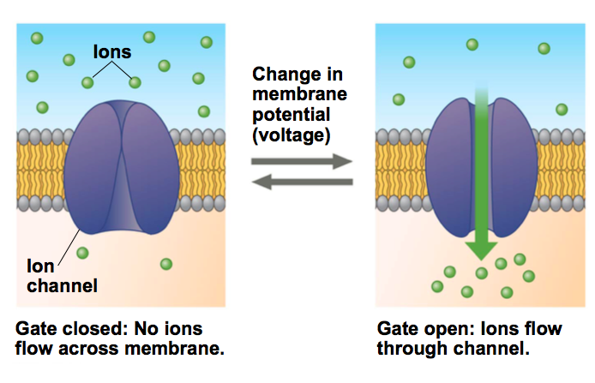
Concept 48.3: Action potentials are the SIGNALS conducted by axons
CHANGES in membrane potential occur because neurons contain gated ion channels that open or close in RESPONSE TO STIMULI

Slide 26
Concept 48.3: Action potentials are the SIGNALS conducted by axons
Hyperpolarization and Depolarization
Hyperpolarization = an INCREASE in magnitude of the membrane potential
Ex: gated K⁺ channels OPEN → K⁺ diffuses OUT of cell → inside of cell becomes MORE negative
Depolarization = a REDUCTION in the magnitude of the membrane potential
Ex: gated Na⁺ channels open → Na⁺ diffuses INTO cell → inside of cell becomes MORE positive

Slide 27
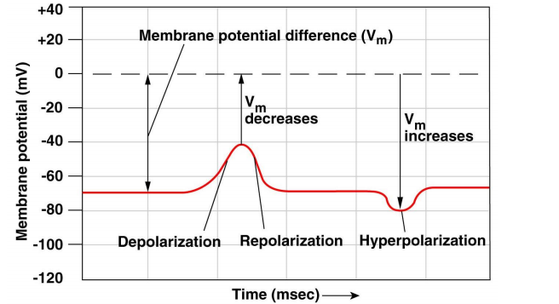

Slide 28
Concept 48.3: Action potentials are the SIGNALS conducted by axons
If a depolarization shifts the membrane potential sufficiently, it results in a MASSIVE change in membrane voltage called an action potential
Action potentials have a CONSTANT magnitude, are ALL-OR-NONE, and TRANSMIT signals over long distances (recall electrical signals)
They arise because some ion channels are voltage-gated, opening OR closing when the membrane potential passes a certain level (threshold)

Slide 29
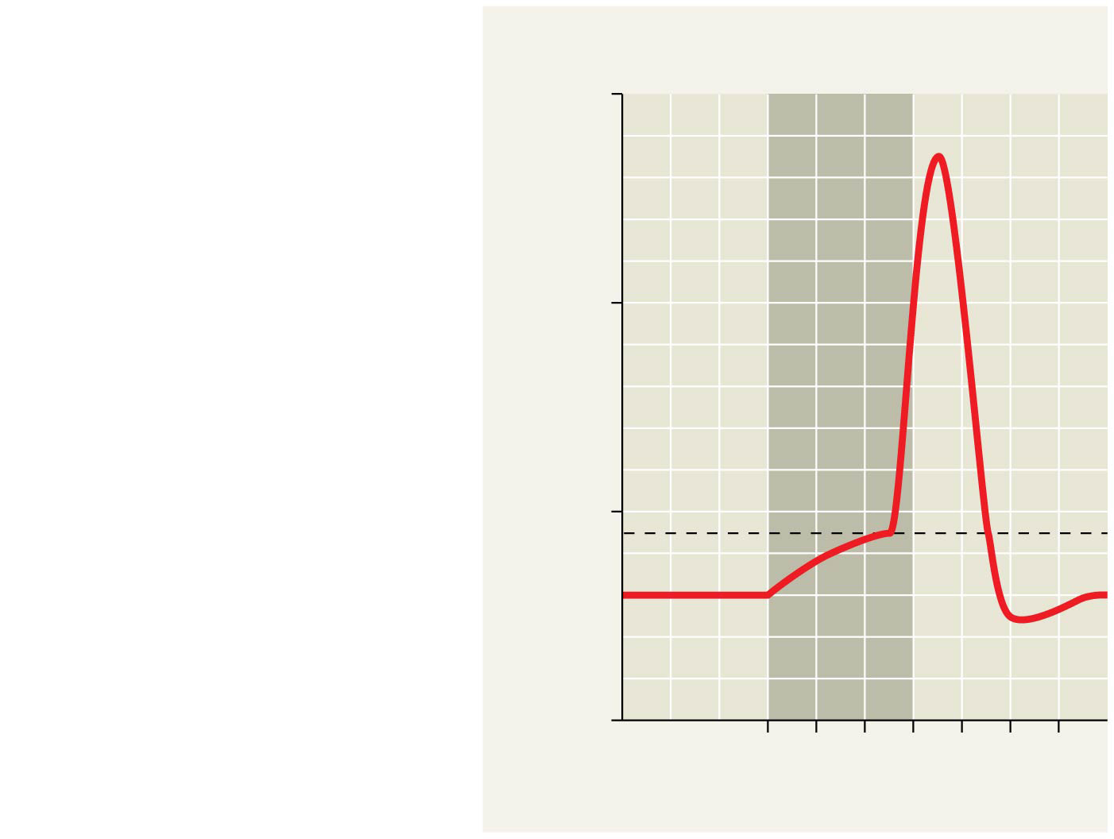
Figure 48.10c
(c)
Action potential
triggered by a
depolarization that
reaches the threshold
Strong depolarizing stimulus
+50
Action
potential
0
Membrane potential (mV)
Threshold
−50
Resting
potential
−100
0
1
2
3
4
5
6
Time (msec)
Notes:
Figure 48.10c Graded potentials and an action potential in a neuron (part 3: action potential)

Slide 30
Concept 48.3: Action potentials are the SIGNALS conducted by axons
Generating an Action Potential
An action potential can be considered as a series of 5 sequential STAGES
At resting potential (-70 mV)…
MOST voltage-gated sodium (Na⁺) + potassium (K⁺) channels = CLOSED

Slide 31
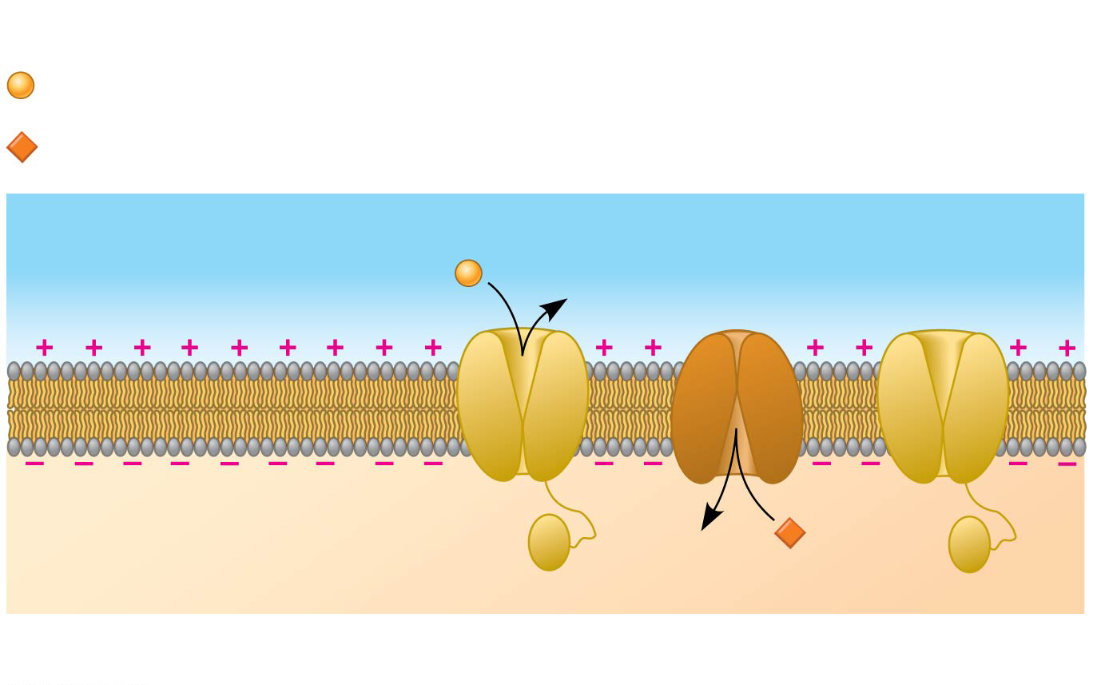
Figure 48.11a
Key
Na⁺
K⁺
OUTSIDE OF CELL
Sodium
channel
Potassium
channel
INSIDE OF CELL
Inactivation loop
1
Resting state
Notes:
Figure 48.11a The role of voltage-gated ion channels in the generation of an action potential (part 1: resting state)

Slide 32
Concept 48.3: Action potentials are the SIGNALS conducted by axons
When an action potential is generated…
Voltage-gated Na⁺ channels = OPEN first → Na⁺ flows INTO THE CELL
During the rising phase…
Threshold is reached → the membrane potential INCREASES → BOOM…ACTION POTENTIAL!
During the falling phase…
Voltage-gated Na⁺ channels = INACTIVATED
Voltage-gated K⁺ channels = OPEN → K⁺ flows OUT OF THE CELL

Slide 33
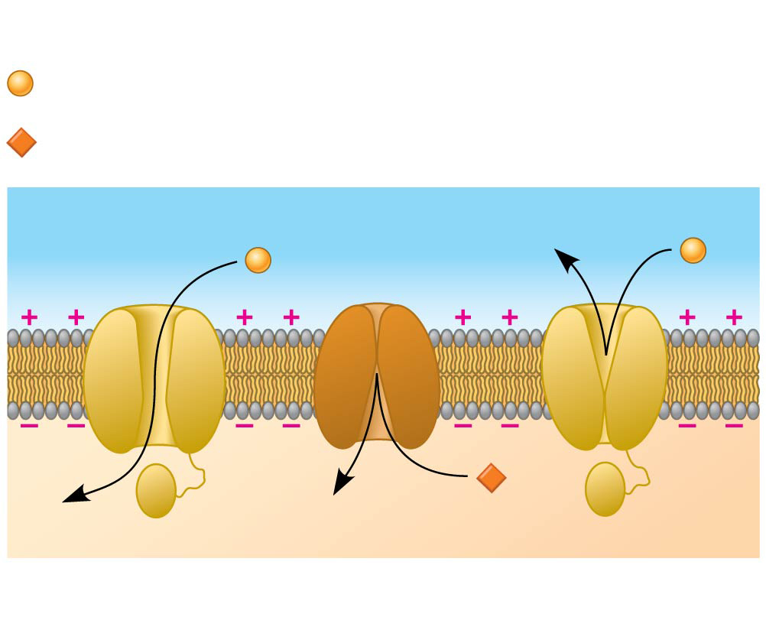
Figure 48.11b
Key
Na⁺
K⁺
2
Depolarization
Notes:
Figure 48.11b The role of voltage-gated ion channels in the generation of an action potential (part 2: depolarization)

Slide 34
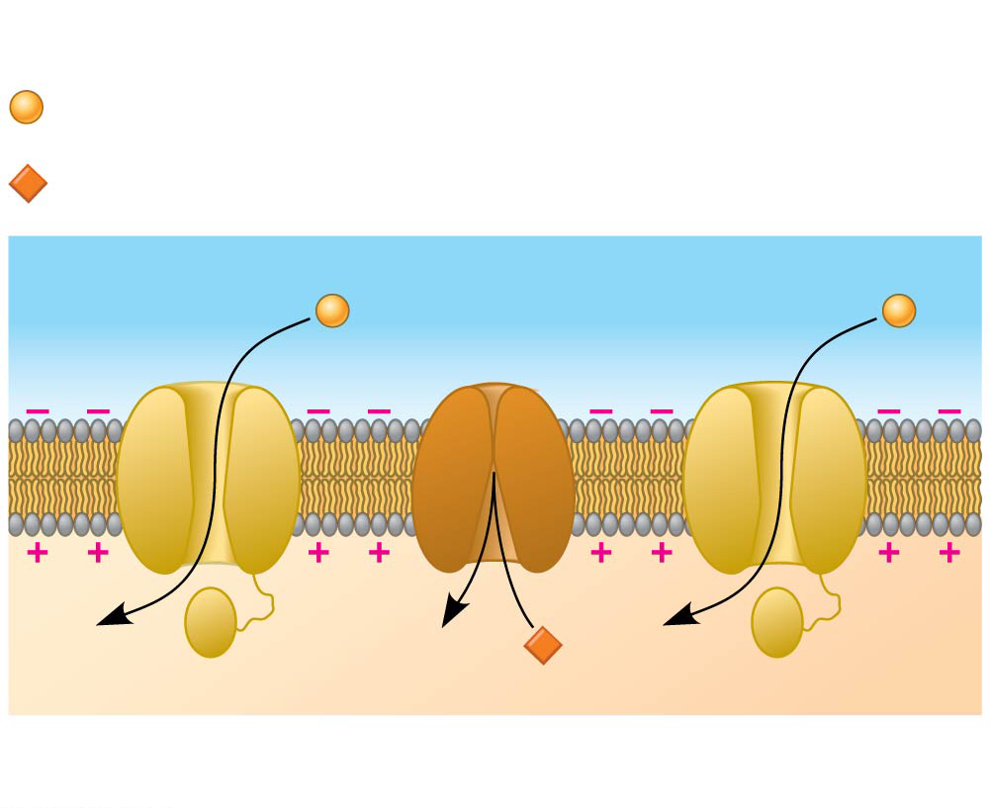
Figure 48.11c
Key
Na⁺
K⁺
3
Rising phase of the action potential
Notes:
Figure 48.11c The role of voltage-gated ion channels in the generation of an action potential (part 3: rising phase)

Slide 35
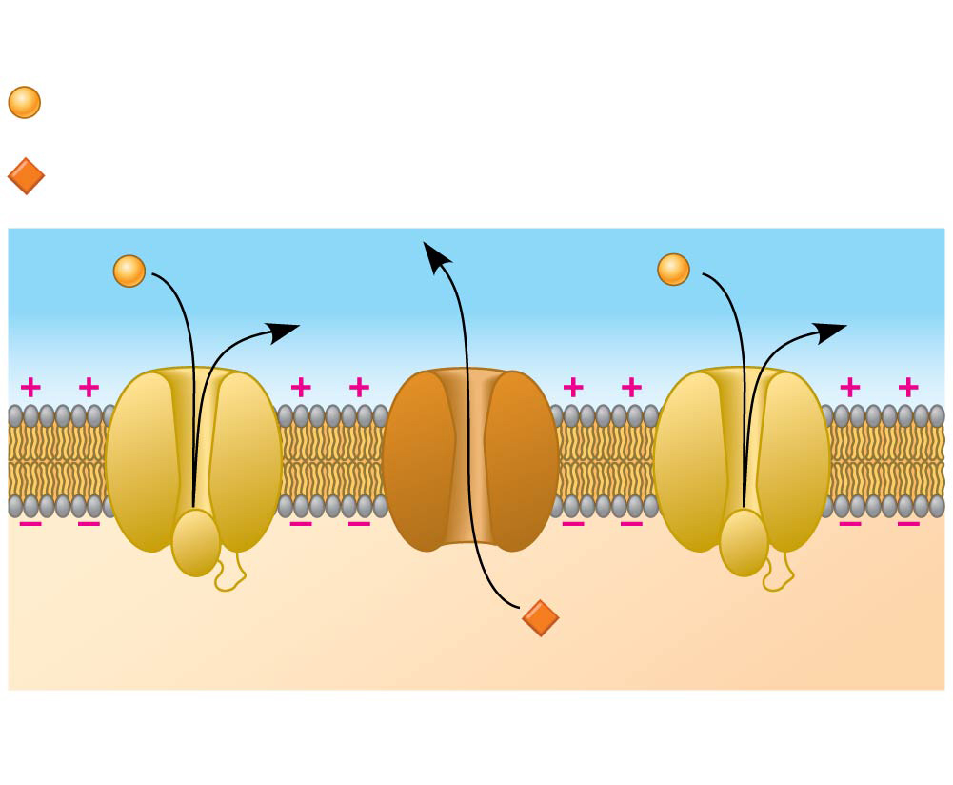
Figure 48.11d
Key
Na⁺
K⁺
4
Falling phase of the action potential
Notes:
Figure 48.11d The role of voltage-gated ion channels in the generation of an action potential (part 4: falling phase)

Slide 36
Concept 48.3: Action potentials are the SIGNALS conducted by axons
When an action potential is generated…
During the undershoot…
Membrane permeability to K⁺ = at first, HIGHER than at rest…
Then voltage-gated K⁺ channels = CLOSED → resting potential (-70 mV) is RESTORED

Slide 37
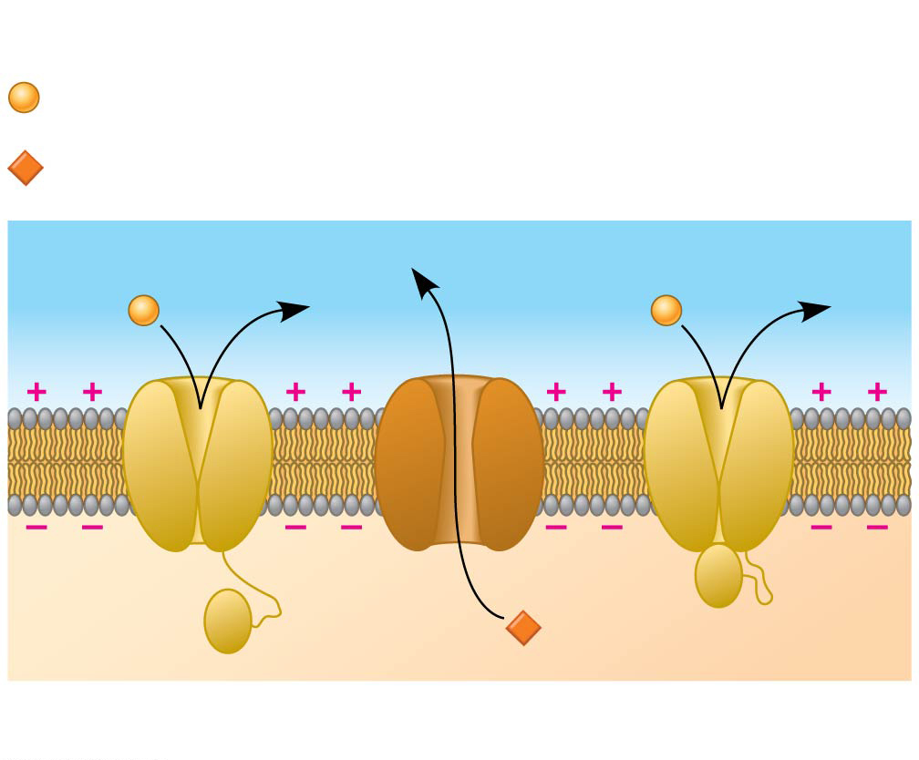
Figure 48.11e
Key
Na⁺
K⁺
5
Undershoot
Notes:
Figure 48.11e The role of voltage-gated ion channels in the generation of an action potential (part 5: undershoot)

Slide 38
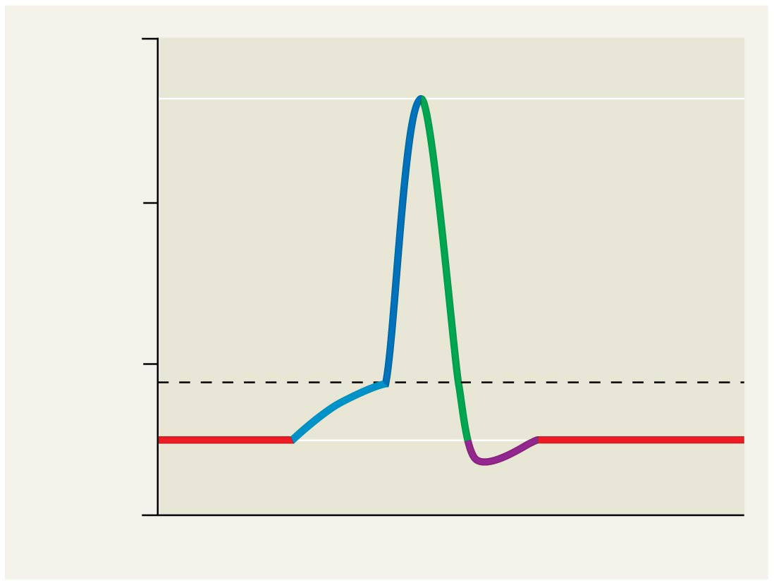
Figure 48.11f
+50
Action
potential
3
0
Membrane potential
(mV)
2
4
Threshold
−50
1
1
5
Resting potential
−100
Time
Notes:
Figure 48.11f The role of voltage-gated ion channels in the generation of an action potential (part 6: graph)

Slide 39
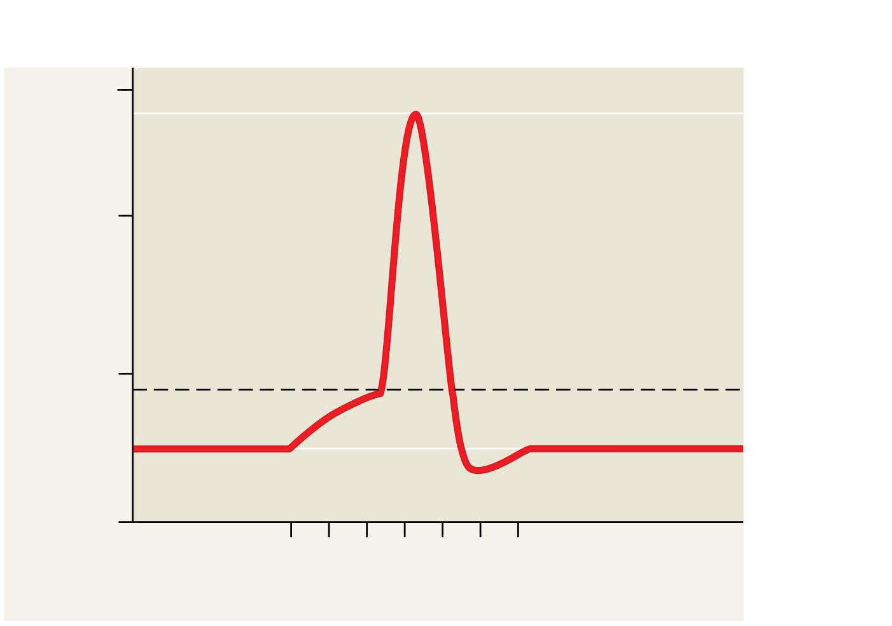
Figure 48.UN03
Action potential
+50
Falling
phase
0
Rising
phase
Membrane potential (mV)
Threshold (−55)
−50
Resting
potential
−70
Depolarization
Undershoot
−100
0
1
2
3
4
5
6
Time (msec)
Notes:
Figure 48.UN03 Summary of key concepts: action potential

Slide 40
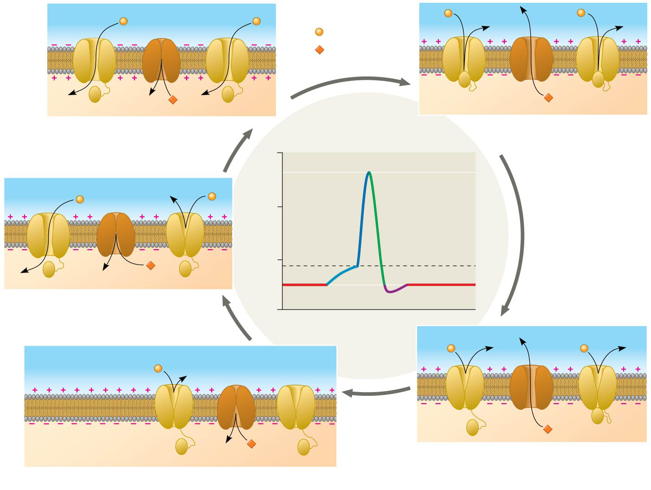
Figure 48.11
Key
Na⁺
K⁺
3
Rising phase of the
action potential
4
Falling phase of the
action potential
+50
Action
potential
0
3
Membrane potential
(mV)
2
4
Threshold
−50
1
5
1
2
Depolarization
−100
Resting potential
Time
OUTSIDE OF CELL
Sodium
channel
Potassium
channel
INSIDE OF CELL
Inactivation loop
5
Undershoot
1
Resting state
Notes:
Figure 48.11 The role of voltage-gated ion channels in the generation of an action potential

Slide 41
Concept 48.3: Action potentials are the SIGNALS conducted by axons
During the refractory period AFTER an action potential, a second action potential CANNOT be initiated
The refractory period is a result of a temporary inactivation of the Na⁺ channels
Think of an action potential like a toilet flush…
All-or-none + travels only one-way
Consistent outcome after reaching threshold
Brief refractory period after completion

Slide 42
WATCH
https://www.youtube.com/watch?v=OZG8M_ldA1M
https://www.youtube.com/watch?v=HYLyhXRp298
https://www.youtube.com/watch?v=fHRC8SlLcH0
https://www.neuroscientificallychallenged.com/

Slide 43
Notes:
The membrane's permeability to sodium ions is at its maximum at label _____.
https://www.polleverywhere.com/multiple_choice_polls/w1XdNjZb3w4dexx

Slide 44
Notes:
The minimum depolarization needed to operate the voltage-gated sodium and potassium channels is indicated by the label _____.
https://www.polleverywhere.com/multiple_choice_polls/epTt1GhzzGjnpjs

Slide 45
Notes:
The neuronal membrane is at its resting potential at label _____.
https://www.polleverywhere.com/multiple_choice_polls/DQKAFW8pgWbLCGe

Slide 46
Concept 48.3: Action potentials are the SIGNALS conducted by axons
Evolutionary Adaptations of Axon Structure
The speed of an action potential INCREASES with the axon’s diameter
In vertebrates, axons are insulated by a myelin sheath, which causes an action potential’s speed to INCREASE
Myelin sheaths are made by glial cells called Schwann cells

Slide 47
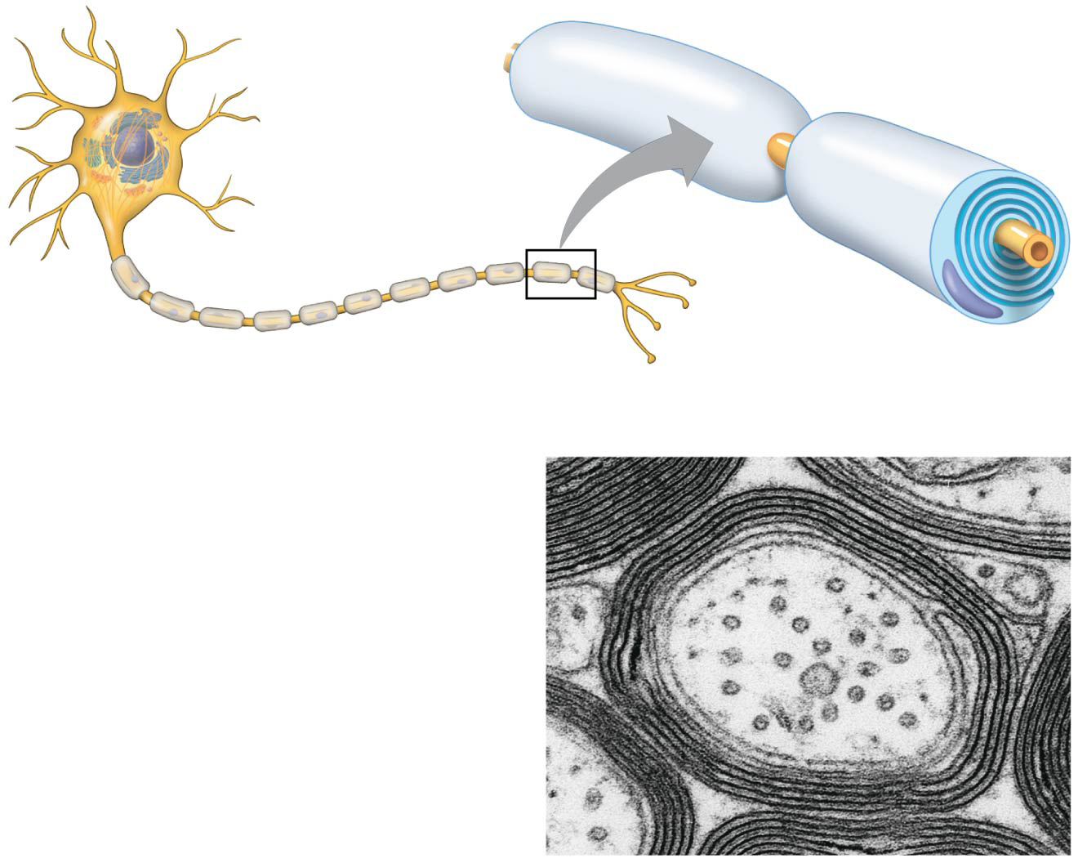
Figure 48.13
Node of Ranvier
Layers of myelin
Axon
Schwann
cell
Schwann
cell
Axon
Nodes of
Ranvier
Nucleus of
Schwann cell
Myelin sheath
0.1 µm
Notes:
Figure 48.13 Schwann cells and the myelin sheath

Slide 48
Concept 48.3: Action potentials are the SIGNALS conducted by axons
Evolutionary Adaptations of Axon Structure
Action potentials are formed only at nodes of Ranvier, gaps in the myelin sheath where voltage-gated Na⁺ channels are found
Action potentials in myelinated axons JUMP between the nodes of Ranvier in a process called saltatory conduction
Combine myelin sheath, nodes of Ranvier, and salutatory conduction and you get the SUPER FAST neuronal signaling that governs EVERYTHING you do!!!

Slide 49
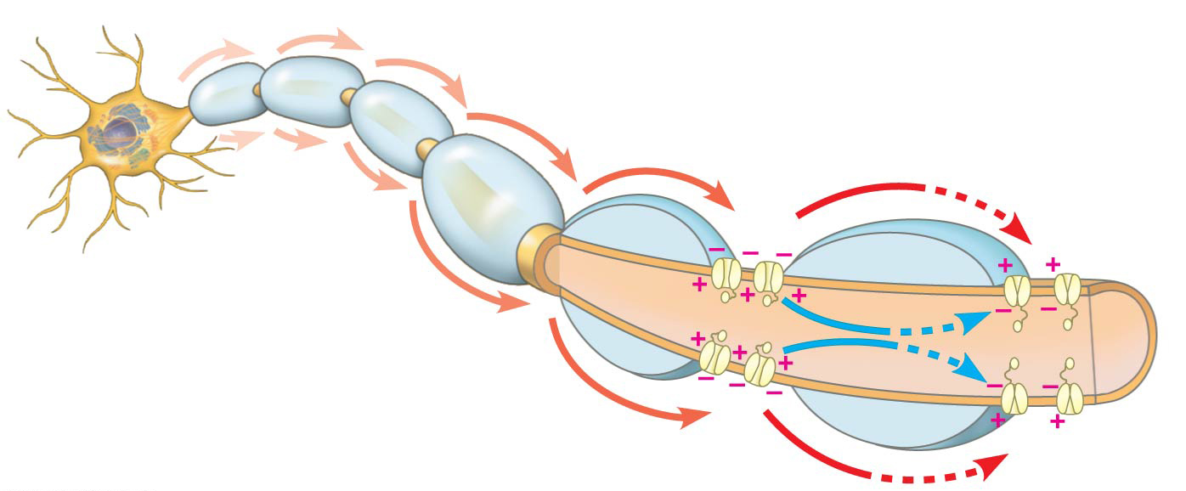
Figure 48.14
Schwann cell
Depolarized region
(node of Ranvier)
Myelin
sheath
Cell body
Axon
Notes:
Figure 48.14 Saltatory conduction

Slide 50
Notes:
Action potentials move along axons _____.
https://www.polleverywhere.com/multiple_choice_polls/QcZgmUU1n2iWL47

Slide 51
Notes:
A toxin that binds specifically to voltage-gated sodium channels in axons would be expected to _____.
https://www.polleverywhere.com/multiple_choice_polls/biS8muMAs4yDeOS

Slide 52
Overview
Concept 48.1: Neuron organization and structure reflect function in information transfer
Concept 48.2: Ion pumps and ion channels establish the resting potential of a neuron
Concept 48.3: Action potentials are the signals conducted by axons
Concept 48.4: Neurons communicate with other cells at synapses

Slide 53
Concept 48.4: Neurons COMMUNICATE with other cells at synapses
At electrical synapses, the electrical current flows from one neuron to another through gap junctions
Ex: Action potentials
At chemical synapses, a chemical NEUROTRANSMITTER carries information between neurons
Most synapses are chemical synapses

Slide 54
Concept 48.4: Neurons COMMUNICATE with other cells at synapses
The presynaptic neuron SYNTHESIZES and PACKAGES the neurotransmitter in synaptic vesicles located in the synaptic terminal
Action potential causes the RELEASE of the neurotransmitter → neurotransmitter DIFFUSES across the synaptic cleft → received by the postsynaptic cell

Slide 55
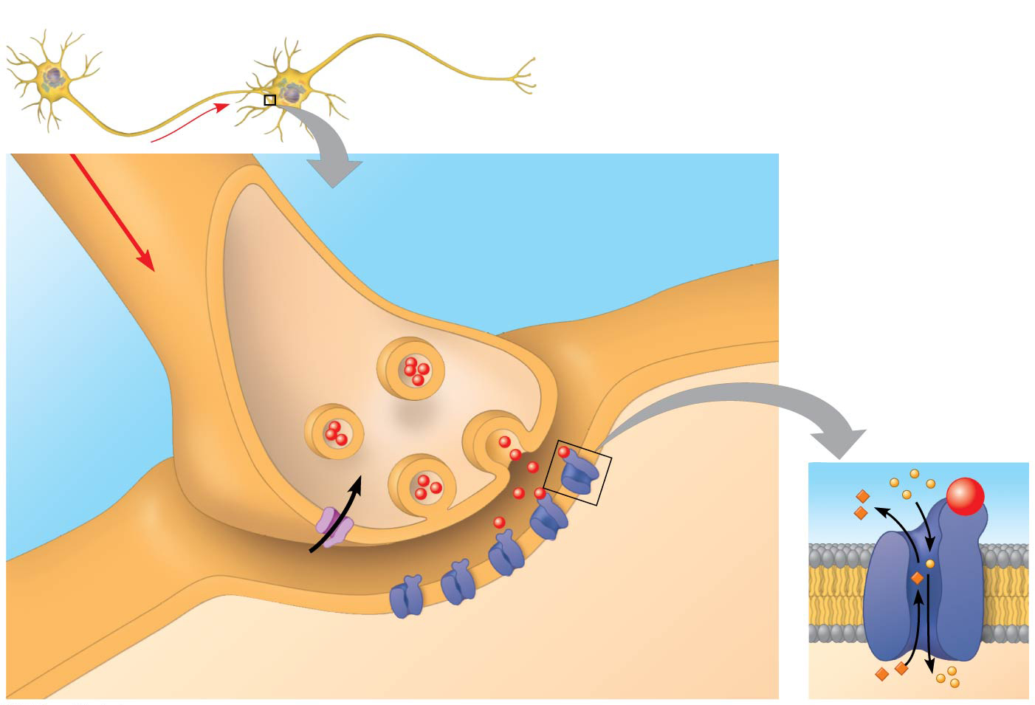
Figure 48.16
Presynaptic cell
Postsynaptic cell
1
Axon
Synaptic vesicle
containing neurotransmitter
Synaptic
cleft
Postsynaptic
membrane
Presynaptic
membrane
3
4
K⁺
Ca²⁺
2
Voltage-gated
Ca²⁺ channel
Ligand-gated
ion channels
Na⁺
Notes:
Figure 48.16 A chemical synapse

Slide 56
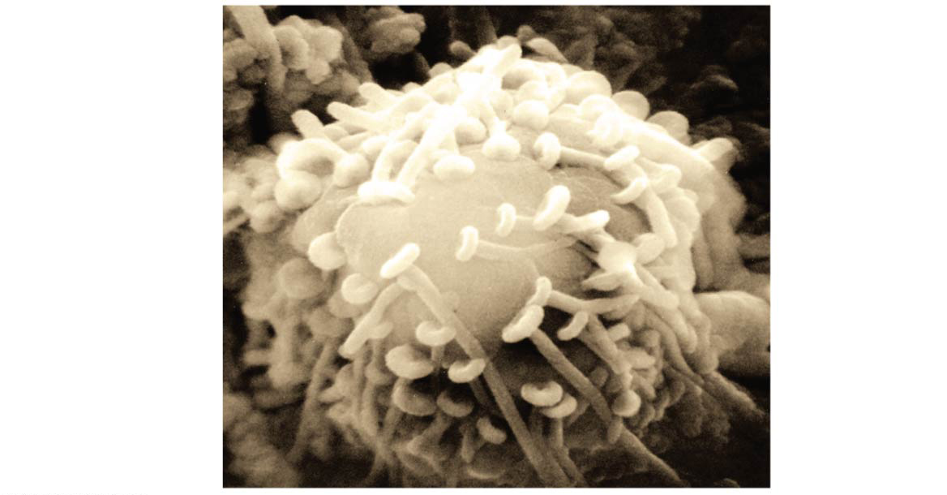
Figure 48.15
Postsynaptic
neuron
Synaptic
terminals
of pre-
synaptic
neurons
5 µm
Notes:
Figure 48.15 Synaptic terminals on the cell body of a postsynaptic neuron (colorized SEM)

Slide 57
Concept 48.4: Neurons COMMUNICATE with other cells at synapses
DIRECT synaptic transmission involves BINDING of neurotransmitters to ligand-gated ion channels in the postsynaptic cell
Neurotransmitter BINDING causes ion channels to OPEN, generating a postsynaptic potential
Excitatory postsynaptic potentials (EPSPs) = DEpolarizations that bring the membrane potential toward threshold
Inhibitory postsynaptic potentials (IPSPs) = HYPERpolarizations that move the membrane potential farther from threshold

Slide 59
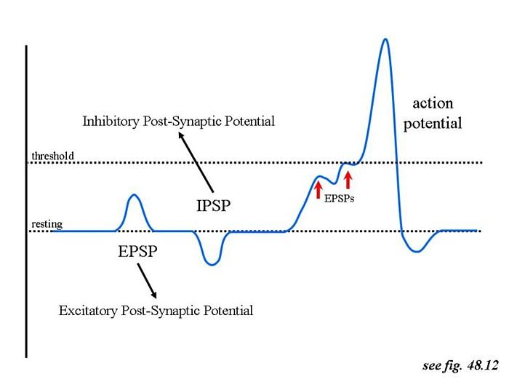

Slide 60
Concept 48.4: Neurons COMMUNICATE with other cells at synapses – Neurotransmitters
Neurotransmitters (NTs)
A single neurotransmitter may BIND specifically to more than a dozen different receptors
Receptor activation and postsynaptic response cease when neurotransmitters are cleared from the synaptic cleft
Neurotransmitters are removed by simple diffusion, inactivation by enzymes, or recapture into the presynaptic neuron

Slide 61
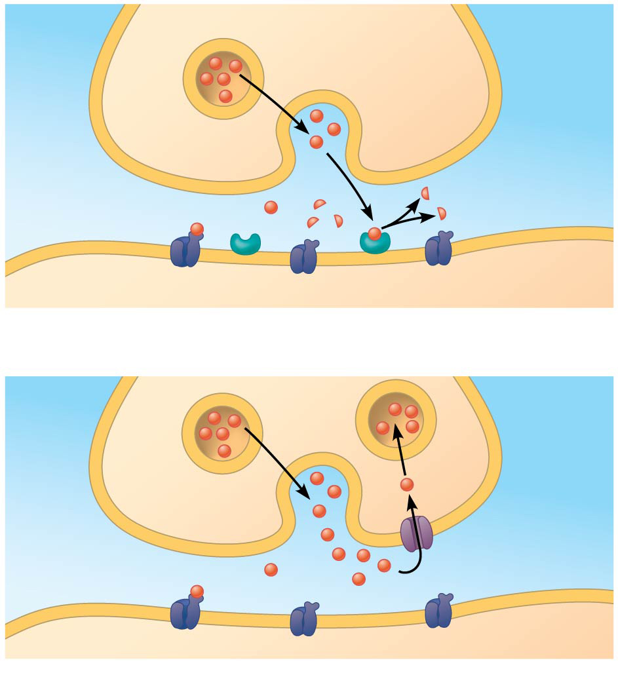
Figure 48.18
PRESYNAPTIC NEURON
Neurotransmitter
Neurotransmitter
receptor
POSTSYNAPTIC NEURON
Inactivating enzyme
(a)
Enzymatic breakdown of neurotransmitter in the
synaptic cleft
Neurotransmitter
Neuro-
transmitter
transport
channel
Neurotransmitter
receptor
(b)
Reuptake of neurotransmitter by presynaptic neuron
Notes:
Figure 48.18 Two mechanisms of terminating neurotransmission

Slide 62
Concept 48.4: Neurons COMMUNICATE with other cells at synapses – Neurotransmitters
Acetylcholine = excitatory NT = involved in muscle stimulation, memory formation, and learning
Amino acid NTs:
Glutamate = excitatory NT = important for neural activation
Gamma-aminobutyric acid (GABA) = chief inhibitory NT
Glycine

Slide 63
Concept 48.4: Neurons COMMUNICATE with other cells at synapses – Neurotransmitters
Biogenic amine NTs:
Epinephrine
Norepinephrine
Dopamine
Serotonin
Technically, the only two things that make you happy

Slide 64
Concept 48.4: Neurons COMMUNICATE with other cells at synapses – Neurotransmitters
Neuropeptides (short chains of AAs) NTs:
Substance P + endorphins = affect our perception of pain
Opiates bind to the same receptors as endorphins and can be used as painkillers
Gases such as nitric oxide (NO) and carbon monoxide (CO) are also NTs

Slide 65
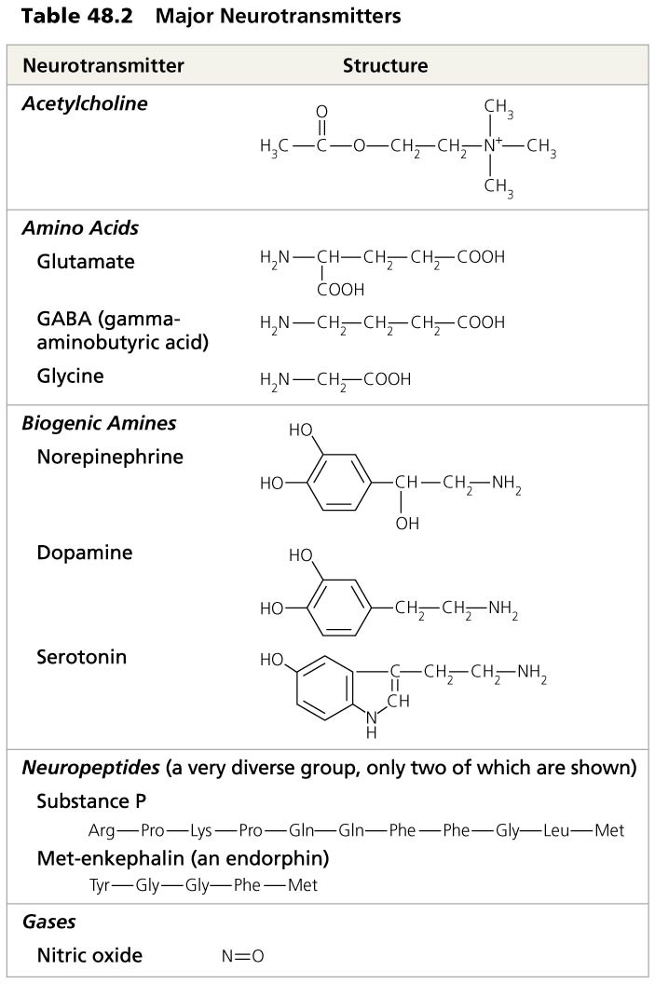
Table 48.2
Notes:
Table 48.2 Major neurotransmitters

Slide 66
Notes:
Neurotransmitters categorized as inhibitory are expected to _____.
https://www.polleverywhere.com/multiple_choice_polls/hwELB89rOBNIboM

Slide 67
Summary
The neuron is the basic structure of the nervous system that reflects function.
A typical neuron has a cell body, axon and dendrites. Many axons have a myelin sheath that acts as an electrical insulator.
The structure of the neuron allows for the detection, generation, transmission and integration of signal information.
Schwann cells, which form the myelin sheath, are separated by gaps of unsheathed axon over which the impulse travels as the signal propagates along the neuron.

Slide 68
Summary
Action potentials propagate impulses along neurons.
Membranes of neurons are polarized by the establishment of electrical potentials across the membranes.
In response to a stimulus, Na+ and K+ gated channels sequentially open and cause the membrane to become locally depolarized.
Na+/K+ pumps, powered by ATP, work to maintain membrane potential.

Slide 69
Summary
Transmission of information between neurons occurs across synapses.
In most animals, transmission across synapses involves chemical messengers called neurotransmitters.
AP Curriculum mentions: Acetylcholine, Epinephrine, Norepinephrine, Dopamine, Serotonin, GABA
Transmission of information along neurons and synapses results in a response.
The response can be stimulatory or inhibitory.

Slide 70
Overview
Concept 48.1: Neuron organization and structure reflect function in information transfer
Concept 48.2: Ion pumps and ion channels establish the resting potential of a neuron
Concept 48.3: Action potentials are the signals conducted by axons
Concept 48.4: Neurons communicate with other cells at synapses

