Slide 1
43
The Immune System

Slide 2
Why do we get…
Sick?
Weather…go out in the cold (*trump gif WRONG*)
Germs…foreign, kill you, body responds to them
Pathogens…infectious diseases
Viruses…influenza
Strep throat

Slide 3
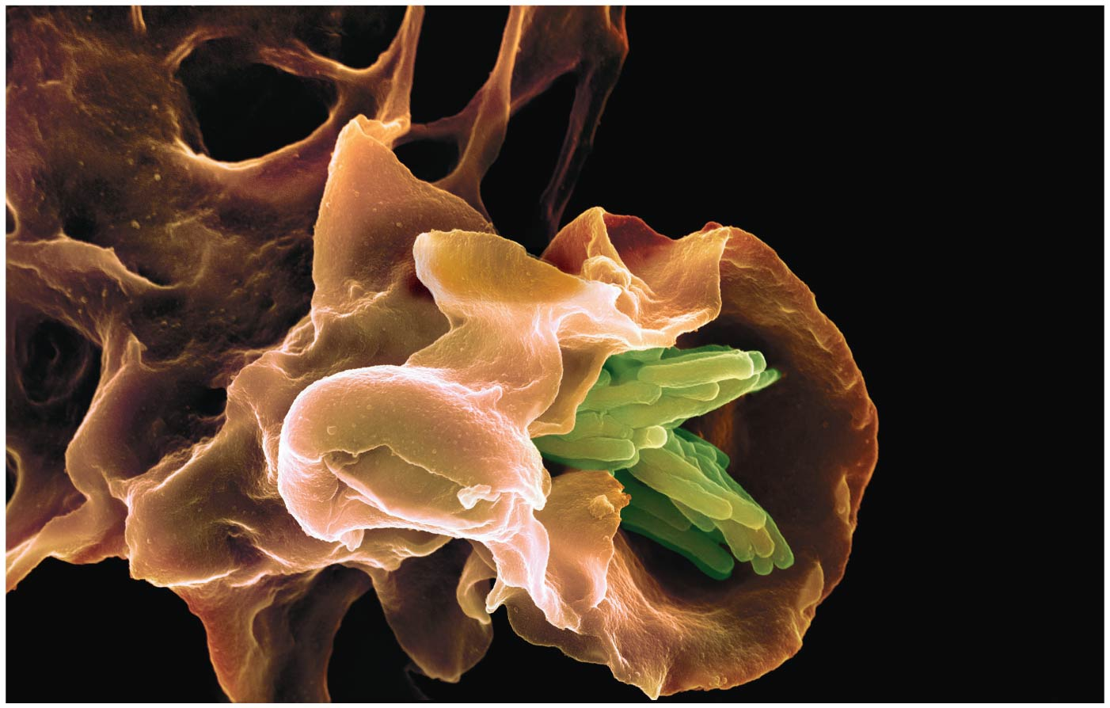
Immune cell attacking a clump of pathogenic bacteria
Notes:
Figure 43.1 What triggered this attack by an immune cell on a clump of bacteria?

Slide 4
An ARMY Built on Recognition & Response
Pathogens, agents that cause disease, infect a wide range of animals, including humans
The immune system RECOGNIZES foreign bodies and RESPONDS with the production of immune cells and proteins
There are two “arms of immunity”
Innate immunity
Adaptive immunity

Slide 6
Overview
Concept 43.1: In innate immunity, recognition and response rely on traits common to groups of pathogens
Concept 43.2: In adaptive immunity, receptors provide pathogen-specific recognition
Concept 43.3: Adaptive immunity defends against infection of body fluids and body cells
Concept 43.4: Disruptions in immune system function can elicit or exacerbate disease

Slide 7
Overview
Concept 43.1: In innate immunity, recognition and response rely on traits common to groups of pathogens
Concept 43.2: In adaptive immunity, receptors provide pathogen-specific recognition
Concept 43.3: Adaptive immunity defends against infection of body fluids and body cells
Concept 43.4: Disruptions in immune system function can elicit or exacerbate disease

Slide 8
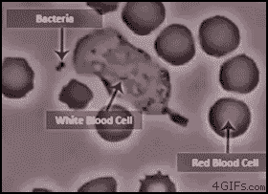
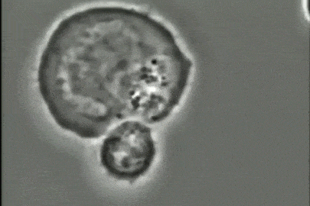
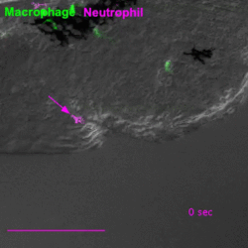
Immune System – The Basics – Innate
ALL animals (and plants!) have innate immunity, a defense active IMMEDIATELY upon infection
Innate immunity is present BEFORE any exposure to pathogens and is effective from the time of birth (thus “innate”)
It responds to a BROAD RANGE of pathogens

Slide 9
Concept 43.1: In innate immunity, recognition and response rely on traits common to groups of pathogens
In vertebrates, innate immunity is a FIRST RESPONSE to infections and also serves as the foundation of adaptive immunity
Innate defenses include barrier defenses and phagocytosis
Additional defenses unique to vertebrates are natural killer (NK) cells and the inflammatory response

Slide 10
Concept 43.1: Recognition and response rely on traits common to groups of pathogens – Innate
Barrier Defenses
Barrier defenses = skin and mucous membranes of the respiratory, urinary, and reproductive tracts
Mucus traps and allows for the removal of microbes
Body fluids (saliva, mucus, even tears) = hostile to many microbes
Low pH of skin and digestive system prevents growth of many bacteria
YOUR BODY IS A LITERAL FORTRESS…TREAT IT THAT WAY

Slide 11
Concept 43.1: Recognition and response rely on traits common to groups of pathogens – Innate
Cellular Innate Defenses
Pathogens entering the mammalian body are subject to phagocytosis (cell-eating)
There are two main types of phagocytic cells in the mammalian body:
Neutrophils engulf and destroy pathogens
Macrophages are found throughout the body
1st gif pwning and phagocytizing bacterium

Slide 12
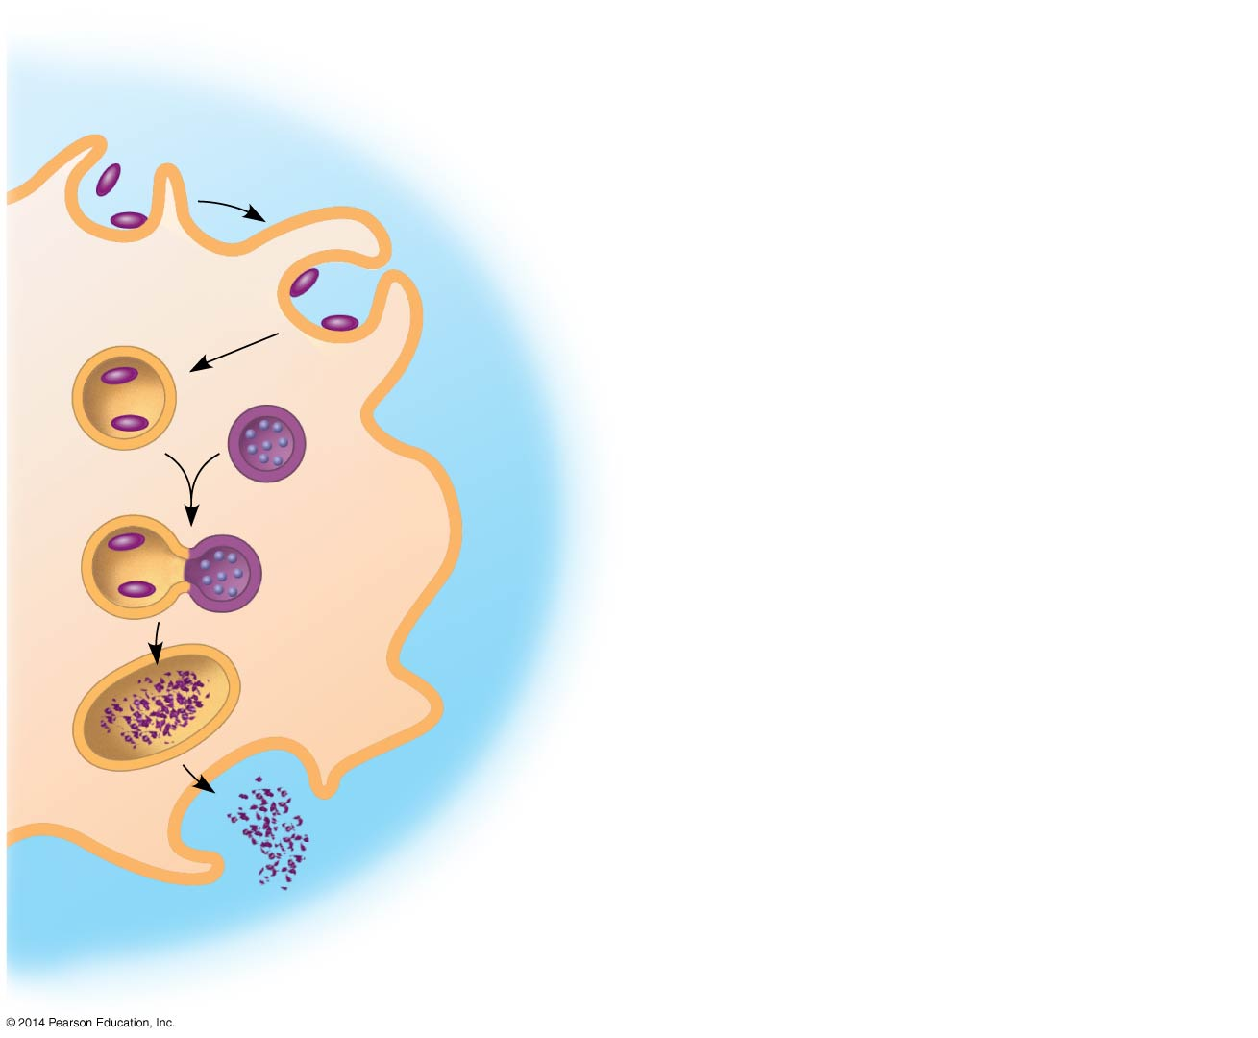
Phagocytosis
1
Pseudopodia surround pathogens.
Pathogen
2
Pathogens engulfed by endocytosis.
PHAGOCYTIC
CELL
3
Vacuole forms.
Lysosome
containing
enzymes
Vacuole
4
Vacuole and lysosome fuse.
5
Pathogens destroyed.
6
Debris from pathogens released.
Notes:
Figure 43.3 Phagocytosis

Slide 13
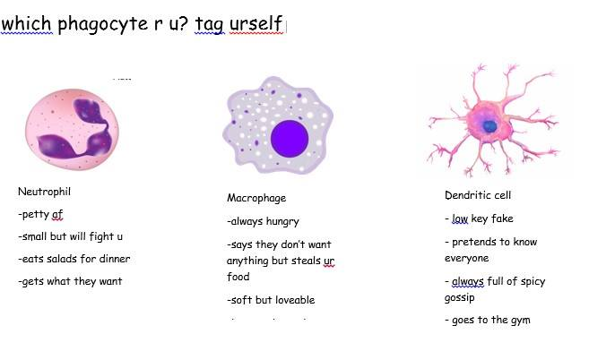

Slide 14
Concept 43.1: Recognition and response rely on traits common to groups of pathogens – Innate
Cellular Innate Defenses
Cellular innate defenses in vertebrates also involve natural killer cells (gr8 name btw)
These CIRCULATE through the body and DETECT abnormal cells
They release chemicals leading to cell death, inhibiting the spread of virally infected or cancerous cells
2nd gif pwning an infected cell, inducing apoptosis

Slide 15
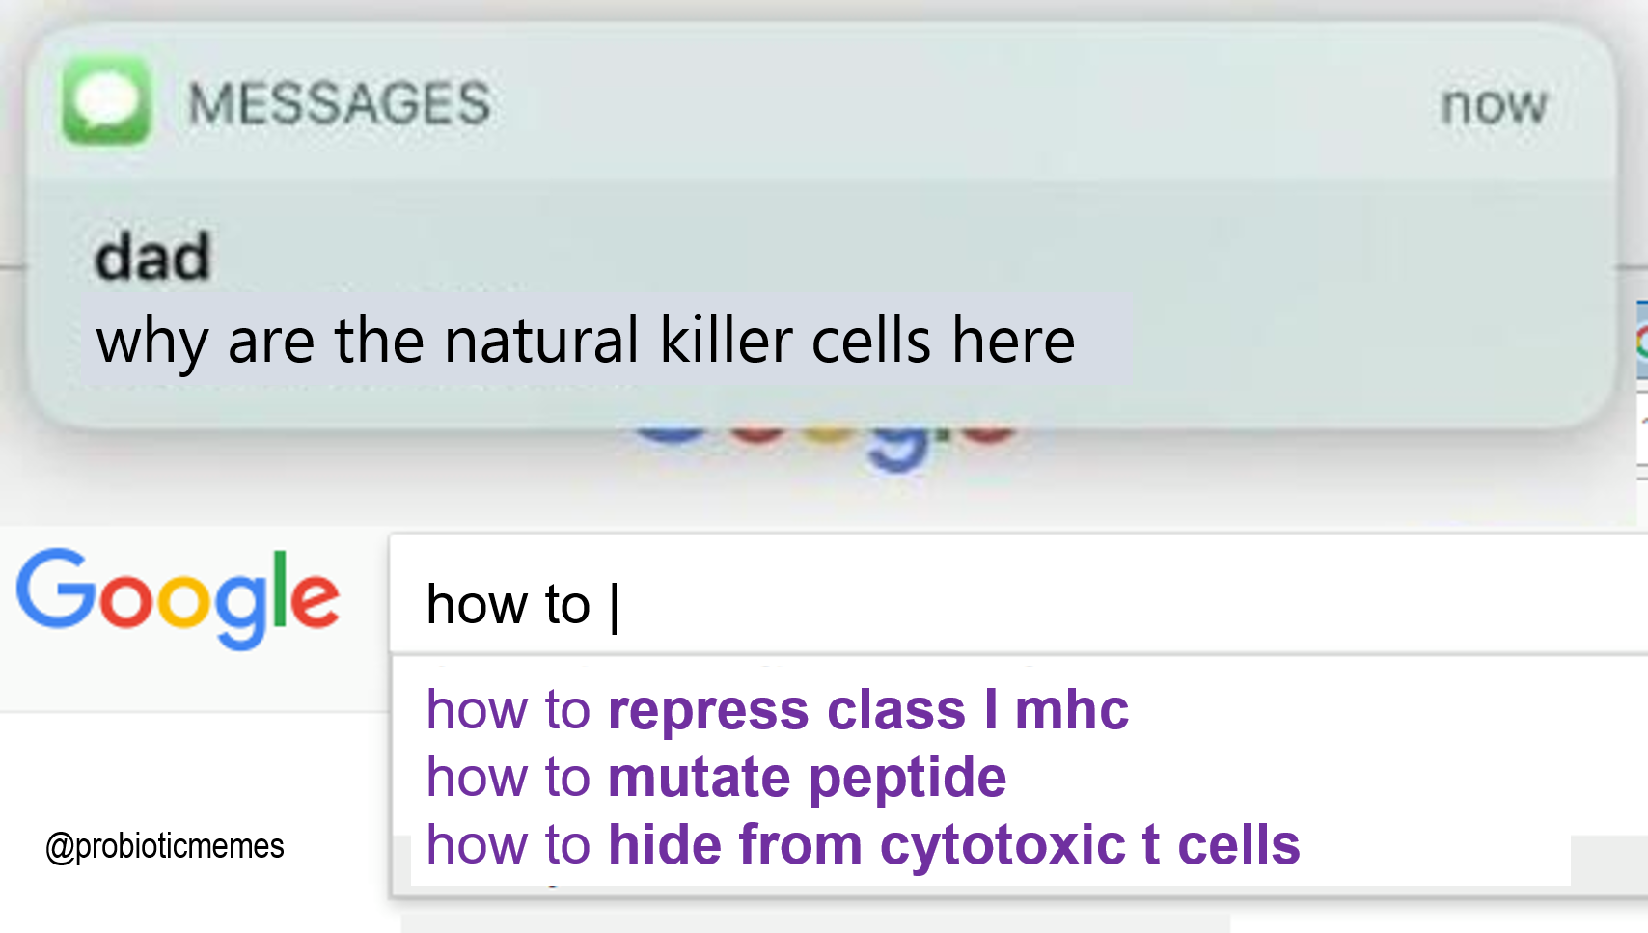

Slide 16
Concept 43.1: Recognition and response rely on traits common to groups of pathogens – Innate
Inflammatory Response
A localized inflammatory response, such as pain and swelling, is brought about by molecules released upon injury of infection
Mast cells release histamine, which triggers blood vessels to DILATE and become more permeable
Activated macrophages and neutrophils release cytokines, signaling molecules that ENHANCE the immune response

Slide 17
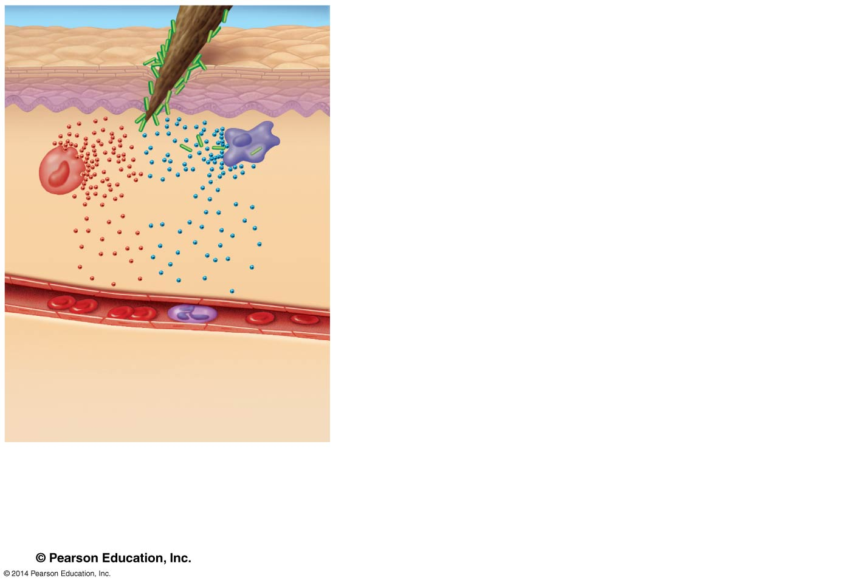
Figure 43.8-1
Pathogen
Splinter
Signaling
molecules
Macro-
phage
Mast
cell
Capillary
Red blood cells
Neutrophil
1
Histamines and cytokines
released. Capillaries dilate.
Notes:
Figure 43.8-1 Major events in a local inflammatory response (step 1)

Slide 18
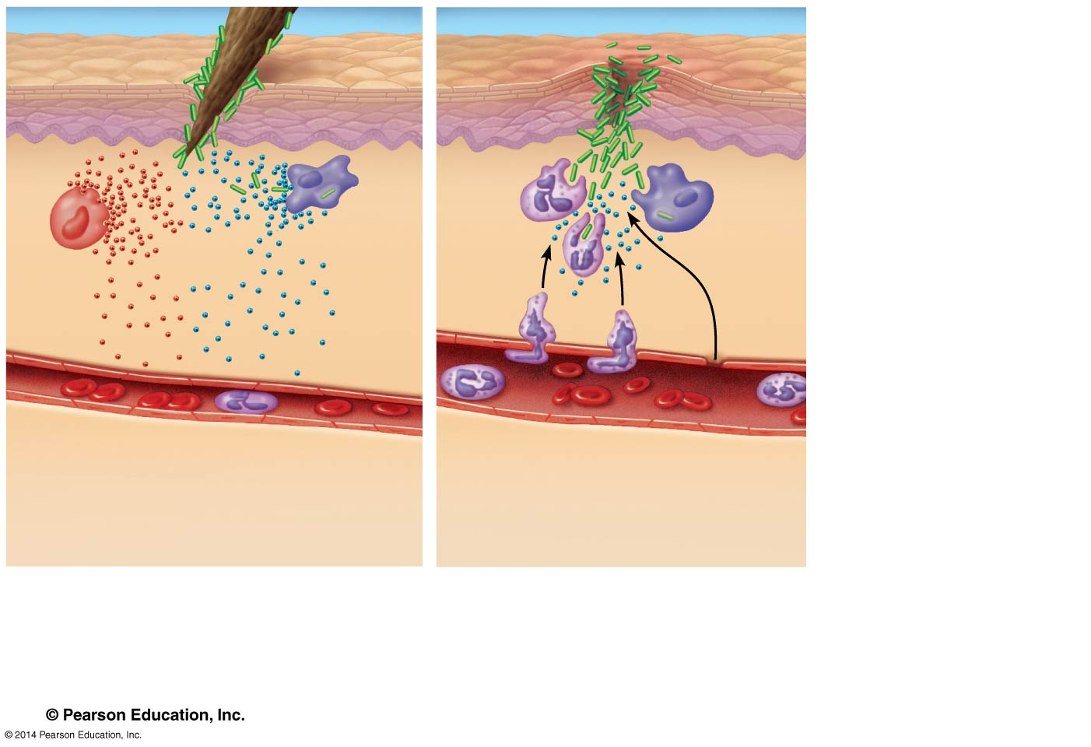
Figure 43.8-2
Pathogen
Splinter
Movement
of fluid
Signaling
molecules
Macro-
phage
Mast
cell
Capillary
Red blood cells
Neutrophil
1
Histamines and cytokines
released. Capillaries dilate.
2
Antimicrobial
peptides enter tissue.
Neutrophils are
recruited.
Resembles this: https://www.youtube.com/watch?v=fHSaAPHP6fE
Notes:
Figure 43.8-2 Major events in a local inflammatory response (step 2)

Slide 19
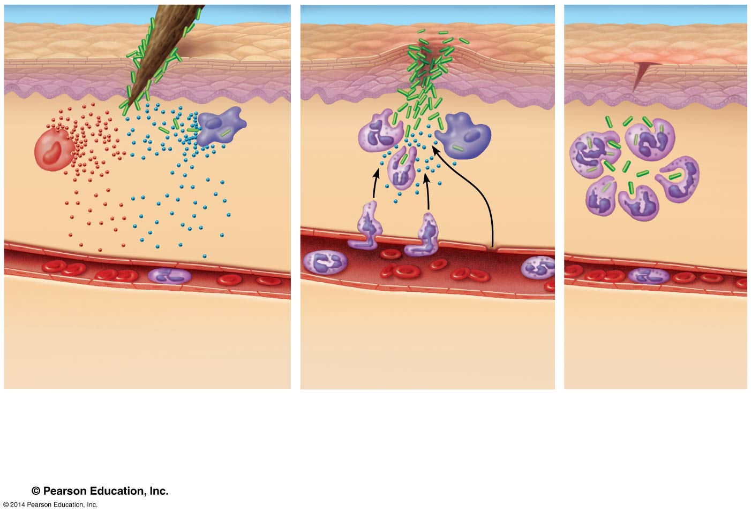
Next time you get cut, imagine all this happening in mere seconds! AMAZING!
Pathogen
Splinter
Movement
of fluid
Signaling
molecules
Macro-
phage
Mast
cell
Capillary
Phagocytosis
Red blood cells
Neutrophil
1
Histamines and cytokines
released. Capillaries dilate.
2
Antimicrobial
peptides enter tissue.
Neutrophils are
recruited.
3
Neutrophils
digest pathogens
and cell debris.
Tissue heals.
Notes:
Figure 43.8-3 Major events in a local inflammatory response (step 3)

Slide 20
Concept 43.1: Recognition and response rely on traits common to groups of pathogens – Innate
Inflammation can be either local or systemic (throughout the body = fever!)
So why all this signaling at the site of injury/infection?
Enhanced blood flow to the site helps deliver antimicrobial peptides that result in an accumulation of pus, a fluid rich in white blood cells, dead pathogens, and cell debris from damaged tissues
Therefore, pus is what’s left of the battle that took place between immune system and pathogen!

Slide 21
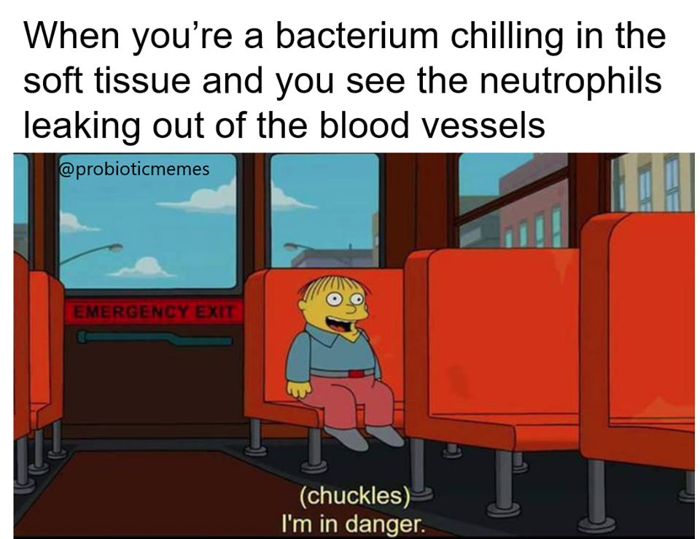

Slide 22
Concept 43.1: Recognition and response rely on traits common to groups of pathogens – Innate
Evasion of Innate Immunity by Pathogens
Some pathogens avoid destruction by MODIFYING their surface to PREVENT recognition
So then what? What if the innate immune response is evaded by a pathogen…?
ACTIVATE ADAPTIVE IMMUNITY!

Slide 23
Overview
Concept 43.1: In innate immunity, recognition and response rely on traits common to groups of pathogens
Concept 43.2: In adaptive immunity, receptors provide pathogen-specific recognition
Concept 43.3: Adaptive immunity defends against infection of body fluids and body cells
Concept 43.4: Disruptions in immune system function can elicit or exacerbate disease

Slide 24
Immune System – The Basics – Adaptive
Vertebrates have adaptive immunity (in addition to innate immunity)
Adaptive immunity, or acquired immunity, develops AFTER exposure to agents such as microbes, toxins, or other foreign substances
It involves a VERY specific response to pathogens

Slide 25
Concept 43.2: In adaptive immunity, receptors provide pathogen-specific recognition
The adaptive response relies on two types of lymphocytes, or white blood cells (WBCs)
T cells = lymphocytes that mature in the thymus
B cells = lymphocytes that mature in bone marrow
Antigens are substances that can elicit a RESPONSE from a B or T cell
T or B cells BIND to antigens via antigen receptors SPECIFIC to a molecular part (epitope) of the pathogen (recall: VERY specific immunity!)

Slide 26
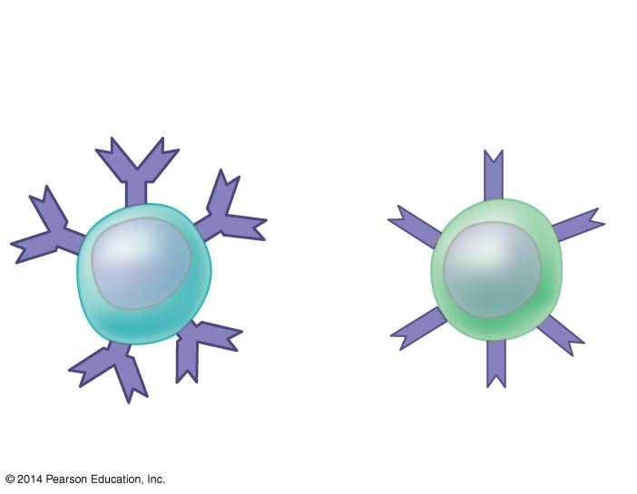
Figure 43.UN01
Antigen
receptors
Mature B cell
Mature T cell
Notes:
Figure 43.UN01 In-text figure, lymphocytes, p. 952

Slide 27
Concept 43.2: In adaptive immunity, receptors provide pathogen-specific recognition
Antigen Recognition by B Cells
Binding of a B cell antigen receptor to an antigen is an early step in B cell activation
This gives rise to B cells that SECRETE a soluble form of the protein called an antibody (Ab) or immunoglobulin (Ig)
Antibodies have the same Y shape as B cell antigen receptors but are secreted, NOT membrane bound

Slide 28
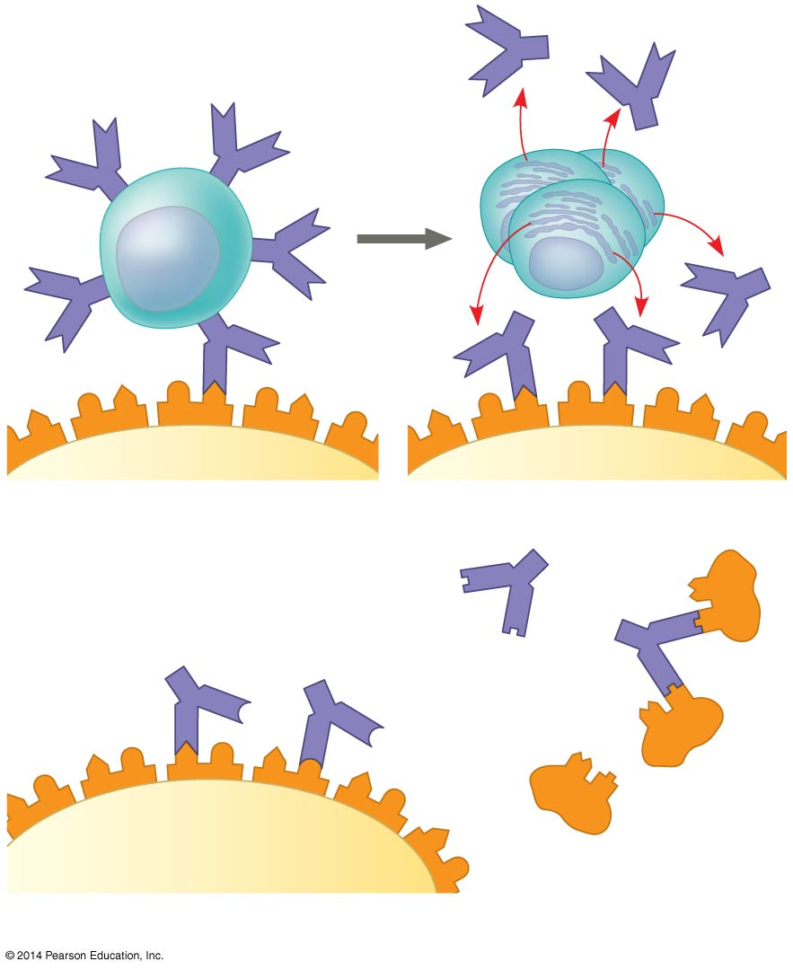
Figure 43.10
Antigen
receptor
Antibody
B cell
Antigen
Epitope
Pathogen
(a)
B cell antigen receptors and antibodies
Antibody C
Antibody A
Antibody B
Antigen
(b)
Antigen receptor specificity
Notes:
Figure 43.10 Antigen recognition by B cells and antibodies

Slide 29
Concept 43.2: In adaptive immunity, receptors provide pathogen-specific recognition
Antigen Recognition by T Cells
Each T cell receptor consists of two polypeptide chains that RECOGNIZE foreign antigens
T cells BIND to antigen fragments displayed or presented on a host cell
These antigen fragments are bound to cell-surface proteins called MHC (major histocompatibility complex) molecules
MHC = host cell-surface proteins that DISPLAY the antigen fragments on the cell surface

Slide 30
Concept 43.2: In adaptive immunity, receptors provide pathogen-specific recognition
Antigen Recognition by T Cells
In infected cells, MHC molecules bind and transport antigen fragments to the cell surface, a process called antigen presentation
A T cell antigen receptor then BINDS to both the antigen fragment and the MHC molecule
This cell-to-cell INTERACTION is necessary for the T cell to become “activated” in order to participate in the adaptive immune response

Slide 31
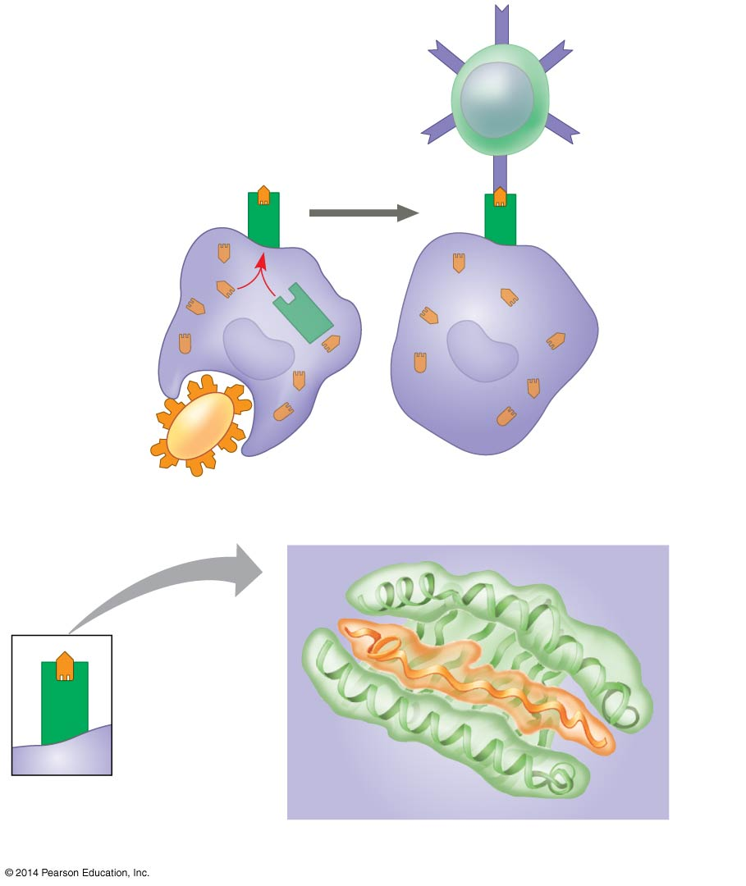
Figure 43.12
Displayed
antigen
fragment
T cell
MHC
molecule
T cell antigen
receptor
Antigen
fragment
Pathogen
Host cell
(a)
Antigen recognition by a T cell
Top view
Antigen
fragment
MHC
molecule
Host cell
(b)
A closer look at antigen presentation
Notes:
Figure 43.12 Antigen recognition by T cells

Slide 32
Concept 43.2: In adaptive immunity, receptors provide pathogen-specific recognition
B/T Cell Proliferation
Once activated, a B or T cell undergoes multiple cell divisions (clonal selection) to produce many clones of identical cells
Some cells from the clone become short-lived effector cells that act IMMEDIATELY against the antigen
Ex: plasma B cells that SECRETE antibodies
Some cells from the clone become LONG-LIVED memory cells that can give rise to effector cells if the same antigen is encountered again

Slide 33
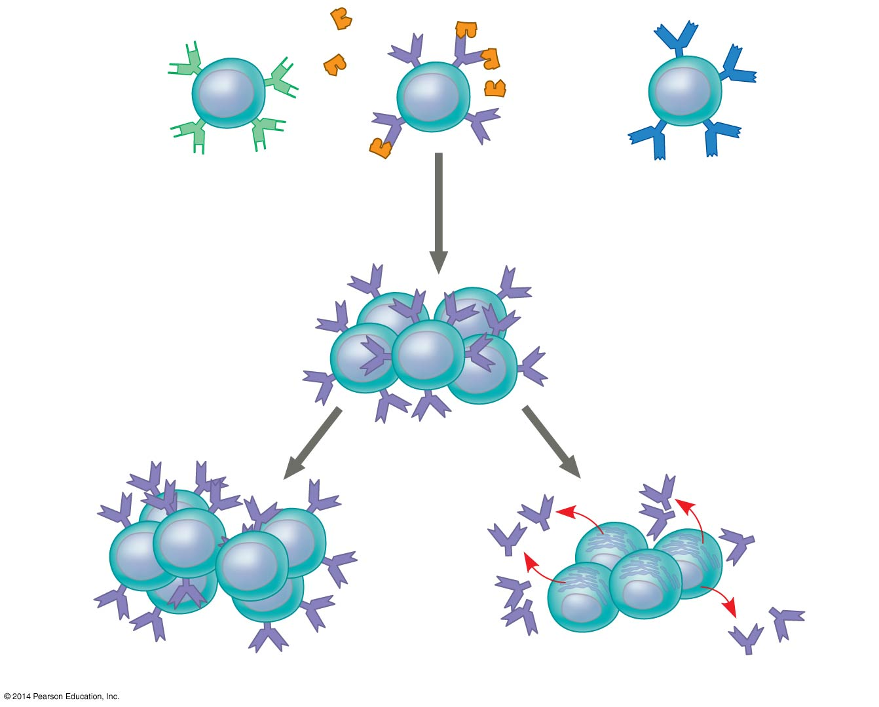
Figure 43.14
B cells that
differ in
antigen
specificity
Antigen
Antigen
receptor
Antibody
Memory cells
Plasma cells
Notes:
Figure 43.14 Clonal selection of B cells

Slide 34
Concept 43.2: In adaptive immunity, receptors provide pathogen-specific recognition
Immunological Memory
Immunological memory is responsible for LONG-TERM protections against diseases
Primary immune response = first exposure to a specific antigen
During this time, selected B and T cells give rise to their effector forms
Secondary immune response = memory cells facilitate a FASTER, more efficient response

Slide 35
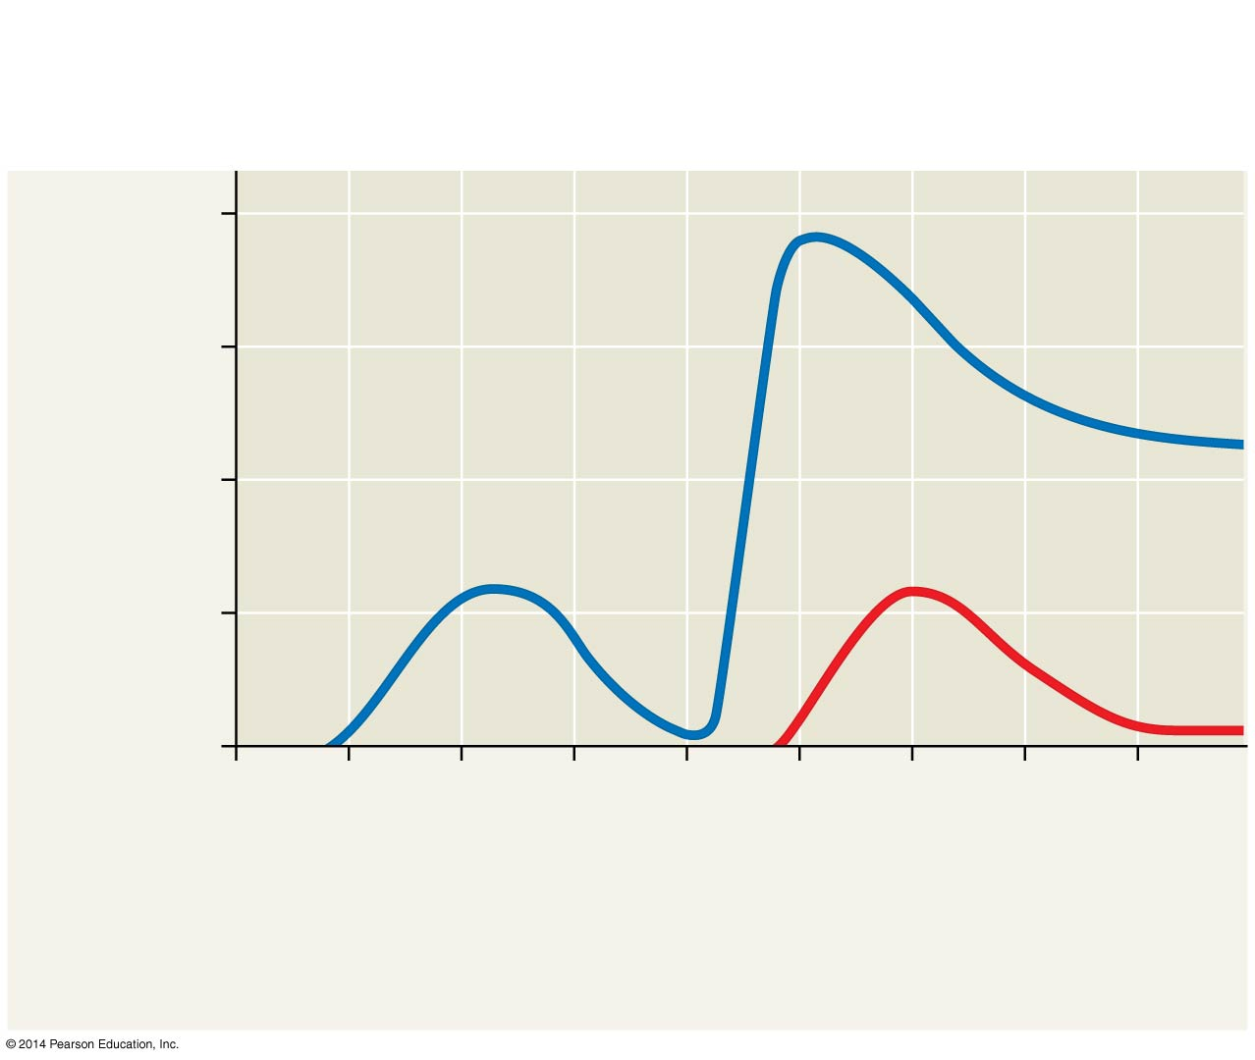
Figure 43.15
Primary immune
response to
antigen A
Secondary immune
response to
antigen A
Primary immune
response to
antigen B
10⁴
10³
Antibodies
to A
Antibody concentration
(arbitrary units)
10²
Antibodies
to B
10¹
10⁰
0
7
14
21
28
35
42
49
56
Exposure
to antigen A
Exposure to
antigens A and B
Time (days)
Notes:
Figure 43.15 The specificity of immunological memory

Slide 36
Concept 43.2: In adaptive immunity, receptors provide pathogen-specific recognition
Summary
The adaptive immune system has four major characteristics
Immense diversity, and thus specificity, of lymphocytes and receptors
Self-tolerance; lack of reactivity against an host’s own molecules (dw about details)
B and T cells proliferate after activation
Immunological memory

Slide 37
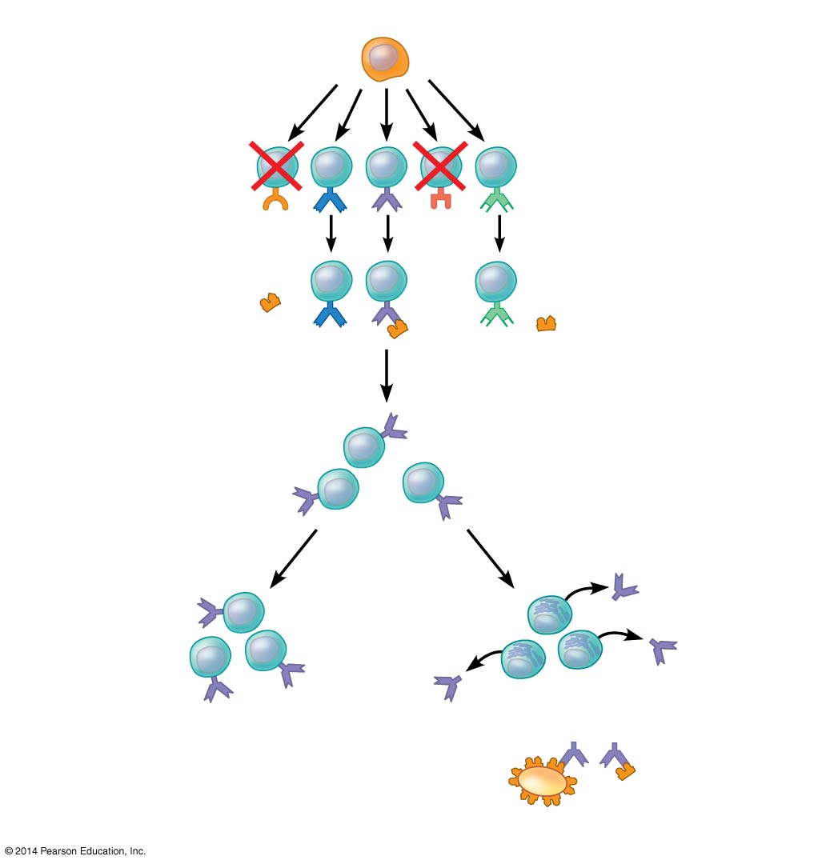
Stem cell
Cell division
and gene
rearrangement
Elimination of
self-reactive
B cells
Antigen
Clonal
selection
Formation of
activated cell
populations
Antibody
Plasma cells
Memory B cells
Pathogen
Receptors bind to antigens
Notes:
Figure 43.UN07 Summary of key concepts: clonal selection

Slide 38
Overview
Concept 43.1: In innate immunity, recognition and response rely on traits common to groups of pathogens
Concept 43.2: In adaptive immunity, receptors provide pathogen-specific recognition
Concept 43.3: Adaptive immunity defends against infection of body fluids and body cells
Concept 43.4: Disruptions in immune system function can elicit or exacerbate disease

Slide 39
Concept 43.3: Adaptive immunity defends against infection of body fluids and body cells
The defenses provided by B and T lymphocytes (aka adaptive immunity) can be divided into two sub-divisions:
Cell-mediated immune response = specialized T cells destroy affected host cells
Humoral immune response = antibodies (Ab) help neutralize or eliminate toxins and pathogens in the blood and lymph (“humors” = body fluids)

Slide 40
Concept 43.3: Adaptive immunity defends against infection of body fluids and body cells
Helper T Cells: A Response to Nearly All Antigens
A type of T cell called a helper T (T_{H}) cell triggers BOTH the humoral and cell-mediated immune responses (it is the ultimate mediator of immunity)
Signals from T_{H} cells initiate production of antibodies that neutralize pathogens AND activate T cells that kill infected cells
Antigen-presenting cells (APCs) have class I and class II MHC molecules on their surfaces that are involved in immune cell-to-cell communication

Slide 41
Concept 43.3: Adaptive immunity defends against infection of body fluids and body cells
Helper T Cells: A Response to Nearly All Antigens
Class II MHC molecules are the basis upon which APCs are recognized (APCs have MHC II)
Antigen receptors on the surface of T_{H} cells BIND to the antigen AND the MHC II molecule of APC → signals are exchanged between the two cells → T_{H} cell activated → T_{H} cell proliferates to form clones of T_{H} cells → Activated T_{H} cells go on to activate appropriate B or T cells
Immunological cascade of activation!

Slide 42
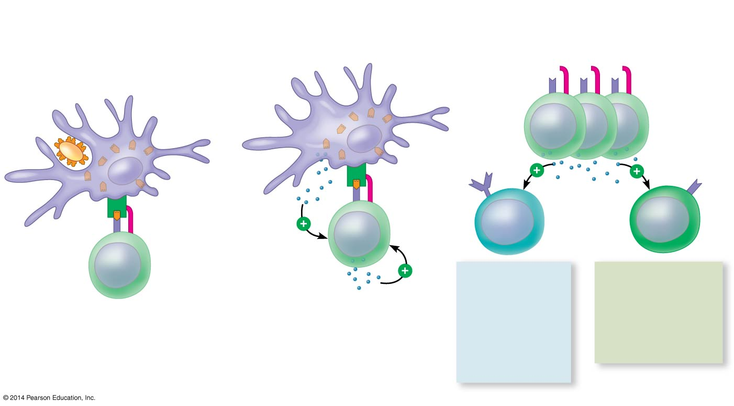
Figure 43.16
Antigen-
presenting
cell
Pathogen
Antigen
fragment
Clone of activated helper T cells
Class II
MHC
molecule
Cytotoxic
T cell
B cell
Antigen
receptor
Accessory
protein
HUMORAL
IMMUNITY
(secretion of
antibodies
by plasma
cells)
CELL-
MEDIATED
IMMUNITY
(attack on
infected cells)
Cytokines
Helper T cell
Notes:
Figure 43.16 The central role of helper T cells in humoral and cell-mediated immune responses

Slide 43
Concept 43.3: Adaptive immunity defends against infection of body fluids and body cells
Cytotoxic T Cells: A Response to Infected Cells
Cytotoxic T (T_{C}) cells use toxic proteins to KILL cells infected by viruses or other INTRAcellular pathogens
T_{H} cells activate T_{C} cells → T_{C} cells RECOGNIZE fragments of foreign proteins produced by infected cells → Activated T_{C} cell secretes proteins → Proteins disrupt membranes of target cells → triggers apoptosis (programmed cell death, cell suicide) in infected cells
Immunological cascade of activation mediated by T_{H} cells leads to cell-mediated immune response

Slide 44
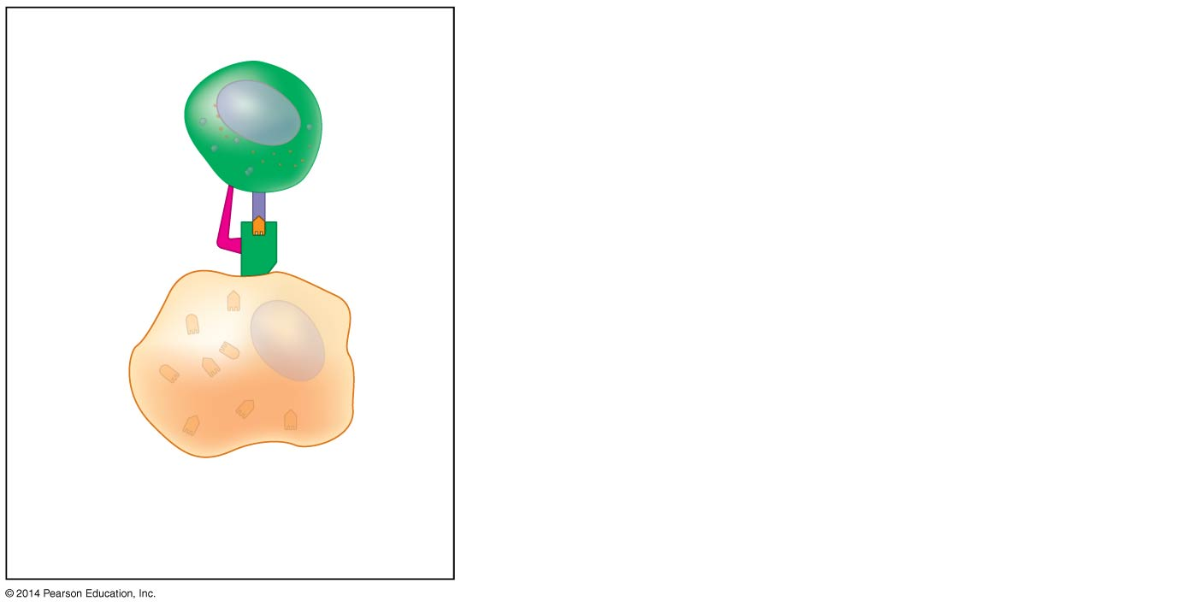
Cell-mediated immunity via T_{C} cells
Cytotoxic
T cell
Accessory
protein
Antigen
receptor
Class I
MHC
molecule
Infected
cell
Antigen
fragment
1
Notes:
Figure 43.17-1 The killing action of cytotoxic T cells on an infected host cell (step 1)

Slide 45
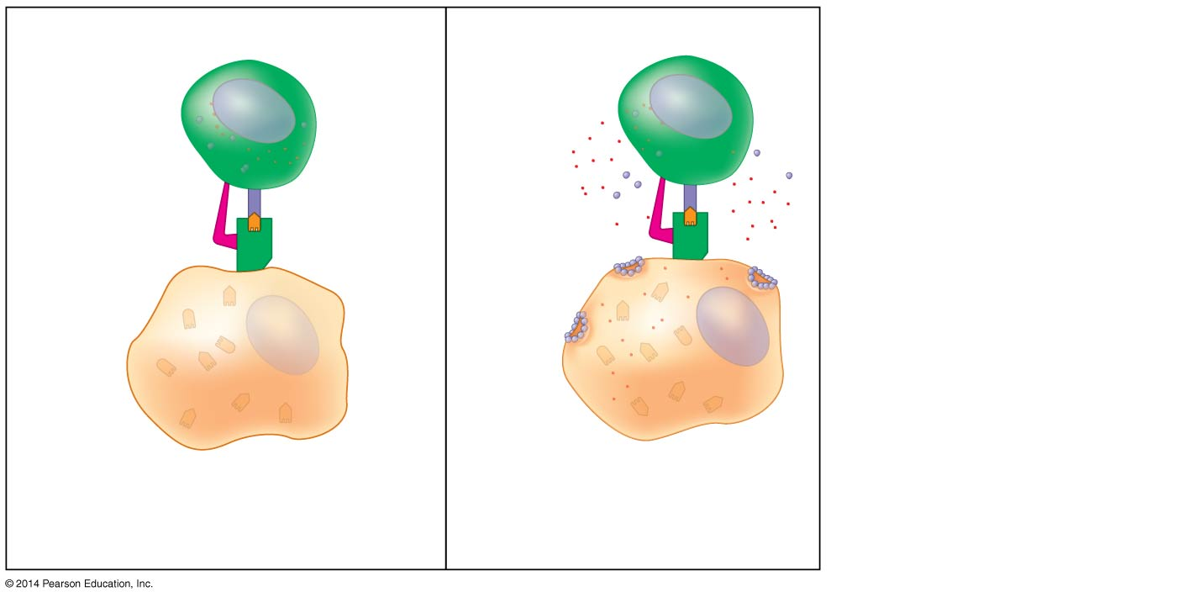
Cell-mediated immunity via T_{C} cells
Cytotoxic
T cell
Granzymes
Accessory
protein
Antigen
receptor
Class I
MHC
molecule
Perforin
Pore
Infected
cell
Antigen
fragment
1
2
Notes:
Figure 43.17-2 The killing action of cytotoxic T cells on an infected host cell (step 2)

Slide 46
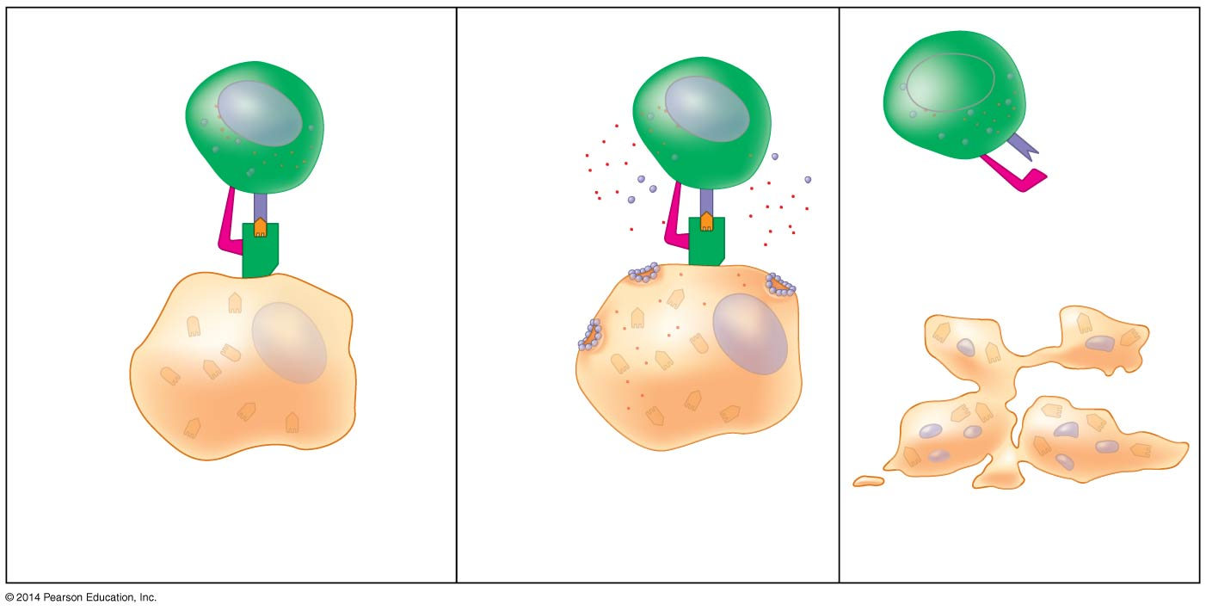
Cell-mediated immunity via T_{C} cells
Cytotoxic
T cell
Granzymes
Released
cytotoxic
T cell
Accessory
protein
Antigen
receptor
Dying
infected
cell
Class I
MHC
molecule
Perforin
Pore
Infected
cell
Antigen
fragment
1
2
3
Notes:
Figure 43.17-3 The killing action of cytotoxic T cells on an infected host cell (step 3)

Slide 47
Concept 43.3: Adaptive immunity defends against infection of body fluids and body cells
B Cells and Antibodies: A Response to Extracellular Pathogens
Antigen binds a B cell → cell takes in foreign molecules by receptor-mediated endocytosis → MHC II of B cell PRESENTS antigen fragment to T_{H} cell (CRITICAL step!) → T_{H} activates B cell → B cell gives rise to thousands of identical plasma cells → plasma cells secrete antibodies that circulate body’s “humors”
This humoral response is characterized by SECRETION of antibodies by B cells via immunological cascade of activation mediated by T_{H} cells

Slide 48
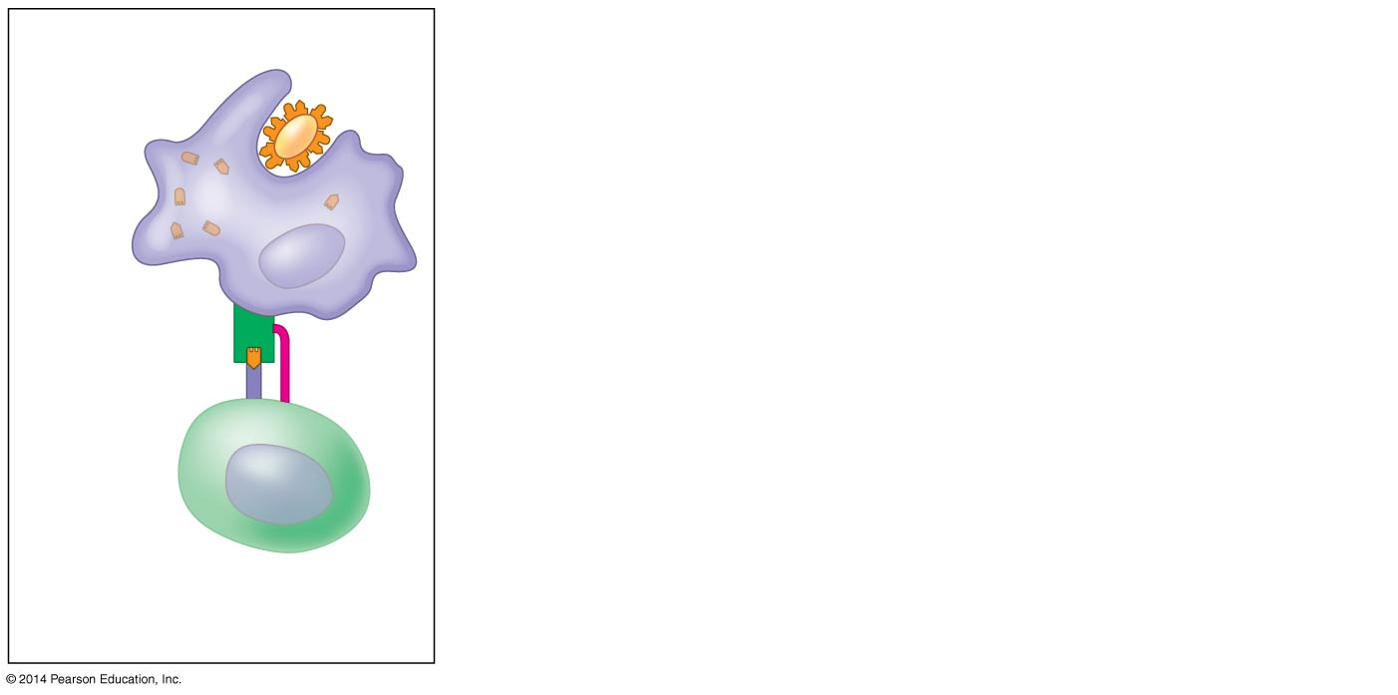
Humoral immunity via B cells
Antigen-
presenting
cell
Pathogen
Antigen
fragments
MHC
Antigen
receptor
CD4
1
Helper T cell
Notes:
Figure 43.18-1 Activation of a B cell in the humoral immune response (step 1)

Slide 49
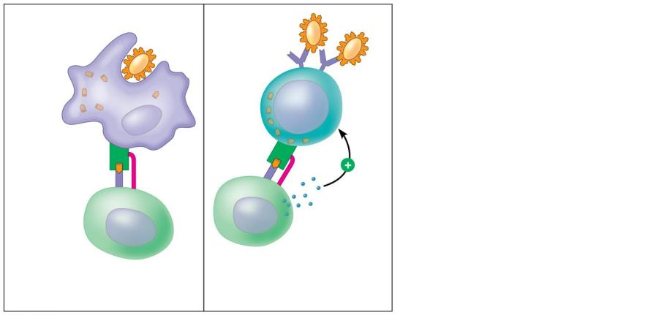
Humoral immunity via B cells
Antigen-
presenting
cell
Pathogen
B cell
Antigen
fragments
MHC
Antigen
receptor
CD4
Cytokines
Activated
helper T cell
1
Helper T cell
2
Notes:
Figure 43.18-2 Activation of a B cell in the humoral immune response (step 2)

Slide 50
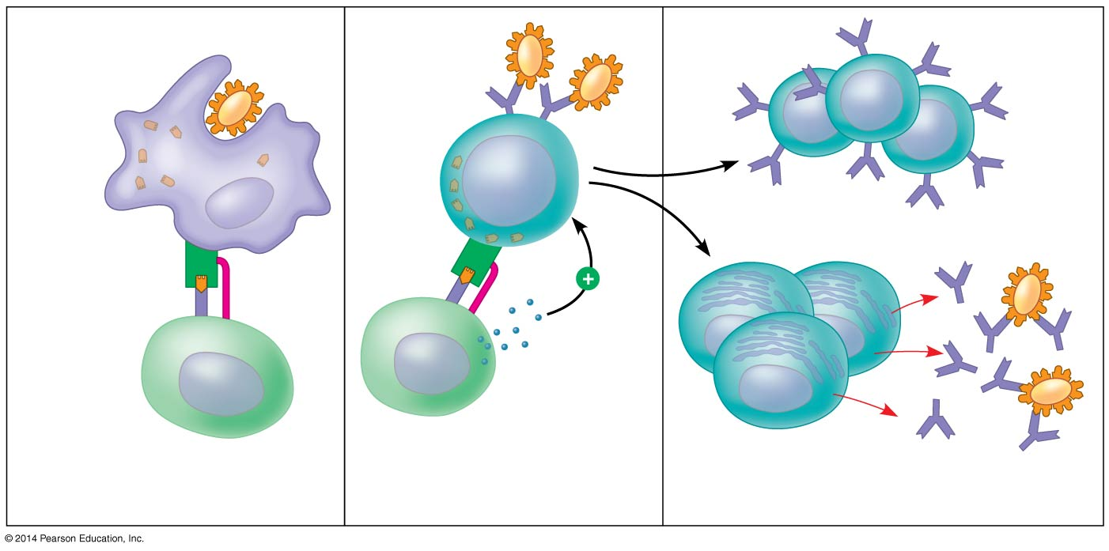
Humoral immunity via B cells
Antigen-
presenting
cell
Pathogen
B cell
Antigen
fragments
Memory B cells
MHC
Antigen
receptor
CD4
Cytokines
Activated
helper T cell
Plasma
cells
Secrete
antibodies
1
Helper T cell
2
3
Why?
Notes:
Figure 43.18-3 Activation of a B cell in the humoral immune response (step 3)

Slide 51
Concept 43.3: Adaptive immunity defends against infection of body fluids and body cells
B Cells and Antibodies: A Response to Extracellular Pathogens
Antibodies do NOT kill pathogens; instead they MARK pathogens for destruction via…
Neutralization = antibodies bind to viral surface proteins to prevent infection of a host cell
Opsonization = promotion of phagocytosis by macrophages and neutrophils
Complement system (dw about this)

Slide 52
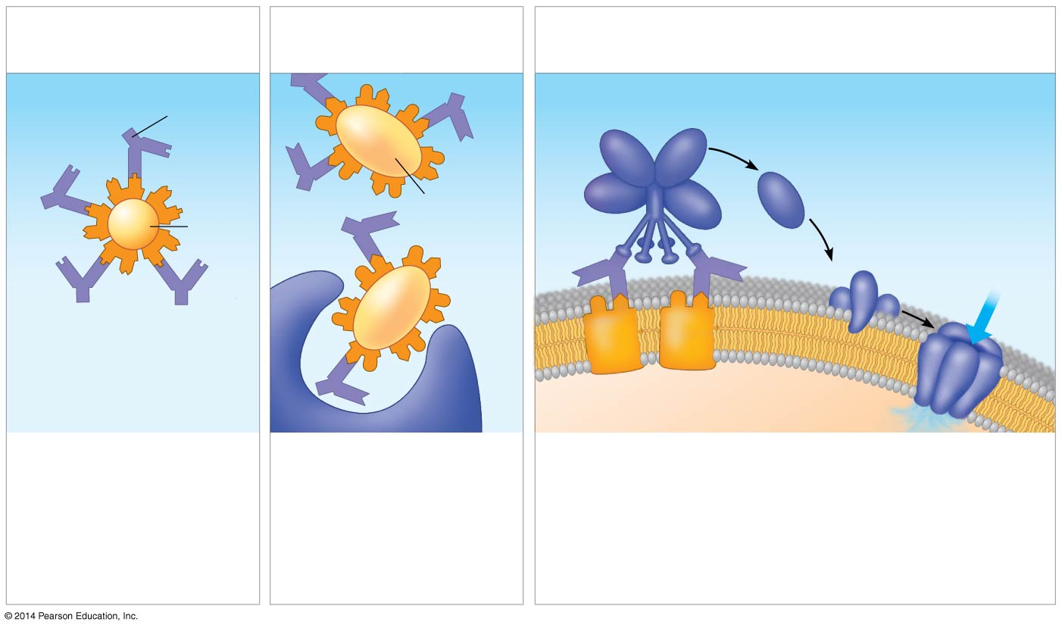
Figure 43.19
(a)
Neutralization
(b)
Opsonization
(c)
Activation of complement
system and pore formation
Antibody
Complement proteins
Formation of
membrane
attack complex
Bacterium
Flow of water
and ions
Virus
Pore
Foreign
cell
Antigen
Macrophage
Blocking of ability
of virus to bind to
a host cell
Promotion of
phagocytosis of
bacteria by
macrophages and
neutrophils
Activation
of the
complement
system
Pore formation allows
water and ions to rush
inside the foreign cell,
which swells and
eventually lyses.
Notes:
Figure 43.19 Antibody-mediated mechanisms of antigen disposal

Slide 53
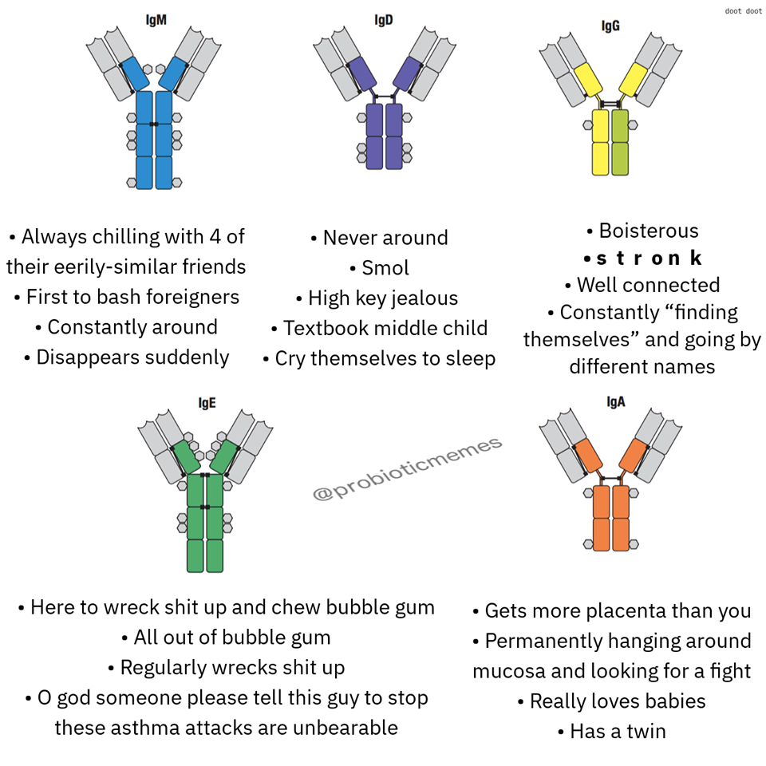
Tag
yourselves

Slide 54
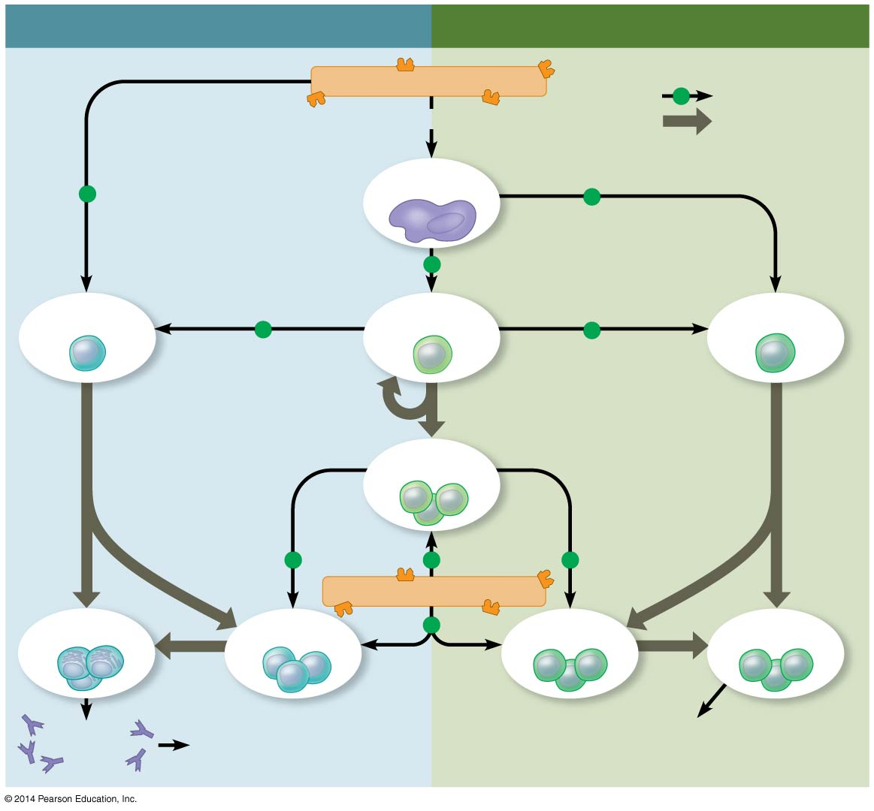
Overview of Adaptive Immunity
HUMORAL IMMUNE RESPONSE
CELL-MEDIATED IMMUNE RESPONSE
Antigen (1st exposure)
Key
+
Stimulates
Engulfed by
Gives rise to
Antigen-
presenting cell
+
+
+
B cell
Helper T cell
Cytotoxic
T cell
+
+
Memory
helper T cells
+
+
+
Antigen (2nd exposure)
Plasma
cells
Memory
B cells
+
Memory
cytotoxic T cells
Active
cytotoxic T cells
Secreted
antibodies
Defend against
extracellular pathogens
Defend against
intracellular pathogens
and cancer
Notes:
Figure 43.20 An overview of the adaptive immune response

Slide 55
Overview
Concept 43.1: In innate immunity, recognition and response rely on traits common to groups of pathogens
Concept 43.2: In adaptive immunity, receptors provide pathogen-specific recognition
Concept 43.3: Adaptive immunity defends against infection of body fluids and body cells
Concept 43.4: Disruptions in immune system function can elicit or exacerbate disease

Slide 56
Concept 43.4: Disruptions in immune system function can elicit or exacerbate disease
If the delicate BALANCE of the immune system is disrupted, effects can be severe…
Allergies are exaggerated (hypersensitive) responses to antigens called allergens
In individuals with autoimmune diseases, the immune system loses self-tolerance and turns AGAINST certain molecules of the host’s own body!!! (top 10 anime betrayals)
Moderate exercise IMPROVES immune system function
Psychological stress has been shown to DISRUPT immune system regulation
Sufficient rest is also important for immunity

Slide 57
Concept 43.4: Disruptions in immune system function can elicit or exacerbate disease
Attack on the Immune System: HIV
Human immunodeficiency virus (HIV) infects helper T cells (aka the most important lymphocytes!)
HIV persists in the host—DESPITE an immune response—because it has a high mutation rate → becomes so hard to R & R
Over time, an untreated HIV infection not only evades the adaptive immune response, but abolishes it…

Slide 58
Concept 43.4: Disruptions in immune system function can elicit or exacerbate disease
Attack on the Immune System: HIV
HIV infection leads to acquired immune deficiency syndrome (AIDS)
People with AIDS are HIGHLY susceptible to opportunistic infections and cancers that take advantage of an immune system in collapse
These infections and cancers would otherwise be controlled and eliminated relatively quickly in a non-AIDS individual

Slide 59
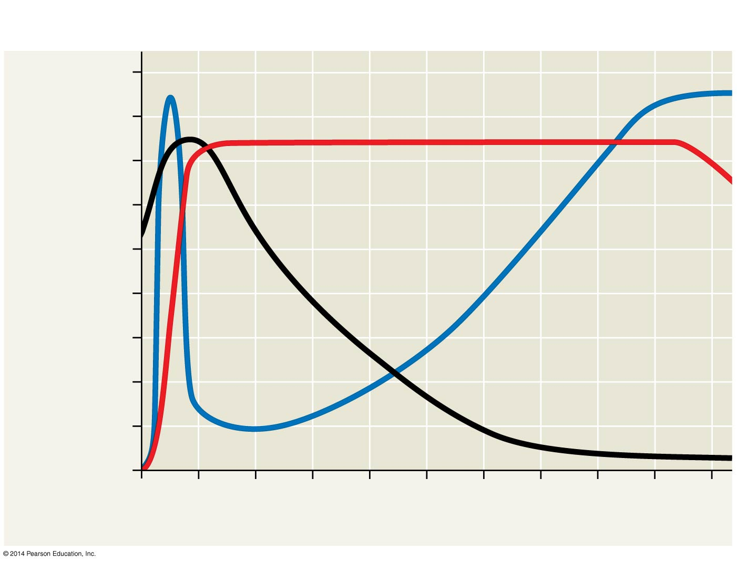
Figure 43.24
Latency
AIDS
Relative anti-HIV antibody
concentration
800
Relative HIV
concentration
600
Helper T cell concentration
in blood (cells/mm³)
Helper T cell
concentration
400
200
0
0
1
2
3
4
5
6
7
8
9
10
Years after untreated infection
Notes:
Figure 43.24 The progress of an untreated HIV infection

Slide 60
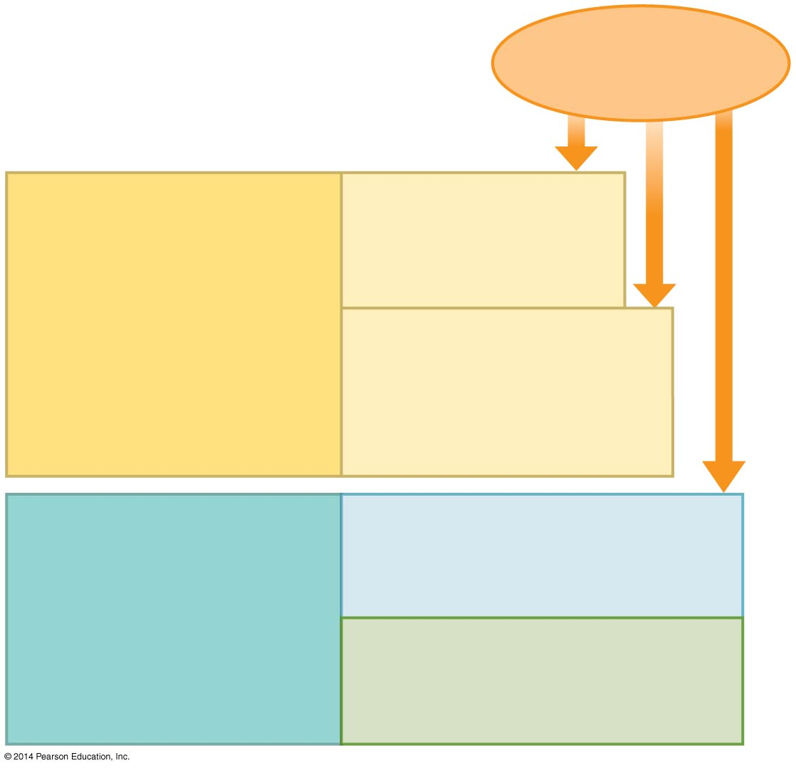
An Overview of Immunity
Pathogens
(such as bacteria,
fungi, and viruses)
INNATE IMMUNITY
(all animals)
Barrier defenses:
Skin
Mucous membranes
Secretions
Recognition of traits
shared by broad
ranges of pathogens,
using a small set of
receptors
Internal defenses:
Phagocytic cells
Natural killer cells
Antimicrobial proteins
Inflammatory response
Rapid response
ADAPTIVE IMMUNITY
(vertebrates only)
Humoral response:
Antibodies defend against
infection in body fluids.
Recognition of traits
specific to particular
pathogens, using a
vast array of receptors
Cell-mediated response:
Cytotoxic cells defend
against infection in body
cells.
Slower response
Notes:
Figure 43.2 Overview of animal immunity

Slide 61
Overview
Concept 43.1: In innate immunity, recognition and response rely on traits common to groups of pathogens
Concept 43.2: In adaptive immunity, receptors provide pathogen-specific recognition
Concept 43.3: Adaptive immunity defends against infection of body fluids and body cells
Concept 43.4: Disruptions in immune system function can elicit or exacerbate disease

Slide 62
WATCH
https://youtu.be/zQGOcOUBi6s
https://youtu.be/GIJK3dwCWCw
https://youtu.be/2DFN4IBZ3rI
https://youtu.be/z3M0vU3Dv8E
https://youtu.be/PSRJfaAYkW4
https://youtu.be/Nw27_jMWw10

