Slide 1
26
Phylogeny and the Tree of Life

Slide 2
Investigating the Tree of Life
Phylogeny is the EVOLUTIONARY HISTORY of a species or group of related species
For example, a phylogeny shows that legless lizards and sneks evolved from different lineages of legged lizards
The discipline of systematics classifies organisms and determines their evolutionary relationships

Slide 3
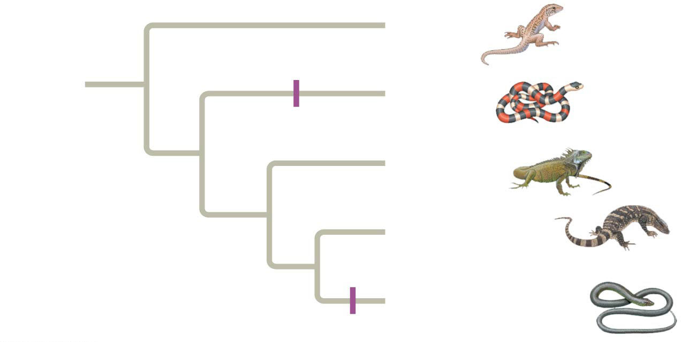
An example of a phylogeny…think of this as a story about evolutionary history
Geckos
ANCESTRAL
LIZARD
(with limbs)
No limbs
Snakes
Iguanas
Monitor lizard
Eastern glass lizard
No limbs
Notes:
Figure 26.2 Convergent evolution of limbless bodies

Slide 4
Overview
Concept 26.1: Phylogenies show evolutionary relationships
Concept 26.2: Phylogenies are inferred from morphological and molecular data
Concept 26.3: Shared characters are used to construct phylogenetic trees
Concept 26.4: An organism’s evolutionary history is documented in its genome
Concept 26.5: Molecular clocks help track evolutionary time
Concept 26.6: Our understanding of the tree of life continues to change based on new data

Slide 5
Overview
Concept 26.1: Phylogenies show evolutionary relationships
Concept 26.2: Phylogenies are inferred from morphological and molecular data
Concept 26.3: Shared characters are used to construct phylogenetic trees
Concept 26.4: An organism’s evolutionary history is documented in its genome
Concept 26.6: Our understanding of the tree of life continues to change based on new data

Slide 6
Concept 26.1: Phylogenies show evolutionary relationships
Taxonomy is the scientific discipline concerned with CLASSIFYING AND NAMING organisms
Utilizes binomial nomenclature: two-part names → “Genus + specific epithet” → Homo sapiens (italicized!)
Utilizes hierarchical classification: grouping species in increasingly inclusive categories
The taxonomic groups from BROAD TO NARROW = domain → kingdom → phylum → class → order → family → genus → species (DKPCOFGS)
Taxon = taxonomic UNIT at any level of hierarchy

Slide 7
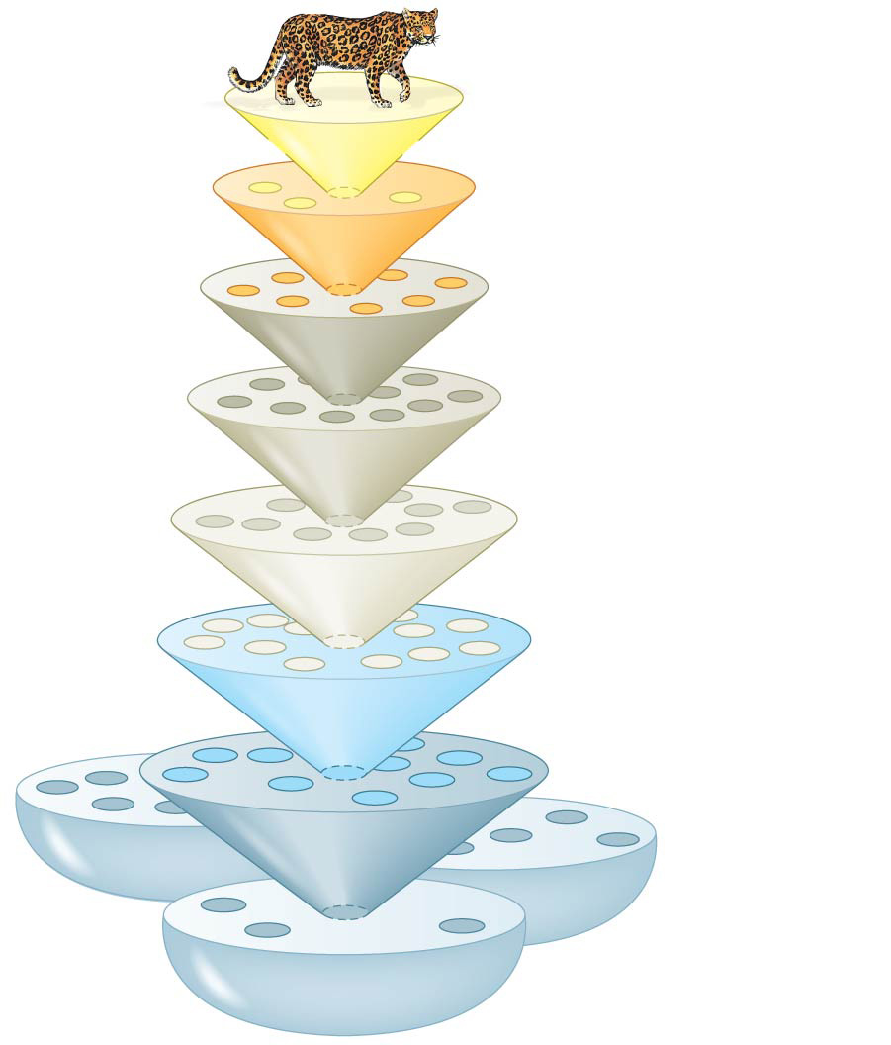
Figure 26.3
Cell
division
error
Species:
Panthera pardus
Genus:
Panthera
Family:
Felidae
Order:
Carnivora
Class:
Mammalia
Phylum:
Chordata
Domain:
Bacteria
Kingdom:
Animalia
Domain:
Archaea
Domain:
Eukarya
Notes:
Figure 26.3 Linnaean classification

Slide 8
Concept 26.1: Phylogenies show evolutionary relationships – Phylogenetic Vocab
Phylogenetic tree = EVOLUTIONARY HISTORY = hypothesis about evolutionary relationships
Branch point = “node” = divergence of two species
Sister taxa = groups that share an IMMEDIATE common ancestor (CA)
Rooted tree = includes branch to represent the last common ancestor (LCA) of ALL taxa in the tree
Basal taxon = diverges EARLY in the history of a group and originates near the LCA of the whole group
Polytomy = branch from which MORE than two groups emerge (NOT preferable, unclear evolutionary history)

Slide 9
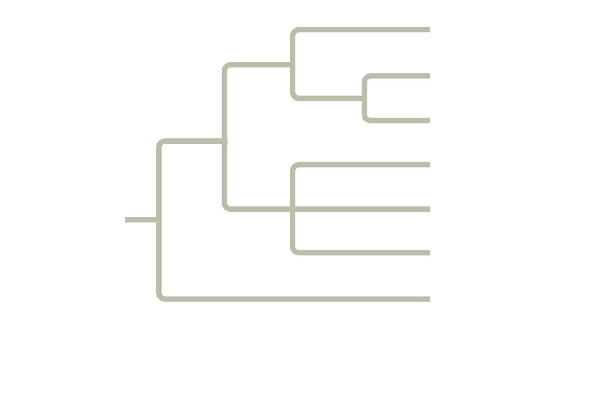
Figure 26.5
Branch point:
where lineages diverge
Taxon A
3
Taxon B
Sister
taxa
4
Taxon C
2
Taxon D
5
Taxon E
ANCESTRAL
LINEAGE
1
Taxon F
Basal
taxon
Taxon G
This branch point
represents the
common ancestor of
taxa A–G.
This branch point forms
a polytomy: an
unresolved pattern of
divergence.
Notes:
Figure 26.5 How to read a phylogenetic tree

Slide 10
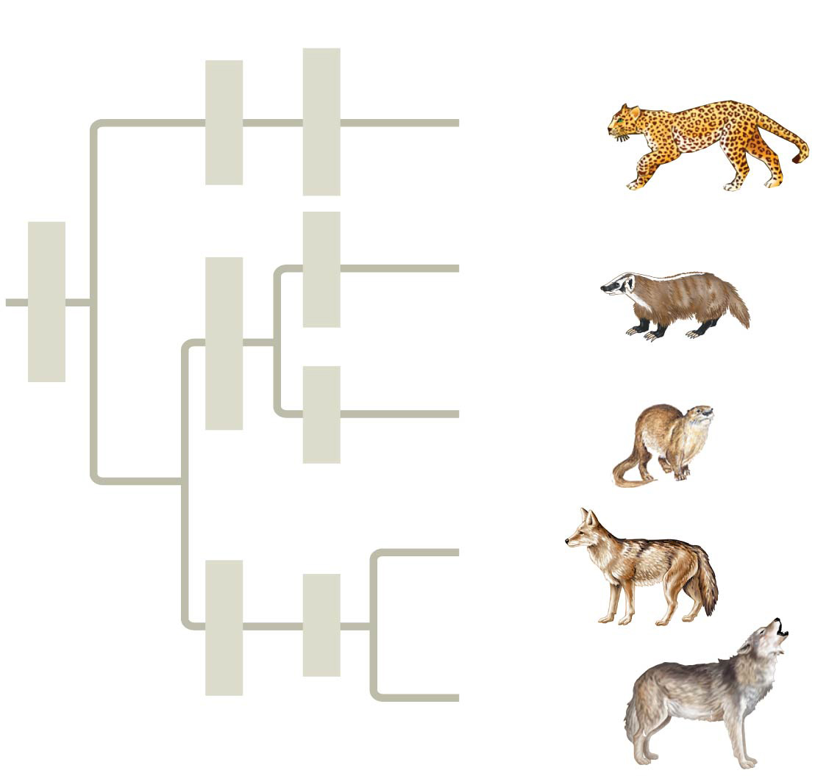
Linking Classification with Phylogeny
Order
Family
Genus
Species
Felidae
Panthera
Panthera
pardus
(leopard)
Taxidea
Taxidea
taxus
(American
badger)
Carnivora
Mustelidae
Lutra
Lutra lutra
(European
otter)
1
Canis
latrans
(coyote)
Canidae
Canis
2
Canis
lupus
(gray wolf)
Notes:
Figure 26.4 The connection between classification and phylogeny

Slide 11
Concept 26.1: Phylogenies show evolutionary relationships – Be Careful!
What We Can and Cannot Learn from Phylogenetic Trees
Phylogenetic trees show patterns of descent, NOT phenotypic similarity
Phylogenetic trees DO NOT indicate when species evolved or how much change occurred in a lineage
It should NOT be assumed that a taxon evolved from the taxon next to it

Slide 12
Overview
Concept 26.1: Phylogenies show evolutionary relationships
Concept 26.2: Phylogenies are inferred from morphological and molecular data
Concept 26.3: Shared characters are used to construct phylogenetic trees
Concept 26.4: An organism’s evolutionary history is documented in its genome
Concept 26.6: Our understanding of the tree of life continues to change based on new data

Slide 13
Concept 26.2: Phylogenies are inferred from morphological and molecular data
To infer phylogenies (make evolutionary hypotheses), systematists gather information about morphologies, genes, and biochemistry of living organisms
Phenotypic and genetic similarities due to shared ancestry are called homologies
Organisms with similar morphologies or DNA sequences are likely to be MORE closely related than organisms with different structures or sequences

Slide 14
Concept 26.2: Phylogenies are inferred from morphological and molecular data
When constructing a phylogeny, systematists need to distinguish whether a similarity is the result of homology or analogy
Homology = similarity due to shared ancestry
Analogy = similarity due to convergent evolution
Similar environmental pressures and natural selection produce similar (analogous) adaptations in organisms from DIFFERENT evolutionary lineages (NOT useful for phylogenies!)

Slide 15
Concept 26.2: Phylogenies are inferred from morphological and molecular data
Homology can be distinguished from analogy by comparing fossil evidence and the degree of complexity
The more elements that are similar in two complex structures, the more likely it is that they are homologous
The best hypotheses for phylogenetic trees fit the most homologous data (morphological, molecular, and fossil)

Slide 16
Concept 26.2: Phylogenies are inferred from morphological and molecular data
It is important to distinguish homology from analogy in molecular similarities
Systematists use computer programs and mathematical tools when analyzing comparable DNA segments from different organisms
Mathematical tools help to identify molecular homoplasies, or coincidences due to analogy/convergent evolution
So if these are bad…what exactly do you use to make phylogenies?

Slide 17
Overview
Concept 26.1: Phylogenies show evolutionary relationships
Concept 26.2: Phylogenies are inferred from morphological and molecular data
Concept 26.3: Shared characters are used to construct phylogenetic trees
Concept 26.4: An organism’s evolutionary history is documented in its genome
Concept 26.6: Our understanding of the tree of life continues to change based on new data

Slide 18
Concept 26.3: Shared characters are used to construct phylogenetic trees
Once homologous characters have been identified, they can be used to infer a phylogeny
Cladistics groups organisms by common descent
Clade = group of species that includes a common ancestral species and ALL its descendants
#goalz of (good) phylogenetic trees!

Slide 19
Concept 26.3: Shared characters are used to construct phylogenetic trees – Clades
A valid clade is monophyletic = consists of the common ancestor species and ALL its descendants (it’s awesome)
Paraphyletic clade = consists of an ancestral species and some, BUT NOT ALL, of the descendants (it’s ehhh)
Polyphyletic clade = includes distantly related species but does NOT include their most recent CA (it’s baaad)

Slide 20
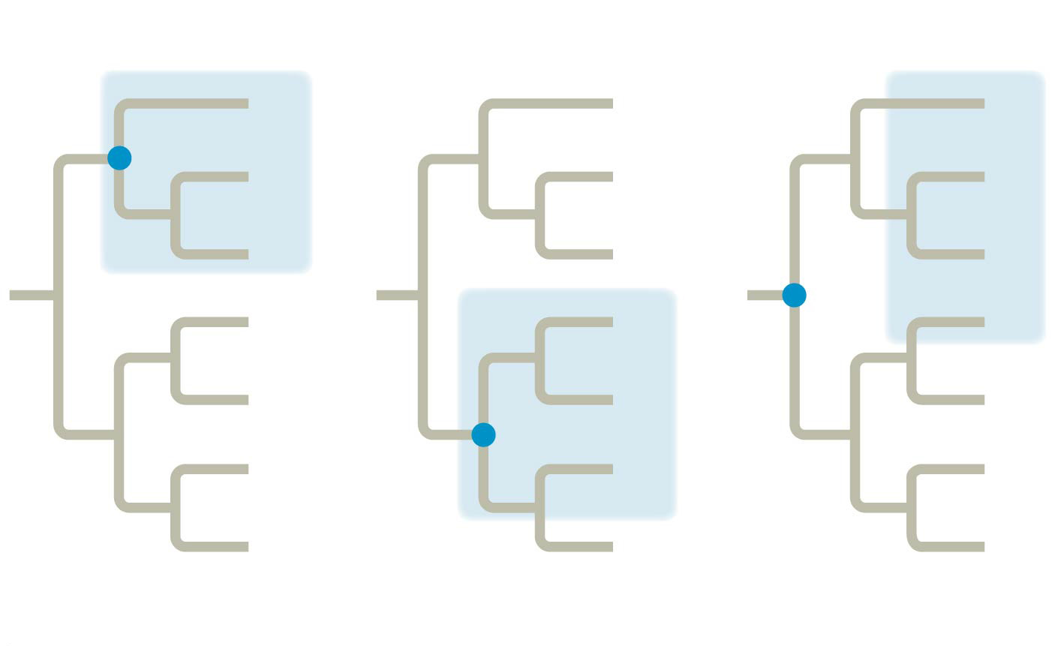
Monophyletic group
Polyphyletic group
A
A
A
B
B
B
C
C
C
D
D
D
E
E
E
F
F
F
G
G
G
Paraphyletic group
Notes:
Figure 26.UN04 Summary of key concepts: shared derived characters

Slide 21
Monophyletic group
Polyphyletic group
A
A
A
B
B
B
C
C
C
D
D
D
E
E
E
F
F
F
G
G
G
Paraphyletic group
Notes:
Figure 26.UN04 Summary of key concepts: shared derived characters

Slide 22
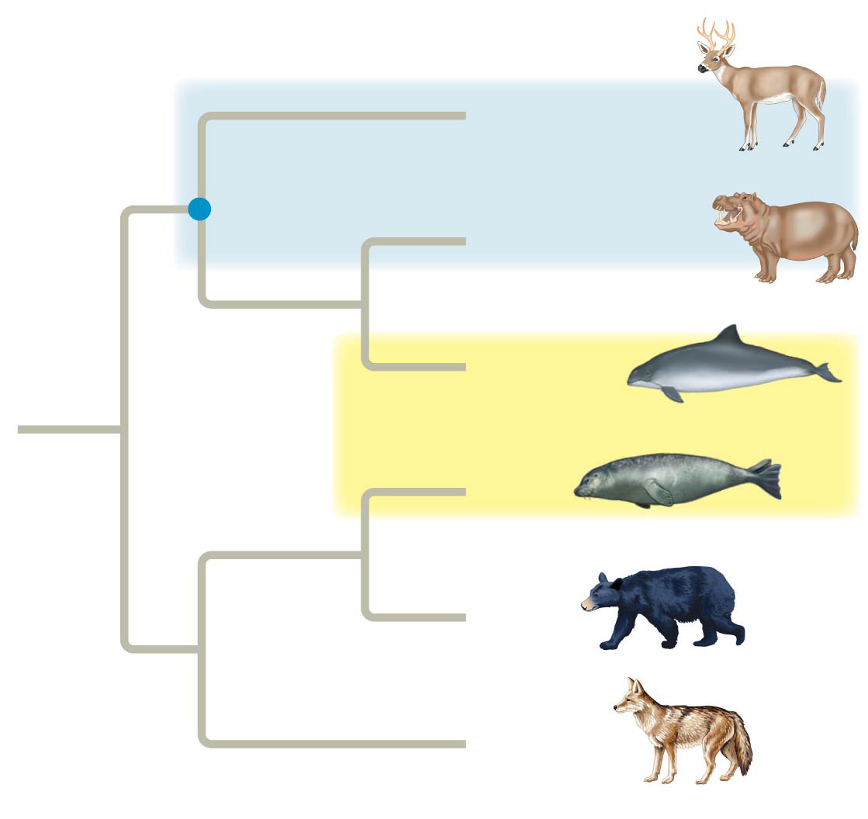
Figure 26.11
Paraphyletic group
Common
ancestor of
even-toed
ungulates
Other even-toed
ungulates
Hippopotamuses
Cetaceans
*triggered*
Seals
Bears
Other
carnivores
Polyphyletic group
Notes:
Figure 26.11 Examples of a paraphyletic and a polyphyletic group

Slide 23
Concept 26.3: Shared characters are used to construct phylogenetic trees – Characters
Phylogenies are based on shared characters
A shared ancestral character is a character that originated in an ancestor of the taxon
Ex: Lungs → in reptiles, amphibians, and mammals
A shared derived character is an evolutionary novelty unique to a particular clade
Ex: Hair/fur → only in mammals
Further explained on last slide

Slide 24
Overview
Concept 26.1: Phylogenies show evolutionary relationships
Concept 26.2: Phylogenies are inferred from morphological and molecular data
Concept 26.3: Shared characters are used to construct phylogenetic trees
Concept 26.4: An organism’s evolutionary history is documented in its genome
Concept 26.6: Our understanding of the tree of life continues to change based on new data

Slide 25
Concept 26.4: An organism’s evolutionary history is documented in its genome
Comparing nucleic acids or other molecules to infer relatedness is a valuable approach for tracing organisms’ phylogeny (evolutionary history)
DNA that codes for rRNA changes relatively slowly and is useful for investigating branching points hundreds of millions of years ago
Mitochondrial DNA (mtDNA) evolves rapidly and can be used to explore RECENT evolutionary events

Slide 26
Concept 26.4: An organism’s evolutionary history is documented in its genome
Gene number and the complexity of an organism are NOT strongly linked…not a good data point for phylogenetics
Ex: humans have just as many genes as a nematode
Genes in complex organisms appear to be very versatile, and each gene can encode multiple proteins that perform many different functions

Slide 27
Overview
Concept 26.1: Phylogenies show evolutionary relationships
Concept 26.2: Phylogenies are inferred from morphological and molecular data
Concept 26.3: Shared characters are used to construct phylogenetic trees
Concept 26.4: An organism’s evolutionary history is documented in its genome
Concept 26.6: Our understanding of the tree of life continues to change based on new data

Slide 28
Concept 26.6: Our understanding of the tree of life continues to CHANGE based on new data
We have gained further insight on branches of the tree of life through molecular systematics
Early taxonomists classified all species as either plants or animals → Later, five kingdoms were recognized: Monera (prokaryotes), Protista, Plantae, Fungi, and Animalia
More recently, the three-domain system has been adopted and supported by data from many sequenced genomes: Bacteria, Archaea, and Eukarya
Overall, it’s important to recognize phylogenies as DYNAMIC (ever-changing based on new data)

Slide 29
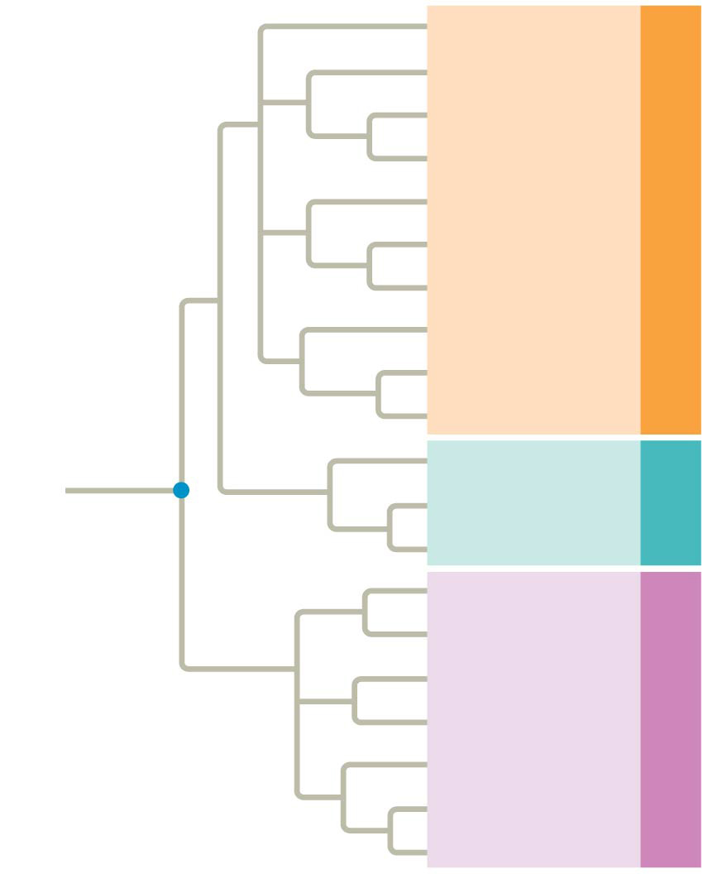
Figure 26.21
Cell
division
error
Euglenozoans
Forams
Diatoms
Ciliates
Red algae
Green algae
Domain Eukarya
Land plants
Amoebas
Fungi
Animals
Nanoarchaeotes
Methanogens
Domain
Archaea
COMMON
ANCESTOR
OF ALL LIFE
Thermophiles
Proteobacteria
(Mitochondria)*
Next lecture!
Chlamydias
Spirochetes
Domain Bacteria
Gram-positive
bacteria
Cyanobacteria
(Chloroplasts)*
Notes:
Figure 26.21 The three domains of life

Slide 30
Summary
Phylogenetic trees and cladograms are graphical representations (models) of evolutionary history that can be tested.
Phylogenetic trees and cladograms can represent traits that are either derived or lost due to evolution.
Phylogenetic trees and cladograms illustrate speciation that has occurred, in that relatedness of any two groups on the tree is shown by how recently two groups had a common ancestor.

Slide 31
Summary
Phylogenetic trees and cladograms can be constructed from morphological similarities of living or fossil species, and from DNA and protein sequence similarities, by employing computer programs that have sophisticated ways of measuring and representing relatedness among organisms.
Phylogenetic trees and cladograms are dynamic (phylogenetic trees and cladograms are constantly being revised), based on the biological data used, new mathematical and computational ideas, and current and emerging knowledge.

Slide 32
Overview
Concept 26.1: Phylogenies show evolutionary relationships
Concept 26.2: Phylogenies are inferred from morphological and molecular data
Concept 26.3: Shared characters are used to construct phylogenetic trees
Concept 26.4: An organism’s evolutionary history is documented in its genome
Concept 26.6: Our understanding of the tree of life continues to change based on new data

Slide 33
Concept 26.3: Shared characters are used to construct phylogenetic trees
In comparison with its ancestor, an organism has both shared and different characteristics
A shared ancestral character is a character that originated in an ancestor of the taxon
Ex: Lungs → in reptiles, amphibians, and mammals
A shared derived character is an evolutionary novelty unique to a particular clade
Ex: Hair/fur → only in mammals

Slide 34
Phylogenetic Tree of Life
https://upload.wikimedia.org/wikipedia/commons/1/11/Tree_of_life_SVG.svg
Find Homo sapiens…you won’t.
WATCH:
https://www.youtube.com/watch?v=6_XMKmFQ_w8
https://www.youtube.com/watch?v=F38BmgPcZ_I
https://www.youtube.com/watch?v=fQwI90bkJl4

