Slide 1
23
The Evolution of Populations

Slide 2
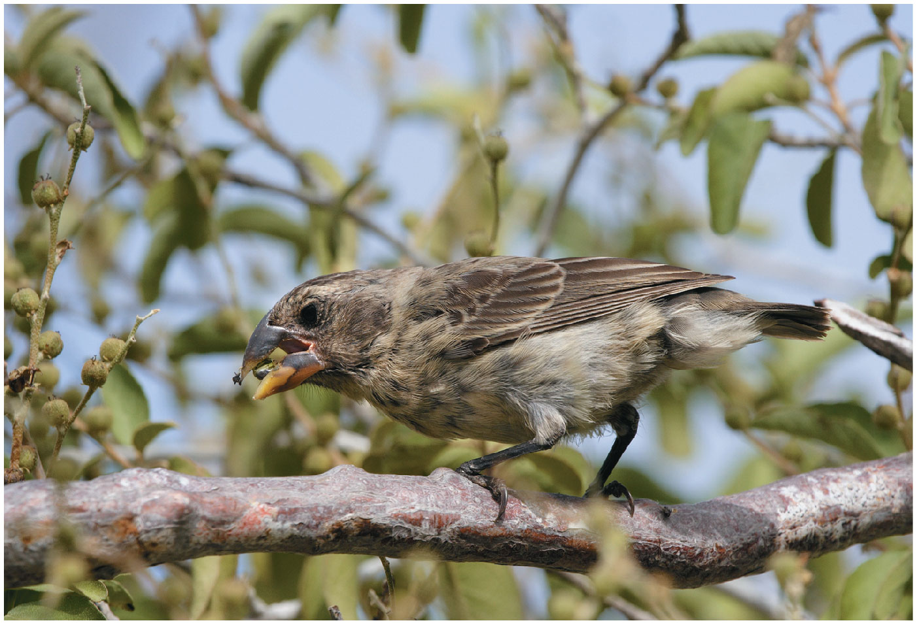
Is this finch evolving?
Notes:
Figure 21.1 Is this finch evolving?

Slide 3
Microevolution = The Smallest Unit of Evolution
A common misconception is that organisms (aka individuals) evolve during their lifetimes (NO!)
Natural selection “acts” on individuals, but ONLY populations evolve
Microevolution: change in allele frequencies in a population over generations (change over time)

Slide 4
Overview
Concept 23.1: Genetic variation makes evolution possible
Concept 23.2: The Hardy-Weinberg equation can be used to test whether a population is evolving
Concept 23.3: Natural selection, genetic drift, and gene flow can alter allele frequencies in a population
Concept 23.4: Natural selection is the only mechanism that consistently causes adaptive evolution

Slide 5
Overview
Concept 23.1: Genetic variation makes evolution possible
Concept 23.2: The Hardy-Weinberg equation can be used to test whether a population is evolving
Concept 23.3: Natural selection, genetic drift, and gene flow can alter allele frequencies in a population
Concept 23.4: Natural selection is the only mechanism that consistently causes adaptive evolution

Slide 6
Concept 23.1: Genetic variation makes evolution possible
Variation in HERITABLE traits is a prerequisite for evolution…without variation, there is no evolution
  Individuals/organisms within a population MUST be different from one another in some way/shape/form
  These differences MUST be heritable
Mendel’s work on pea plants provided evidence of discrete heritable units (genes)

Slide 7
Concept 23.1: Genetic variation makes evolution possible
Genetic variation among individuals is ultimately caused by DIFFERENCES in genes or other DNA segments
Phenotype = inherited genotype + environmental influences (NATURE + NURTURE)
  However, natural selection can ONLY act on phenotypic variation with a genotypic component
  Therefore, only genetically determined variation can have evolutionary consequences

Slide 8
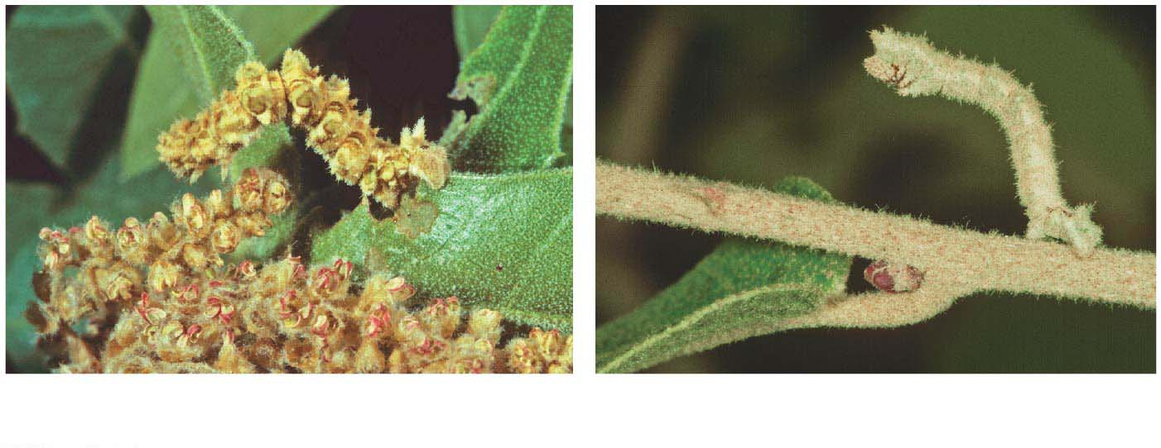
Can natural selection act on this kind of variation?
(a)
(b)
(a) Caterpillars raised on a diet of
oak flowers
(b) Caterpillars raised on a diet of
oak leaves
Notes:
Figure 21.5 Nonheritable variation

Slide 9
Concept 23.1: Genetic variation makes evolution possible – Sources of Variation
New genes and alleles can arise by genetic mutations → formation of new alleles → the “start” of evolution
Mutation: RANDOM CHANGE in nucleotide sequence of DNA (aka genetic variation)
  Only mutations in cells that produce gametes can be passed to offspring and thus, acted upon by evolution (HERITABLE genetic variation)
  Mutations in somatic cells are NOT passed to offspring and thus, are NOT acted upon by evolution (NON-heritable variation)

Slide 10
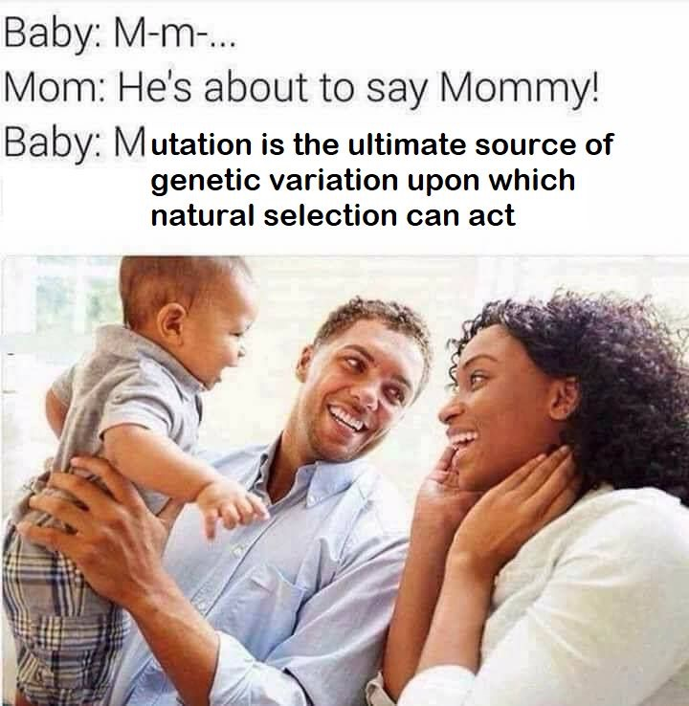

Slide 11
Concept 23.1: Genetic variation makes evolution possible – Sources of Variation
Sexual reproduction can shuffle existing alleles into new combinations via genetic recombination
  Gamete formation → meiosis → meiosis I → prophase I → synapsis/crossing over/recombination between non-sister chromatids of tetrad
Random fertilization of random egg + random sperm
In sexually-reproducing organisms…
  Recombination of alleles + mutation produce the heritable genetic differences/variation that make adaptation, and thus evolution, possible

Slide 12
Overview
Concept 23.1: Genetic variation makes evolution possible
Concept 23.2: The Hardy-Weinberg equation can be used to test whether a population is evolving
Concept 23.3: Natural selection, genetic drift, and gene flow can alter allele frequencies in a population
Concept 23.4: Natural selection is the only mechanism that consistently causes adaptive evolution

Slide 13
Concept 23.2: The Hardy-Weinberg equation can be used to test whether a population is evolving
The first step in testing whether evolution is occurring in a population is to clarify what we mean by a “population”
  Population: localized group of individuals capable of interbreeding and producing fertile offspring

Slide 14
Concept 23.2: The Hardy-Weinberg equation can be used to test whether a population is evolving
A gene pool consists of ALL the alleles for ALL loci in a population
A locus is “fixed” if ALL individuals in a population are homozygous for the same allele
If there are two or more alleles for a locus, diploid individuals may be EITHER homozygous or heterozygous

Slide 15
Concept 23.2: The HW equation can be used to test whether a population is evolving
The frequency of an allele in a population can be calculated…for diploid (2n) organisms:
  Total # alleles at locus = (total number of individuals x 2)
    Total # dominant alleles at locus = (2 alleles for each homozygous dominant individual + 1 allele for each heterozygous individual)
    Total # recessive alleles at locus = (2 alleles for each homozygous recessive individual + 1 allele for each heterozygous individual)

Slide 16
Concept 23.2: The HW equation can be used to test whether a population is evolving
By convention, if there are two alleles (dominant and recessive) at a locus, p and q are used to represent their frequencies
  p typically represents the dominant allele
  q typically represents the recessive allele
The frequency of ALL alleles in a population adds up to 1…therefore, p + q = 1
  p + q = 1 → allele frequency equation

Slide 17
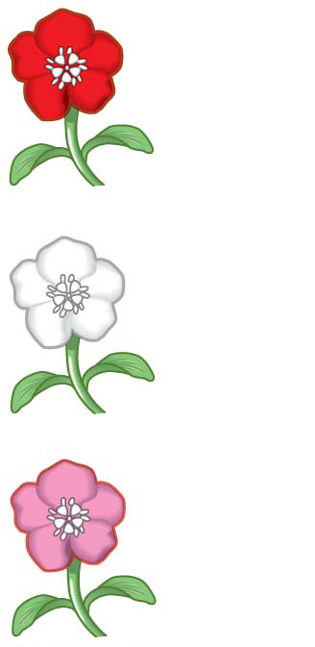
Figure 23.UN01
C^{R} C^{R}
C^{W} C^{W}
C^{R} C^{W}
Notes:
Figure 23.UN01 In-text figure, incomplete dominance, p 484

Slide 18
Concept 23.2: The HW equation can be used to test whether a population is evolving
Ex: Consider a population of wildflowers
  320 red flowers (C^{R}C^{R})
  160 pink flowers (C^{R}C^{W})
  20 white flowers (C^{W}C^{W})
To calculate the number of copies of each allele:
  C^{R} = (320 × 2) + 160 = 800 dominant C^{R} alleles in the gene pool
  C^{W} = (20 × 2) + 160 = 200 recessive C^{W} alleles in the gene pool

Slide 19
Concept 23.2: The HW equation can be used to test whether a population is evolving
To calculate allelic frequencies (AFs):
  p = freq C^{R} = 800 / (800 + 200) = 0.8 = 80% of gene pool is C^{R}
  q = freq C^{W} = 200 / (800 + 200) = 0.2 = 20% of gene pool is C^{W}
  Note that allele frequencies are always decimals/percentages
The sum of alleles is always 1 because p + q = 1
  0.8 + 0.2 = 1

Slide 20
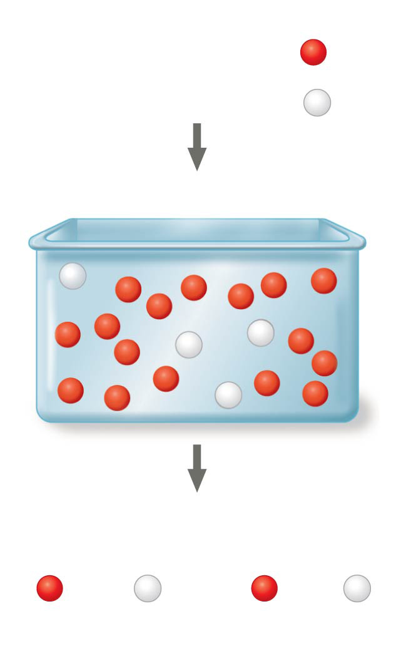
Figure 23.7
Frequencies of alleles
p = frequency of C^{R} allele = 0.8
q = frequency of C^{W} allele = 0.2
Alleles in the population
Gametes produced
Each egg:
Each sperm:
80%
chance
20%
chance
80%
chance
20%
chance
Notes:
Figure 23.7 Selecting alleles at random from a gene pool

Slide 21
Concept 23.2: The HW equation can be used to test whether a population is evolving
To calculate genotypic frequencies (GFs):
  Use (p + q = 1)² → p² + 2pq + q² = 1 because genotypes are always DIPLOID (ex: C^{R}C^{R})
    p² = homozygous dominant genotypic frequency = % of individuals in population who are homozygous dominant
    q² = homozygous recessive genotypic frequency = % of individuals in population who are homozygous recessive
    2pq = heterozygous genotypic frequency = % of individuals in population who are heterozygous

Slide 22
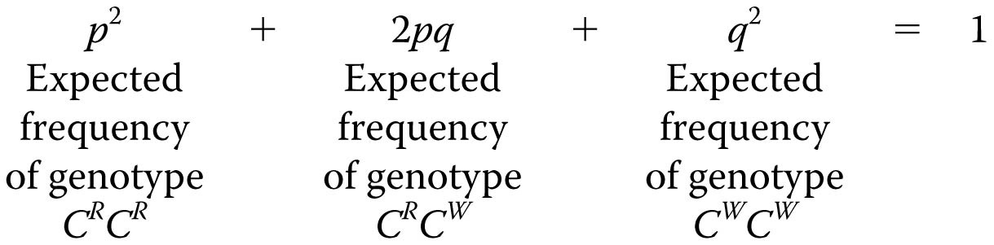
Figure 23.UN02
Notes:
Figure 23.UN02 In-text figure, Hardy-Weinberg equation, p. 486

Slide 23
Concept 23.2: The HW equation can be used to test whether a population is evolving
From the flower color example, the genotypic frequencies can be calculated:
  C^{R}C^{R} = p² = (0.8)² = 0.64
  C^{R}C^{W} = 2pq = 2(0.8)(0.2) = 0.32
  C^{W}C^{W} = q² = (0.2)² = 0.04
The frequency of genotypes can be confirmed using a Punnett square

Slide 24
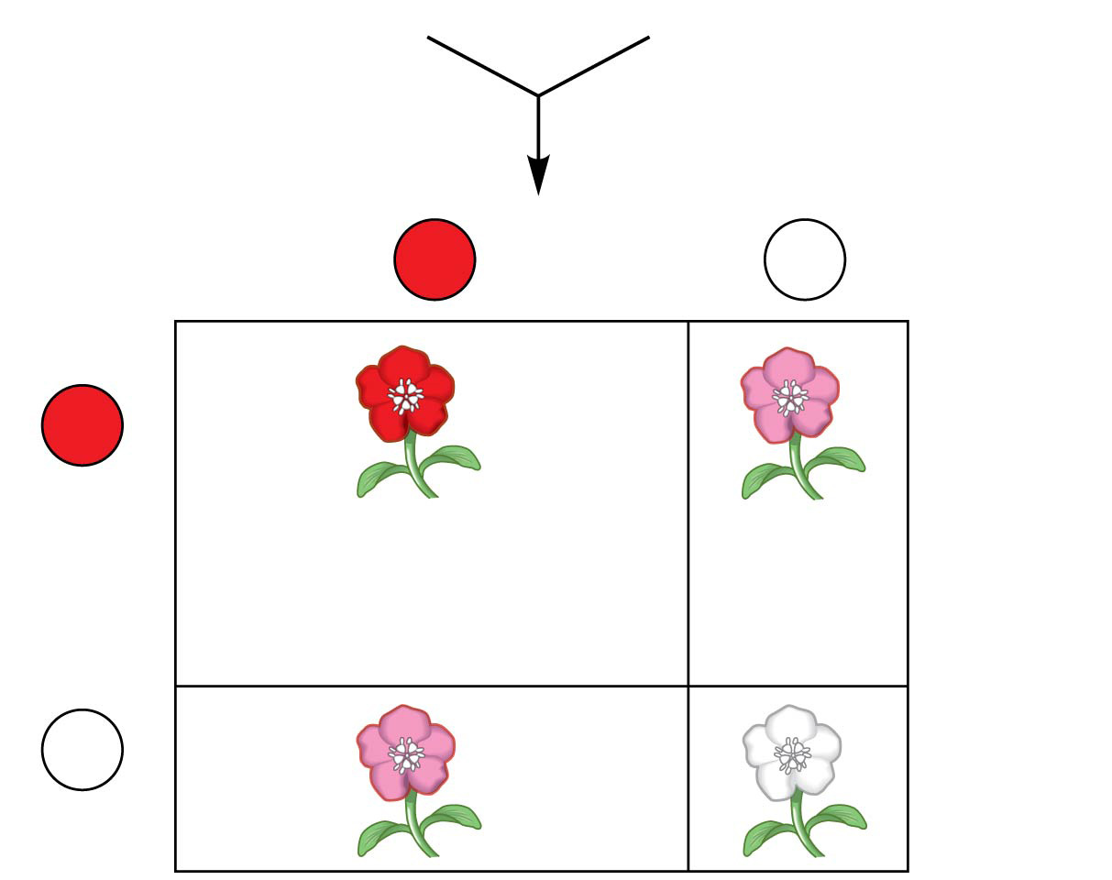
Figure 23.8a
80% C^{R} (p = 0.8)
20% C^{W} (q = 0.2)
Sperm
C^{R}
p = 0.8
C^{W}
q = 0.2
C^{R}
p = 0.8
0.64 (p²)
C^{R}C^{R}
0.16 (pq)
C^{R}C^{W}
Eggs
C^{W}
0.16 (qp)
C^{R}C^{W}
0.04 (q²)
C^{W}C^{W}
q = 0.2
Notes:
Figure 23.8a The Hardy-Weinberg principle (part 1: Punnett square)

Slide 25
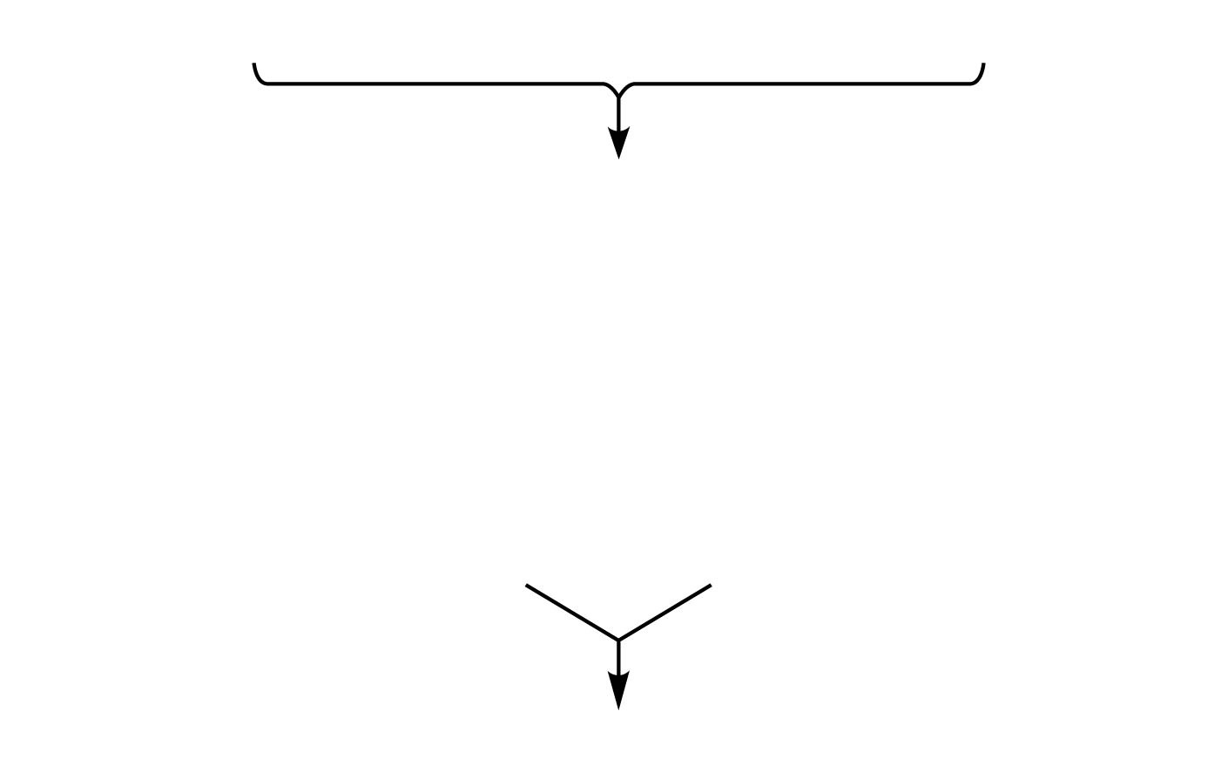
Figure 23.8b
64% C^{R}C^{R}, 32% C^{R}C^{W}, and 4% C^{W}C^{W}
Gametes of this generation:
64% C^{R}
(from C^{R}C^{R} plants)
+
16% C^{R}
(from C^{R}C^{W} plants)
= 80% C^{R} = 0.8 = p
4% C^{W}
(from C^{W}C^{W} plants)
+
16% C^{W}
(from C^{R}C^{W} plants)
= 20% C^{W} = 0.2 = q
With random mating, these gametes will result in the same
mix of genotypes in the next generation:
64% C^{R}C^{R}, 32% C^{R}C^{W}, and 4% C^{W}C^{W} plants
Notes:
Figure 23.8b The Hardy-Weinberg principle (part 2: equations)

Slide 26
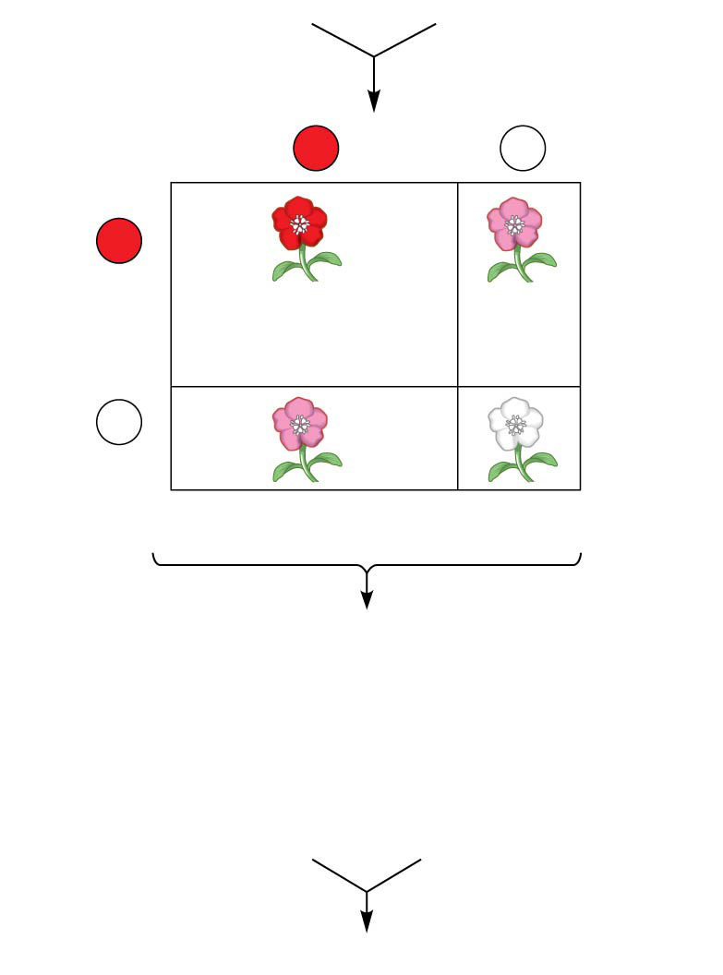
Figure 23.8
80% C^{R} (p = 0.8)
20% C^{W} (q = 0.2)
Sperm
C^{R}
p = 0.8
C^{W}
q = 0.2
C^{R}
p = 0.8
0.64 (p²)
C^{R}C^{R}
0.16 (pq)
C^{R}C^{W}
Eggs
C^{W}
0.16 (qp)
C^{R}C^{W}
0.04 (q²)
C^{W}C^{W}
q = 0.2
64% C^{R}C^{R}, 32% C^{R}C^{W}, and 4% C^{W}C^{W}
Gametes of this generation:
64% C^{R}
(from C^{R}C^{R} plants)
+
16% C^{R}
(from C^{R}C^{W} plants)
= 80% C^{R} = 0.8 = p
4% C^{W}
(from C^{W}C^{W} plants)
+
16% C^{W}
(from C^{R}C^{W} plants)
= 20% C^{W} = 0.2 = q
With random mating, these gametes will result in the same
mix of genotypes in the next generation:
64% C^{R}C^{R}, 32% C^{R}C^{W}, and 4% C^{W}C^{W} plants
Notes:
Figure 23.8 The Hardy-Weinberg principle

Slide 27
Concept 23.2: The HW equation can be used to test whether a population is evolving
The 5 conditions for non-evolving populations within HW equilibrium are:
  No mutations
  Random mating
  No natural selection
  Extremely large population size
  No gene flow
These are rarely met in nature!!!

Slide 28
Concept 23.2: The HW equation can be used to test whether a population is evolving
Conditions for Hardy-Weinberg Equilibrium
The Hardy-Weinberg equation describes the genetic makeup we expect for a population that is NOT evolving at a particular locus
Thus, the Hardy-Weinberg theorem describes a HYPOTHETICAL population that is NOT EVOLVING
  In real populations, allele and genotype frequencies change over time…aka populations evolve
So you’re prob wondering…why am I learning about something so hypothetical?

Slide 29
Concept 23.2: The HW equation can be used to test whether a population is evolving
The HW equation can be used to TEST whether a population is evolving
If the observed genetic makeup of the population differs from expectations under Hardy-Weinberg (non-evolving expectations), it suggests that the population may be evolving
HWE = diagnostic tool!

Slide 30
Overview
Concept 23.1: Genetic variation makes evolution possible
Concept 23.2: The Hardy-Weinberg equation can be used to test whether a population is evolving
Concept 23.3: Natural selection, genetic drift, and gene flow can alter allele frequencies in a population
Concept 23.4: Natural selection is the only mechanism that consistently causes adaptive evolution

Slide 31
Concept 23.3: Natural selection, genetic drift, and gene flow can alter allele frequencies in a population
Three major factors alter allele frequencies and bring about evolutionary change
  Natural selection (adaptive evolution)
  Genetic drift
  Gene flow

Slide 32
Concept 23.3: Natural selection can alter allele frequencies in a population
Differential reproductive success (aka fitness winners and fitness losers) results in certain alleles being passed to the next generation in greater proportions (variation)
Natural selection can cause adaptive evolution, an improvement in the match between organisms and their environment
  Ex: Allele that confers resistance to DDT pesticide in fruit flies INCREASED in frequency after DDT pesticide began to widely be used in agriculture

Slide 33
Concept 23.3: Genetic drift can alter allele frequencies in a population
Genetic drift describes how allele frequencies fluctuate unpredictably from one generation to the next
Genetic drift = stochastically driven = randomly driven
Genetic drift tends to REDUCE genetic variation through LOSSES of alleles
The smaller the population size, the greater the effect of genetic drift

Slide 34

Figure 23.9–1
C^{R}C^{R}
C^{R}C^{R}
C^{R}C^{W}
C^{R}C^{R}
C^{R}C^{R}
C^{W}C^{W}
C^{R}C^{W}
C^{R}C^{W}
C^{R}C^{R}
C^{R}C^{W}
Generation 1
p (frequency of C^{R}) = 0.7
q (frequency of C^{W}) = 0.3
Notes:
Figure 23.9-1 Genetic drift (step 1)

Slide 35
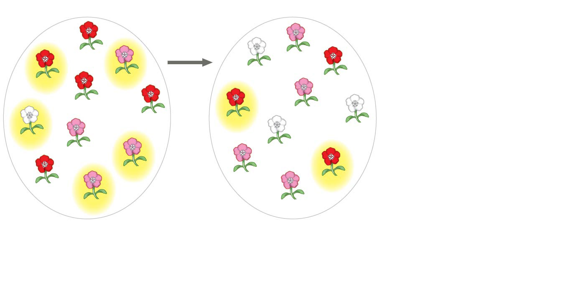
Figure 23.9–2
5 plants
leave
offspring
C^{R}C^{R}
C^{R}C^{W}
C^{R}C^{W}
C^{W}C^{W}
C^{R}C^{R}
C^{R}C^{R}
C^{R}C^{R}
C^{R}C^{W}
C^{R}C^{R}
C^{R}C^{R}
C^{W}C^{W}
C^{W}C^{W}
C^{W}C^{W}
C^{R}C^{W}
C^{R}C^{W}
C^{R}C^{W}
C^{R}C^{R}
C^{R}C^{R}
C^{R}C^{W}
C^{R}C^{W}
Generation 1
p (frequency of C^{R}) = 0.7
q (frequency of C^{W}) = 0.3
Generation 2
p = 0.5
q = 0.5
Notes:
Figure 23.9-2 Genetic drift (step 2)

Slide 36
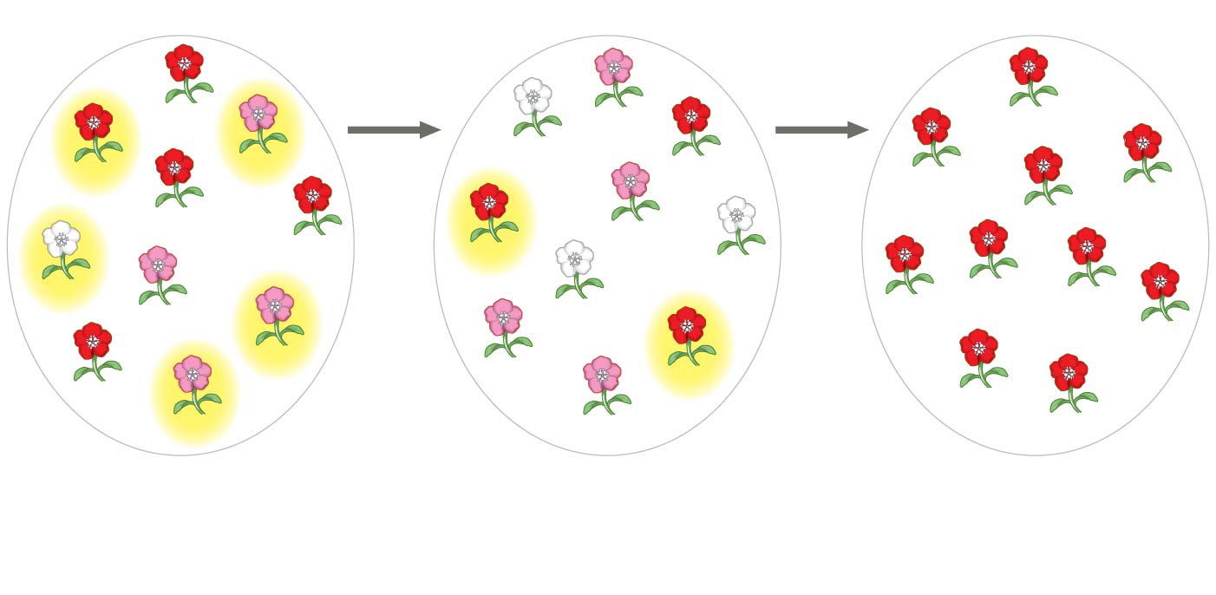
Figure 23.9–3
5 plants
leave
offspring
2 plants
leave
offspring
C^{R}C^{R}
C^{R}C^{W}
C^{R}C^{R}
C^{R}C^{W}
C^{W}C^{W}
C^{R}C^{R}
C^{R}C^{R}
C^{R}C^{R}
C^{R}C^{R}
C^{R}C^{R}
C^{R}C^{W}
C^{R}C^{R}
C^{R}C^{R}
C^{R}C^{R}
C^{W}C^{W}
C^{W}C^{W}
C^{W}C^{W}
C^{R}C^{R}
C^{R}C^{R}
C^{R}C^{R}
C^{R}C^{W}
C^{R}C^{R}
C^{R}C^{W}
C^{R}C^{W}
C^{R}C^{R}
C^{R}C^{R}
C^{R}C^{R}
C^{R}C^{W}
C^{R}C^{W}
C^{R}C^{R}
Generation 1
p (frequency of C^{R}) = 0.7
q (frequency of C^{W}) = 0.3
Generation 2
p = 0.5
q = 0.5
Generation 3
p = 1.0
q = 0.0
Reduced variation through the loss of q allele via genetic drift
Notes:
Figure 23.9-3 Genetic drift (step 3)

Slide 37
Concept 23.3: Genetic drift can alter allele frequencies in a population
Genetic drift describes how allele frequencies fluctuate unpredictably from one generation to the next…there are two types:
  Founder effect
  Bottleneck effect

Slide 38
Concept 23.3: Genetic drift can alter allele frequencies in a population – Founder Effect
The founder effect occurs when a few individuals become ISOLATED from a larger population
Allele frequencies in the small “founder” population can be quite different from those in the larger parent population

Slide 39
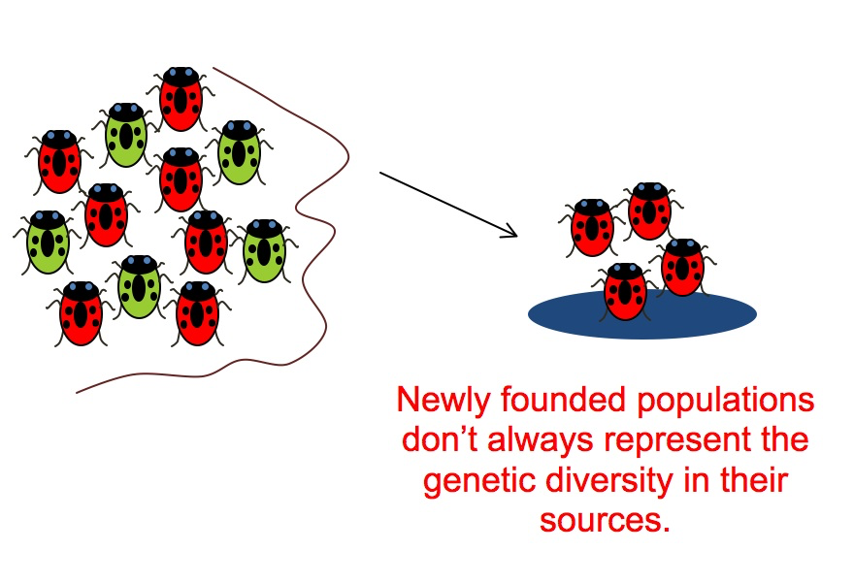
Concept 23.3: Genetic drift can alter allele frequencies in a population – Founder Effect

Slide 40
Concept 23.3: Genetic drift can alter allele frequencies in a population – Bottleneck Effect
The bottleneck effect is a sudden REDUCTION in population size due to a random change in the environment (ex: tornado)
The resulting gene pool may no longer be reflective of the original population’s gene pool
If the population remains small, it may be further affected by genetic drift

Slide 41
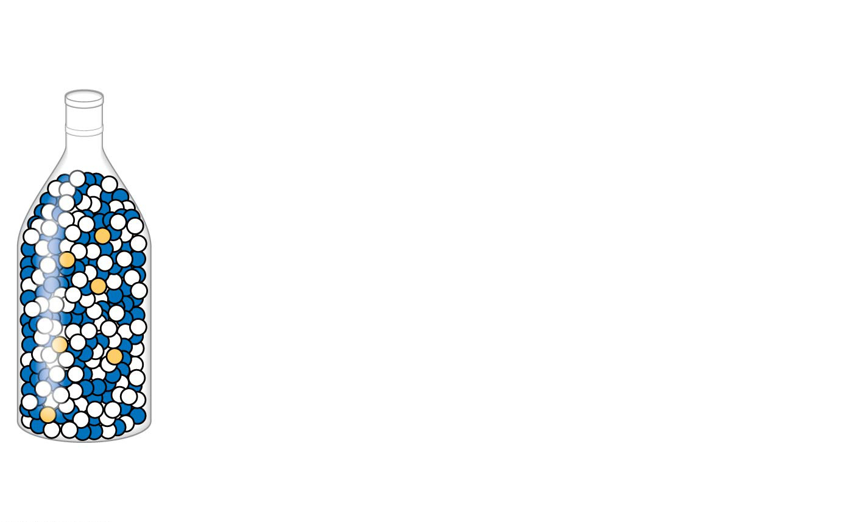
Figure 23.10–1
Original
population
Notes:
Figure 23.10-1 The bottleneck effect (step 1)

Slide 42
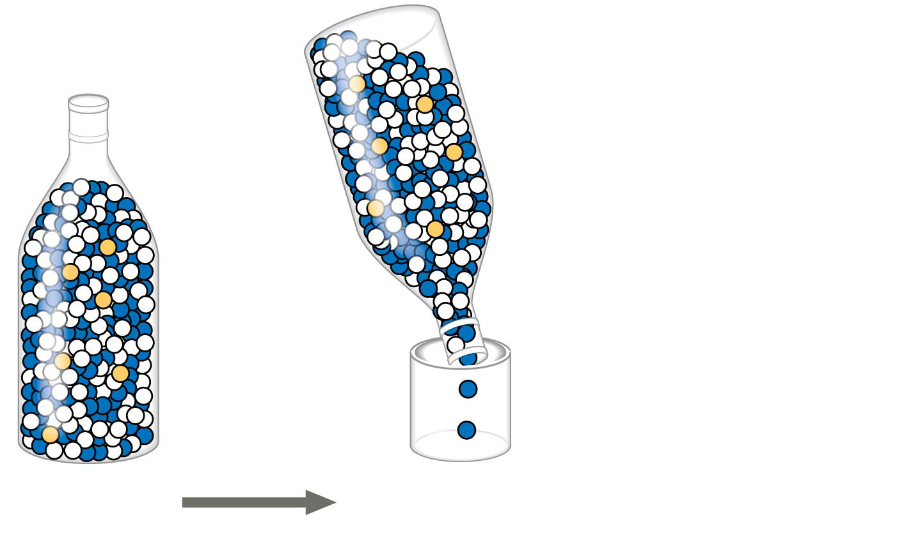
Figure 23.10–2
Original
population
Bottlenecking
event
Notes:
Figure 23.10-2 The bottleneck effect (step 2)

Slide 43
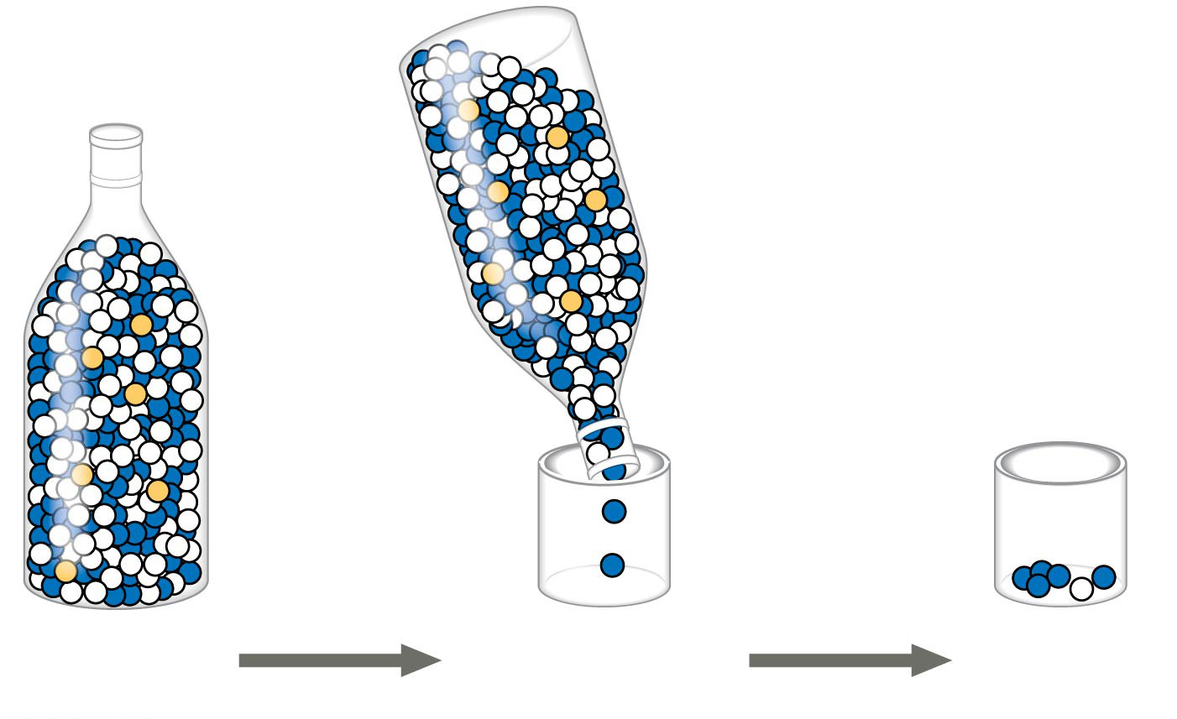
Figure 23.10–3
Original
population
Bottlenecking
event
Surviving
population
Quite different
Notes:
Figure 23.10-3 The bottleneck effect (step 3)

Slide 44
Concept 23.3: Genetic drift can alter allele frequencies in a population – Summary
Genetic drift is significant in small populations
Genetic drift can cause allele frequencies to change at random
Genetic drift can lead to a loss of genetic variation within populations
Genetic drift can cause harmful alleles to become fixed

Slide 45
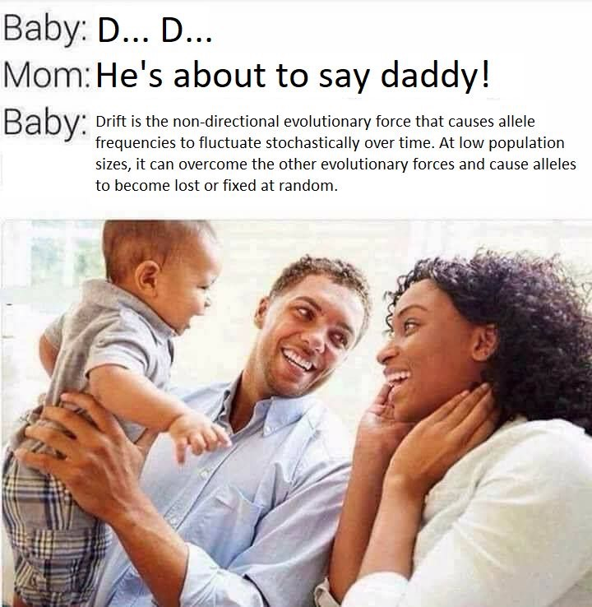

Slide 46
Concept 23.3: Gene flow can alter allele frequencies in a population
Gene flow consists of the movement of alleles between populations
Alleles can be transferred through the movement of fertile individuals or gametes
  Ex: pollen that travels hundreds of miles to a new population
Gene flow tends to REDUCE variation between two otherwise isolated populations over time

Slide 47
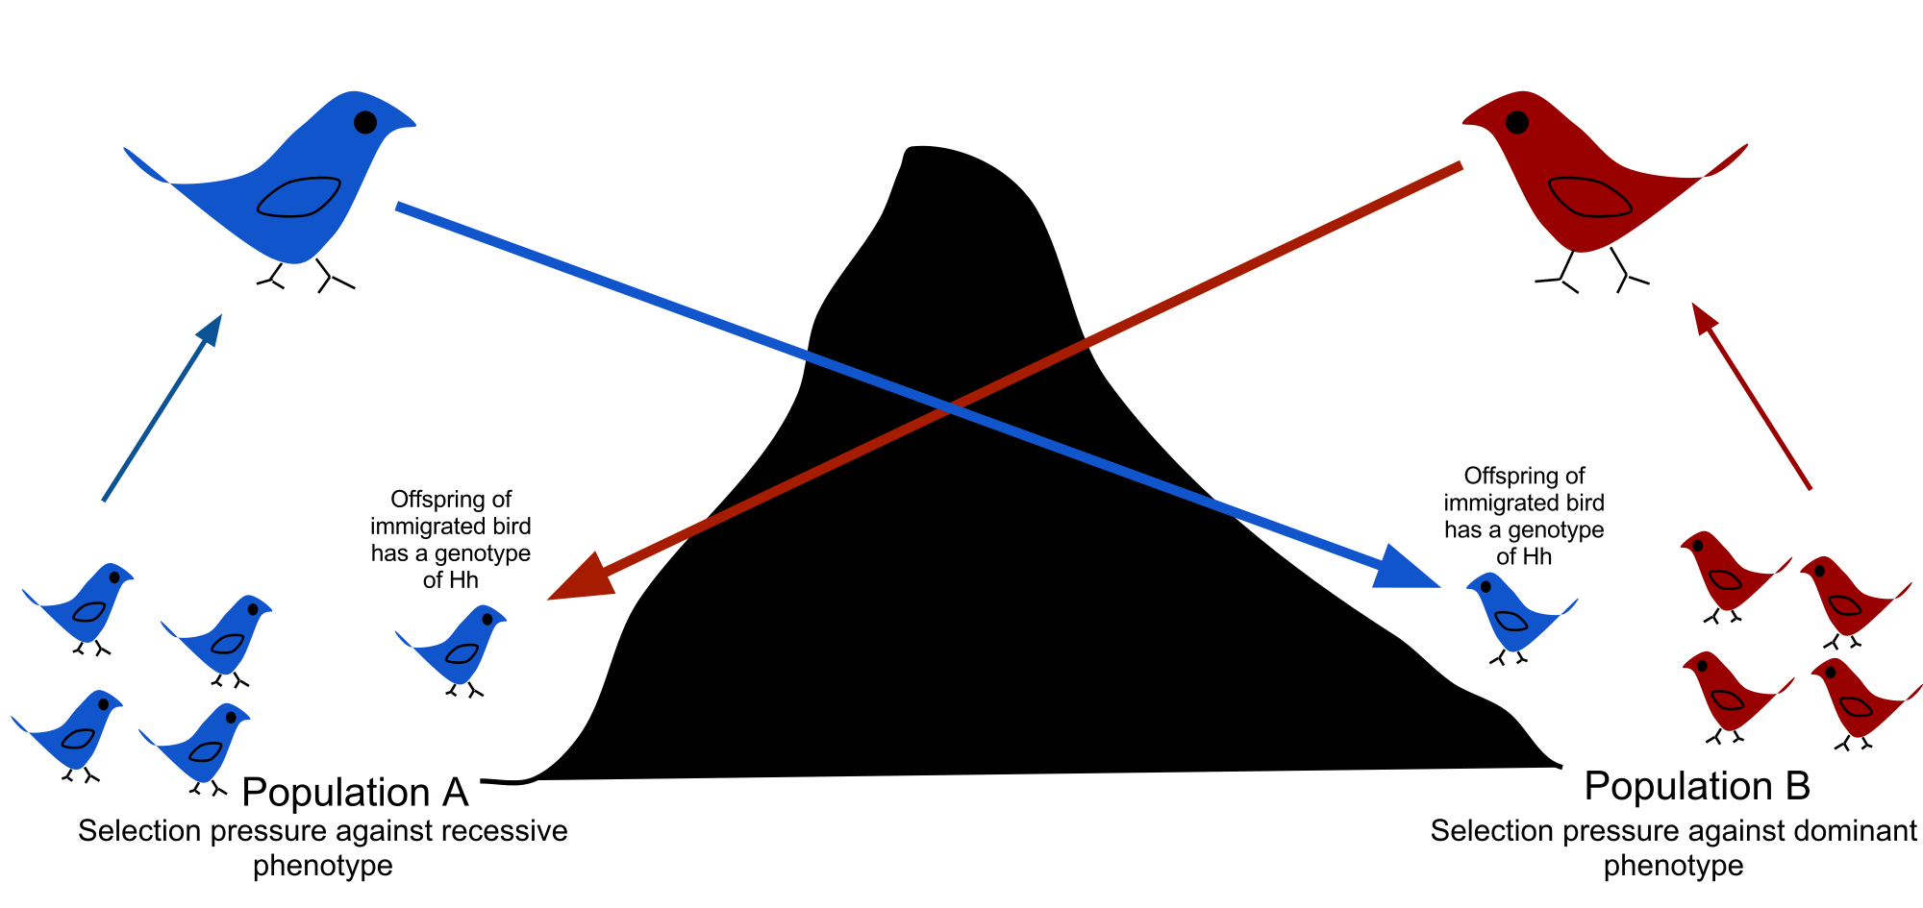
Concept 23.3: Gene flow can alter allele frequencies in a population

Slide 48
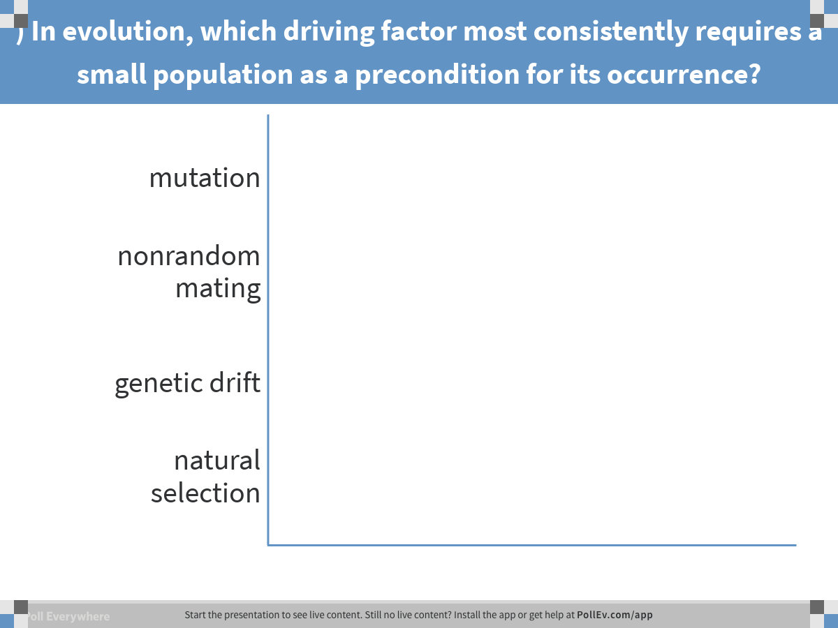
Notes:
) In evolution, which driving factor most consistently requires a small population as a precondition for its occurrence?
https://www.polleverywhere.com/multiple_choice_polls/fIUO0gXq2PmpmxH

Slide 49
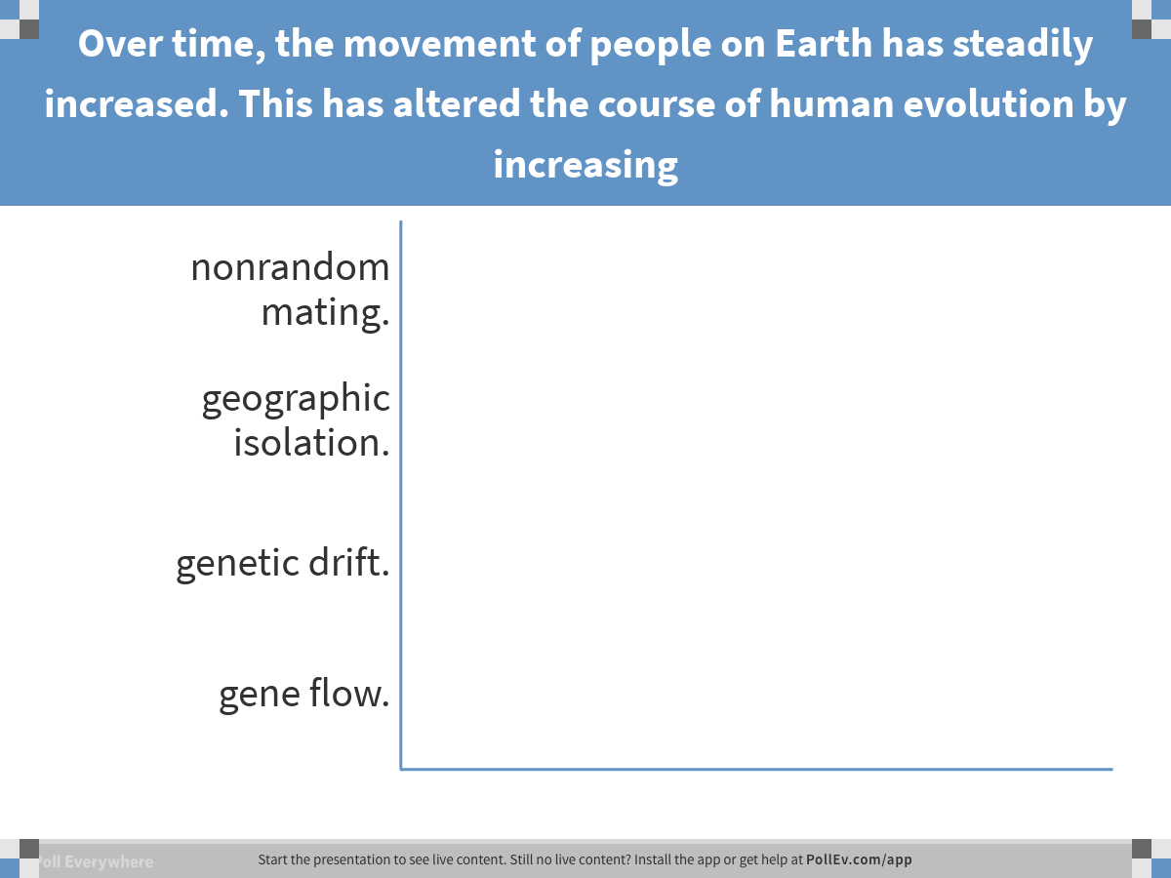
Notes:
Over time, the movement of people on Earth has steadily increased. This has altered the course of human evolution by increasing
https://www.polleverywhere.com/multiple_choice_polls/weYcIQIuXQNQSsT

Slide 50
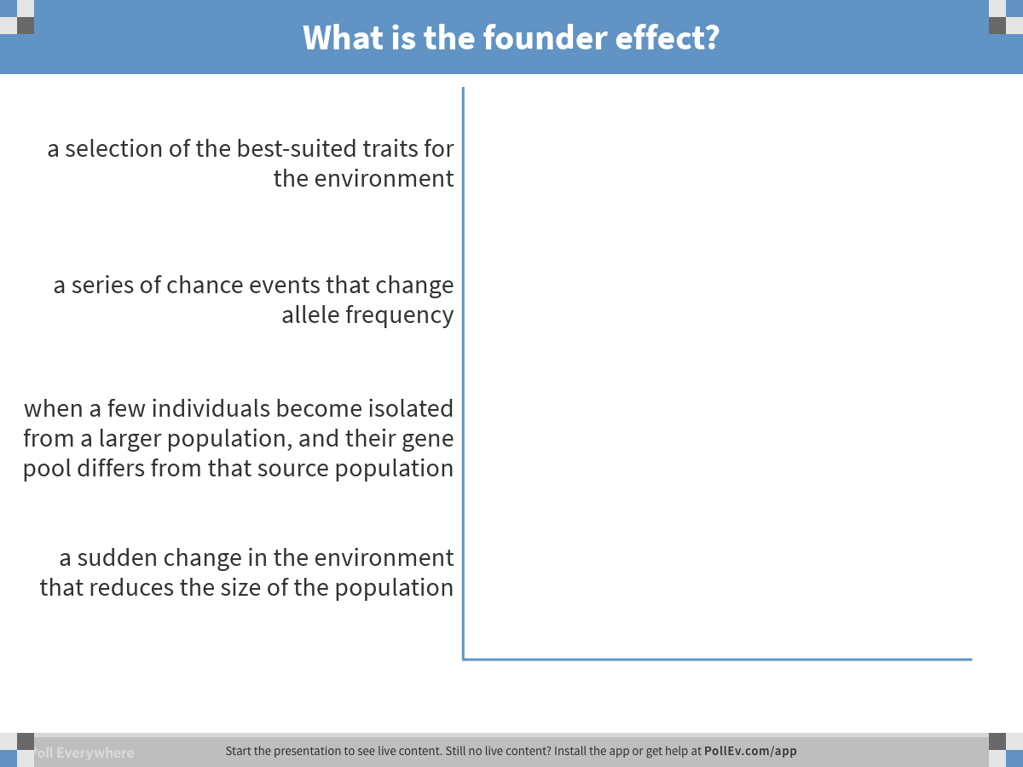
Notes:
What is the founder effect?
https://www.polleverywhere.com/multiple_choice_polls/fTgj1YeT5iyrSSy

Slide 51
Overview
Concept 23.1: Genetic variation makes evolution possible
Concept 23.2: The Hardy-Weinberg equation can be used to test whether a population is evolving
Concept 23.3: Natural selection, genetic drift, and gene flow can alter allele frequencies in a population
Concept 23.4: Natural selection is the only mechanism that consistently causes adaptive evolution

Slide 52
Concept 23.4: Natural selection is the only mechanism that consistently causes adaptive evolution
Evolution by natural selection involves both chance and “sorting”
  New genetic variations arise by chance (mutations)
  Beneficial alleles are “sorted” and favored by natural selection
Only natural selection consistently INCREASES the frequencies of alleles that provide reproductive advantage

Slide 53
Concept 23.4: Natural selection is the only mechanism that consistently causes adaptive evolution
Natural selection increases the frequencies of alleles that ENHANCE S+R (S+R = purpose of life)
  Adaptive evolution occurs as the match between a species and its environment INCREASES
  Because the environment can change, adaptive evolution is a CONTINUOUS process
Genetic drift and gene flow do NOT consistently lead to adaptive evolution—they can increase OR decrease the match between an organism and its environment (random and unpredictable changes)

Slide 54
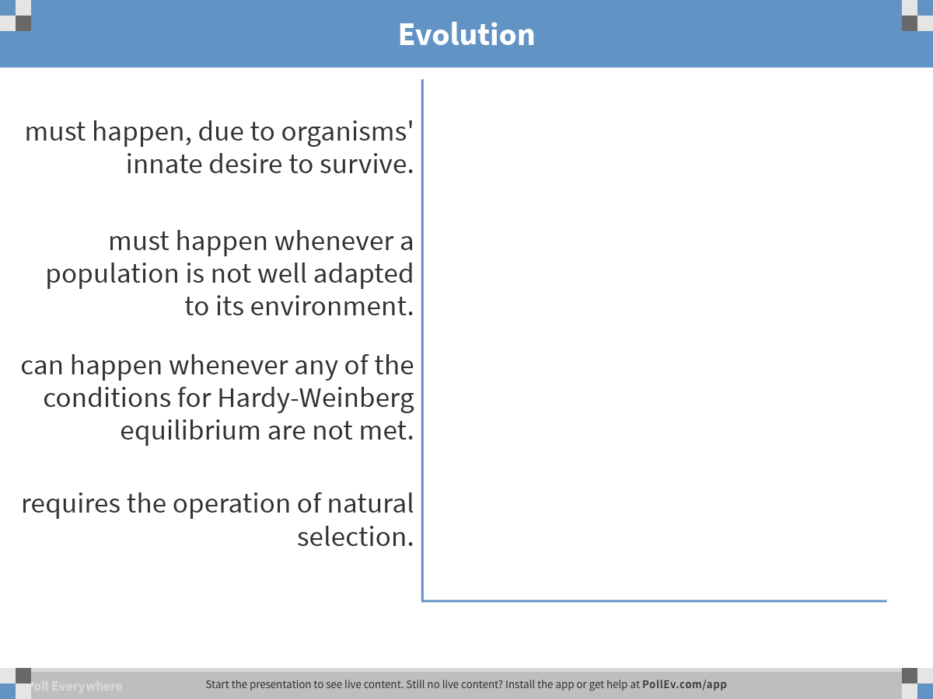
Notes:
Evolution
https://www.polleverywhere.com/multiple_choice_polls/zfgN5N0IFLwrsgi

Slide 55
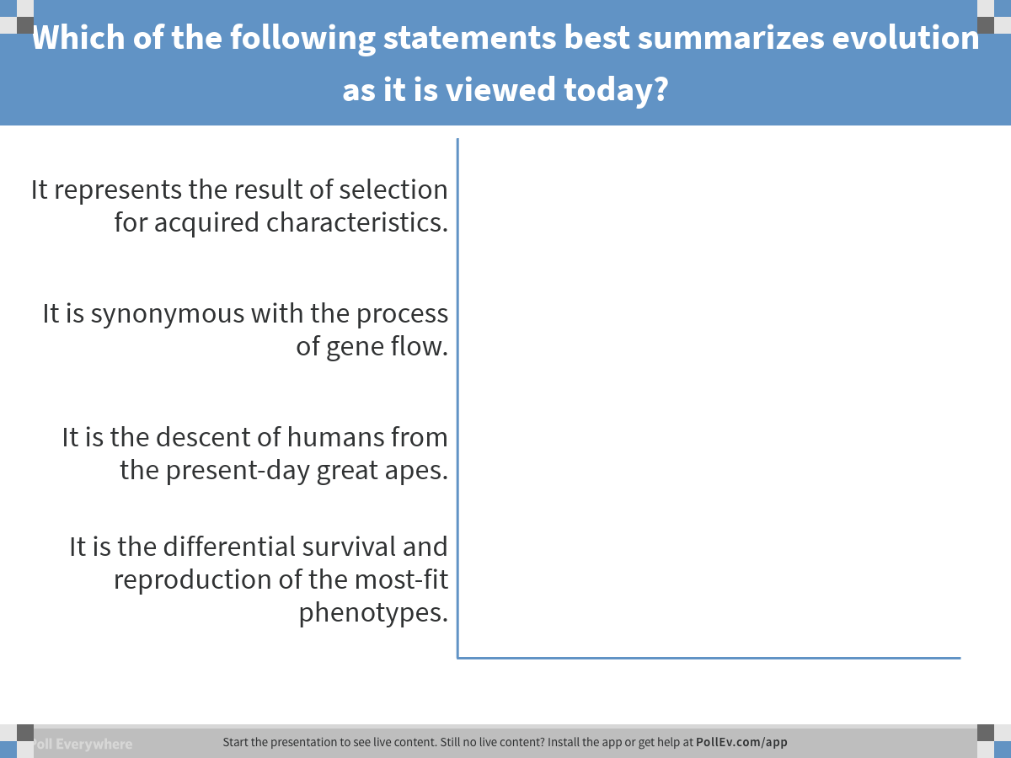
Notes:
Which of the following statements best summarizes evolution as it is viewed today?
https://www.polleverywhere.com/multiple_choice_polls/XZ6IgUfECFQ35c0

Slide 56
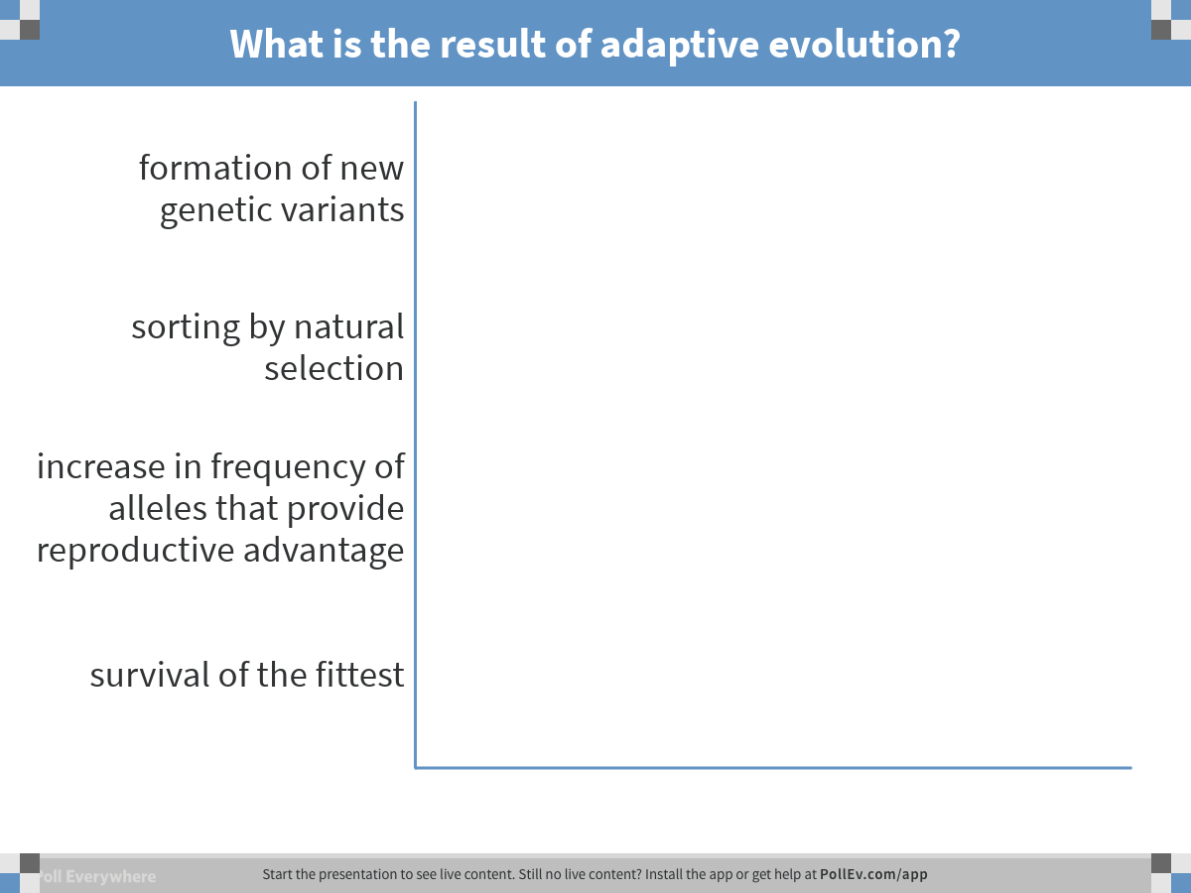
Notes:
What is the result of adaptive evolution?
https://www.polleverywhere.com/multiple_choice_polls/t35XyAoNpuzoXGG

Slide 57
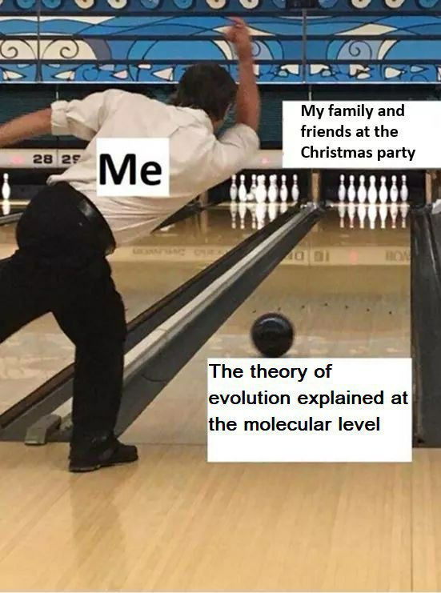

Slide 58
Overview
Concept 23.1: Genetic variation makes evolution possible
Concept 23.2: The Hardy-Weinberg equation can be used to test whether a population is evolving
Concept 23.3: Natural selection, genetic drift, and gene flow can alter allele frequencies in a population
Concept 23.4: Natural selection is the only mechanism that consistently causes adaptive evolution

