Slide 1
AP Biology – Ch. 19+20+21 – Viruses + Biotechnology + Genome Evo
AP Exam Questions

Slide 2
Do Now
What do you have in common with a virus?

Slide 3
Do Now
What do you have in common with a virus?
Nucleic acids
Proteins

Slide 4
Overview
Today, we’ll be answering and analyzing real AP biology multiple choice exam questions on Viruses (Ch. 19.1-19.2), Biotechnology (Ch. 20.1, 20.4), and Genome Evo (Ch. 21.2-21.6).
I will walk us through questions 1-3.
We will complete questions 4-8 as a class in groups.
You will complete questions 9-20 independently using the strategies learned today.

Slide 5
Bloom’s taxonomy
Levels of Questions
Level 1: Knowledge/comprehension
Level 2: Application/analysis
Level 3: Synthesis/evaluation

Slide 6
Question 1
Which of the following supports the argument that viruses are nonliving?
A) They are not cellular.
B) Their DNA does not encode proteins.
C) They have RNA rather than DNA.
D) They do not evolve.
Bloom's Taxonomy: Knowledge/Comprehension
Section: 19.1

Slide 7
Question 1
Which of the following supports the argument that viruses are nonliving?
A) They are not cellular.
B) Their DNA does not encode proteins.
C) They have RNA rather than DNA.
D) They do not evolve.
Bloom's Taxonomy: Knowledge/Comprehension
Section: 19.1

Slide 8
Question 2
Which of the following is in the correct order for one cycle of polymerase chain reaction (PCR)?
A) Denature DNA; add fresh enzyme; anneal primers; add dNTPs; extend primers.
B) Anneal primers; denature DNA; extend primers.
C) Extend primers; anneal primers; denature DNA.
D) Denature DNA; anneal primers; extend primers.
Bloom's Taxonomy: Application/Analysis
Section: 20.1

Slide 9
Question 2
Which of the following is in the correct order for one cycle of polymerase chain reaction (PCR)?
A) Denature DNA; add fresh enzyme; anneal primers; add dNTPs; extend primers.
B) Anneal primers; denature DNA; extend primers.
C) Extend primers; anneal primers; denature DNA.
D) Denature DNA; anneal primers; extend primers.
Bloom's Taxonomy: Application/Analysis
Section: 20.1

Slide 10
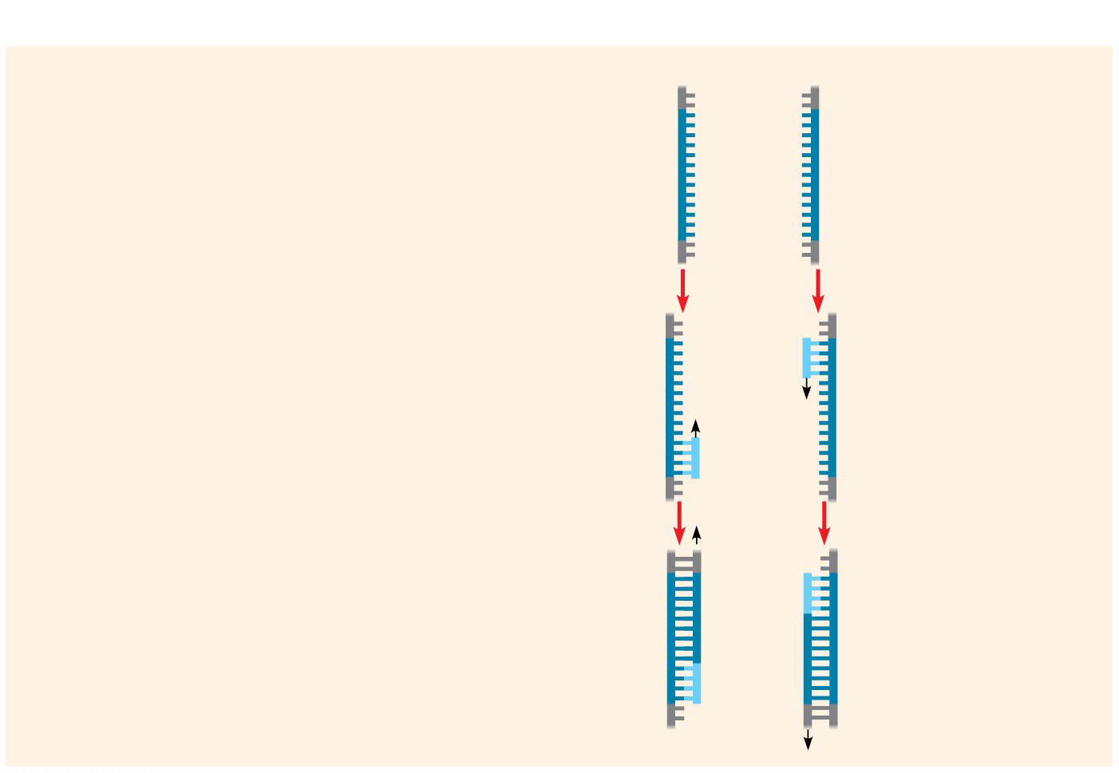
Figure 20.8b-3
Technique
1
Denaturation
5′
3′
3′
5′
2
Annealing
Cycle 1 yields 2 molecules
Primers
3
Extension
New nucleotides
Notes:
Figure 20.8b-3 Research method: the polymerase chain reaction (PCR) (part 2, step 3)

Slide 11
Question 3
The comparison between the number of human genes and those of other animal species has led to many conclusions, including that _____.
A) the density of the human genome is far higher than in most other animals
B) the number of proteins expressed by the human genome is far more than the number of its genes
C) most human DNA consists of genes for protein, tRNA, rRNA, and miRNA
D) the genomes of most other organisms are significantly smaller than the human genome
Bloom's Taxonomy: Synthesis/Evaluation
Section: 21.3

Slide 12
Question 3
The comparison between the number of human genes and those of other animal species has led to many conclusions, including that _____.
A) the density of the human genome is far higher than in most other animals
B) the number of proteins expressed by the human genome is far more than the number of its genes
C) most human DNA consists of genes for protein, tRNA, rRNA, and miRNA
D) the genomes of most other organisms are significantly smaller than the human genome
Bloom's Taxonomy: Synthesis/Evaluation
Section: 21.3

Slide 13
For the next 5 questions…
Work in your groups to come up with ONE consensus answer
Be prepared to explain your reasoning! (one “volunteer”)

Slide 14
Question 4
Which of the following is characteristic of the lytic cycle?
A) Viral DNA is incorporated into the host genome.
B) The viral genome replicates without destroying the host.
C) A large number of phages are released at a time.
D) The virus—host relationship usually lasts for generations.
Bloom's Taxonomy: Knowledge/Comprehension
Section: 19.2

Slide 15
Question 4
Which of the following is characteristic of the lytic cycle?
A) Viral DNA is incorporated into the host genome.
B) The viral genome replicates without destroying the host.
C) A large number of phages are released at a time.
D) The virus—host relationship usually lasts for generations.
Bloom's Taxonomy: Knowledge/Comprehension
Section: 19.2

Slide 16
Question 5
In many ways, the regulation of the genes of a particular group of viruses will be similar to the regulation of the host genes. Therefore, which of the following would you expect of the genes of a bacteriophage?
A) regulation via acetylation of histones
B) positive control mechanisms rather than negative
C) control of more than one gene in an operon
D) reliance on transcription activators
Bloom's Taxonomy: Synthesis/Evaluation
Section: 19.2

Slide 17
Question 5
In many ways, the regulation of the genes of a particular group of viruses will be similar to the regulation of the host genes. Therefore, which of the following would you expect of the genes of a bacteriophage?
A) regulation via acetylation of histones
B) positive control mechanisms rather than negative
C) control of more than one gene in an operon
D) reliance on transcription activators
Bloom's Taxonomy: Synthesis/Evaluation
Section: 19.2

Slide 18
Question 6
What is the most logical sequence of steps for splicing foreign DNA into a plasmid and inserting the plasmid into a bacterium?
I. Transform bacteria with a recombinant DNA molecule.
II. Cut the plasmid DNA using restriction enzymes (endonucleases).
III. Extract plasmid DNA from bacterial cells.
IV. Hydrogen-bond the plasmid DNA to nonplasmid DNA fragments.
V. Use ligase to seal plasmid DNA to nonplasmid DNA.
A) II, III, V, IV, I
B) III, II, IV, V, I
C) III, IV, V, I, II
D) IV, V, I, II, III
Bloom's Taxonomy: Knowledge/Comprehension
Section: 20.1

Slide 19
Question 6
What is the most logical sequence of steps for splicing foreign DNA into a plasmid and inserting the plasmid into a bacterium?
I. Transform bacteria with a recombinant DNA molecule.
II. Cut the plasmid DNA using restriction enzymes (endonucleases).
III. Extract plasmid DNA from bacterial cells.
IV. Hydrogen-bond the plasmid DNA to nonplasmid DNA fragments.
V. Use ligase to seal plasmid DNA to nonplasmid DNA.
A) II, III, V, IV, I
B) III, II, IV, V, I
C) III, IV, V, I, II
D) IV, V, I, II, III
Bloom's Taxonomy: Knowledge/Comprehension
Section: 20.1

Slide 20
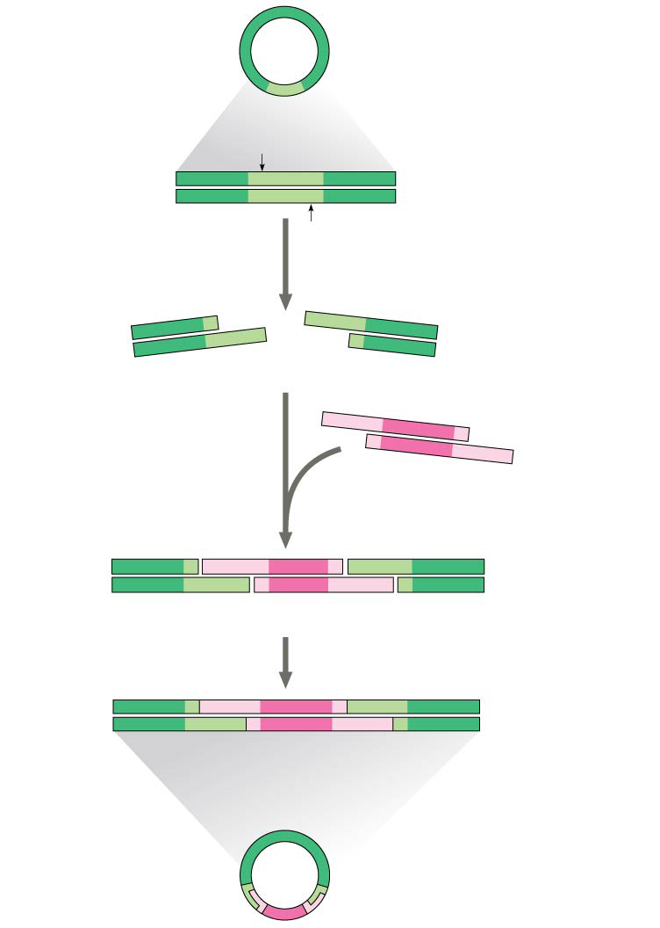
Figure 20.6
Bacterial plasmid
Restriction site
5′
GAATTC
3′
DNA
CTTAAG
3′
5′
1
Restriction enzyme cuts the sugar-phosphate backbones at each arrow.
5′
3′
5′
3′
G
AATTC
CTTAA
G
3′
5′
3′
5′
Sticky end
5′
3′
2
Base pairing of sticky ends produces various combinations.
AATTC
G
G
CTTAA
3′
5′
Fragment from different DNA molecule cut by the same restriction enzyme
5′
3′
5′
3′
5′
T
3′
G
A
A
T
T
C
G
A
A
T
C
C
T
T
A
A
G
C
T
T
A
A
G
3′
5′
3′
5′
3′
5′
3
DNA ligase seals the strands.
One possible combination
5′
3′
3′
Recombinant DNA molecule
5′
Recombinant plasmid
Notes:
Figure 20.6 Using a restriction enzyme DNA ligase to make a recombinant DNA plasmid

Slide 21
Question 7
What information is critical to the success of polymerase chain reaction (PCR) itself?
A) The DNA sequence of the ends of the DNA to be amplified must be known.
B) The complete DNA sequence of the DNA to be amplified must be known.
C) The sequence of restriction-enzyme recognition sites in the DNA to be amplified must be known.
D) The sequence of restriction-enzyme recognition sites in the DNA to be amplified and in the plasmid where the amplified DNA fragment will be cloned must be known.
Bloom's Taxonomy: Application/Analysis
Section: 20.1

Slide 22
Question 7
What information is critical to the success of polymerase chain reaction (PCR) itself?
A) The DNA sequence of the ends of the DNA to be amplified must be known.
B) The complete DNA sequence of the DNA to be amplified must be known.
C) The sequence of restriction-enzyme recognition sites in the DNA to be amplified must be known.
D) The sequence of restriction-enzyme recognition sites in the DNA to be amplified and in the plasmid where the amplified DNA fragment will be cloned must be known.
Bloom's Taxonomy: Application/Analysis
Section: 20.1

Slide 23
Question 8
Several of the different globin genes are expressed in humans, but at different times in development. What mechanism could allow for this?
A) exon shuffling
B) pseudogene activation
C) differential translation of mRNAs
D) differential gene regulation over time
Bloom's Taxonomy: Synthesis/Evaluation
Section: 21.6

Slide 24
Question 8
Several of the different globin genes are expressed in humans, but at different times in development. What mechanism could allow for this?
A) exon shuffling
B) pseudogene activation
C) differential translation of mRNAs
D) differential gene regulation over time
Bloom's Taxonomy: Synthesis/Evaluation
Section: 21.6

Slide 25
Questions 9-20
Independently complete these questions. Be sure to use the strategies we’ve discussed!

Slide 26
Questions 9-20 Answers
9. C
10. D
11. C
12. C
13. C
14. B
15. B
16. C
17. B
18. D
19. D
20. C

Slide 27
Exit Ticket
In groups, come up with your own multiple choice question/answer from any topic covered thus far.
Be sure to appropriately classify it using Bloom’s taxonomy.
Level 1: Knowledge/comprehension
Level 2: Application/analysis
Level 3: Synthesis/evaluation

