Slide 1
19
Viruses

Slide 2
What do you think of when you hear the word “virus?”
“Computer.” – Brad
“Flu.” – Sydney
“HPV.” – Corley
“No.” – Janna
“Zombies.” – Lauren
“Ebola to kno de wae.” – Brad
“Amino acids.” – Whitney

Slide 3
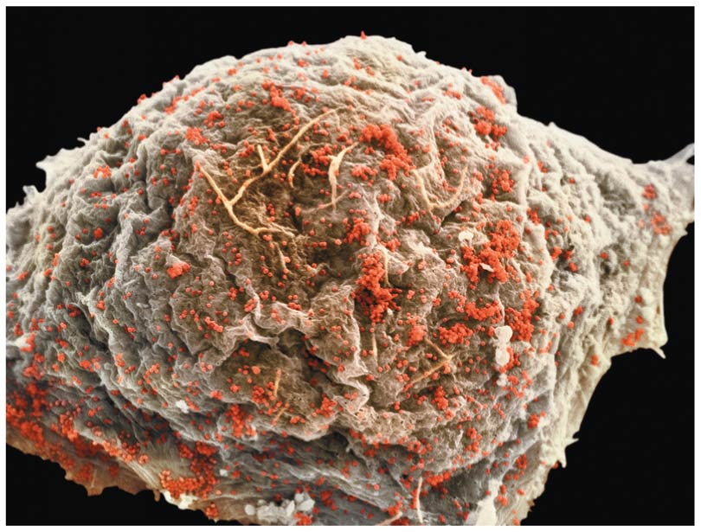
Notes:
Figure 19.1a Are the viruses (red) budding from this cell alive? (part 1: micrograph)

Slide 4
“A Kind of Borrowed Life”
A virus is an infectious particle consisting of genes packaged in a protein coat
Viruses are much simpler in structure than even prokaryotic cells
Viruses cannot reproduce or carry out metabolism outside of a host cell

Slide 5
Overview
Concept 19.1: A virus consists of a nucleic acid surrounded by a protein coat
Concept 19.2: Viruses replicate only in host cells
Concept 19.3: Viruses, viroids, and prions are formidable pathogens in animals and plants

Slide 6
Overview
Concept 19.1: A virus consists of a nucleic acid surrounded by a protein coat
Concept 19.2: Viruses replicate only in host cells

Slide 7
Concept 19.1: A virus consists of a nucleic acid surrounded by a protein coat – Overview
General Structure of Viruses
Viruses are NOT cells
A virus…
is very small
is an infectious particle
consists of NUCLEIC ACID enclosed in a PROTEIN COAT (capsid)
SOMETIMES also has a host-derived membranous envelope enclosing everything else

Slide 8
Concept 19.1: A virus consists of a nucleic acid surrounded by a protein coat – Nucleic Acids
Structure of Viruses – Cray-cray Genomes
Viral genomes may consist of either…
Double- or single-stranded DNA (!) = “DNA virus”
Double- or single-stranded RNA (!) = “RNA virus”
The genome is either…
A single linear molecule of the nucleic acid
A single circular molecule of the nucleic acid
Viruses have between three and several thousand genes in their genome (!!!)

Slide 9
Concept 19.1: A virus consists of a nucleic acid surrounded by a protein coat – Capsid
Structure of Viruses – Capsid
A capsid is the protein shell that encloses the viral genome
Capsids are built from protein subunits called capsomeres
A capsid can have a variety of structures

Slide 10
Concept 19.1: A virus consists of a nucleic acid surrounded by a protein coat – Envelope
Structure of Viruses – Envelope
Viral envelopes (derived from membranes of host cells) surround the capsids of influenza viruses and many other viruses found in animals
This accessory structure INCREASES viral infectivity
Viral envelopes contain a combination of viral and host cell molecules

Slide 11
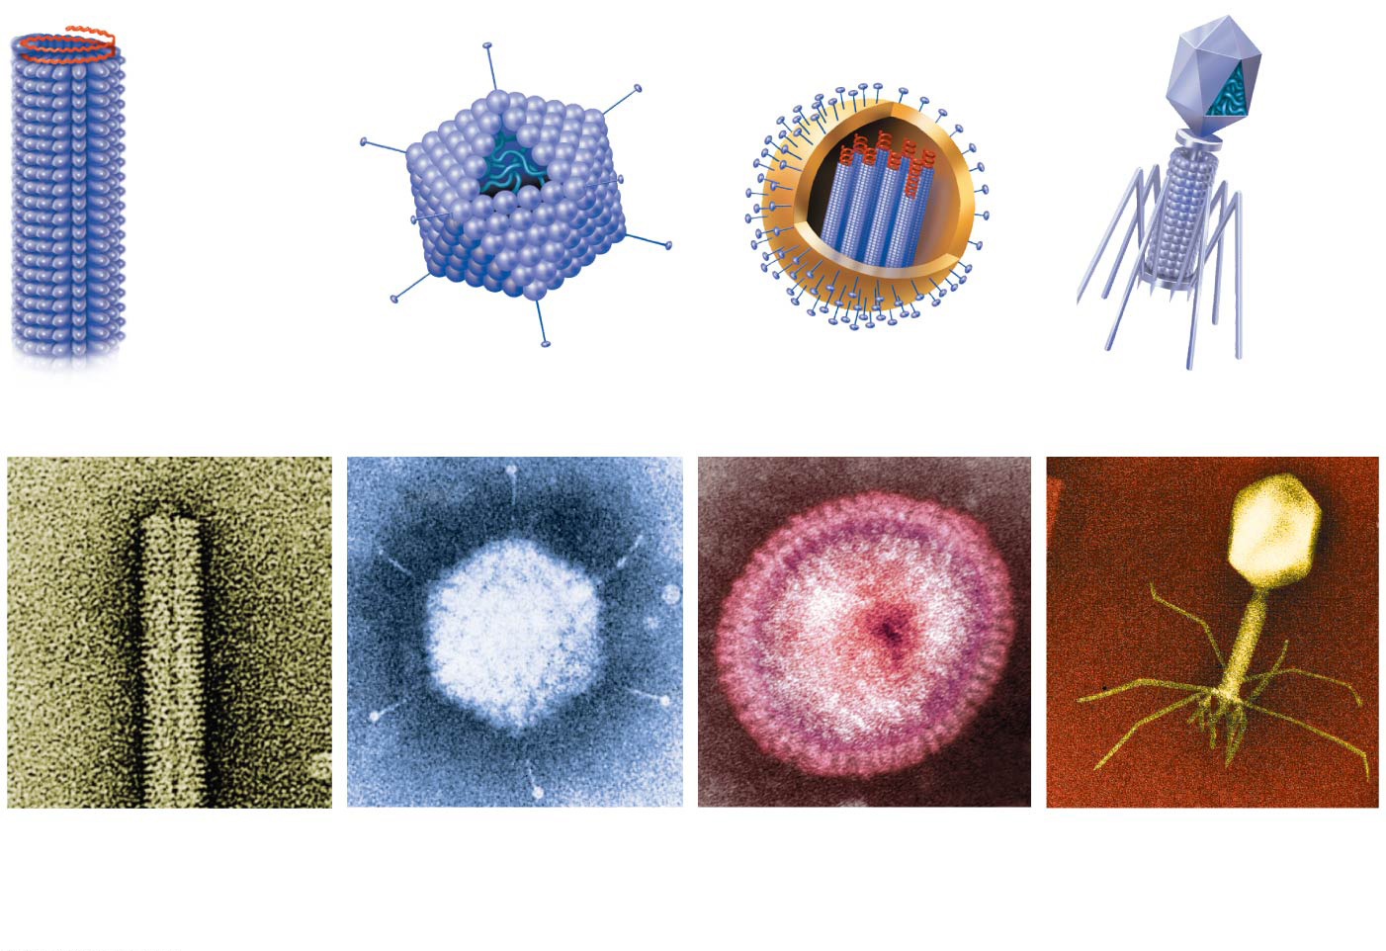
Figure 19.3
RNA
Membranous
envelope
RNA
Head
Capsomere
DNA
Capsid
DNA
Capsomere
of capsid
Tail
sheath
Tail
fiber
Glycoprotein
Glycoproteins
18 × 250 nm
70–90 nm (diameter)
80–200 nm (diameter)
80 × 225 nm
20 nm
50 nm
50 nm
50 nm
(a)
Tobacco mosaic
virus
(b)
Adenoviruses
(c)
Influenza viruses
(d)
Bacteriophage T4
Notes:
Figure 19.3 Viral structure

Slide 12
Concept 19.1: A virus consists of a nucleic acid surrounded by a protein coat – Bacteriophages
Bacteriophages, also called phages, are viruses that infect bacteria
They have the most complex capsids found among viruses
Phages have an elongated capsid head that encloses their DNA
A protein tail piece attaches the phage to the host and injects the phage DNA inside

Slide 13
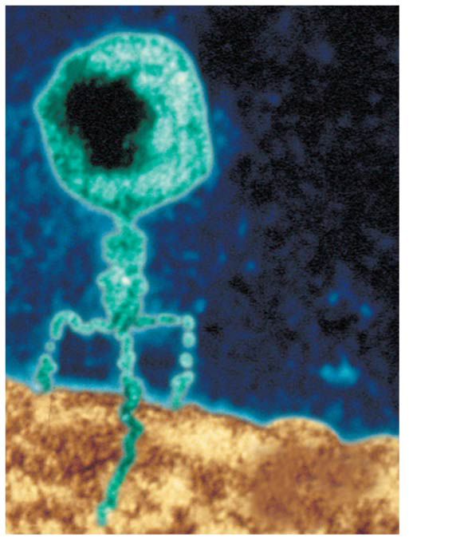
Figure 16.3
Phage head
DNA
Tail sheath
Tail fiber
Genetic material
100 nm
Bacterial cell
Notes:
Figure 16.3 A virus infecting a bacterial cell

Slide 14
Overview
Concept 19.1: A virus consists of a nucleic acid surrounded by a protein coat
Concept 19.2: Viruses replicate only in host cells

Slide 15
Notes:
Viruses _____.
https://www.polleverywhere.com/multiple_choice_polls/fO8Pg3MANOVmXlv

Slide 16
Notes:
What is the main structural difference between enveloped and nonenveloped viruses?
https://www.polleverywhere.com/multiple_choice_polls/sUtSbifTTUjYk1E

Slide 17
Concept 19.2: Viruses replicate only in host cells
Viruses are obligate intracellular parasites → can replicate ONLY within a host cell
Each virus has a host range, a limited number of host cells that it can infect
Once a viral genome has entered a cell, the cell begins to manufacture viral proteins
The virus HIJACKS host enzymes, ribosomes, tRNAs, amino acids, ATP, and other molecules
Viral nucleic acid molecules and capsomeres SPONTANEOUSLY self-assemble into new viruses (!!!)

Slide 18
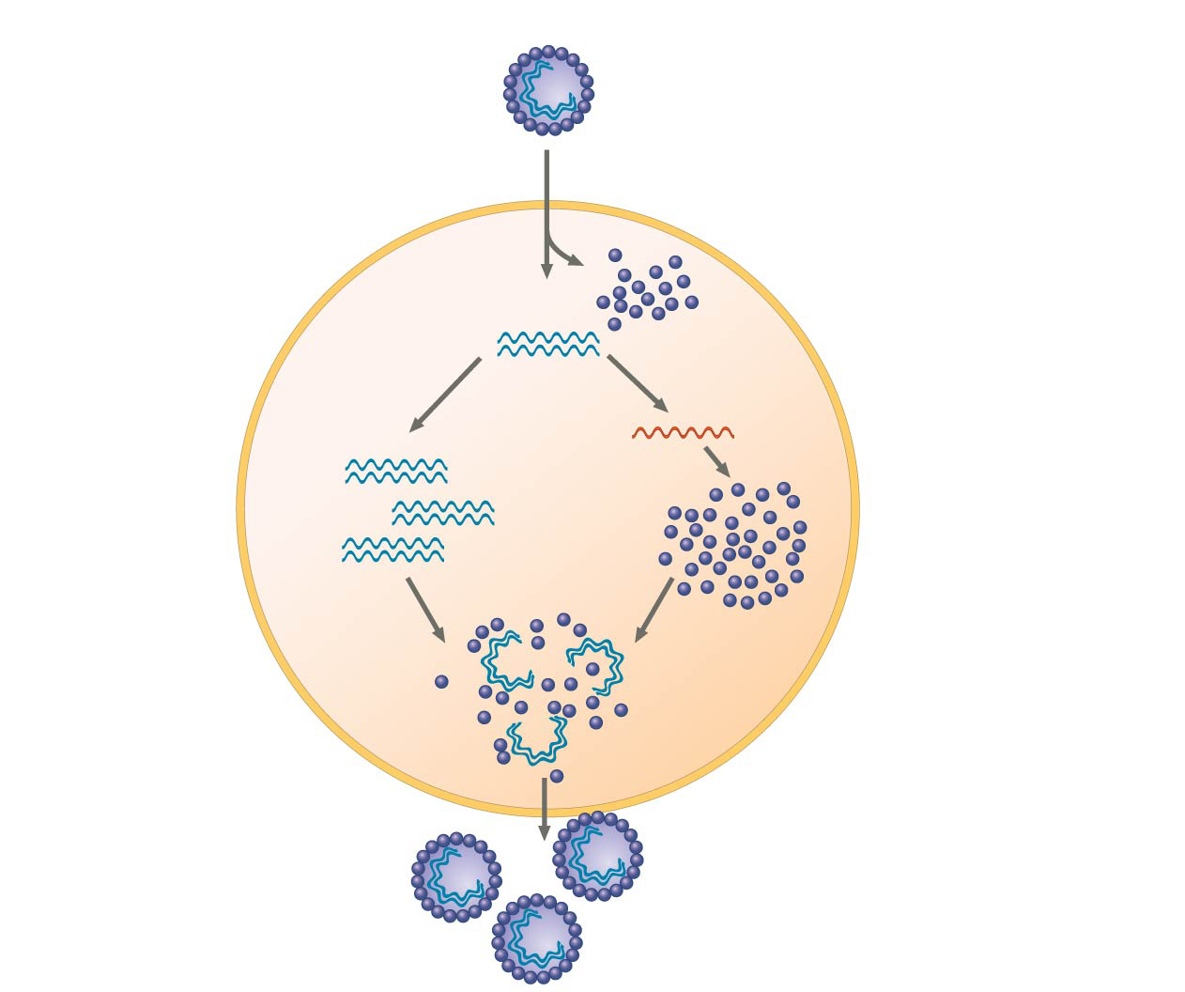
Figure 19.4
VIRUS
DNA
3
Transcription and
manufacture of
capsid proteins
Capsid
1
Entry and
uncoating
HOST
CELL
2
Replication
Viral DNA
mRNA
Viral DNA
Capsid
proteins
4
Self-assembly of
new virus particles
and their exit from
the cell
Notes:
Figure 19.4 A simplified viral replicative cycle

Slide 19
Notes:
The host range of a virus is determined by _____.
https://www.polleverywhere.com/multiple_choice_polls/sg7ozJyimVpE8hi

Slide 20
Concept 19.2: Viruses replicate only in host cells
Replicative Cycles of Phages
Phages are the best understood of all viruses
Phages have two alternative reproductive mechanisms:
Lytic cycle
Lysogenic cycle

Slide 21
Concept 19.2: Viruses replicate only in host cells
Replicative Cycles of Phages
Phages are the best understood of all viruses
Phages have two alternative reproductive mechanisms:
Lytic cycle
Lysogenic cycle

Slide 22
Concept 19.2: Viruses replicate only in host cells
The lytic cycle is a phage replicative cycle that culminates in the DEATH OF THE HOST CELL
The lytic cycle produces new phages and LYSES (breaks open) the host’s cell wall, releasing the progeny viruses
A phage that reproduces only by the lytic cycle is called a virulent phage
Bacteria have defenses against phages, including restriction enzymes that recognize and cut up certain foregin phage DNA

Slide 23
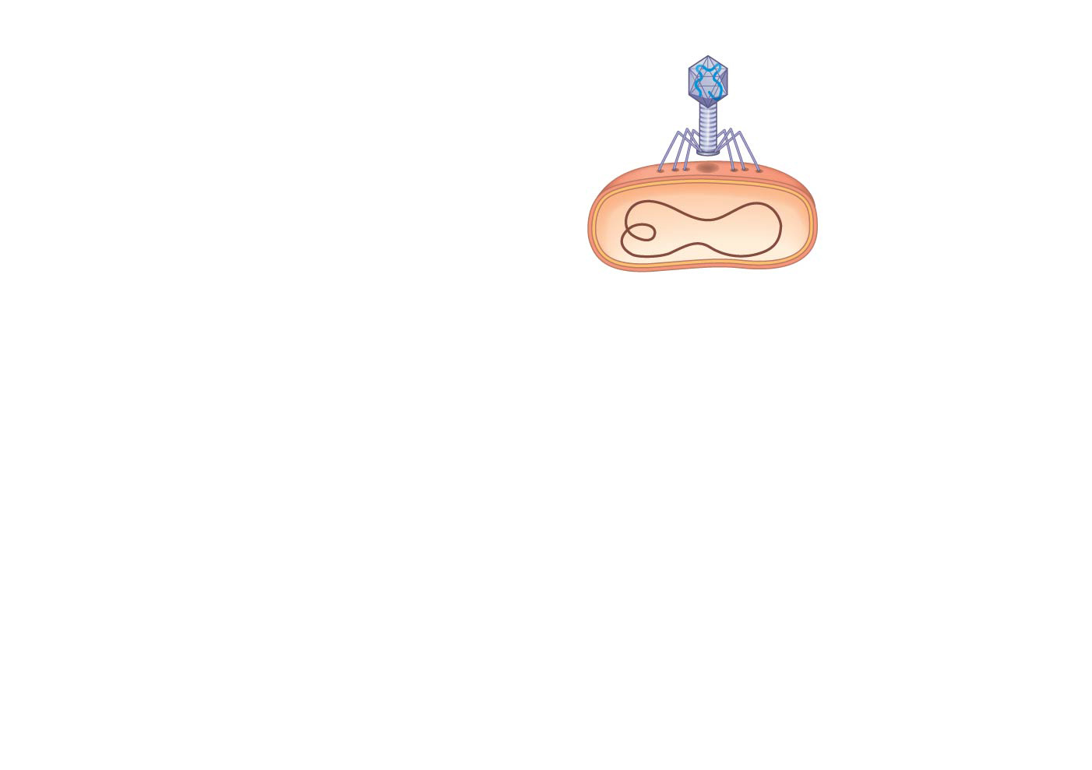
Figure 19.5-1
1
Attachment
Notes:
Figure 19.5-1 The lytic cycle of phage T4, a virulent phage (step 1)

Slide 24
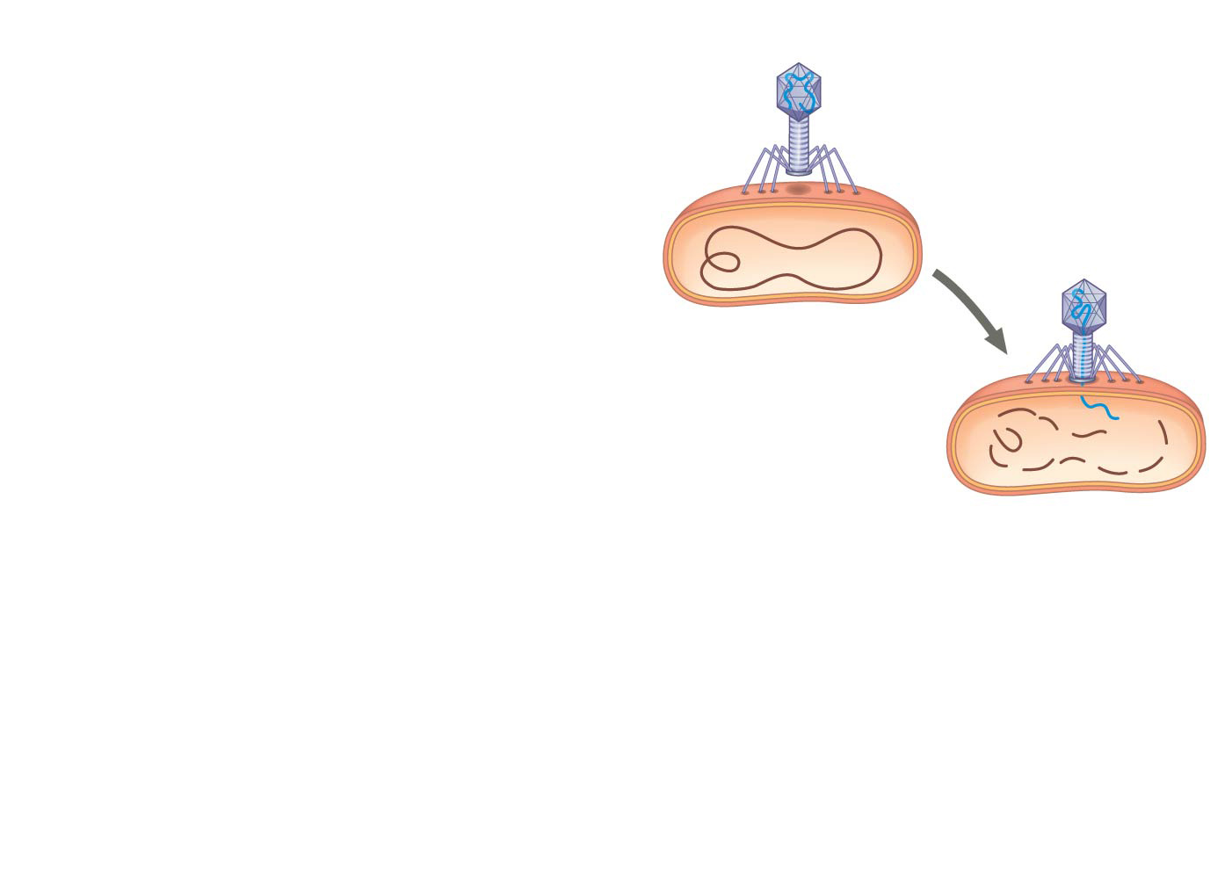
Figure 19.5-2
1
Attachment
2
Entry of phage
DNA and
degradation
of host DNA
Notes:
Figure 19.5-2 The lytic cycle of phage T4, a virulent phage (step 2)

Slide 25
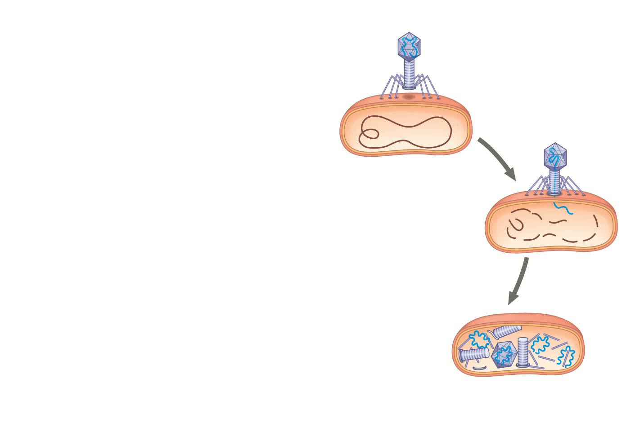
Figure 19.5-3
1
Attachment
2
Entry of phage
DNA and
degradation
of host DNA
3
Synthesis of viral
genomes and
proteins
Notes:
Figure 19.5-3 The lytic cycle of phage T4, a virulent phage (step 3)

Slide 26
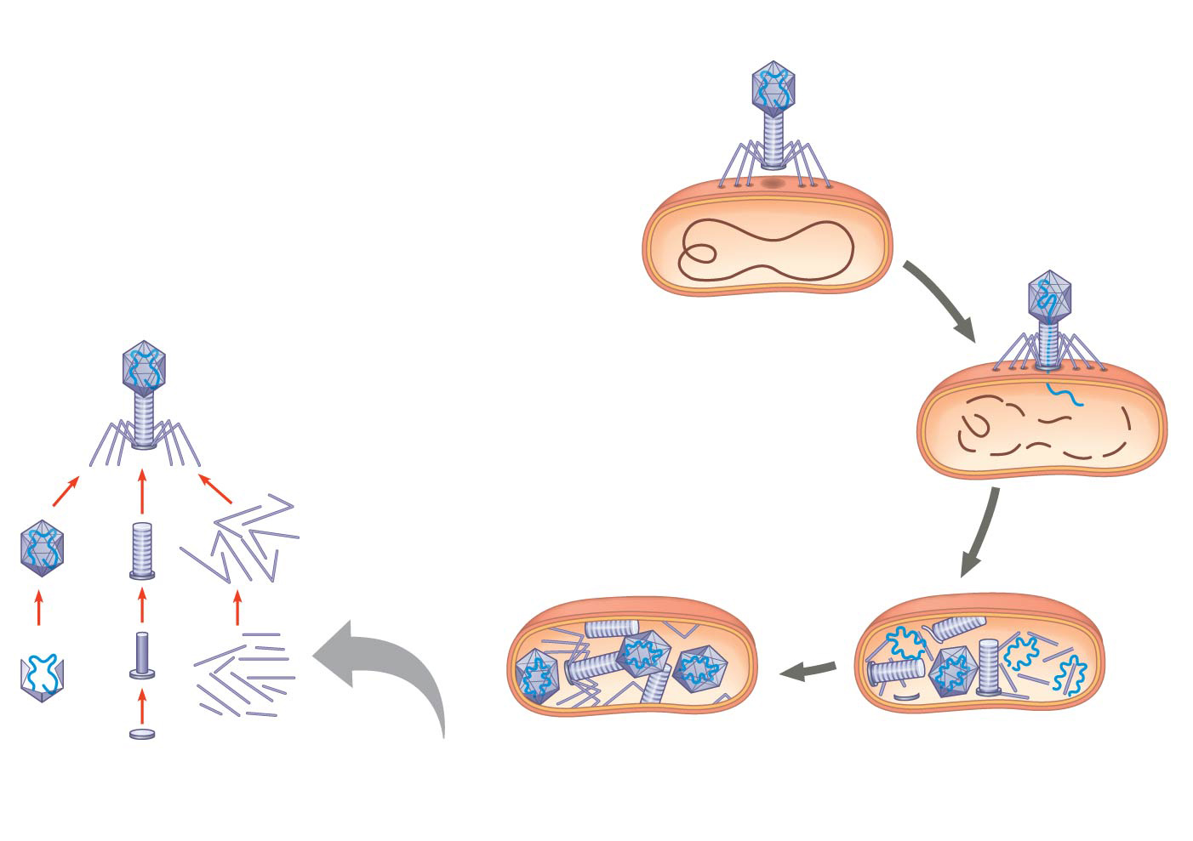
Figure 19.5-4
1
Attachment
2
Entry of phage
DNA and
degradation
of host DNA
Phage assembly
3
Synthesis of viral
genomes and
proteins
Head
Tail
Tail
fibers
4
Self-assembly
Notes:
Figure 19.5-4 The lytic cycle of phage T4, a virulent phage (step 4)

Slide 27
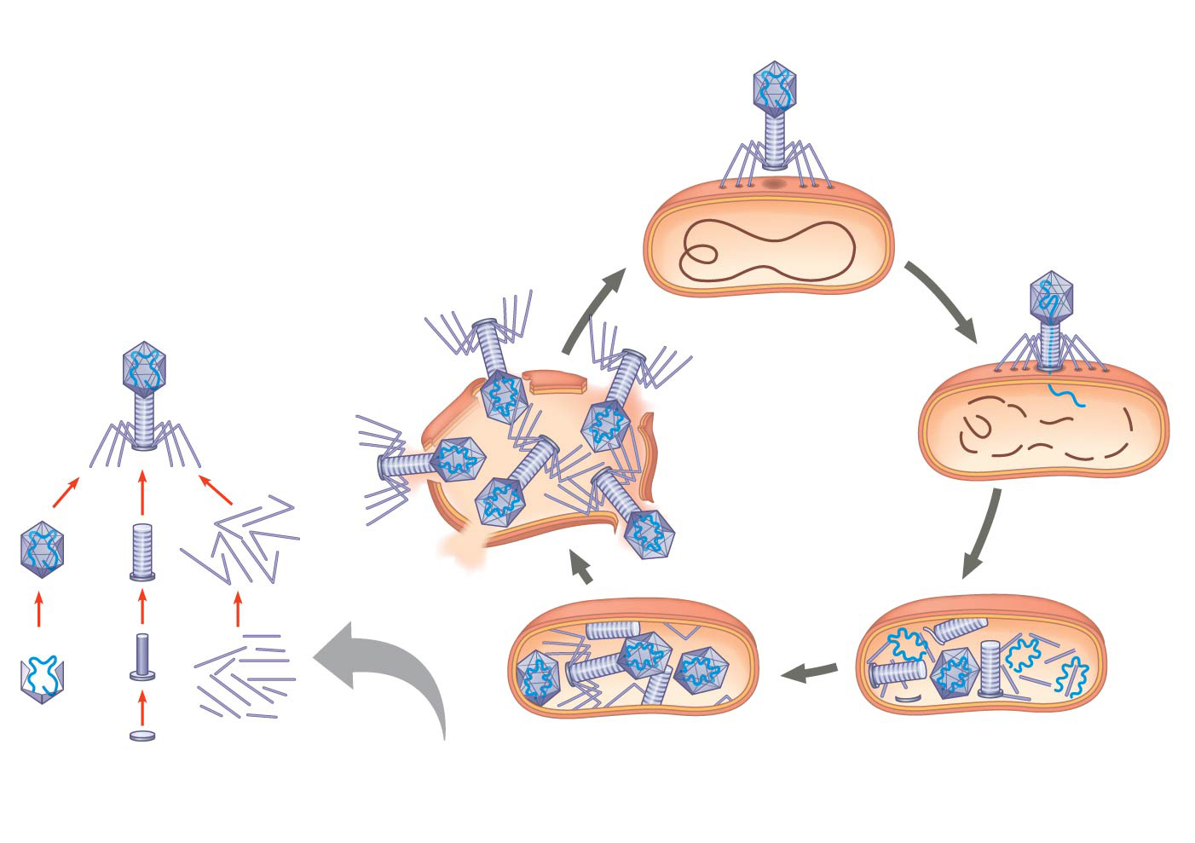
Figure 19.5-5
1
Attachment
2
Entry of phage
DNA and
degradation
of host DNA
5
Release
Phage assembly
3
Synthesis of viral
genomes and
proteins
Head
Tail
Tail
fibers
4
Self-assembly
Notes:
Figure 19.5-5 The lytic cycle of phage T4, a virulent phage (step 5)

Slide 28
Notes:
Which of the following is characteristic of the lytic cycle?
https://www.polleverywhere.com/multiple_choice_polls/vDMRsdHsPtgqXKS

Slide 29
Concept 19.2: Viruses replicate only in host cells
Replicative Cycles of Phages
Phages are the best understood of all viruses
Phages have two alternative reproductive mechanisms:
Lytic cycle
Lysogenic cycle

Slide 30
Concept 19.2: Viruses replicate only in host cells
The lysogenic cycle replicates the phage genome WITHOUT DESTROYING THE HOST
SNEAKY!
The viral DNA molecule is incorporated into the host cell’s chromosome
This integrated viral DNA is known as a prophage
Every time the host divides, it copies the phage DNA and passes the copies to daughter cells (SNEAKY!)

Slide 31
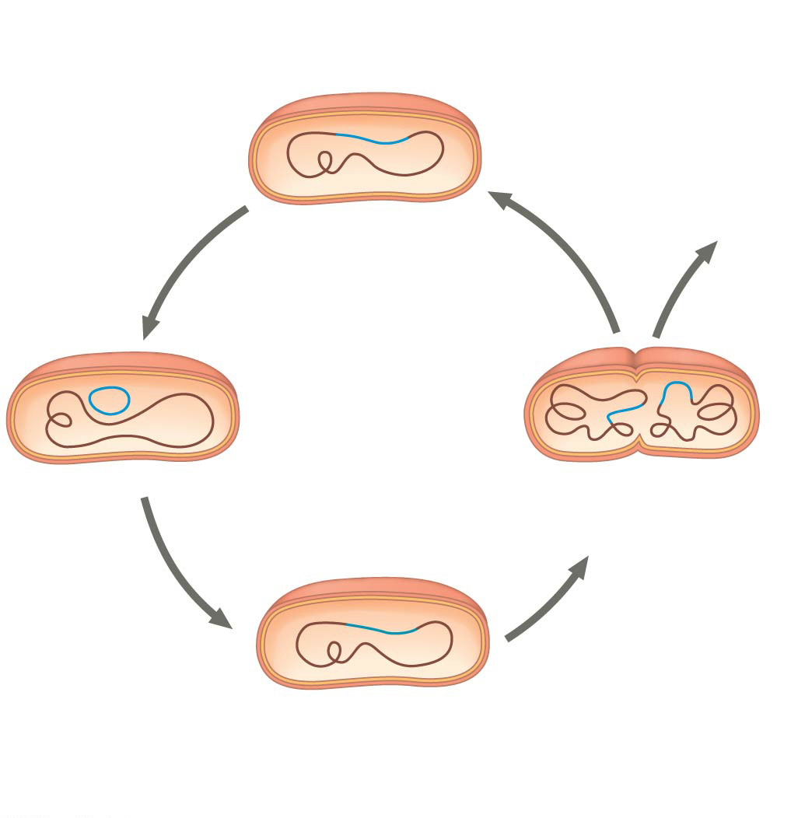
Figure 19.6b
Daughter cell
with prophage
Many cell
divisions
create many
infected
bacteria.
Prophage exits
chromosome.
Lysogenic
cycle
Prophage is copied
with bacterial
chromosome.
Prophage
Phage DNA integrates
into bacterial
chromosome.
Notes:
Figure 19.6b The lytic and lysogenic cycles of phage λ, a temperate phage (part 2: lysogenic)

Slide 32
Concept 19.2: Viruses replicate only in host cells
An environmental signal can trigger the virus genome to exit the bacterial chromosome and SWITCH to the lytic mode
Phages that use BOTH the lytic and lysogenic cycles are called temperate phages (ex: lambda phages)

Slide 33
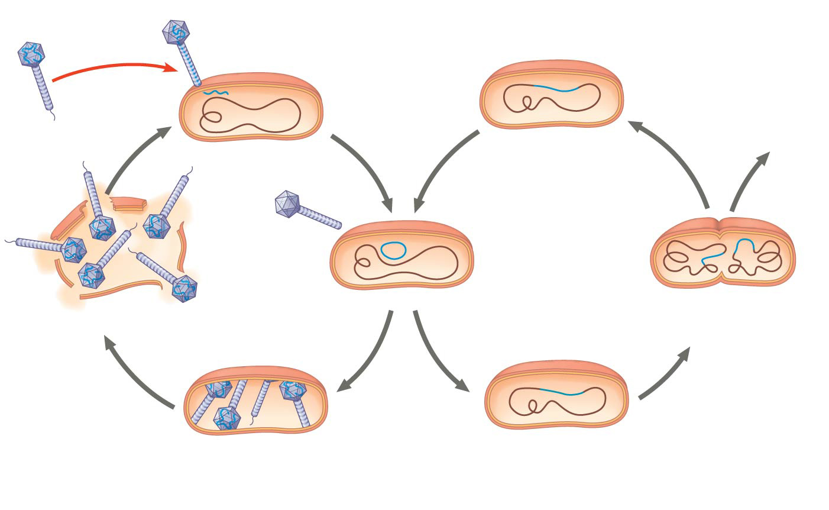
Figure 19.6
Phage
DNA
Daughter cell
with prophage
The phage injects its DNA.
Many cell
divisions
create many
infected
bacteria.
Tail fiber
Phage DNA
circularizes.
Phage
Bacterial
chromosome
Prophage exits
chromosome.
Lytic
cycle
Lysogenic
cycle
Prophage is copied
with bacterial
chromosome.
The cell lyses,
releasing
phages.
Prophage
Phage DNA and proteins
are synthesized and
assembled.
Phage DNA integrates
into bacterial
chromosome.
Notes:
Figure 19.6 The lytic and lysogenic cycles of phage λ, a temperate phage

Slide 34
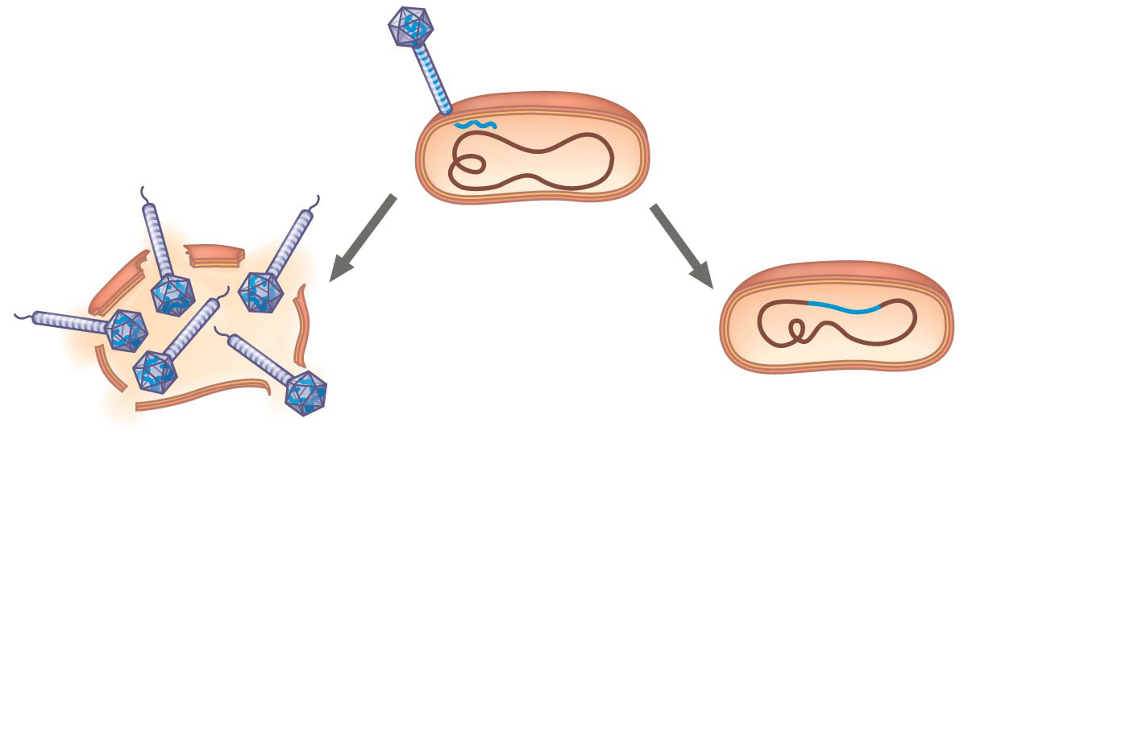
Figure 19.UN03
The phage attaches to a
host cell and injects its DNA.
Phage DNA
Prophage
Bacterial
chromosome
Lytic cycle
Lysogenic cycle
• Virulent or temperate phage
• Destruction of host DNA
• Production of new phages
• Lysis of host cell causes
releases of progeny phages
• Temperate phage only
• Genome integrates into bacterial
chromosome as prophage, which
(1) is replicated and passed on to
daughter cells and
(2) can be induced to leave the
chromosome and initiate a lytic
cycle
Notes:
Figure 19.UN03 Summary of key concepts: lytic and lysogenic cycles

Slide 35
Notes:
In many ways, the regulation of the genes of a particular group of viruses will be similar to the regulation of the host genes. Therefore, which of the following would you expect of the genes of a bacteriophage?
https://www.polleverywhere.com/multiple_choice_polls/A0tHM0fAEKbVg7s

Slide 36
Notes:
Which of the following statements describes the lysogenic cycle of lambda (λ) phage?
https://www.polleverywhere.com/multiple_choice_polls/qHG7xDZrCwvQROw

Slide 37
Concept 19.2: Viruses replicate only in host cells – Animal Viruses
Animal Viruses
There are two key variables used to classify viruses that infect animals
An RNA or DNA genome
A single-stranded or double-stranded genome
Whereas few bacteriophages have an envelope or an RNA genome, many animal viruses have BOTH

Slide 38
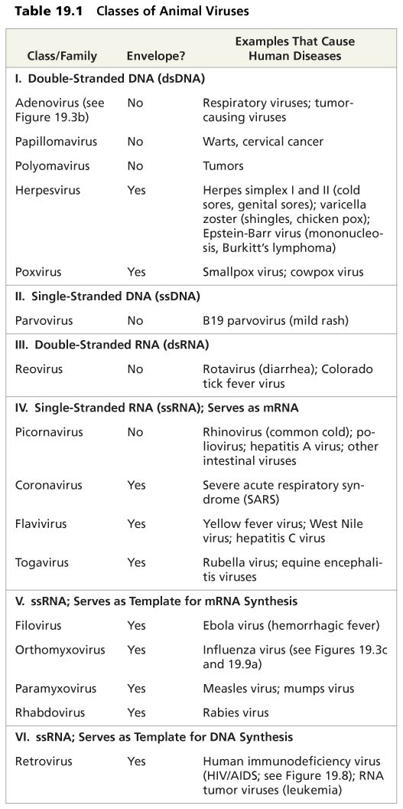
Table 19.1
Notes:
Table 19.1 Classes of animal viruses

Slide 39
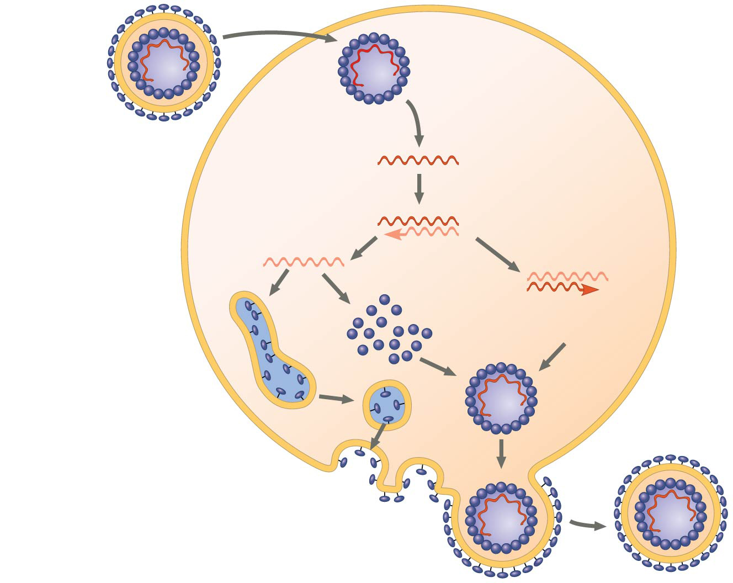
Figure 19.7
Capsid
RNA
HOST CELL
Envelope (with
glycoproteins)
Viral genome
(RNA)
Template
mRNA
Capsid
proteins
Copy of
genome
(RNA)
ER
Glyco-
proteins
New virus
Notes:
Figure 19.7 The replicative cycle of an enveloped RNA virus

Slide 40
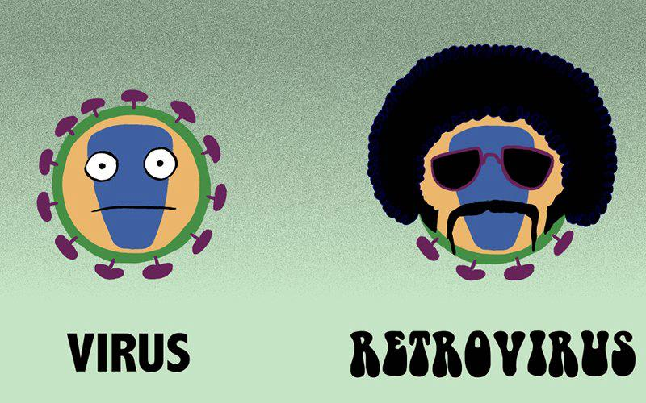
Concept 19.2: Viruses replicate only in host cells – Animal Viruses
Animal Viruses
The broadest variety of RNA genomes is found in viruses that infect animals
Ex: Retroviruses use reverse transcriptase to copy their RNA genome into DNA
HIV (human immunodeficiency virus) is the retrovirus that causes AIDS (acquired immunodeficiency syndrome)

Slide 41
Concept 19.2: Viruses replicate only in host cells – Animal Viruses
Animal Viruses
The viral DNA that is integrated into the host genome is called a provirus
Unlike a prophage, a provirus remains a PERMANENT resident of the host cell
RNA polymerase transcribes the proviral DNA into RNA molecules
The RNA molecules function both as mRNA for synthesis of viral proteins and as genomes for new virus particles released from the cell

Slide 42
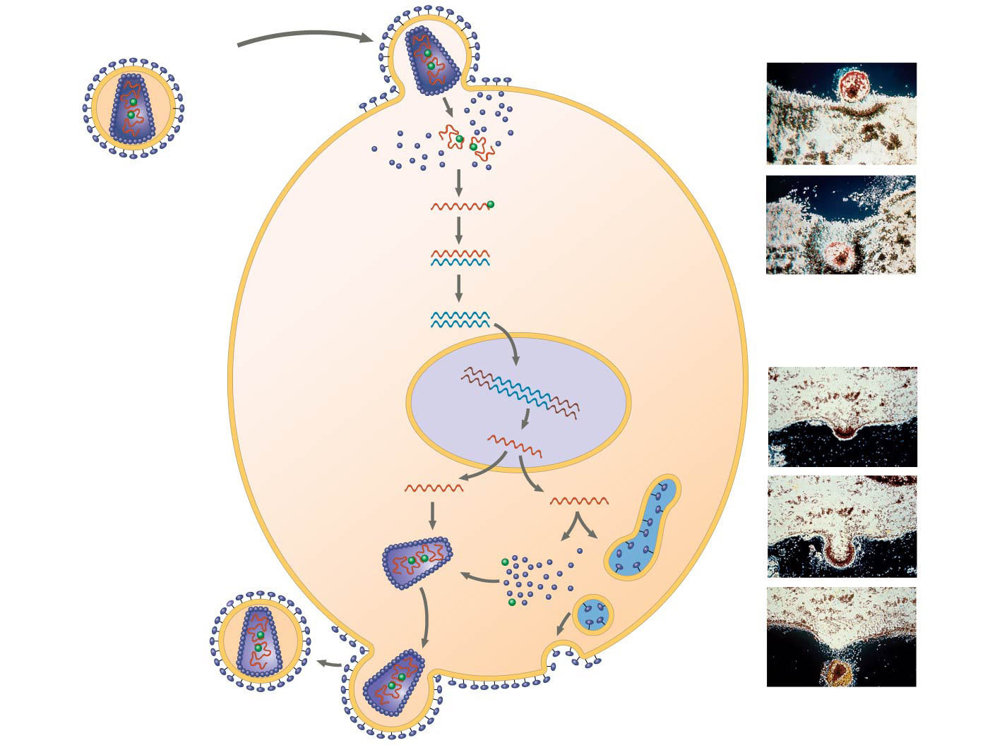
Figure 19.8
Glycoprotein
Viral envelope
Membrane of
white blood cell
HIV
Capsid
RNA (two
identical
strands)
HOST
CELL
HIV
Reverse
transcriptase
Reverse
transcriptase
Viral RNA
RNA-DNA
hybrid
0.25 µm
DNA
HIV entering a cell
NUCLEUS
Provirus
Chromosomal
DNA
RNA genome
for the progeny
viruses
mRNA
New virus
New HIV leaving
a cell
Notes:
Figure 19.8 The replicative cycle of HIV, the retrovirus that causes AIDS

Slide 43
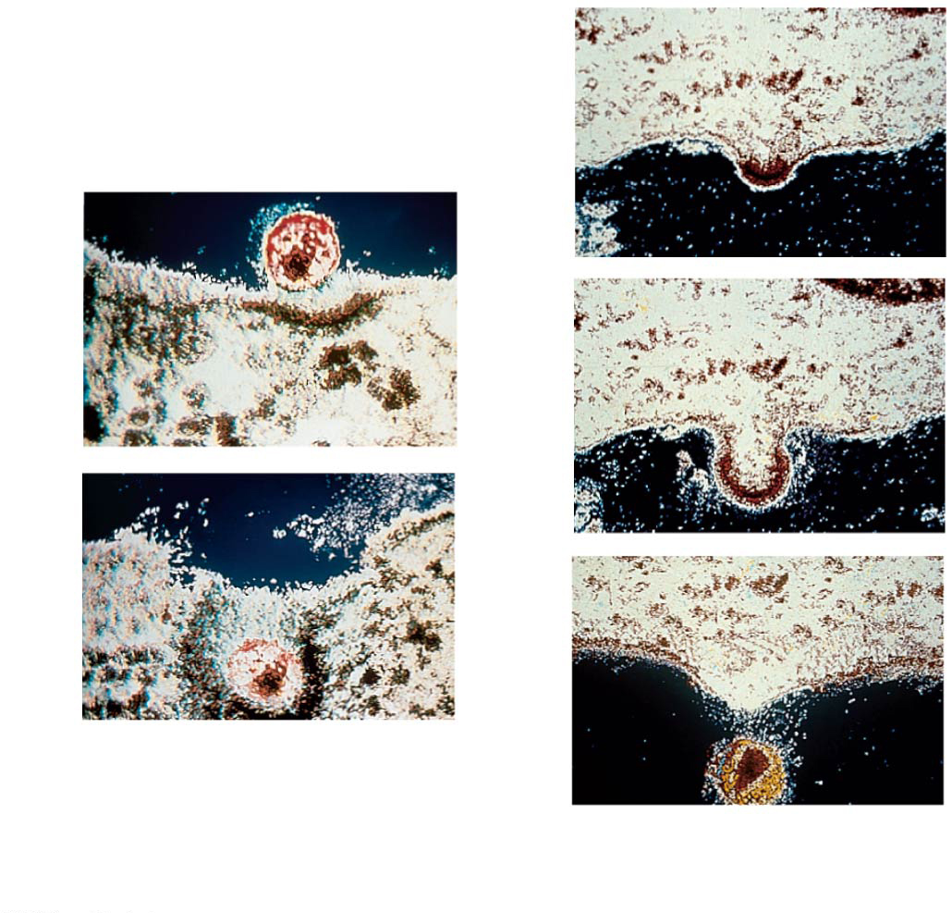
Figure 19.8c
Membrane of
white blood cell
HIV
0.25 µm
HIV entering a cell
New HIV leaving
a cell
Notes:
Figure 19.8c The replicative cycle of HIV, the retrovirus that causes AIDS (part 3: TEMs)

Slide 44
Concept 19.2: Viruses replicate only in host cells – Evolution
Viruses have the ability to introduce genetic change into organisms as well as to undergo rapid genetic change themselves
Transduction: Moving from one host to another, viruses pick up pieces of the first host’s DNA and carry it to the next cell to be infected (common in bacteria)
Viruses LACK critical error-checking mechanisms and thus have high rates of mutation
Viral mutations can rapidly accumulate and give rise to genetically novel viruses WITHIN one organism! (HIV)
Viral mutations can also lead to totally new genetic strains (common cold, flu)

Slide 45
Concept 19.2: Viruses replicate only in host cells – Evolution
Viruses do not fit our definition of living organisms
There is controversy about whether this virus evolved before or after cells
Since viruses can replicate only within cells, they probably evolved as bits of cellular nucleic acid
Candidates for the source of viral genomes include plasmids and transposons
Plasmids, transposons, and viruses are all mobile genetic elements

Slide 46
Overview
Concept 19.1: A virus consists of a nucleic acid surrounded by a protein coat
Concept 19.2: Viruses replicate only in host cells

Slide 47
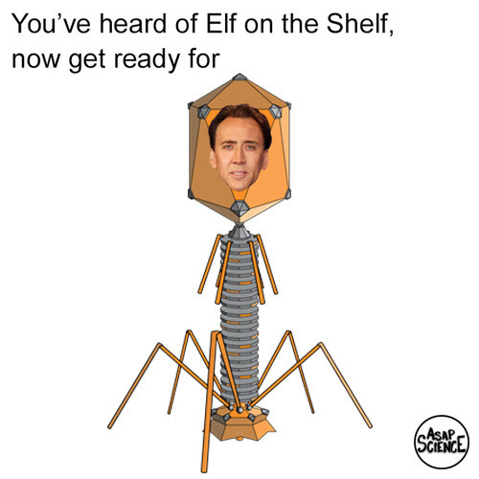
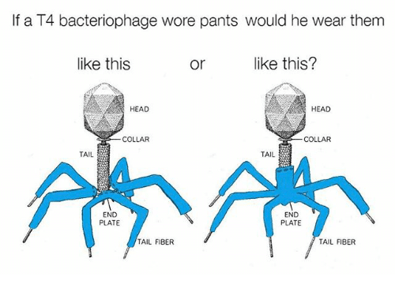
Via Brad

