Slide 1
0
18
Regulation of Gene Expression

Slide 2
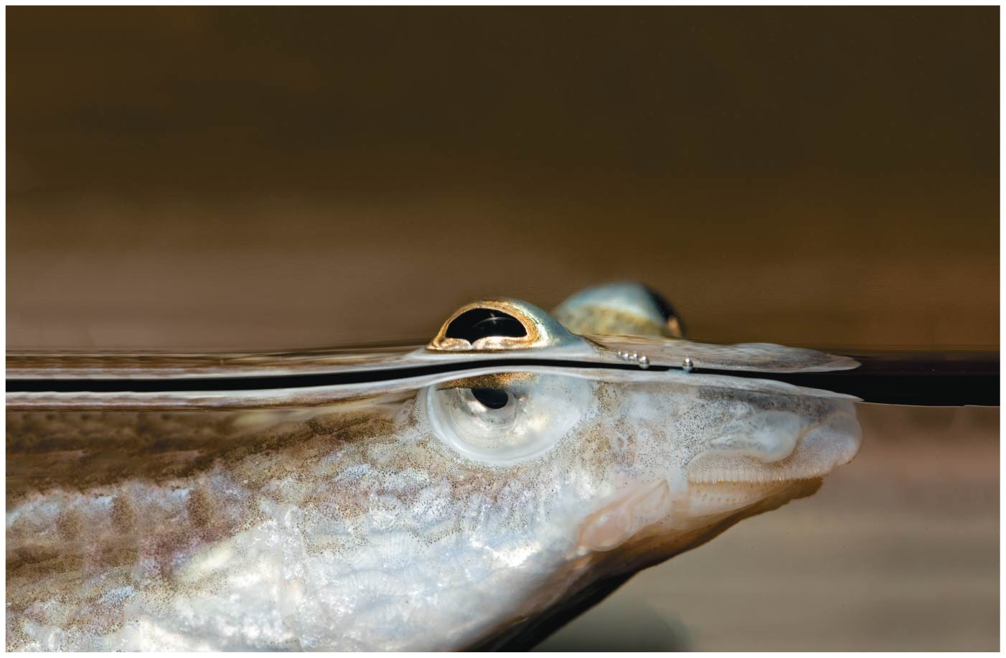
Figure 18.1
Notes:
Figure 18.1 How can this fish’s eyes see equally well in both air and water?

Slide 3
Why regulate gene expression?
Prokaryotes and eukaryotes precisely REGULATE gene expression in response to environmental conditions
In multicellular eukaryotes, gene expression regulates development and is responsible for differences in cell types
RNA molecules play many roles in regulating gene expression in eukaryotes

Slide 4
Overview
Concept 18.1: Bacteria respond to environmental change by regulating transcription
Concept 18.2: Eukaryotic gene expression is regulated at many stages
Concept 18.3: Noncoding RNAs play multiple roles in controlling gene expression
Concept 18.4: A program of differential gene expression leads to the different cell types in a multicellular organism

Slide 5
Overview
Concept 18.1: Bacteria respond to environmental change by regulating transcription
Concept 18.2: Eukaryotic gene expression is regulated at many stages
Concept 18.3: Noncoding RNAs play multiple roles in controlling gene expression
Concept 18.4: A program of differential gene expression leads to the different cell types in a multicellular organism

Slide 6
Concept 18.1: Bacteria respond to environmental change by regulating transcription
Natural selection has favored bacteria that produce ONLY the products needed by that cell
A cell can REGULATE the production of enzymes via gene regulation
One mechanism for control of gene expression in bacteria is the operon model

Slide 7
Notes:
Altering patterns of gene expression in prokaryotes would most likely serve an organism's survival by _____.
https://www.polleverywhere.com/multiple_choice_polls/qfADNwGdjD1okjT

Slide 8
Concept 18.1: Bacteria respond to environmental change by regulating transcription – Operon
An operon is an entire stretch of DNA that includes the operator, the promoter, and the genes that they control
A cluster of functionally related genes can be coordinately controlled by a single “on-off switch”
The “switch” is a segment of DNA called an operator usually positioned within/near the promoter

Slide 9
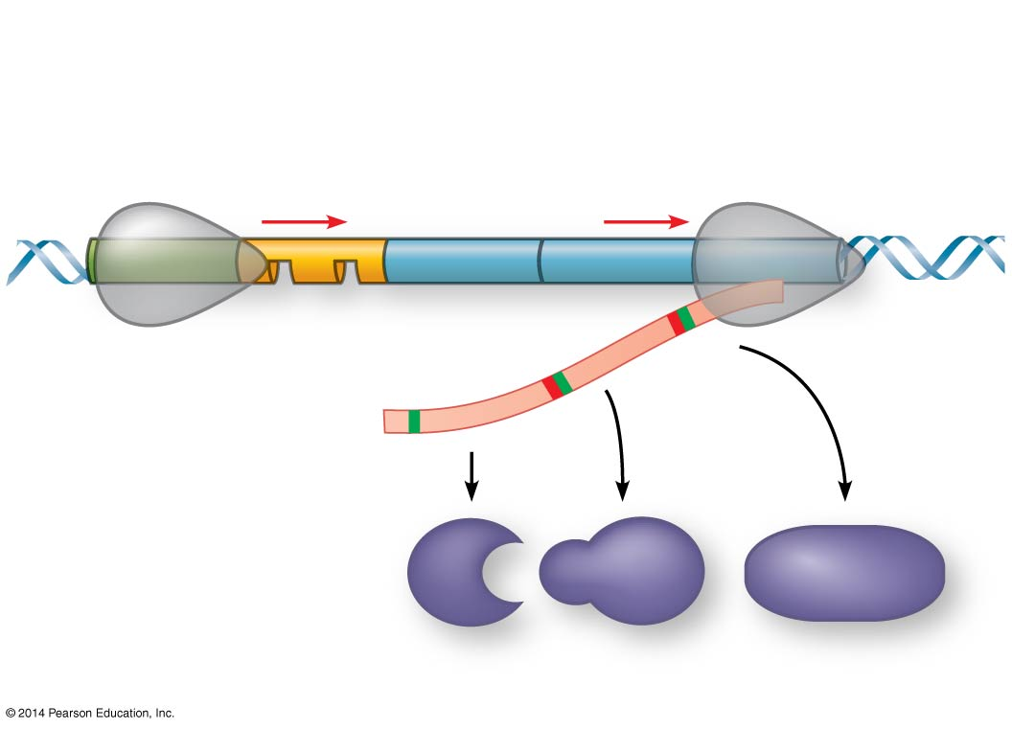
Figure 18.UN06
Operon
Promoter
Genes
A B C
Operator
RNA polymerase
A B C
Polypeptides
Notes:
Figure 18.UN06 Summary of key concepts: operon, general

Slide 10
Concept 18.1: Bacteria respond to environmental change by regulating transcription – Operon
The operon can be switched OFF by a protein repressor
The repressor PREVENTS gene transcription by binding to the operator and blocking RNA polymerase
A corepressor is a molecule that cooperates with a repressor protein to switch an operon off

Slide 11
Notes:
A lack of which molecule would result in a cell's inability to "turn off" genes?
https://www.polleverywhere.com/multiple_choice_polls/tjbMgE9IWaDOrbb

Slide 12
Concept 18.1: Bacteria respond to environmental change by regulating transcription – Operon
NOTE: The repressor is the product of a separate regulatory gene NOT FOUND ON THE OPERON!!!
The repressor can be in an ACTIVE or INACTIVE form, depending on the presence (or lack thereof) of other molecules
Ex: trp operon: INACTIVE w/out tryptophan + ACTIVE w/ tryprotphan
Ex: lac operon INACTIVE w/ lactose + ACTIVE w/out lactose

Slide 13
Notes:
Which of the following is a protein produced by a regulatory gene?
https://www.polleverywhere.com/multiple_choice_polls/RvsS6Kpg8qfqjAH

Slide 14
Concept 18.1: Bacteria respond to environmental change by regulating transcription – trp Operon
E. coli can synthesize the amino acid tryptophan when it has insufficient tryptophan (needs trp, makes trp)
By default: trp operon = ON → genes for tryptophan synthesis = transcribed
Regulation: trp operon = OFF (REPRESSED) if tryptophan levels are high/sufficient → genes for tryptophan synthesis = NOT transcribed
When enough tryptophan is synthesized, it beings to bind to the trp repressor protein → turns the operon OFF
This repressor protein is active only in the presence of its corepressor tryptophan

Slide 15
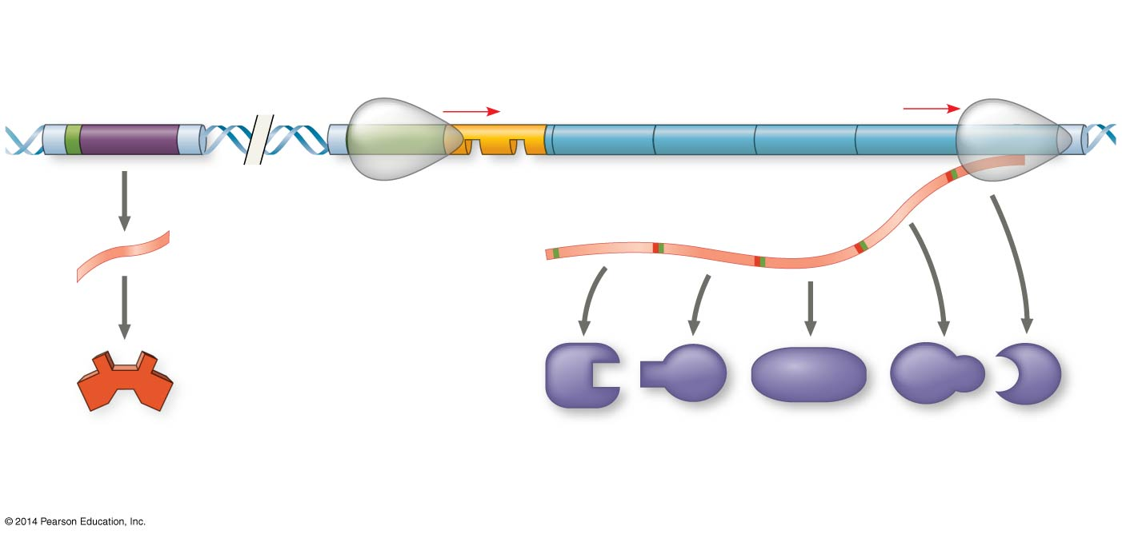
Figure 18.3a
NOT PART OF OPERON!
DNA
trp operon
Promoter
Promoter
Regulatory gene
Genes of operon
trpR
trpE
trpD
trpC
trpB
trpA
RNA polymerase
Operator
mRNA
Start codon
Stop codon
3′
mRNA 5′
5′
Protein
Inactive repressor
E D C B A
Polypeptide subunits that make up enzymes for tryptophan synthesis
(a) Tryptophan absent, repressor inactive, operon on
Notes:
Figure 18.3a The trp operon in E. coli: regulated synthesis of repressible enzymes (part 1: tryptophan absent)

Slide 16
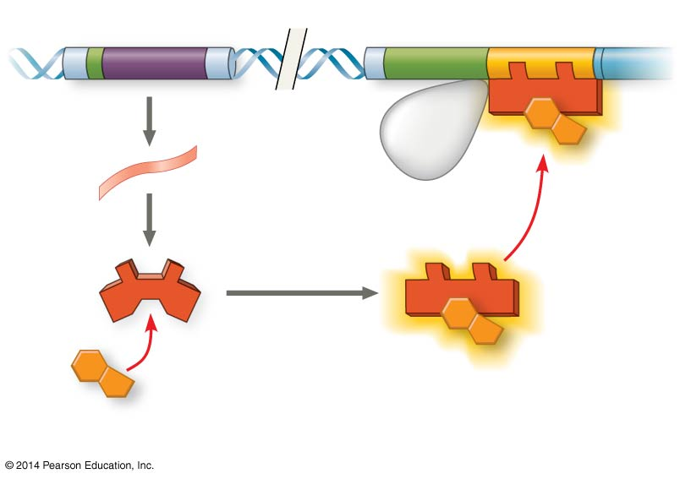
Figure 18.3b
NOT PART OF OPERON!
DNA
trpR
trpE
No RNA made
3′
mRNA
5′
Protein
Active repressor
Tryptophan (corepressor)
(b) Tryptophan present, repressor active, operon off
Notes:
Figure 18.3b The trp operon in E. coli: regulated synthesis of repressible enzymes (part 2: tryptophan present)

Slide 17
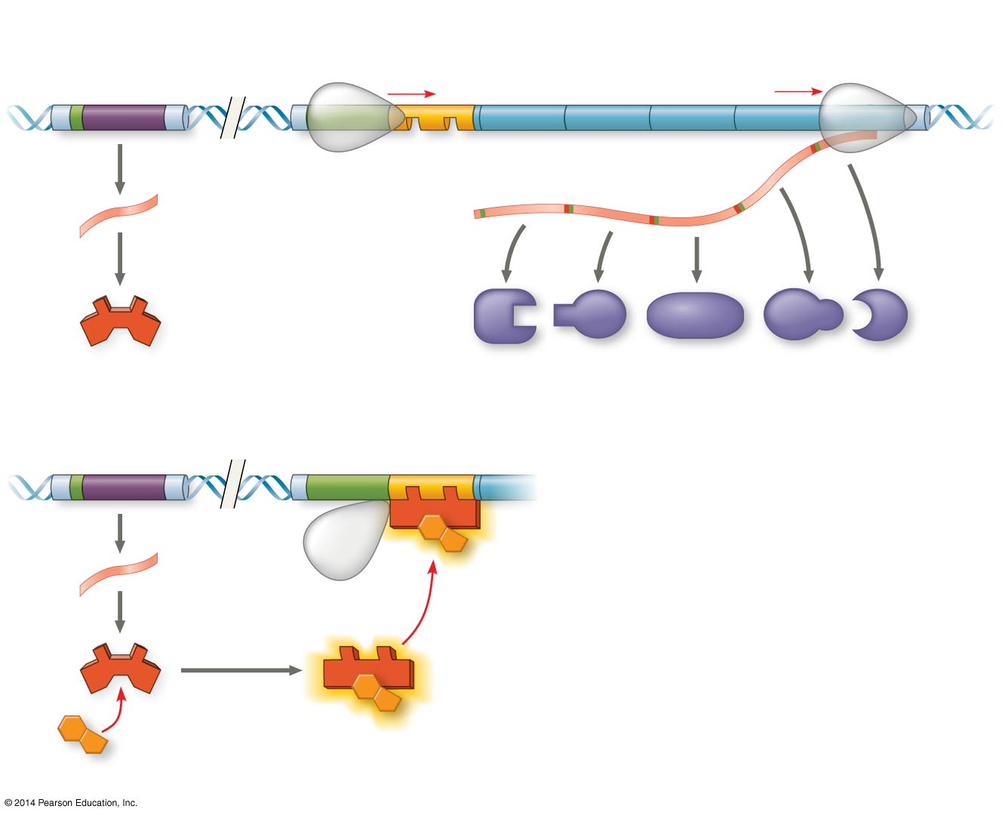
Figure 18.3
trp operon
DNA
Promoter
Promoter
Regulatory gene
Genes of operon
trpR
trpE
trpD
trpC
trpB
trpA
RNA polymerase
Operator
Start codon
Stop codon
mRNA
3′
mRNA 5′
5′
Protein
Inactive repressor
E D C B A
(a) Tryptophan absent, repressor inactive, operon on
Polypeptide subunits that make up enzymes for tryptophan synthesis
DNA
trpR
trpE
No RNA made
mRNA
3′
5′
Protein
Active repressor
Tryptophan (corepressor)
(b) Tryptophan present, repressor active, operon off
Notes:
Figure 18.3 The trp operon in E. coli: regulated synthesis of repressible enzymes

Slide 18
Concept 18.1: Bacteria respond to environmental change by regulating transcription: (-) Regulation
Negative (-) Gene Regulation of Operons
A repressible operon is one that is USUALLY ON
Binding of a repressor to the operator shuts off transcription
Repressible enzymes usually function in anabolic pathways; their synthesis is REPRESSED by high levels of the end product
Ex: trp operon = repressible operon

Slide 19
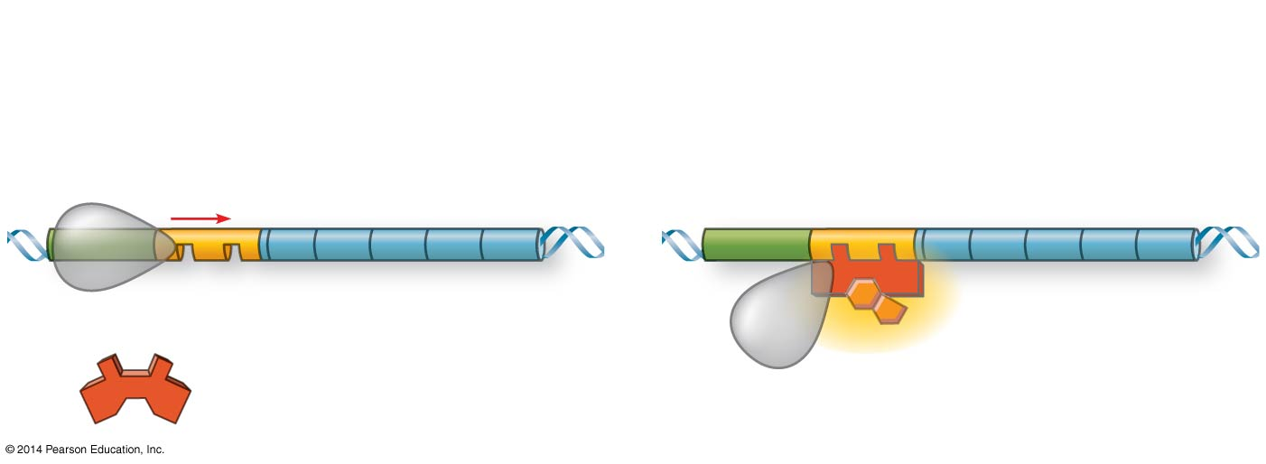
Figure 18.UN07
Repressible operon:
Genes expressed
Genes not expressed
Promoter
Genes
Operator
Active repressor: corepressor bound
Inactive repressor: no corepressor present
Corepressor
The “Norm”
The “Regulated”
Notes:
Figure 18.UN07 Summary of key concepts: operon, repressible

Slide 20
Notes:
A mutation that inactivates a regulatory gene of a repressible operon in an E. coli cell would result in _____.
https://www.polleverywhere.com/multiple_choice_polls/cWaGe7f0yLQTywW

Slide 21
Notes:
For a repressible operon to be transcribed, which of the following must occur?
https://www.polleverywhere.com/multiple_choice_polls/aNbvRAFzijvfNTj

Slide 22
Concept 18.1: Bacteria respond to environmental change by regulating transcription: (-) Regulation
Negative (-) Gene Regulation of Operons
An inducible operon is one that is USUALLY OFF
An inducer INACTIVATES the repressor and turns on transcription (repressor off…genes txned)
Inducible enzymes usually function in catabolic pathways; their synthesis is INDUCED by a chemical signal

Slide 23
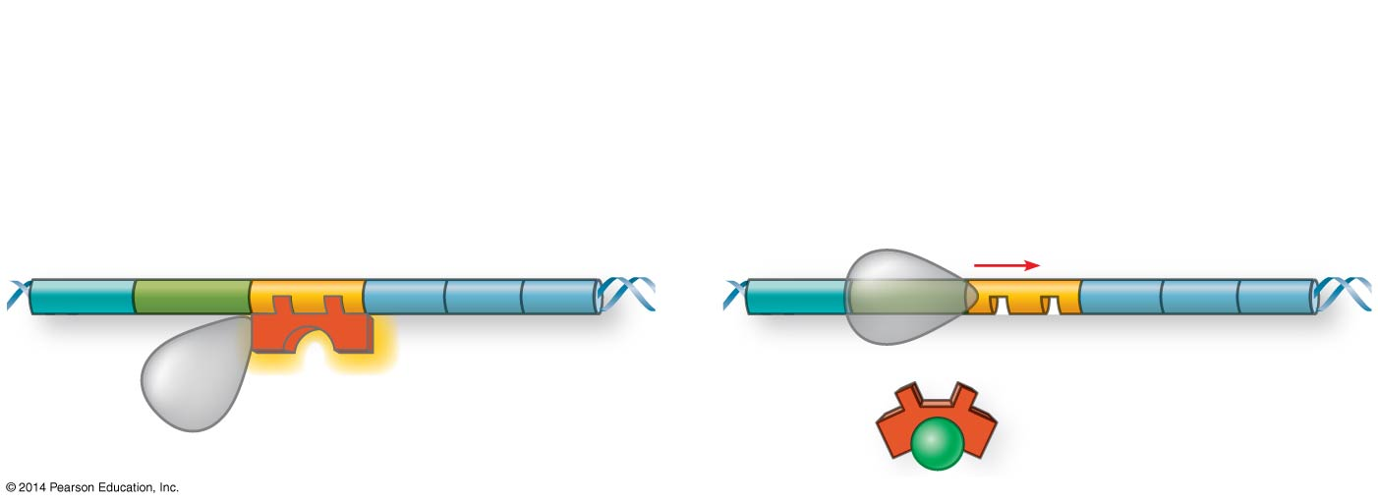
Figure 18.UN08
Inducible operon:
Genes not expressed
Genes expressed
Promoter
Operator
Genes
Active repressor: no inducer present
Inactive repressor: inducer bound
Inducer
The “Norm”
The “Regulated”
Notes:
Figure 18.UN08 Summary of key concepts: operon, inducible

Slide 24
Concept 18.1: Bacteria respond to environmental change by regulating transcription: (-) Regulation
Negative (-) Gene Regulation of Operons
Ex: lac operon = inducible operon
Contains genes that code for enzymes used in the hydrolysis and metabolism of lactose
By itself, the lac repressor is active and switches the lac operon OFF (off “by default”)
In the presence of an inducer (allolactose) → repressor falls off operator → lac metabolism genes txned

Slide 25
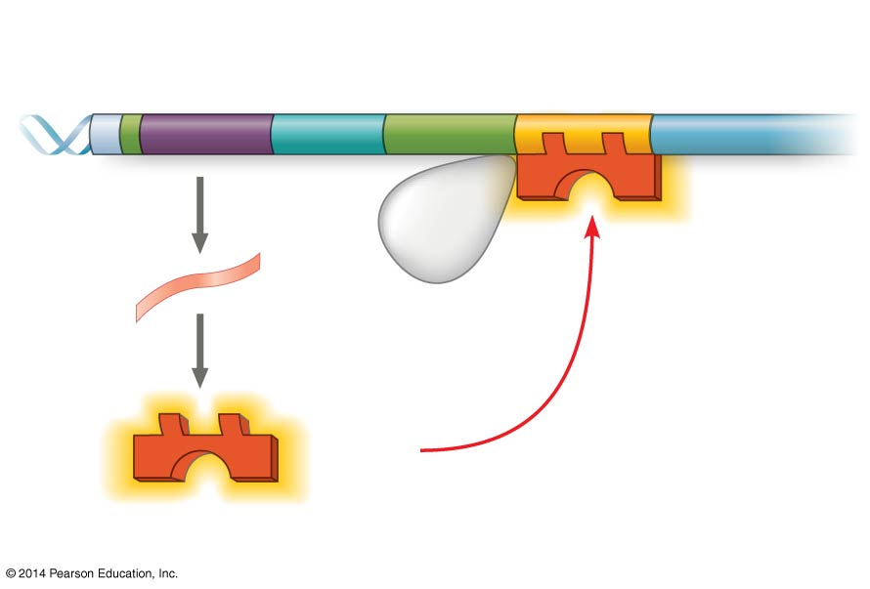
Figure 18.4a
NOT PART OF OPERON!
Regulatory gene
Promoter
DNA
Operator
I
lac
IacZ
No RNA made
3′
mRNA
5′
RNA polymerase
Protein
Active repressor
(a) Lactose absent, repressor active, operon off
Notes:
Figure 18.4a The lac operon in E. coli: regulated synthesis of inducible enzymes (part 1: lactose absent)

Slide 26
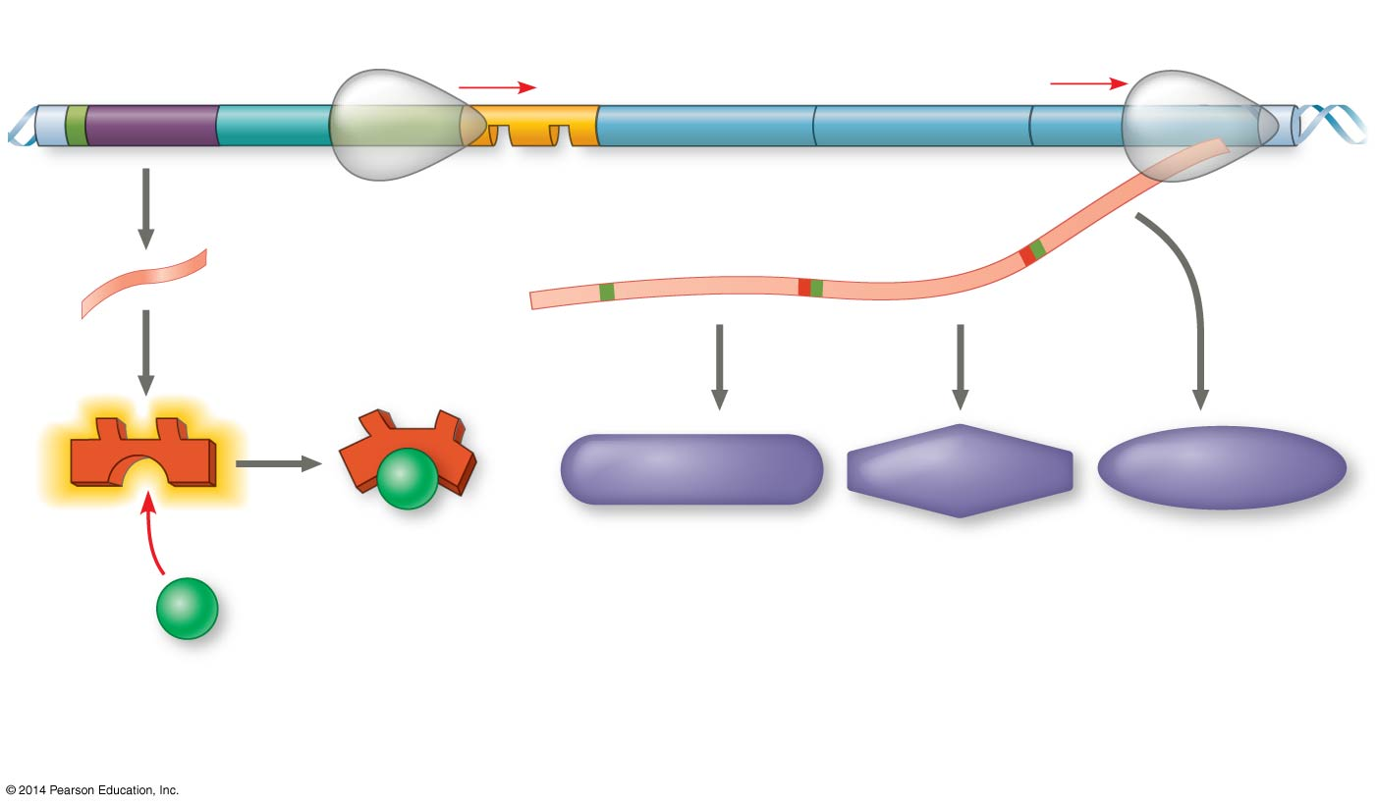
Figure 18.4b
NOT PART OF OPERON!
DNA
lac operon
lac
I
lacZ
lacY
lacA
mRNA
RNA polymerase
3′
Start codon
Stop codon
5′
mRNA 5′
Protein
β-Galactosidase
Permease
Transacetylase
Inactive repressor
Allolactose (inducer)
(b) Lactose present, repressor inactive, operon on
Notes:
Figure 18.4b The lac operon in E. coli: regulated synthesis of inducible enzymes (part 2: lactose present)

Slide 27
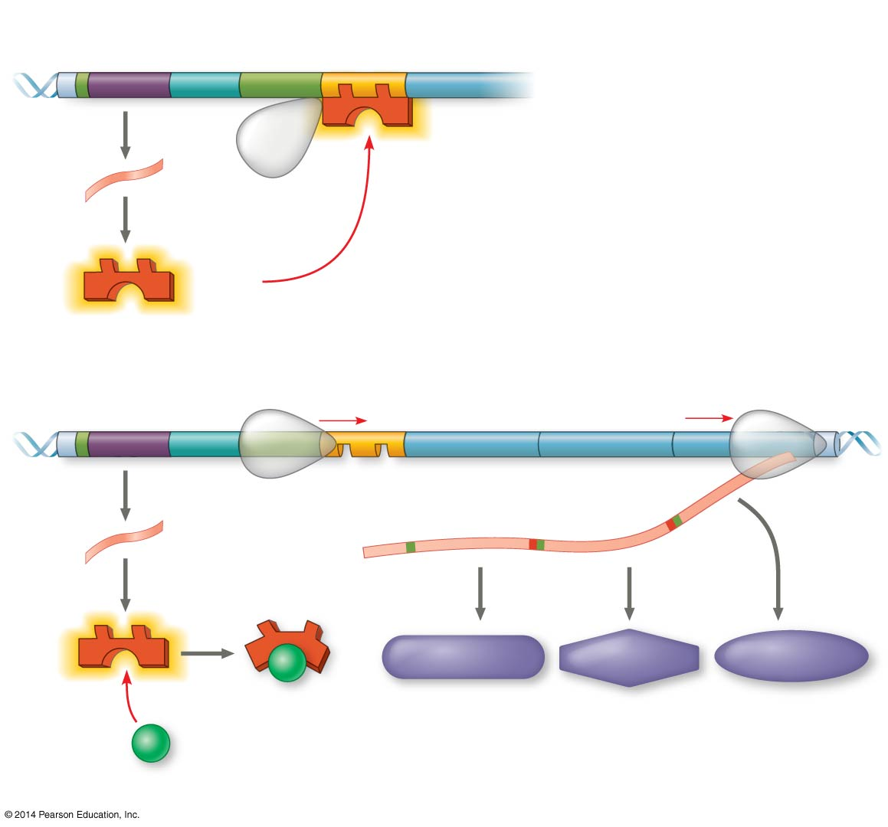
Figure 18.4
Regulatory gene
Promoter
DNA
Operator
lac
I
IacZ
No RNA made
mRNA
3′
5′
RNA polymerase
Protein
Active repressor
(a) Lactose absent, repressor active, operon off
lac operon
DNA
lac
I
lacZ
lacY
lacA
RNA polymerase
Start codon
Stop codon
3′
mRNA
3′
5′
mRNA 5′
Protein
β-Galactosidase
Permease
Transacetylase
Inactive repressor
Allolactose (inducer)
(b) Lactose present, repressor inactive, operon on
Notes:
Figure 18.4 The lac operon in E. coli: regulated synthesis of inducible enzymes

Slide 28
Notes:
Transcription of structural genes in an inducible operon _____.
https://www.polleverywhere.com/multiple_choice_polls/PGpF0fmTLJyviD4

Slide 29
Concept 18.1: Bacteria respond to environmental change by regulating transcription: (-) Regulation
Regulation of the trp and lac operons involves negative control of genes because operons are switched off by the active form of the repressor
Negative control is all about the repressor

Slide 30
Concept 18.1: Bacteria respond to environmental change by regulating transcription: (+) Regulation
Positive control occurs via stimulatory protein
CAP = catabolite activator protein
Activator of transcription, BUT is in inactive form
CAP+cAMP
Activator of transcription, in active form
What dictates active vs. inactive form?
The “Glucose Golden Rule” = Presence (or lack thereof) of glucose

Slide 31
Concept 18.1: Bacteria respond to environmental change by regulating transcription: (+) Regulation
When glucose (a preferred food source of E. coli) is scarce, CAP IS ACTIVATED by binding with cyclic AMP (cAMP)
Activated CAP attaches to the promoter of the lac operon and INCREASES the affinity of RNA polymerase, thus ACCELERATING TRANSCRIPTION of lac metabolism genes
When glucose levels increase, CAP detaches from the lac operon, and lac operon transcription returns to a “normal rate”
It’ll still happen, but not nearly as much or as efficiently as with CAP+cAMP (active CAP)

Slide 32
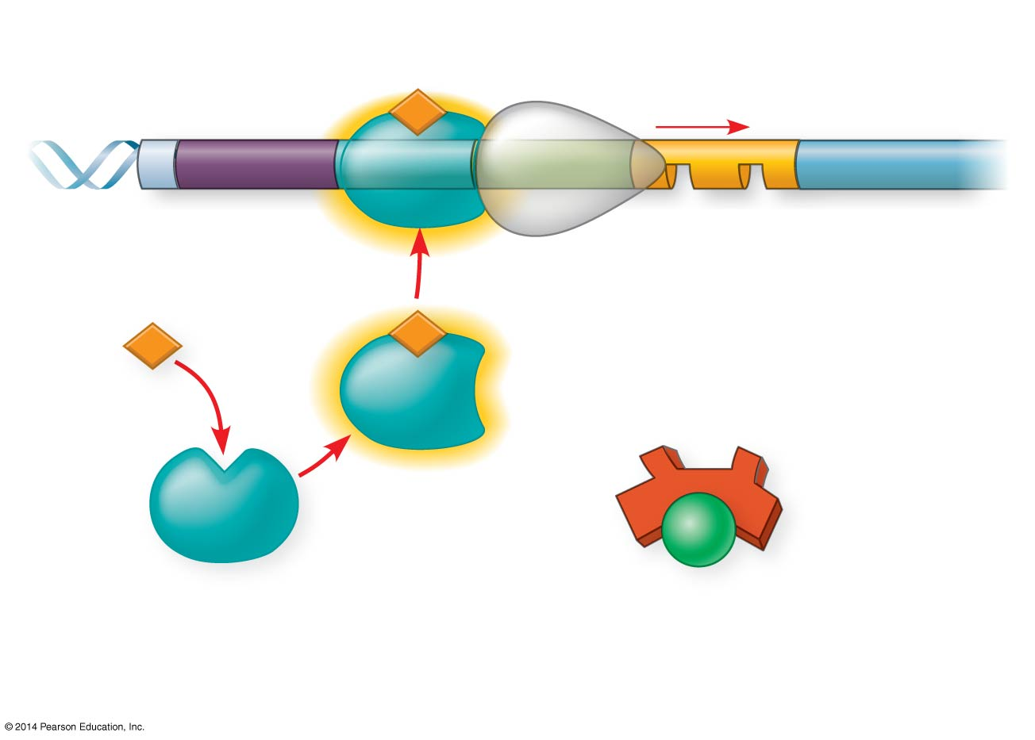
Figure 18.5a
Why?
Promoter
Operator
DNA
lac
I
lacZ
CAP-binding site
RNA polymerase binds and transcribes
Active
CAP
cAMP
Inactive lac repressor
Inactive
CAP
Allolactose
(a) Lactose present, glucose scarce (cAMP level high): abundant lac mRNA synthesized
Notes:
Figure 18.5a Positive control of the lac operon by catabolite activator protein (CAP) (part 1: glucose scarce)

Slide 33
Figure 18.5a
Promoter
Operator
DNA
lac
I
lacZ
CAP-binding site
RNA polymerase binds and transcribes
Active
CAP
cAMP
That’s why!
Inactive lac repressor
Inactive
CAP
Allolactose
(a) Lactose present, glucose scarce (cAMP level high): abundant lac mRNA synthesized
Notes:
Figure 18.5a Positive control of the lac operon by catabolite activator protein (CAP) (part 1: glucose scarce)

Slide 34
Figure 18.5b
Why?
Promoter
DNA
lac
lacZ
I
CAP-binding site
Operator
RNA polymerase less likely to bind
Inactive
CAP
Inactive lac repressor
(b) Lactose present, glucose present (cAMP level low): little lac mRNA synthesized
Notes:
Figure 18.5b Positive control of the lac operon by catabolite activator protein (CAP) (part 2: glucose present)

Slide 35
Figure 18.5b
Promoter
DNA
lac
lacZ
I
CAP-binding site
Operator
RNA polymerase less likely to bind
Inactive
CAP
That’s why!
Inactive lac repressor
(b) Lactose present, glucose present (cAMP level low): little lac mRNA synthesized
Notes:
Figure 18.5b Positive control of the lac operon by catabolite activator protein (CAP) (part 2: glucose present)

Slide 36
Notes:
In positive control of several sugar-metabolism-related operons, the catabolite activator protein (CAP) binds to DNA to stimulate transcription. What causes an increase in CAP activity in stimulating transcription?
https://www.polleverywhere.com/multiple_choice_polls/GPhxDS5VhWnM6JX

Slide 37
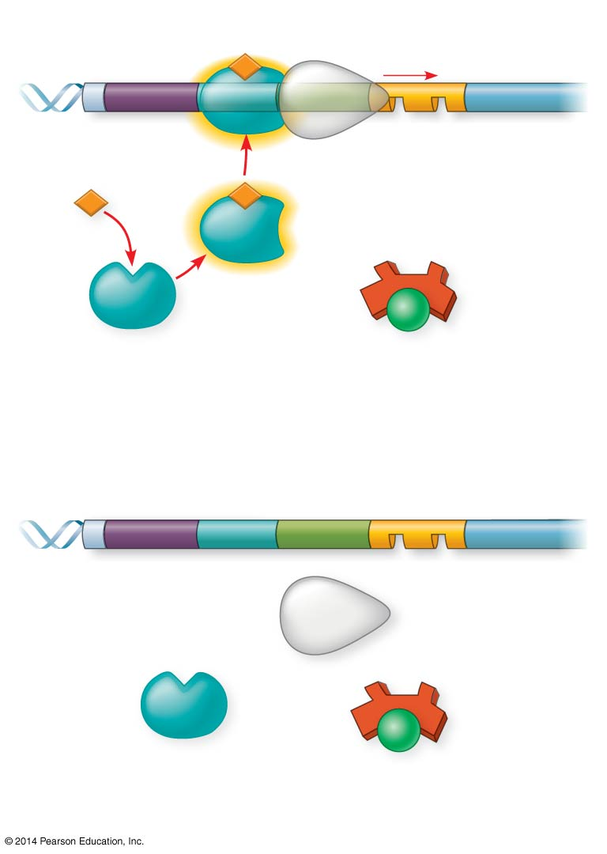
Figure 18.5
Promoter
DNA
Operator
lac
I
lacZ
CAP-binding site
RNA polymerase binds and transcribes
Active
CAP
cAMP
Inactive lac repressor
Inactive
CAP
Allolactose
(a) Lactose present, glucose scarce (cAMP level high): abundant lac mRNA synthesized
Promoter
DNA
lac
I
lacZ
CAP-binding site
Operator
RNA polymerase less likely to bind
Inactive
CAP
Inactive lac repressor
(b) Lactose present, glucose present (cAMP level low): little lac mRNA synthesized
Notes:
Figure 18.5 Positive control of the lac operon by catabolite activator protein (CAP)

Slide 38
Notes:
The lactose operon is likely to be transcribed when _____.
https://www.polleverywhere.com/multiple_choice_polls/W0mMVtFN3DHBvbK

Slide 39
Notes:
There is a mutation in the repressor that results in a molecule known as a super-repressor because it represses the lac operon permanently. Which of these would characterize such a mutant?
https://www.polleverywhere.com/multiple_choice_polls/pHoctdnilxomL96

Slide 40
18.1 RECAP
True/False: Pro and Eu BOTH regulate gene expression
True/False: The operon model of gene regulation applies to ALL organisms
True/False: An operon is a stretch of DNA that includes the operator, promoter, and regulatory gene
True/False: A repressor physically blocks RNA polymerase
True/False: The trp and lac operon repressors are both normally ACTIVE
True/False: Tryptophan is a corepressor
True/False: A repressible operon is usually ON
True/False: The lac operon is an inducible operon
True/False: The trp operon leads to a catabolic pathway
True/False: CAP is usually in its active form
True/False: High cAMP levels promote an active CAP
True/False: High glucose levels promote an active CAP

Slide 41
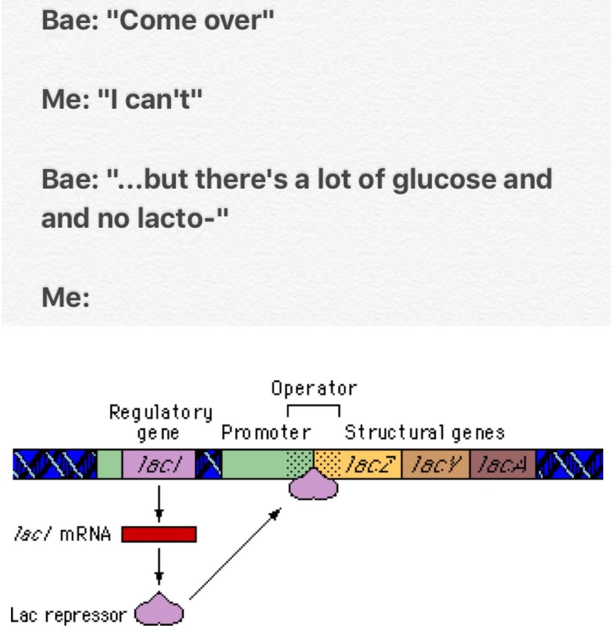

Slide 42
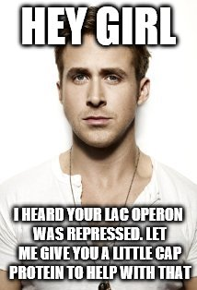
(active)

Slide 43
Overview
Concept 18.1: Bacteria respond to environmental change by regulating transcription
Concept 18.2: Eukaryotic gene expression is regulated at many stages
Concept 18.3: Noncoding RNAs play multiple roles in controlling gene expression
Concept 18.4: A program of differential gene expression leads to the different cell types in a multicellular organism

Slide 44
Concept 18.2: Eukaryotic gene expression is regulated at many stages
All organisms must regulate which genes are expressed at any given time
In multicellular organisms, regulation of gene expression is essential for cell specialization

Slide 45
Concept 18.2: Eukaryotic gene expression is regulated at many stages
Differential Gene Expression
Almost all the cells in an organism are genetically identical!!! (carry same exact genome)
Differences between cell types result from differential gene expression, the expression of different genes by different cells with the SAME genome!
Abnormalities in gene expression can lead to diseases including cancer
Gene expression is REGULATED at many stages

Slide 46
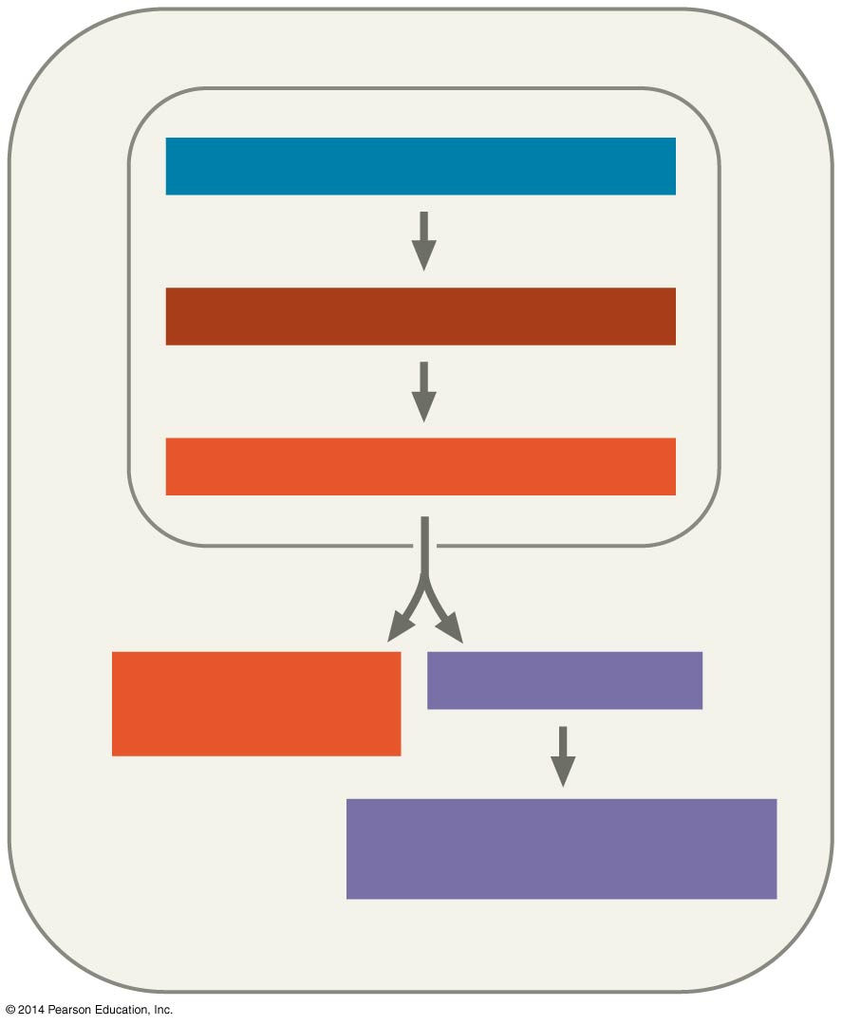
Figure 18.UN09a
CHROMATIN MODIFICATION
TRANSCRIPTION
RNA PROCESSING
mRNA DEGRADATION
TRANSLATION
PROTEIN PROCESSING AND DEGRADATION
Notes:
Figure 18.UN09a Summary of key concepts: eukaryotic regulation of gene expression (part 1)

Slide 47
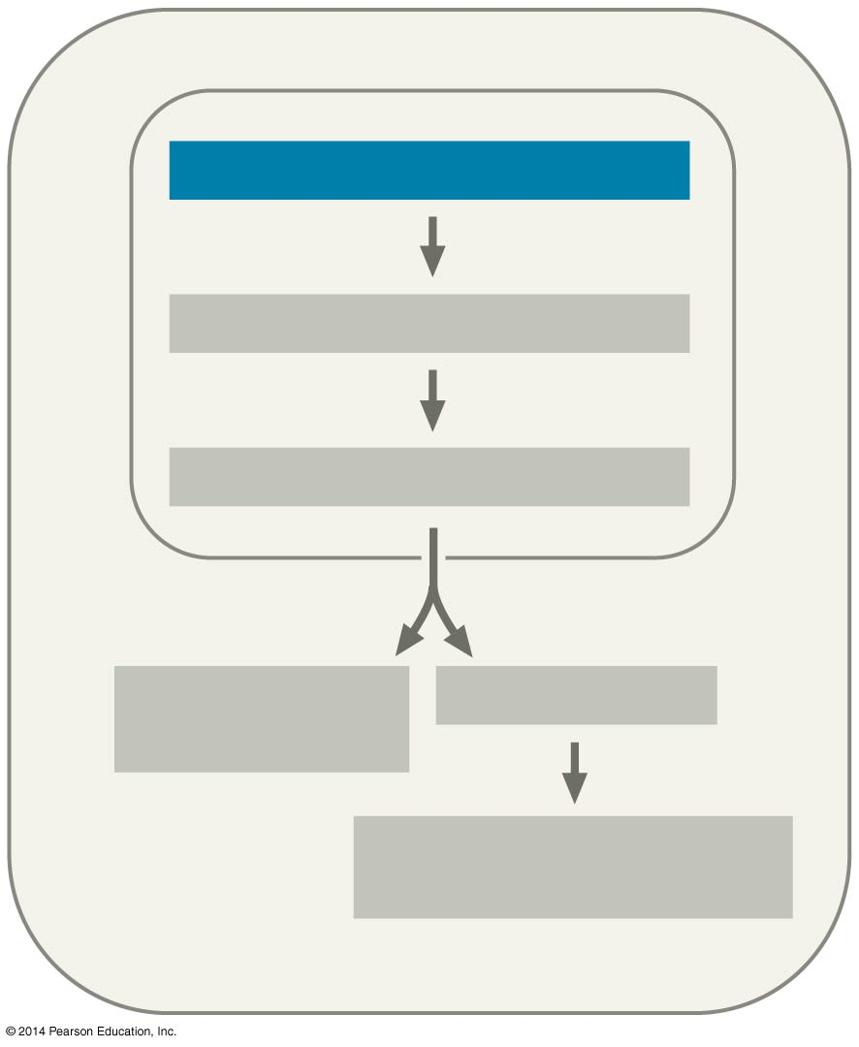
Figure 18.UN01
CHROMATIN MODIFICATION
TRANSCRIPTION
RNA PROCESSING
mRNA DEGRADATION
TRANSLATION
PROTEIN PROCESSING AND DEGRADATION
Notes:
Figure 18.UN01 In-text figure, chromatin modification, p. 366

Slide 48
Concept 18.2: Eukaryotic gene expression is regulated at many stages – Chromatin
The structural organization of chromatin helps regulate gene expression in several ways
Chemical modifications to histones and DNA of chromatin influence both chromatin structure and therefore, gene expression
Makes a region of DNA either more or less able to bind the transcription machinery

Slide 49
Concept 18.2: Eukaryotic gene expression is regulated at many stages – Chromatin
Histone Modifications
In histone acetylation, acetyl groups are attached to positively charged lysines in histone tails
This LOOSENS chromatin structure, thereby PROMOTING the initiation of transcription

Slide 50
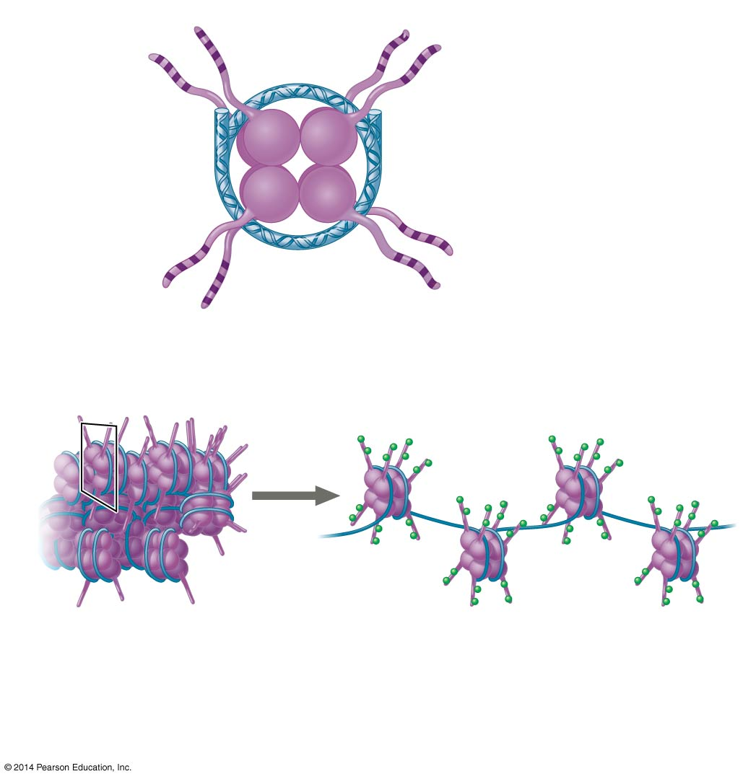
Figure 18.7
Histone tails
DNA double helix
Amino acids available for chemical modification
Nucleosome (end view)
(a) Histone tails protrude outward from a nucleosome
Acetyl groups
DNA
Unacetylated histones (side view)
Acetylated histones
(b) Acetylation of histone tails promotes loose chromatin structure that permits transcription
Notes:
Figure 18.7 A simple model of histone tails and the effect of histone acetylation

Slide 51
Concept 18.2: Eukaryotic gene expression is regulated at many stages – Chromatin
DNA Modifications
DNA methylation, the addition of methyl groups to certain bases in DNA, is associated with REDUCED transcription
DNA methylation can cause long-term INACTIVATION of genes in cellular differentiation
Ex: Genomic imprinting
Methylation regulates expression of either the maternal or paternal alleles of certain genes at the start of development

Slide 52
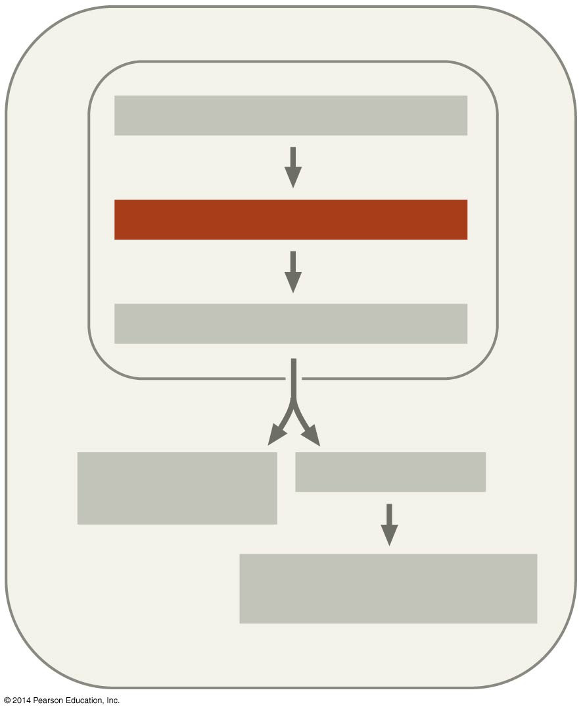
Figure 18.UN02
CHROMATIN MODIFICATION
TRANSCRIPTION
RNA PROCESSING
mRNA DEGRADATION
TRANSLATION
PROTEIN PROCESSING AND DEGRADATION
Notes:
Figure 18.UN02 In-text figure, transcription, p. 369

Slide 53
Concept 18.2: Eukaryotic gene expression is regulated at many stages – TXN
TXN Initiation Regulation
Associated with most eukaryotic genes are multiple control elements, segments of noncoding DNA that serve as binding sites for transcription factors that help regulate transcription

Slide 54
Concept 18.2: Eukaryotic gene expression is regulated at many stages – TXN
Transcription Factors (Initiation)
To INITIATE transcription, eukaryotic RNA polymerase requires the assistance of transcription factors
General transcription factors are essential for the transcription of ALL protein-coding genes
Some transcription factors function as repressors, inhibiting expression of a particular gene

Slide 55
Concept 18.2: Eukaryotic gene expression is regulated at many stages – TXN
Enhancers and Specific Transcription Factors
In eukaryotes, high levels of transcription of particular genes depend on control elements interacting with specific transcription factors
Proximal control elements are located close to the promoter
Distal control elements, groupings of which are called enhancers, may be far away from a gene or even located in an intron
An activator is a protein that binds to an enhancer and STIMULATES transcription of a gene

Slide 56
Figure 18.10-1
DNA
Activators
Promoter
Gene
Enhancer
Distal control element
TATA box
Notes:
Figure 18.10-1 A model for the action of enhancers and transcription activators (step 1)

Slide 57
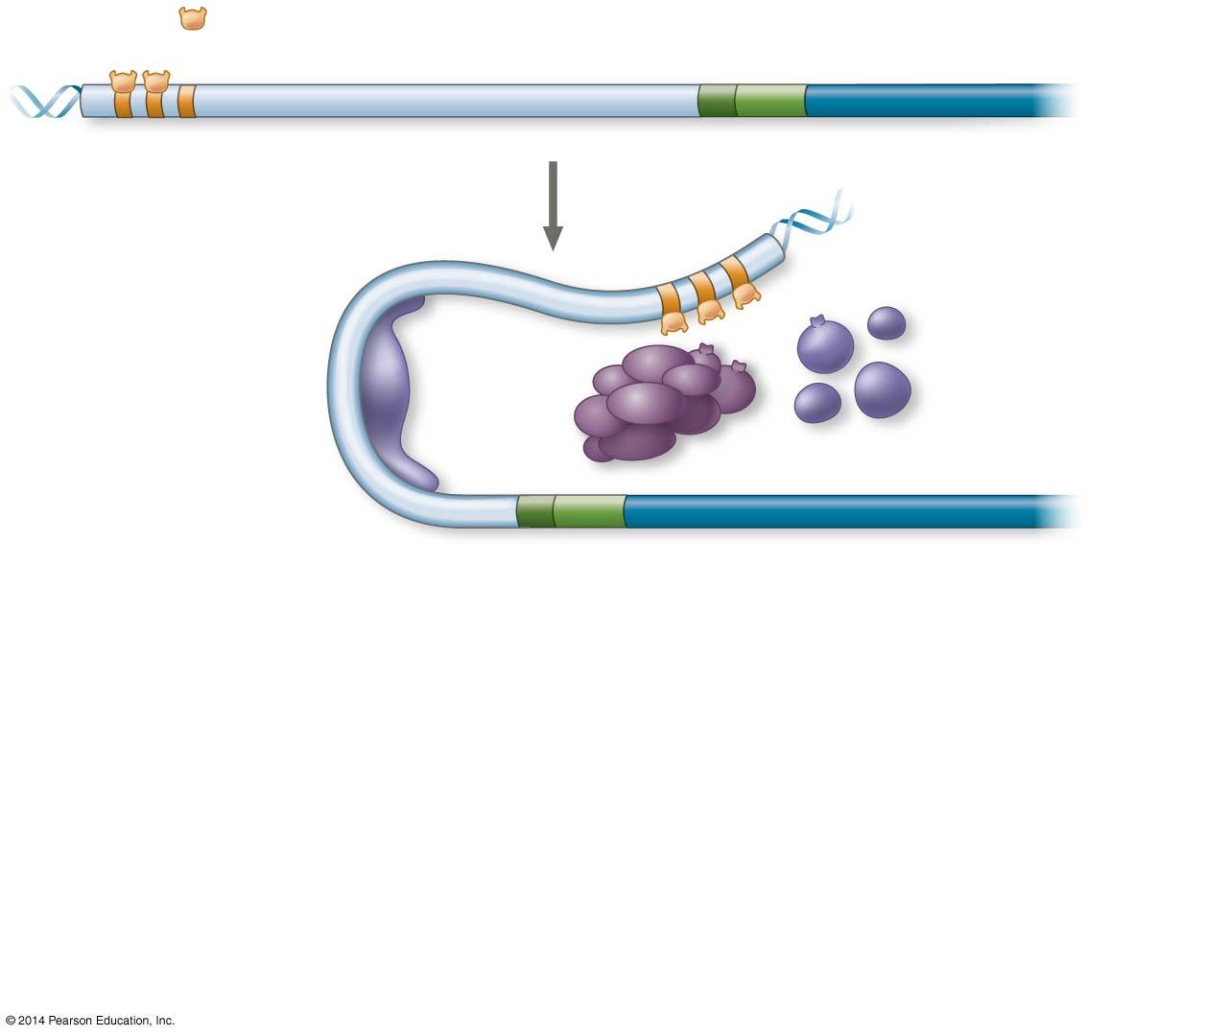
Figure 18.10-2
DNA
Activators
Promoter
Gene
Enhancer
Distal control element
TATA box
General transcription factors
DNA- bending protein
Group of mediator proteins
Notes:
Figure 18.10-2 A model for the action of enhancers and transcription activators (step 2)

Slide 58
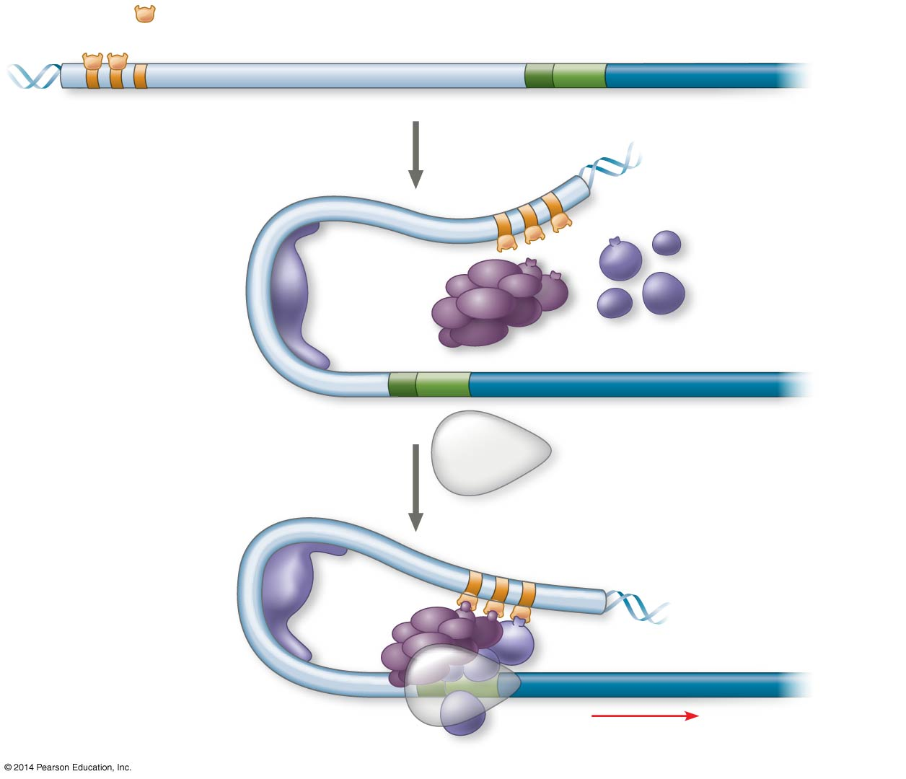
Figure 18.10-3
DNA
Activators
Promoter
Gene
Enhancer
Distal control element
TATA box
General transcription factors
DNA- bending protein
Group of mediator proteins
RNA polymerase II
RNA polymerase II
Transcription initiation complex
RNA synthesis
Notes:
Figure 18.10-3 A model for the action of enhancers and transcription activators (step 3)

Slide 59
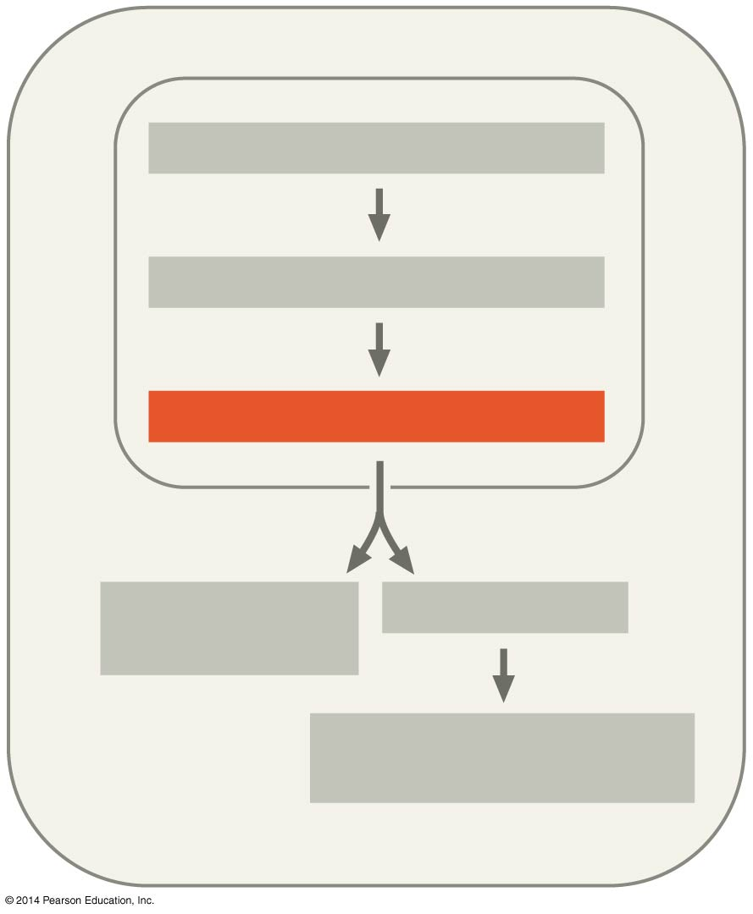
Figure 18.UN04
CHROMATIN MODIFICATION
TRANSCRIPTION
RNA PROCESSING
mRNA DEGRADATION
TRANSLATION
PROTEIN PROCESSING AND DEGRADATION
Notes:
Figure 18.UN04 In-text figure, RNA processing, p. 372

Slide 60
Concept 18.2: Eukaryotic gene expression is regulated at many stages – RNA Processing
Post-Transcriptional Regulation
Allows a cell to fine-tune gene expression rapidly in response to environmental changes
In alternative RNA splicing, different mRNA molecules are produced from the same primary transcript, depending on which RNA segments are treated as exons and which as introns

Slide 61
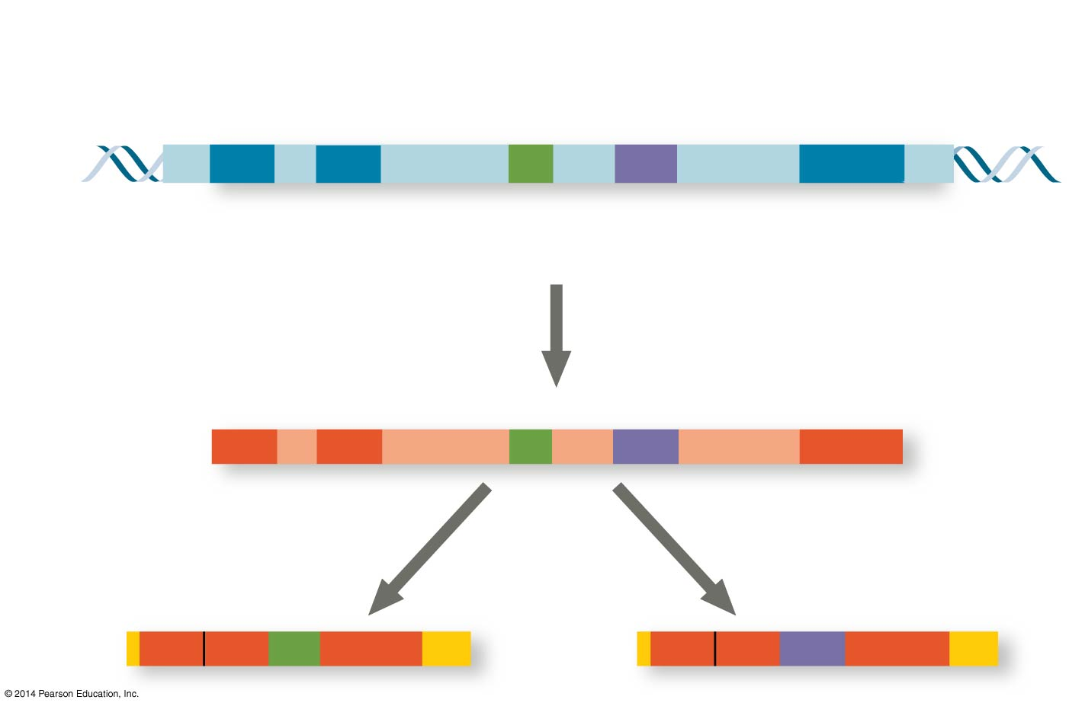
Figure 18.13
Exons
DNA
1 2 3 4 5
Troponin T gene
Primary RNA transcript
1 2 3 4 5
RNA splicing
mRNA
1 2 3 5
OR
1 2 4 5
Notes:
Figure 18.13 Alternative RNA splicing of the troponin T gene

Slide 62
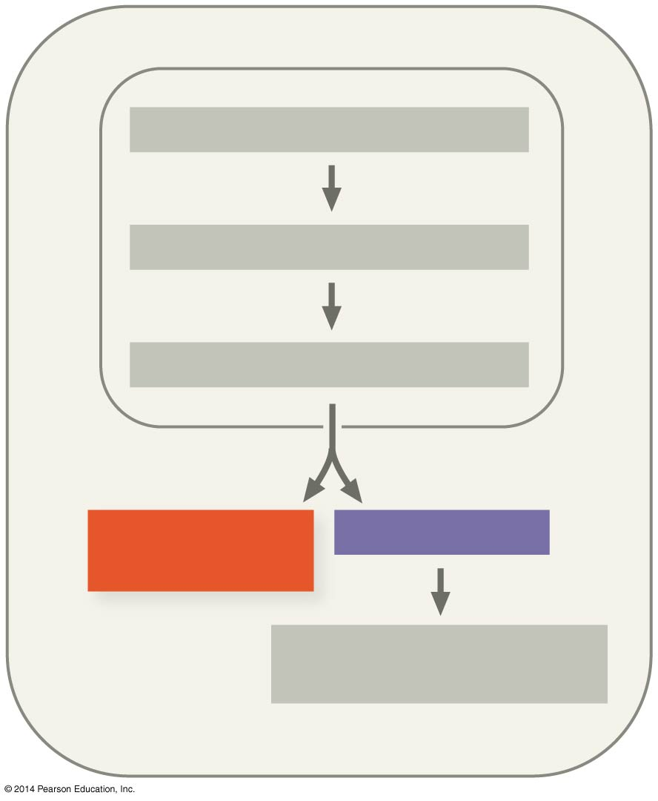
Figure 18.UN05
CHROMATIN MODIFICATION
TRANSCRIPTION
RNA PROCESSING
mRNA DEGRADATION
TRANSLATION
PROTEIN PROCESSING AND DEGRADATION
Notes:
Figure 18.UN05 In-text figure, mRNA degradation and translation, p. 374

Slide 63
Concept 18.2: Eukaryotic gene expression is regulated at many stages – TSN
Initiation of Translation and mRNA Degradation
The initiation of translation of selected mRNAs can be blocked by regulatory proteins that bind to sequences or structures of the mRNA
Alternatively, translation of all mRNAs in a cell may be regulated simultaneously

Slide 64
Concept 18.2: Eukaryotic gene expression is regulated at many stages – TSN
Initiation of Translation and mRNA Degradation
The life span of mRNA molecules in the cytoplasm is a key to determining protein synthesis
Eukaryotic mRNA is more long lived than prokaryotic mRNA
Nucleotide sequences that influence the lifespan of mRNA in eukaryotes reside in the untranslated region (UTR) at the 3′ end of the molecule

Slide 65
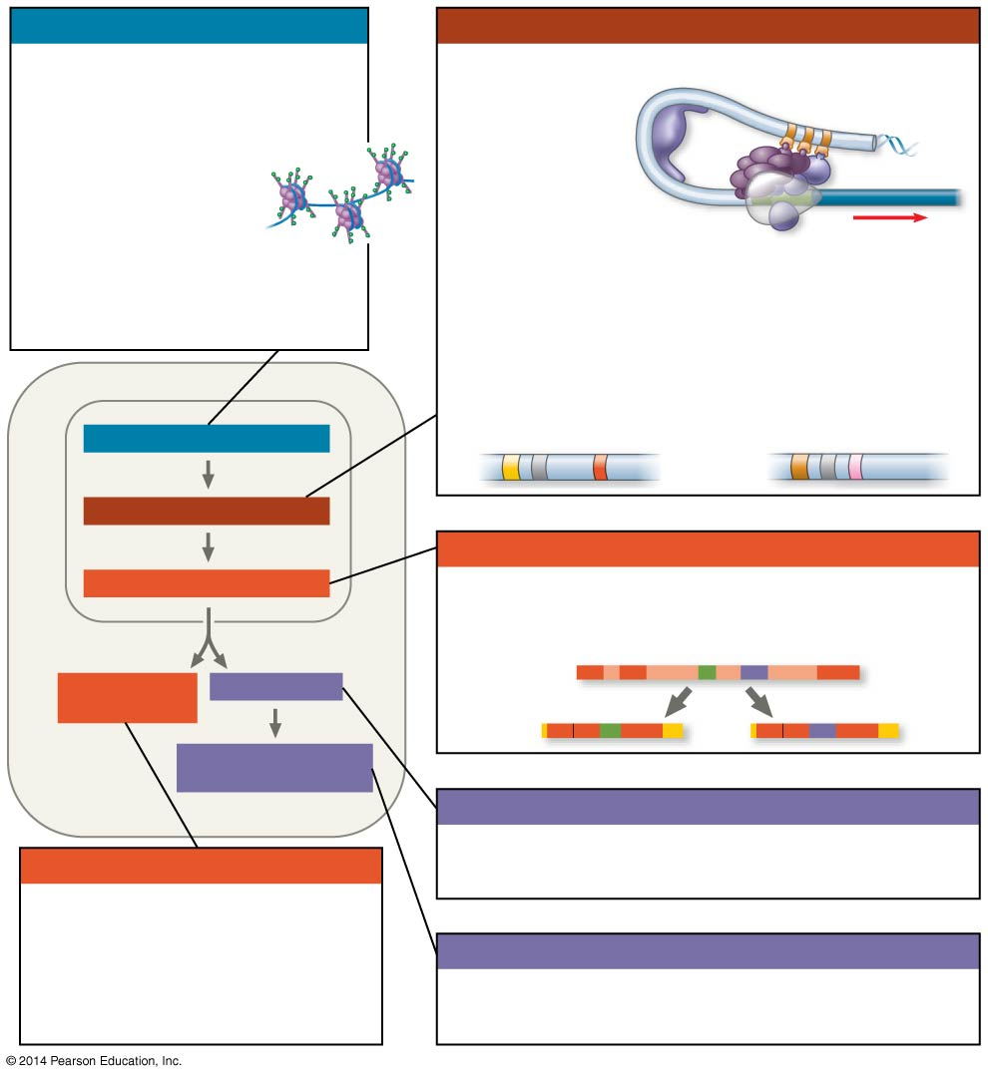
Figure 18.UN09
Chromatin modification
Transcription
• Genes in highly compacted chromatin are generally not transcribed.
• Histone acetylation
seems to loosen
chromatin structure,
enhancing transcription.
• DNA methylation generally
reduces transcripton.
• Regulation of transcription initiation: DNA control elements in enhancers bind specific tran- scription factors. Bending of the DNA enables activators to contact proteins at the promoter, initiating transcription.
• Coordinate regulation:
Enhancer for liver-specific genes
Enhancer for lens-specific genes
CHROMATIN MODIFICATION
TRANSCRIPTION
RNA processing
RNA PROCESSING
• Alternative RNA splicing:
Primary RNA transcript
mRNA DEGRADATION
TRANSLATION
mRNA
OR
PROTEIN PROCESSING AND DEGRADATION
Translation
mRNA degradation
• Initiation of translation can be controlled via regulation of initiation factors.
• Each mRNA has a characteristic life span, determined in part by sequences in the 5′ and 3′ UTRs.
Protein processing and degradation
• Protein processing and degradation are subject to regulation.
Notes:
Figure 18.UN09 Summary of key concepts: eukaryotic regulation of gene expression

Slide 66
Overview
Concept 18.1: Bacteria respond to environmental change by regulating transcription
Concept 18.2: Eukaryotic gene expression is regulated at many stages
Concept 18.3: Noncoding RNAs play multiple roles in controlling gene expression
Concept 18.4: A program of differential gene expression leads to the different cell types in a multicellular organism

Slide 67
Concept 18.3: Noncoding RNAs play multiple roles in controlling gene expression
Only a small fraction of DNA codes for proteins, and a very small fraction of the non-protein-coding DNA consists of genes for RNA such as rRNA and tRNA
A significant amount of the genome may be transcribed into noncoding RNAs (ncRNAs)
Noncoding RNAs regulate gene expression at two points: mRNA translation and chromatin configuration

Slide 68
Effects on mRNAs by MicroRNAs and Small Interfering RNAs
MicroRNAs (miRNAs) are small single-stranded RNA molecules that can bind to and degrade mRNA or block its translation (~50% of human genes are regulated by these btw)
Small interfering RNAs (siRNAs) are similar to miRNAs in size and function
The blocking of gene expression by siRNAs is called RNA interference (RNAi)

Slide 69
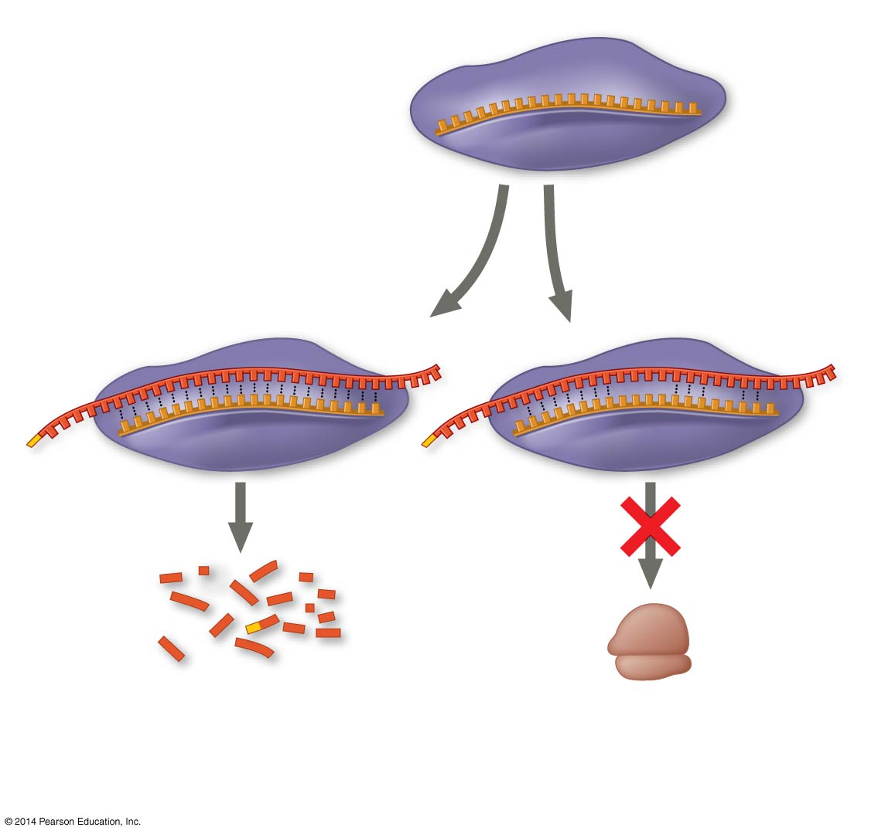
Figure 18.14
miRNA
miRNA- protein complex
1
The miRNA binds to a target mRNA.
OR
mRNA degraded
Translation blocked
2
If bases are completely complementary, mRNA is degraded. If match is less than complete, translation is blocked.
Notes:
Figure 18.14 Regulation of gene expression by miRNAs

Slide 70
Overview
Concept 18.1: Bacteria respond to environmental change by regulating transcription
Concept 18.2: Eukaryotic gene expression is regulated at many stages
Concept 18.3: Noncoding RNAs play multiple roles in controlling gene expression
Concept 18.4: A program of differential gene expression leads to the different cell types in a multicellular organism

Slide 71
Concept 18.4: A program of differential gene expression leads to the different cell types in a multicellular organism
During embryonic development, a fertilized egg gives rise to MANY different cell types
Cell types are organized successively into tissues, organs, organ systems, and the whole organism
Gene expression orchestrates the developmental programs of animals

Slide 72
Concept 18.4: A program of differential gene expression leads to the different cell types
Greatest Example Ever: Embryonic Development
Goal: Transformation of zygote to adult (nbd)
Steps: Cell division (duh), cell differentiation, and morphogenesis…all governed by differential gene expression (WOW)
Cell differentiation is the process by which cells become specialized in structure and function
The physical processes that give an organism its shape constitute morphogenesis

Slide 73
Concept 18.4: A program of differential gene expression leads to the different cell types
Ex: Embryonic Development
Another important source of developmental information is the environment AROUND the cell, especially signals from nearby embryonic cells
In the process called induction, signal molecules from embryonic cells cause transcriptional changes in nearby target cells
Thus, interactions between cells INDUCE differentiation of specialized cell types (that was the goal!)

Slide 74
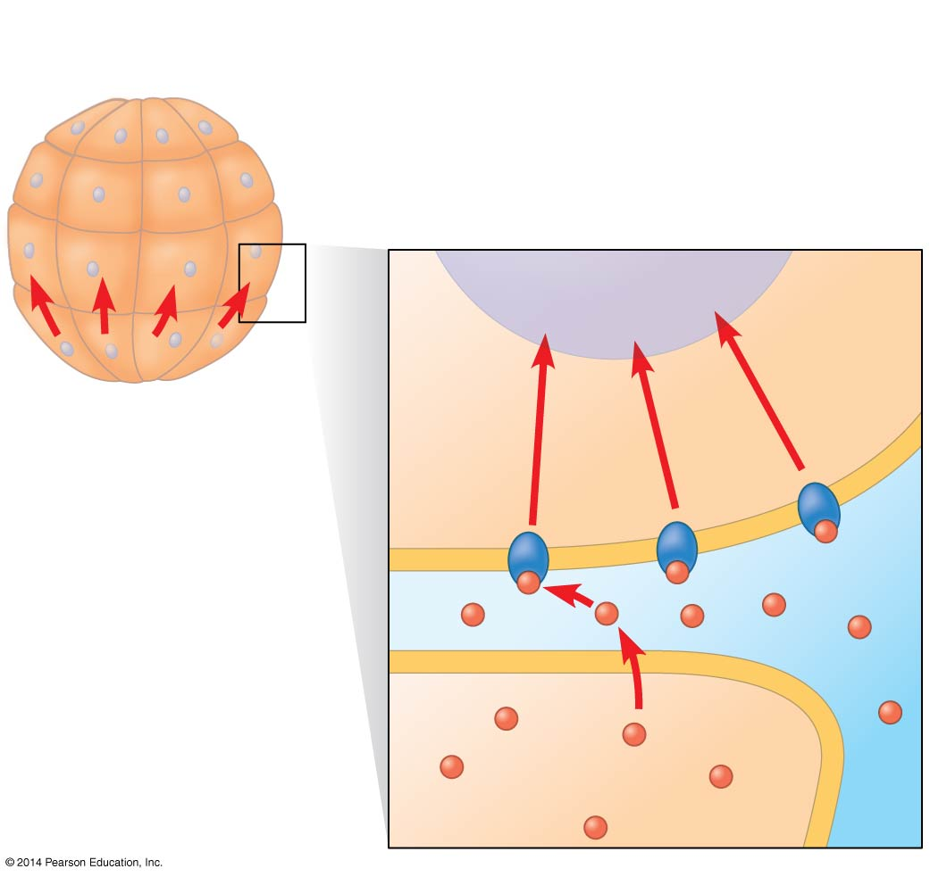
Figure 18.17b
(b) Induction by nearby cells
Early embryo (32 cells)
NUCLEUS
Signal transduction pathway
Signal receptor
Signaling molecule
Notes:
Figure 18.17b Sources of developmental information for the early embryo (part 2: induction)

Slide 75
Overview
Concept 18.1: Bacteria respond to environmental change by regulating transcription
Concept 18.2: Eukaryotic gene expression is regulated at many stages
Concept 18.3: Noncoding RNAs play multiple roles in controlling gene expression
Concept 18.4: A program of differential gene expression leads to the different cell types in a multicellular organism

