Slide 1
0
16
The Molecular Basis of Inheritance

Slide 2
Life’s Operating Instructions
In 1953, James Watson and Francis Crick introduced (kinda stole IMO) an elegant double-helical model for the structure of deoxyribonucleic acid, or DNA
Hereditary information is encoded in DNA and reproduced in all cells of the body
This DNA program directs the development of biochemical, anatomical, physiological, and (to some extent) behavioral traits

Slide 3
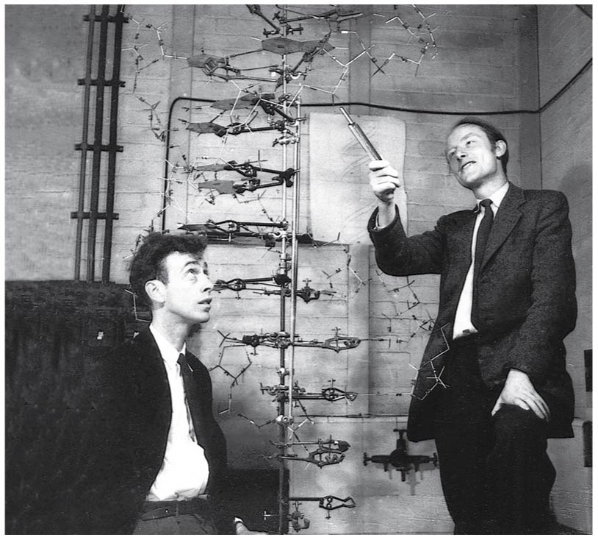
Figure 16.1a
Notes:
Figure 16.1a What is the structure of DNA? (part 1: Watson and Crick)

Slide 4
Figure 16.1a
Watson…genius/thief/sexist/borderline racist
Crick…co-genius/co-thief
Notes:
Figure 16.1a What is the structure of DNA? (part 1: Watson and Crick)

Slide 5
Overview
Concept 16.1: DNA is the genetic material
Concept 16.2: Many proteins work together in DNA replication and repair
Concept 16.3: A chromosome consists of a DNA molecule packed together with proteins

Slide 6
Overview
Concept 16.1: DNA is the genetic material
Concept 16.2: Many proteins work together in DNA replication and repair
Concept 16.3: A chromosome consists of a DNA molecule packed together with proteins

Slide 7
Concept 16.1: DNA is the genetic material
When T. H. Morgan’s group showed that “genes” are located on chromosomes, the two components of chromosomes—DNA and protein—became candidates for the genetic material
Early in the 20th century, the identification of the molecules of inheritance loomed as a major challenge to biologists
DNA ultimately became known as genetic material due to 3 key pieces of experimental evidence.

Slide 8
Concept 16.1: DNA is the genetic material – Evidence #1
The role of DNA in heredity was first discovered by studying bacteria and the viruses that infect them
The discovery of the genetic role of DNA began with research by Frederick Griffith in 1928 (Griffith experiment)
Griffith worked with two strains of a bacterium
One pathogenic strain
One harmless strain

Slide 9
Concept 16.1: DNA is the genetic material – Evidence #1
When Griffith mixed heat-killed remains of the pathogenic strain with living cells of the harmless strain, some living cells became pathogenic!
He called this phenomenon TRANSFORMATION, now defined as a change in genotype and phenotype due to assimilation of foreign DNA

Slide 10
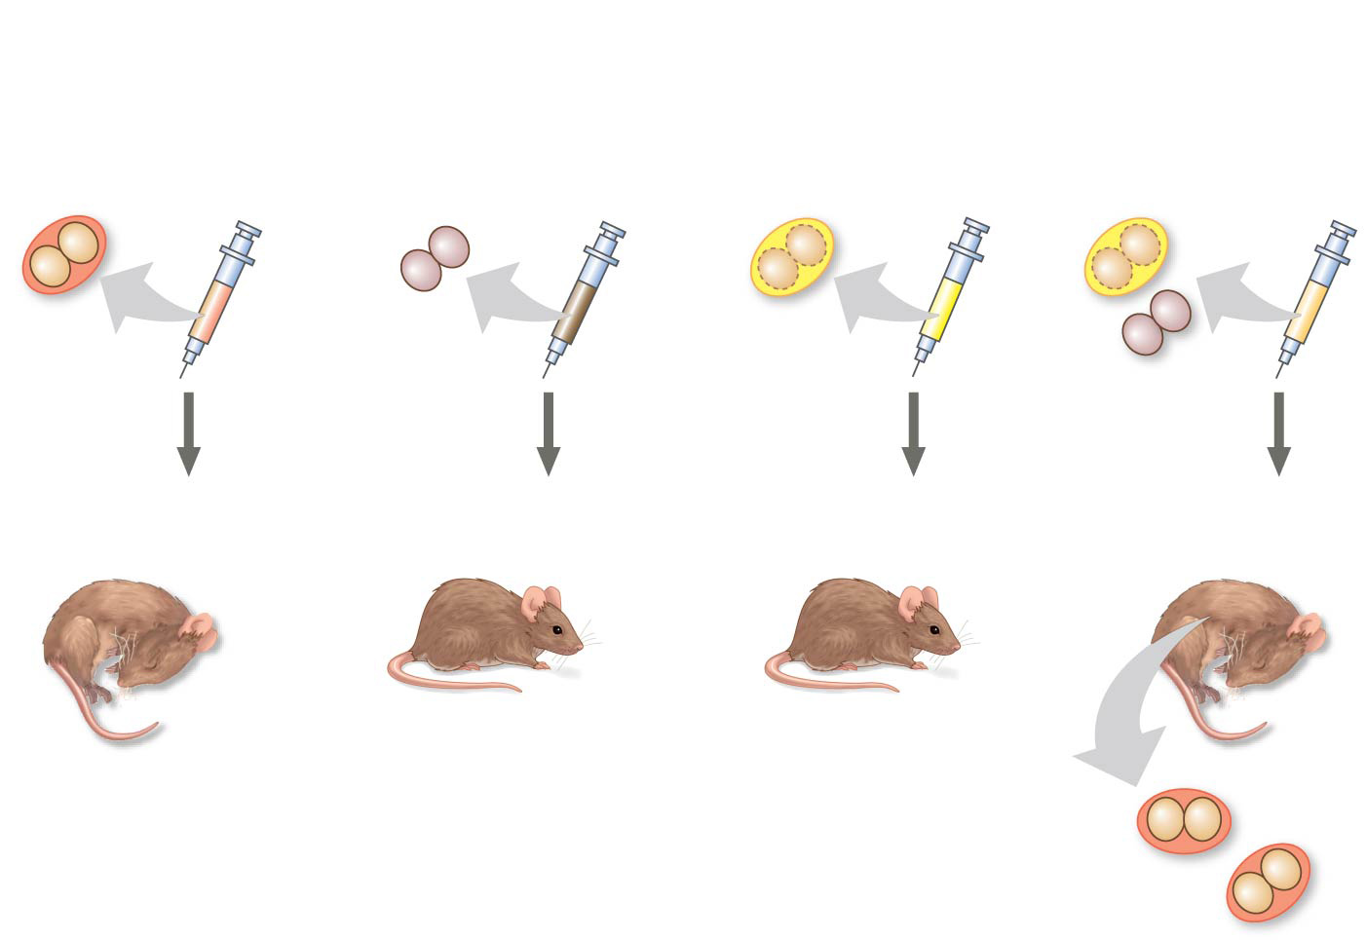
Figure 16.2
Transformation HERE
Experiment
Living S cells (pathogenic control)
Living R cells (nonpathogenic control)
Heat-killed S cells (nonpathogenic control)
Mixture of heat- killed S cells and living R cells
Results
Mouse dies
Mouse healthy
Mouse healthy
Mouse dies
Living S cells
Notes:
Figure 16.2 Inquiry: Can a genetic trait be transferred between different bacterial strains?

Slide 11
Notes:
In his transformation experiments, what did Griffith observe?
https://www.polleverywhere.com/multiple_choice_polls/lNrTfMhLcUgyZz8

Slide 12
Notes:
How do we describe transformation in bacteria?
https://www.polleverywhere.com/multiple_choice_polls/u4W31FmlFiLcIWh

Slide 13
Concept 16.1: DNA is the genetic material – Evidence #2
In 1944, Oswald Avery, Colin MacLeod, and Maclyn McCarty announced that the transforming substance was DNA (Avery, MacLeod, McCarty experiments)
Many biologists remained skeptical, mainly because little was known about DNA

Slide 14
Concept 16.1: DNA is the genetic material – Evidence #3
More evidence for DNA as the genetic material came from studies of viruses that infect bacteria
Such viruses, called bacteriophages (or phages), are widely used in molecular genetics research
A virus is DNA (sometimes RNA) enclosed by a protective coat, often simply protein

Slide 15
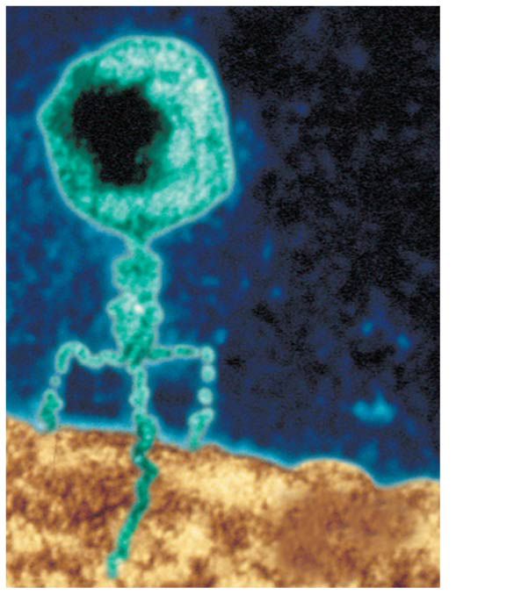
Figure 16.3
Phage head
DNA
Tail sheath
Tail fiber
Genetic material
100 nm
Bacterial cell
Notes:
Figure 16.3 A virus infecting a bacterial cell

Slide 16
Concept 16.1: DNA is the genetic material – Evidence #3
In 1952, Alfred Hershey and Martha Chase (Hershey-Chase experiment) showed that DNA is the genetic material of a phage known as T2
They designed an experiment showing that only one of the two components of T2 (DNA or protein) enters an E. coli cell during infection
They concluded that the injected DNA of the phage provides the genetic information

Slide 17
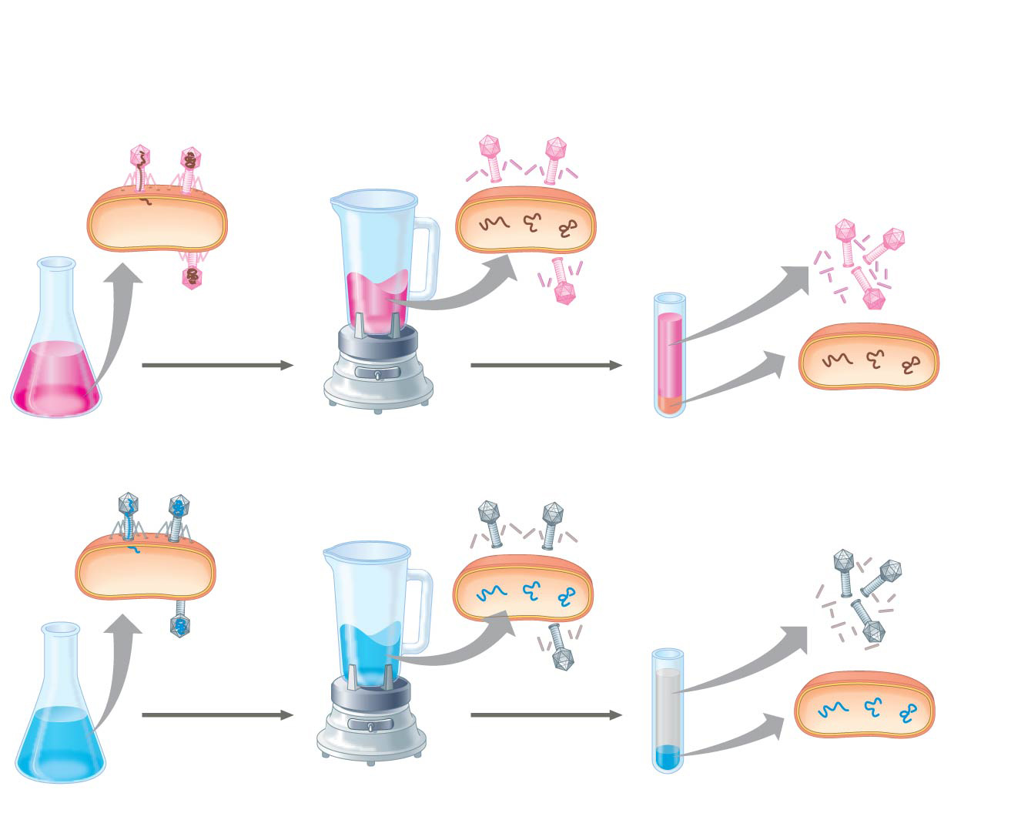
Figure 16.4
Experiment
Batch 1: Radioactive sulfur (³⁵S) in phage protein
1
Labeled phages infect cells.
2
Agitation frees outside phage parts from cells.
3
Centrifuged cells form a pellet.
Radioactive protein
4
Radioactivity (phage protein) found in liquid
Centrifuge
Pellet
Batch 2: Radioactive phosphorus (³²P) in phage DNA
Radioactive DNA
Centrifuge
Pellet
4
Radioactivity (phage DNA) found in pellet
Notes:
Figure 16.4 Inquiry: Is protein or DNA the genetic material of phage T2?

Slide 18
Notes:
In trying to determine whether DNA or protein is the genetic material, Hershey and Chase made use of which of the following facts?
https://www.polleverywhere.com/multiple_choice_polls/KRNusLTIaeibb1h

Slide 19
Concept 16.1: DNA is the genetic material Evidence Summary
CONCLUSION: DNA is DEF genetic material (NOT protein)
Griffith experiment
Avery, MacLeod, McCarty experiments
Hershey-Chase experiment
Next question…what even is DNA?

Slide 20
Concept 16.1: DNA is the genetic material – Structure of DNA
It was known that DNA is a polymer of nucleotides (monomer subunit), each consisting of…
Nitrogenous base
Sugar
Phosphate group
One nucleotide subunit (monomer)

Slide 21
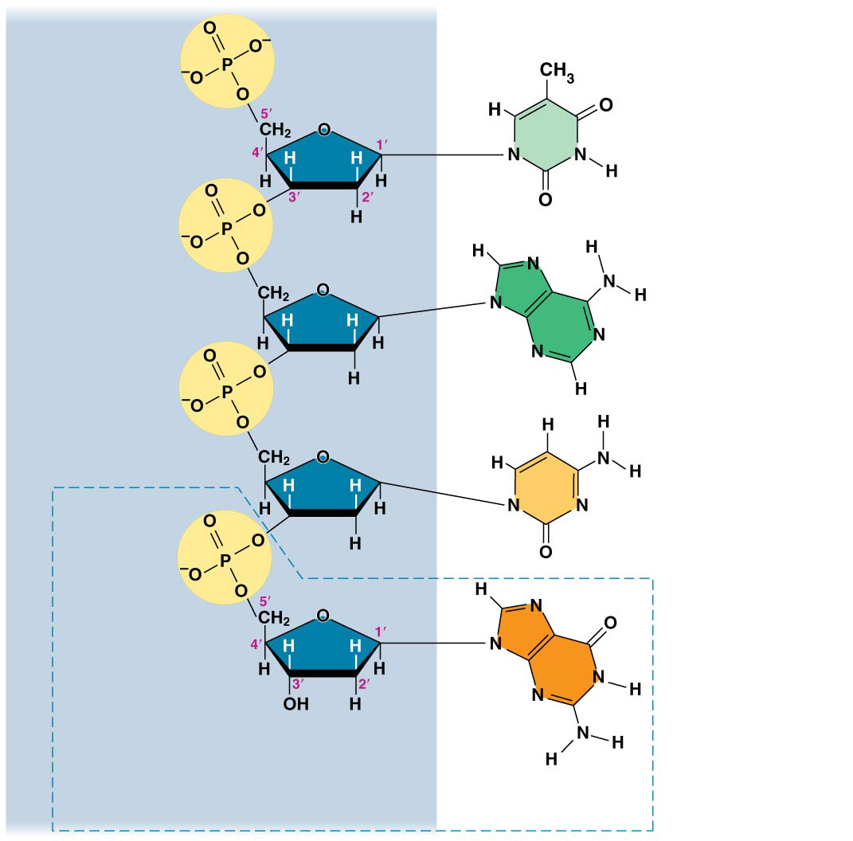
Figure 16.5
Sugar– phosphate backbone
5′ end
Nitrogenous bases
Thymine (T)
Adenine (A)
Cytosine (C)
Phosphate
Guanine (G)
3′ end
Sugar (deoxyribose)
DNA nucleotide
Nitrogenous base
Notes:
Figure 16.5 The structure of a DNA strand

Slide 22
Concept 16.1: DNA is the genetic material – Structure of DNA
Around 1950, Erwin Chargaff’s work shed more light on what DNA truly is…aka its structure
His findings became known as Chargaff’s rules
The base composition of DNA varies between species
In any species the number of A and T bases are equal (A = T) and the number of G and C bases are equal (G = C)

Slide 23
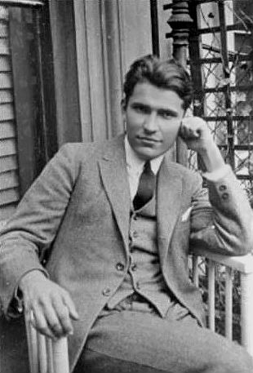
The Gaff-father

Slide 24
Notes:
Which of the following investigators was (were) responsible for the following discovery? In DNA from any species, the amount of adenine equals the amount of thymine, and the amount of guanine equals the amount of cytosine.
https://www.polleverywhere.com/multiple_choice_polls/ScHuKJKH6PI0cxy

Slide 25
Notes:
Cytosine makes up 42% of the nucleotides in a sample of DNA from an organism. Approximately what percentage of the nucleotides in this sample will be thymine?
https://www.polleverywhere.com/multiple_choice_polls/zDYZLWcsqSJc0vX

Slide 26
Concept 16.1: DNA is the genetic material – Structure of DNA
No one really understood how Chargaff’s rules actually worked to allow DNA to function as genetic material
After DNA was accepted as the genetic material, the challenge was to determine HOW its structure accounts for its role in heredity

Slide 27
Concept 16.1: DNA is the genetic material – Structure of DNA
Rosalind Franklin and Maurice Wilkins were using a technique called X-ray crystallography to study molecular structure
Franklin produced a game-changing picture of the DNA molecule using this technique
Photo 51—the most famous picture in all of biological research
FYI…pic was actually taken by Franklin’s PhD student—Raymond Gosling (no relation to Ryan)

Slide 28
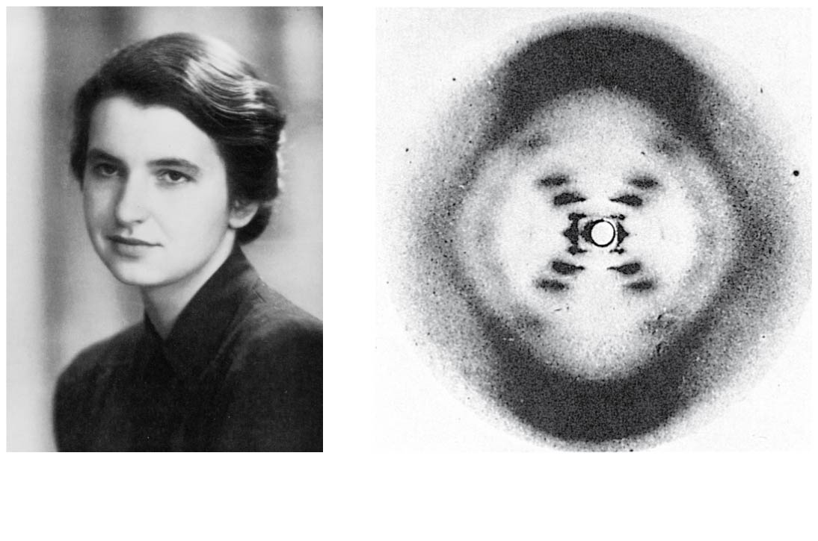
Figure 16.6
(a) Rosalind Franklin
(b) Franklin’s X-ray diffraction photograph of DNA
Notes:
Figure 16.6 Rosalind Franklin and her X-ray diffraction photo of DNA

Slide 29
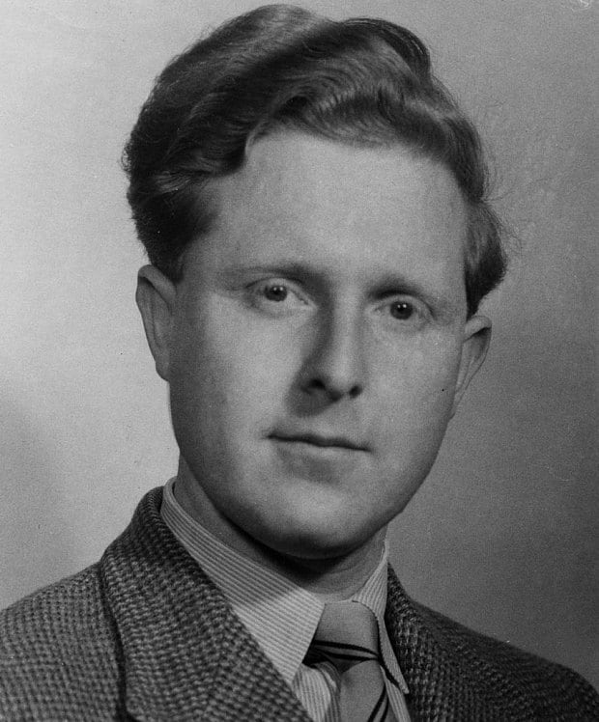
Figure 16.6
#boss
IG/Snap Story Worthy
Ray G
(a) Rosalind Franklin
(b) Franklin’s X-ray diffraction photograph of DNA
Notes:
Figure 16.6 Rosalind Franklin and her X-ray diffraction photo of DNA

Slide 30
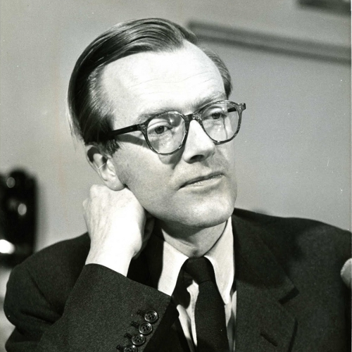
Maurice Wilkins

Slide 31
Maurice Wilkins
TRAITOR

Slide 32
Concept 16.1: DNA is the genetic material – Structure of DNA
Franklin’s X-ray crystallographic images of DNA enabled Watson to deduce…
DNA was helical + width of the helix + spacing of the nitrogenous bases
The pattern in the photo suggested that the DNA molecule was made up of TWO strands, forming a double helix
Watson and Crick built models of a double helix to conform to the X-rays and chemistry of DNA

Slide 33
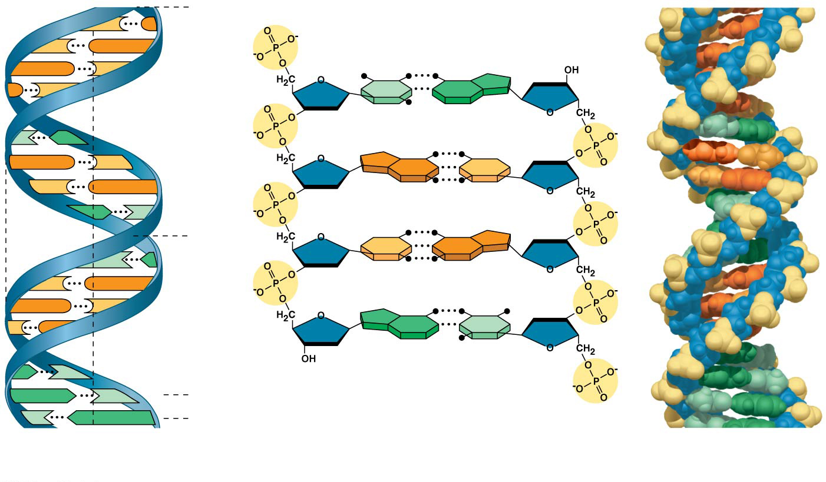
Figure 16.7
5′ end
C
G
C
G
Hydrogen bond
3′ end
G
C
G
C
T
A
3.4 nm
T
A
G
C
G
C
C
G
A
T
1 nm
C
G
T
A
C
G
G
C
C
G
A
T
A
T
3′ end
A
T
0.34 nm
T
A
5′ end
(a) Key features of DNA structure
(b) Partial chemical structure
(c) Space-filling model
Notes:
Figure 16.7 The structure of the double helix

Slide 34
Concept 16.1: DNA is the genetic material – Structure of DNA
Franklin ALSO had concluded that there were two outer sugar-phosphate backbones, with the nitrogenous bases paired in the molecule’s interior
Watson used (STOLE) this information to build a model in which the backbones were antiparallel (their subunits run in opposite directions)
“Outside” of molecule = done…what about the “inside”? HOW do the bases specifically pair?

Slide 35
Figure 16.7
5′ end
C
G
C
G
Hydrogen bond
3′ end
G
C
G
C
T
A
3.4 nm
T
A
G
C
G
C
C
G
A
T
1 nm
C
G
T
A
C
G
G
C
C
G
A
T
A
T
3′ end
A
T
0.34 nm
T
A
5′ end
(a) Key features of DNA structure
(b) Partial chemical structure
(c) Space-filling model
Notes:
Figure 16.7 The structure of the double helix

Slide 36
Concept 16.1: DNA is the genetic material – Structure of DNA
At first, Watson and Crick thought the bases paired like with like (A with A, and so on), but such pairings did not result in a uniform width
Instead, pairing a purine with a pyrimidine resulted in a uniform width consistent with Franklin’s X-ray data and also followed Chargaff’s rules

Slide 37
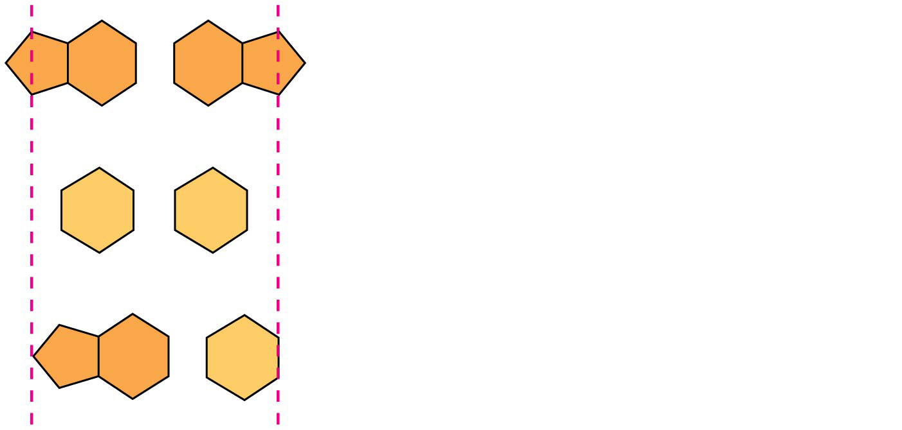
Figure 16.UN02
Purine + purine: too wide
Pyrimidine + pyrimidine: too narrow
Purine + pyrimidine: width consistent with X-ray data
Notes:
Figure 16.UN02 In-text figure, purines and pyrimidines, p. 318

Slide 38
Concept 16.1: DNA is the genetic material – Structure of DNA
Watson and Crick reasoned that the pairing was more specific, dictated by the base structures
They “determined” that adenine (A) paired ONLY with thymine (T), and guanine (G) paired ONLY with cytosine (C)
The “Watson-Crick” model explains Chargaff’s rules: in any organism, the amount of A = T, and the amount of G = C
Really should be called the “Franklin-Gosling-Wilkins-Chargaff-Watson-Crick” model…in that order.

Slide 39
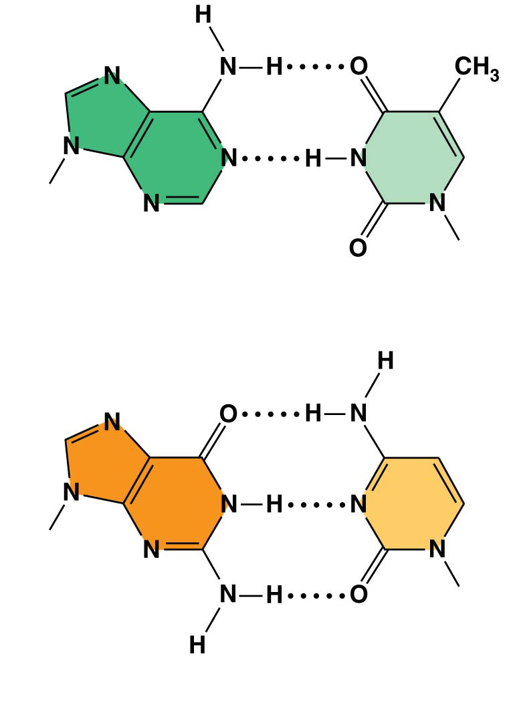
Figure 16.8
Sugar
Sugar
Adenine (A)
Thymine (T)
Sugar
Sugar
Guanine (G)
Cytosine (C)
Notes:
Figure 16.8 Base pairing in DNA

Slide 40
Concept 16.1: DNA is the genetic material – Structure Summary
DNA…(according to Franklin, Gosling, Wilkins, Chargaff, Watson, Crick, and many others!!!)
is composed of nucleotides (sugar + phosphate + nitrogenous base)
is a double helix
is antiparallel + complementary
has a sugar-phosphate backbone (“outsides”)
has nitrogenous base-pairing interior (A with T and C with G, “insides”)
Follows Chargaff’s rules: (A = T) (G = C)

Slide 41
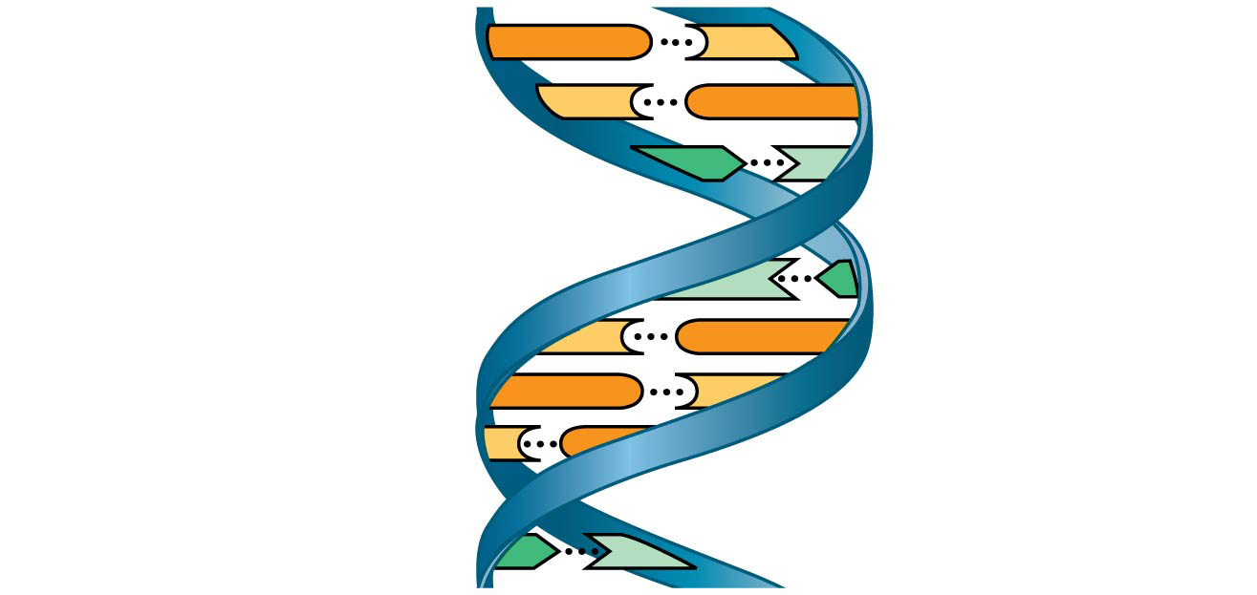
Figure 16.UN03
5′ end
3′ end
G
C
C
G
Nitrogenous bases
A
T
Sugar-phosphate backbone
T
A
C
G
G
C
C
G
Hydrogen bond
A
T
3′ end
5′ end
Notes:
Figure 16.UN03 Summary of key concepts: double helix

Slide 42
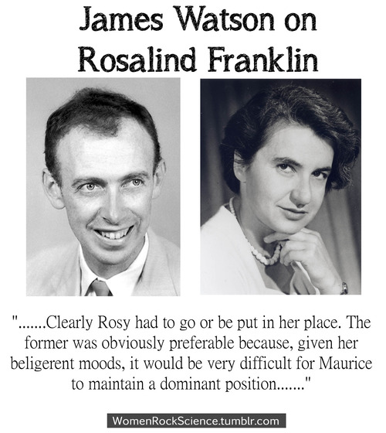

Slide 43
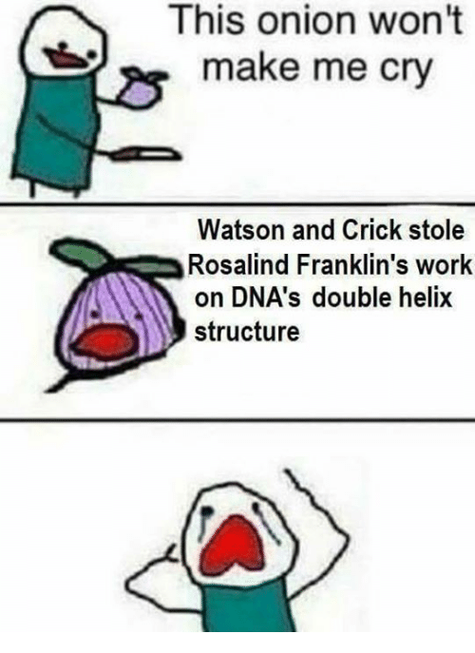

Slide 44
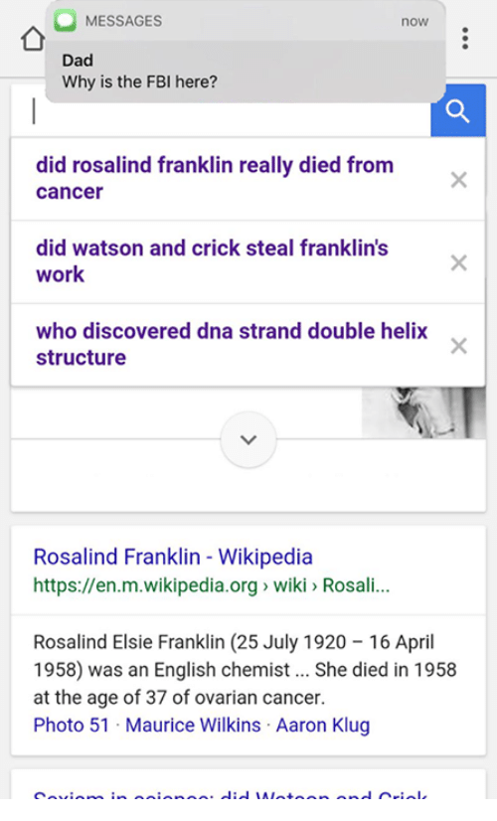
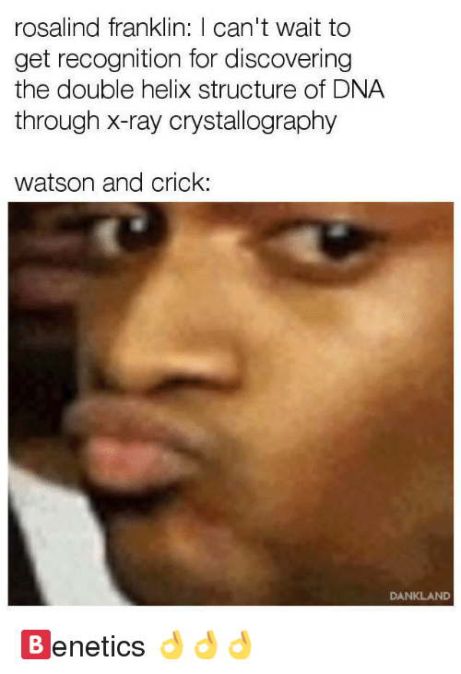

Slide 45
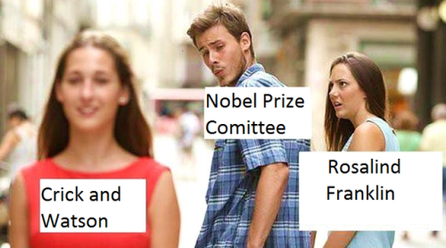

Slide 46
Notes:
It became apparent to Watson and Crick after completion of their model that the DNA molecule could carry a vast amount of hereditary information in which of the following?
https://www.polleverywhere.com/multiple_choice_polls/Wgsor2zzvKIz13n

Slide 47
Notes:
In the polymerization of DNA, a phosphodiester bond is formed between a phosphate group of the nucleotide being added and _____ of the last nucleotide in the polymer.
https://www.polleverywhere.com/multiple_choice_polls/4Ta28wGjr2LDQGb

Slide 48
Overview
Concept 16.1: DNA is the genetic material
Concept 16.2: Many proteins work together in DNA replication and repair
Concept 16.3: A chromosome consists of a DNA molecule packed together with proteins

Slide 49
Concept 16.2: Many proteins work together in DNA replication and repair
The relationship between structure and function is manifest in the double helix
Watson and Crick noted that the specific base pairing suggested a possible copying mechanism for genetic material

Slide 50
Concept 16.2: Many proteins work together in DNA replication and repair
The basic principle: base pairing to a template strand
Since the two strands of DNA are complementary, each strand acts as a template for building a new strand in replication
In DNA replication, the parent molecule unwinds (“unzips”), and two new daughter strands are built based on base-pairing rules

Slide 51
Figure 16.9-1
A
T
C
G
T
A
A
T
G
C
(a) Parental molecule
Notes:
Figure 16.9-1 A model for DNA replication: the basic concept (step 1)

Slide 52
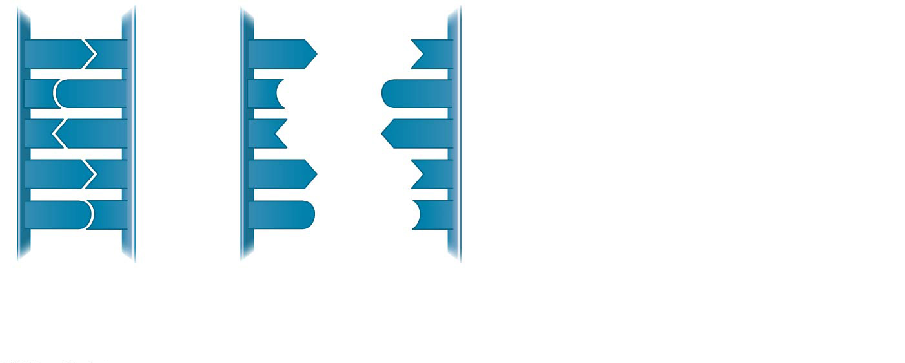
Figure 16.9-2
A
T
A
T
C
G
C
G
T
A
T
A
A
T
A
T
G
C
G
C
(a) Parental molecule
(b) Separation of parental strands into templates
Notes:
Figure 16.9-2 A model for DNA replication: the basic concept (step 2)

Slide 53
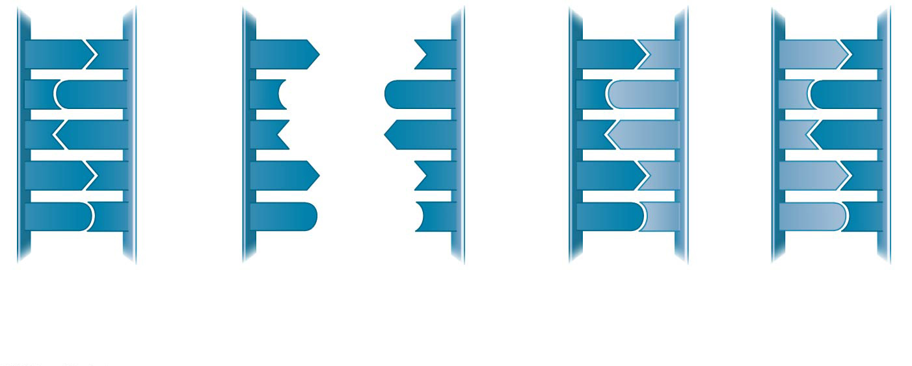
Figure 16.9-3
A
T
A
T
A
T
A
T
C
G
C
G
C
G
C
G
T
A
T
A
T
A
T
A
A
T
A
T
A
T
A
T
G
C
G
C
G
C
G
C
(a) Parental molecule
(b) Separation of parental strands into templates
(c) Formation of new strands complementary to template strands
Notes:
Figure 16.9-3 A model for DNA replication: the basic concept (step 3)

Slide 54
Concept 16.2: Many proteins work together in DNA replication and repair
Watson and Crick’s semiconservative model of replication predicts that when a double helix replicates, each daughter molecule will have…
One old strand (derived or “conserved” from the parent molecule)
One newly made strand based on the parental template
Competing (incorrect) models were the conservative model (the two parent strands rejoin) and the dispersive model (each strand is a mix of old and new)

Slide 55
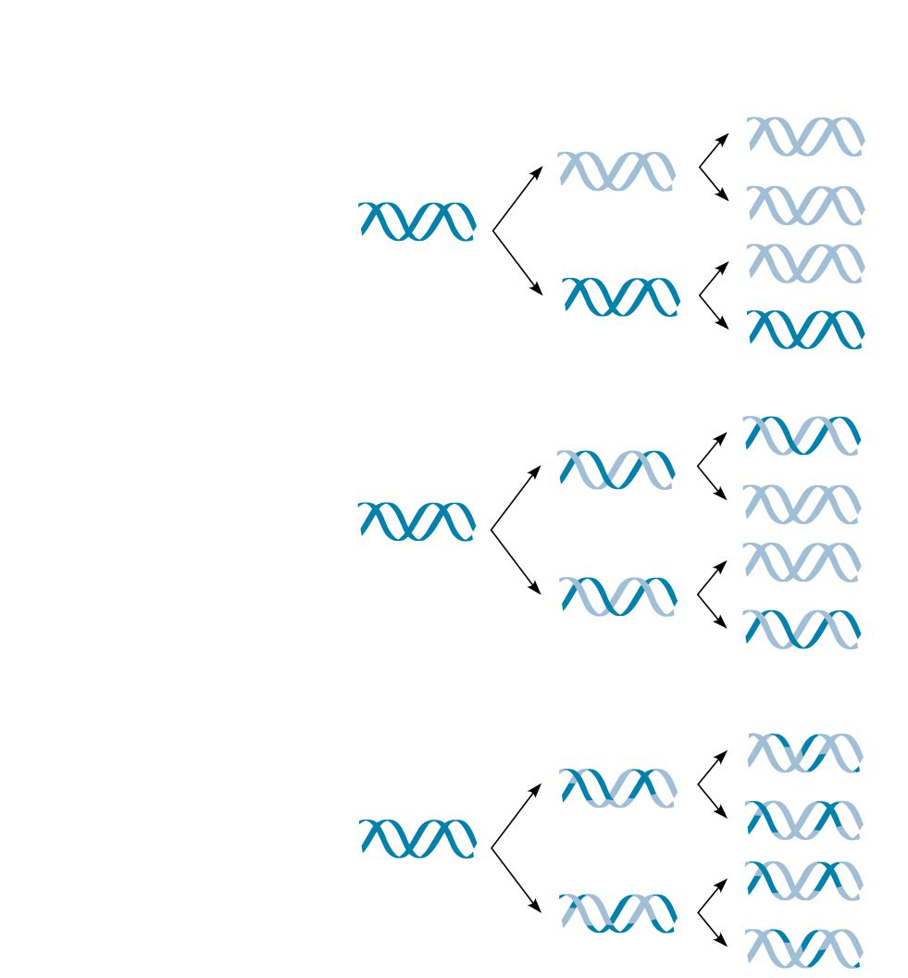
Figure 16.10
First replication
Second replication
Parent cell
(a) Conservative model
(b) Semiconserva- tive model
(c) Dispersive model
Notes:
Figure 16.10 Three alternative models of DNA replication

Slide 56
Figure 16.10
First replication
Second replication
Parent cell
(a) Conservative model
W
R
O
N
G
C
O
R
R
E
C
T
(b) Semiconserva- tive model
(c) Dispersive model
W
R
O
N
G
Notes:
Figure 16.10 Three alternative models of DNA replication

Slide 57
Concept 16.2: Many proteins work together in DNA replication and repair
How does DNA replication actually occur?
The copying of DNA is remarkable in its speed and accuracy
More than a dozen enzymes and other proteins participate in DNA replication

Slide 58
Concept 16.2: Many proteins work together in DNA replication and repair
The Key Players
Helicase
Single-stranded binding protein (SSB)
Topoisomerase
DNA Polymerase
RNA Polymerase (primase)
DNA Ligase

Slide 59
Concept 16.2: Many proteins work together in DNA replication and repair
Replication begins at particular sites called origins of replication, where the two DNA strands are separated, opening up a replication “bubble”
A eukaryotic chromosome may have hundreds or even thousands of origins of replication
A prokaryotic chromosome only has a single origin of replication
Replication proceeds in both directions from each origin, until the entire molecule is copied

Slide 60
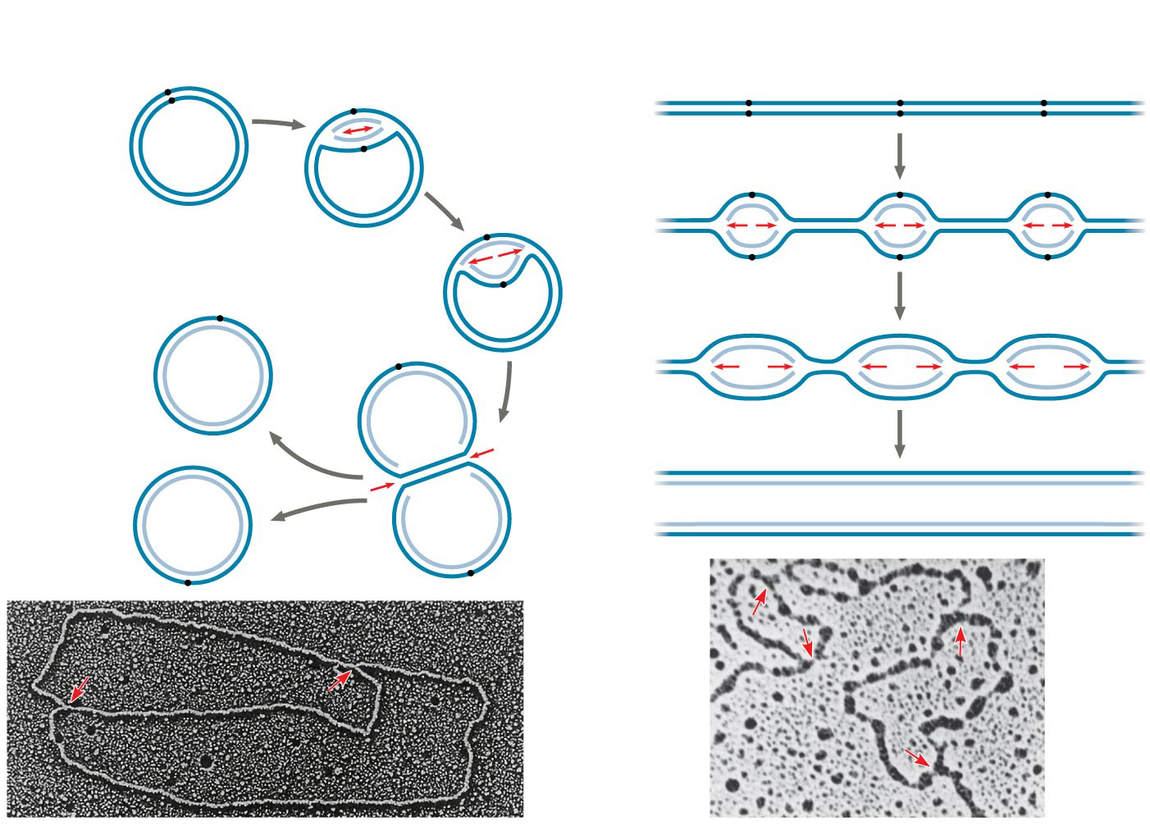
Figure 16.12
(a) Origin of replication in an E. coli cell
(b) Origins of replication in a eukaryotic cell
Origin of replication
Parental (template) strand
Origin of replication
Daughter (new) strand
Eukaryotic chromosome
Parental (template) strand
Double-stranded DNA molecule
Bacterial chromosome
Replication fork
Daughter (new) strand
Double- stranded DNA molecule
Replication bubble
Bubble
Replication fork
Two daughter DNA molecules
Two daughter DNA molecules
0.5 µm
0.25 µm
Notes:
Figure 16.12 Origins of replication in E. coli and eukaryotes

Slide 61
Concept 16.2: Many proteins work together in DNA replication and repair
At the end of each replication bubble is a replication fork, a Y-shaped region where new DNA strands are elongating
Helicases (1) are enzymes that untwist the double helix at the replication forks
Single-strand binding proteins (2) bind to and stabilize single-stranded DNA
Topoisomerase (3) corrects “overwinding” ahead of replication forks by breaking, swiveling, and rejoining DNA strands (aka it relieves strain)

Slide 62
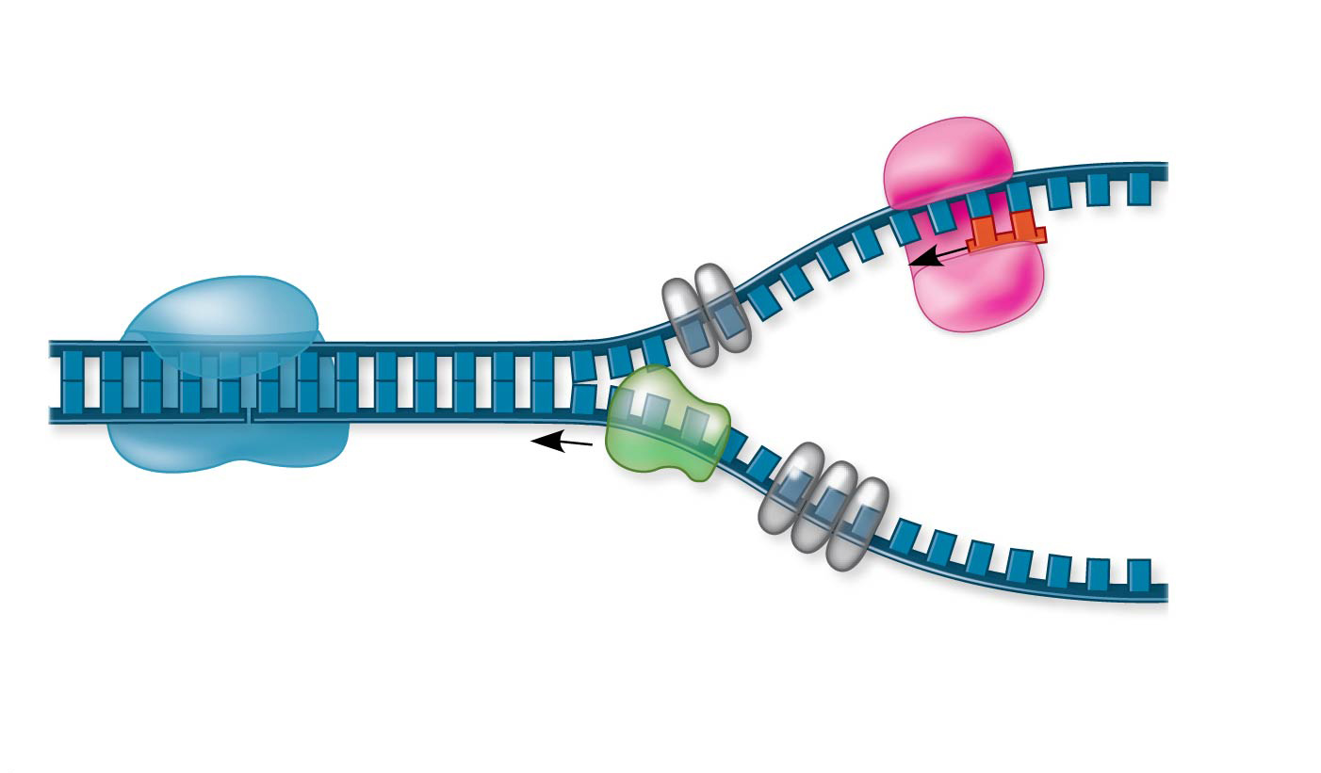
Figure 16.13
Primase
Topoisomerase
3′
RNA primer
5′
3′
5′
Replication fork
3′
5′
Helicase
Single-strand binding proteins
Notes:
Figure 16.13 Some of the proteins involved in the initiation of DNA replication

Slide 63
Concept 16.2: Many proteins work together in DNA replication and repair
Enzymes called DNA polymerases (4) catalyze the elongation of new DNA at a replication fork by working off of a parent template strand
DNA polymerases cannot initiate synthesis on their own…can only add nucleotides to an existing “open” 3′ end (Needs a free 3’–OH)
Requires a short RNA primer that is provided by a separate enzyme, RNA primase (5)
Primase can start an RNA chain from scratch by using the parental DNA as a template strand
Provides “head-start” for DNA polymerase
Notes:
The rate of elongation is about 500 nucleotides per second in bacteria and 50 per second in human cells!!!
DNA polymerases proofread newly made DNA, replacing any incorrect nucleotides
In mismatch repair of DNA, repair enzymes correct errors in base pairing
DNA can be damaged by exposure to harmful chemical or physical agents such as cigarette smoke and X-rays; it can also undergo spontaneous changes
In nucleotide excision repair, a nuclease cuts out and replaces damaged stretches of DNA

Slide 64
Concept 16.2: Many proteins work together in DNA replication and repair
Each nucleotide that is added to a growing DNA strand is a nucleoside triphosphate (dNTP)
dATP, dTTP, dCTP, dGTP
As each monomer joins the DNA strand, it loses two phosphate groups as a molecule of pyrophosphate (FUEL/ENERGY)

Slide 65
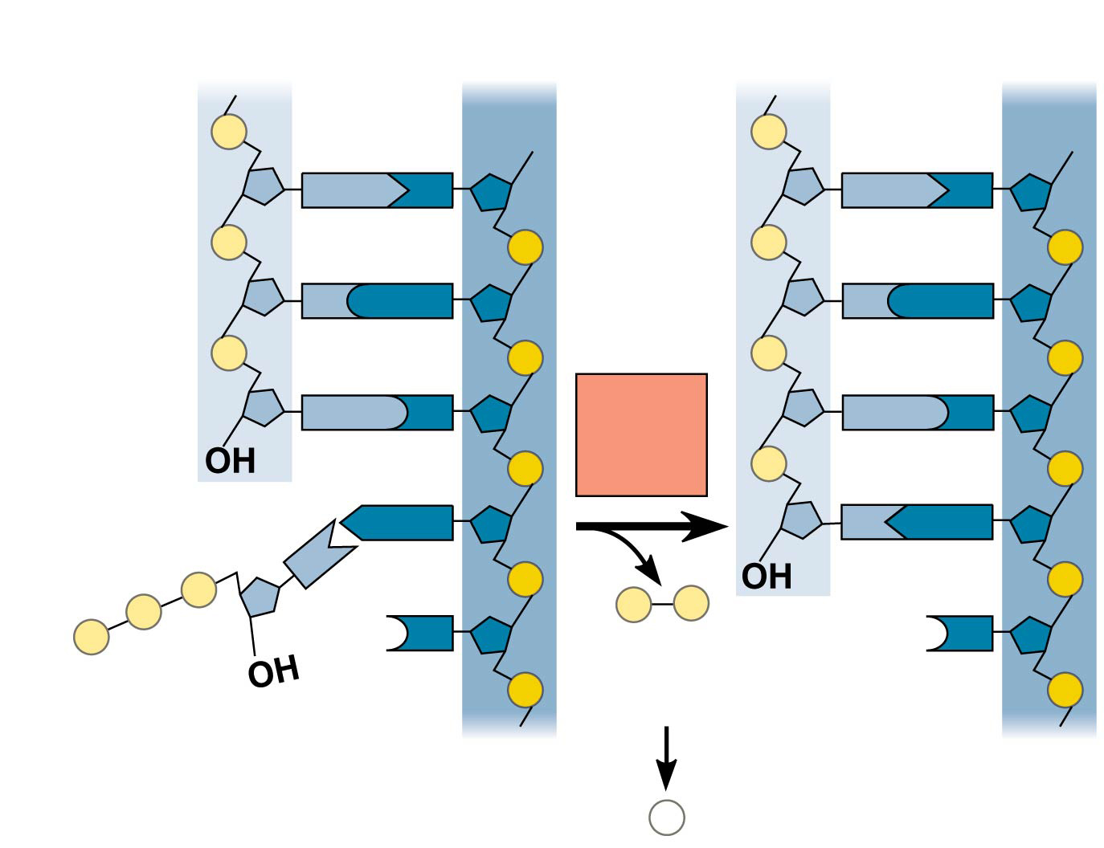
Figure 16.14
New strand
Template strand
5′
3′
5′
3′
Sugar
A
T
A
T
Phosphate
Base
C
G
C
G
G
C
DNA poly- merase
G
C
OH
3′
A
T
A
T
P
OH
P
P
P
i
P
C
3′
C
OH
Pyro- phosphate
Nucleotide
5′
5′
2
P
i
Notes:
Figure 16.14 Incorporation of a nucleotide into a DNA strand

Slide 66
Concept 16.2: Many proteins work together in DNA replication and repair
The antiparallel structure of the double helix affects replication
DNA polymerase “reads” the template strand in the 3’ to 5’ direction, thus…
DNA polymerase SYNTHESIZES (elongates) a new strand in the 5’ to 3’ direction
DNA polymerases add nucleotides only to the free 3′ end of a growing strand; therefore, a new DNA strand can ELONGATE ONLY IN THE 5′ TO 3′ DIRECTION

Slide 67
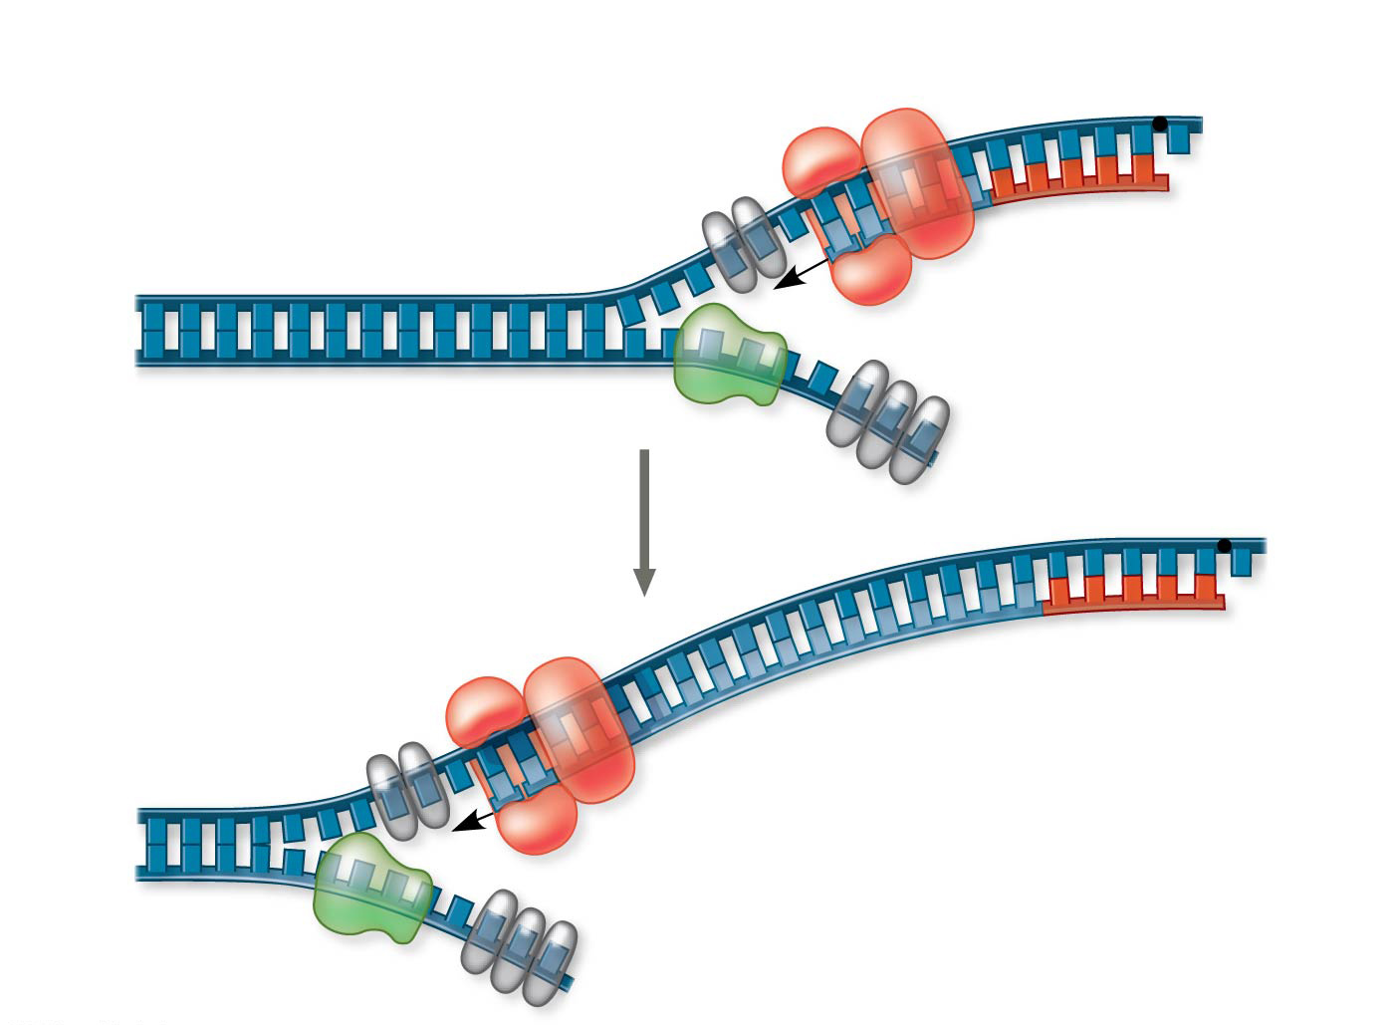
Figure 16.15b
1
DNA pol III starts to synthesize leading strand.
Origin of replication
3′
5′
RNA primer
5′
3′
Sliding clamp
3′
DNA pol III
Parental DNA
5′
3′
5′
5′
Continuous elongation in the 5′ to 3′ direction
3′
2
3′
5′
Notes:
Figure 16.15b Synthesis of the leading strand during DNA replication (part 2)

Slide 68
Concept 16.2: Many proteins work together in DNA replication and repair
Along one template strand of DNA, the DNA polymerase synthesizes a leading strand continuously, moving toward the replication fork
To elongate the other new strand, called the lagging strand, DNA polymerase must work in the direction away from the replication fork
The lagging strand is synthesized as a series of segments called Okazaki fragments, which are joined together by DNA ligase (6)

Slide 69
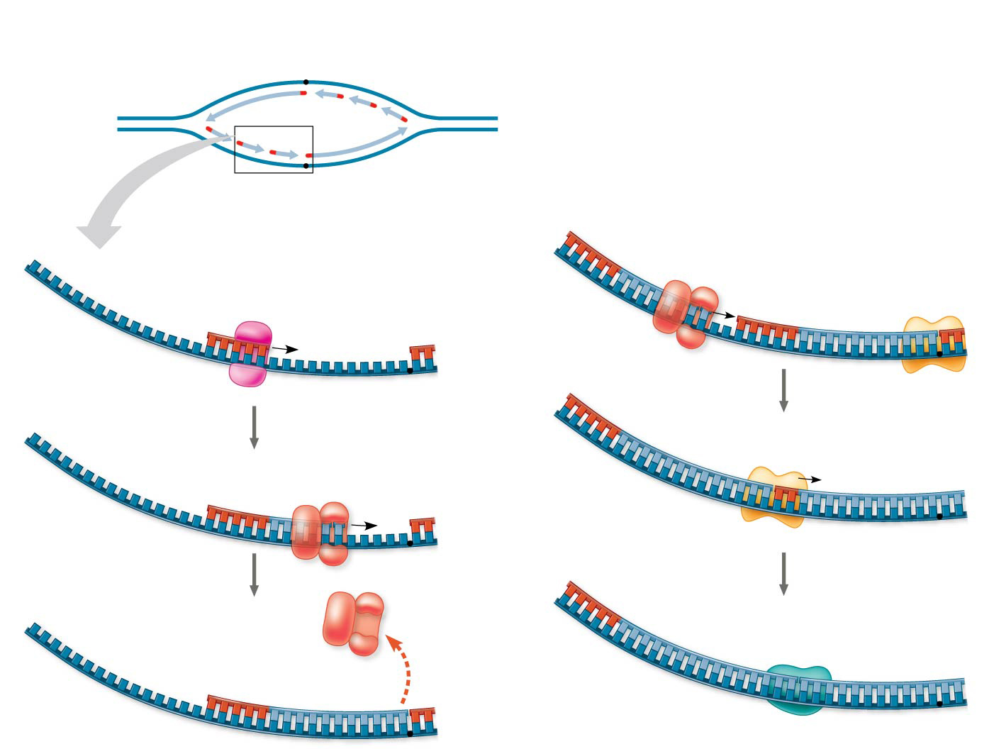
Figure 16.16
Overview
Lagging strand
Origin of replication
Leading strand
Lagging strand
2
1
Leading strand
RNA primer for fragment 2
Overall directions of replication
5′
Okazaki fragment 2
4
DNA pol III makes Okazaki fragment 2.
3′
1
Primase makes
RNA primer.
3′
Origin of replication
2
5′
3′
1
3′
Template strand
5′
3′
5′
5′
5′
5
DNA pol I replaces RNA with DNA.
2
DNA pol III makes Okazaki fragment 1.
3′
3′
RNA primer for fragment 1
2
5′
1
3′
1
3′
5′
3′
5′
5′
6
DNA ligase forms bonds between DNA fragments.
5′
3
DNA pol III detaches.
3′
3′
Okazaki fragment 1
2
1
3′
5′
3′
5′
1
5′
Overall direction of replication
Notes:
Figure 16.16 Synthesis of the lagging strand

Slide 70
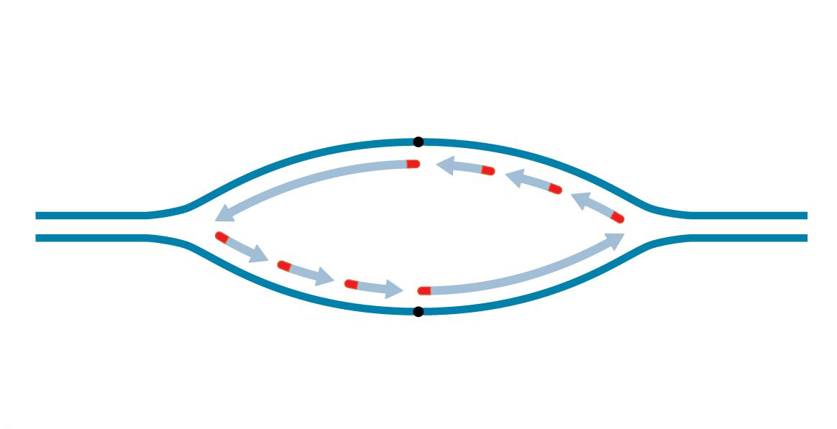
Figure 16.16a
Overview
Lagging strand
Origin of replication
Leading strand
Lagging strand
F2
F1
Leading strand
Overall directions of replication
Notes:
Figure 16.16a Synthesis of the lagging strand (part 1)

Slide 71
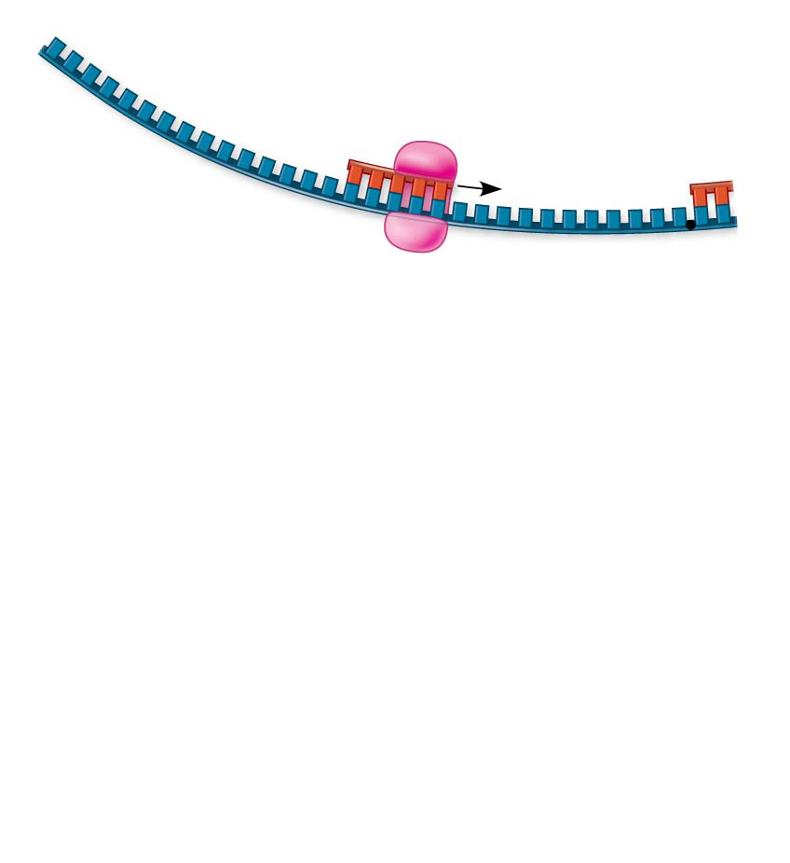
Figure 16.16b-1
3′
1
Primase makes
RNA primer.
Origin of replication
5′
3′
Template strand
5′
3′
5′
Notes:
Figure 16.15b-1 Synthesis of the lagging strand (part 2, step 1)

Slide 72
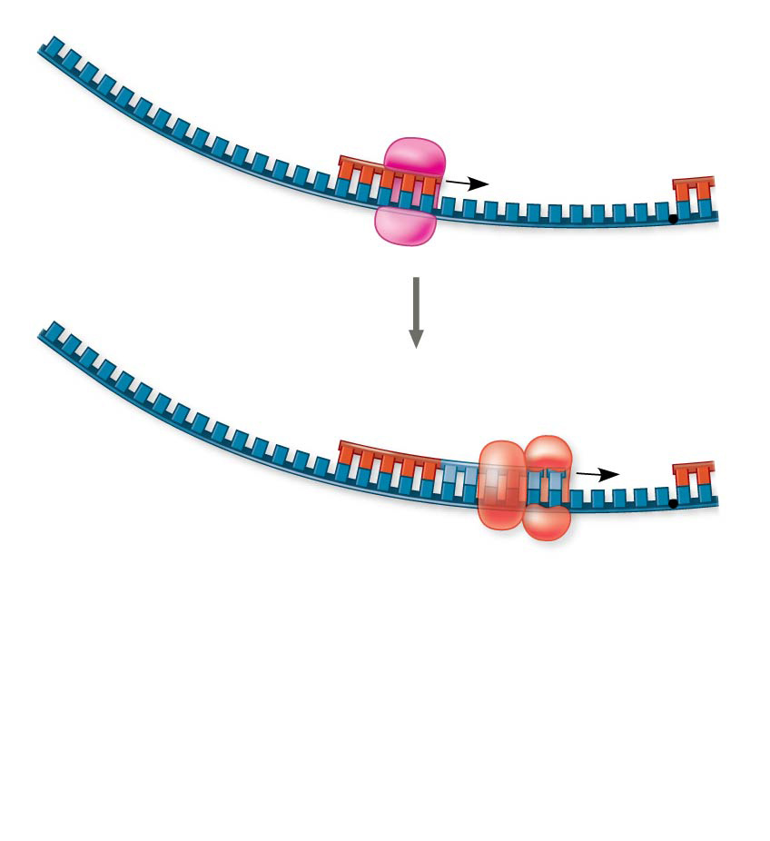
Figure 16.16b-2
3′
1
Primase makes
RNA primer.
Origin of replication
5′
3′
Template strand
5′
3′
5′
2
DNA pol III makes Okazaki fragment 1.
3′
RNA primer for fragment 1
5′
F1
3′
5′
3′
5′
Notes:
Figure 16.16b-2 Synthesis of the lagging strand (part 2, step 2)

Slide 73
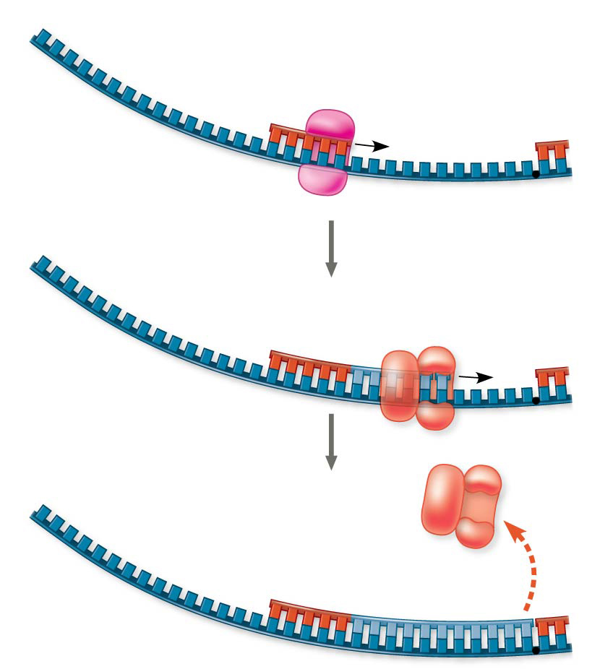
Figure 16.16b-3
3′
1
Primase makes
RNA primer.
Origin of replication
5′
3′
Template strand
5′
3′
5′
2
DNA pol III makes Okazaki fragment 1.
3′
RNA primer for fragment 1
5′
F1
3′
5′
3′
5′
3
DNA pol III detaches.
3′
Okazaki fragment 1
5′
3′
5′
F1
Notes:
Figure 16.16b-3 Synthesis of the lagging strand (part 2, step 3)

Slide 74
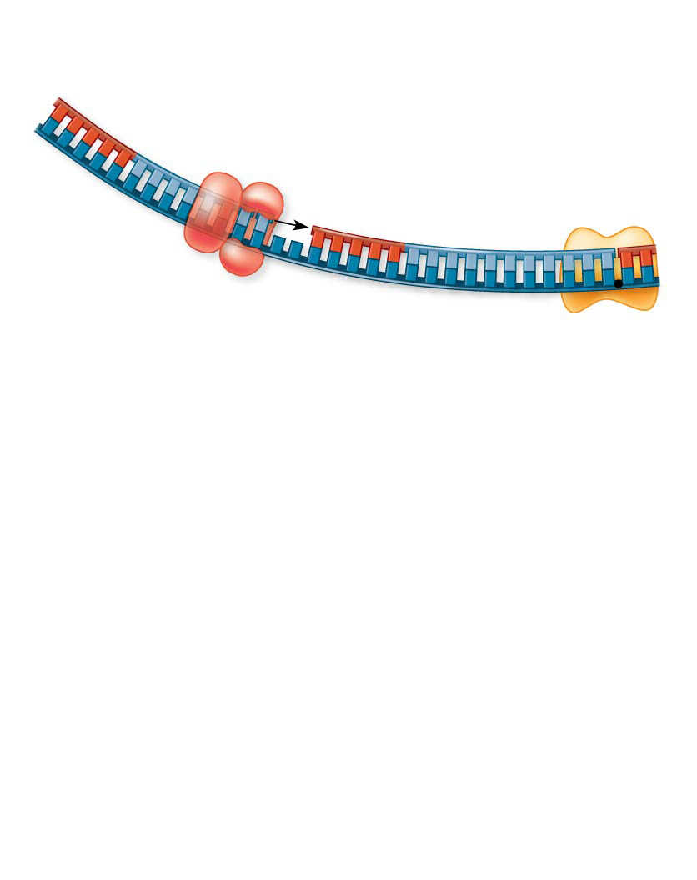
Figure 16.16c-1
RNA primer for fragment 2
5′
Okazaki fragment 2
4
DNA pol III makes Okazaki fragment 2.
3′
F2
3′
5′
F1
Notes:
Figure 16.16c-1 Synthesis of the lagging strand (part 3, step 1)

Slide 75
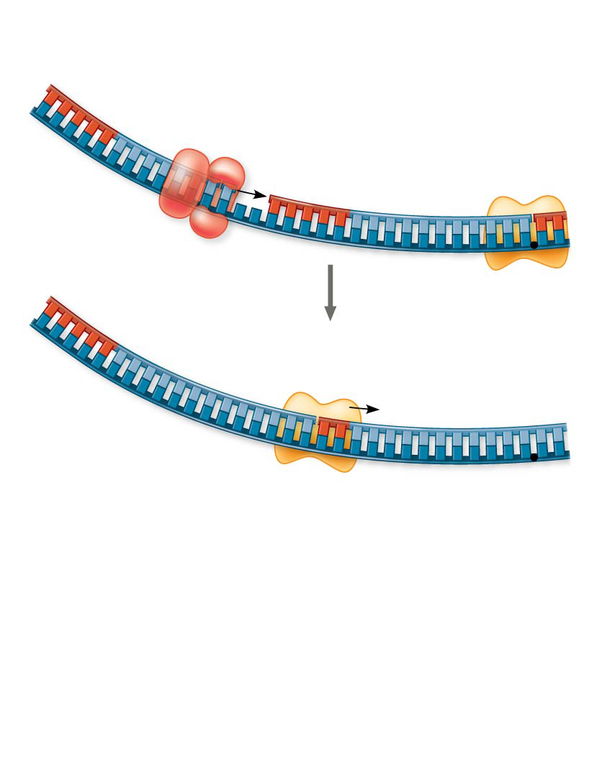
Figure 16.16c-2
RNA primer for fragment 2
5′
Okazaki fragment 2
4
DNA pol III makes Okazaki fragment 2.
3′
F2
3′
5′
F1
5′
3′
5
DNA pol I replaces RNA with DNA.
F2
3′
5′
F1
Notes:
Figure 16.16c-2 Synthesis of the lagging strand (part 3, step 2)

Slide 76
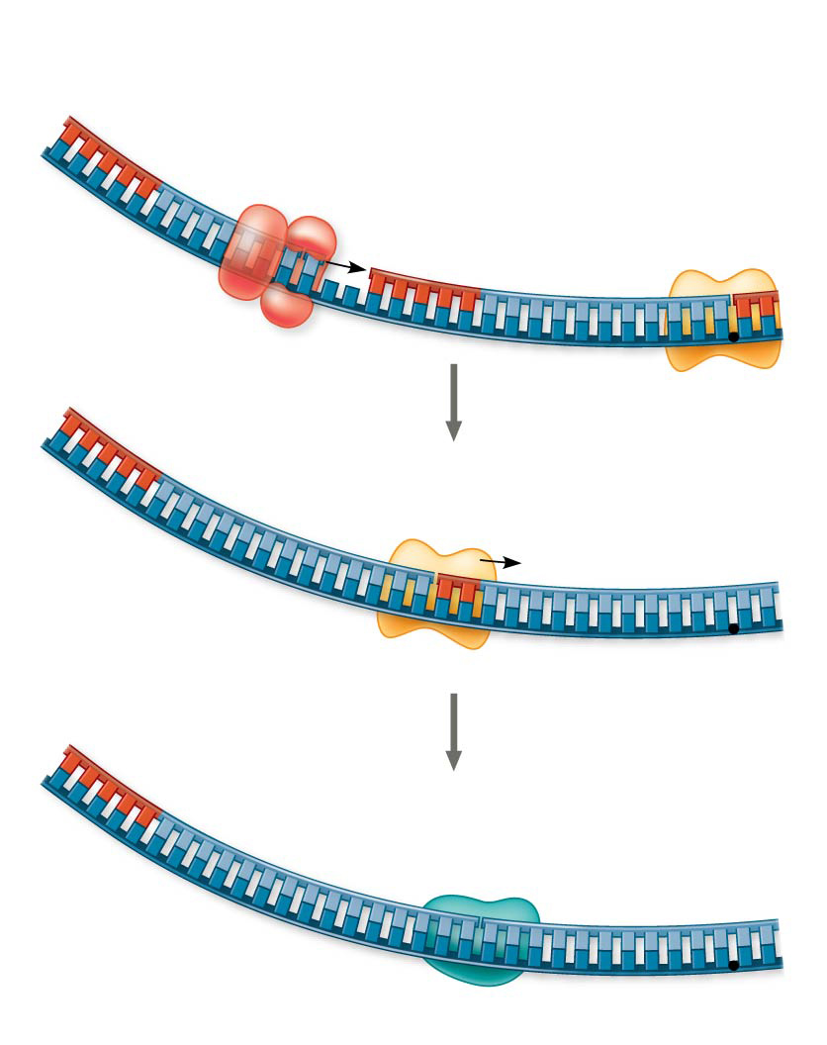
Figure 16.16c-3
RNA primer for fragment 2
5′
Okazaki fragment 2
4
DNA pol III makes Okazaki fragment 2.
3′
F2
3′
5′
F1
5′
3′
5
DNA pol I replaces RNA with DNA.
F2
3′
5′
F1
6
DNA ligase forms bonds between DNA fragments.
5′
3′
F2
F1
3′
5′
Overall direction of replication
Notes:
Figure 16.16c-3 Synthesis of the lagging strand (part 3, step 3)

Slide 77
Figure 16.16
Overview
Lagging strand
Origin of replication
Leading strand
Lagging strand
2
1
Leading strand
RNA primer for fragment 2
Overall directions of replication
5′
Okazaki fragment 2
4
DNA pol III makes Okazaki fragment 2.
3′
1
Primase makes
RNA primer.
3′
Origin of replication
2
5′
3′
1
3′
Template strand
5′
3′
5′
5′
5′
5
DNA pol I replaces RNA with DNA.
2
DNA pol III makes Okazaki fragment 1.
3′
3′
RNA primer for fragment 1
2
5′
1
3′
1
3′
5′
3′
5′
5′
6
DNA ligase forms bonds between DNA fragments.
5′
3
DNA pol III detaches.
3′
3′
Okazaki fragment 1
2
1
3′
5′
3′
5′
1
5′
Overall direction of replication
Notes:
Figure 16.16 Synthesis of the lagging strand

Slide 78
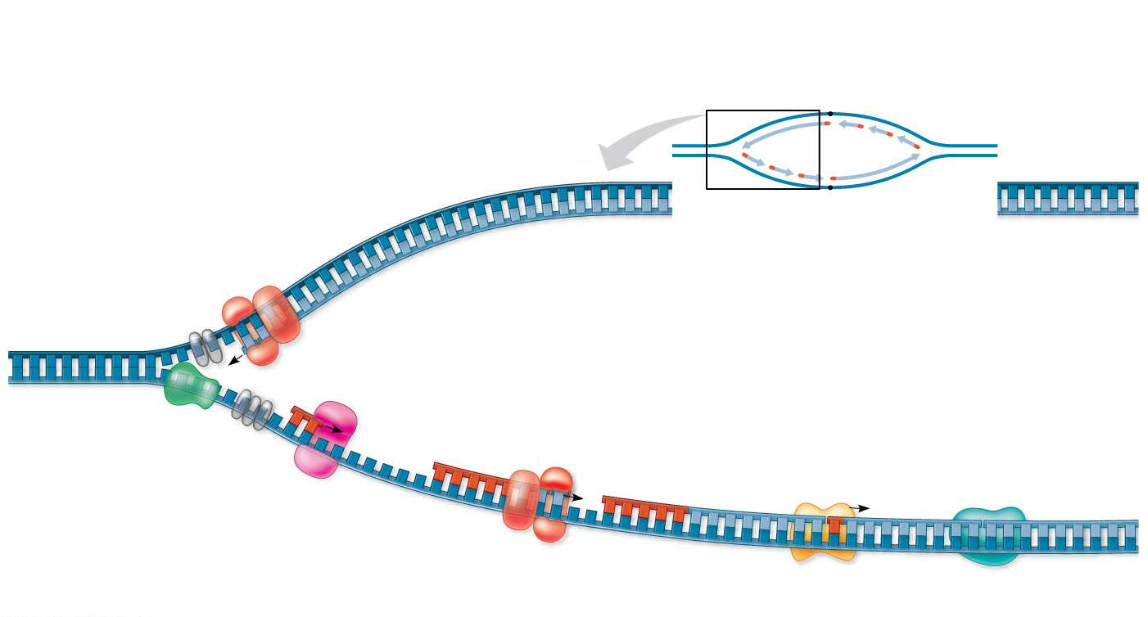
Figure 16.17
Overview
Leading strand
Origin of replication
Lagging strand
Leading strand template
3′
Lagging strand
Leading strand
Single-strand binding proteins
5′
Leading strand
Overall directions of replication
Helicase
5′
DNA pol III
3′
Primer
3′
5′
3′
Primase
Parental DNA
5
DNA pol III
Lagging strand
5′
3′
DNA pol I
DNA ligase
4
5′
3
2
1
3′
Lagging strand template
5′
Notes:
Figure 16.17 A summary of bacterial DNA replication

Slide 79
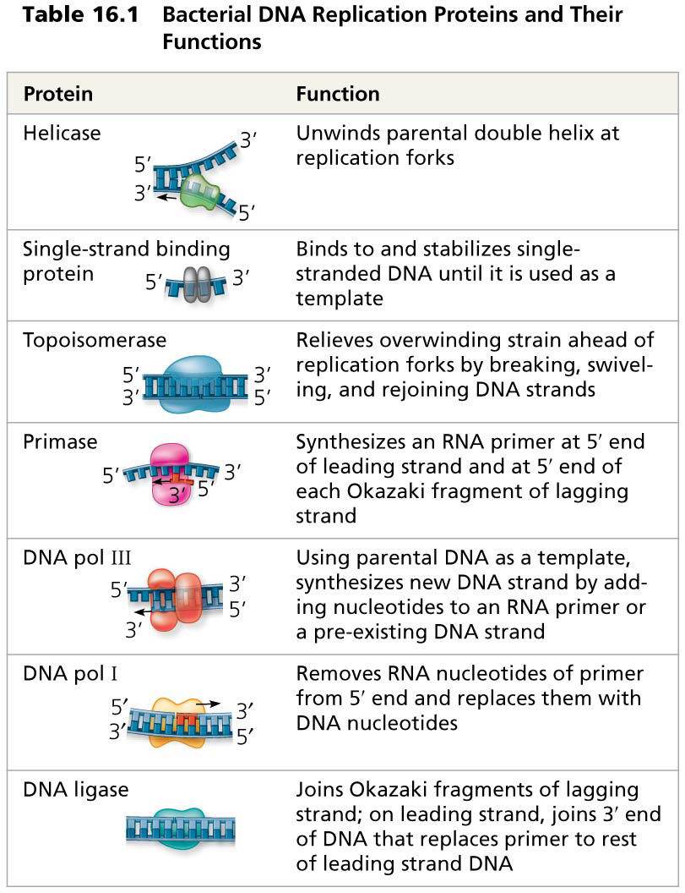
Table 16.1
Notes:
Table 16.1 Bacterial DNA replication proteins and their functions

Slide 80
WATCH
https://www.youtube.com/watch?v=TNKWgcFPHqw&t=36s
https://www.youtube.com/watch?v=dKubyIRiN84
https://www.youtube.com/watch?v=0Ha9nppnwOc

Slide 81
Overview
Concept 16.1: DNA is the genetic material
Concept 16.2: Many proteins work together in DNA replication and repair
Concept 16.3: A chromosome consists of a DNA molecule packed together with proteins

Slide 82
Concept 16.3: A chromosome consists of a DNA molecule packed together with proteins
The bacterial chromosome is a double-stranded, circular DNA molecule associated with a small amount of protein
In a bacterium, the DNA is “supercoiled” and found in a region of the cell called the nucleoid

Slide 83
Concept 16.3: A chromosome consists of a DNA molecule packed together with proteins
Eukaryotic genomes fit into the nucleus through an elaborate, multilevel system of packing
Eukaryotic chromosomes have linear DNA molecules associated with a large amount of protein
In the eukaryotic cell, DNA is precisely combined with proteins in a complex called chromatin

Slide 84
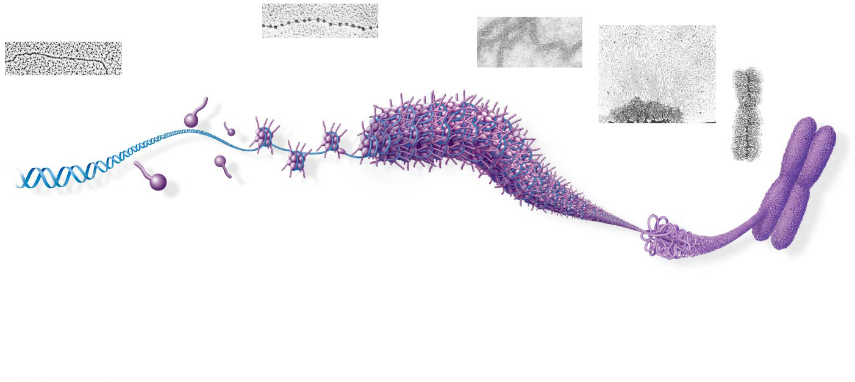
Figure 16.22
Chromatid (700 nm)
Nucleosome (10 nm in diameter)
DNA double helix (2 nm in diameter)
30-nm fiber
H1
Loops
Scaffold
Histones
Histone tail
300-nm fiber
DNA, the double helix
Histones
Nucleosomes, or “beads on a string” (10-nm fiber)
30-nm fiber
Looped domains (300-nm fiber)
Replicated chromosome (1,400 nm)
Metaphase chromosome
Notes:
Figure 16.22 Exploring chromatin packing in a eukaryotic chromosome

Slide 85
Concept 16.3: A chromosome consists of a DNA molecule packed together with proteins
Most chromatin is loosely packed in the nucleus during interphase and condenses prior to mitosis
Loosely packed chromatin is called euchromatin
During interphase a few regions of chromatin (centromeres and telomeres) are highly condensed into heterochromatin
Dense packing of the heterochromatin makes it difficult for the cell to express genetic information coded in these regions

Slide 86
Overview
Concept 16.1: DNA is the genetic material
Concept 16.2: Many proteins work together in DNA replication and repair
Concept 16.3: A chromosome consists of a DNA molecule packed together with proteins

