Slide 1
0
15
The Chromosomal Basis of Inheritance

Slide 2
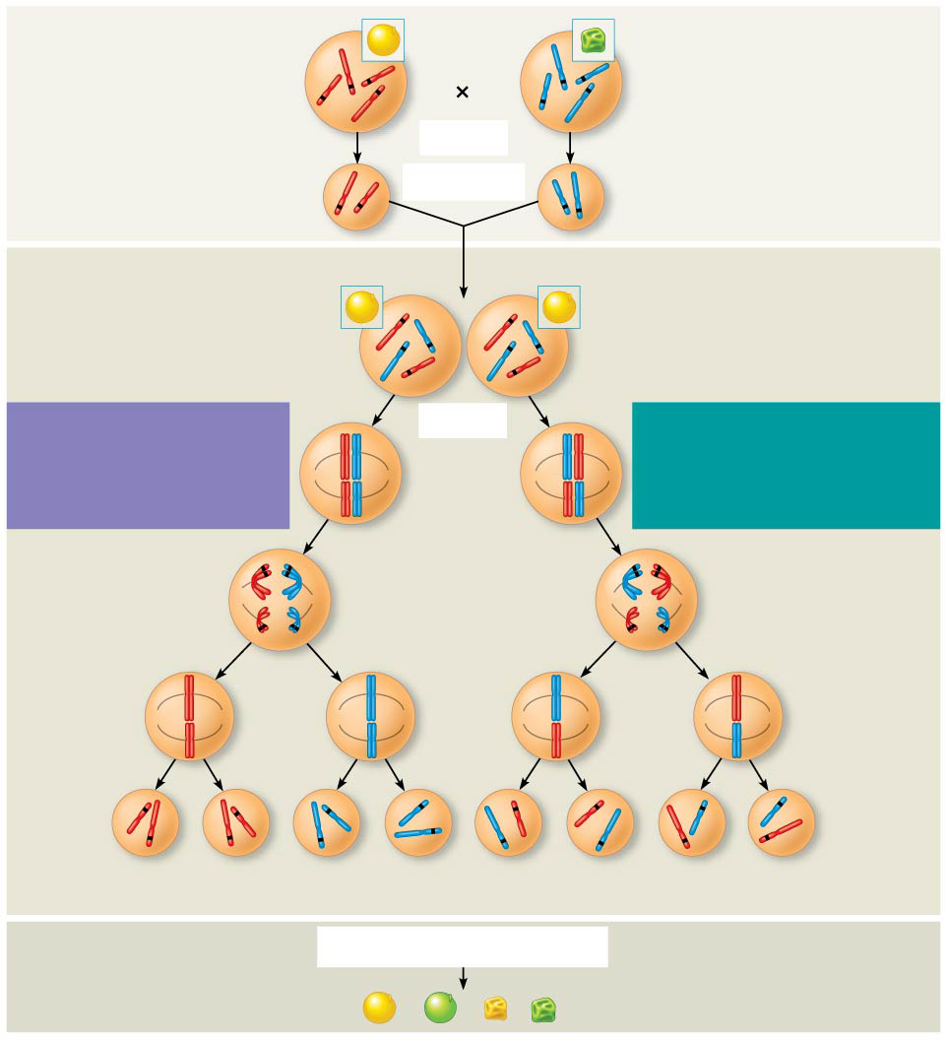
Figure 15.2
P Generation
Yellow-round seeds (YYRR)
Green-wrinkled seeds (yyrr)
Y
r
y
Y
R
R
y
r
Meiosis
Fertilization
Gametes
R
Y
y
r
F₁ Generation
All F₁ plants produce yellow-round seeds (YyRr).
R
y
R
y
r
r
Y
Y
Recall Mendel’s genius work
LAW OF SEGREGATION The two alleles for each gene separate.
Meiosis
LAW OF INDEPENDENT ASSORTMENT Alleles of genes on nonhomologous chromosomes assort independently.
R
r
r
R
Metaphase I
Y
y
Y
y
1
1
R
r
r
R
Anaphase I
Y
y
Y
y
R
r
Metaphase II
r
R
2
y
2
Y
y
Y
Y
Y
y
y
Y
Y
y
y
R
R
r
r
r
r
R
R
¹ ₄
YR
¹ ₄
yr
¹ ₄
Yr
¹ ₄
yR
F₂ Generation
An F₁ × F₁ cross-fertilization
3
Fertilization results in the 9:3:3:1 phenotypic ratio in the F₂ generation.
3
Fertilization recombines the R and r alleles at random.
9
: 3
: 1
: 3
Notes:
Figure 15.2 The chromosomal basis of Mendel’s laws

Slide 3
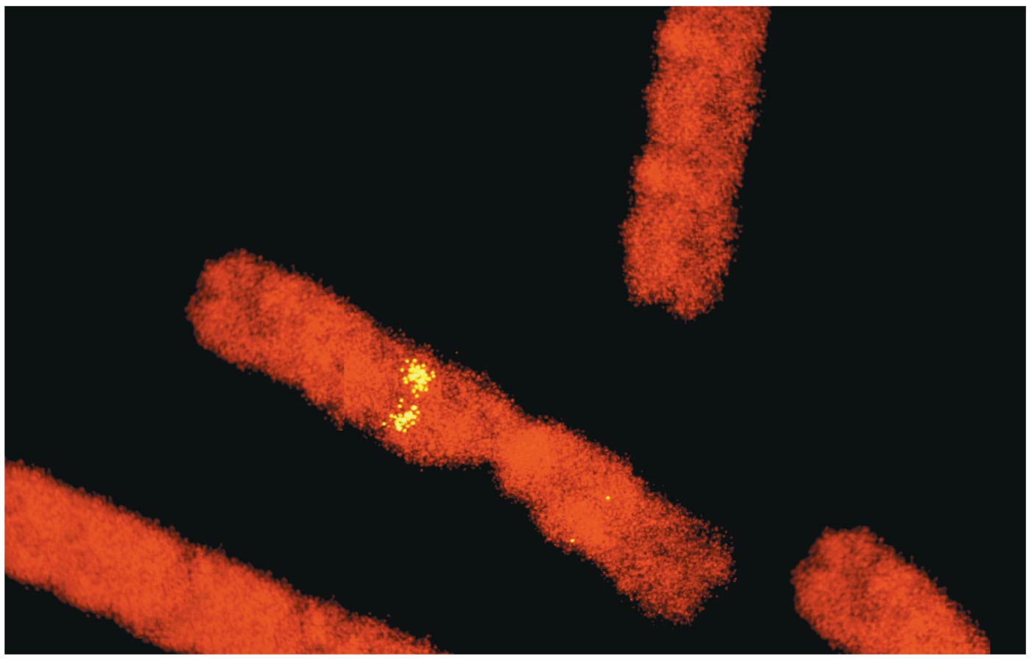
Locating Genes Along Chromosomes
Mendel’s “hereditary factors” were purely abstract when first proposed…still a genius tho
Today we can show that the factors aka GENES, are located on actual chromosomes

Slide 4
Overview
Concept 15.1: Morgan showed that Mendelian inheritance has its physical basis in the behavior of chromosomes
Concept 15.2: Sex-linked genes exhibit unique patterns of inheritance
Concept 15.3: Linked genes tend to be inherited together because they are located near each other on the same chromosome
Concept 15.4: Alterations of chromosome number or structure cause some genetic disorders
Concept 15.5: Some inheritance patterns are exceptions to standard Mendelian inheritance

Slide 5
Overview
Concept 15.1: Morgan showed that Mendelian inheritance has its physical basis in the behavior of chromosomes
Concept 15.2: Sex-linked genes exhibit unique patterns of inheritance
Concept 15.3: Linked genes tend to be inherited together because they are located near each other on the same chromosome
Concept 15.4: Alterations of chromosome number or structure cause some genetic disorders
Concept 15.5: Some inheritance patterns are exceptions to standard Mendelian inheritance

Slide 6
Concept 15.1: Morgan showed that Mendelian inheritance has its physical basis in the behavior of chromosomes
The first solid evidence associating a specific gene with a specific chromosome came in the early 20th century from the work of Thomas Hunt Morgan
These early experiments provided convincing evidence that the “chromosomes” are the location of Mendel’s “heritable factors”
Morgan’s model organism = Drosophila melanogaster (fruit fly)

Slide 7
Genetics 101: More vocab
Wild type (w+) = “normal” phenotypes
Phenotypes that were most common in the fly populations
Mutant (w) = Traits alternative to the wild type are called mutant phenotypes
BTW…
F
M

Slide 8
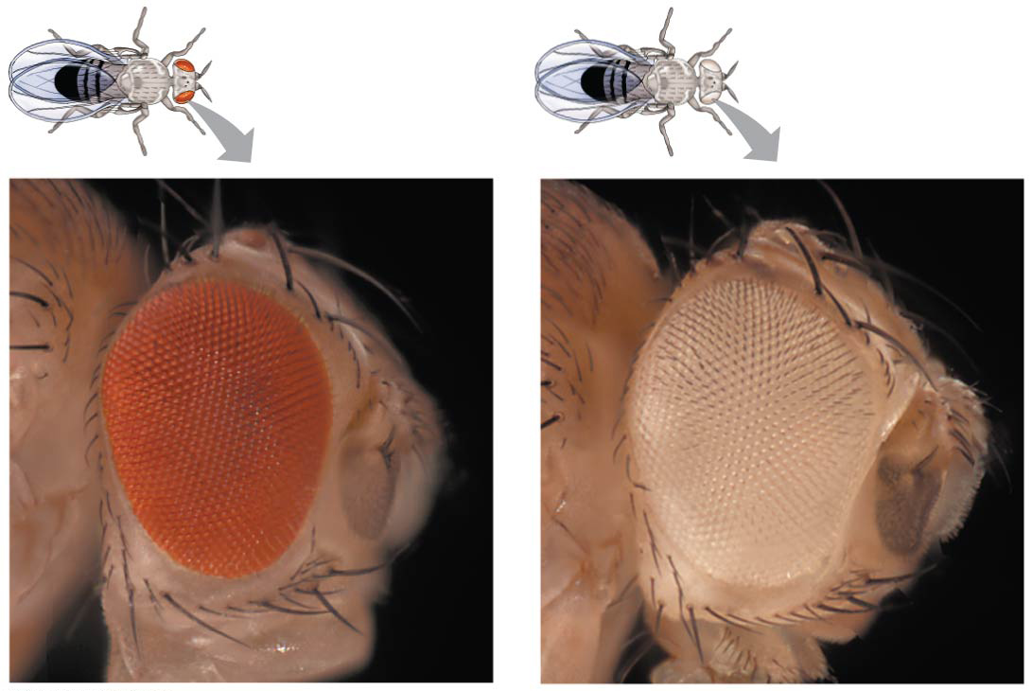
Figure 15.3
Wild type = w+ = red eyes
Mutant = w = white eyes
Notes:
Figure 15.3 Morgan’s first mutant

Slide 9
Correlating Behavior of a Gene’s Alleles with Behavior of a Chromosome Pair
In one experiment, Morgan mated male flies with white eyes (mutant) with female flies with red eyes (wild type)
The F₁ generation ALL had red eyes (males AND females)
The F₂ generation showed a 3:1 red to white eye ratio, but ONLY males had white eyes
That’s quite odd…

Slide 10
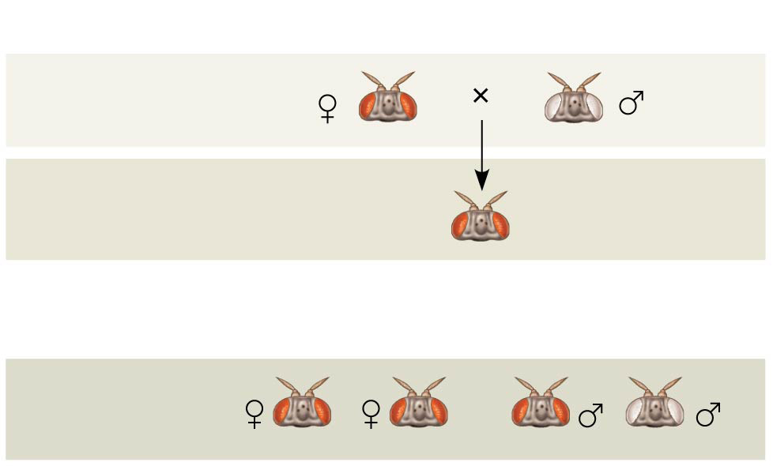
Figure 15.4a
Experiment
P Generation
F₁ Generation
All offspring had red eyes.
Results
F₂ Generation
Notes:
Figure 15.4a Inquiry: In a cross between a wild-type female fruit fly and a mutant white-eyed male, what color eyes will the F₁ and F₂ offspring have? (part 1: experiment and results)

Slide 11
Correlating Behavior of a Gene’s Alleles with Behavior of a Chromosome Pair
Morgan determined that the white-eyed mutant allele MUST be located on the X chromosome
Morgan’s finding supported the chromosome theory of inheritance
Morgan = genius, just like Mendel

Slide 12
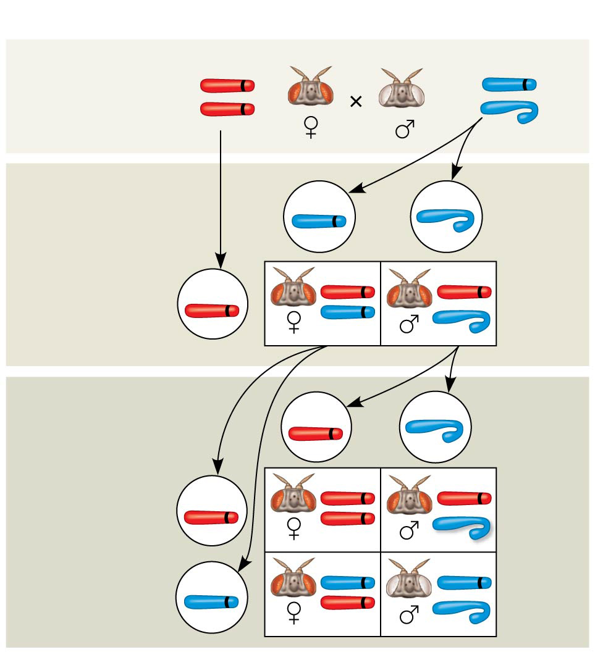
Figure 15.4b
Conclusion
P Generation
w⁺
w
X
X
X
Y
w⁺
w
Sperm
Eggs
F₁ Generation
w⁺
w⁺
w⁺
w
w⁺
Sperm
Eggs
w⁺
w⁺
F₂ Generation
w⁺
w⁺
w
w
w
w⁺
Notes:
Figure 15.4b Inquiry: In a cross between a wild-type female fruit fly and a mutant white-eyed male, what color eyes will the F₁ and F₂ offspring have? (part 2: conclusion)

Slide 13
Overview
Concept 15.1: Morgan showed that Mendelian inheritance has its physical basis in the behavior of chromosomes
Concept 15.2: Sex-linked genes exhibit unique patterns of inheritance
Concept 15.3: Linked genes tend to be inherited together because they are located near each other on the same chromosome
Concept 15.4: Alterations of chromosome number or structure cause some genetic disorders
Concept 15.5: Some inheritance patterns are exceptions to standard Mendelian inheritance

Slide 14
Concept 15.2: Sex-linked genes exhibit unique patterns of inheritance
Morgan’s discovery of a trait that correlated with the sex of flies was key to the development of the chromosome theory of inheritance
In humans and some other animals, there is a chromosomal basis of sex determination

Slide 15
The Chromosomal Basis of Sex Determination
In humans and other mammals, there are two varieties of sex chromosomes
Larger X chromosome
Smaller Y chromosome
A person with two X chromosomes (XX) = female
A person with one X chromosome and one Y chromosome (XY) = male
SRY gene (sex-determining region on the Y) is responsible for “maleness” development

Slide 16
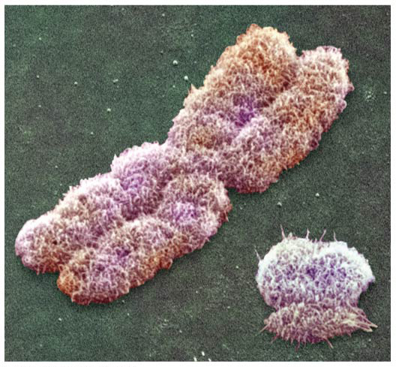
Figure 15.5
X
Y
Notes:
Figure 15.5 Human sex chromosomes

Slide 17
Concept 15.2: Sex-linked genes exhibit unique patterns of inheritance
A gene that is located on either sex chromosome is called a sex-linked gene
Genes on the Y chromosome are called Y-linked genes; there are few of these
Genes on the X chromosome are called X-linked genes
X chromosomes have genes for MANY characters UNRELATED to sex

Slide 18
Concept 15.2: Sex-linked genes exhibit unique patterns of inheritance
X-linked genes follow UNIQUE, NON-MENDELIAN patterns of inheritance
For a recessive X-linked trait to be expressed…
A female needs TWO copies of the allele = homozygous recessive genotype
A male needs ONLY ONE copy of the allele = “hemizygous” genotype
X-linked recessive disorders are MUCH MORE COMMON in males than in females

Slide 19
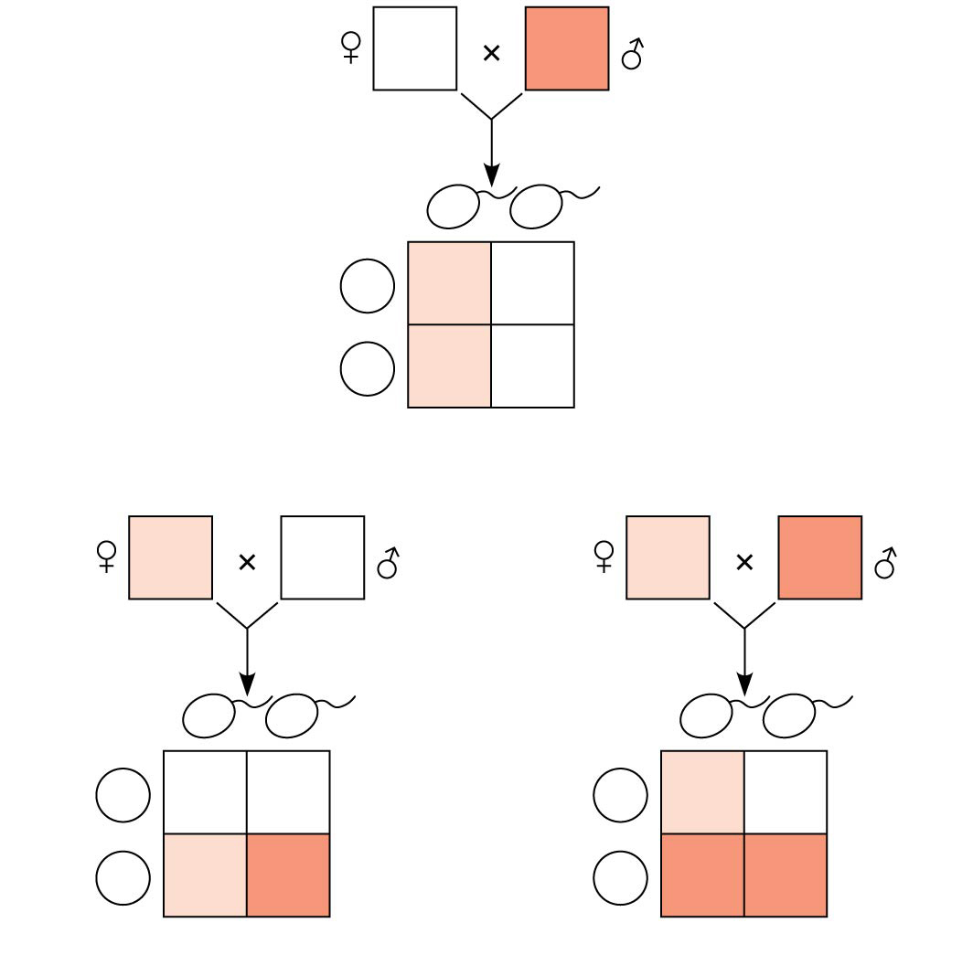
Figure 15.7
X^{N}X^{N}
X^{n}Y
X^{n}
Y
Sperm
Eggs
X^{N}X^{n}
X^{N}Y
X^{N}
X^{N}
X^{N}X^{n}
X^{N}Y
(a)
X^{N}X^{n}
X^{N}Y
X^{N}X^{n}
X^{n}Y
X^{N}
Y
Sperm
X^{n}
Y
Sperm
Eggs
X^{N}X^{N}
X^{N}Y
Eggs
X^{N}
X^{N}
X^{N}X^{n}
X^{N}Y
X^{n}
X^{N}X^{n}
X^{n}Y
X^{n}
X^{n}X^{n}
X^{n}Y
(b)
(c)
Notes:
Figure 15.7 The transmission of X-linked recessive traits

Slide 20
Concept 15.2: Sex-linked genes exhibit unique patterns of inheritance
Some disorders caused by recessive alleles on the X chromosome in humans
Color blindness (mostly X-linked)
Duchenne muscular dystrophy
Hemophilia

Slide 21
X Inactivation in Female Mammals
In mammalian females, one of the two X chromosomes in each cell is randomly inactivated during embryonic development
The inactive X condenses into a Barr body
If a female is heterozygous for a particular gene located on the X chromosome, she will be a mosaic for that character

Slide 22
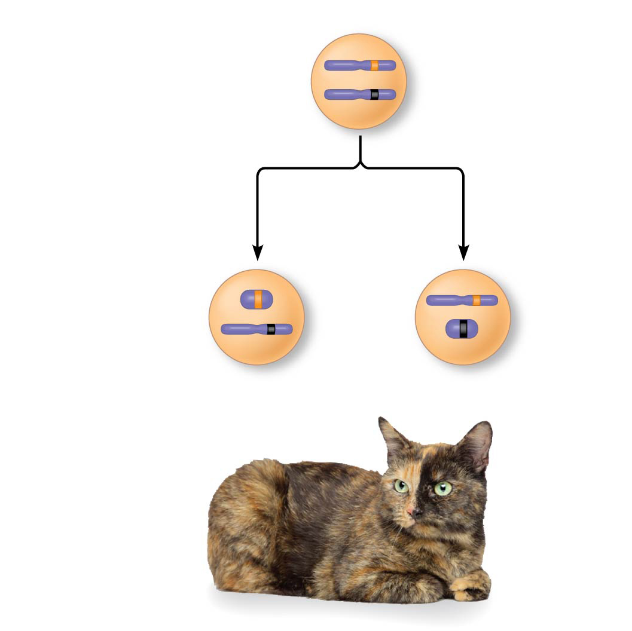
Figure 15.8
X chromosomes
Allele for orange fur
Early embryo:
Allele for black fur
Cell division and X chromosome inactivation
Two cell populations in adult cat:
Inactive X
Active X
Active X
Black fur
Orange fur
Notes:
Figure 15.8 X inactivation and the tortoiseshell cat

Slide 23
Notes:
When Thomas Hunt Morgan crossed his red-eyed F1 generation flies to each other, the F2 generation included both red- and white-eyed flies. Remarkably, all the white-eyed flies were male. What was the explanation for this result?
https://www.polleverywhere.com/multiple_choice_polls/eidsIxRlLUoGOAg

Slide 24
Notes:
Which of the following is the meaning of the chromosome theory of inheritance as expressed in the early twentieth century?
https://www.polleverywhere.com/multiple_choice_polls/jVVbN23tA5SOLNg

Slide 25
Notes:
Males are more often affected by sex-linked traits than females because _____.
https://www.polleverywhere.com/multiple_choice_polls/7kGWSqasJB2iVIR

Slide 26
Notes:
SRY is best described as _____.
https://www.polleverywhere.com/multiple_choice_polls/38vPYqSiKN9RFpv

Slide 27
Notes:
In cats, black fur color is caused by an X-linked allele; the other allele at this locus causes orange color. The heterozygote is tortoiseshell. What kinds of offspring would you expect from the cross of a black female and an orange male?
https://www.polleverywhere.com/multiple_choice_polls/22XJmtRIZ9fHLSe

Slide 28
Notes:
Cinnabar eyes is a sex-linked, recessive characteristic in fruit flies. If a female having cinnabar eyes is crossed with a wild-type male, what percentage of the F1 males will have cinnabar eyes?
https://www.polleverywhere.com/multiple_choice_polls/wo7zkeFiLWIPKGf

Slide 29
Overview
Concept 15.1: Morgan showed that Mendelian inheritance has its physical basis in the behavior of chromosomes
Concept 15.2: Sex-linked genes exhibit unique patterns of inheritance
Concept 15.3: Linked genes tend to be inherited together because they are located near each other on the same chromosome
Concept 15.4: Alterations of chromosome number or structure cause some genetic disorders
Concept 15.5: Some inheritance patterns are exceptions to standard Mendelian inheritance

Slide 30
Concept 15.3: Linked genes tend to be inherited together because they are located near each other on the same chromosome
Each chromosome has hundreds or thousands of genes (except the Y chromosome)
Genes located on the SAME chromosome that tend to be inherited TOGETHER are called linked genes

Slide 31
Recombination of Unlinked Genes: Independent Assortment of Chromosomes
Offspring with a phenotype matching one of the parental phenotypes are called parental types
Offspring with nonparental phenotypes (new combinations of traits) are called recombinant types, or recombinants
A 50% frequency of recombination is observed for any two genes on DIFFERENT chromosomes
This is what Mendel predicted…but Morgan showed that this isn’t always the case!

Slide 32
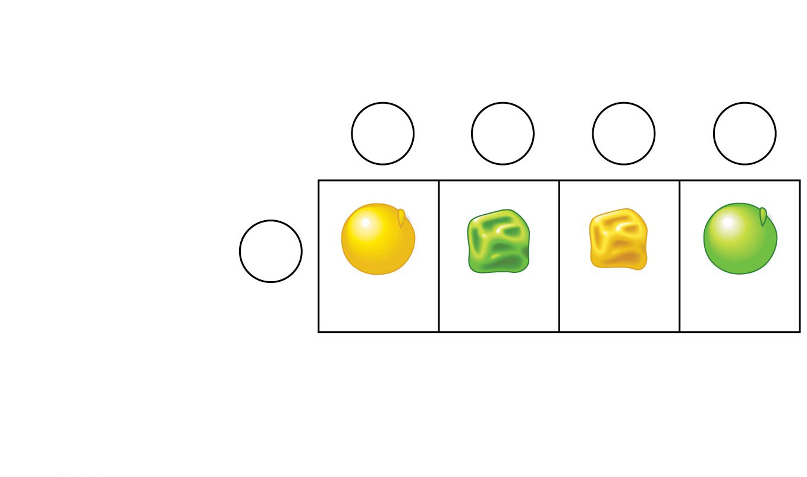
Figure 15.UN02
Mendel = Genius
Gametes from yellow-round dihybrid parent (YyRr)
YR
yr
Yr
yR
Gametes from testcross homozygous recessive parent (yyrr)
yr
YyRr
yyrr
Yyrr
yyRr
Parental- type offspring
Recombinant offspring
Notes:
Figure 15.UN02 In-text figure, Punnett square, p. 300

Slide 33
Morgan’s Genius
Morgan found that body color and wing size in fruit flies are usually inherited TOGETHER in specific combinations (parental phenotypes)
body color = b⁺/b and wing size = vg⁺/vg
He noted that these genes DO NOT assort independently, and reasoned that they were on the same chromosome
These genes violated Mendel’s laws!

Slide 34
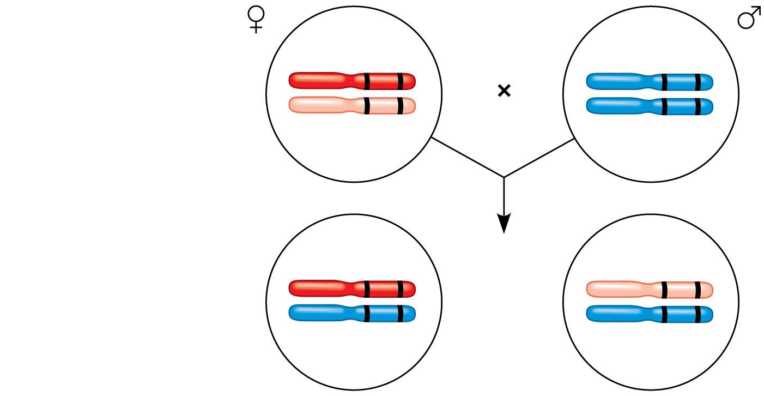
Figure 15.UN01
Morgan = Genius
F₁ dihybrid female and homozygous
recessive male in testcross
b⁺ vg⁺
b vg
b vg
b vg
b⁺ vg⁺
b vg
Most offspring
or
b vg
b vg
Notes:
Figure 15.UN01 In-text figure, testcross, p. 300

Slide 35
Recombination of Linked Genes: Crossing Over
Morgan discovered that genes can be linked, but the linkage was incomplete, because some recombinant phenotypes (Mendel’s prediction) were still observed
He proposed that some process must occasionally break the physical connection between genes on the same chromosome
That mechanism was the crossing over of homologous chromosomes during Prophase I of Meiosis I!!!!!!!!!!!!!!!!!!!!!!!!!!!!!!!!!!!!!!!!!!!!!!!!!!!!!!!!!!!!!!!!!

Slide 36
Animation: Crossing Over

Slide 37
Notes:
Which of the following statements is true of linkage?
https://www.polleverywhere.com/multiple_choice_polls/0Z0bkrtepet32lA

Slide 38
Notes:
How would one explain a testcross involving F1 dihybrid flies in which more parental-type offspring than recombinant-type offspring are produced?
https://www.polleverywhere.com/multiple_choice_polls/O7skoj7JyEGwnKf

Slide 39
Notes:
What does a frequency of recombination of 50% indicate?
https://www.polleverywhere.com/multiple_choice_polls/n008e11Qn3wJ9Op

Slide 40
Overview
Concept 15.1: Morgan showed that Mendelian inheritance has its physical basis in the behavior of chromosomes
Concept 15.2: Sex-linked genes exhibit unique patterns of inheritance
Concept 15.3: Linked genes tend to be inherited together because they are located near each other on the same chromosome
Concept 15.4: Alterations of chromosome number or structure cause some genetic disorders
Concept 15.5: Some inheritance patterns are exceptions to standard Mendelian inheritance

Slide 41
Concept 15.4: Alterations of chromosome number or structure cause some genetic disorders
Large-scale chromosomal alterations in humans and other mammals often lead to spontaneous abortions (miscarriages) or cause a variety of developmental disorders

Slide 42
Abnormal Chromosome Number
In nondisjunction, pairs of homologous chromosomes do not separate normally during meiosis
As a result, one gamete receives two of the same type of chromosome, and another gamete receives no copy

Slide 43
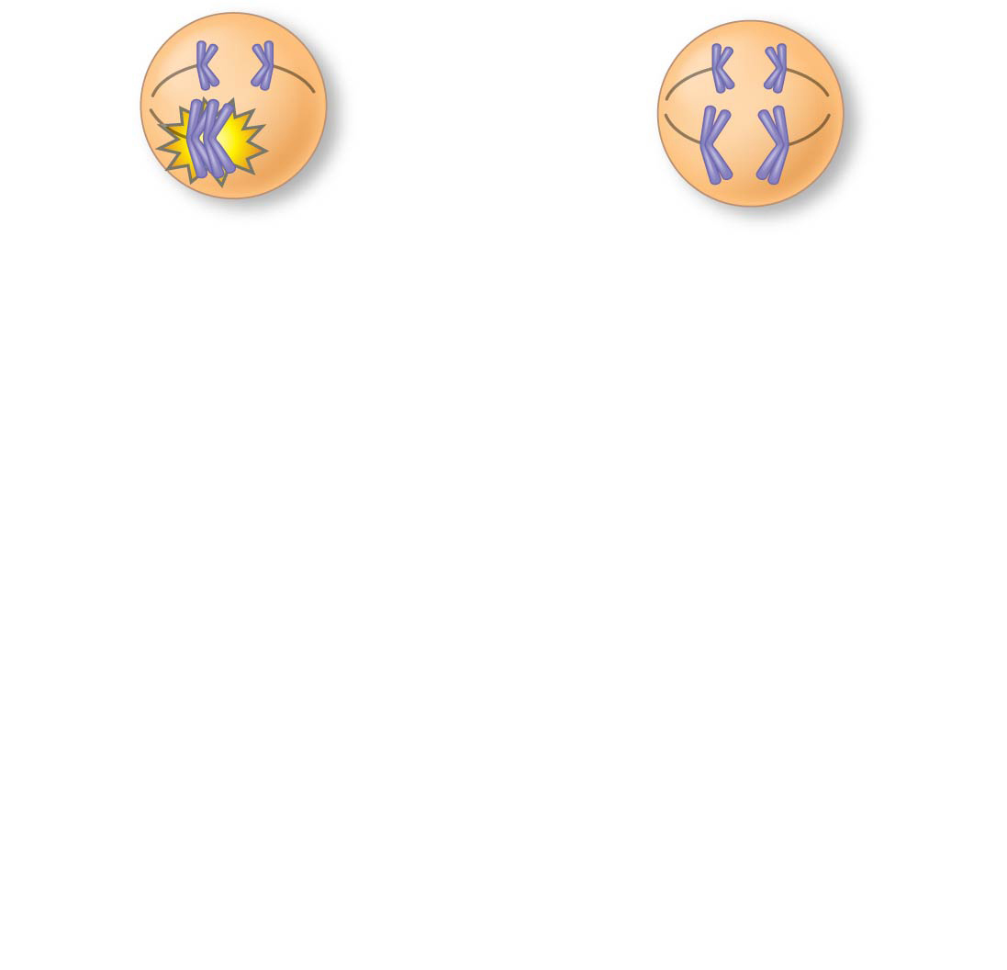
Figure 15.13-1
Meiosis I
Nondisjunction
Notes:
Figure 15.13-1 Meiotic nondisjunction (step 1)

Slide 44
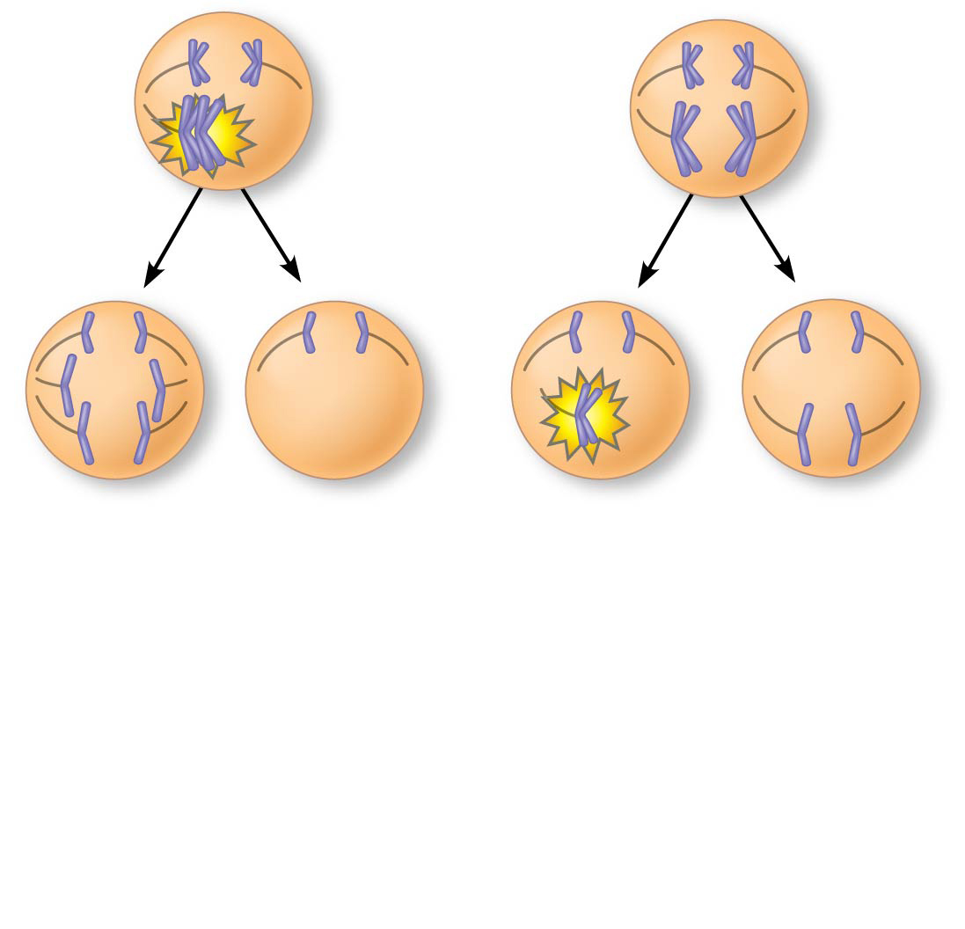
Figure 15.13-2
Meiosis I
Nondisjunction
Meiosis II
Non- disjunction
Notes:
Figure 15.13-2 Meiotic nondisjunction (step 2)

Slide 45
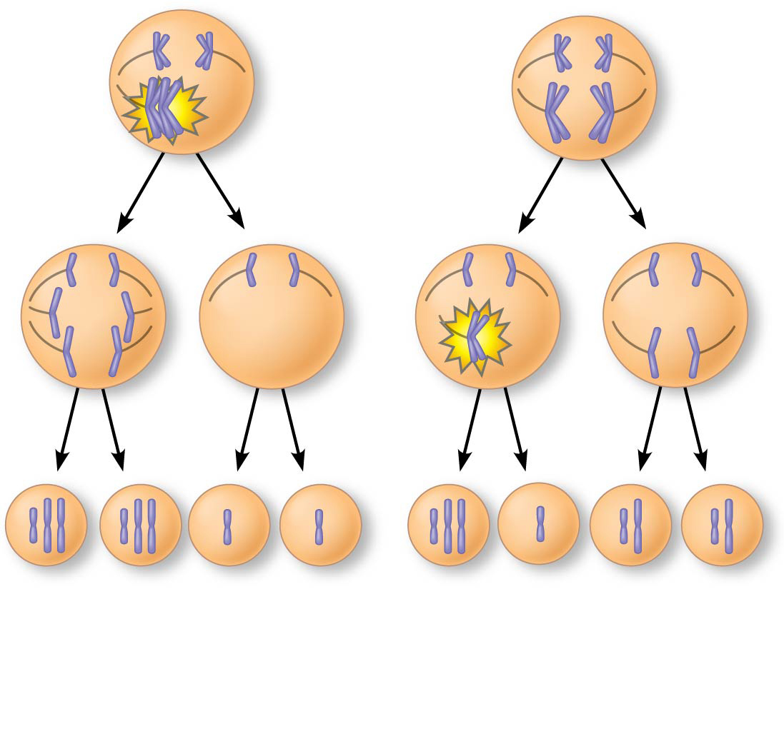
Figure 15.13-3
Meiosis I
Nondisjunction
Meiosis II
Non- disjunction
Gametes
n + 1
n + 1
n − 1
n − 1
n + 1
n − 1
n
n
Number of chromosomes
(a) Nondisjunction of homo- logous chromosomes in meiosis I
(b) Nondisjunction of sister chromatids in meiosis II
Notes:
Figure 15.13-3 Meiotic nondisjunction (step 3)

Slide 46
Notes:
If cell X enters meiosis, and nondisjunction of one chromosome occurs in one of its daughter cells during meiosis II, what will be the result at the completion of meiosis?
https://www.polleverywhere.com/multiple_choice_polls/yA1ZKXUoRk1qdIo

Slide 47
Abnormal Chromosome Number
Aneuploidy results from the fertilization of gametes in which nondisjunction occurred
Offspring with this condition have an ABNORMAL number of a particular chromosome
A monosomic zygote has only one copy of a particular chromosome
A trisomic zygote has three copies of a particular chromosome

Slide 48
Aneuploidy in Humans: Down Syndrome (Trisomy 21)
Down syndrome is an aneuploid condition that results from three copies of chromosome 21
It affects about one out of every 700 children born in the United States
The frequency of Down syndrome increases with the age of the mother, a correlation that has not been explained

Slide 49
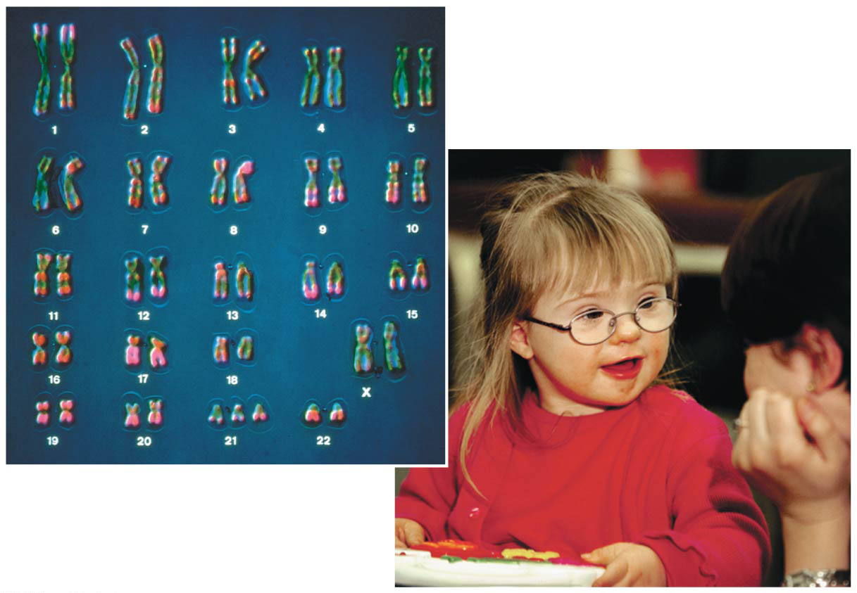
Figure 15.15
Notes:
Figure 15.15 Down syndrome

Slide 50
Notes:
A couple has a child with Down syndrome. The mother is 39 years old at the time of delivery. Which of the following is the most probable cause of the child's condition?
https://www.polleverywhere.com/multiple_choice_polls/5f2i1koRuBatS1U

Slide 51
Aneuploidy in Humans: Sex Chromosomes
Nondisjunction of sex chromosomes produces a variety of aneuploid conditions
XXX females are pretty healthy, with no unusual physical features
Klinefelter syndrome is the result of an extra chromosome in a male, producing XXY individuals
Monosomy X, called Turner syndrome, produces X0 females, who are sterile; it is the only known viable monosomy in humans

Slide 52
Notes:
Which of the following is an example of monosomy?
https://www.polleverywhere.com/multiple_choice_polls/yTwUCrp7IW7Epsv

Slide 53
Abnormal Chromosome Number
Polyploidy is a condition in which an organism has more than two complete sets of chromosomes
Triploidy (3n) is three sets of chromosomes
Tetraploidy (4n) is four sets of chromosomes
Polyploidy is common in plants, but not animals

Slide 54
Alterations of Chromosome Structure
Breakage of a chromosome can lead to four types of changes in chromosome structure
Deletion removes a chromosomal segment
Duplication repeats a segment
Inversion reverses orientation of a segment within a chromosome
Translocation moves a segment from one chromosome to another

Slide 55
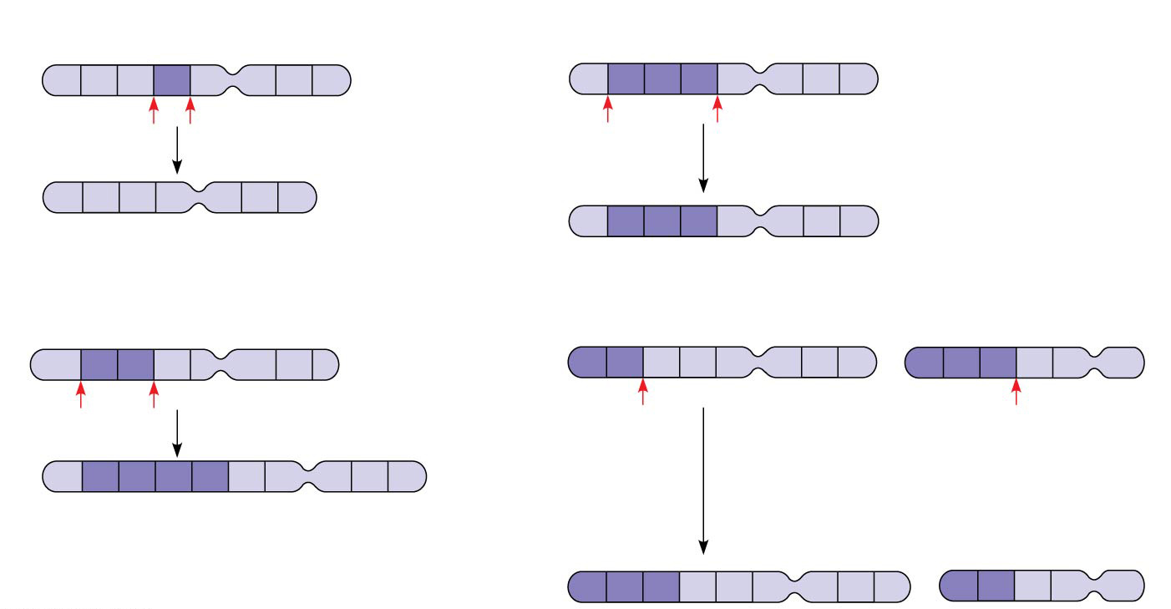
Figure 15.14
(a) Deletion
(c) Inversion
A B C D E F G H
A B C D E F G H
A deletion removes a chromosomal segment.
An inversion reverses a segment within a chromosome.
A B C E F G H
A D C B E F G H
(b) Duplication
(d) Translocation
A B C D E F G H
A B C D E F G H
M N O P Q R
A duplication repeats a segment.
A translocation moves a segment from one chromosome to a nonhomologous chromosome.
A B C B C D E F G H
M N O C D E F G H
A B P Q R
Notes:
Figure 15.14 Alterations of chromosome structure

Slide 56
Disorders Caused by Structurally Altered Chromosomes
The syndrome cri du chat (“cry of the cat”), results from a specific deletion in chromosome 5
A child born with this syndrome is severely intellectually disabled and has a catlike cry; individuals usually die in infancy or early childhood
Certain cancers, including chronic myelogenous leukemia (CML), are caused by translocations of chromosomes

Slide 57
Notes:
One possible result of chromosomal breakage is for a fragment to join a nonhomologous chromosome. What is this alteration called?
https://www.polleverywhere.com/multiple_choice_polls/reKt4cEzj4KJQm2

Slide 58
Overview
Concept 15.1: Morgan showed that Mendelian inheritance has its physical basis in the behavior of chromosomes
Concept 15.2: Sex-linked genes exhibit unique patterns of inheritance
Concept 15.3: Linked genes tend to be inherited together because they are located near each other on the same chromosome
Concept 15.4: Alterations of chromosome number or structure cause some genetic disorders
Concept 15.5: Some inheritance patterns are exceptions to standard Mendelian inheritance

Slide 59
Concept 15.5: Some inheritance patterns are exceptions to standard Mendelian inheritance
There are two normal exceptions to Mendelian genetics
One exception involves genes located in the nucleus
The other exception involves genes located outside the nucleus
In both cases, the sex of the parent contributing an allele is a factor in the pattern of inheritance

Slide 60
Genomic Imprinting
For a few mammalian traits, the phenotype depends on which parent passed along the alleles for those traits
Such variation in phenotype is called genomic imprinting
Genomic imprinting involves the silencing of certain genes depending on which parent passes them on

Slide 61
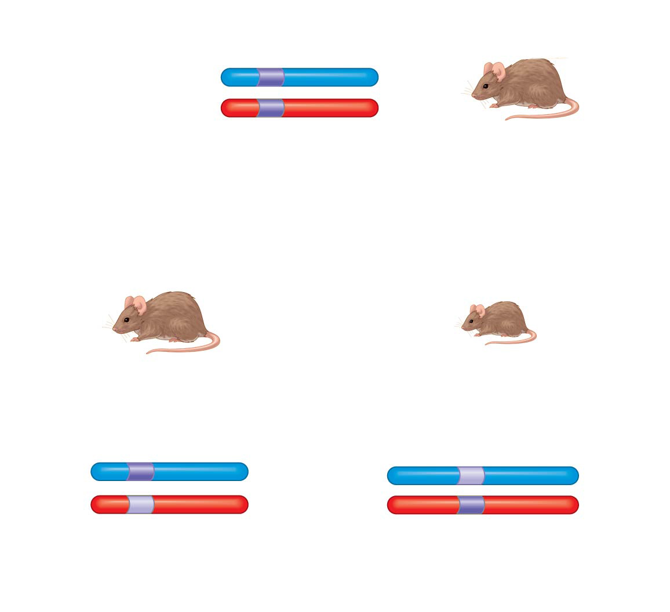
Figure 15.17
Normal Igf2 allele is expressed.
Paternal chromosome
Maternal chromosome
Normal Igf2 allele is not expressed.
Normal-sized mouse (wild type)
(a) Homozygote
Mutant Igf2 allele inherited from mother
Mutant Igf2 allele inherited from father
Normal-sized mouse (wild type)
Dwarf mouse (mutant)
Normal Igf2 allele is expressed.
Mutant Igf2 allele is expressed.
Mutant Igf2 allele is not expressed.
Normal Igf2 allele is not expressed.
(b) Heterozygotes
Notes:
Figure 15.17 Genomic imprinting of the mouse Igf2 gene

Slide 62
Inheritance of Organelle Genes
Extranuclear genes (or cytoplasmic genes) are found in organelles in the cytoplasm
Mitochondria, chloroplasts, and other plant plastids carry small circular DNA molecules
Extranuclear genes are inherited MATERNALLY because the zygote’s cytoplasm always comes from the egg

Slide 63
Defective Inheritance of Organelle Genes
Some defects in mitochondrial genes prevent cells from making enough ATP and result in diseases that affect the muscular and nervous systems
Mitochondrial myopathy
Leber’s hereditary optic neuropathy

Slide 64
Notes:
Mitochondrial DNA is primarily involved in coding for proteins needed for protein complexes of the electron transport chain and ATP synthase. Therefore, mutations in mitochondrial genes would most affect _____.
https://www.polleverywhere.com/multiple_choice_polls/Z2c3guglRQJGMMz

Slide 65
Overview
Concept 15.1: Morgan showed that Mendelian inheritance has its physical basis in the behavior of chromosomes
Concept 15.2: Sex-linked genes exhibit unique patterns of inheritance
Concept 15.3: Linked genes tend to be inherited together because they are located near each other on the same chromosome
Concept 15.4: Alterations of chromosome number or structure cause some genetic disorders
Concept 15.5: Some inheritance patterns are exceptions to standard Mendelian inheritance

