Slide 1
0
13
Meiosis and Sexual Life Cycles

Slide 2
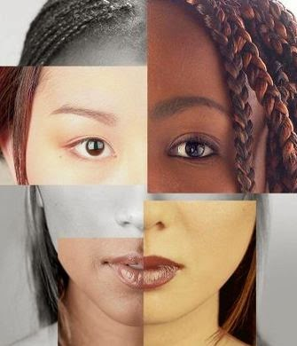
How is all the variation between humans even possible?

Slide 3
Welcome to Genetics!
Living organisms are distinguished by their ability to reproduce their own kind
Heredity is the transmission of traits from one generation to the next
Variation is demonstrated by the differences in appearance that offspring show from parents and siblings
Genetics is the scientific study of heredity and variation

Slide 4
Overview
Concept 13.1: Offspring acquire genes from parents by inheriting chromosomes
Concept 13.2: Fertilization and meiosis alternate in sexual life cycles
Concept 13.3: Meiosis reduces the number of chromosome sets from diploid to haploid
Concept 13.4: Genetic variation produced in sexual life cycles contributes to evolution

Slide 5
Overview
Concept 13.1: Offspring acquire genes from parents by inheriting chromosomes
Concept 13.2: Fertilization and meiosis alternate in sexual life cycles
Concept 13.3: Meiosis reduces the number of chromosome sets from diploid to haploid
Concept 13.4: Genetic variation produced in sexual life cycles contributes to evolution

Slide 6
Concept 13.1: Offspring acquire genes from parents by inheriting chromosomes
In a literal sense, children DO NOT inherit particular physical traits from their parents
It is GENES that are actually inherited…

Slide 7
Inheritance of Genes
Genes are the UNITS of heredity and are made up of segments of DNA
Genes are passed to the next generation via reproductive cells called gametes (sperm and eggs)
Most DNA is packaged into chromosomes
Humans have 46 chromosomes in their somatic cells, all cells of the body EXCEPT gametes
A gene’s SPECIFIC POSITION along a chromosome is called the locus

Slide 8
Comparison of Asexual and Sexual Reproduction
In asexual reproduction, a single individual passes ALL of its genes to its offspring WITHOUT the fusion of gametes
A clone is a group of genetically IDENTICAL individuals from the same parent
In sexual reproduction, two parents give rise to offspring that have UNIQUE combinations of genes INHERITED from the two parents

Slide 9
Notes:
Which of the following defines a genome?
https://www.polleverywhere.com/multiple_choice_polls/2b3CjuJ8Z03SyLU

Slide 10
Notes:
Asexual reproduction occurs during _____.
https://www.polleverywhere.com/multiple_choice_polls/owB0ynA6AUFq6SS

Slide 11
Overview
Concept 13.1: Offspring acquire genes from parents by inheriting chromosomes
Concept 13.2: Fertilization and meiosis alternate in sexual life cycles
Concept 13.3: Meiosis reduces the number of chromosome sets from diploid to haploid
Concept 13.4: Genetic variation produced in sexual life cycles contributes to evolution

Slide 12
Concept 13.2: Fertilization and meiosis alternate in sexual life cycles
A life cycle is the generation-to-generation sequence of STAGES in the reproductive history of an organism
Let’s focus on the human sexual life cycle…

Slide 13
Behavior of Chromosome Sets in the Human Life Cycle
At sexual maturity, the ovaries and testes produce haploid gametes
Gametes are the ONLY types of human cells produced by meiosis, rather than mitosis
Meiosis results in ONE SET of chromosomes in each gamete

Slide 14
Behavior of Chromosome Sets in the Human Life Cycle
Fertilization is the UNION of gametes
Sperm + egg = fertilized egg = zygote with one set of chromosomes from EACH parent
The zygote produces SOMATIC CELLS BY MITOSIS → develops into an adult
Fertilization and meiosis ALTERNATE in sexual life cycles to maintain chromosome number

Slide 15
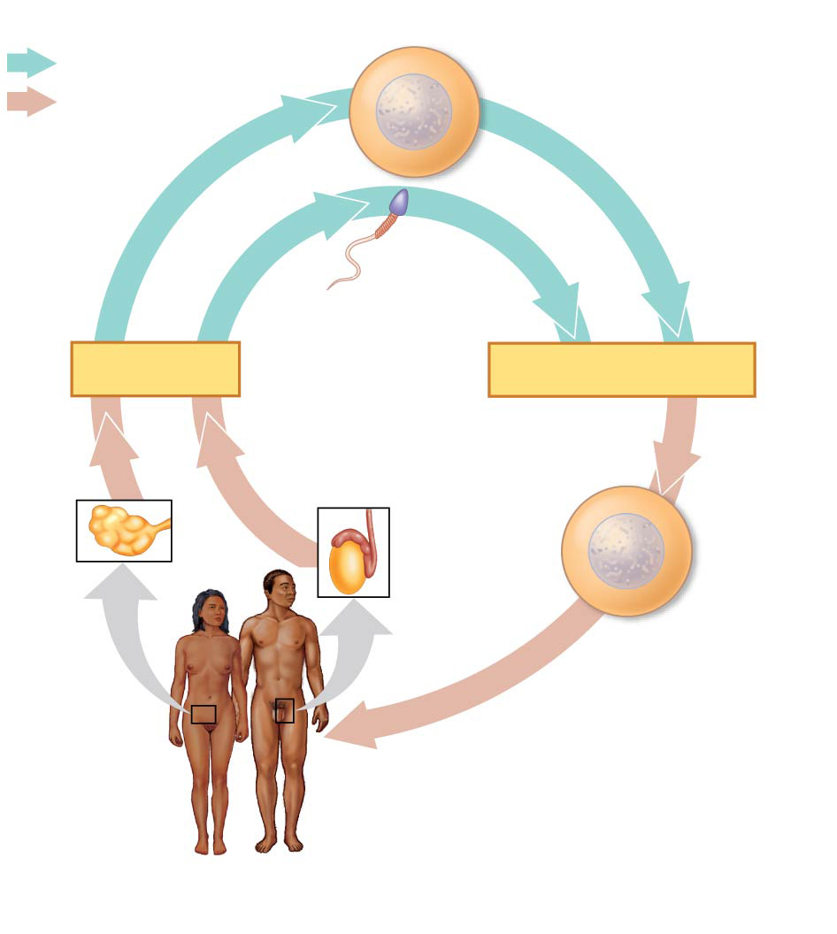
Figure 13.5
Key
Haploid gametes (n = 23)
Haploid (n)
Egg (n)
Diploid (2n)
Sperm (n)
MEIOSIS
FERTILIZATION
Ovary
Testis
Diploid
zygote
(2n = 46)
Mitosis and
development
Multicellular diploid
adults (2n = 46)
Notes:
Figure 13.5 The human life cycle

Slide 16
Sets of Chromosomes in Human Cells
A karyotype is an ordered display of the pairs of chromosomes from a cell
Human somatic cells have 23 PAIRS of chromosomes = 46 total chromosomes
The two chromosomes in each pair are called homologous chromosomes, or homologs
Chromosomes in a homologous pair are the SAME length and shape and carry genes controlling the SAME inherited characters

Slide 17
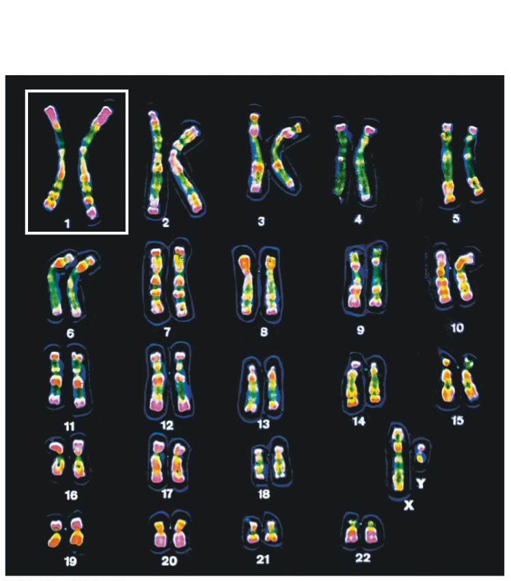
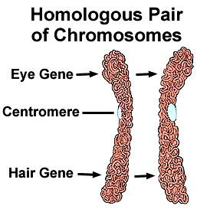
Figure 13.3b
Notes:
Figure 13.3b Research method: preparing a karyotype (part 2: results)

Slide 18
Sets of Chromosomes in Human Cells
The sex chromosomes, which determine the sex of the individual, are called X and Y
Human females have a homologous pair of X chromosomes (XX)
Human males have one X and one Y chromosome (XY)
The remaining 22 pairs of chromosomes are called autosomes

Slide 19
Sets of Chromosomes in Human Cells
Each pair of homologous chromosomes includes one chromosome from EACH PARENT
The 46 chromosomes in a human somatic cell are two sets of 23: one from the mother and one from the father
Your genome = 50% from mom + 50% from dad
A diploid cell (2n) has two sets of chromosomes
For humans, the diploid number is 46 (2n = 46)

Slide 20
Sets of Chromosomes in Human Cells
A gamete (sperm or egg) contains a SINGLE SET of chromosomes and is haploid (n)
For humans, the haploid number is 23 (n = 23)
Each set of 23 consists of 22 autosomes and a single sex chromosome
In an unfertilized egg (ovum), the sex chromosome is X
In a sperm cell, the sex chromosome may be either X or Y

Slide 21
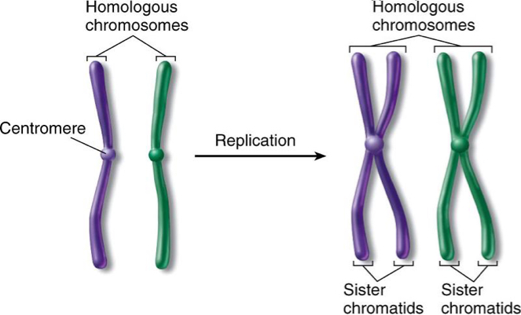
Chromosomal Replication
In a cell in which DNA synthesis has occurred, each chromosome is replicated
Each replicated chromosome consists of two identical sister chromatids

Slide 22
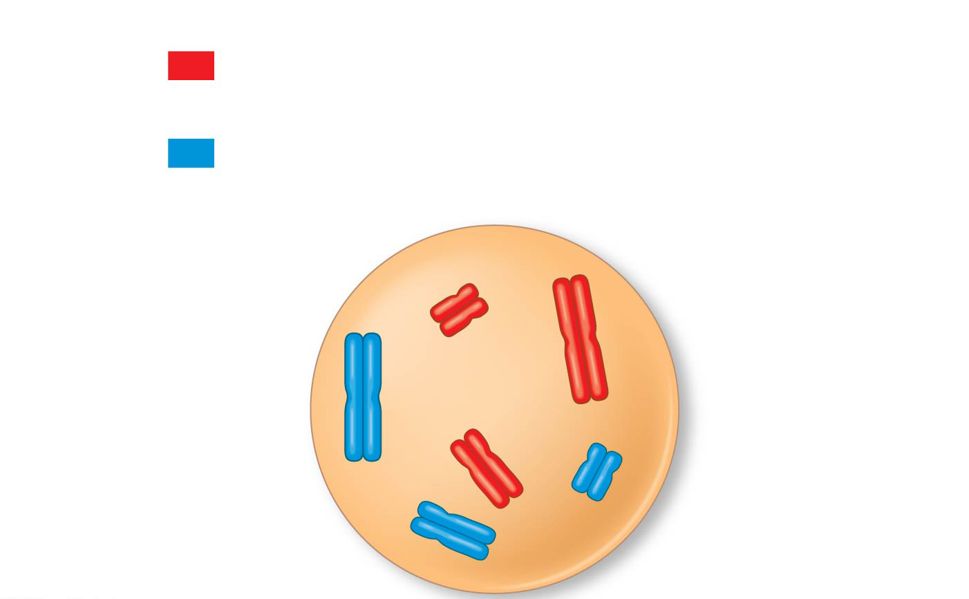
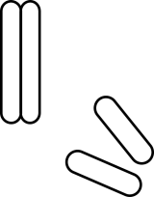
Figure 13.4
Key
Maternal set of
chromosomes (n = 3)
2n = 6
Paternal set of
chromosomes (n = 3)
Sister chromatids
of one duplicated
chromosome
Centromere
Two nonsister
chromatids in
a homologous pair
Pair of homologous
chromosomes
(one from each set)
Notes:
Figure 13.4 Describing chromosomes

Slide 23
The Purpose of Sexual Life Cycles
ONLY DIPLOID CELLS can undergo meiosis
In all sexual life cycles, the halving and doubling of chromosomes contributes to genetic variation in offspring
THIS IS THE PURPOSE OF SEXUAL REPRODUCTION!!!

Slide 24
Notes:
Which of the following is a true statement about sexual vs. asexual reproduction?
https://www.polleverywhere.com/multiple_choice_polls/elOe1bhhUlOZ0ml

Slide 25
Notes:
Which of the following is true of a species that has a chromosome number of 2n = 16?
https://www.polleverywhere.com/multiple_choice_polls/9iQZhrRomSRoH3y

Slide 26
Notes:
A triploid cell contains sets of three homologous chromosomes. If a cell of a usually diploid species with 42 chromosomes per cell is triploid, this cell would be expected to have which of the following?
https://www.polleverywhere.com/multiple_choice_polls/m2GRADJV75xFepb

Slide 27
Notes:
Homologous chromosomes _____.
https://www.polleverywhere.com/multiple_choice_polls/5tKm0k1wCV67qtK

Slide 28
Notes:
The human X and Y chromosomes _____.
https://www.polleverywhere.com/multiple_choice_polls/a50iFziTpwZiMWN

Slide 29
Overview
Concept 13.1: Offspring acquire genes from parents by inheriting chromosomes
Concept 13.2: Fertilization and meiosis alternate in sexual life cycles
Concept 13.3: Meiosis reduces the number of chromosome sets from diploid to haploid
Concept 13.4: Genetic variation produced in sexual life cycles contributes to evolution

Slide 30
Concept 13.3: Meiosis reduces the number of chromosome sets from diploid to haploid
Like mitosis, meiosis is preceded by the replication of chromosomes
Meiosis takes place in two consecutive cell divisions, called meiosis I and meiosis II
The two cell divisions result in FOUR genetically unique, haploid daughter cells (rather than the two identical, diploid daughter cells in mitosis)
Each daughter cell has ONLY HALF as many chromosomes as the parent cell

Slide 31
Preview: The Stages of Meiosis
Chromosomes duplicate during interphase
The resulting sister chromatids are closely associated along their lengths
This is called sister chromatid cohesion
The chromatids are sorted into four haploid daughter cells
Meiosis: “results may vary”

Slide 32
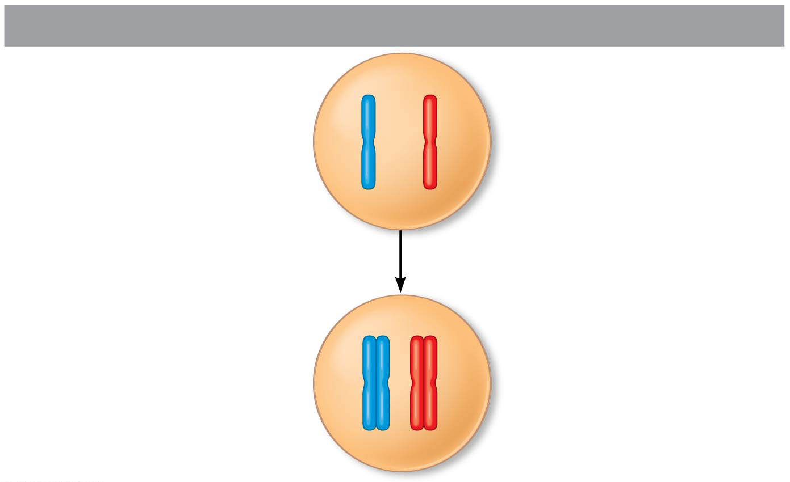
Figure 13.7a
Interphase
Pair of
homologous
chromosomes
in diploid
parent cell
Chromosomes
duplicate
Pair of duplicated
homologous
chromosomes
Sister
chromatids
Diploid cell with
duplicated
chromosomes
Notes:
Figure 13.7a Overview of meiosis: how meiosis reduces chromosome number (part 1: interphase)

Slide 33
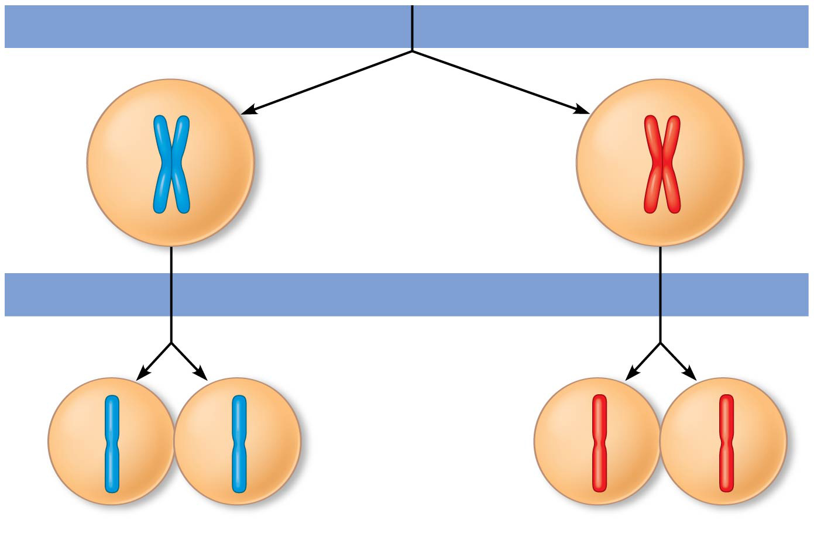
Figure 13.7b
Meiosis I
1
Homologous
chromosomes
separate
Haploid cells with
duplicated chromosomes
Meiosis II
2
Sister chromatids
separate
Haploid cells with unduplicated chromosomes
Notes:
Figure 13.7b Overview of meiosis: how meiosis reduces chromosome number (part 2: meiosis I and II)

Slide 34
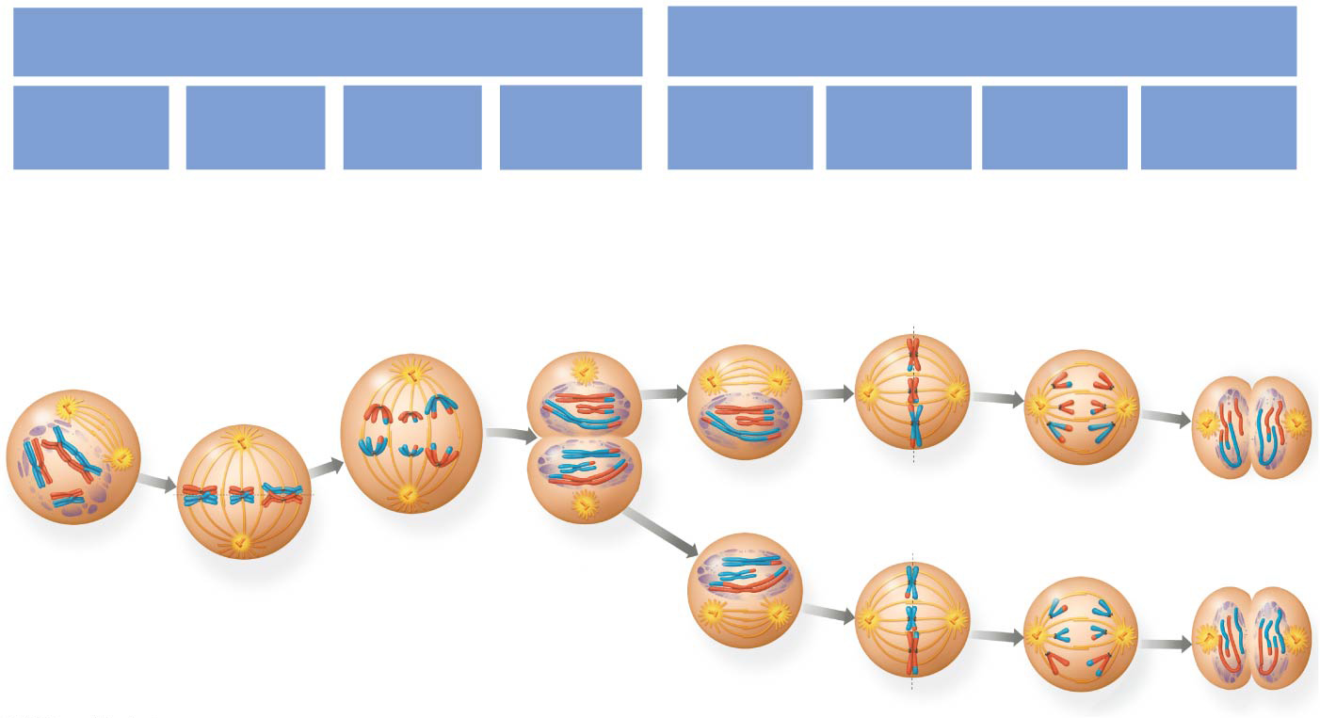
Figure 13.8
MEIOSIS I: Separates
homologous chromosomes
MEIOSIS II: Separates
sister chromatids
Telophase I
and
Cytokinesis
Telophase II
and
Cytokinesis
Prophase I
Metaphase I
Anaphase I
Prophase II
Metaphase II
Anaphase II
Centrosome
(with
centriole
pair)
Centromere
(with
kineto-
chore)
Sister
chromatids
remain
attached
Sister
chroma-
tids
Chiasmata
Meta-
phase
plate
Spindle
Sister
chromatids
separate
Haploid
daughter
cells
forming
Homo-
logous
chromo-
somes
Homologous
chromo-
somes
separate
Cleavage
furrow
Fragments
of nuclear
envelope
Microtubules
attached to kinetochore
Notes:
Figure 13.8 Exploring meiosis in an animal cell

Slide 35
Meiosis I: Separates Homologous Chromosomes
Division in meiosis I occurs in four phases
Prophase I
Metaphase I
Anaphase I
Telophase I and cytokinesis

Slide 36
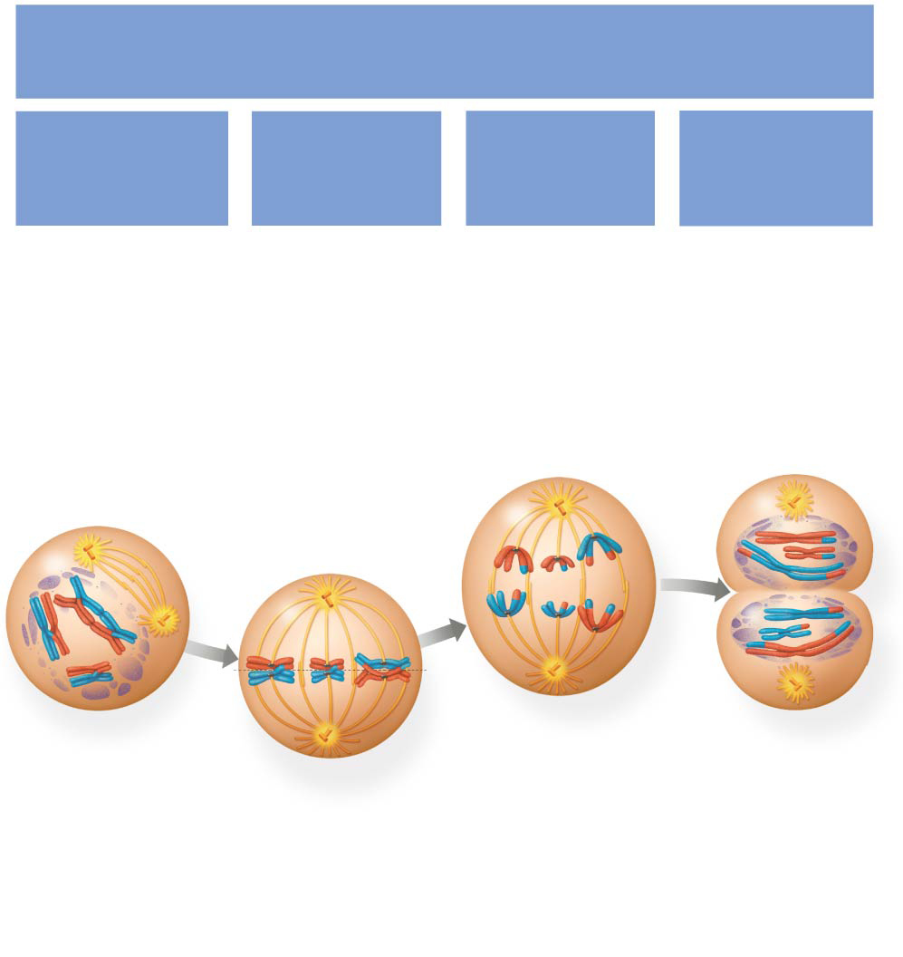
Figure 13.8a
MEIOSIS I: Separates
homologous chromosomes
Telophase I
and
Cytokinesis
Prophase I
Metaphase I
Anaphase I
Centrosome
(with
centriole
pair)
Centromere
(with
kineto-
chore)
Sister
chromatids
remain
attached
Sister
chroma-
tids
Chiasmata
Meta-
phase
plate
Spindle
Homo-
logous
chromo-
somes
Homologous
chromo-
somes
separate
Cleavage
furrow
Fragments
of nuclear
envelope
Microtubules
attached to kinetochore
Notes:
Figure 13.8a Exploring meiosis in an animal cell (part 1: meiosis I)

Slide 37
Figure 13.8a
MEIOSIS I: Separates
homologous chromosomes
Telophase I
and
Cytokinesis
Prophase I
Metaphase I
Anaphase I
Centrosome
(with
centriole
pair)
Centromere
(with
kineto-
chore)
Sister
chromatids
remain
attached
Sister
chroma-
tids
Chiasmata
Meta-
phase
plate
Spindle
Homo-
logous
chromo-
somes
Homologous
chromo-
somes
separate
Cleavage
furrow
Fragments
of nuclear
envelope
Microtubules
attached to kinetochore
Notes:
Figure 13.8a Exploring meiosis in an animal cell (part 1: meiosis I)

Slide 38
Meiosis I: Separates Homologous Chromosomes
1. Prophase I
In early prophase I each chromosome PAIRS with its homolog and crossing over occurs
Homologous pairing forms a TETRAD
X-shaped regions called chiasmata are sites of CROSSOVER

Slide 39
Crossing Over and Synapsis During Prophase I
After interphase, the sister chromatids are held together by proteins called cohesins
The nonsister chromatids are BROKEN at precisely corresponding positions
A zipper-like structure called the synaptonemal complex holds the homologs together tightly
DNA breaks are repaired, JOINING DNA from one nonsister chromatid to the corresponding segment of another (“crossing over” between mom and dad homologs)

Slide 40
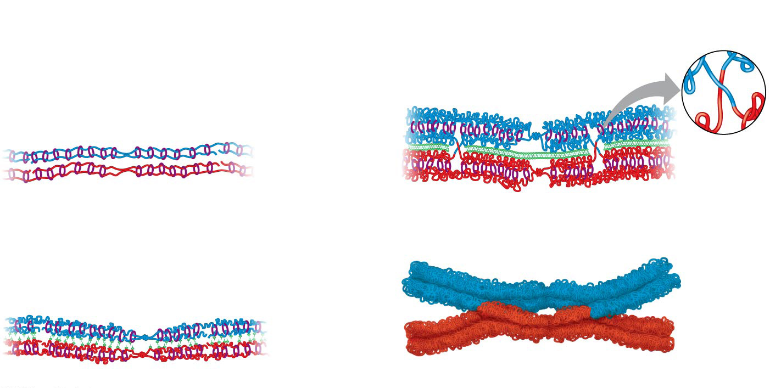
Figure 13.9
Pair of
homologous
chromosomes:
DNA
breaks
DNA
breaks
Paternal
sister
chromatids
Crossover
Crossover
Centromere
Cohesins
1
Maternal
sister
chromatids
3
Chiasmata
Synaptonemal
complex forming
2
4
Notes:
Figure 13.9 Crossing over and synapsis in prophase I: a closer look

Slide 41
Notes:
When we first see chiasmata under a microscope, we know that _____.
https://www.polleverywhere.com/multiple_choice_polls/1o2LSx1E4IjxG16

Slide 42
Figure 13.8a
MEIOSIS I: Separates
homologous chromosomes
Telophase I
and
Cytokinesis
Prophase I
Metaphase I
Anaphase I
Centrosome
(with
centriole
pair)
Centromere
(with
kineto-
chore)
Sister
chromatids
remain
attached
Sister
chroma-
tids
Chiasmata
Meta-
phase
plate
Spindle
Homo-
logous
chromo-
somes
Homologous
chromo-
somes
separate
Cleavage
furrow
Fragments
of nuclear
envelope
Microtubules
attached to kinetochore
Notes:
Figure 13.8a Exploring meiosis in an animal cell (part 1: meiosis I)

Slide 43
Meiosis I: Separates Homologous Chromosomes
2. Metaphase I
In metaphase I, pairs of homologs LINE UP at the metaphase plate, with one chromosome facing each pole
Microtubules from ONE pole are attached to the kinetochore of ONE chromosome of each tetrad
Microtubules from the OTHER pole are attached to the kinetochore of the OTHER chromosome

Slide 44
Figure 13.8a
MEIOSIS I: Separates
homologous chromosomes
Telophase I
and
Cytokinesis
Prophase I
Metaphase I
Anaphase I
Centrosome
(with
centriole
pair)
Centromere
(with
kineto-
chore)
Sister
chromatids
remain
attached
Sister
chroma-
tids
Chiasmata
Meta-
phase
plate
Spindle
Homo-
logous
chromo-
somes
Homologous
chromo-
somes
separate
Cleavage
furrow
Fragments
of nuclear
envelope
Microtubules
attached to kinetochore
Notes:
Figure 13.8a Exploring meiosis in an animal cell (part 1: meiosis I)

Slide 45
Meiosis I: SEPARATES HOMOLOGOUS CHROMOSOMES
3. Anaphase I
IN ANAPHASE I, PAIRS OF HOMOLOGOUS CHROMOSOMES SEPARATE!!!
This was the goal of meiosis I! DONE.
One chromosome of each pair moves toward opposite poles, guided by the spindle apparatus
Sister chromatids REMAIN ATTACHED at the centromere and move as one unit toward the pole (next goal = separate sister chromatids)

Slide 46
Figure 13.8a
MEIOSIS I: Separates
homologous chromosomes
Telophase I
and
Cytokinesis
Prophase I
Metaphase I
Anaphase I
Centrosome
(with
centriole
pair)
Centromere
(with
kineto-
chore)
Sister
chromatids
remain
attached
Sister
chroma-
tids
Chiasmata
Meta-
phase
plate
Spindle
Homo-
logous
chromo-
somes
Homologous
chromo-
somes
separate
Cleavage
furrow
Fragments
of nuclear
envelope
Microtubules
attached to kinetochore
Notes:
Figure 13.8a Exploring meiosis in an animal cell (part 1: meiosis I)

Slide 47
Meiosis I: Separates Homologous Chromosomes
4. Telophase I and Cytokinesis
In the beginning of telophase I, each half of the cell has a HAPLOID SET of chromosomes
Each chromosome STILL consists of two sister chromatids
Cytokinesis usually occurs simultaneously, forming TWO HAPLOID daughter cells

Slide 48
Notes:
After telophase I of meiosis, the chromosomal makeup of each daughter cell is _____.
https://www.polleverywhere.com/multiple_choice_polls/985TQKWeBLccpSo

Slide 49
Figure 13.8a
MEIOSIS I: Separates
homologous chromosomes
Telophase I
and
Cytokinesis
Prophase I
Metaphase I
Anaphase I
Centrosome
(with
centriole
pair)
Centromere
(with
kineto-
chore)
Sister
chromatids
remain
attached
Sister
chroma-
tids
Chiasmata
Meta-
phase
plate
Spindle
Homo-
logous
chromo-
somes
Homologous
chromo-
somes
separate
Cleavage
furrow
Fragments
of nuclear
envelope
Microtubules
attached to kinetochore
Notes:
Figure 13.8a Exploring meiosis in an animal cell (part 1: meiosis I)

Slide 50
Figure 13.8a
MEIOSIS I: Separates
homologous chromosomes
DONE
Telophase I
and
Cytokinesis
Prophase I
Metaphase I
Anaphase I
Centrosome
(with
centriole
pair)
Centromere
(with
kineto-
chore)
Sister
chromatids
remain
attached
Sister
chroma-
tids
Chiasmata
Meta-
phase
plate
Spindle
Homo-
logous
chromo-
somes
Homologous
chromo-
somes
separate
Cleavage
furrow
Fragments
of nuclear
envelope
Microtubules
attached to kinetochore
Notes:
Figure 13.8a Exploring meiosis in an animal cell (part 1: meiosis I)

Slide 51
Notes:
If a cell has completed meiosis I and is just beginning meiosis II, which of the following is an appropriate description of its contents?
https://www.polleverywhere.com/multiple_choice_polls/1lpcHBiFsuqN59e

Slide 52
Notes:
Which of the following happens at the conclusion of meiosis I?
https://www.polleverywhere.com/multiple_choice_polls/NHFys4NShVLiUVM

Slide 53
Interkinesis = End of Meiosis I, Start of Meiosis II
In animal cells, a cleavage furrow forms; in plant cells, a cell plate forms
NO CHROMOSOME REPLICATION occurs between the end of meiosis I and the beginning of meiosis II because the chromosomes are already replicated

Slide 54
Meiosis II: Separates Sister Chromatids
Division in meiosis II also occurs in four phases
Prophase II
Metaphase II
Anaphase II
Telophase II and cytokinesis
Meiosis II is VERY SIMILAR to mitosis

Slide 55
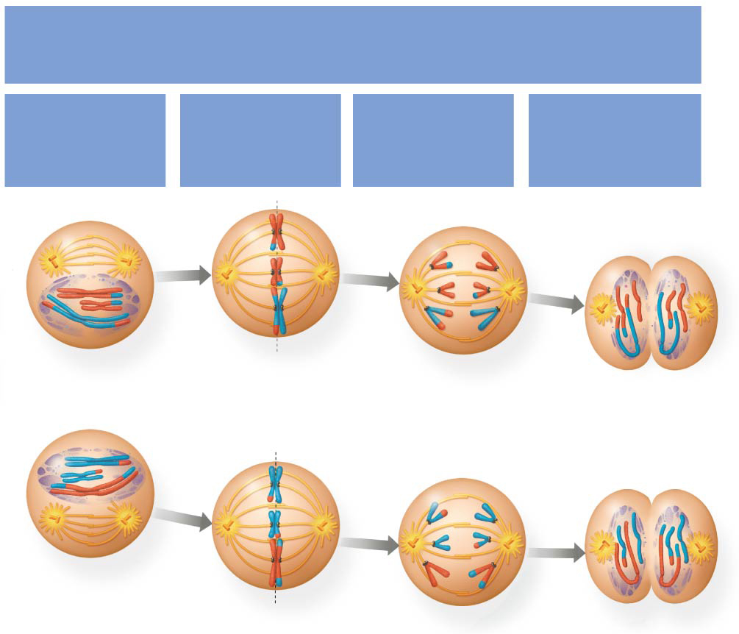
Figure 13.8b
MEIOSIS II: Separates
sister chromatids
Telophase II
and
Cytokinesis
Prophase II
Metaphase II
Anaphase II
Sister
chromatids
separate
Haploid
daughter
cells
forming
Notes:
Figure 13.8b Exploring meiosis in an animal cell (part 2: meiosis II)

Slide 56
Figure 13.8b
MEIOSIS II: Separates
sister chromatids
Telophase II
and
Cytokinesis
Prophase II
Metaphase II
Anaphase II
Sister
chromatids
separate
Haploid
daughter
cells
forming
Notes:
Figure 13.8b Exploring meiosis in an animal cell (part 2: meiosis II)

Slide 57
Meiosis II: Separates Sister Chromatids
1. Prophase II
In prophase II, a spindle apparatus forms
In late prophase II, chromosomes (each still composed of two chromatids) move toward the metaphase plate

Slide 58
Figure 13.8b
MEIOSIS II: Separates
sister chromatids
Telophase II
and
Cytokinesis
Prophase II
Metaphase II
Anaphase II
Sister
chromatids
separate
Haploid
daughter
cells
forming
Notes:
Figure 13.8b Exploring meiosis in an animal cell (part 2: meiosis II)

Slide 59
Meiosis II: Separates Sister Chromatids
2. Metaphase II
In metaphase II, the sister chromatids are arranged at the metaphase plate
Because of crossing over in meiosis I, the two sister chromatids of each chromosome are NO LONGER GENETICALLY IDENTICAL
The kinetochores of sister chromatids attach to microtubules extending from opposite poles

Slide 60
Figure 13.8b
MEIOSIS II: Separates
sister chromatids
Telophase II
and
Cytokinesis
Prophase II
Metaphase II
Anaphase II
Sister
chromatids
separate
Haploid
daughter
cells
forming
Notes:
Figure 13.8b Exploring meiosis in an animal cell (part 2: meiosis II)

Slide 61
Meiosis II: SEPARATES SISTER CHROMATIDS
Anaphase II
IN ANAPHASE II, THE SISTER CHROMATIDS SEPARATE!!!
This was the goal of meiosis II! DONE.
The sister chromatids of each chromosome now move as two NEWLY INDIVIDUAL chromosomes toward opposite poles

Slide 62
Notes:
Sister chromatids separate from each other during _____.
https://www.polleverywhere.com/multiple_choice_polls/xyjjjMXTkkXS28u

Slide 63
Figure 13.8b
MEIOSIS II: Separates
sister chromatids
Telophase II
and
Cytokinesis
Prophase II
Metaphase II
Anaphase II
Sister
chromatids
separate
Haploid
daughter
cells
forming
Notes:
Figure 13.8b Exploring meiosis in an animal cell (part 2: meiosis II)

Slide 64
Meiosis II: Separates Sister Chromatids
Telophase II and Cytokinesis
In telophase II, the chromosomes arrive at opposite poles
Nuclei reform, and the chromosomes begin DECONDENSING
Revert back to chromatin form

Slide 65
Figure 13.8b
MEIOSIS II: Separates
sister chromatids
Telophase II
and
Cytokinesis
Prophase II
Metaphase II
Anaphase II
Sister
chromatids
separate
Haploid
daughter
cells
forming
Notes:
Figure 13.8b Exploring meiosis in an animal cell (part 2: meiosis II)

Slide 66
End of Meiosis II
Cytokinesis separates the cytoplasm
At the end of meiosis…
FOUR daughter cells
HAPLOID set of chromosomes in each
Each daughter cell is GENETICALLY UNIQUE from the others AND from the parent cell
VARIATION = PURPOSE OF SEXUAL REPRODUCTION!!!

Slide 67
Figure 13.8b
MEIOSIS II: Separates
sister chromatids
DONE
Telophase II
and
Cytokinesis
Prophase II
Metaphase II
Anaphase II
Sister
chromatids
separate
Haploid
daughter
cells
forming
Notes:
Figure 13.8b Exploring meiosis in an animal cell (part 2: meiosis II)

Slide 68
Figure 13.8
DONE
DONE
MEIOSIS I: Separates
homologous chromosomes
MEIOSIS II: Separates
sister chromatids
Telophase I
and
Cytokinesis
Telophase II
and
Cytokinesis
Prophase I
Metaphase I
Anaphase I
Prophase II
Metaphase II
Anaphase II
Centrosome
(with
centriole
pair)
Centromere
(with
kineto-
chore)
Sister
chromatids
remain
attached
Sister
chroma-
tids
Chiasmata
Meta-
phase
plate
Spindle
Sister
chromatids
separate
Haploid
daughter
cells
forming
Homo-
logous
chromo-
somes
Homologous
chromo-
somes
separate
Cleavage
furrow
Fragments
of nuclear
envelope
Microtubules
attached to kinetochore
Notes:
Figure 13.8 Exploring meiosis in an animal cell

Slide 70
Notes:
How do cells at the completion of meiosis compare with cells that are in prophase of meiosis I? They have _____.
https://www.polleverywhere.com/multiple_choice_polls/OBMpgDTlknIs1fe

Slide 71
Notes:
Meiosis II is similar to mitosis in that
https://www.polleverywhere.com/multiple_choice_polls/B22ahVBnGWdAOAC

Slide 72
Overview
Concept 13.1: Offspring acquire genes from parents by inheriting chromosomes
Concept 13.2: Fertilization and meiosis alternate in sexual life cycles
Concept 13.3: Meiosis reduces the number of chromosome sets from diploid to haploid
Concept 13.4: Genetic variation produced in sexual life cycles contributes to evolution

Slide 73
Concept 13.4: Genetic variation produced in sexual life cycles contributes to evolution
Mutations (changes in an organism’s DNA) are the ORIGINAL source of genetic diversity
Mutations create different versions of genes called alleles
RESHUFFLING (AKA MEIOSIS) of alleles during sexual reproduction produces genetic variation

Slide 74
Origins of Genetic Variation Among Offspring
The behavior of chromosomes during meiosis and fertilization is responsible for most of the VARIATION that arises in each generation
Three mechanisms contribute to genetic variation
1. Independent assortment of chromosomes
2. Crossing over
3. Random fertilization

Slide 75
Notes:
For a species with a haploid number of 23 chromosomes, how many different combinations of maternal and paternal chromosomes are possible for the gametes?
https://www.polleverywhere.com/multiple_choice_polls/gI2UQi2s16Svt5q

Slide 76
Notes:
agine that there are twenty-five different species of protists living in a tide pool. Some of these species reproduce both sexually and asexually, and some of them can reproduce only asexually. The pool gradually becomes infested with disease-causing viruses and bacteria. Which species are more likely to thrive in the changing environment?
https://www.polleverywhere.com/multiple_choice_polls/H6L6ornvl57z5ia

Slide 77
Overview
Concept 13.1: Offspring acquire genes from parents by inheriting chromosomes
Concept 13.2: Fertilization and meiosis alternate in sexual life cycles
Concept 13.3: Meiosis reduces the number of chromosome sets from diploid to haploid
Concept 13.4: Genetic variation produced in sexual life cycles contributes to evolution

Slide 78
The following slides compare/contrast meiosis and mitosis

Slide 79
A Comparison of Mitosis and Meiosis
Mitosis CONSERVES the number of chromosome sets, producing cells that are genetically IDENTICAL to the parent cell
Mitosis = conservative replication
Meiosis REDUCES the number of chromosomes sets from two (diploid) to one (haploid), producing cells that DIFFER genetically from each other AND from the parent cell
Meiosis = reductive variation

Slide 80
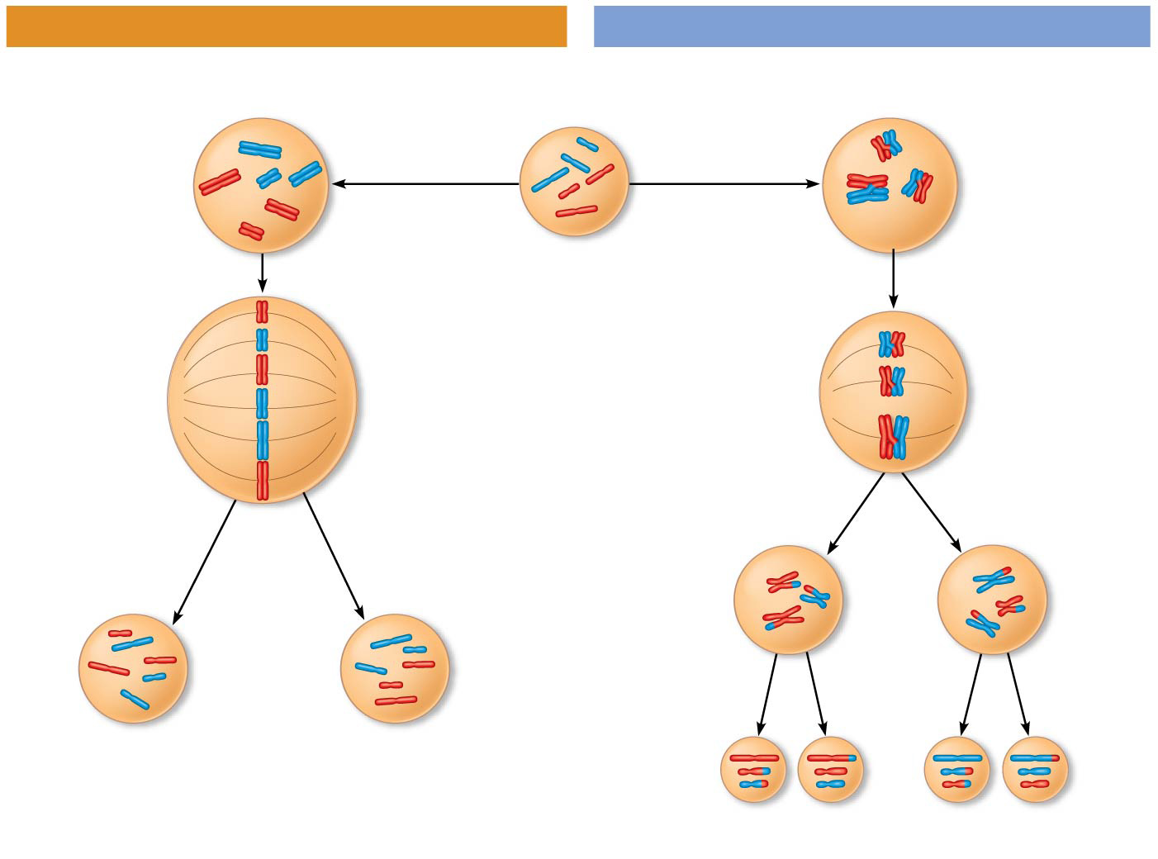
Figure 13.10a
MITOSIS
MEIOSIS
Parent cell
Chiasma
MEIOSIS I
Prophase
Prophase I
Homologous
chromosome
pair
Chromosome
duplication
Chromosome
duplication
Duplicated
chromosome
2n = 6
Individual
chromosomes
line up.
Pairs of
homologous
chromosomes
line up.
Metaphase I
Metaphase
Anaphase I
Anaphase
Telophase
Sister
chromatids
separate.
Homologs
separate.
Telophase I
Daughter
cells of
meiosis I
Sister
chroma-
tids
separate.
MEIOSIS
II
2n
2n
Daughter cells
of mitosis
n
n
n
n
Daughter cells of meiosis II
Notes:
Figure 13.10a A comparison of mitosis and meiosis (part 1: mitosis vs. meiosis art)

Slide 81
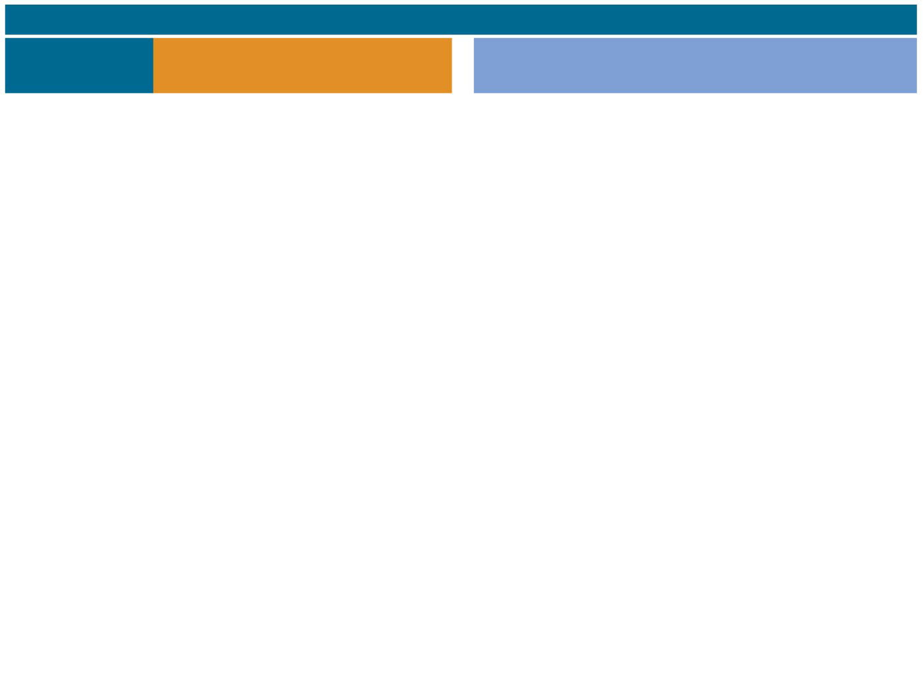
Figure 13.10b
SUMMARY
Property
Mitosis (occurs in both diploid
and haploid cells)
Meiosis (can only occur in diploid cells)
DNA
replication
Occurs during interphase
before mitosis begins
Occurs during interphase before
meiosis I begins
Number of
divisions
One, including prophase,
prometaphase, metaphase,
anaphase, and telophase
Two, each including prophase, metaphase,
anaphase, and telophase
Synapsis of
homologous
chromosomes
Does not occur
Occurs during prophase I along with
crossing over between nonsister
chromatids; resulting chiasmata hold
pairs together due to sister chromatid
cohesion
Number of
daughter cells
and genetic
composition
Two, each genetically
identical to the parent
cell, with the same number
of chromosomes
Four, each haploid (n); genetically different
from the parent cell and from each other
Role in the
animal or
plant body
Enables multicellular animal
or plant (gametophyte or
sporophyte) to arise from a
single cell; produces cells
for growth, repair, and, in
some species, asexual
reproduction; produces
gametes in the gametophyte
plant
Produces gametes (in animals) or spores
(in the sporophyte plant); reduces number
of chromosomes sets by half and introduces
genetic variability among the gametes or
spores
Notes:
Figure 13.10b A comparison of mitosis and meiosis (part 2: mitosis vs. meiosis table)

Slide 82
A Comparison of Mitosis and Meiosis
Three events are unique to meiosis, and all three occur in MEIOSIS I
Synapsis and crossing over in prophase I: Homologous chromosomes physically connect and EXCHANGE genetic information
Homologous pairing at the metaphase I plate (tetrad formation)
Separation of homologs during anaphase I

Slide 83
A Comparison of Mitosis and Meiosis
In mitosis, cohesins are cleaved at the end of metaphase, so sister chromatids SEPARATE
Sister chromatid cohesion allows sister chromatids to STAY TOGETHER through meiosis I
In meiosis, cohesins need to be cleaved TWICE
Along the chromosome arms in anaphase I (separation of homologs, sister chromatids are still together)
At the centromeres in anaphase II (separation of sister chromatids)
Meiosis I is called the reductive division because it REDUCES the number of chromosomes per cell

