Slide 1
AP Biology – Ch. 11+12 – Cell Communication & Cell Cycle
AP Exam Questions

Slide 2
Do Now
Using what you know about cell communication and cell signaling, how can a muscle get affected by the fight-or-flight hormone epinephrine (adrenaline)?

Slide 3
Overview
Today, we’ll be answering and analyzing real AP biology multiple choice exam questions on Cell Communication (Ch. 11.1-11.5) and Cell Cycle (Ch. 12.1-12.3).
I will walk us through questions 1-3.
We will complete questions 4-8 as a class in groups.
You will complete questions 9-15 independently using the strategies learned today.

Slide 4
Bloom’s taxonomy
Levels of Questions
Level 1: Knowledge/comprehension
Level 2: Application/analysis
Level 3: Synthesis/evaluation

Slide 5
Question 1
A G-protein receptor with GTP bound to it _____.
A) is in its active state
B) signals a protein to maintain its shape and conformation
C) will use cGMP as a second messenger
D) directly affects gene expression
Bloom's Taxonomy: Knowledge/Comprehension
Section: 11.2

Slide 6
Question 1
A G-protein receptor with GTP bound to it _____.
A) is in its active state
B) signals a protein to maintain its shape and conformation
C) will use cGMP as a second messenger
D) directly affects gene expression
Bloom's Taxonomy: Knowledge/Comprehension
Section: 11.2

Slide 7
Question 2
If an animal cell suddenly lost the ability to produce GTP, what might happen to its signaling system?
A) It would not be able to activate and inactivate the G protein on the cytoplasmic side of the plasma membrane.
B) It would be able to carry out reception and transduction but would not be able to respond to a signal.
C) It would use ATP instead of GTP to activate and inactivate the G protein on the cytoplasmic side of the plasma membrane.
D) It would employ a transduction pathway directly from an external messenger.
Bloom's Taxonomy: Application/Analysis
Section: 11.2

Slide 8
Question 2
If an animal cell suddenly lost the ability to produce GTP, what might happen to its signaling system?
A) It would not be able to activate and inactivate the G protein on the cytoplasmic side of the plasma membrane.
B) It would be able to carry out reception and transduction but would not be able to respond to a signal.
C) It would use ATP instead of GTP to activate and inactivate the G protein on the cytoplasmic side of the plasma membrane.
D) It would employ a transduction pathway directly from an external messenger.
Bloom's Taxonomy: Application/Analysis
Section: 11.2

Slide 9
Question 3
Besides the ability of some cancer cells to overproliferate (over divide), what else could logically result in a tumor?
A) changes in the order of cell cycle stages
B) lack of appropriate cell death
C) inability to form spindles
D) inability of chromosomes to meet at the metaphase plate
Bloom's Taxonomy: Synthesis/Evaluation
Section: 12.3

Slide 10
Question 3
Besides the ability of some cancer cells to overproliferate (over divide), what else could logically result in a tumor?
A) changes in the order of cell cycle stages
B) lack of appropriate cell death
C) inability to form spindles
D) inability of chromosomes to meet at the metaphase plate
Bloom's Taxonomy: Synthesis/Evaluation
Section: 12.3

Slide 11
For the next 5 questions…
Work in your groups to come up with ONE consensus answer
Be prepared to explain your reasoning! (one “volunteer”)

Slide 12
Question 4
Put the steps of the process of signal transduction in the order they occur:
A conformational change in the signal-receptor complex activates an
enzyme.
2. Protein kinases are activated.
3. A signal molecule binds to a receptor.
4. Target proteins are phosphorylated.
5. Second messenger molecules are released.
A) 1, 2, 3, 4, 5
B) 3, 1, 2, 4, 5
C) 3, 1, 5, 2, 4
D) 1, 2, 5, 3, 4
Bloom's Taxonomy: Application/Analysis
Section: 11.3

Slide 13
Question 4
Put the steps of the process of signal transduction in the order they occur:
A conformational change in the signal-receptor complex activates an
enzyme.
2. Protein kinases are activated.
3. A signal molecule binds to a receptor.
4. Target proteins are phosphorylated.
5. Second messenger molecules are released.
A) 1, 2, 3, 4, 5
B) 3, 1, 2, 4, 5
C) 3, 1, 5, 2, 4
D) 1, 2, 5, 3, 4
Bloom's Taxonomy: Application/Analysis
Section: 11.3

Slide 14
Question 5
At puberty, an adolescent female body changes in both structure and function of several organ systems, primarily under the influence of changing concentrations of estrogens and other steroid hormones. How can one hormone, such as estrogen, mediate so many effects?
A) Estrogen is produced in very large concentration by nearly every tissue of the body.
B) Each cell responds in the same way when steroids bind to the cell surface.
C) Estrogen is kept away from the surface of any cells not able to bind it at the surface.
D) Estrogen binds to specific receptors inside many kinds of cells, each with different responses.
Bloom's Taxonomy: Synthesis/Evaluation
Section: 11.4

Slide 15
Question 5
At puberty, an adolescent female body changes in both structure and function of several organ systems, primarily under the influence of changing concentrations of estrogens and other steroid hormones. How can one hormone, such as estrogen, mediate so many effects?
A) Estrogen is produced in very large concentration by nearly every tissue of the body.
B) Each cell responds in the same way when steroids bind to the cell surface.
C) Estrogen is kept away from the surface of any cells not able to bind it at the surface.
D) Estrogen binds to specific receptors inside many kinds of cells, each with different responses.
Bloom's Taxonomy: Synthesis/Evaluation
Section: 11.4

Slide 16
Question 6
What is the final result of mitosis in a human?
A) genetically identical 2n somatic cells
B) genetically different 2n somatic cells
C) genetically identical 1n somatic cells
D) genetically identical 2n gamete cells
Bloom's Taxonomy: Knowledge/Comprehension
Section: 12.1

Slide 17
Question 6
What is the final result of mitosis in a human?
A) genetically identical 2n somatic cells
B) genetically different 2n somatic cells
C) genetically identical 1n somatic cells
D) genetically identical 2n gamete cells
Bloom's Taxonomy: Knowledge/Comprehension
Section: 12.1

Slide 18
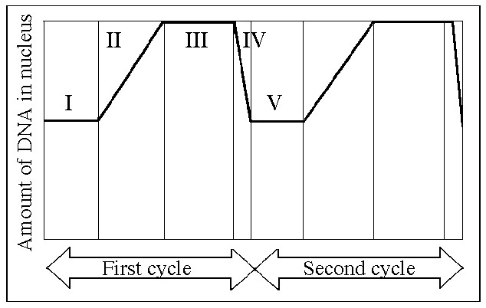
Question 7
In the figure, G1 is represented by which numbered part(s) of the cycle?
A) I or V
B) II or IV
C) III only
D) V only
Bloom's Taxonomy: Application/Analysis
Section: 12.2

Slide 19
Question 7
In the figure, G1 is represented by which numbered part(s) of the cycle?
A) I or V
B) II or IV
C) III only
D) V only
Bloom's Taxonomy: Application/Analysis
Section: 12.2

Slide 20
Question 8
In the figure, MPF reaches its highest concentration during this stage.
A) I
B) II
C) III
D) IV
Bloom's Taxonomy: Application/Analysis
Section: 12.3

Slide 21
Question 8
In the figure, MPF reaches its highest concentration during this stage.
A) I
B) II
C) III
D) IV
Bloom's Taxonomy: Application/Analysis
Section: 12.3

Slide 22
Questions 9-15
Independently complete these questions. Be sure to use the strategies we’ve discussed!

Slide 23
Questions 9-15 Answers
9. C
10. C
11. C
12. B
13. C
14. A
15. C

Slide 24
Exit Ticket
In groups, come up with your own multiple choice question/answer from any topic covered thus far.
Be sure to appropriately classify it using Bloom’s taxonomy.
Level 1: Knowledge/comprehension
Level 2: Application/analysis
Level 3: Synthesis/evaluation

