Slide 1
0
8
An Introduction to Metabolism

Slide 2
Notes:
What does the phrase, "I have a fast metabolism," mean to you?
https://www.polleverywhere.com/free_text_polls/TDTc26pUkYbFtpG

Slide 3
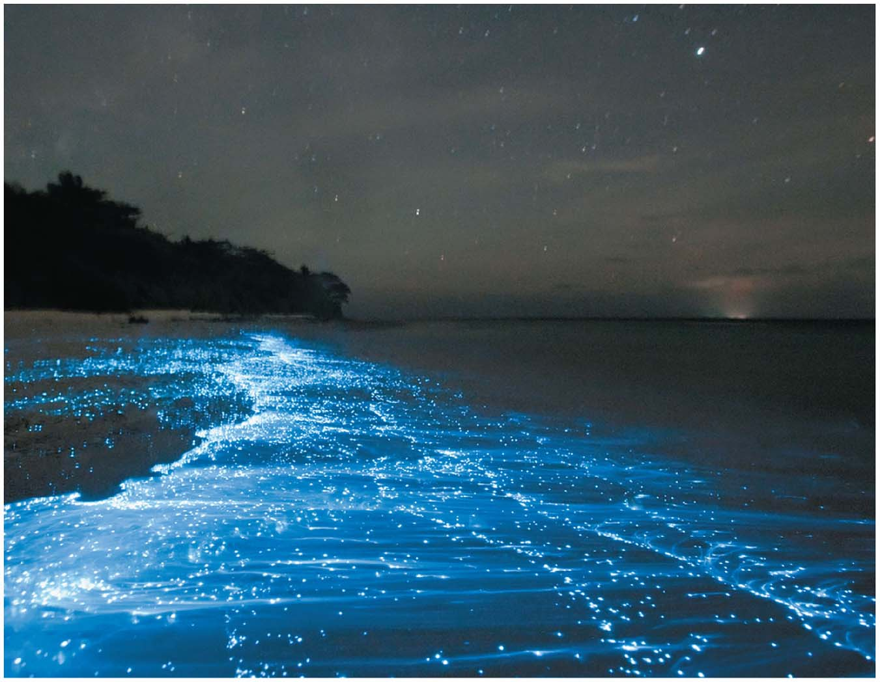
What causes these breaking waves to glow?
Notes:
Figure 6.1 What causes these breaking waves to glow?

Slide 4
The Energy of Life
The living cell is a miniature chemical factory where thousands of reactions occur
The cell extracts energy stored in sugars and other fuels and applies energy to perform work
Some organisms even convert energy to light, as in bioluminescence

Slide 5
Overview
Concept 8.1: An organism’s metabolism transforms matter and energy, subject to the laws of thermodynamics
Concept 8.2: The free-energy change of a reaction tells us whether or not the reaction occurs spontaneously
Concept 8.3: ATP powers cellular work by coupling exergonic reactions to endergonic reactions
Concept 8.4: Enzymes speed up metabolic reactions by lowering energy barriers
Concept 8.5: Regulation of enzyme activity helps control metabolism

Slide 6
Overview
Concept 8.1: An organism’s metabolism transforms matter and energy, subject to the laws of thermodynamics
Concept 8.2: The free-energy change of a reaction tells us whether or not the reaction occurs spontaneously
Concept 8.3: ATP powers cellular work by coupling exergonic reactions to endergonic reactions
Concept 8.4: Enzymes speed up metabolic reactions by lowering energy barriers
Concept 8.5: Regulation of enzyme activity helps control metabolism

Slide 7
Concept 8.1: An organism’s metabolism transforms matter and energy, subject to the laws of thermodynamics
Metabolism = totality of an organism’s chemical reactions
Emergent property of life that arises from orderly interactions between molecules
Metabolic pathway = begins with a specific molecule + ends with a specific product
Each step is CATALYZED by a specific ENZYME

Slide 8
Generalized Metabolic Pathway
Enzyme 1
Enzyme 2
Enzyme 3
A
B
C
D
Reaction 1
Reaction 2
Reaction 3
Starting
molecule
Product
Notes:
Figure 8.UN01 In-text figure, generalized metabolic pathway, p. 142

Slide 9
Concept 8.1: An organism’s metabolism transforms matter and energy, subject to the laws of thermodynamics
Types of Metabolic Pathways
Catabolic pathways RELEASE ENERGY by breaking down complex molecules into simpler compounds
E.g. cellular respiration → BREAKDOWN of glucose in the presence of oxygen
Anabolic pathways CONSUME ENERGY to build complex molecules from simpler ones
E.g. protein SYNTHESIS from amino acid monomers

Slide 10
Concept 8.1: An organism’s metabolism transforms matter and energy, subject to the laws of thermodynamics
Forms of Energy
Energy = capacity to CAUSE CHANGE
Kinetic energy = energy associated with motion
Heat (thermal energy) = kinetic energy associated with random movement of atoms or molecules
Potential energy = energy that matter possesses because of its location or structure
Chemical energy = potential energy available for release in a chemical reaction
Energy can be CONVERTED from one form to another

Slide 11
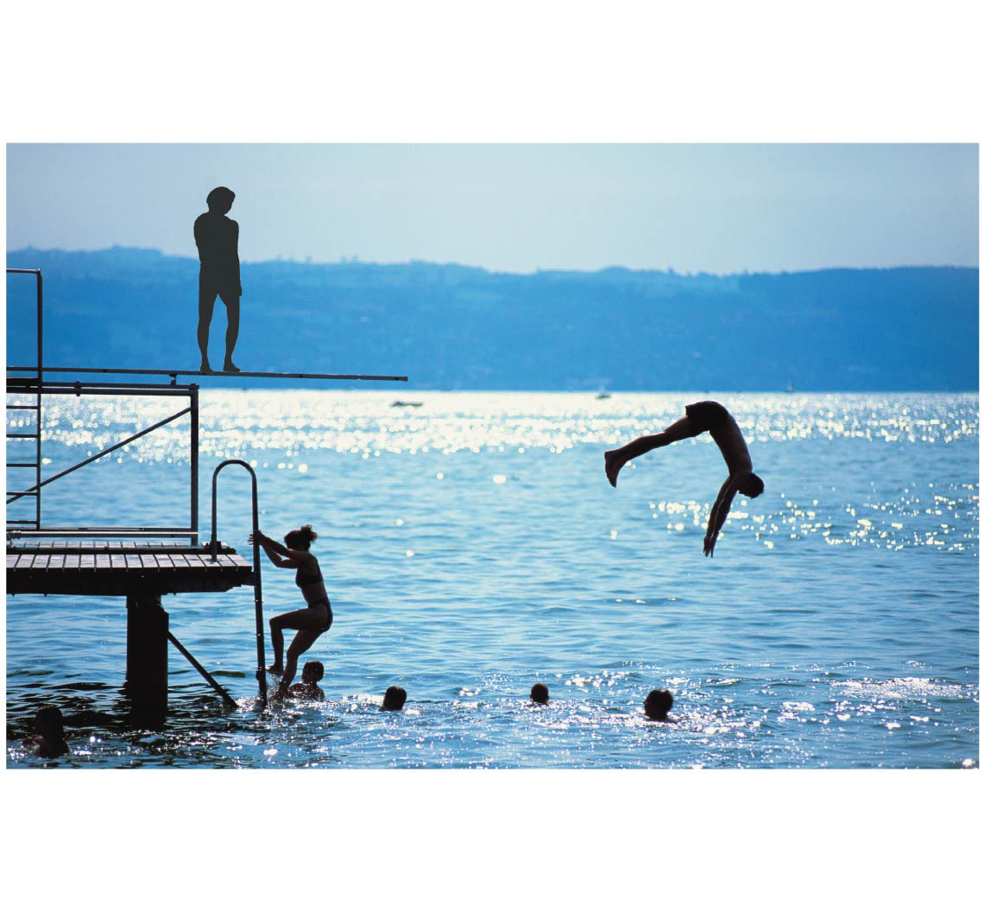
Transfor-mations between potential and kinetic energy
A diver has more potential
energy on the platform
than in the water.
Diving converts
potential energy to
kinetic energy.
Climbing up converts the kinetic
energy of muscle movement
to potential energy.
A diver has less potential
energy in the water
than on the platform.
Notes:
Figure 8.2 Transformations between potential and kinetic energy

Slide 12
Concept 8.1: An organism’s metabolism transforms matter and energy, subject to the laws of thermodynamics
Thermodynamics = the study of energy transformations
An ISOLATED system, such as that approximated by liquid in a thermos, is UNABLE TO EXCHANGE energy or matter with its surroundings
In an OPEN system, energy and matter CAN BE TRANSFERRED between the system and its surroundings
Organisms = OPEN SYSTEMS

Slide 13
Concept 8.1: An organism’s metabolism transforms matter and energy, subject to the laws of thermodynamics
The First Law of Thermodynamics
According to the first law of thermodynamics, the energy of the universe is constant
Energy CANNOT be created or destroyed, but it can be transferred and transformed
The first law is also called the principle of conservation of energy

Slide 14
Concept 8.1: An organism’s metabolism transforms matter and energy, subject to the laws of thermodynamics
The Second Law of Thermodynamics
During every energy transfer or transformation, some energy is unusable, and is often lost as heat
According to the second law of thermodynamics
Every energy transfer or transformation increases the entropy (disorder) of the universe

Slide 15
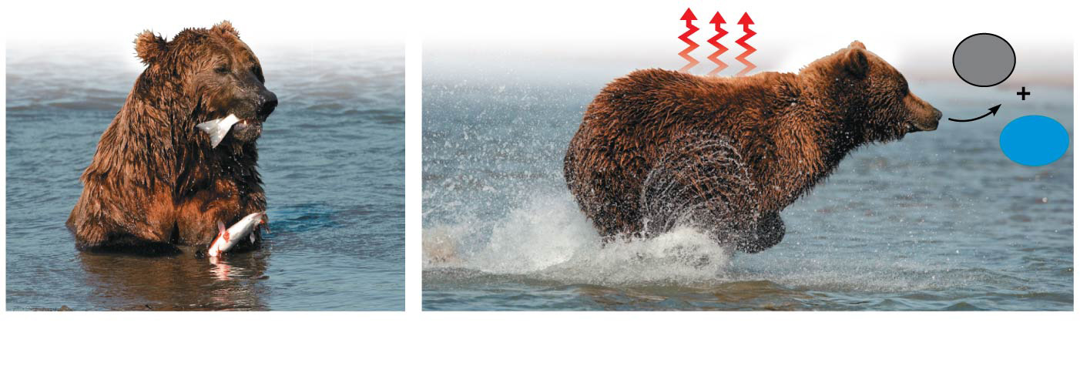
The two laws of thermodynamics
Heat
CO₂
H₂O
Chemical
energy
(a)
First law of thermo-
dynamics
(b)
Second law of thermodynamics
Notes:
Figure 8.3 The two laws of thermodynamics

Slide 16
Concept 8.1: An organism’s metabolism transforms matter and energy, subject to the laws of thermodynamics
The Laws of Energy Transformation
Living cells unavoidably convert organized forms of energy to heat
Spontaneous processes occur WITHOUT energy input; they can happen quickly or slowly
For a process to occur without energy input, it MUST INCREASE THE ENTROPY of the universe

Slide 17
Notes:
Which of the following is true of metabolism in its entirety in all organisms?
https://www.polleverywhere.com/multiple_choice_polls/lPkQqEUjqDY2WZj

Slide 18
Notes:
Which of the following involves a decrease in entropy?
https://www.polleverywhere.com/multiple_choice_polls/wt8eiO70cIBHa7A

Slide 19
Notes:
Which of the following is a statement of the first law of thermodynamics?
https://www.polleverywhere.com/multiple_choice_polls/Qrgp1owsvvT4IuN

Slide 20
Overview
Concept 8.1: An organism’s metabolism transforms matter and energy, subject to the laws of thermodynamics
Concept 8.2: The free-energy change of a reaction tells us whether or not the reaction occurs spontaneously
Concept 8.3: ATP powers cellular work by coupling exergonic reactions to endergonic reactions
Concept 8.4: Enzymes speed up metabolic reactions by lowering energy barriers
Concept 8.5: Regulation of enzyme activity helps control metabolism

Slide 21
Concept 8.2: The free-energy change of a reaction tells us whether or not the reaction occurs spontaneously
Biologists want to know:
Which reactions occur spontaneously?
Which reactions require an input of energy?
To do so, they need to determine ENERGY CHANGES that occur in chemical reactions

Slide 22
Concept 8.2: The free-energy change of a reaction tells us whether or not the reaction occurs spontaneously
Free-Energy Change, ΔG
A living system’s free energy is energy that can DO WORK when temperature and pressure are uniform, as in a living cell
The change in free energy (∆G) during a process is related to the change in enthalpy, or change in total energy (∆H), change in entropy (∆S), and temperature in Kelvin units (T)
∆G = ∆H − T∆S

Slide 23
Concept 8.2: The free-energy change of a reaction tells us whether or not the reaction occurs spontaneously
Free-Energy Change, ΔG
∆G = ∆H − T∆S
Only processes with a NEGATIVE ∆G are SPONTANEOUS
Spontaneous processes can be harnessed to perform cell work

Slide 24
Concept 8.2: The free-energy change of a reaction tells us whether or not the reaction occurs spontaneously
Exergonic and Endergonic Reactions in Metabolism
Exergonic reaction
Proceeds with a net RELEASE of free energy
SPONTANEOUS

Slide 25
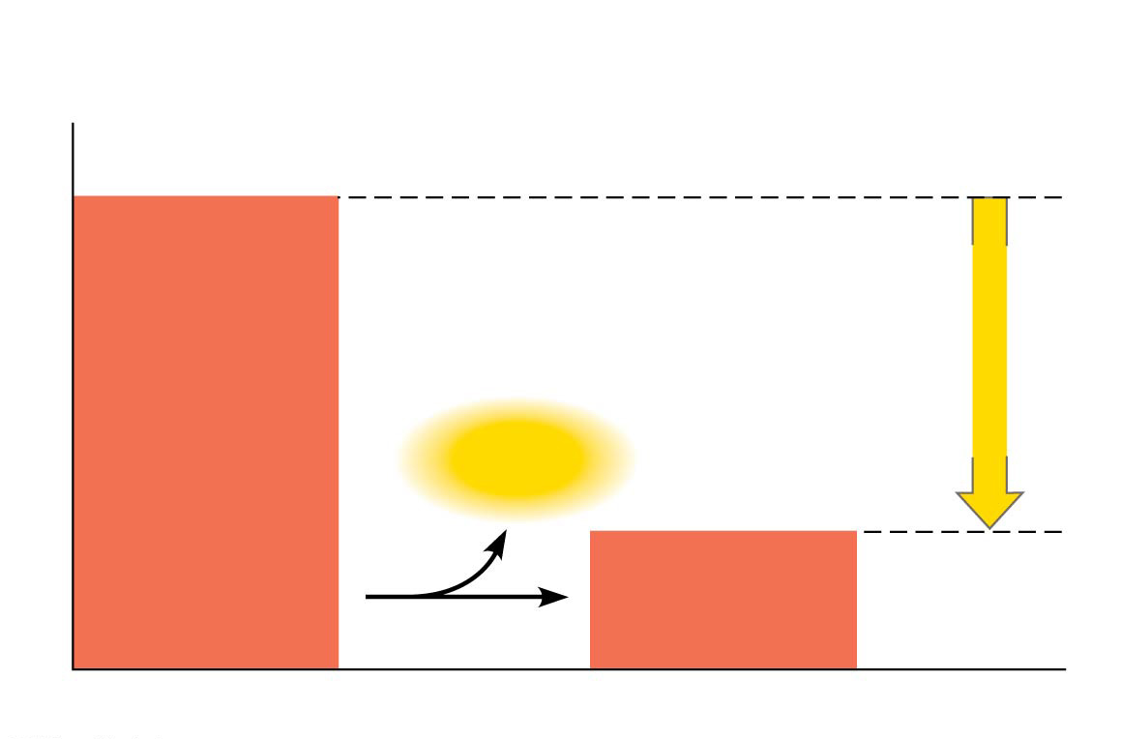
Figure 8.6a
(a)
Exergonic reaction: energy released,
spontaneous
Reactants
Amount of
energy
released
(∆G < 0)
Free energy
Energy
Products
Progress of the reaction
Notes:
Figure 8.6a Free energy changes (∆G) in exergonic and endergonic reactions (part 1: exergonic)

Slide 26
Concept 8.2: The free-energy change of a reaction tells us whether or not the reaction occurs spontaneously
Exergonic and Endergonic Reactions in Metabolism
Endergonic reaction
ABSORBS free energy from its surroundings
NONSPONTANEOUS

Slide 27
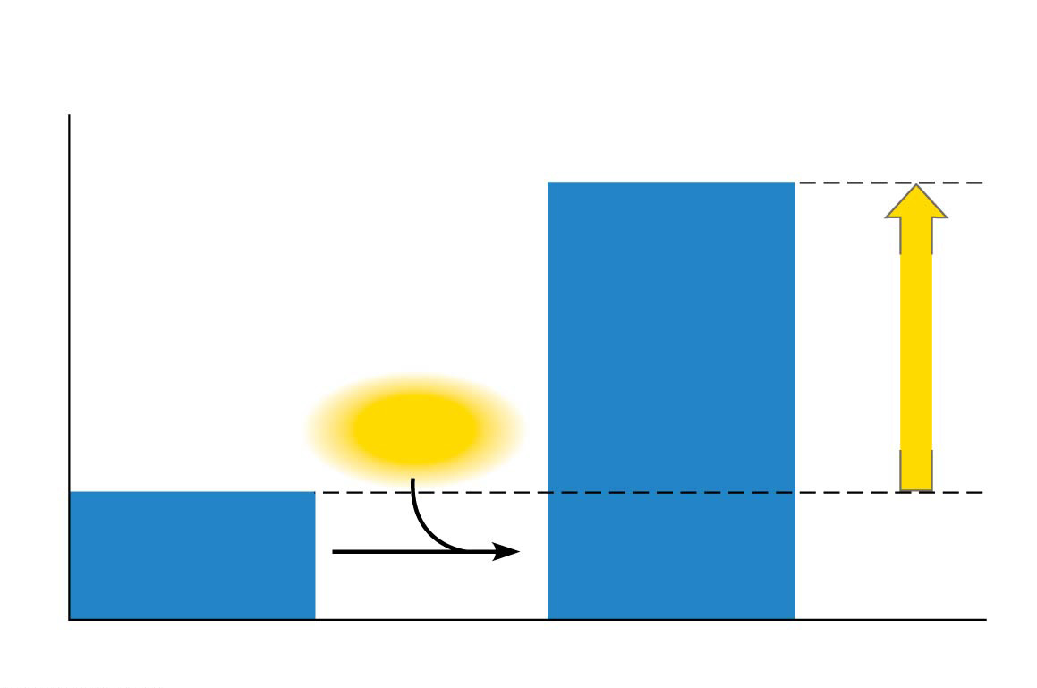
Figure 8.6b
(b)
Endergonic reaction: energy required,
nonspontaneous
Products
Amount of
energy
required
(∆G > 0)
Free energy
Energy
Reactants
Progress of the reaction
Notes:
Figure 8.6b Free energy changes (∆G) in exergonic and endergonic reactions (part 2: endergonic)

Slide 28
Concept 8.2: The free-energy change of a reaction tells us whether or not the reaction occurs spontaneously
Exergonic and Endergonic Reactions in Metabolism
Cells are NOT IN EQUILIBRIUM; they are OPEN systems experiencing a constant flow of materials
A defining feature of life is that METABOLISM IS NEVER AT EQUILIBRIUM
A catabolic pathway in a cell releases free energy in a series of reactions (more on that next lecture)

Slide 29
Notes:
The mathematical expression for the change in free energy of a system is ΔG =ΔH - TΔS. Which of the following is (are) correct?
https://www.polleverywhere.com/multiple_choice_polls/N4XTKSh77Af3TPU

Slide 30
Notes:
In solution, why do hydrolysis reactions occur more readily than condensation reactions?
https://www.polleverywhere.com/multiple_choice_polls/5gWY40b3uJzdn0P

Slide 31
Notes:
Choose the pair of terms that correctly completes this sentence: Catabolism is to anabolism as _____ is to _____.
https://www.polleverywhere.com/multiple_choice_polls/9HDzJNGHpWl42Tp

Slide 32
Overview
Concept 8.1: An organism’s metabolism transforms matter and energy, subject to the laws of thermodynamics
Concept 8.2: The free-energy change of a reaction tells us whether or not the reaction occurs spontaneously
Concept 8.3: ATP powers cellular work by coupling exergonic reactions to endergonic reactions
Concept 8.4: Enzymes speed up metabolic reactions by lowering energy barriers
Concept 8.5: Regulation of enzyme activity helps control metabolism

Slide 33
Concept 8.3: ATP powers cellular work by coupling exergonic reactions to endergonic reactions
A cell does three main kinds of work
Chemical
Transport
Mechanical
To do work, cells manage energy resources by energy coupling, the use of an exergonic process to drive an endergonic one
Most energy coupling in cells is mediated by ATP

Slide 34
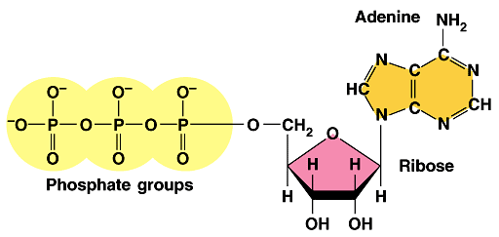
Concept 8.3: ATP powers cellular work by coupling exergonic reactions to endergonic reactions
The Structure and Hydrolysis of ATP
ATP (adenosine triphosphate) is the cell’s energy shuttle
ATP is composed of ribose (a sugar), adenine (a nitrogenous base), and three phosphate groups

Slide 35
Concept 8.3: ATP powers cellular work by coupling exergonic reactions to endergonic reactions
The Structure and Hydrolysis of ATP
The bonds between the phosphate groups of ATP’s tail can be broken by hydrolysis
Energy is RELEASED from ATP when the terminal phosphate bond is broken
This RELEASE of energy comes from the chemical change to a state of LOWER free energy, not from the phosphate bonds themselves

Slide 36
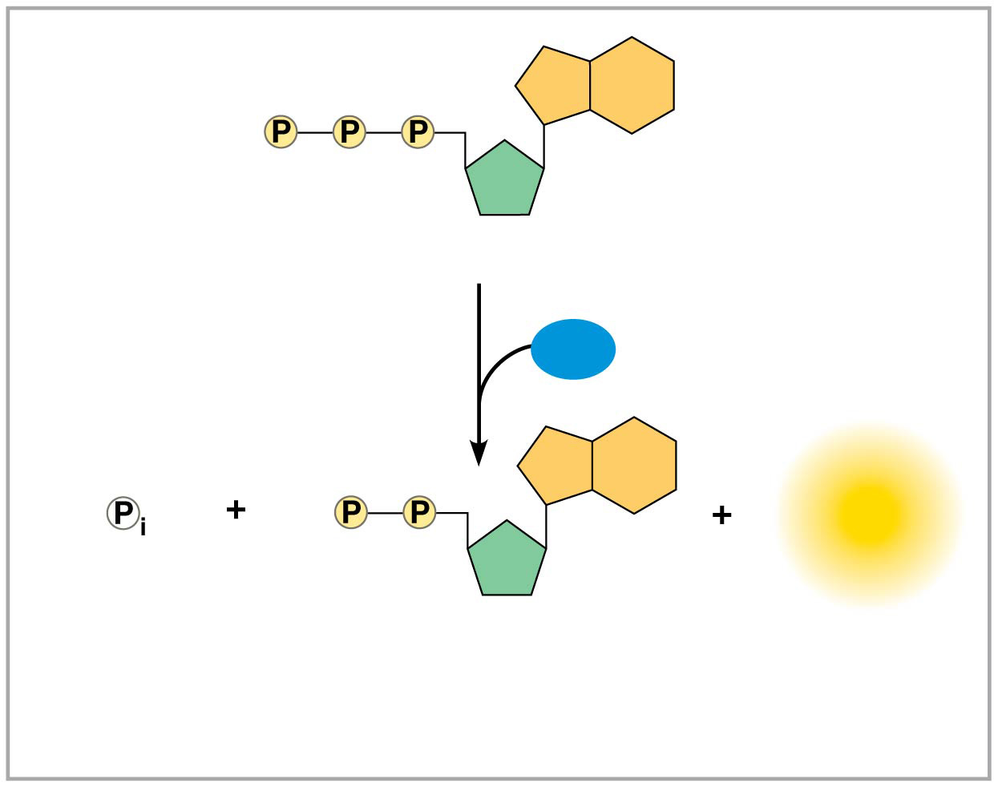
The structure and hydrolysis of adenosine triphosphate (ATP)
Adenosine triphosphate (ATP)
H₂O
Energy
Inorganic
phosphate
Adenosine diphosphate
(ADP)
(b) The hydrolysis of ATP
Notes:
Figure 8.9b The structure and hydrolysis of adenosine triphosphate (ATP) (part 2: hydrolysis)

Slide 37
Concept 8.3: ATP powers cellular work by coupling exergonic reactions to endergonic reactions
How the Hydrolysis of ATP Performs Work
The three types of cellular work (mechanical, transport, and chemical) are powered by the hydrolysis of ATP
In the cell, the energy from the exergonic reaction of ATP hydrolysis can be used to drive an endergonic reaction
Overall, the ATP-COUPLED REACTIONS ARE EXERGONIC

Slide 38
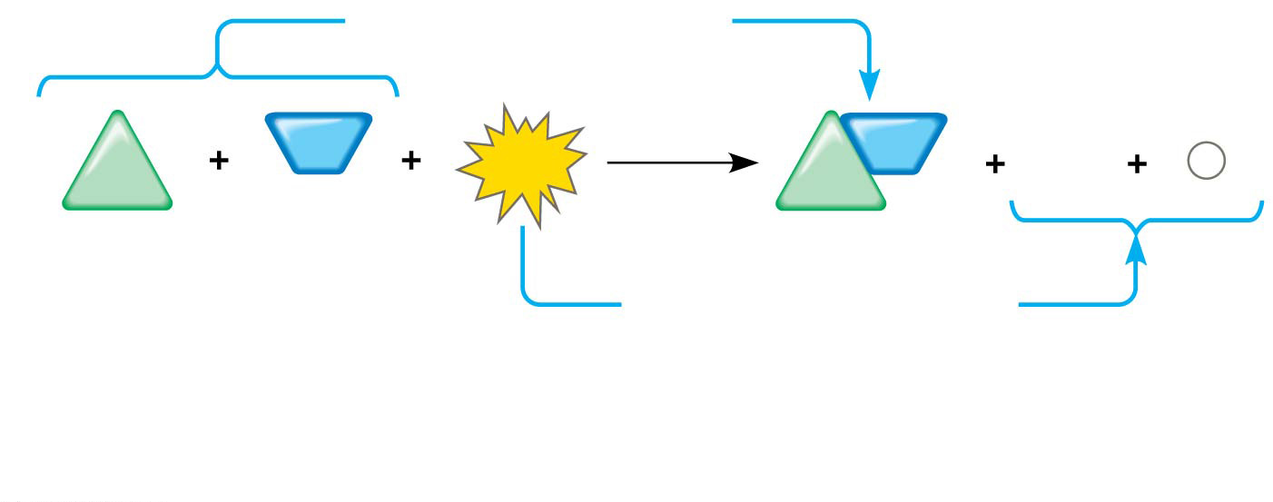
How ATP drives chemical work: energy coupling using ATP hydrolysis
∆G_{Glu}
= +3.4 kcal/mol
NH₃
NH₂
ADP
P
Glu
ATP
Glu
_{i}
∆G_{Glu}
= +3.4 kcal/mol
∆G_{ATP}
= −7.3 kcal/mol
+ ∆G_{ATP}
= −7.3 kcal/mol
Net ∆G
= −3.9 kcal/mol
(c) Free-energy change for coupled reaction
Notes:
Figure 8.10c How ATP drives chemical work: energy coupling using ATP hydrolysis (part 3: free energy change)

Slide 39
Concept 8.3: ATP powers cellular work by coupling exergonic reactions to endergonic reactions
The Regeneration of ATP
ATP is a RENEWABLE resource that is regenerated by addition of a phosphate group to adenosine diphosphate (ADP)
The energy to phosphorylate ADP comes from catabolic reactions in the cell
The ATP cycle is a revolving door through which energy passes during its transfer from catabolic to anabolic pathways

Slide 40
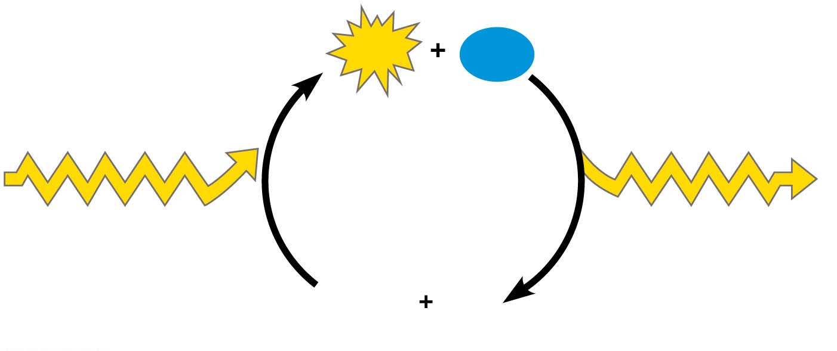
The ATP cycle
ATP
H₂O
Energy from
catabolism (exergonic,
energy-releasing
processes)
Energy for cellular
work (endergonic,
energy-consuming
processes)
ADP
P
i
© 2016 Pearson Education, Inc.
Notes:
Figure 6.11 The ATP cycle

Slide 41
Notes:
Why is ATP an important molecule in metabolism?
https://www.polleverywhere.com/multiple_choice_polls/j3in5HM9VidiaLu

Slide 42
Notes:
Catabolic pathways _____.
https://www.polleverywhere.com/multiple_choice_polls/B34N2o6jNGzVr10

Slide 43
Notes:
When chemical, transport, or mechanical work is done by an organism, what happens to the heat generated?
https://www.polleverywhere.com/multiple_choice_polls/HSb78yegYgo9eQ5

Slide 44
Overview
Concept 8.1: An organism’s metabolism transforms matter and energy, subject to the laws of thermodynamics
Concept 8.2: The free-energy change of a reaction tells us whether or not the reaction occurs spontaneously
Concept 8.3: ATP powers cellular work by coupling exergonic reactions to endergonic reactions
Concept 8.4: Enzymes speed up metabolic reactions by lowering energy barriers
Concept 8.5: Regulation of enzyme activity helps control metabolism

Slide 45
Concept 8.4: Enzymes speed up metabolic reactions by lowering energy barriers
Catalyst = chemical agent that SPEEDS UP a reaction WITHOUT being consumed by the reaction
Enzyme = CATALYTIC protein
E.g. hydrolysis of sucrose enzyme sucrase = “enzyme-catalyzed reaction”

Slide 46
Sucrose Hydrolysis
Sucrase
Sucrose
(C₁₂H₂₂O₁₁)
Glucose
(C₆H₁₂O₆)
Fructose
(C₆H₁₂O₆)
Notes:
Figure 8.UN02 In-text figure, sucrose hydrolysis, p.151

Slide 47
Concept 8.4: Enzymes speed up metabolic reactions by lowering energy barriers
The Activation Energy Barrier
The initial energy needed to start a chemical reaction is called the free energy of activation, or activation energy (E_{A})
Enzymes catalyze reactions by LOWERING the E_{A} barrier
ENZYMES DO NOT AFFECT THE CHANGE IN FREE ENERGY (∆G); instead, they hasten reactions that would occur eventually

Slide 48
Animation: How Enzymes Work

Slide 49
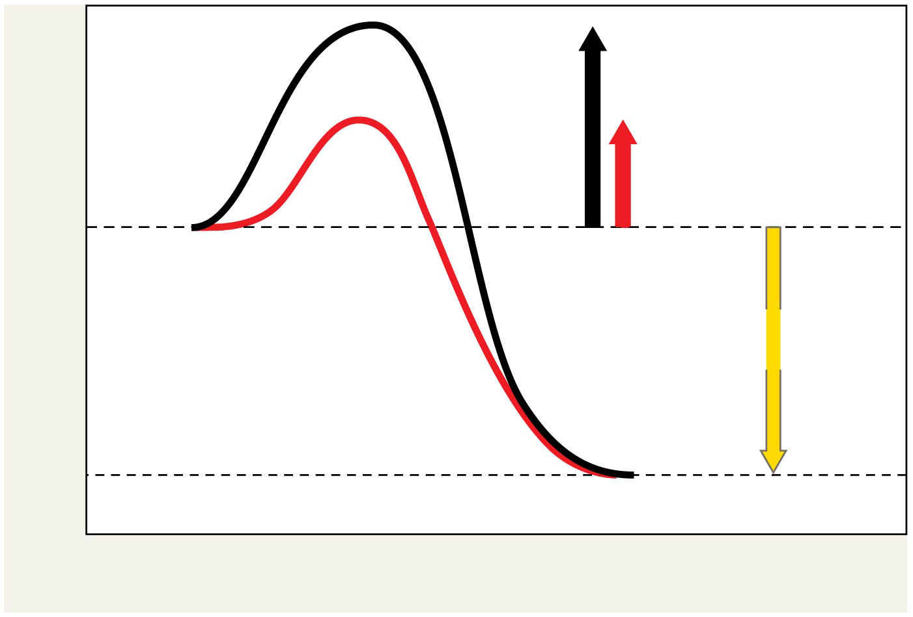
The effect of an enzyme on activation energy
Course of
reaction
without
enzyme
E_{A}
without
enzyme
E_{A} with
enzyme
is lower
Reactants
Free energy
Course of
reaction
with enzyme
∆G is unaffected
by enzyme
Products
Progress of the reaction
Notes:
Figure 8.14 The effect of an enzyme on activation energy

Slide 50
Concept 8.4: Enzymes speed up metabolic reactions by lowering energy barriers
Substrate Specificity of Enzymes
The reactant that an enzyme acts on is called the enzyme’s “substrate”
The enzyme BINDS to its substrate, forming an enzyme-substrate complex
Active site = region on the enzyme where substrate binds
Induced fit of a substrate brings chemical groups of the active site into positions that enhance their ability to catalyze the reaction
The reaction catalyzed by each enzyme is VERY SPECIFIC

Slide 51
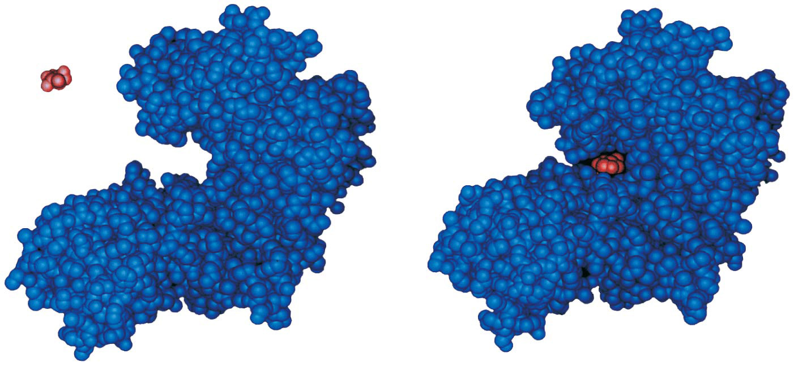
Induced fit between an enzyme and its substrate
Substrate
Active site
Enzyme
Enzyme-substrate
complex
Notes:
Figure 8.15 Induced fit between an enzyme and its substrate

Slide 52
Concept 8.4: Enzymes speed up metabolic reactions by lowering energy barriers
Catalysis in the Enzyme’s Active Site
In an enzymatic reaction, the substrate binds to the active site of the enzyme…so what?
The active site can LOWER an E_{A} barrier by:
Orienting substrates correctly
Straining substrate bonds
Providing a favorable microenvironment
Covalently bonding to the substrate

Slide 53
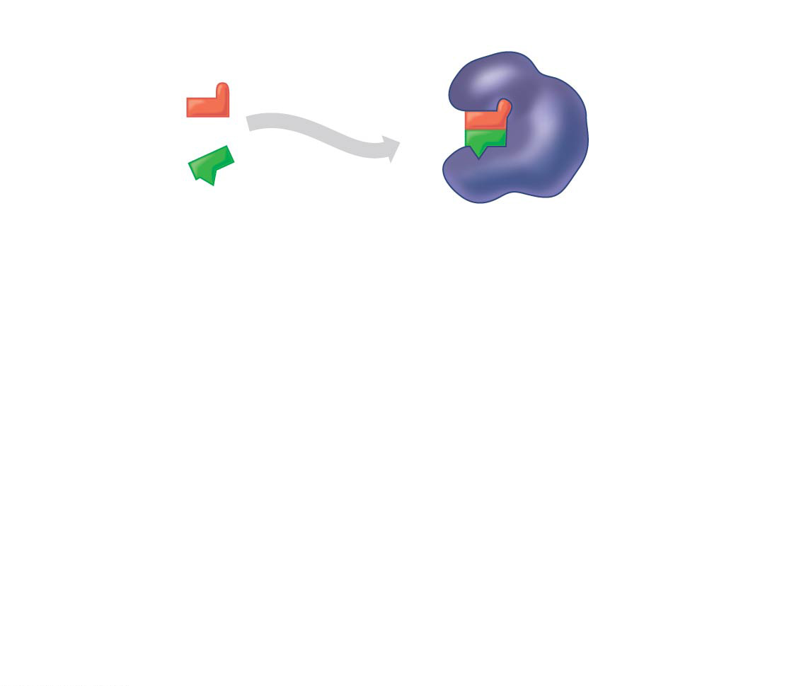
Figure 8.16-1
1
Substrates enter
active site.
2
Substrates are
held in active
site by weak
interactions.
Substrates
Enzyme-substrate
complex
Notes:
Figure 8.16-1 The active site and catalytic cycle of an enzyme (step 1)

Slide 54
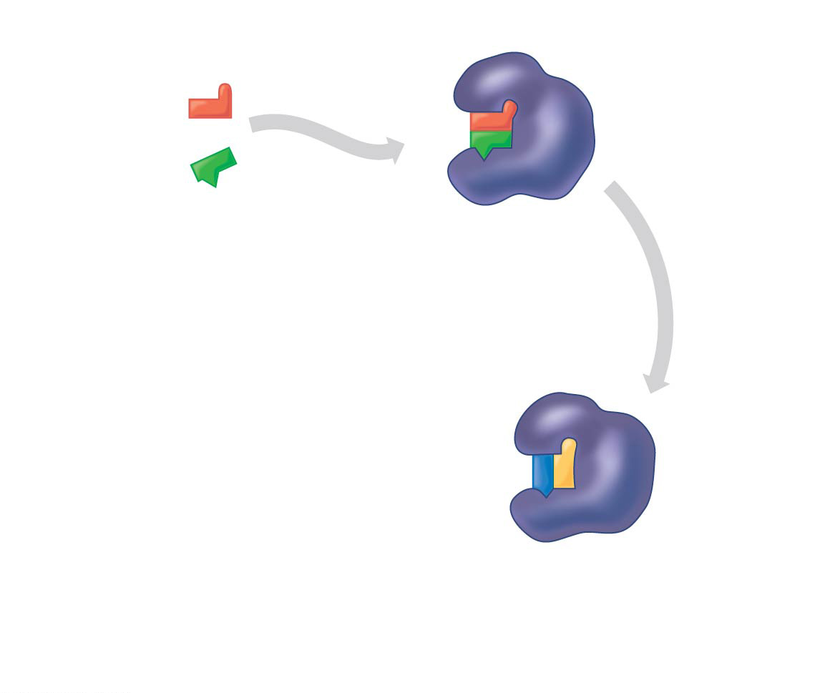
Figure 8.16-2
1
Substrates enter
active site.
2
Substrates are
held in active
site by weak
interactions.
Substrates
Enzyme-substrate
complex
3
Substrates are
converted to
products.
Notes:
Figure 8.16-2 The active site and catalytic cycle of an enzyme (step 2)

Slide 55
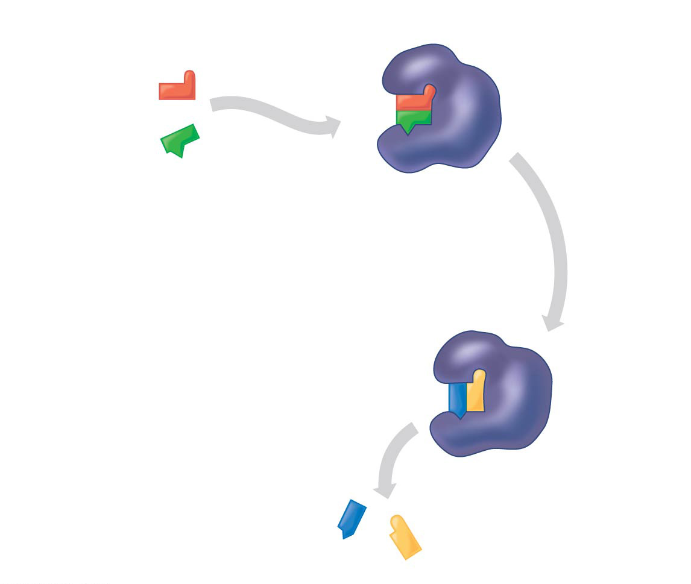
Figure 8.16-3
1
Substrates enter
active site.
2
Substrates are
held in active
site by weak
interactions.
Substrates
Enzyme-substrate
complex
4
Products are
released.
3
Substrates are
converted to
products.
Products
Notes:
Figure 8.16-3 The active site and catalytic cycle of an enzyme (step 3)

Slide 56
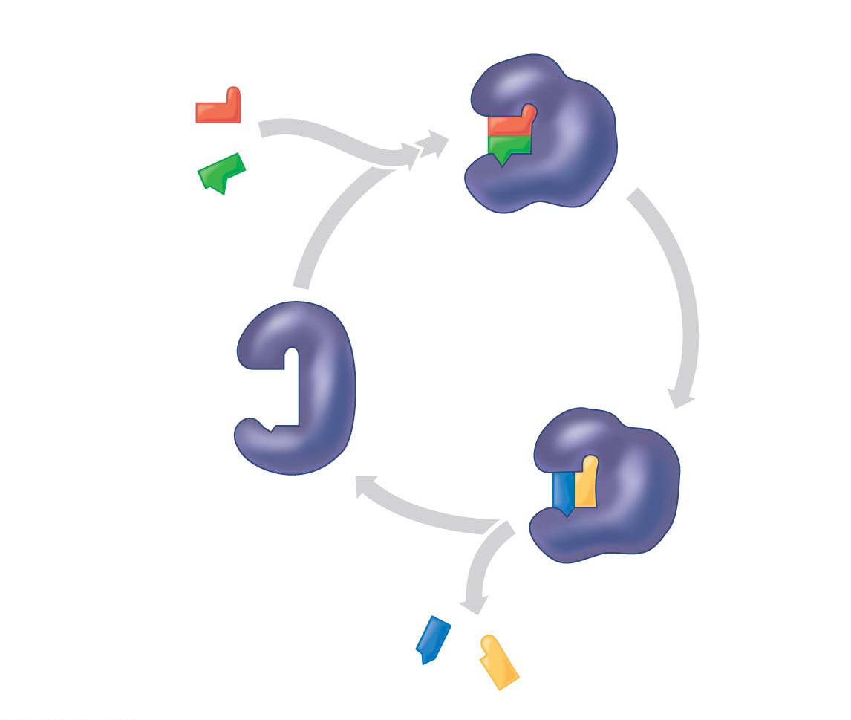
Figure 8.16-4
1
Substrates enter
active site.
2
Substrates are
held in active
site by weak
interactions.
Substrates
Enzyme-substrate
complex
5
Active site
is available
for new
substrates.
Enzyme
4
Products are
released.
3
Substrates are
converted to
products.
Products
Notes:
Figure 8.16-4 The active site and catalytic cycle of an enzyme (step 4)

Slide 57
Concept 8.4: Enzymes speed up metabolic reactions by lowering energy barriers
Effects of Temperature and pH
Each enzyme has an optimal temperature in which it can function
Each enzyme has an optimal pH in which it can function
Optimal conditions favor the MOST ACTIVE SHAPE for the enzyme molecule

Slide 58
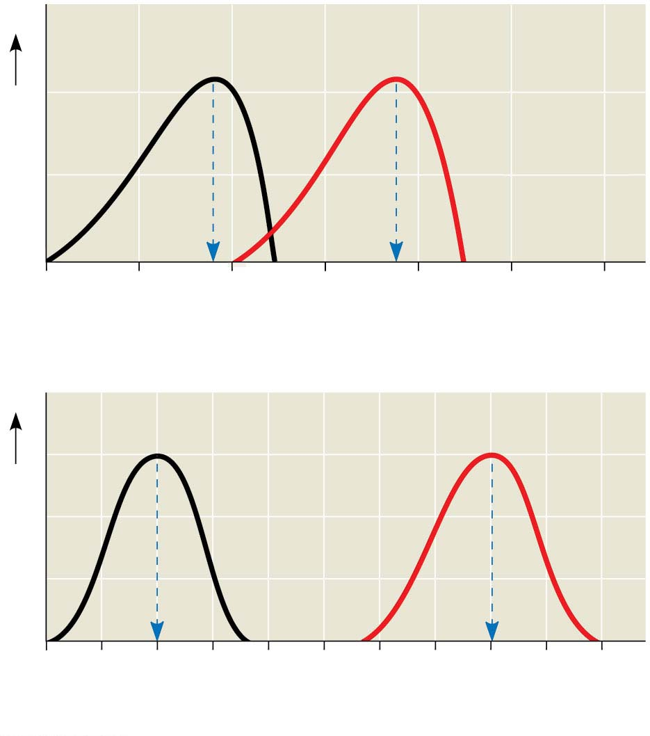
Environmental factors affecting enzyme activity
Optimal temperature for
typical human enzyme (37°C)
Optimal temperature for
enzyme of thermophilic
(heat-loving)
bacteria (75°C)
Rate of reaction
0
20
40
60
80
100
120
Temperature (°C)
(a) Optimal temperature for two enzymes
Optimal pH for pepsin
(stomach
enzyme)
Optimal pH for trypsin
(intestinal
enzyme)
Rate of reaction
0
1
2
3
4
5
6
7
8
9
10
pH
(b) Optimal pH for two enzymes
Notes:
Figure 6.16 Environmental factors affecting enzyme activity

Slide 59
Concept 8.4: Enzymes speed up metabolic reactions by lowering energy barriers
Cofactors
Cofactors are NON-PROTEIN enzyme “helpers”
Cofactors may be inorganic (such as a metal in ionic form) or organic
An organic cofactor = coenzyme
Coenzymes include vitamins

Slide 60
Concept 8.4: Enzymes speed up metabolic reactions by lowering energy barriers
Enzyme Inhibitors
Competitive inhibitors BIND TO THE ACTIVE SITE of an enzyme, competing with the substrate
Noncompetitive inhibitors BIND TO ANOTHER PART OF AN ENZYME, causing the enzyme to change shape and making the active site less effective
Examples of inhibitors include toxins, poisons, pesticides, and antibiotics

Slide 61
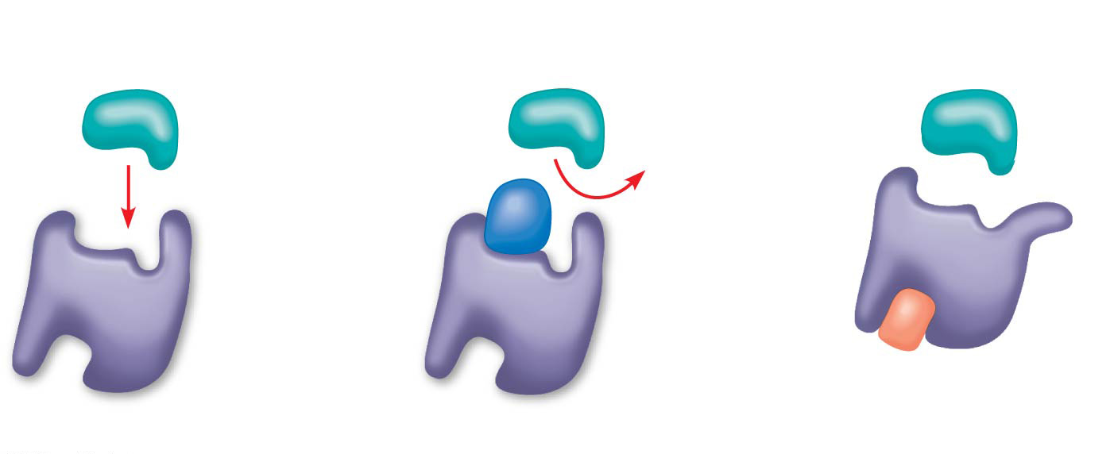
Inhibition of enzyme activity
(a) Normal binding
(b) Competitive inhibition
(c)
Noncompetitive
inhibition
Substrate
Active site
Competitive
inhibitor
Enzyme
Noncompetitive
inhibitor
Notes:
Figure 8.18 Inhibition of enzyme activity

Slide 62
Notes:
During a laboratory experiment, you discover that an enzyme-catalyzed reaction has a ∆G of -20 kcal/mol. If you double the amount of enzyme in the reaction, what will be the ∆G for the new reaction?
https://www.polleverywhere.com/multiple_choice_polls/I8aZX1LdwG1g0Yn

Slide 63
Notes:
Which of the following is true of enzymes?
https://www.polleverywhere.com/multiple_choice_polls/zTx4COzu6M7XWSE

Slide 64
Notes:
A noncompetitive inhibitor decreases the rate of an enzyme reaction by _____.
https://www.polleverywhere.com/multiple_choice_polls/PvFKpuwqyHyUyK8

Slide 65
Overview
Concept 8.1: An organism’s metabolism transforms matter and energy, subject to the laws of thermodynamics
Concept 8.2: The free-energy change of a reaction tells us whether or not the reaction occurs spontaneously
Concept 8.3: ATP powers cellular work by coupling exergonic reactions to endergonic reactions
Concept 8.4: Enzymes speed up metabolic reactions by lowering energy barriers
Concept 8.5: Regulation of enzyme activity helps control metabolism

Slide 66
Concept 8.5: Regulation of enzyme activity helps control metabolism
Chemical CHAOS would result if a cell’s metabolic pathways were not TIGHTLY REGULATED
A cell does this by switching on or off the genes that encode specific enzymes or by regulating the activity of enzymes

Slide 67
Concept 8.5: Regulation of enzyme activity helps control metabolism
Allosteric Regulation of Enzymes
Allosteric regulation may either inhibit or stimulate an enzyme’s activity
Allosteric regulation occurs when a regulatory molecule binds to a protein AT ONE SITE and affects the protein’s function at another site

Slide 68
Concept 8.5: Regulation of enzyme activity helps control metabolism
Allosteric Activation and Inhibition
Most allosterically regulated enzymes are made from polypeptide subunits
Each enzyme has active and inactive forms
The binding of an activator stabilizes the active form of the enzyme
The binding of an inhibitor stabilizes the inactive form of the enzyme

Slide 69
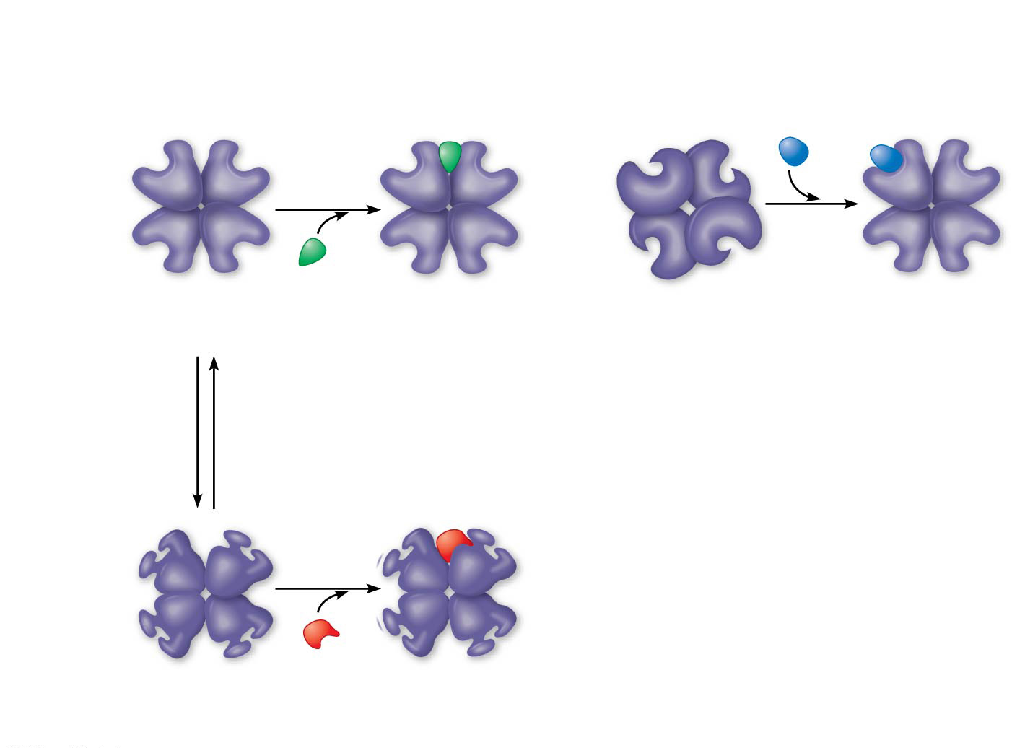
Figure 8.20
(a) Allosteric activators and inhibitors
Allosteric enzyme
with four subunits
Active site
(one of four)
Regulatory
site (one
of four)
Activator
Active form
Stabilized
active form
Inactive form
Stabilized
active form
Oscillation
Non-
functional
active site
Inhibitor
Inactive form
Stabilized
inactive form
Notes:
Figure 8.20 Allosteric regulation of enzyme activity

Slide 70
Notes:
A series of enzymes catalyze the reaction X → Y → Z → A. Product A binds to the enzyme that converts X to Y at a position remote from its active site. This binding decreases the activity of the enzyme. What is substance X?
https://www.polleverywhere.com/multiple_choice_polls/np7WKY0BQAmXvxT

Slide 71
Overview
Concept 8.1: An organism’s metabolism transforms matter and energy, subject to the laws of thermodynamics
Concept 8.2: The free-energy change of a reaction tells us whether or not the reaction occurs spontaneously
Concept 8.3: ATP powers cellular work by coupling exergonic reactions to endergonic reactions
Concept 8.4: Enzymes speed up metabolic reactions by lowering energy barriers
Concept 8.5: Regulation of enzyme activity helps control metabolism

