Slide 1
0
7
Membrane Structure and Function

Slide 2
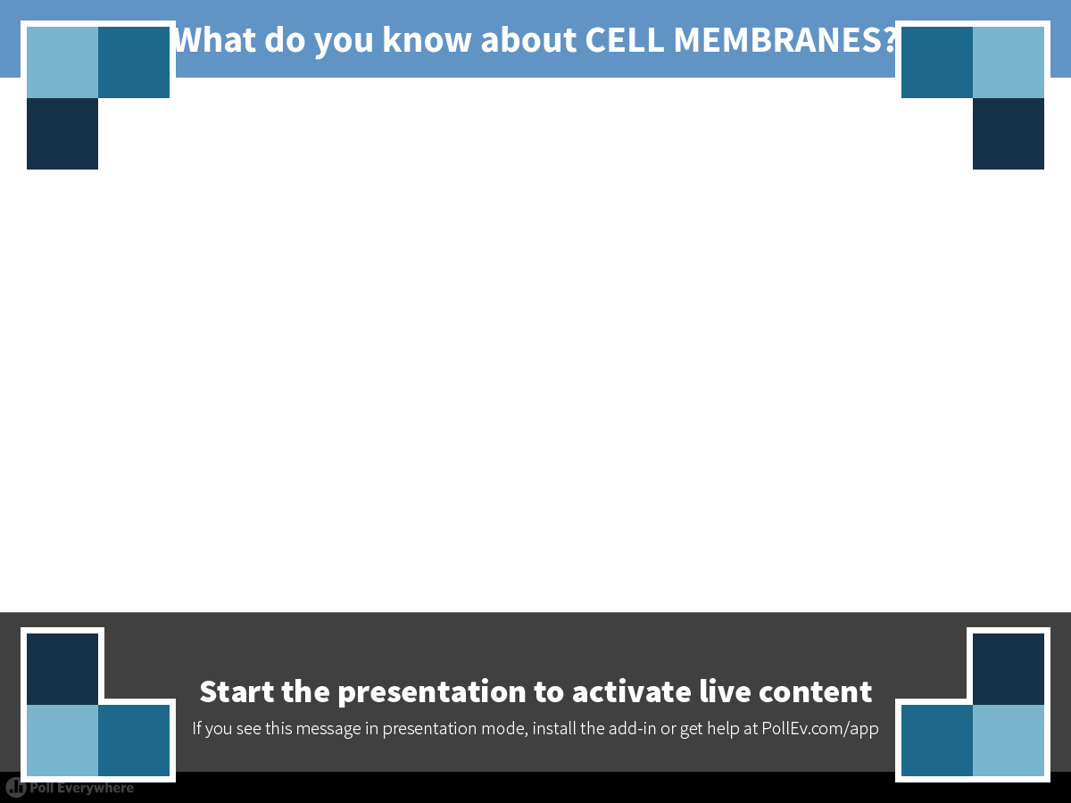
Notes:
What do you know about CELL MEMBRANES?
https://www.polleverywhere.com/free_text_polls/75T1C2JhUKo6sSf

Slide 3
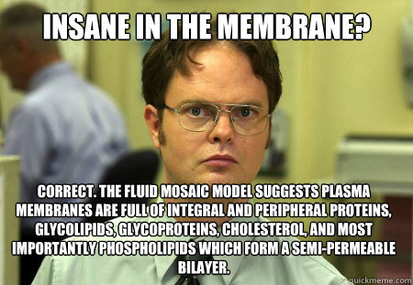
Life at the Edge
The plasma membrane is the boundary that SEPARATES the living cell from its surroundings
The plasma membrane exhibits selective permeability, allowing some substances to cross it more easily than others

Slide 4
Overview
Concept 7.1: Cellular membranes are fluid mosaics of lipids and proteins
Concept 7.2: Membrane structure results in selective permeability
Concept 7.3: Passive transport is diffusion of a substance across a membrane with no energy investment
Concept 7.4: Active transport uses energy to move solutes against their gradients
Concept 7.5: Bulk transport across the
plasma membrane occurs by exocytosis and endocytosis

Slide 5
Overview
Concept 7.1: Cellular membranes are fluid mosaics of lipids and proteins
Concept 7.2: Membrane structure results in selective permeability
Concept 7.3: Passive transport is diffusion of a substance across a membrane with no energy investment
Concept 7.4: Active transport uses energy to move solutes against their gradients
Concept 7.5: Bulk transport across the
plasma membrane occurs by exocytosis and endocytosis

Slide 6
Concept 7.1: Cellular membranes are fluid mosaics of lipids and proteins
Phospholipids are the most abundant lipid in the plasma membrane
Phospholipids are amphipathic molecules, containing hydrophobic (tails) and hydrophilic (heads) regions
A phospholipid bilayer can exist as a stable BOUNDARY between two aqueous compartments

Slide 7
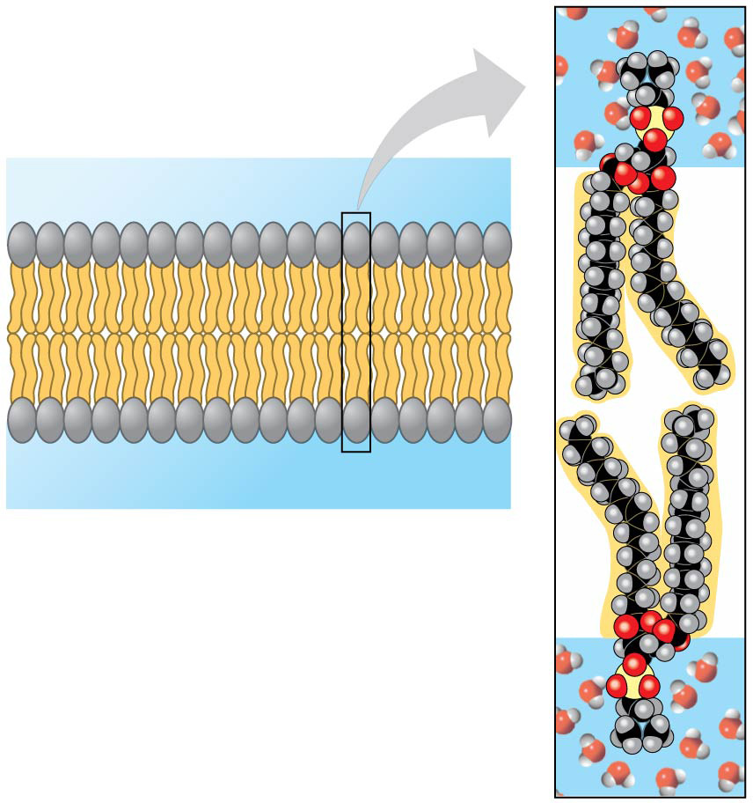
Phospholipid bilayer (cross section)
Hydrophilic head
WATER
WATER
Hydrophobic tail
Notes:
Figure 7.2 Phospholipid bilayer (cross section)

Slide 8
Concept 7.1: Cellular membranes are fluid mosaics of lipids and proteins
The fluid mosaic model states that a membrane is a fluid structure with a “mosaic” of various proteins embedded in it

Slide 9
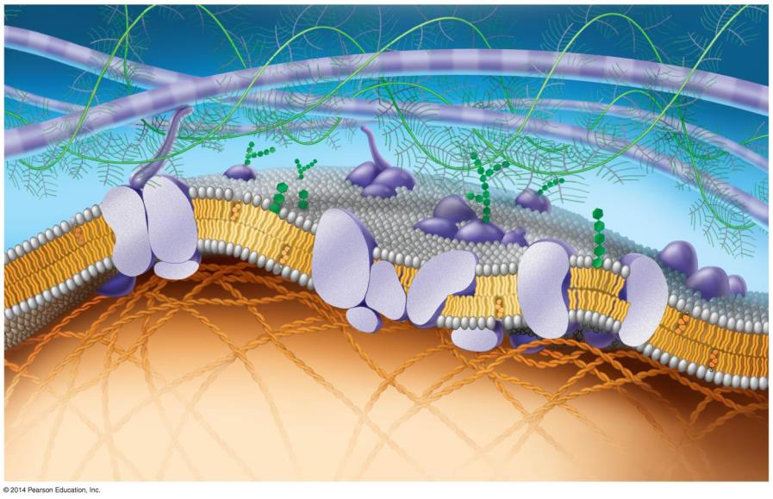
Updated model of an animal cell’s plasma membrane (cutaway view)
Fibers of extra-
cellular matrix (ECM)
Glyco-
protein
Glycolipid
Carbohydrate
EXTRACELLULAR
SIDE OF
MEMBRANE
Cholesterol
Microfilaments
of cytoskeleton
Peripheral
proteins
Integral
protein
CYTOPLASMIC
SIDE OF
MEMBRANE
Notes:
Figure 7.3 Updated model of an animal cell’s plasma membrane (cutaway view)

Slide 10
Concept 7.1: Cellular membranes are fluid mosaics of lipids and proteins
The Fluidity of Membranes
Phospholipids in the plasma membrane CAN MOVE within the bilayer
  Most of the lipids, and some proteins, drift LATERALLY
  Rarely, a lipid may flip-flop transversely across
  the membrane

Slide 11
Concept 7.1: Cellular membranes are fluid mosaics of lipids and proteins
The Fluidity of Membranes
As temperatures cool, membranes switch from a fluid state to a solid state
The temperature at which a membrane solidifies depends on the types of lipids
Membranes rich in unsaturated fatty acids are MORE FLUID than those rich in saturated fatty acids
Membranes MUST BE FLUID to work properly; they are usually about as fluid as salad oil

Slide 12
Concept 7.1: Cellular membranes are fluid mosaics of lipids and proteins
The Fluidity of Membranes
The steroid CHOLESTEROL has different effects on membrane fluidity at different temperatures
At warm temperatures (such as 37°C), cholesterol restrains movement of phospholipids
AT COOL TEMPERATURES, IT MAINTAINS FLUIDITY BY PREVENTING TIGHT PACKING

Slide 13
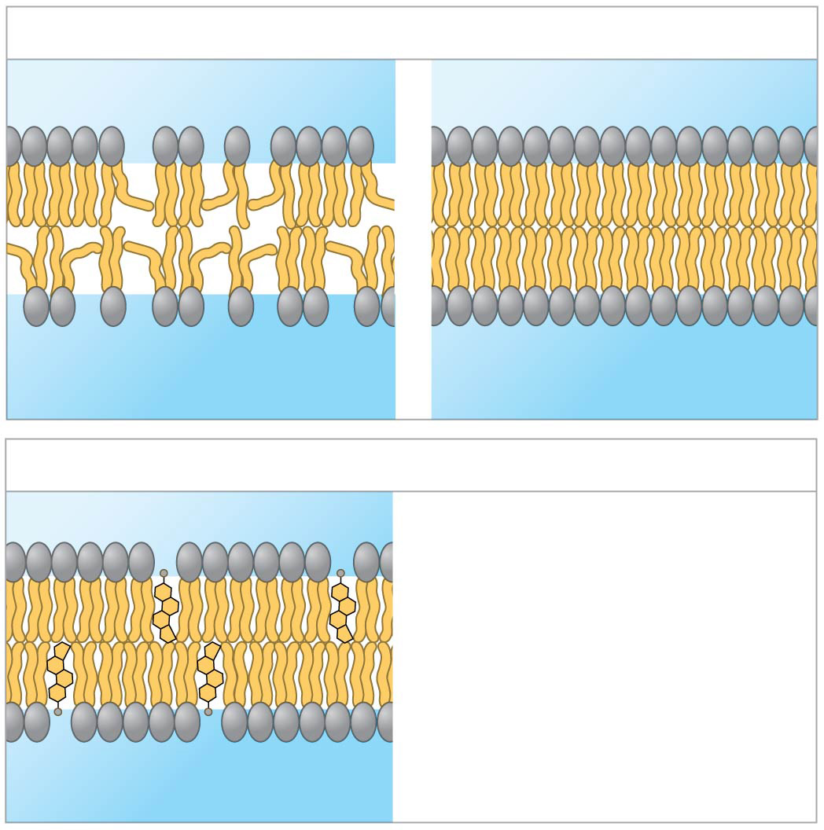
Factors that affect membrane fluidity
(a) Unsaturated versus saturated hydrocarbon tails
Fluid
Viscous
Unsaturated tails
prevent packing.
Saturated tails pack
together.
(b) Cholesterol within the animal cell membrane
Cholesterol reduces
membrane fluidity at
moderate temperatures,
but at low temperatures
hinders solidification.
Cholesterol
Notes:
Figure 7.5 Factors that affect membrane fluidity

Slide 14
Concept 7.1: Cellular membranes are fluid mosaics of lipids and proteins
Membrane Proteins and Their Functions
A membrane is a collage of different proteins, often grouped together, embedded in the fluid matrix of the lipid bilayer
Proteins determine most of the membrane’s specific functions

Slide 15
Concept 7.1: Cellular membranes are fluid mosaics of lipids and proteins
Membrane Proteins and Their Functions
Six major functions of membrane proteins
  Transport
  Enzymatic activity
  Signal transduction
  Cell-cell recognition
  Intercellular joining
  Attachment to the cytoskeleton and extracellular matrix (ECM)

Slide 16
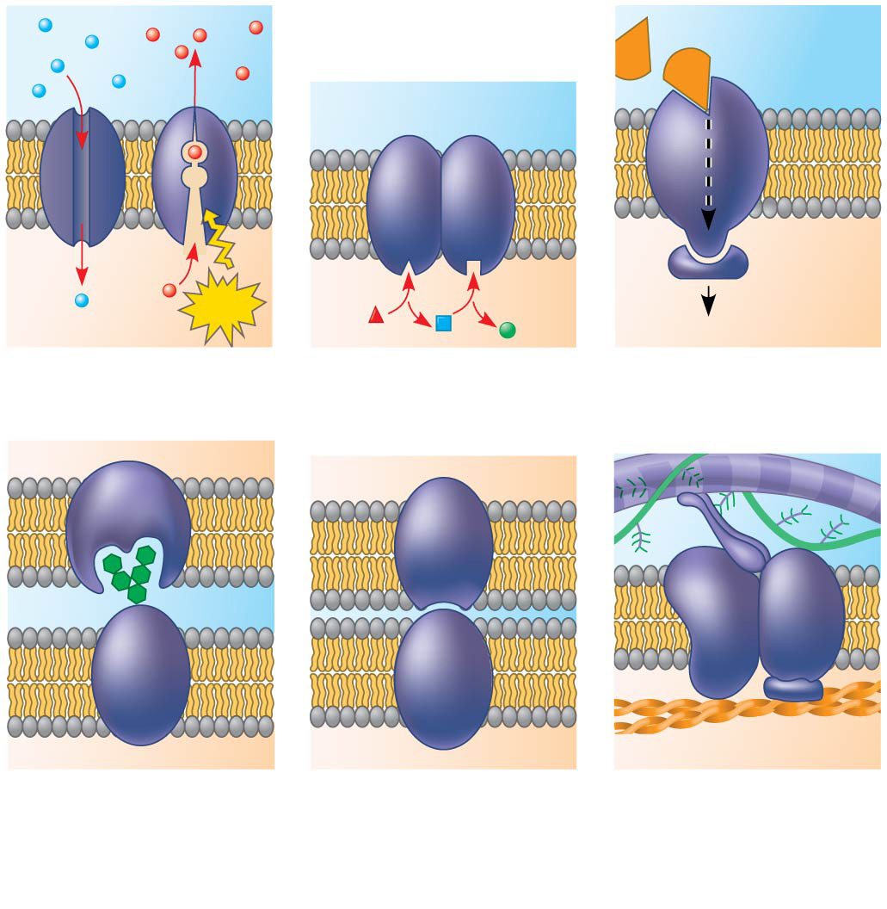
Figure 7.7
Signaling
molecule
Enzymes
Receptor
ATP
Signal transduction
(a) Transport
(b) Enzymatic
activity
(c) Signal
transduction
Glyco-
protein
(d) Cell-cell
recognition
(e) Intercellular
joining
(f) Attachment to
the cytoskeleton
and extracellular
matrix (ECM)
Notes:
Figure 7.7 Some functions of membrane proteins

Slide 17
Concept 7.1: Cellular membranes are fluid mosaics of lipids and proteins
Membrane Proteins and Their Functions
Peripheral proteins are bound to the surface of the membrane
Integral proteins penetrate the hydrophobic core
  Integral proteins that span the membrane are called transmembrane proteins
    The hydrophobic regions of an integral protein consist of one or more stretches of NONPOLAR
    AMINO ACIDS, often coiled into alpha helices

Slide 18
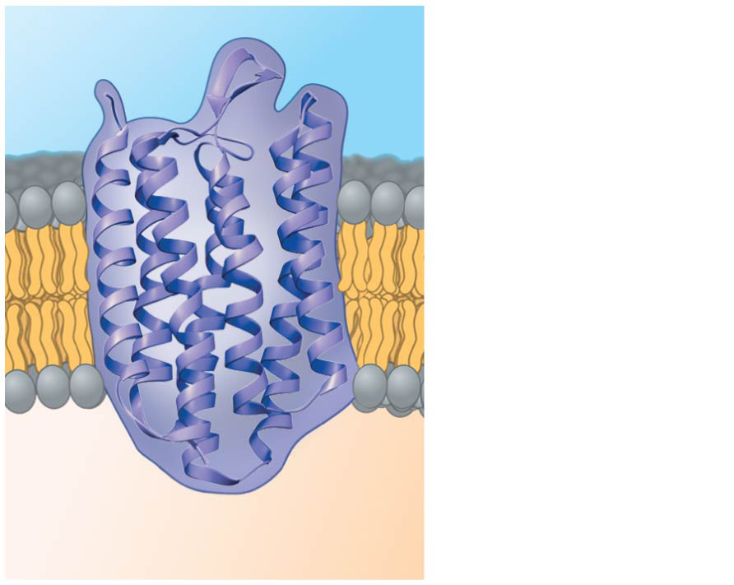
The structure of a transmembrane protein
N-terminus
EXTRACELLULAR
SIDE
α helix
CYTOPLASMIC
SIDE
C-terminus
Notes:
Figure 7.6 The structure of a transmembrane protein

Slide 19
Concept 7.1: Cellular membranes are fluid mosaics of lipids and proteins
The Role of Membrane Carbohydrates in Cell-Cell Recognition
Cells recognize each other by binding to molecules, often containing carbohydrates, on the extracellular surface of the plasma membrane
Membrane carbohydrates may be covalently bonded to lipids (forming glycolipids) or more commonly to proteins (forming glycoproteins)

Slide 20
Concept 7.1: Cellular membranes are fluid mosaics of lipids and proteins
Synthesis and Sidedness of Membranes
Membranes have distinct inside and outside faces
The asymmetrical distribution of proteins, lipids, and associated carbohydrates in the plasma membrane is determined when the membrane is BUILT BY THE ER AND GOLGI APPARATUS

Slide 21
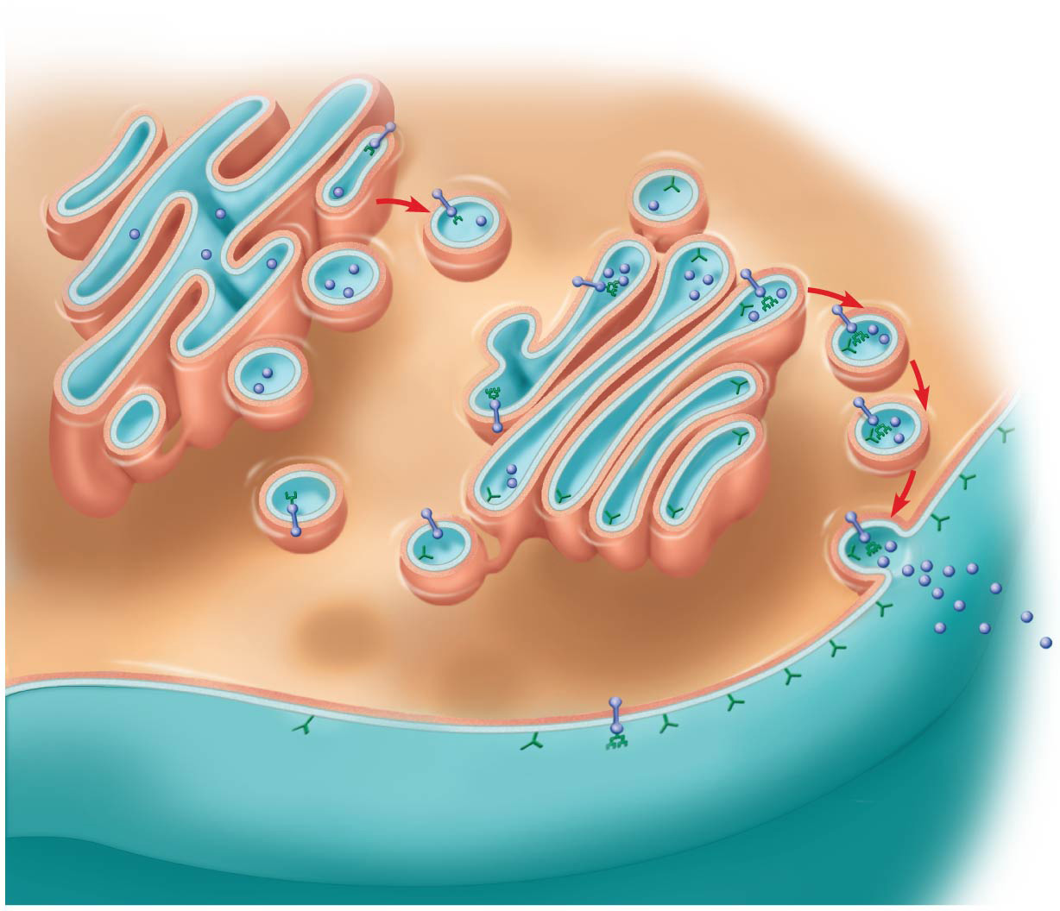
Synthesis of membrane components and their orientation in the membrane
Transmembrane
glycoproteins
Secretory
protein
Golgi
apparatus
Vesicle
Attached
carbohydrate
Glycolipid
ER
lumen
Plasma membrane:
Cytoplasmic face
Extracellular face
Transmembrane
glycoprotein
Secreted
protein
Membrane
glycolipid
Notes:
Figure 7.9 Synthesis of membrane components and their orientation in the membrane

Slide 22
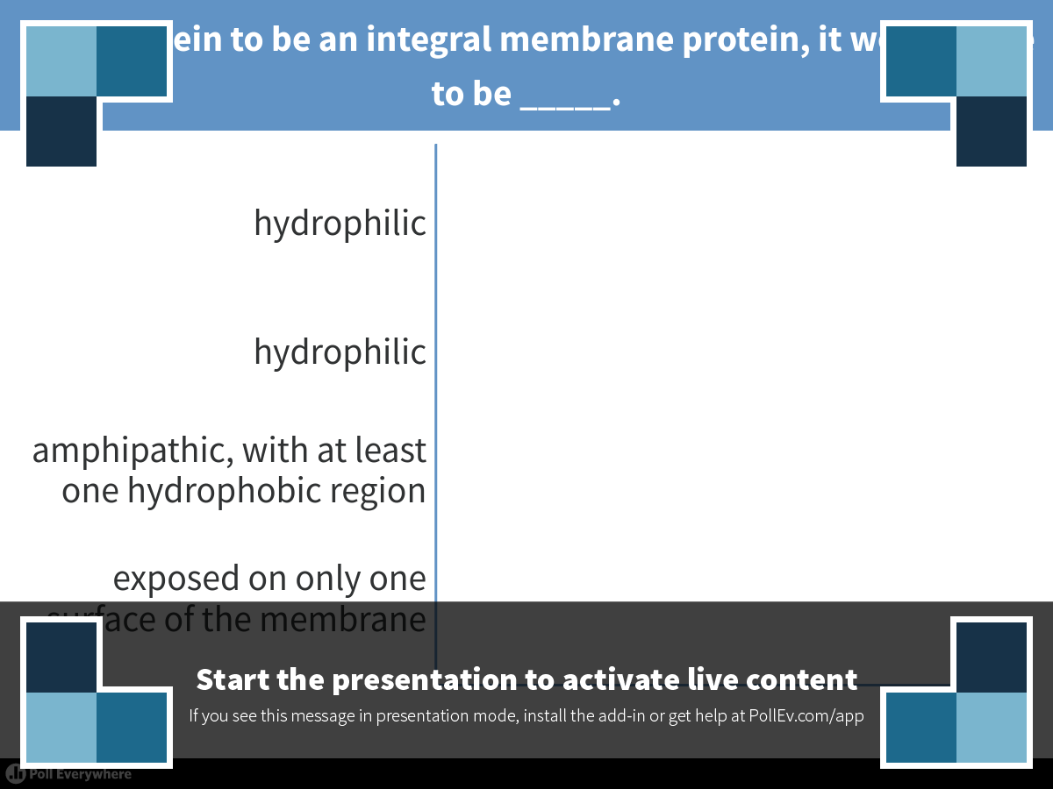
Notes:
For a protein to be an integral membrane protein, it would have to be _____.
https://www.polleverywhere.com/multiple_choice_polls/IpQDWT2PLHrYT3K

Slide 23
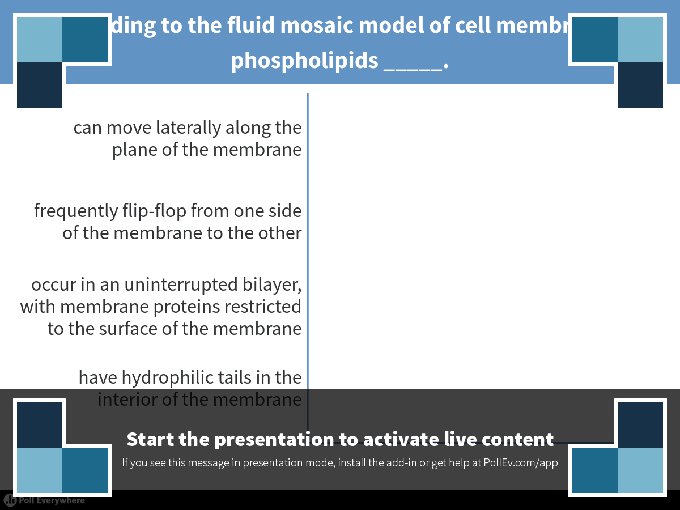
Notes:
According to the fluid mosaic model of cell membranes, phospholipids _____.
https://www.polleverywhere.com/multiple_choice_polls/Bsaoz710UxSHem1

Slide 24
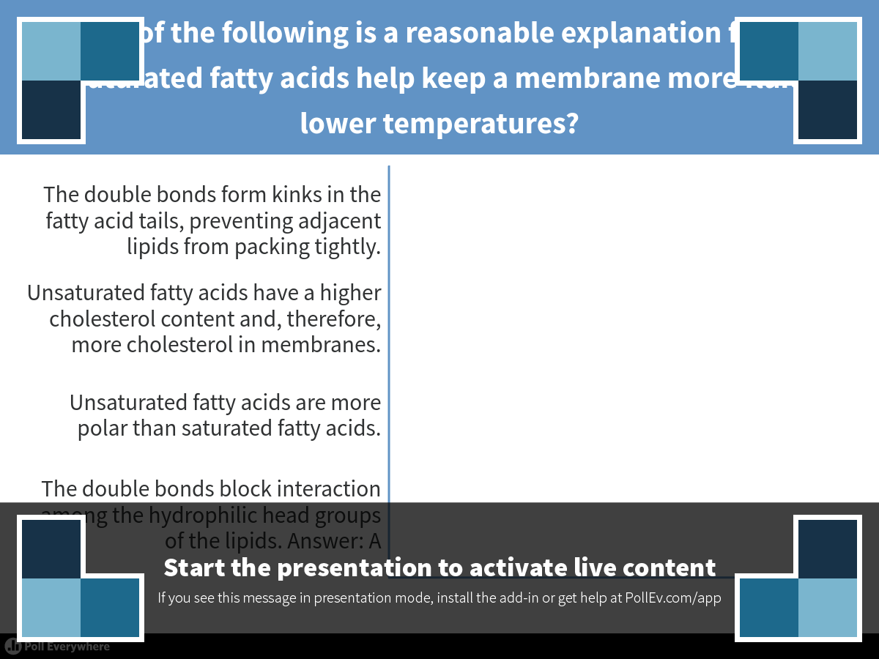
Notes:
Which of the following is a reasonable explanation for why unsaturated fatty acids help keep a membrane more fluid at lower temperatures?
https://www.polleverywhere.com/multiple_choice_polls/kaBD4YL46JtHX1j

Slide 25
Overview
Concept 7.1: Cellular membranes are fluid mosaics of lipids and proteins
Concept 7.2: Membrane structure results in selective permeability
Concept 7.3: Passive transport is diffusion of a substance across a membrane with no energy investment
Concept 7.4: Active transport uses energy to move solutes against their gradients
Concept 7.5: Bulk transport across the
plasma membrane occurs by exocytosis and endocytosis

Slide 26
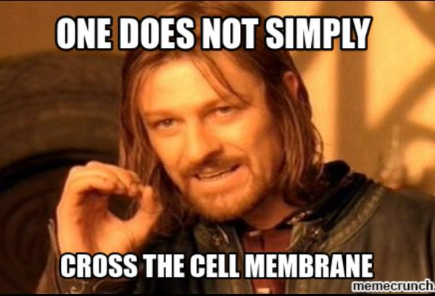

Slide 27
Concept 7.2: Membrane structure results in selective permeability
A cell must exchange materials with its surroundings, a process controlled by the
plasma membrane
Plasma membranes are selectively permeable, regulating the cell’s molecular traffic

Slide 28
Concept 7.2: Membrane structure results in selective permeability
The Permeability of the Lipid Bilayer
Small, uncharged polar molecules and small nonpolar molecules, such as N2, freely and rapidly pass across the lipid bilayer membrane.
Large, hydrophilic molecules including ions and polar molecules DO NOT cross the membrane this easily…so how do they cross then?

Slide 29
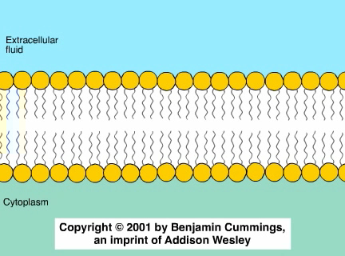
Animation: Membrane Selectivity

Slide 30
Concept 7.2: Membrane structure results in selective permeability
Transport Proteins
Transport proteins allow passage of hydrophilic substances across the membrane
Some transport proteins, called channel proteins, have a hydrophilic channel that certain molecules or ions can use as a tunnel
  Channel proteins called aquaporins facilitate the passage of water

Slide 31
Concept 7.2: Membrane structure results in selective permeability
Transport Proteins
Other transport proteins, called carrier proteins, bind to molecules and CHANGE SHAPE to shuttle them across the membrane
A transport protein is SPECIFIC for the substance
it moves

Slide 32
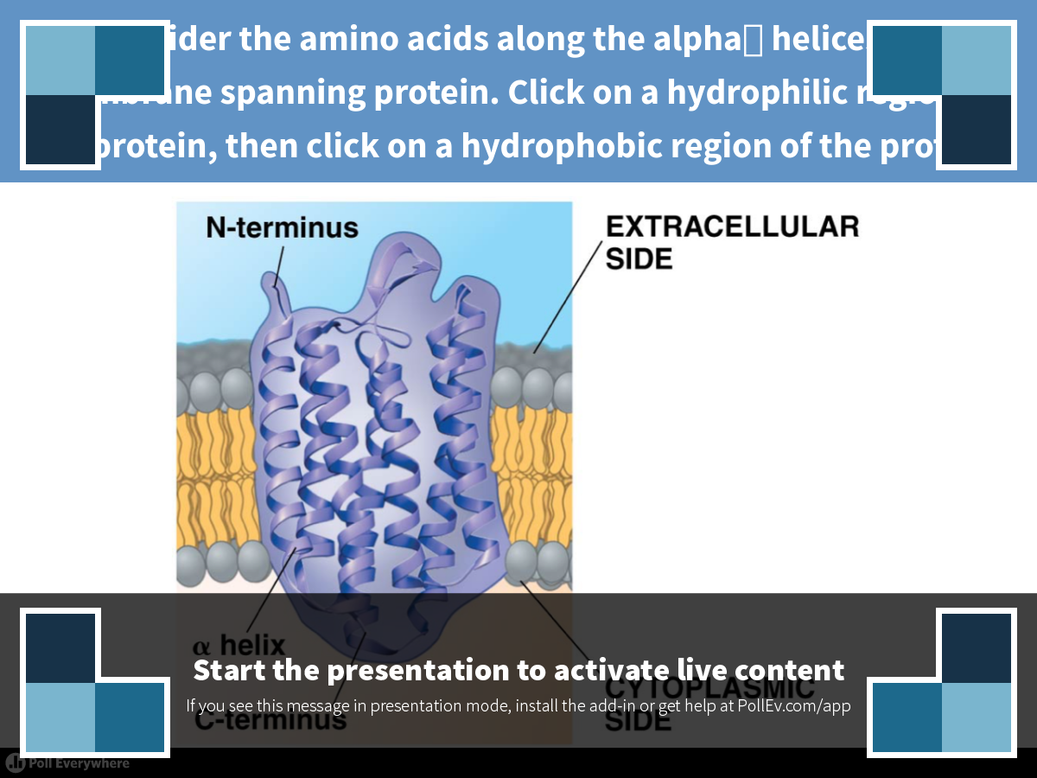
Notes:
Consider the amino acids along the alpha helices of a membrane spanning protein. Click on a hydrophilic region of the protein, then click on a hydrophobic region of the protein.
https://www.polleverywhere.com/clickable_images/O8vh7eIME7oqBS6

Slide 33
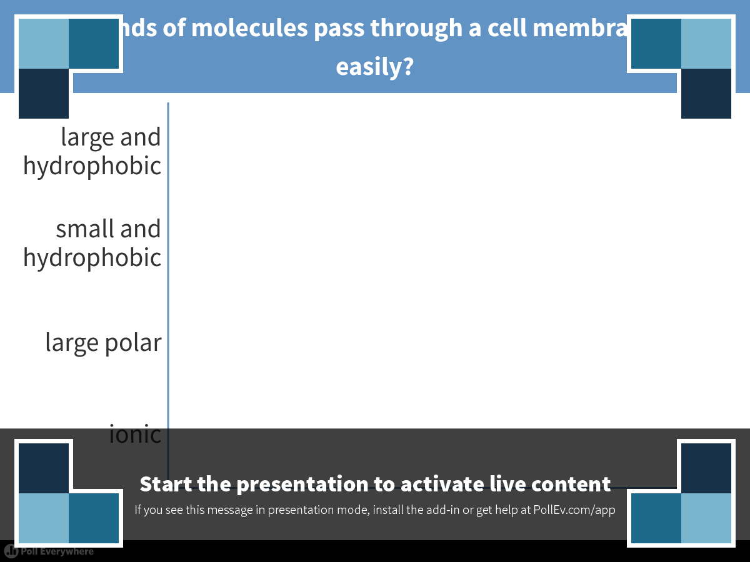
Notes:
What kinds of molecules pass through a cell membrane most easily?
https://www.polleverywhere.com/multiple_choice_polls/11qS23wMcqkbUBx

Slide 34
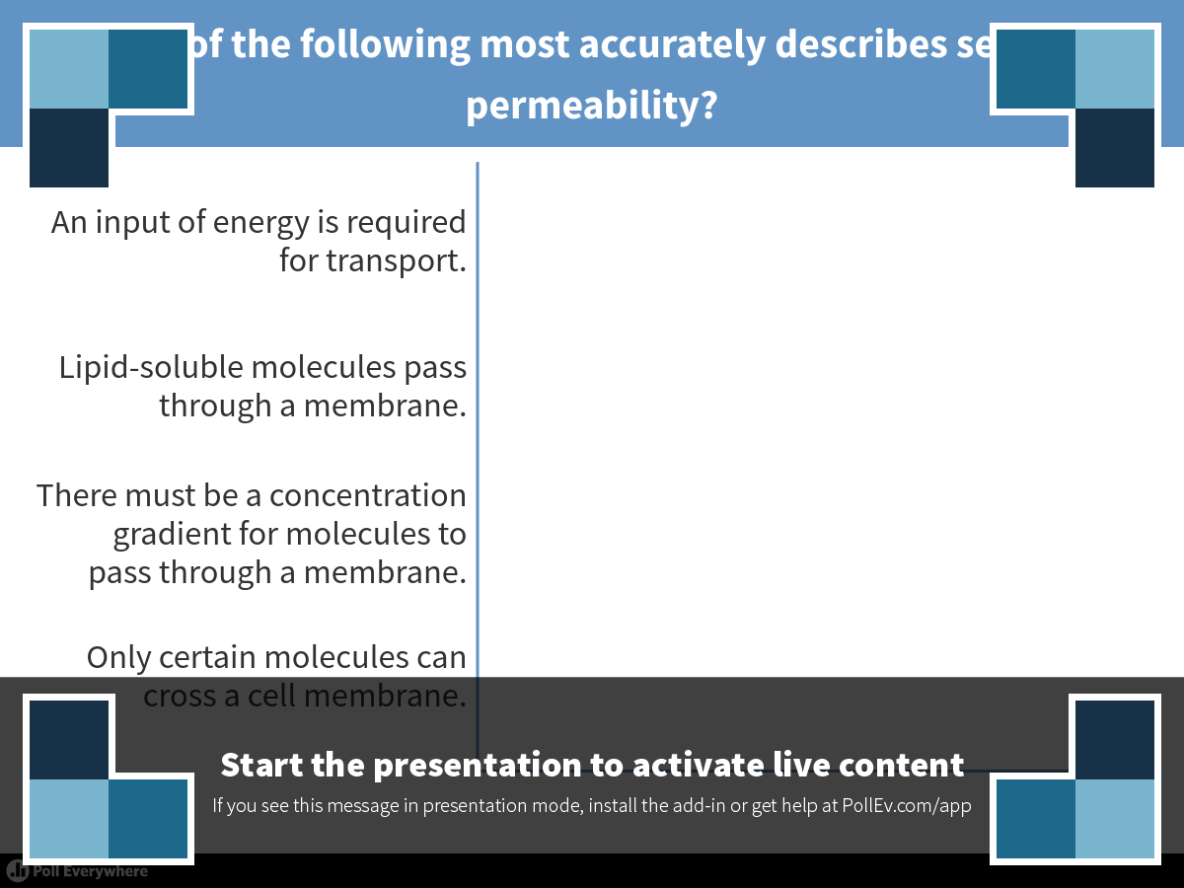
Notes:
Which of the following most accurately describes selective permeability?
https://www.polleverywhere.com/multiple_choice_polls/QRSI157B5Fi6mCP

Slide 35
Overview
Concept 7.1: Cellular membranes are fluid mosaics of lipids and proteins
Concept 7.2: Membrane structure results in selective permeability
Concept 7.3: Passive transport is diffusion of a substance across a membrane with no energy investment
Concept 7.4: Active transport uses energy to move solutes against their gradients
Concept 7.5: Bulk transport across the
plasma membrane occurs by exocytosis and endocytosis

Slide 36
Concept 7.3: Passive transport is diffusion of a substance across a membrane with no energy investment
Diffusion is the tendency for molecules to spread out EVENLY into the available space
Although each molecule moves randomly, diffusion of a population of molecules may be directional
At dynamic equilibrium, as many molecules cross the membrane in one direction as in the other

Slide 37
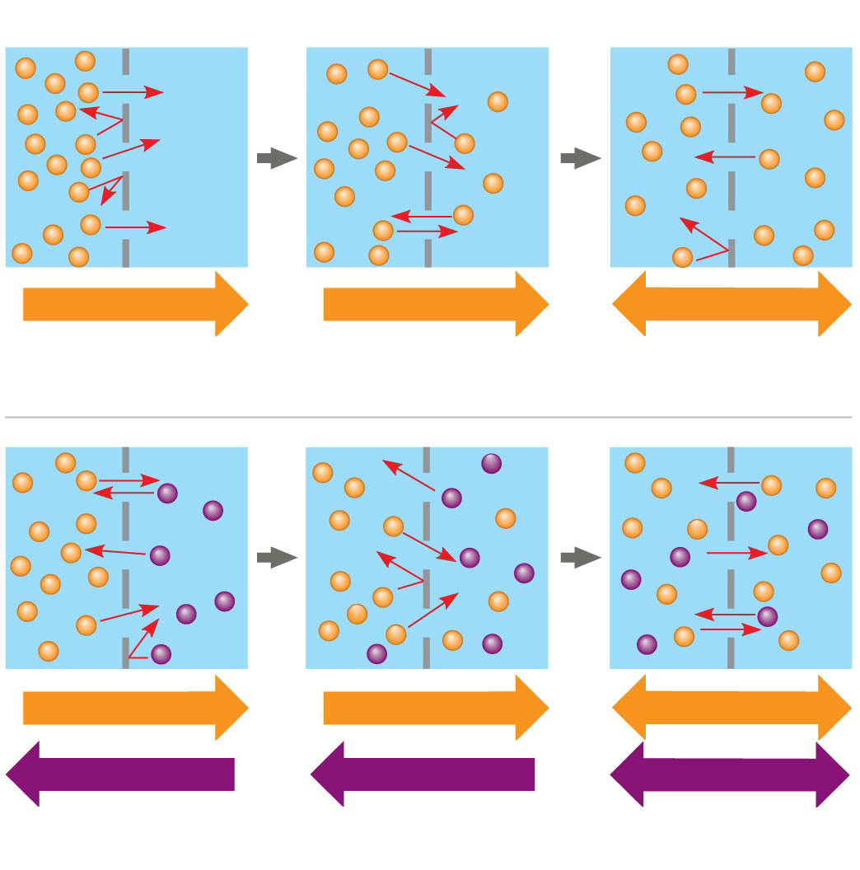
The diffusion of solutes across a synthetic membrane
Molecules of dye
Membrane (cross section)
WATER
Net diffusion
Net diffusion
Equilibrium
(a) Diffusion of one solute
Net diffusion
Net diffusion
Equilibrium
Net diffusion
Net diffusion
Equilibrium
(b) Diffusion of two solutes
Notes:
Figure 7.10 The diffusion of solutes across a synthetic membrane

Slide 38
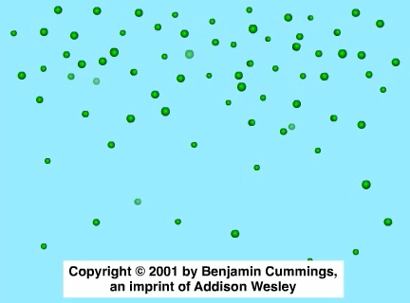
Animation: Diffusion

Slide 39
Concept 7.3: Passive transport is diffusion of a substance across a membrane with no energy investment
Substances diffuse “DOWN” their concentration gradient, from an area of HIGH concentration to an area of LOW concentration
No work must be done to move substances down the concentration gradient
The diffusion of a substance across a biological membrane is passive transport because NO ENERGY IS EXPENDED by the cell to make it happen

Slide 40
Concept 7.3: Passive transport is diffusion of a substance across a membrane with no energy investment
Effects of Osmosis on Water Balance
Osmosis is the diffusion of WATER across a selectively permeable membrane
Water diffuses across a membrane from the region of LOWER SOLUTE CONCENTRATION to the region of HIGHER SOLUTE CONCENTRATION until the solute concentration is equal on both sides

Slide 41
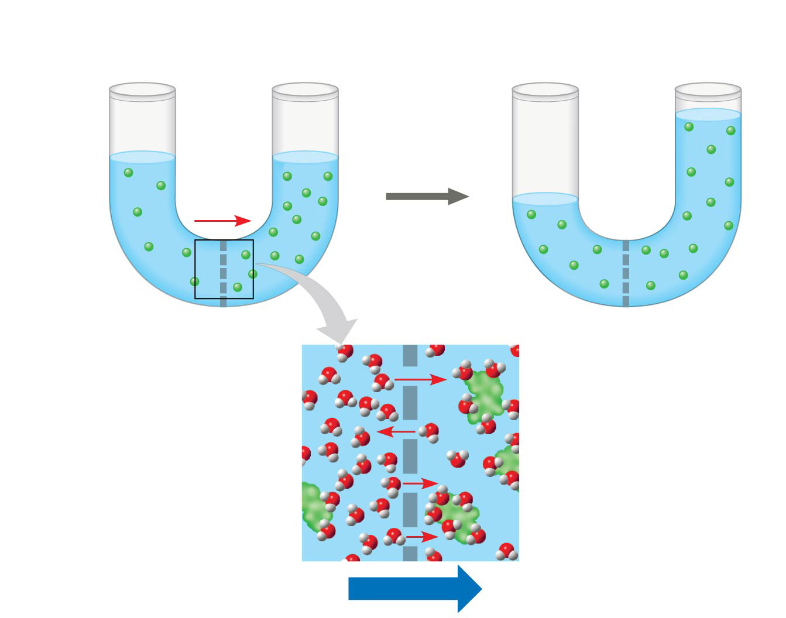
Osmosis
Lower concentration
of solute (sugar)
Higher concentration
of solute
More similar
concentrations of solute
Sugar
molecule
H₂O
Selectively
permeable
membrane
Osmosis
Notes:
Figure 7.11 Osmosis

Slide 42
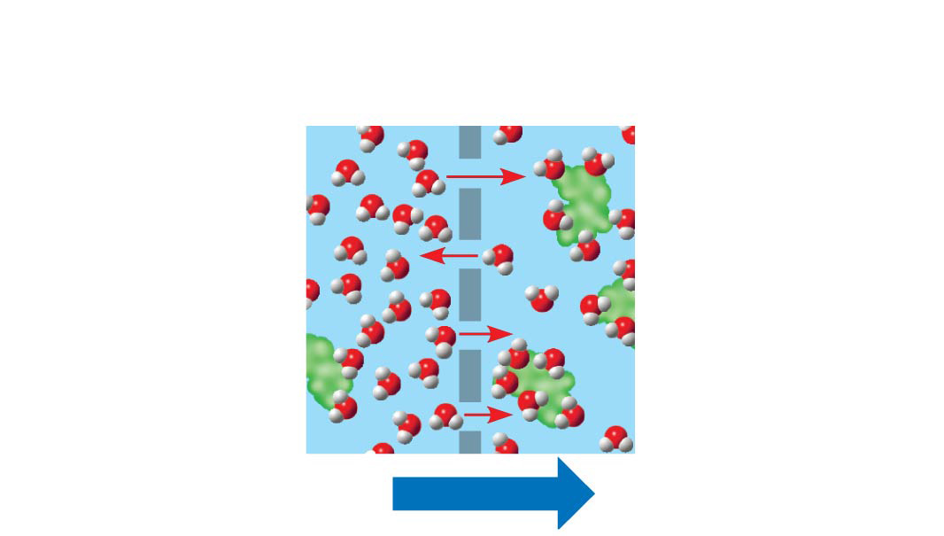
Figure 7.11a
Selectively
permeable
membrane
Water
molecules can
pass through
pores, but sugar
molecules
cannot.
Water molecules
cluster around
sugar molecules.
This side has
fewer solute
molecules,
more free
water molecules.
This side has
more solute
molecules,
fewer free
water molecules.
Osmosis
Notes:
Figure 7.11a Osmosis (part 1: detail of membrane)

Slide 43
Concept 7.3: Passive transport is diffusion of a substance across a membrane with no energy investment
Water Balance of Cells
Tonicity is the ability of a surrounding solution to cause a cell to gain or lose water
Isotonic solution: Solute concentration is the same as that inside the cell; NO NET WATER MOVEMENT across the plasma membrane
Hypertonic solution: Solute concentration is greater than that inside the cell; CELL LOSES WATER
Hypotonic solution: Solute concentration is less than that inside the cell; CELL GAINS WATER

Slide 44
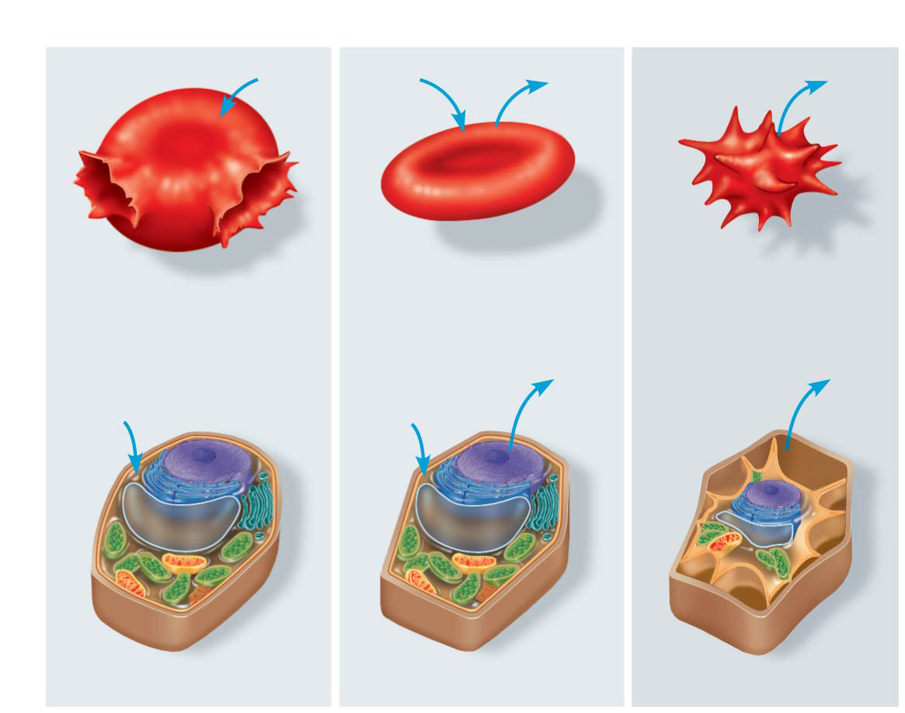
Figure 7.12
Hypotonic
Isotonic
Hypertonic
H₂O
H₂O
H₂O
H₂O
(a) Animal cell
Lysed
Normal
Shriveled
Cell
wall
Plasma
membrane
H₂O
Plasma
membrane
H₂O
H₂O
H₂O
(b) Plant cell
Turgid (normal)
Flaccid
Plasmolyzed
Notes:
Figure 7.12 The water balance of living cells

Slide 45
Concept 7.3: Passive transport is diffusion of a substance across a membrane with no energy investment
Hypertonic or hypotonic environments create osmotic problems for organisms
  Osmoregulation, the control of solute concentrations and water balance, is a necessary adaptation for life in such environments
In a hypertonic environment, plant cells lose water
  The membrane pulls away from the cell wall causing the plant to wilt, a usually lethal effect called plasmolysis

Slide 46
Concept 7.3: Passive transport is diffusion of a substance across a membrane with no energy investment
Facilitated Diffusion: Passive Transport Aided by Proteins
In facilitated diffusion, transport proteins speed the PASSIVE movement of molecules across the plasma membrane
Transport proteins include channel proteins and carrier proteins
  Carrier proteins undergo a subtle change in shape that translocates the solute-binding site across the membrane

Slide 47
Concept 7.3: Passive transport is diffusion of a substance across a membrane with no energy investment
Facilitated Diffusion: Passive Transport Aided by Proteins
Channel proteins provide corridors that allow a specific molecule or ion to cross the membrane
Aquaporins facilitate the diffusion of water
Ion channels facilitate the diffusion of ions
  Some ion channels, called gated channels, open or close in response to a stimulus

Slide 48
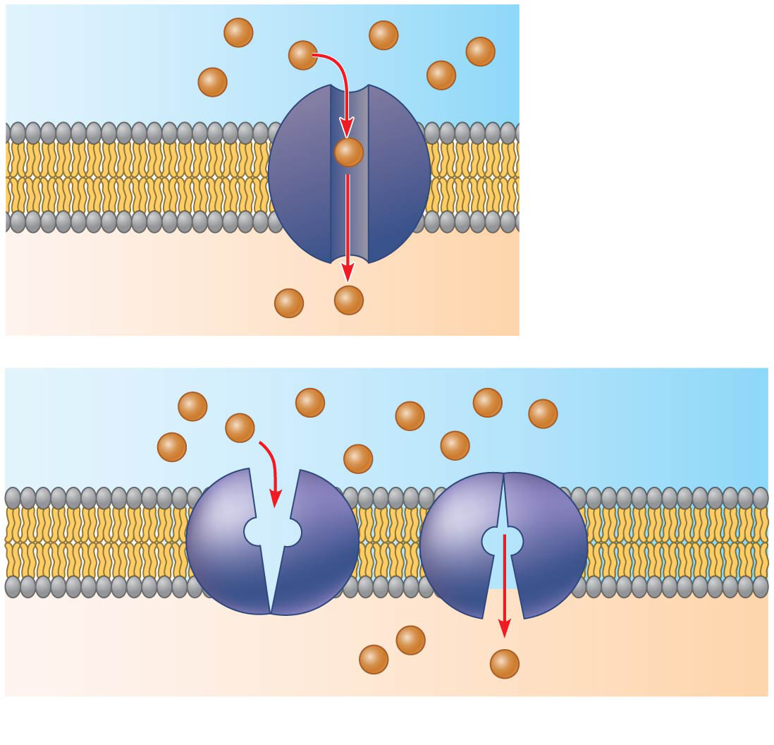
Two types of transport proteins that carry out facilitated diffusion
EXTRACELLULAR
FLUID
(a) A channel
protein
Channel protein
Solute
CYTOPLASM
Carrier protein
Solute
(b) A carrier protein
Notes:
Figure 7.14 Two types of transport proteins that carry out facilitated diffusion

Slide 49
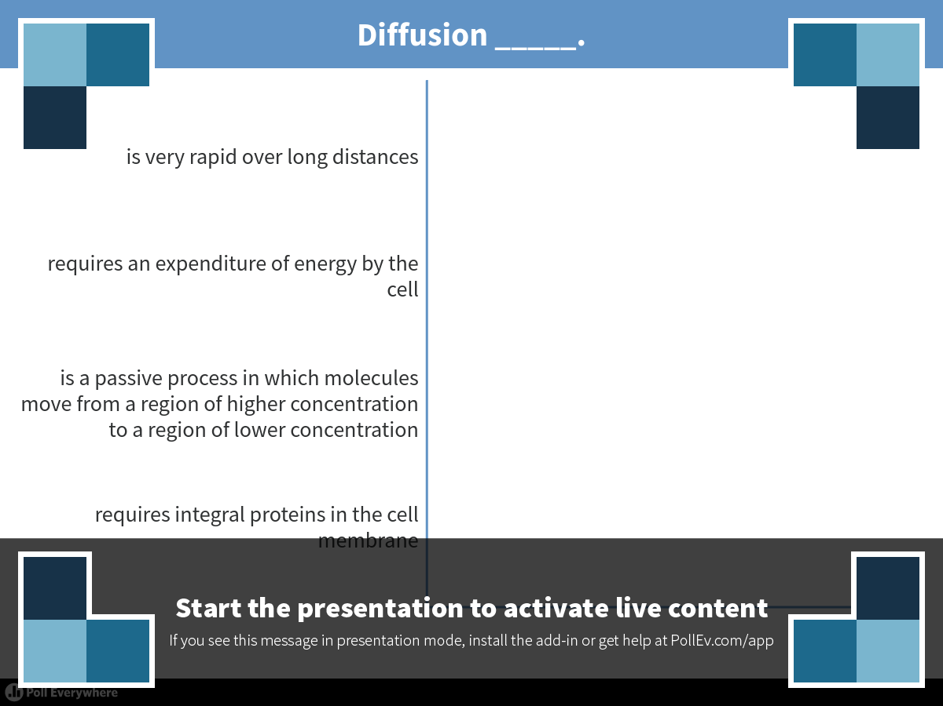
Notes:
Diffusion _____.
https://www.polleverywhere.com/multiple_choice_polls/Y96qL1A3d2yoM2W

Slide 50
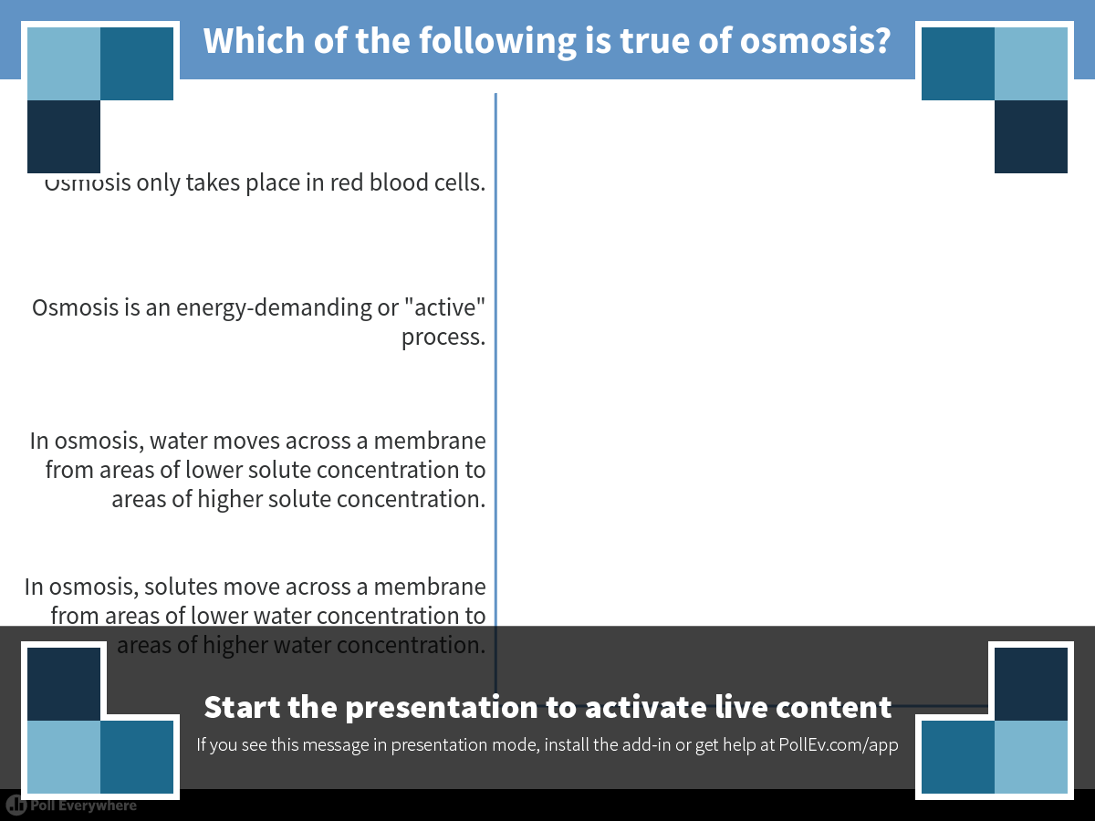
Notes:
Which of the following is true of osmosis?
https://www.polleverywhere.com/multiple_choice_polls/6aFdThN8D6Ibmx1

Slide 51
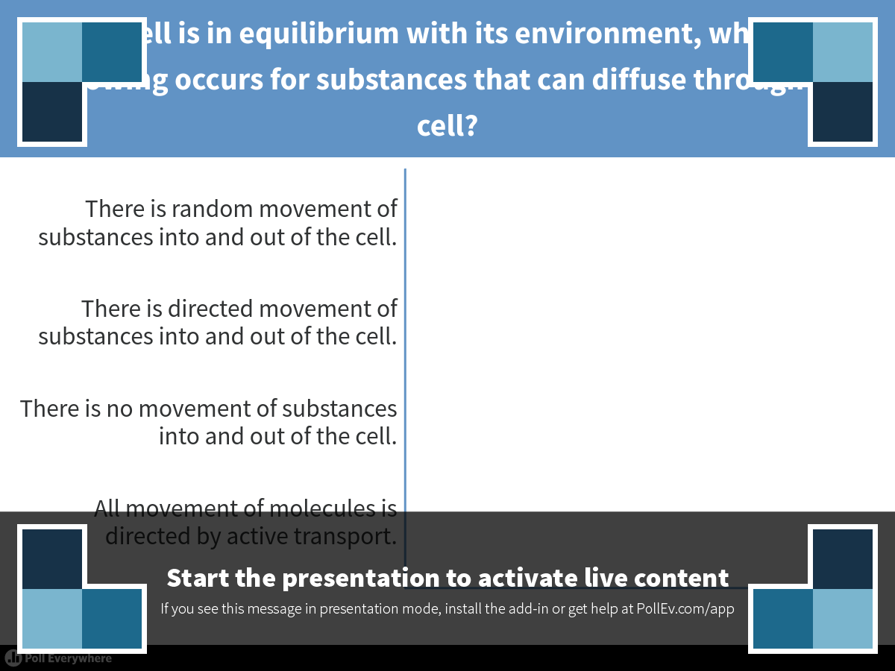
Notes:
When a cell is in equilibrium with its environment, which of the following occurs for substances that can diffuse through the cell?
https://www.polleverywhere.com/multiple_choice_polls/iM3P7hVnfGgaPjU

Slide 52
Overview
Concept 7.1: Cellular membranes are fluid mosaics of lipids and proteins
Concept 7.2: Membrane structure results in selective permeability
Concept 7.3: Passive transport is diffusion of a substance across a membrane with no energy investment
Concept 7.4: Active transport uses energy to move solutes against their gradients
Concept 7.5: Bulk transport across the
plasma membrane occurs by exocytosis and endocytosis

Slide 53
Concept 7.4: Active transport uses energy to move solutes against their gradients
Facilitated diffusion is still passive because the solute moves down its concentration gradient, and the transport requires no energy
Some transport proteins, however, can move solutes AGAINST their concentration gradients

Slide 54
Concept 7.4: Active transport uses energy to move solutes against their gradients
The Need for Energy in Active Transport
Active transport moves substances AGAINST their concentration gradients
  Active transport allows cells to maintain concentration gradients that differ from their surroundings
  Active transport requires energy, usually in the form of ATP
Active transport is performed by specific proteins embedded in the membranes
  The sodium-potassium pump is one type of active transport system

Slide 55
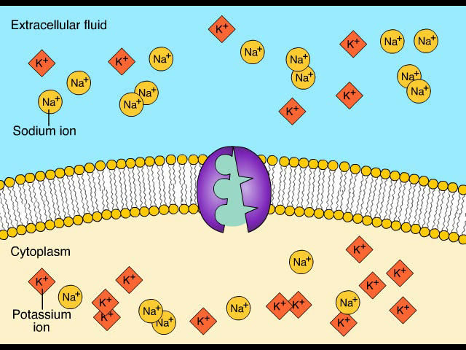
Animation: Active Transport

Slide 56
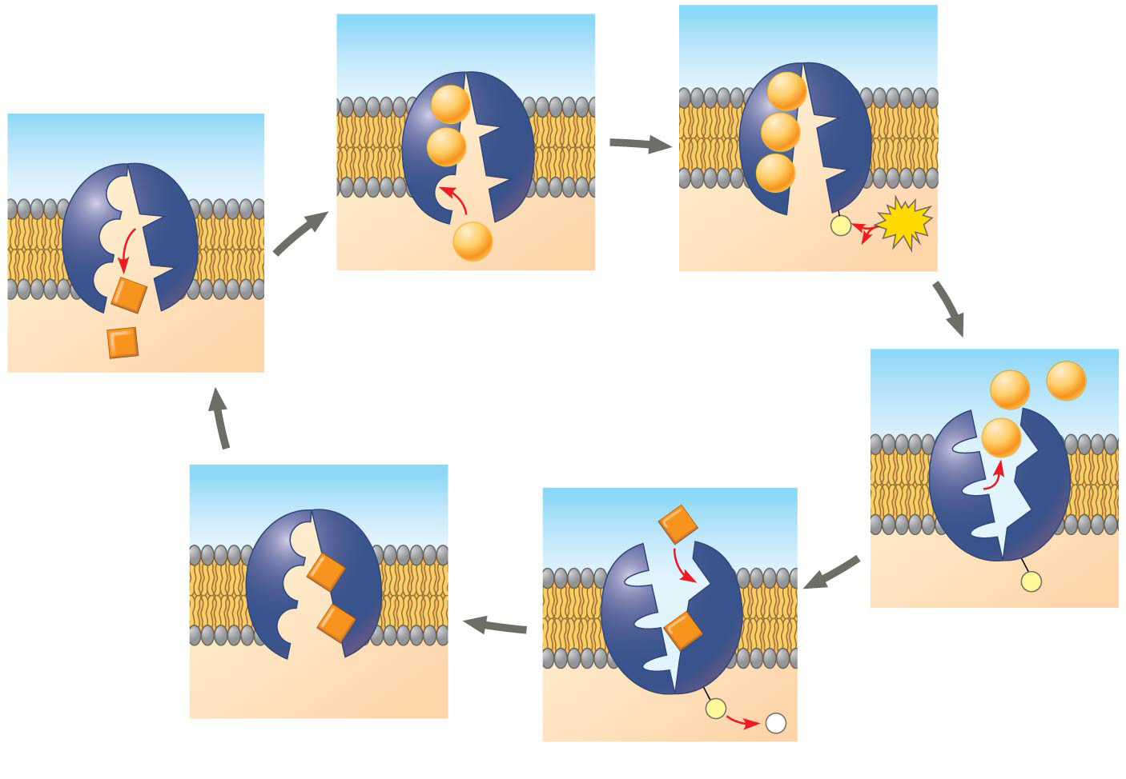
The sodium-potassium pump: a specific case of active transport
EXTRACELLULAR
FLUID
[Na⁺] high
[K⁺] low
Na⁺
Na⁺
Na⁺
Na⁺
Na⁺
Na⁺
[Na⁺] low
[K⁺] high
P
ATP
CYTOPLASM
ADP
K⁺
1
2
K⁺
6
Na⁺
Na⁺
Na⁺
K⁺
K⁺
P
K⁺
K⁺
3
P
P
5
i
4
Notes:
Figure 7.15 The sodium-potassium pump: a specific case of active transport

Slide 57
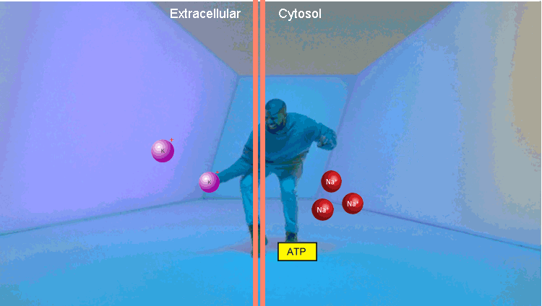

Slide 58
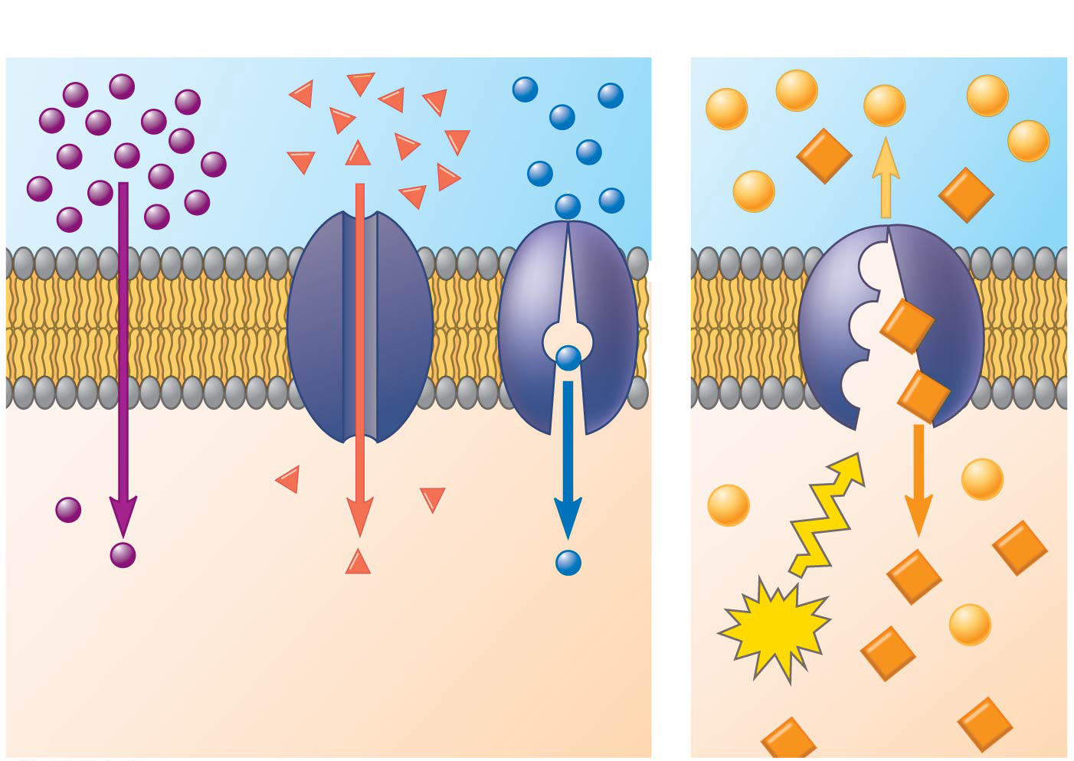
Figure 7.16
Passive transport
Active transport
Diffusion
Facilitated diffusion
ATP
Notes:
Figure 7.16 Review: passive and active transport

Slide 59
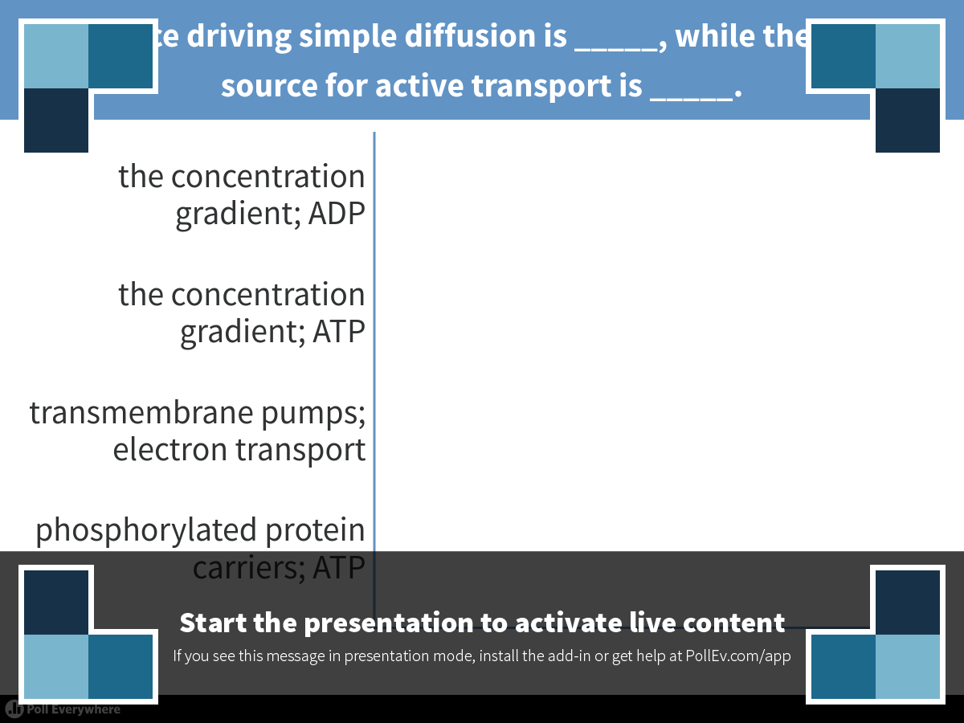
Notes:
The force driving simple diffusion is _____, while the energy source for active transport is _____.
https://www.polleverywhere.com/multiple_choice_polls/NTEtwacE4sHOBPn

Slide 60
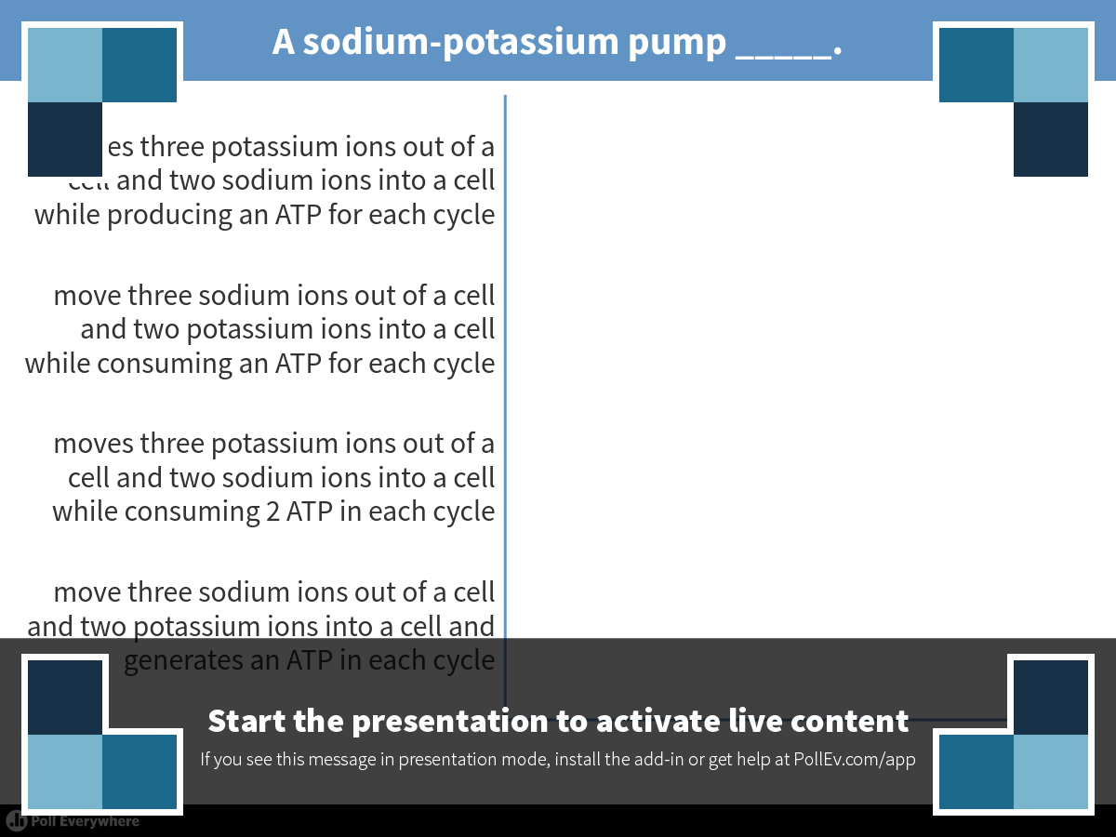
Notes:
A sodium-potassium pump _____.
https://www.polleverywhere.com/multiple_choice_polls/uanNaUEKWqLvucC

Slide 61
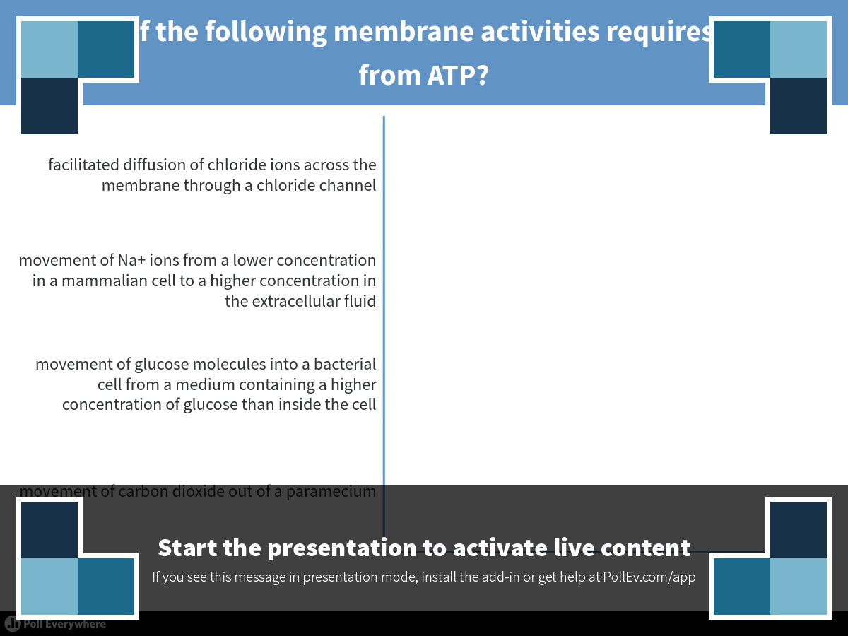
Notes:
Which of the following membrane activities requires energy from ATP?
https://www.polleverywhere.com/multiple_choice_polls/OVvl1YZLPYF9QOI

Slide 62
Overview
Concept 7.1: Cellular membranes are fluid mosaics of lipids and proteins
Concept 7.2: Membrane structure results in selective permeability
Concept 7.3: Passive transport is diffusion of a substance across a membrane with no energy investment
Concept 7.4: Active transport uses energy to move solutes against their gradients
Concept 7.5: Bulk transport across the
plasma membrane occurs by exocytosis and endocytosis

Slide 63
Concept 7.5: Bulk transport across the plasma membrane occurs by exocytosis and endocytosis
Small molecules and water enter or leave the cell through the lipid bilayer or via transport proteins
LARGE molecules, such as polysaccharides and proteins, cross the membrane IN BULK VIA VESICLES
Bulk transport requires energy

Slide 64
Concept 7.5: Bulk transport across the plasma membrane occurs by exocytosis and endocytosis
Exocytosis
In exocytosis, transport vesicles migrate to the membrane, fuse with it, and release their contents OUTSIDE the cell
Many secretory cells use exocytosis to export
their products

Slide 65
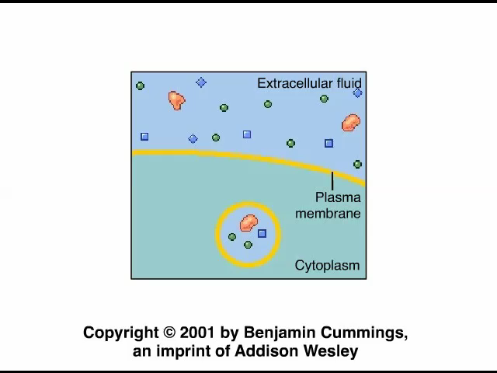
Animation: Exocytosis

Slide 66
Concept 7.5: Bulk transport across the plasma membrane occurs by exocytosis and endocytosis
Endocytosis
In endocytosis, the cell TAKES IN macromolecules by forming vesicles from the plasma membrane
Endocytosis is a reversal of exocytosis, involving different proteins
There are three types of endocytosis
  Phagocytosis (“cellular eating”)
  Pinocytosis (“cellular drinking”)
  Receptor-mediated endocytosis

Slide 67
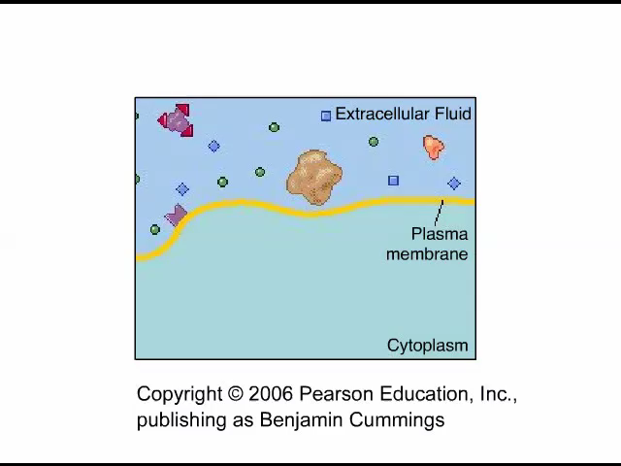
Concept 7.5: Bulk transport across the plasma membrane occurs by exocytosis and endocytosis
In phagocytosis a cell engulfs a particle in a vacuole
  The vacuole fuses with a lysosome to digest the particle

Slide 68
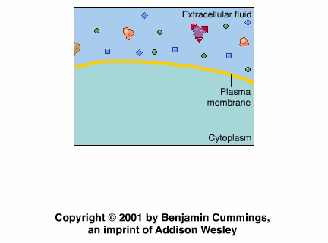
Concept 7.5: Bulk transport across the plasma membrane occurs by exocytosis and endocytosis
In pinocytosis, molecules dissolved in droplets are taken up when extracellular fluid is “gulped” into tiny vesicles

Slide 69
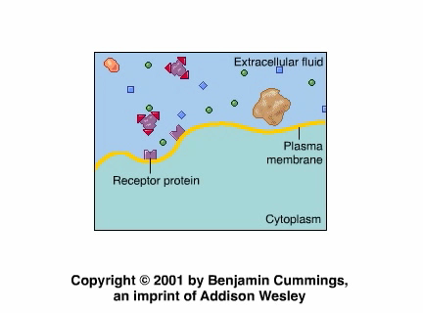
Concept 7.5: Bulk transport across the plasma membrane occurs by exocytosis and endocytosis
In receptor-mediated endocytosis, binding of ligands to receptors triggers vesicle formation
A ligand is any molecule that binds specifically
to a receptor site of another molecule

Slide 70
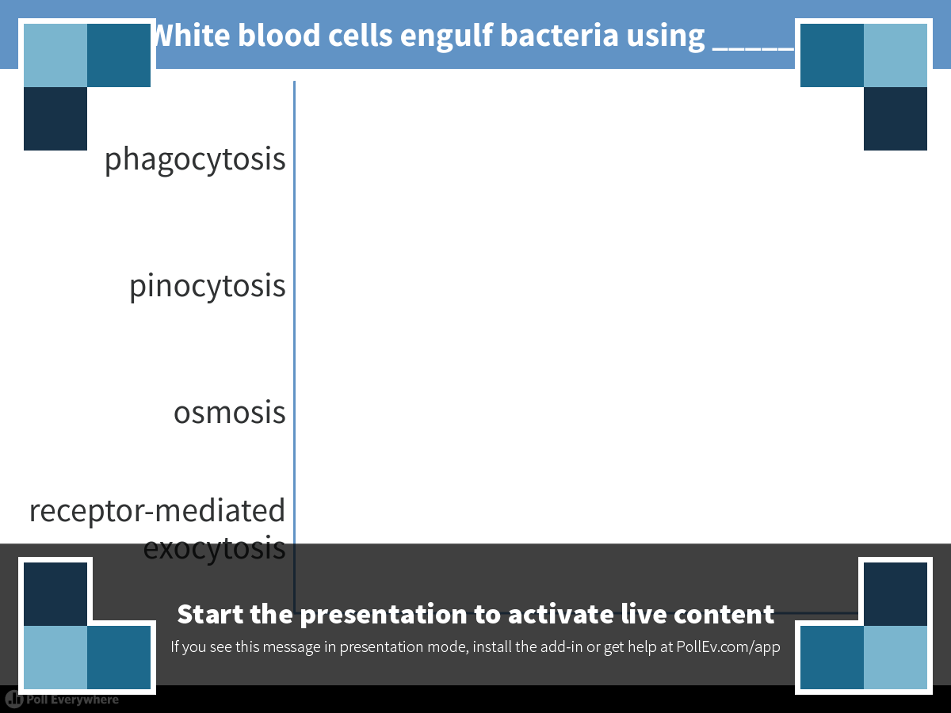
Notes:
White blood cells engulf bacteria using _____.
https://www.polleverywhere.com/multiple_choice_polls/NmbckczpLDwZJWK

Slide 71
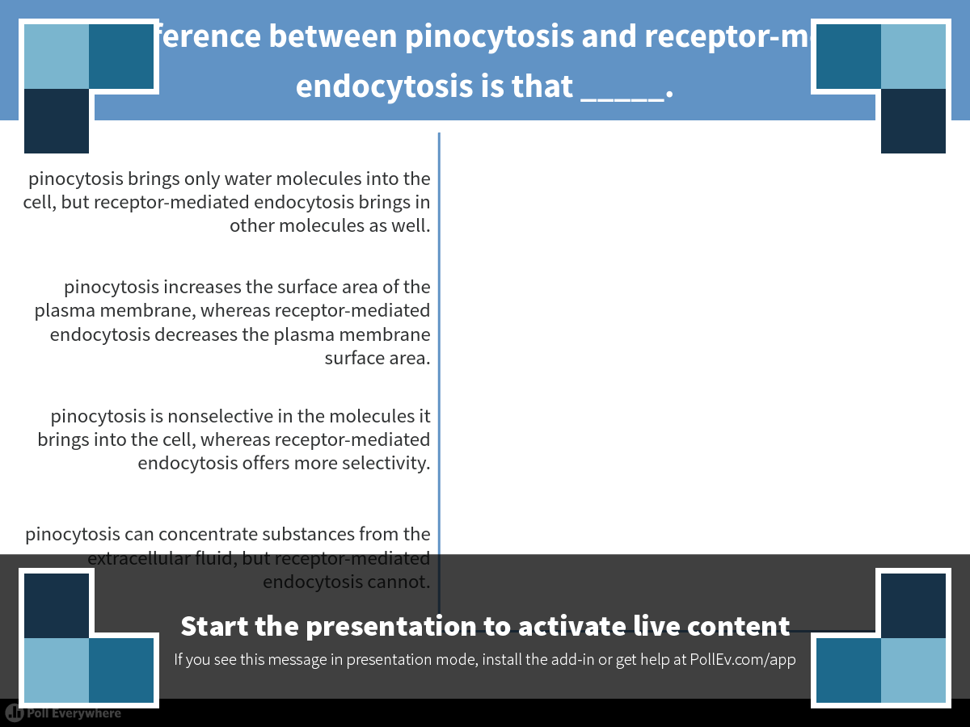
Notes:
The difference between pinocytosis and receptor-mediated endocytosis is that _____.
https://www.polleverywhere.com/multiple_choice_polls/TKOlWLvPkOiiJjv

Slide 72
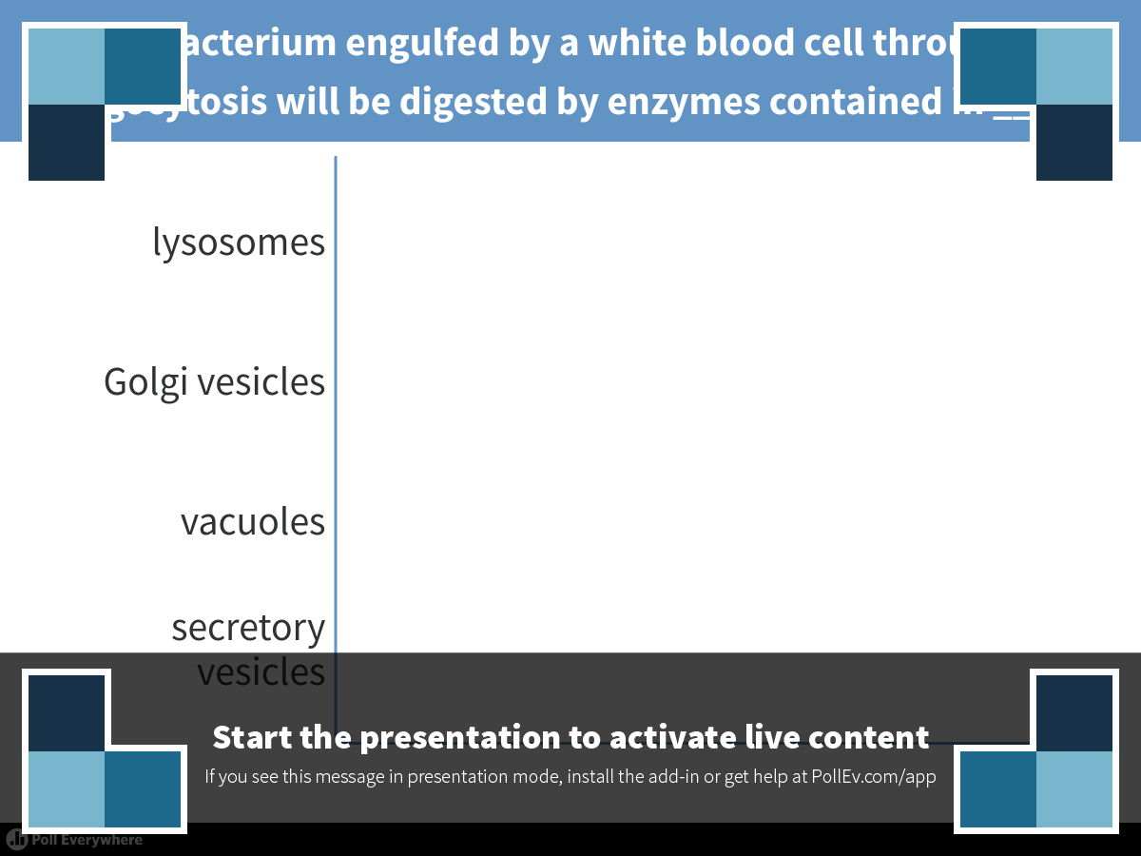
Notes:
A bacterium engulfed by a white blood cell through phagocytosis will be digested by enzymes contained in _____.
https://www.polleverywhere.com/multiple_choice_polls/G0FreW8tYGEnqcy

Slide 73
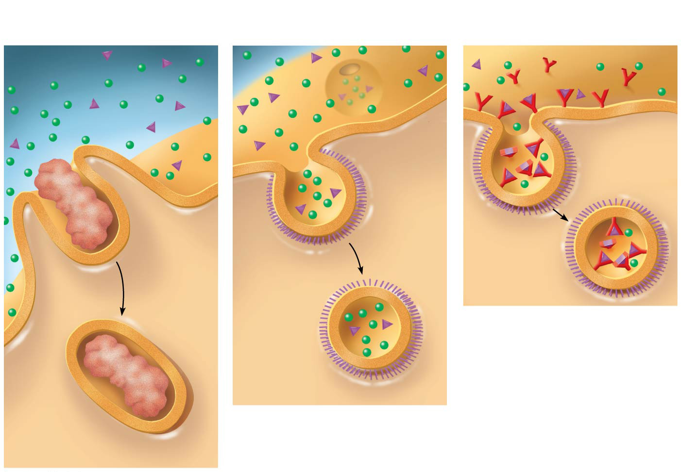
Exploring endocytosis in animal cells
Receptor-Mediated
Endocytosis
Phagocytosis
Pinocytosis
EXTRACELLULAR
FLUID
Solutes
Pseudopodium
Receptor
Plasma
membrane
Coat
protein
“Food”
or
other
particle
Coated
pit
Coated
vesicle
Food
vacuole
CYTOPLASM
Notes:
Figure 7.19 Exploring endocytosis in animal cells

Slide 74
Overview
Concept 7.1: Cellular membranes are fluid mosaics of lipids and proteins
Concept 7.2: Membrane structure results in selective permeability
Concept 7.3: Passive transport is diffusion of a substance across a membrane with no energy investment
Concept 7.4: Active transport uses energy to move solutes against their gradients
Concept 7.5: Bulk transport across the
plasma membrane occurs by exocytosis and endocytosis

