Slide 1
0
4
Carbon and the Molecular Diversity of Life

Slide 2
Do Now
Does CARBON behave as a polar or non-polar atom? Explain using the term “electronegativity.”
C = 4 valence electrons
→NOT electronegative
→sharing of electrons (covalent bond)
→C makes NON-POLAR covalent bonds

Slide 3
Overview
Objective: SWBAT describe why carbon is unparalleled in its ability to form large, complex, and varied molecules due to its chemical properties.
Concept 4.1: Organic chemistry is the study of carbon compounds
Concept 4.2: Carbon atoms can form diverse molecules by bonding to four other atoms
Concept 4.3: A few chemical groups are key to molecular function

Slide 4
Carbon: The Backbone of Life
Living organisms consist mostly of carbon-based compounds
Proteins, DNA, carbohydrates, and other molecules that distinguish living matter are all composed of carbon compounds

Slide 5
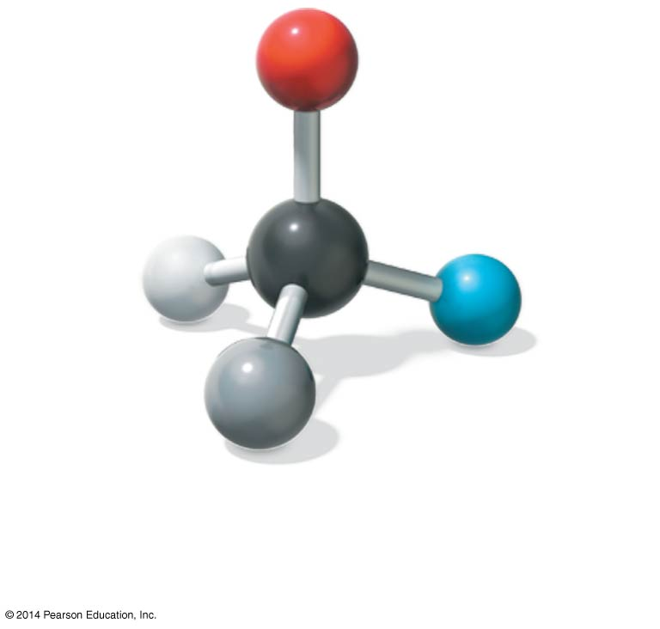
Figure 4.1a
Carbon can bond to four other atoms or
groups of atoms, making a large variety of
molecules possible.
Notes:
Figure 4.1a What properties make carbon the basis of all life? (part 1: carbon atom)

Slide 6
Concept 4.1: Organic chemistry is the study of carbon compounds
Organic chemistry is the study of compounds that contain carbon
Organic compounds range from simple molecules to colossal ones
Most organic compounds contain hydrogen atoms in addition to carbon atoms

Slide 7
Overview
Objective: SWBAT describe why carbon is unparalleled in its ability to form large, complex, and varied molecules due to its chemical properties.
Concept 4.1: Organic chemistry is the study of carbon compounds
Concept 4.2: Carbon atoms can form diverse molecules by bonding to four other atoms
Concept 4.3: A few chemical groups are key to molecular function

Slide 8
Concept 4.2: Carbon atoms can form diverse molecules by bonding to four other atoms
Electron configuration is the key to an atom’s characteristics
Electron configuration determines the kinds and number of bonds an atom will form with other atoms

Slide 9
Concept 4.2: Carbon atoms can form diverse molecules by bonding to four other atoms
The Formation of Bonds with Carbon
With four valence electrons, carbon can form four covalent bonds with a variety of atoms
This ability makes large, complex molecules possible
In molecules with multiple carbons, each carbon bonded to four other atoms has a tetrahedral shape

Slide 10
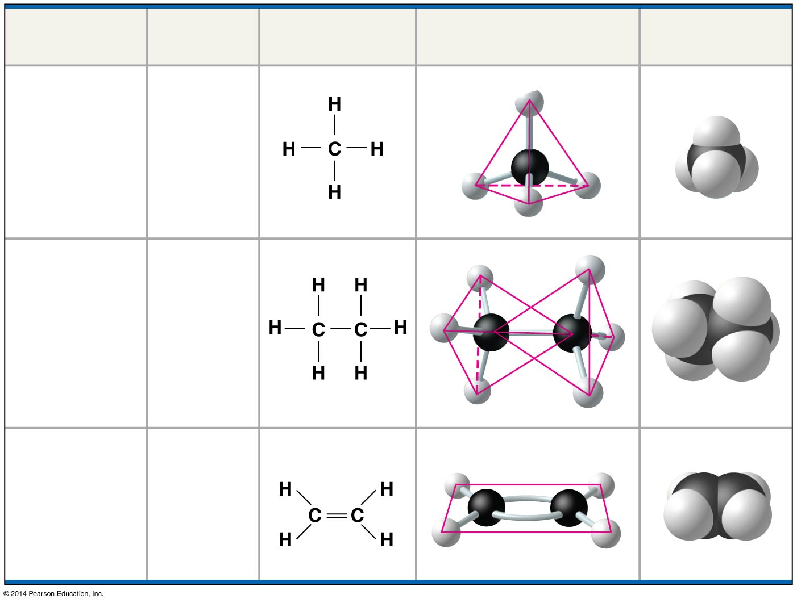
Figure 4.3
Molecule
Molecular
Formula
Structural
Formula
Ball-and-Stick Model
Space-Filling
Model
(a) Methane
CH₄
(b) Ethane
C₂H₆
(c) Ethene
(ethylene)
C₂H₄
Notes:
Figure 4.3 The shapes of three simple organic molecules

Slide 11
Concept 4.2: Carbon atoms can form diverse molecules by bonding to four other atoms
The electron configuration of carbon gives it covalent compatibility with many different elements
The valences of carbon and its most frequent partners (hydrogen, oxygen, and nitrogen) are the building code for the architecture of living molecules

Slide 12
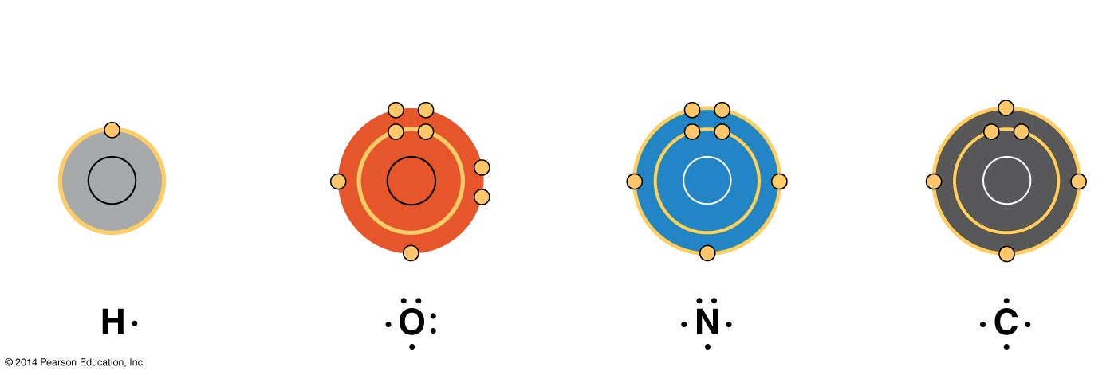
Figure 4.4
Hydrogen
(valence = 1)
Oxygen
(valence = 2)
Nitrogen
(valence = 3)
Carbon
(valence = 4)
Notes:
Figure 4.4 Valences of the major elements of organic molecules

Slide 13
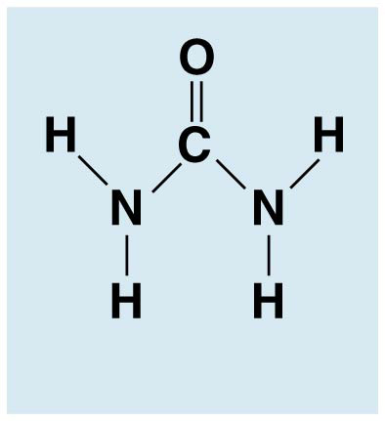
Concept 4.2: Carbon atoms can form diverse molecules by bonding to four other atoms
Carbon atoms can partner with atoms other than hydrogen; for example:
Carbon dioxide: CO₂
Urea: CO(NH₂)₂

Slide 14
Concept 4.2: Carbon atoms can form diverse molecules by bonding to four other atoms
Molecular Diversity Arising from Variation in Carbon Skeletons
Carbon chains form the skeletons of most organic molecules
Carbon chains vary in length and shape

Slide 15
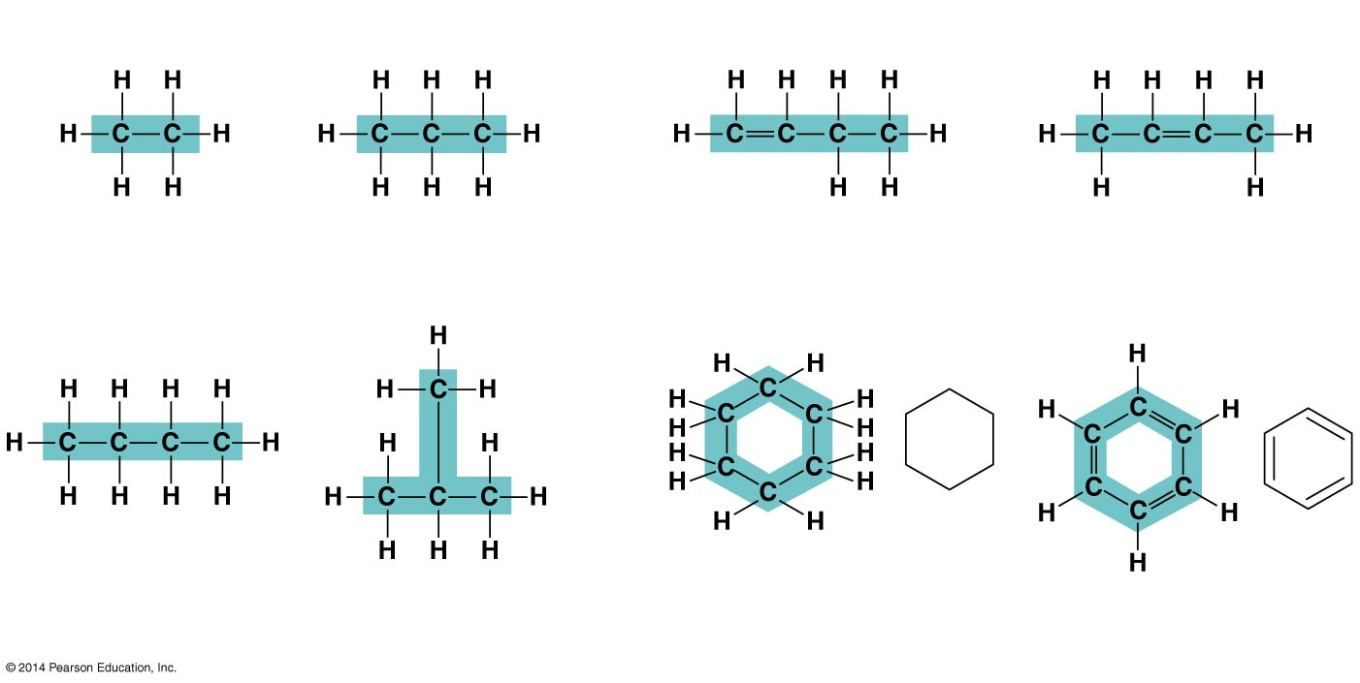
Figure 4.5
(a) Length
(c) Double bond position
Ethane
Propane
1-Butene
2-Butene
(b) Branching
(d) Presence of rings
Butane
2-Methylpropane
(isobutane)
Cyclohexane
Benzene
Notes:
Figure 4.5 Four ways that carbon skeletons can vary

Slide 16
Concept 4.2: Carbon atoms can form diverse molecules by bonding to four other atoms
Hydrocarbons are organic molecules consisting of only carbon and hydrogen
Many organic molecules, such as fats, have hydrocarbon components
Hydrocarbons can undergo reactions that release a large amount of energy

Slide 17
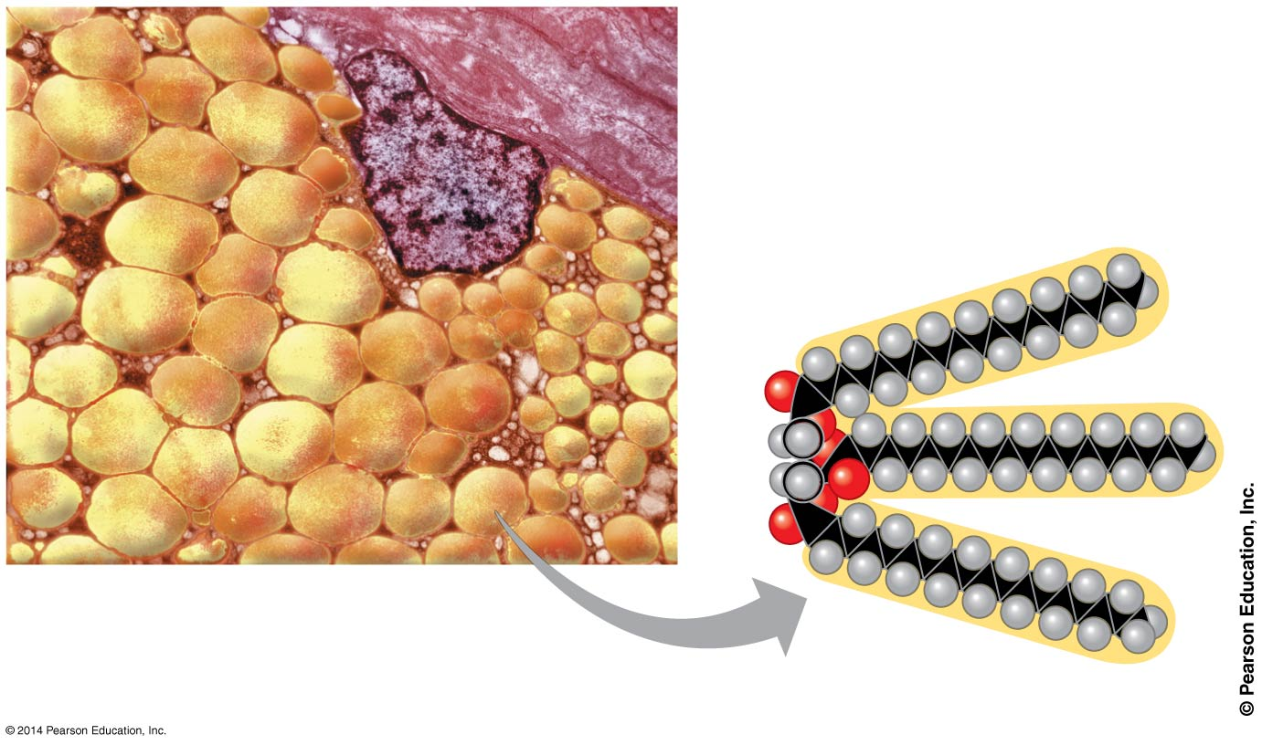
Figure 4.6
Nucleus
Fat droplets
10 μm
(a) Part of a human adipose cell
(b) A fat molecule
Notes:
Figure 4.6 The role of hydrocarbons in fats

Slide 18
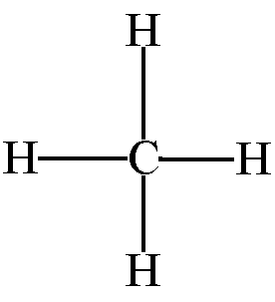
Let’s make a hydrocarbon!
CH4 = Methane gas

Slide 19
Concept 4.2: Carbon atoms can form diverse molecules by bonding to four other atoms
Isomers are compounds with the same molecular formula but different structures and properties
Structural isomers have different covalent arrangements of their atoms
Cis-trans isomers have the same covalent bonds but differ in spatial arrangements
Enantiomers are isomers that are mirror images of each other

Slide 20
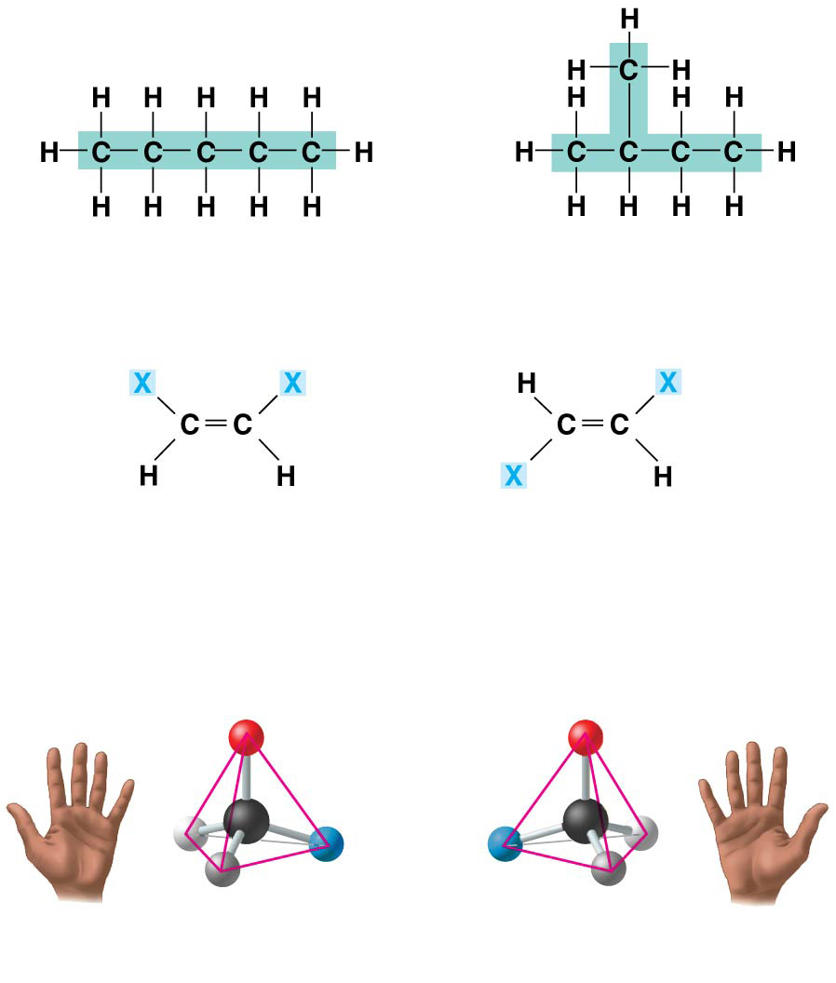
Figure 4.7
(a) Structural isomers
Pentane
2-methyl butane
(b) Cis-trans isomers
cis isomer: The two Xs are
on the same side.
trans isomer: The two Xs are
on opposite sides.
(c) Enantiomers
CO₂H
CO₂H
C
C
H
NH₂
NH₂
H
CH₃
CH₃
L isomer
D isomer
Notes:
Figure 4.7 Three types of isomers, compounds with the same molecular formula but different structures

Slide 21
Group Activity
Examine each of the molecules you’ve been given in your groups.
What atoms are present?
How many atoms are there?
Are these two molecules isomers? How do you know?
Write your answers in your notes.

Slide 22
Overview
Objective: SWBAT describe why carbon is unparalleled in its ability to form large, complex, and varied molecules due to its chemical properties.
Concept 4.1: Organic chemistry is the study of carbon compounds
Concept 4.2: Carbon atoms can form diverse molecules by bonding to four other atoms
Concept 4.3: A few chemical groups are key to molecular function

Slide 23
Concept 4.3: A few chemical groups are key to molecular function
Distinctive properties of organic molecules depend on the carbon skeleton and on the chemical groups attached to it
A number of characteristic groups can replace the hydrogens attached to skeletons of organic molecules

Slide 24
Concept 4.3: A few chemical groups are key to molecular function
The Chemical Groups Most Important in the Processes of Life
Estradiol and testosterone are both steroids with a common carbon skeleton, in the form of four fused rings
These sex hormones differ only in the chemical groups attached to the rings of the carbon skeleton

Slide 25
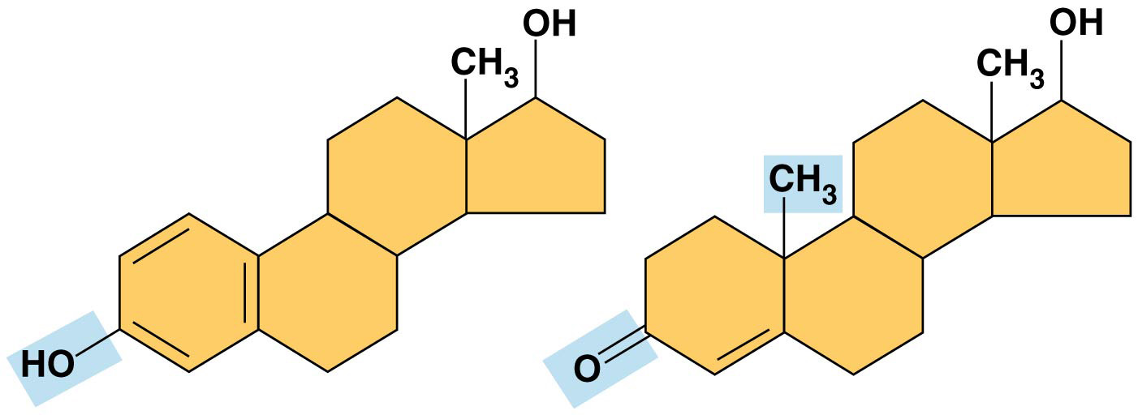
Figure 4.UN03
Estradiol
Testosterone
Notes:
Figure 4.UN03 In-text figure, sex hormones, p. 62

Slide 26
Concept 4.3: A few chemical groups are key to molecular function
The Chemical Groups Most Important in the Processes of Life
Functional groups are the components of organic molecules that are most commonly involved in chemical reactions
The number and arrangement of functional groups give each molecule its unique properties

Slide 27
Concept 4.3: A few chemical groups are key to molecular function
The seven functional groups that are most important in the chemistry of life
Hydroxyl group
Carbonyl group
Carboxyl group
Amino group
Sulfhydryl group
Phosphate group
Methyl group

Slide 28
Figure 4.9aa
Hydroxyl group (—OH)
Ethanol, the alcohol
present
in alcoholic
beverages
(may be written HO—)
Polar due to electronegative oxygen. Forms hydrogen bonds with water.
Compound name: Alcohol
Notes:
Figure 4.9aa Some biologically important chemical groups (part 1a: hydroxyl)

Slide 29
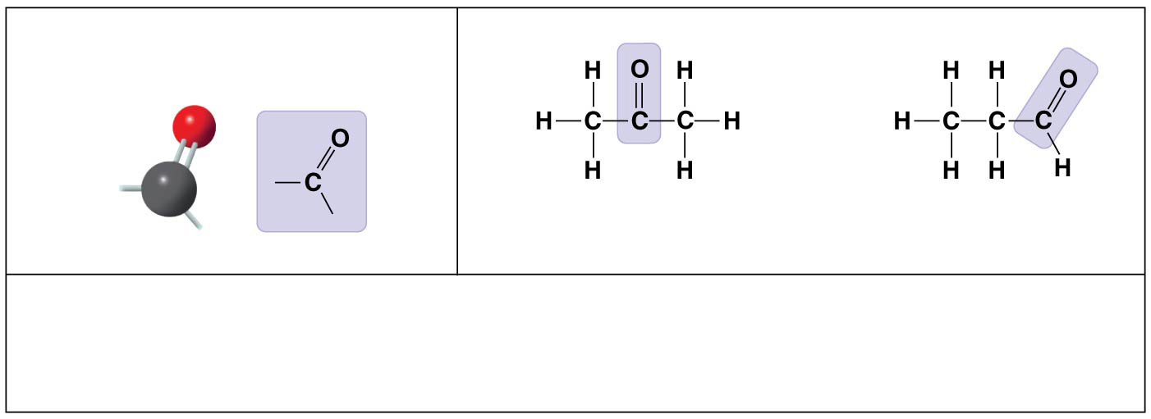
Figure 4.9ab
Carbonyl group
—
( C＝O)
—
Acetone,
the simplest ketone
Propanal,
an aldehyde
Sugars with ketone groups are called ketoses; those with aldehydes
are called aldoses.
Compound name: Ketone or aldehyde
Notes:
Figure 4.9ab Some biologically important chemical groups (part 1b: carbonyl)

Slide 30
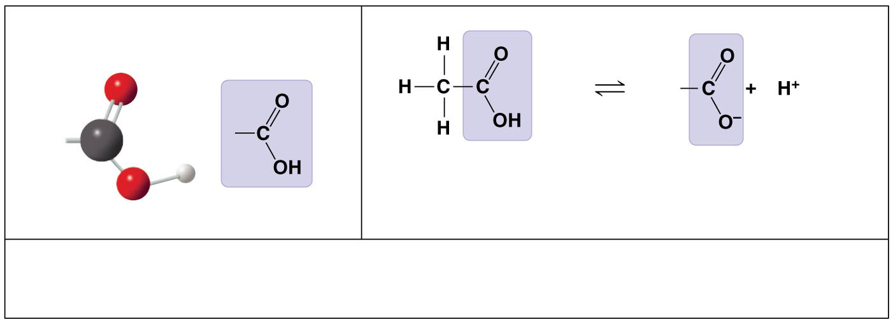
Figure 4.9ac
Carboxyl group (—COOH)
Acetic acid, which
gives vinegar its
sour taste
Ionized form of —COOH
(carboxylate ion),
found in cells
Acts as an acid.
Compound name: Carboxylic acid, or organic acid
Notes:
Figure 4.9ac Some biologically important chemical groups (part 1c: carboxyl)

Slide 31
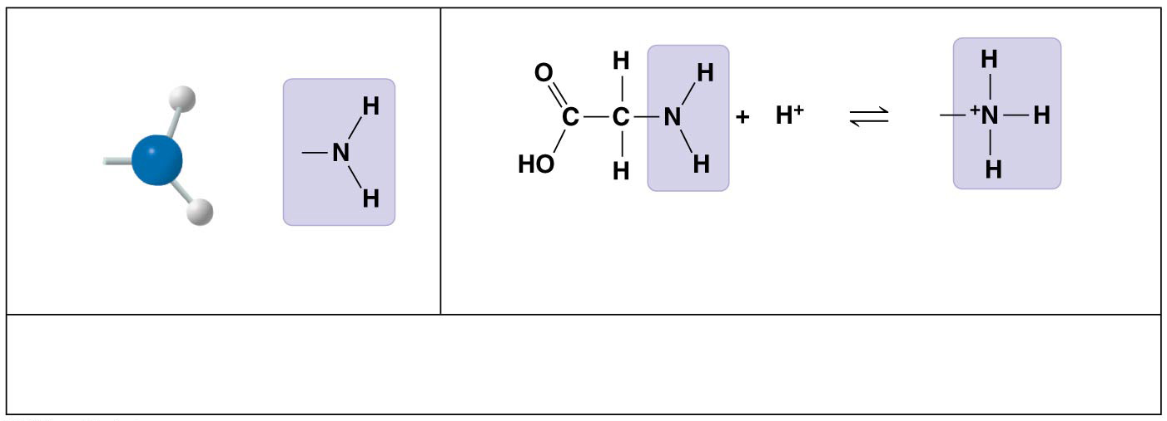
Figure 4.9ad
Amino group (—NH₂)
Glycine, an amino acid
(note its carboxyl group)
Ionized form
of —NH₂,
found in cells
Acts as a base.
Compound name: Amine
Notes:
Figure 4.9ad Some biologically important chemical groups (part 1d: amino)

Slide 32
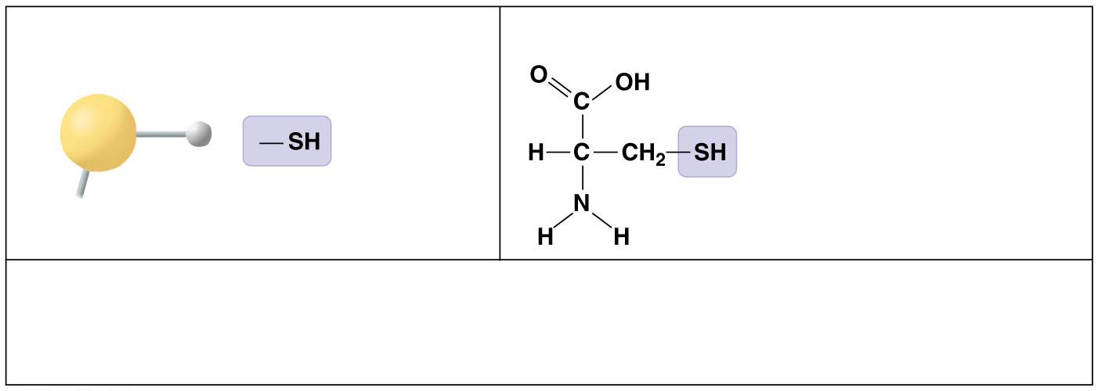
Figure 4.9ba
Sulfhydryl group (—SH)
Cysteine, a sulfur-
containing amino acid
(may be written HS—)
Two —SH groups can react, forming a “cross-link” that helps stabilize
protein structure.
Compound name: Thiol
Notes:
Figure 4.9ba Some biologically important chemical groups (part 2a: sulfhydryl)

Slide 33
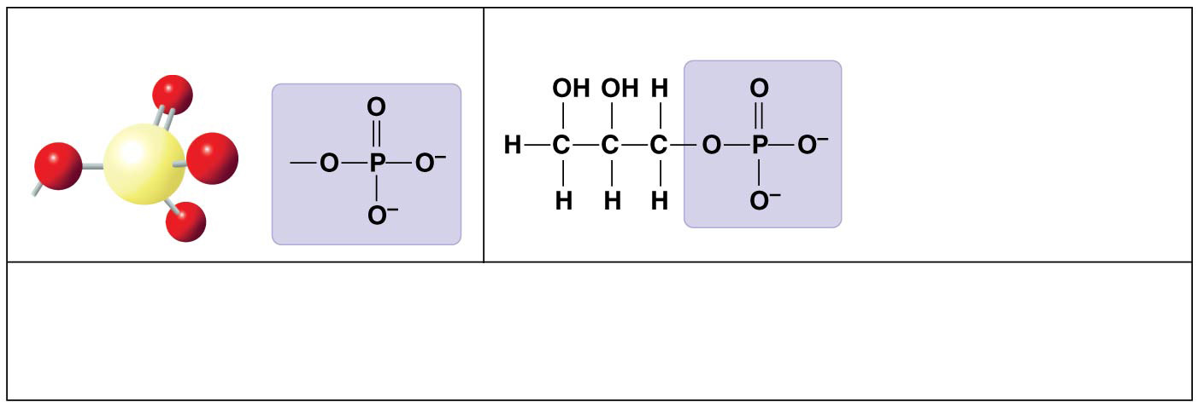
Figure 4.9bb
Phosphate group (—OPO₃²⁻)
Glycerol phosphate,
which takes part in
many important
chemical reactions in
cells
Contributes negative charge. When attached, confers on a molecule the ability
to react with water, releasing energy.
Compound name: Organic phosphate
Notes:
Figure 4.9bb Some biologically important chemical groups (part 2b: phosphate)

Slide 34
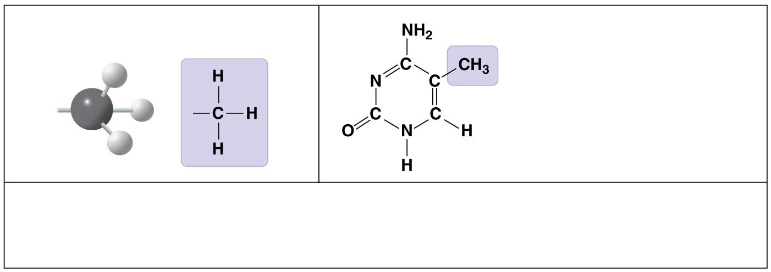
Figure 4.9bc
Methyl group (—CH₃)
5-Methyl cytosine, a
component of DNA
that has been modified
by addition of a methyl
group
Affects the expression of genes. Affects the shape and function of
sex hormones.
Compound name: Methylated compound
Notes:
Figure 4.9bc Some biologically important chemical groups (part 2c: methyl)

Slide 35
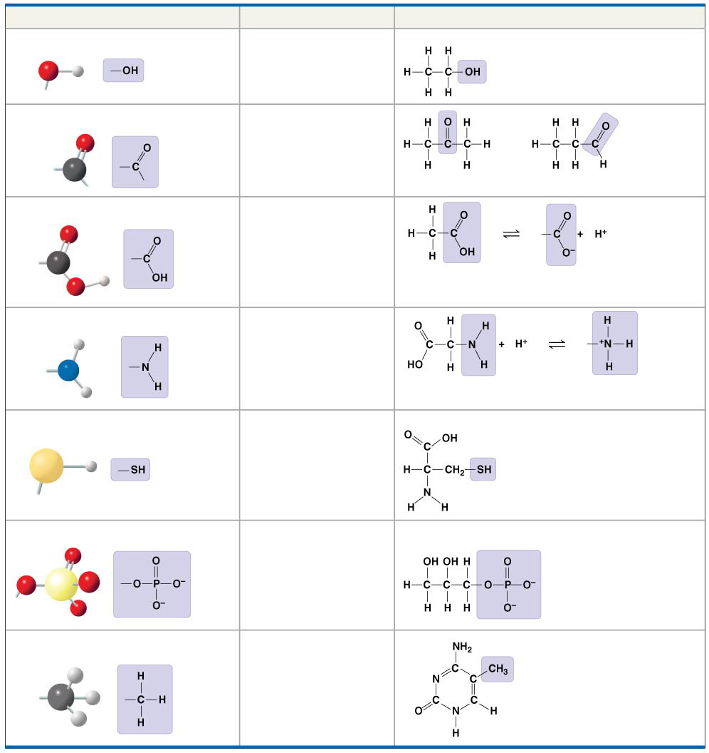
Figure 4.9
Chemical Group
Compound Name
Examples
Hydroxyl group (—OH)
Alcohol
Ethanol
Carbonyl group
—
Ketone
Aldehyde
( C＝O)
—
Acetone
Propanal
Carboxyl group (—COOH)
Carboxylic acid, or
organic acid
Acetic acid
Amino group (—NH₂)
Amine
Glycine
Sulfhydryl group (—SH)
Thiol
Cysteine
Phosphate group (—OPO₃²⁻)
Organic
phosphate
Glycerol phosphate
Methyl group (—CH₃)
Methylated
compound
5-Methyl cytosine
Notes:
Figure 4.9 Some biologically important chemical groups

Slide 36
Group Activity
Examine each of the molecules from the previous activity in groups.
What functional group(s) is/are present? Write your answer in your notes.

Slide 37
Concept 4.3: A few chemical groups are key to molecular function
ATP: An Important Source of Energy for Cellular Processes
An important organic phosphate is adenosine triphosphate (ATP)
ATP consists of an organic molecule called adenosine attached to a string of three phosphate groups
ATP stores the potential to react with water, a reaction that releases energy to be used by the cell

Slide 38
Figure 4.UN04
Adenosine
Notes:
Figure 4.UN04 In-text figure, ATP phosphate chain, p. 64

Slide 39
Overview
Objective: SWBAT describe why carbon is unparalleled in its ability to form large, complex, and varied molecules due to its chemical properties.
Concept 4.1: Organic chemistry is the study of carbon compounds
Concept 4.2: Carbon atoms can form diverse molecules by bonding to four other atoms
Concept 4.3: A few chemical groups are key to molecular function

Slide 40
The Chemical Elements of Life: A Review
The versatility of carbon makes possible the great diversity of organic molecules
Variation at the molecular level lies at the foundation of all biological diversity
Exit Ticket:
Create a HYDROCARBON with ONE of the functional groups we discussed.

