Slide 1
0
3
Water and Life

Slide 2
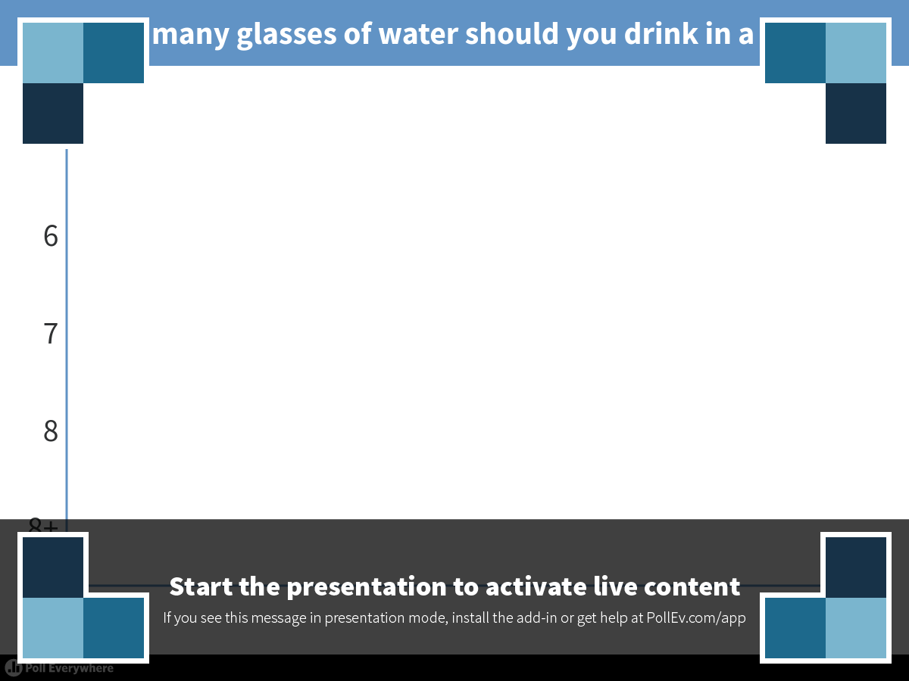
Notes:
How many glasses of water should you drink in a day?
https://www.polleverywhere.com/multiple_choice_polls/L5O4GcLCLmVUYxN

Slide 3

The Universal Elixir of Life
Water is the biological medium on Earth
Water is the only common substance to exist in the natural environment in all three physical states of matter
The STRUCTURE of the water molecule allows it to interact with other molecules
Water’s unique emergent properties help make Earth suitable for life

Slide 4
Overview
Concept 3.1: Polar covalent bonds in water molecules result in hydrogen bonding
Concept 3.2: Four emergent properties of water contribute to Earth’s suitability for life
Concept 3.3: Acidic and basic conditions affect living organisms

Slide 5
Overview
Concept 3.1: Polar covalent bonds in water molecules result in hydrogen bonding
Concept 3.2: Four emergent properties of water contribute to Earth’s suitability for life
Concept 3.3: Acidic and basic conditions affect living organisms

Slide 6
Concept 3.1: Polar covalent bonds in water molecules result in hydrogen bonding
In the water molecule, the electrons of the polar covalent bonds spend more time near the oxygen than the hydrogen (why?)
The water molecule is thus a polar molecule:
the overall charge is UNEVENLY distributed
  Polarity allows water molecules to form hydrogen bonds with each other

Slide 7
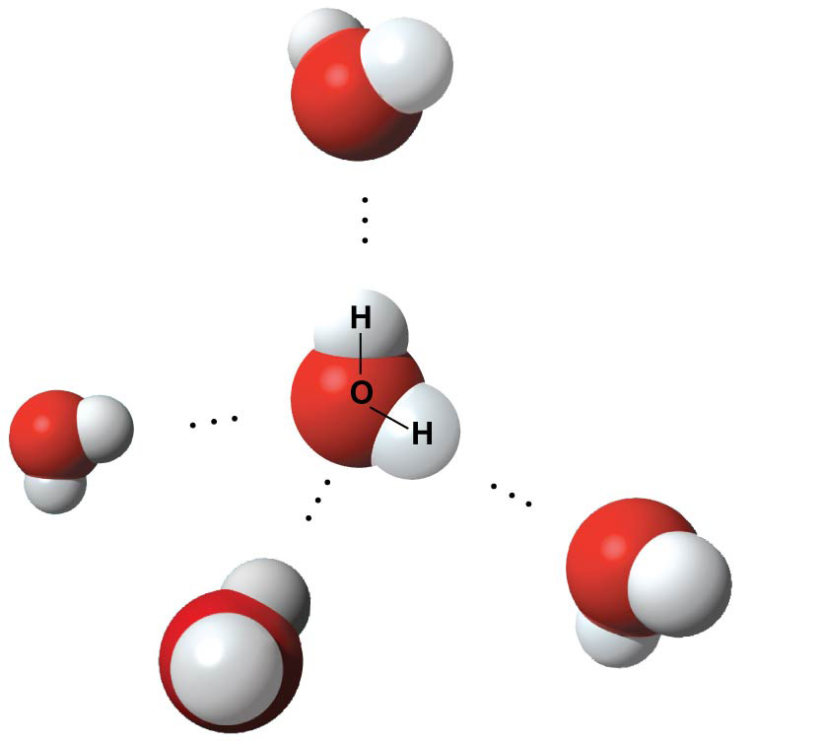
Figure 3.2
δ−
Hydrogen
bond
δ+
Polar covalent
bonds
δ+
δ−
δ−
δ+
δ+
δ−
Notes:
Figure 3.2 Hydrogen bonds between water molecules

Slide 8
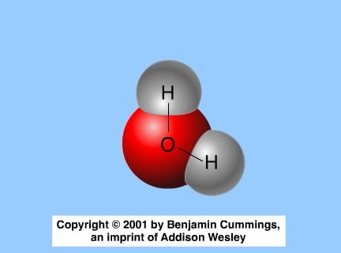
Animation: Water Structure

Slide 9
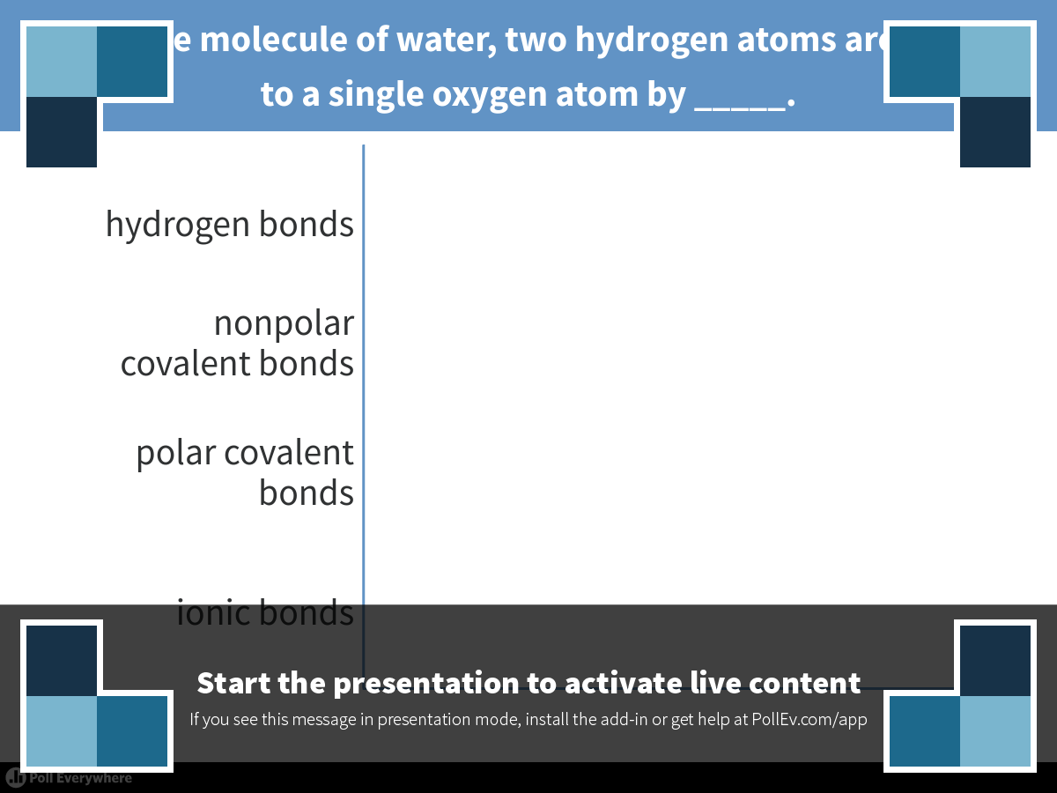
Notes:
In a single molecule of water, two hydrogen atoms are bonded to a single oxygen atom by _____.
https://www.polleverywhere.com/multiple_choice_polls/xUm8quVRFxA80tV

Slide 10
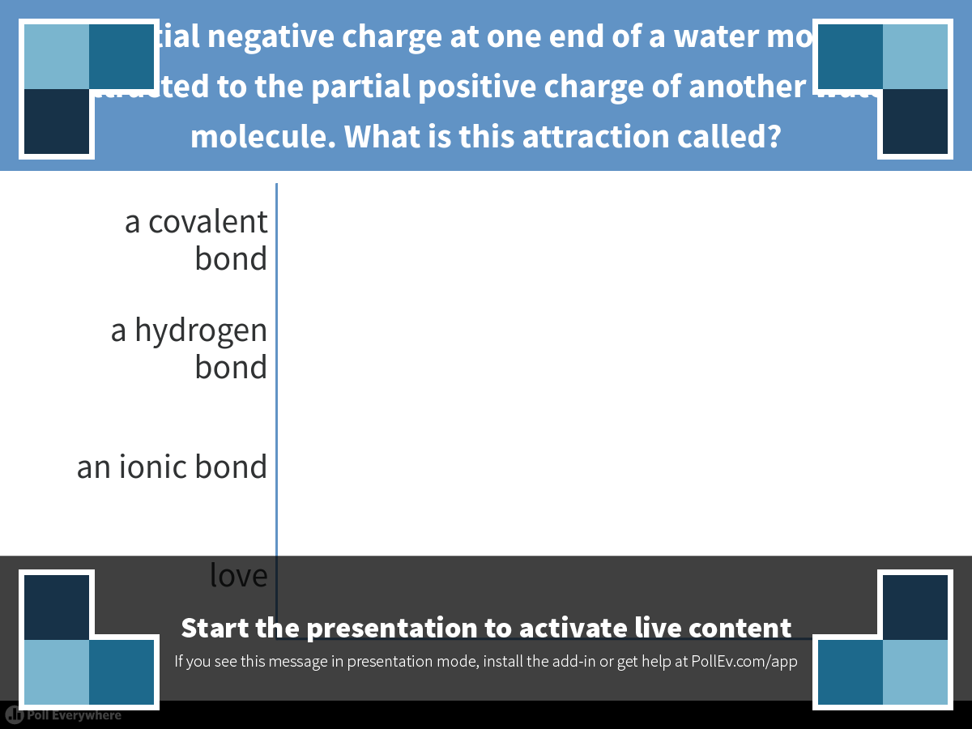
Notes:
The partial negative charge at one end of a water molecule is attracted to the partial positive charge of another water molecule. What is this attraction called?
https://www.polleverywhere.com/multiple_choice_polls/iJxibHjsbr1ZAVk

Slide 11
Overview
Concept 3.1: Polar covalent bonds in water molecules result in hydrogen bonding
Concept 3.2: Four emergent properties of water contribute to Earth’s suitability for life
Concept 3.3: Acidic and basic conditions affect living organisms

Slide 12
Concept 3.2: Four emergent properties of water contribute to Earth’s suitability for life
Four of water’s properties that facilitate an environment for life are…
  Cohesive/adhesive behavior
  Ability to moderate temperature
  Expansion upon freezing
  Versatility as a solvent

Slide 13
Concept 3.2: Four emergent properties of water contribute to Earth’s suitability for life
Four of water’s properties that facilitate an environment for life are…
  Cohesive/adhesive behavior
  Ability to moderate temperature
  Expansion upon freezing
  Versatility as a solvent

Slide 14
Concept 3.2: Four emergent properties of water contribute to Earth’s suitability for life
1. Cohesive/adhesive behavior
Collectively, hydrogen bonds hold water molecules together, a phenomenon called cohesion
  Cohesion helps the transport of water AGAINST GRAVITY in plants
Adhesion is an attraction between DIFFERENT substances
  E.g. between water and plant cell walls

Slide 15
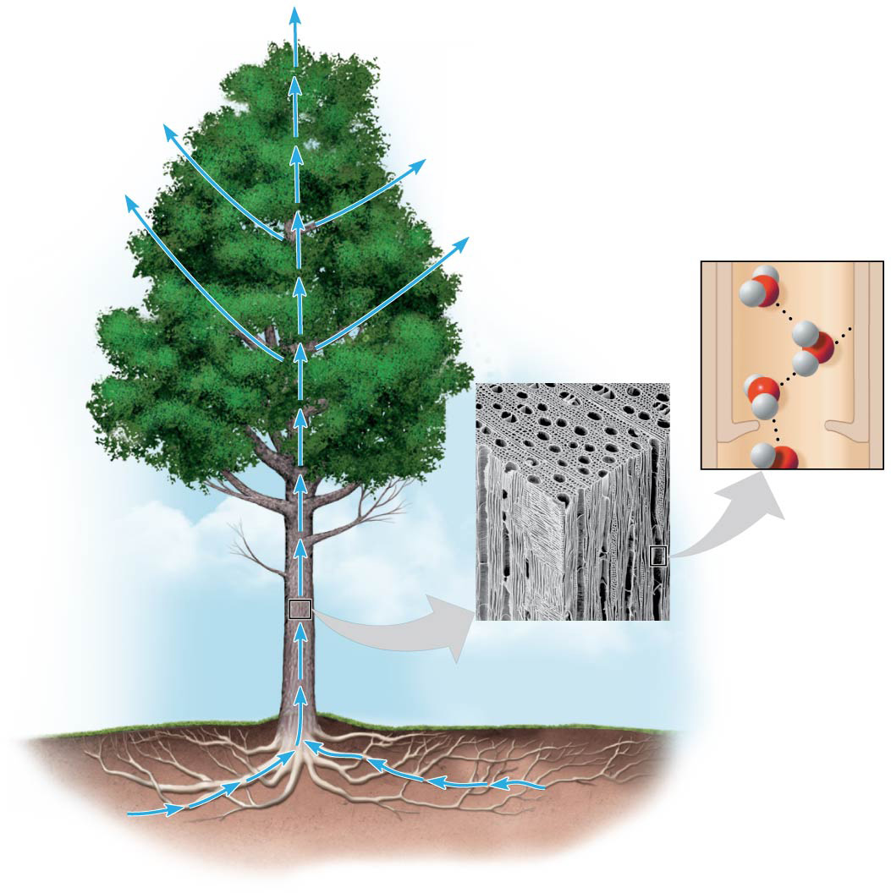
Figure 3.3
H₂O
Adhesion
Two types
of water-
conducting
cells
Direction
of water
movement
Cohesion
300 μm
H₂O
H₂O
Notes:
Figure 3.3 Water transport in plants

Slide 16
Concept 3.2: Four emergent properties of water contribute to Earth’s suitability for life
Four of water’s properties that facilitate an environment for life are…
  Cohesive/adhesive behavior
  Ability to moderate temperature
  Expansion upon freezing
  Versatility as a solvent

Slide 17
Concept 3.2: Four emergent properties of water contribute to Earth’s suitability for life
2. Ability to moderate temperature
Water resists changing its temperature because of its HIGH SPECIFIC HEAT
  Heat is absorbed when hydrogen bonds break
  Heat is released when hydrogen bonds form
The high specific heat of water minimizes temperature fluctuations to within limits that
permit life

Slide 18

Temperatures for the Pacific Ocean and Southern California on an August day
Burbank
90°
San Bernardino
100°
Santa Barbara 73°
Los Angeles
(Airport) 75°
Riverside 96°
Santa Ana
84°
70s (°F)
80s
90s
100s
Palm Springs
106°
Pacific Ocean 68°
San Diego 72°
40 miles
Notes:
Figure 3.5 Temperatures for the Pacific Ocean and Southern California on an August day

Slide 19
Concept 3.2: Four emergent properties of water contribute to Earth’s suitability for life
2. Ability to moderate temperature
Evaporation = transformation from liquid → gas
  Water = HIGH heat of vaporization = heat a liquid must absorb for 1 g to be converted to gas
As a liquid evaporates, its remaining surface cools → “evaporative cooling”
  Helps STABILIZE temperatures in organisms and bodies of water

Slide 20
Concept 3.2: Four emergent properties of water contribute to Earth’s suitability for life
Four of water’s properties that facilitate an environment for life are…
  Cohesive/adhesive behavior
  Ability to moderate temperature
  Expansion upon freezing
  Versatility as a solvent

Slide 21
Concept 3.2: Four emergent properties of water contribute to Earth’s suitability for life
  3. Expansion upon freezing = ice floats in water
Ice floats in liquid water because hydrogen bonds in ice are more “ordered,” making ICE LESS DENSE THAN WATER
If ice sank, all bodies of water would eventually freeze solid, making life impossible on Earth

Slide 22
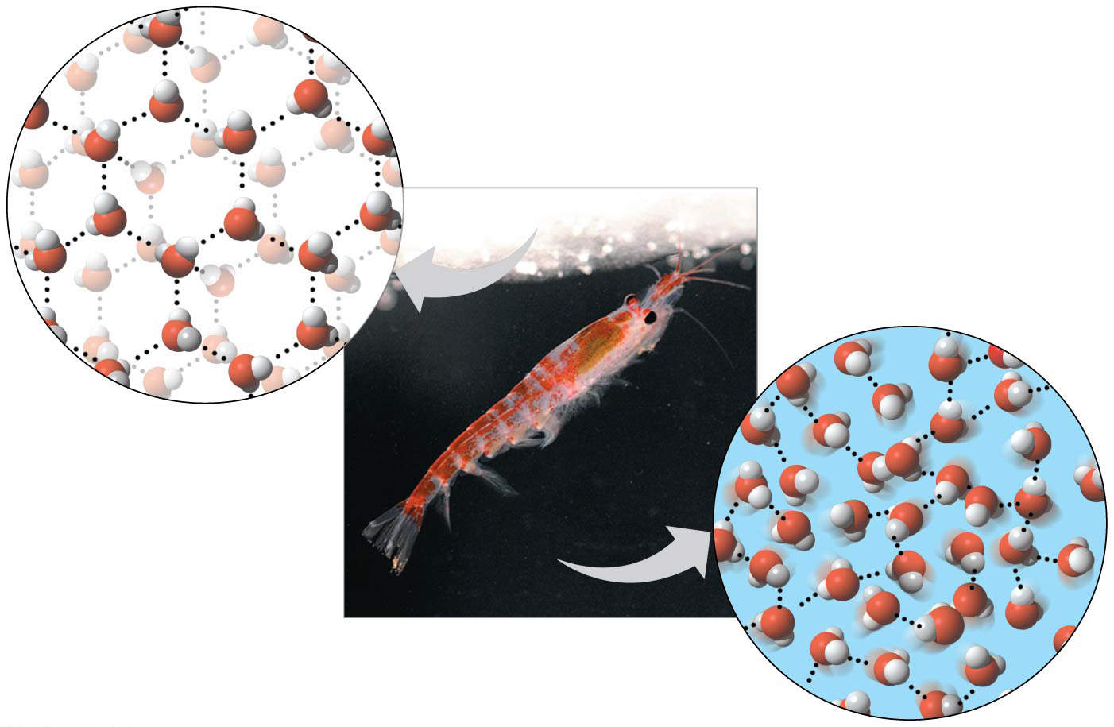
Figure 3.6
Hydrogen bond
Liquid water:
Hydrogen bonds
break and re-form
Ice:
Hydrogen bonds
are stable
Notes:
Figure 3.6 Ice: crystalline structure and floating barrier

Slide 23
Concept 3.2: Four emergent properties of water contribute to Earth’s suitability for life
Four of water’s properties that facilitate an environment for life are…
  Cohesive/adhesive behavior
  Ability to moderate temperature
  Expansion upon freezing
  Versatility as a solvent

Slide 24
Concept 3.2: Four emergent properties of water contribute to Earth’s suitability for life
  4. Versatility as a solvent – the solvent of life
Solution = completely homogeneous liquid mixture of substances
  Solvent = DISSOLVING agent of a solution
  Solute = substance that is dissolved
Aqueous solution → water = solvent
  Water is a versatile solvent due to its polarity
  Most chemical reactions in organisms involve solutes dissolved in water

Slide 25
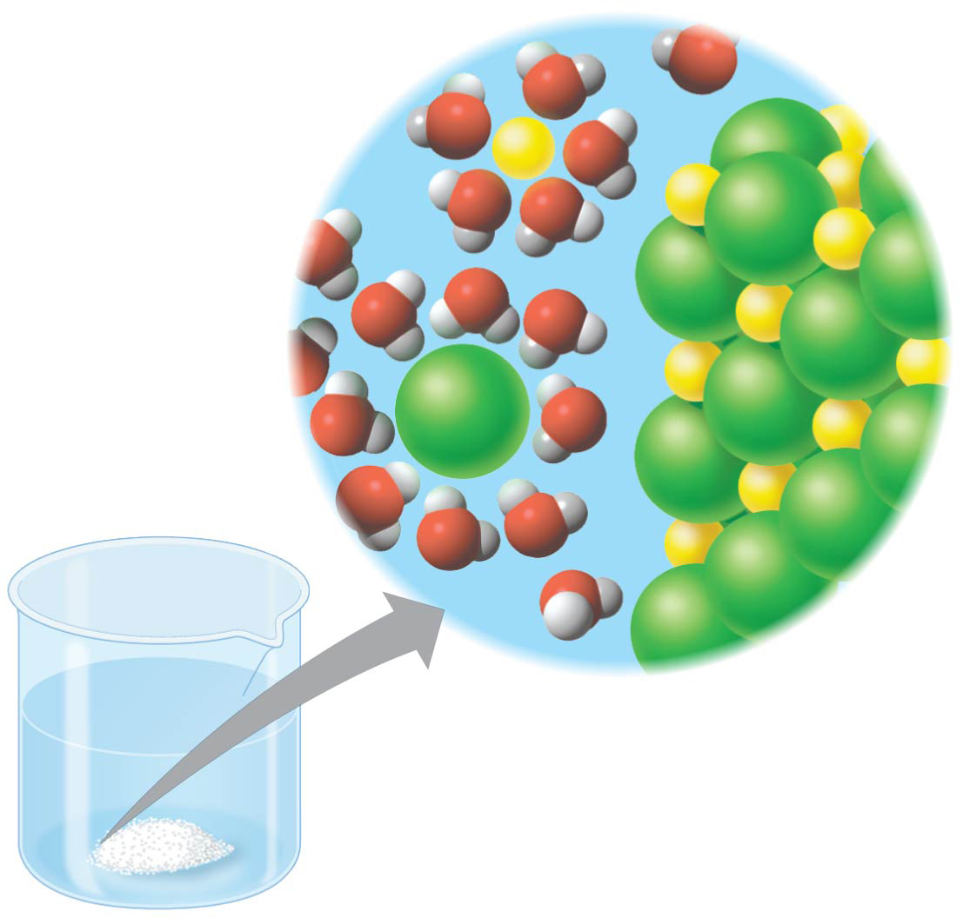
When an ionic compound is dissolved in water, each ion is surrounded by a sphere of water molecules called a hydration shell
−
Na⁺
+
+
−
−
+
−
−
Na⁺
−
+
+
Cl–
Cl⁻
+
−
−
+
−
+
−
−
Notes:
Figure 3.7 Table salt dissolving in water

Slide 26
Concept 3.2: Four emergent properties of water contribute to Earth’s suitability for life
  4. Versatility as a solvent – the solvent of life
Hydrophilic substance = affinity for water
Hydrophobic substance = does NOT have an affinity for water
  Oil molecules are hydrophobic because they
  have relatively nonpolar bonds
  Hydrophobic molecules related to oils are the major ingredients of cell membranes

Slide 27
Concept 3.2: Four emergent properties of water contribute to Earth’s suitability for life
Four of water’s properties that facilitate an environment for life are…
  Cohesive/adhesive behavior
  Ability to moderate temperature
  Expansion upon freezing
  Versatility as a solvent

Slide 28
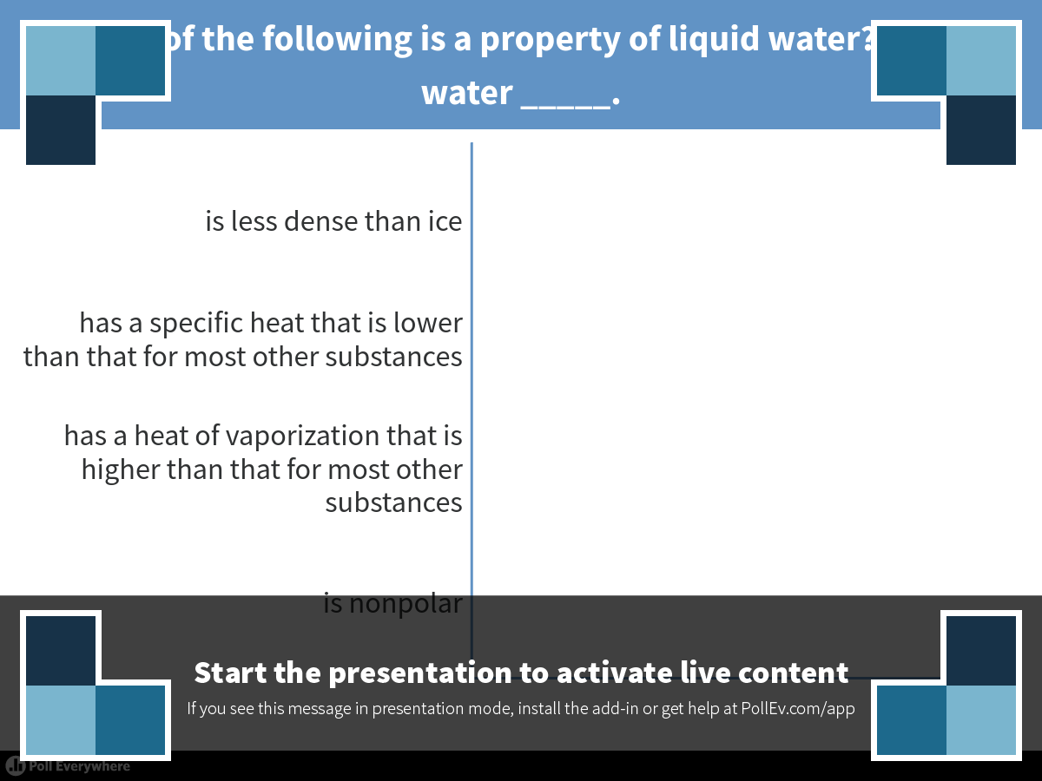
Notes:
Which of the following is a property of liquid water? Liquid water _____.
https://www.polleverywhere.com/multiple_choice_polls/lrpjqcr0jZSHxL8

Slide 29
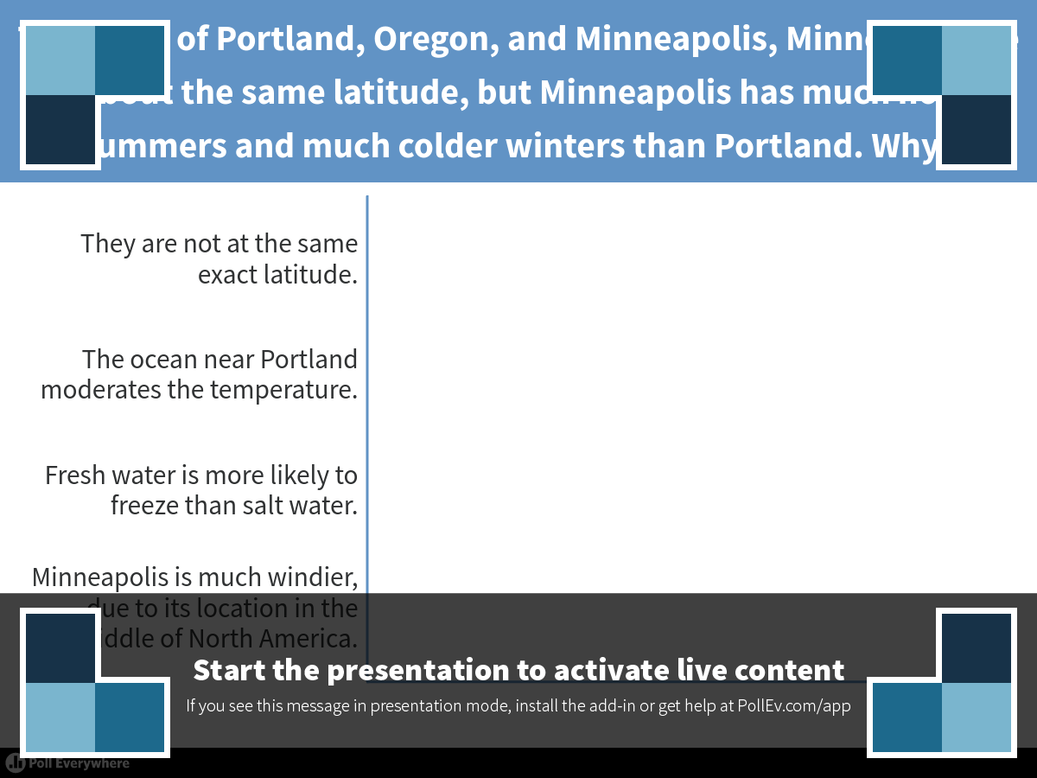
Notes:
The cities of Portland, Oregon, and Minneapolis, Minnesota, are at about the same latitude, but Minneapolis has much hotter summers and much colder winters than Portland. Why?
https://www.polleverywhere.com/multiple_choice_polls/YpqOZw1UwngyyBm

Slide 30
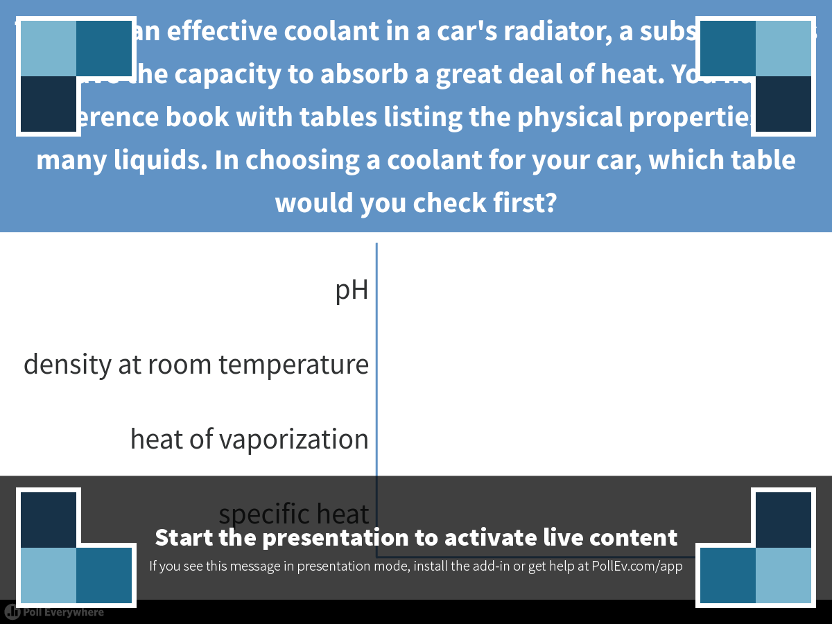
Notes:
To act as an effective coolant in a car's radiator, a substance has to have the capacity to absorb a great deal of heat. You have a reference book with tables listing the physical properties of many liquids. In choosing a coolant for your car, which table would you check first?
https://www.polleverywhere.com/multiple_choice_polls/fHON6PAPEOrU4Gn

Slide 31
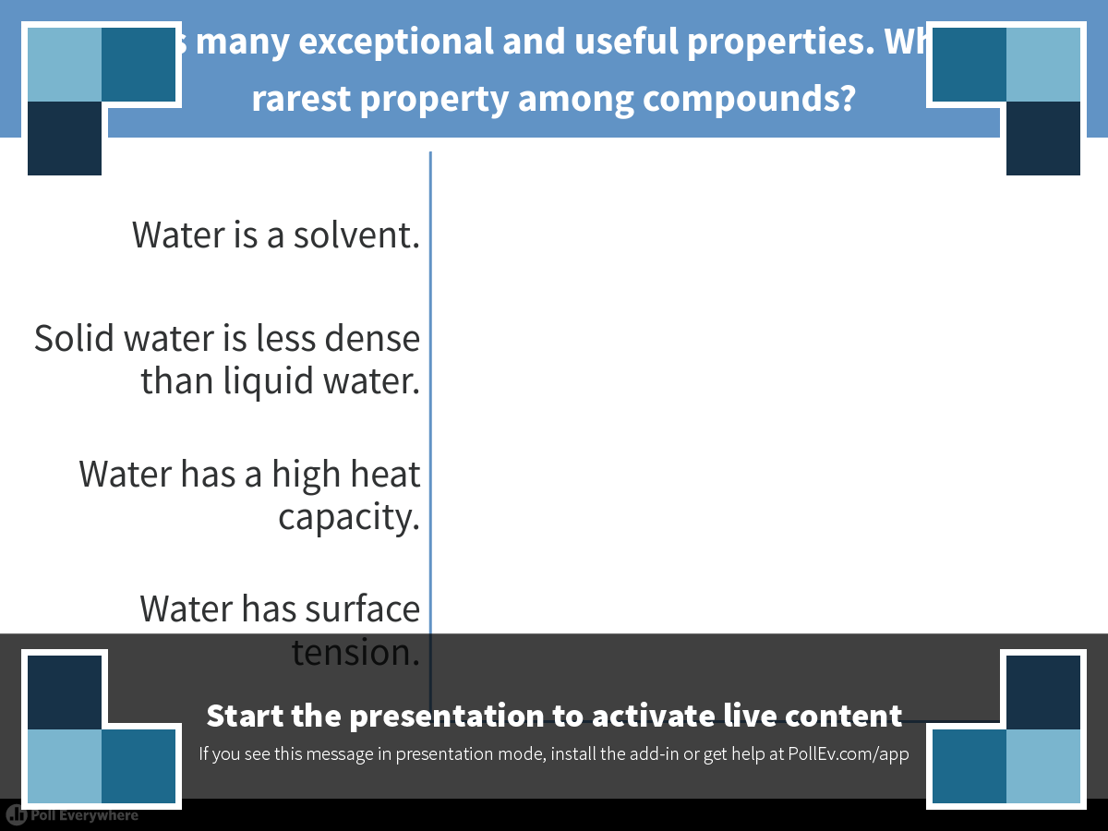
Notes:
Water has many exceptional and useful properties. Which is the rarest property among compounds?
https://www.polleverywhere.com/multiple_choice_polls/vLqxrAhJI8NbKDx

Slide 32
Overview
Concept 3.1: Polar covalent bonds in water molecules result in hydrogen bonding
Concept 3.2: Four emergent properties of water contribute to Earth’s suitability for life
Concept 3.3: Acidic and basic conditions affect living organisms

Slide 33
Concept 3.3: Acidic and basic conditions affect living organisms
A hydrogen atom in a hydrogen bond between two water molecules can shift from one to the other
  The hydrogen atom leaves its electron behind and is transferred as a proton, or hydrogen ion (H⁺)
  The molecule that lost the proton is now a hydroxide ion (OH⁻)
  The molecule with the extra proton is now a hydronium ion (H₃O⁺), though it is often represented as H⁺

Slide 34
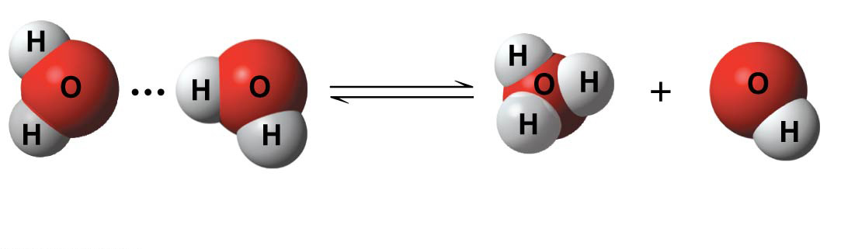
Figure 3.UN01
+
−
2 H₂O
Hydronium
ion (H₃O⁺)
Hydroxide
ion (OH⁻)
Notes:
Figure 3.UN01 In-text figure, dissociation of water, p. 51

Slide 35
Concept 3.3: Acidic and basic conditions affect living organisms
Acid = any substance that INCREASES the H⁺ concentration of a solution
  Acidic solutions have pH values LESS THAN 7
Base = any substance that REDUCES the H⁺ concentration of a solution
  Basic solutions have pH values GREATER THAN 7
Most biological fluids have pH values in the range of 6 to 8

Slide 36
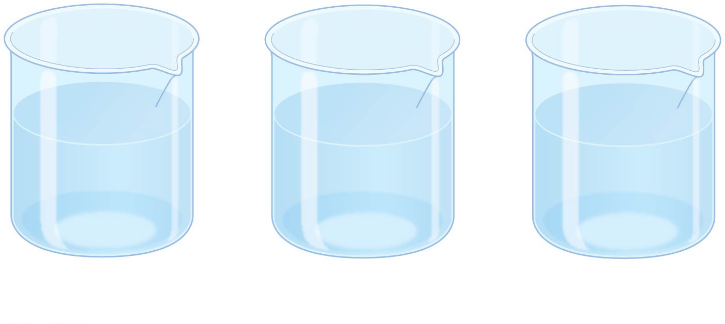
Figure 3.10a
OH⁻
OH⁻
H⁺
OH⁻
OH⁻
H⁺
OH⁻
OH⁻
H⁺
H⁺
OH⁻
H⁺
H⁺
OH⁻
OH⁻
OH⁻
OH⁻
OH⁻
H⁺
H⁺
OH⁻
OH⁻
H⁺
H⁺
H⁺
H⁺
H⁺
H⁺
Basic
solution
Neutral
solution
Acidic
solution
Notes:
Figure 3.10a The pH scale and pH values of some aqueous solutions (part 1: ions)

Slide 37
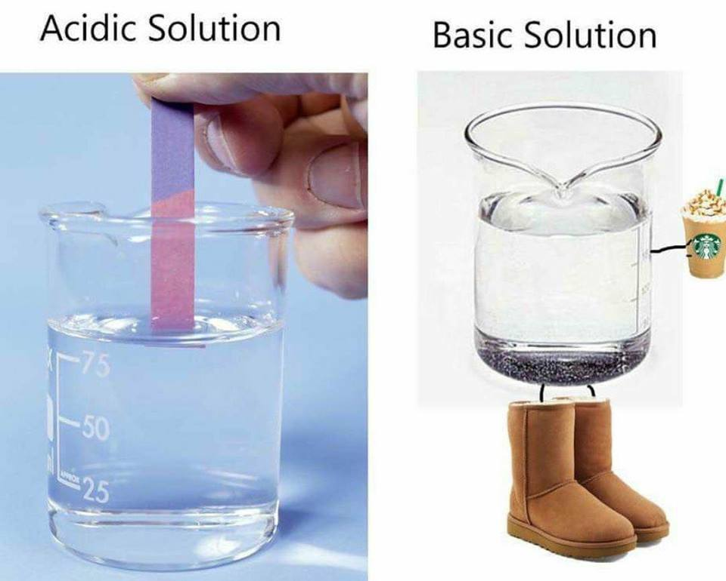
Notes:
Figure 3.10a The pH scale and pH values of some aqueous solutions (part 1: ions)

Slide 38
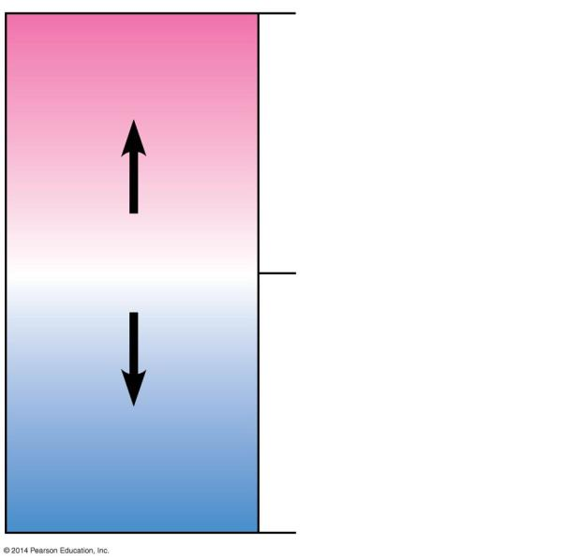
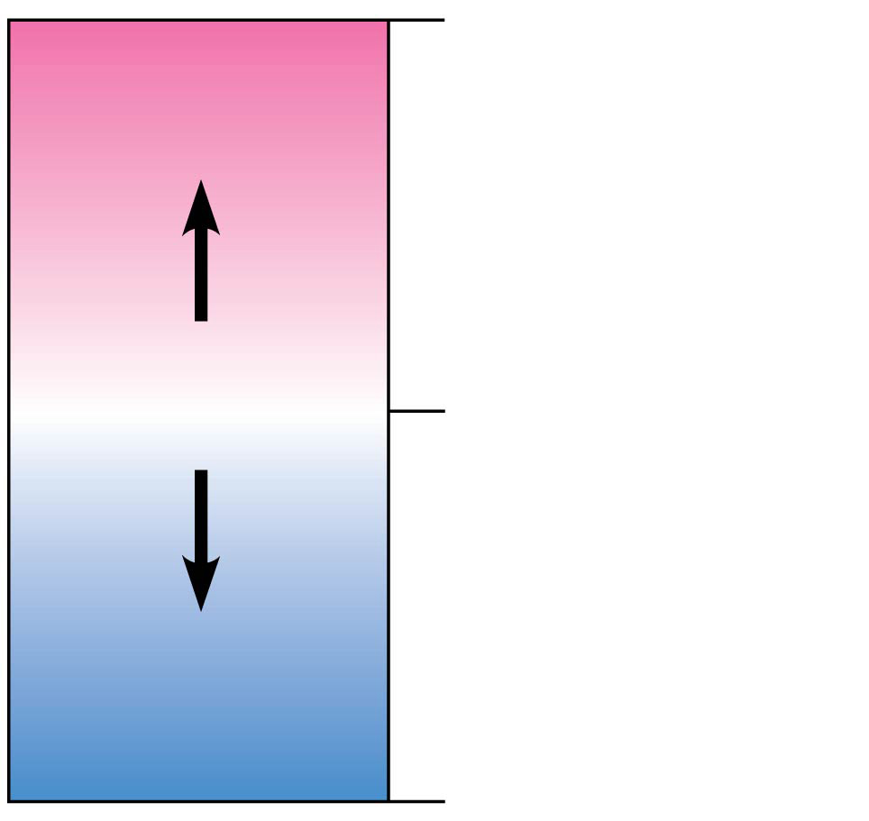
Figure 3.UN04
0
Acidic
[H⁺] > [OH⁻]
Acids donate H⁺ in
aqueous solutions.
Neutral
[H⁺] = [OH⁻]
7
Bases donate OH⁻
or accept H⁺ in
aqueous solutions.
Basic
[H⁺] < [OH⁻]
14
Notes:
Figure 3.UN04 Summary of key concepts: pH scale

Slide 39
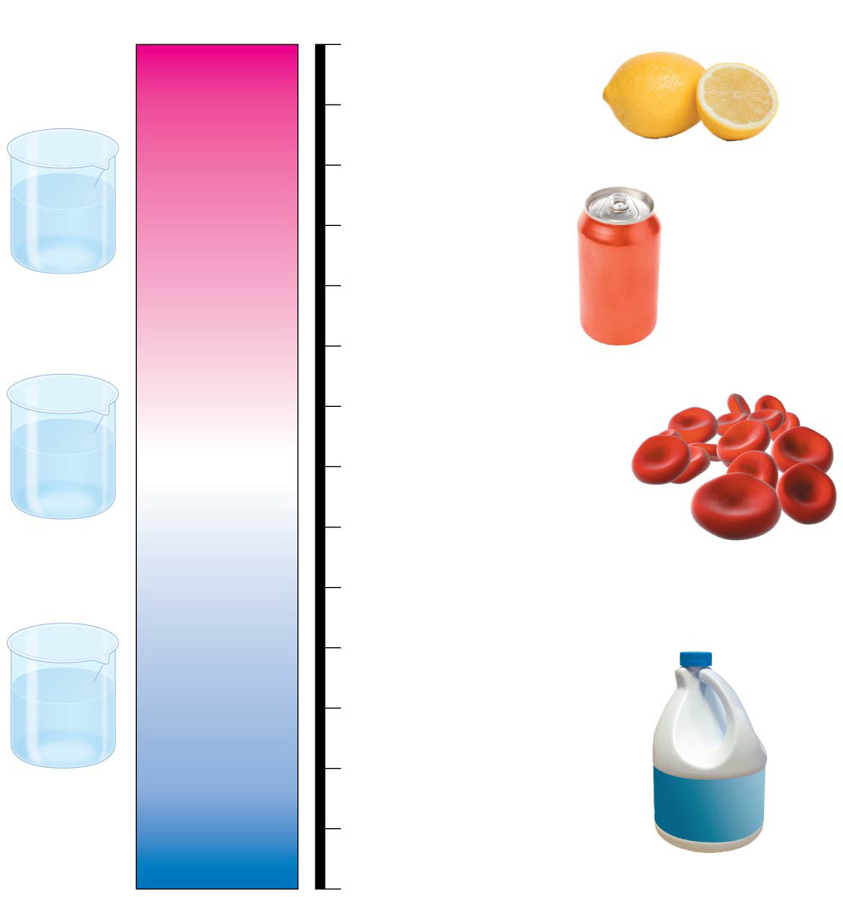
Figure 3.10
pH Scale
0
1
2
3
4
5
6
7
8
9
10
11
12
13
14
Battery acid
Gastric juice, lemon juice
H⁺
H⁺
H⁺
OH–
H⁺
Vinegar, wine,
cola
OH–
H⁺
H⁺
Increasingly Acidic
[H⁺] > [OH⁻]
H⁺
H⁺
Acidic
solution
Tomato juice
Beer
Black coffee
Rainwater
Urine
Saliva
OH–
OH–
Neutral
[H⁺] = [OH⁻]
H⁺
H⁺
OH–
Pure water
Human blood, tears
OH–
OH–
H⁺
H⁺
H⁺
Seawater
Inside of small intestine
Neutral
solution
Increasingly Basic
[H⁺] < [OH⁻]
Milk of magnesia
OH–
OH–
OH–
H⁺
OH–
Household ammonia
OH–
H⁺
OH–
OH–
Basic
solution
Household
bleach
Oven cleaner
Notes:
Figure 3.10 The pH scale and pH values of some aqueous solutions

Slide 40
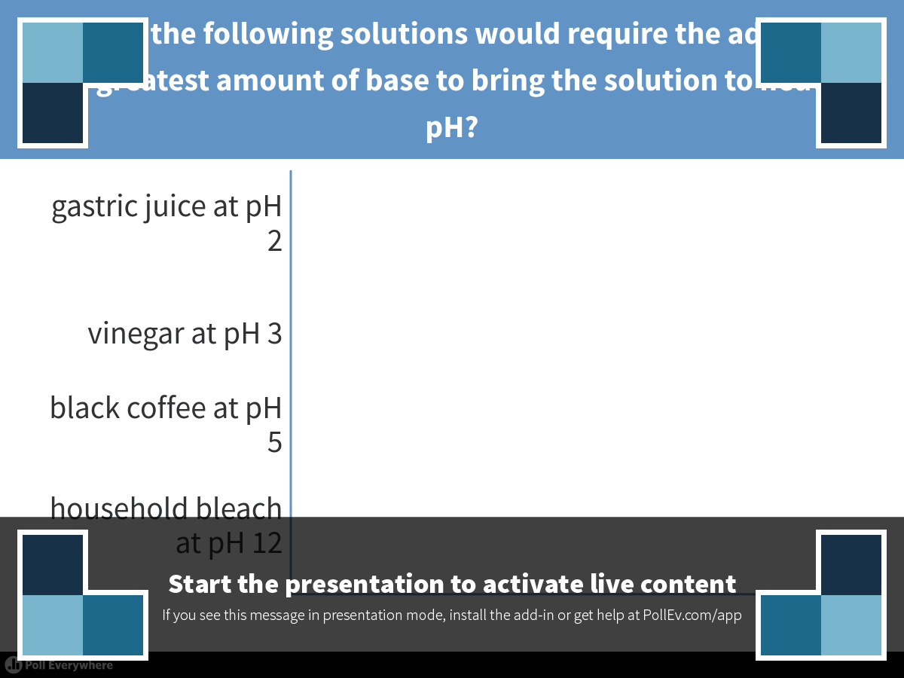
Notes:
Which of the following solutions would require the addition of the greatest amount of base to bring the solution to neutral pH?
https://www.polleverywhere.com/multiple_choice_polls/HbNd1jc489xoD5B

Slide 41
Overview
Concept 3.1: Polar covalent bonds in water molecules result in hydrogen bonding
Concept 3.2: Four emergent properties of water contribute to Earth’s suitability for life
Concept 3.3: Acidic and basic conditions affect living organisms

