Slide 1
0
2
The Chemical Context of Life

Slide 2
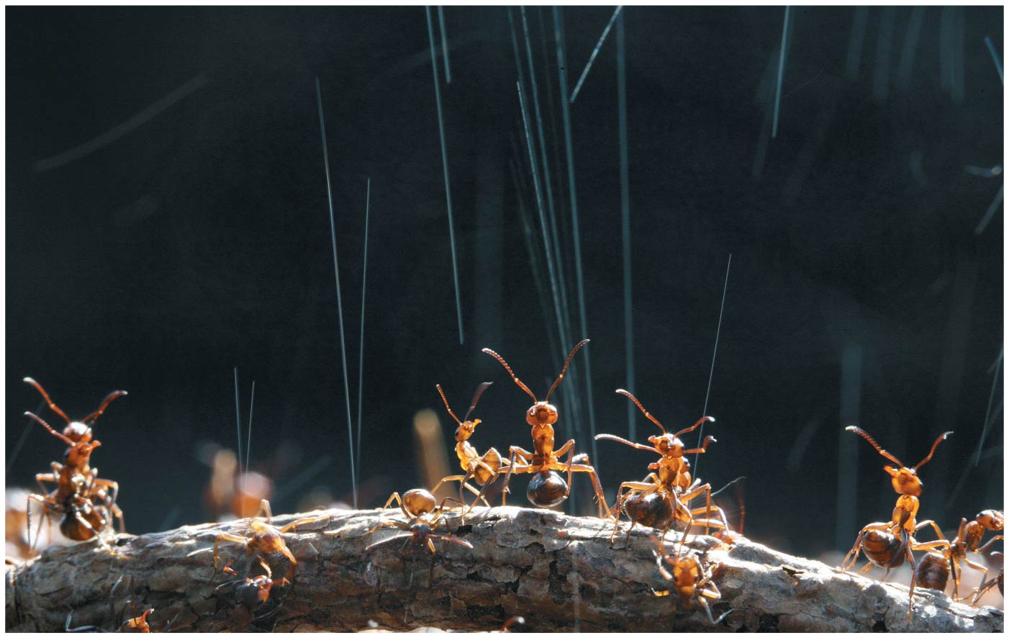
What are these ants doing…
Notes:
Figure 2.1 What weapon are these wood ants shooting into the air?

Slide 3
A Chemical Connection to Biology
Biology = study of life
Living organisms and their environments are subject to basic laws of PHYSICS and CHEMISTRY
One awesome example is the use of formic acid by ants to protect themselves against predators and microbial parasites

Slide 4
Notes:
Which best describes your experience in your last chemistry class?
https://www.polleverywhere.com/multiple_choice_polls/WYUMKjBGUqT8Rwo

Slide 5
Overview
Concept 2.1: Matter consists of chemical elements in pure form and in combinations called compounds
Concept 2.2: An element’s properties depend on the structure of its atoms
Concept 2.3: The formation and function of molecules depend on chemical bonding between atoms
Concept 2.4: Chemical reactions make and break chemical bonds

Slide 6
Overview
Concept 2.1: Matter consists of chemical elements in pure form and in combinations called compounds
Concept 2.2: An element’s properties depend on the structure of its atoms
Concept 2.3: The formation and function of molecules depend on chemical bonding between atoms
Concept 2.4: Chemical reactions make and break chemical bonds

Slide 7
Concept 2.1: Matter consists of chemical elements in pure form and in combinations called compounds
Organisms are composed of matter
Matter = anything that takes up space + has mass + made up of elements
Element = a substance that CANNOT be broken down to other substances by chemical reactions
A compound = a substance consisting of two or more elements in a FIXED RATIO
A compound has characteristics DIFFERENT from those of its elements

Slide 8
Notes:
What is matter?
https://www.polleverywhere.com/multiple_choice_polls/wkm2KzcAgVVA0fq

Slide 9
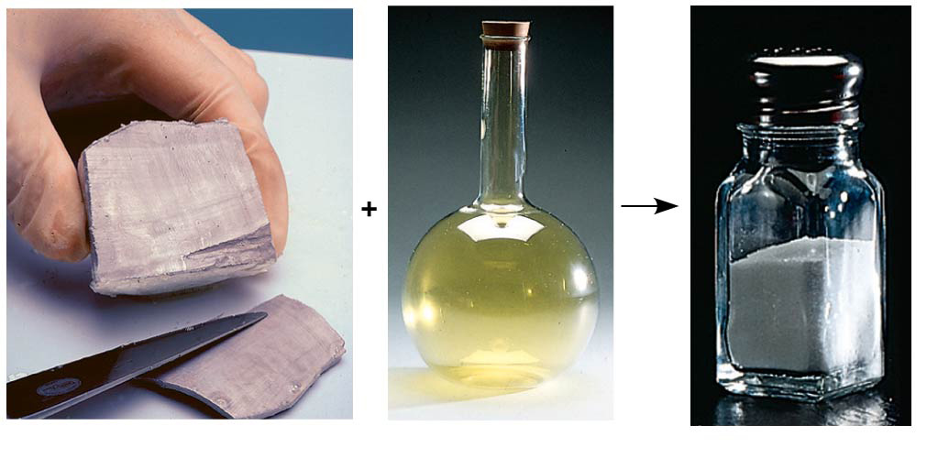
Figure 2.2
Sodium
Chlorine
Sodium chloride
Notes:
Figure 2.2 The emergent properties of a compound

Slide 10
Notes:
Sodium is a _____. Chlorine is a _____. Sodium chloride is a _____.
https://www.polleverywhere.com/multiple_choice_polls/f13J8BJhJ1F2lGd

Slide 11
Concept 2.1: Matter consists of chemical elements in pure form and in combinations called compounds
The Elements of Life
Carbon, hydrogen, oxygen, and nitrogen (CHON) = 96% of living matter!
Most of the remaining 4% consists of calcium, phosphorus, potassium, and sulfur

Slide 12
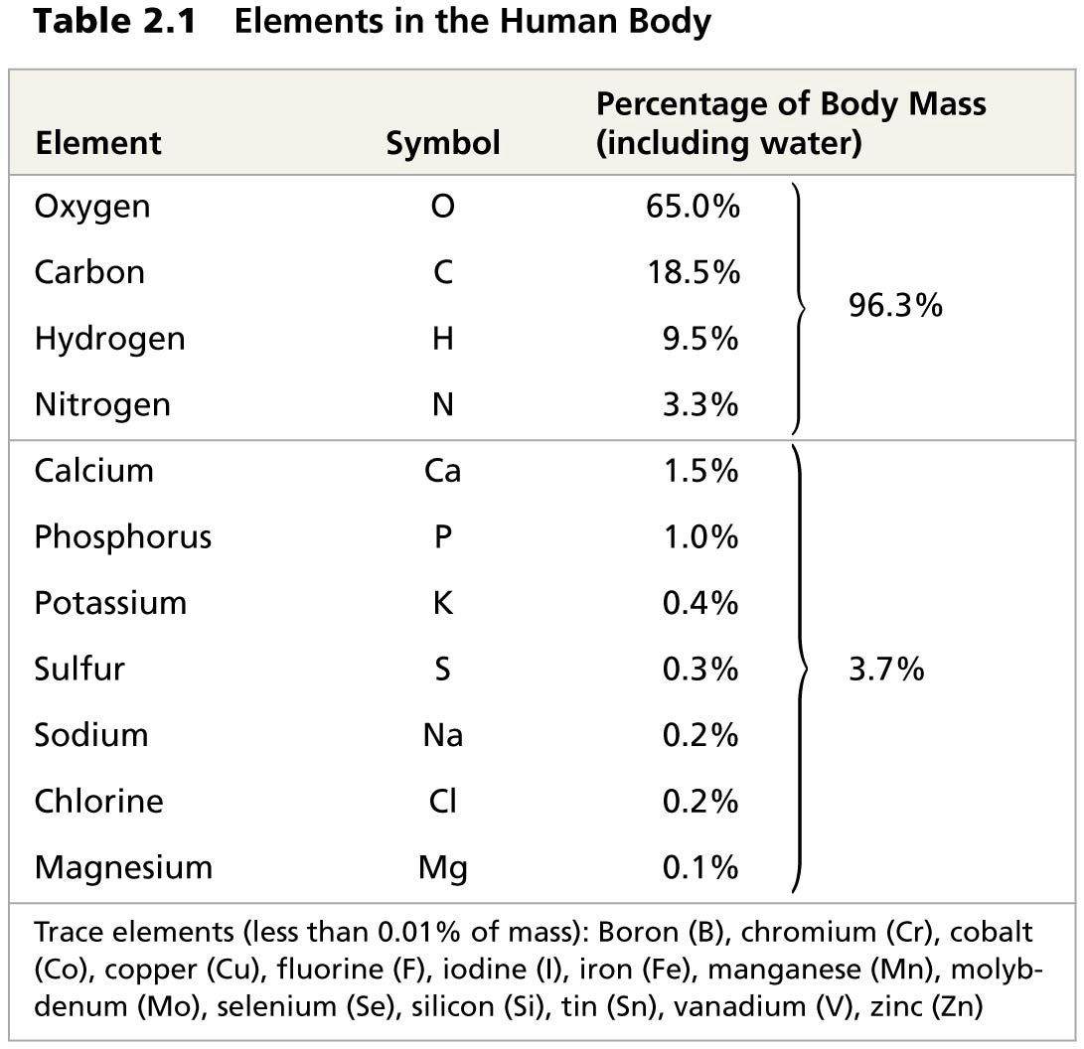
Table 2.1
Notes:
Table 2.1 Elements in the human body

Slide 13
Notes:
Which of the following are compounds?
https://www.polleverywhere.com/multiple_choice_polls/klujJg0uJDPb1IF

Slide 14
Overview
Concept 2.1: Matter consists of chemical elements in pure form and in combinations called compounds
Concept 2.2: An element’s properties depend on the structure of its atoms
Concept 2.3: The formation and function of molecules depend on chemical bonding between atoms
Concept 2.4: Chemical reactions make and break chemical bonds

Slide 15
Concept 2.2: An element’s properties depend on the structure of its atoms
Each element consists of unique atoms
Atom = the smallest unit of matter that still retains the properties of an element
Atoms are composed of subatomic particles
Neutrons (neutral, no electrical charge)
Protons (positive [+] charge)
Electrons (negative [-] charge)

Slide 16
Figure 2.UN04
Nucleus
Protons (+ charge)
determine element
+
−
+
Electrons (− charge
form negative cloud
and determine
chemical behavior
−
Neutrons (no charge)
determine isotope
Atom
Notes:
Figure 2.UN04 Summary of key concepts: atom components

Slide 17
Notes:
Which of the following is the best description of an atom's physical structure?
https://www.polleverywhere.com/multiple_choice_polls/5E7DIqDAIJlLkZJ

Slide 18
Concept 2.2: An element’s properties depend on the structure of its atoms
Electron Distribution and Chemical Properties
The chemical behavior of an atom is determined by the distribution of electrons in electron shells
Valence electrons are those in the outermost shell, or valence shell
The chemical behavior of an atom is mostly determined by the valence electrons
Elements with a FULL valence shell = “chemically inert”

Slide 19
Overview
Concept 2.1: Matter consists of chemical elements in pure form and in combinations called compounds
Concept 2.2: An element’s properties depend on the structure of its atoms
Concept 2.3: The formation and function of molecules depend on chemical bonding between atoms
Concept 2.4: Chemical reactions make and break chemical bonds

Slide 20
Concept 2.3: The formation and function of molecules depend on chemical bonding between atoms
Atoms with INCOMPLETE valence shells can share or transfer valence electrons with certain other atoms
These interactions usually result in atoms staying close together, held by attractions called chemical bonds
E.g. covalent bond = SHARING of a pair of valence electrons by two atoms = STRONG bond
Molecule = two or more atoms held together by covalent bonds

Slide 21
Figure 2.9-1
Hydrogen atoms (2 H)
+
+
Notes:
Figure 2.9-1 Formation of a covalent bond (step 1)

Slide 22
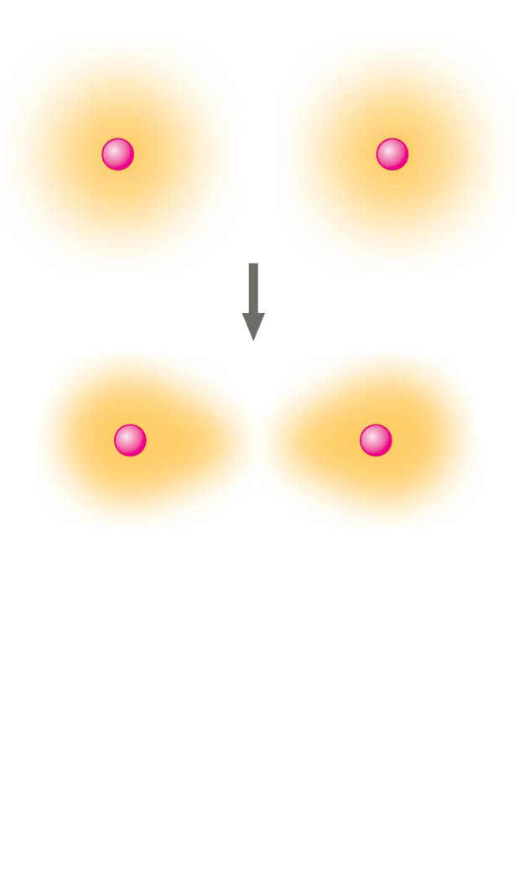
Figure 2.9-2
Hydrogen atoms (2 H)
+
+
+
+
Notes:
Figure 2.9-2 Formation of a covalent bond (step 2)

Slide 23
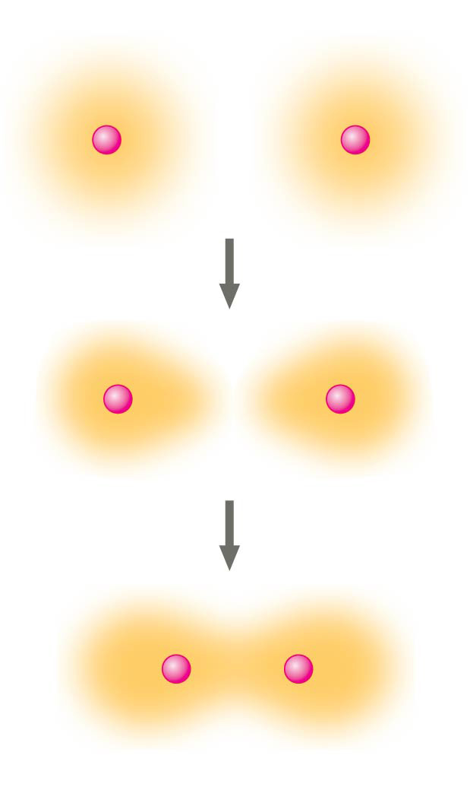
Figure 2.9-3
Hydrogen atoms (2 H)
+
+
+
+
+
+
Hydrogen molecule (H₂)
Notes:
Figure 2.9-3 Formation of a covalent bond (step 3)

Slide 24
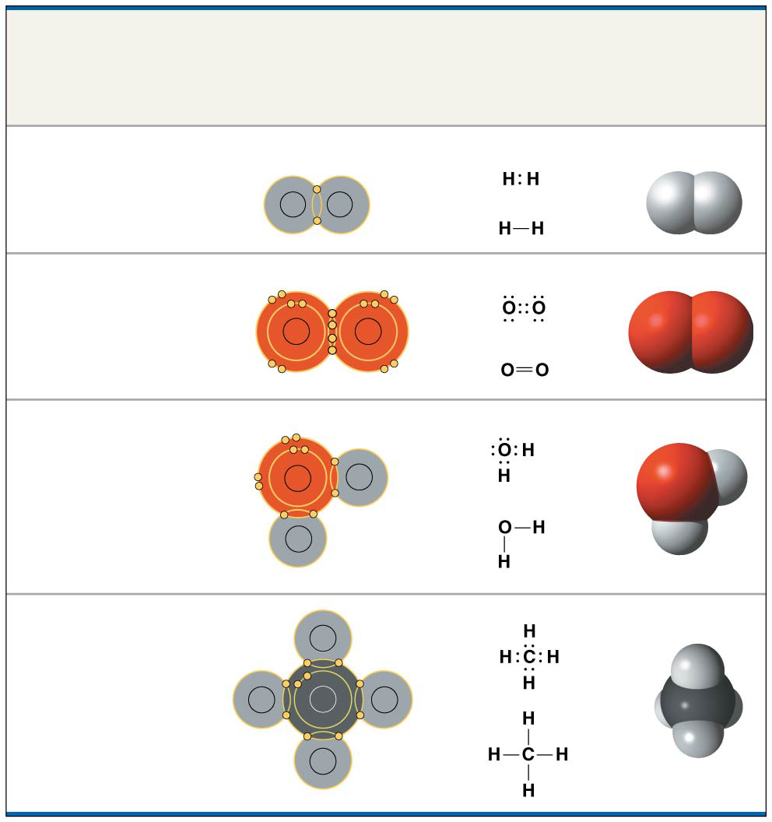
Figure 2.10
Name and Molecular Formula
Electron
Distribution
Diagram
Lewis Dot
Structure and
Structural
Formula
Space-
Filling
Model
(a) Hydrogen (H₂)
H
H
(b) Oxygen (O₂)
O
O
(c) Water (H₂O)
O
H
H
(d) Methane (CH₄)
H
H
C
H
H
Notes:
Figure 2.10 Covalent bonding in four molecules

Slide 25
Concept 2.3: The formation and function of molecules depend on chemical bonding between atoms
Electronegativity
Atoms in a molecule attract electrons to varying degrees
Electronegativity = atom’s attraction for the electrons of a covalent bond
The more electronegative an atom, the more STRONGLY it pulls shared electrons toward itself

Slide 26
Concept 2.3: The formation and function of molecules depend on chemical bonding between atoms
Types of Covalent Bonding (Strong)
Single covalent bond = single bond = sharing of ONE PAIR of valence electrons
Double covalent bond = double bond = sharing of TWO PAIRS of valence electrons

Slide 27
Figure 2.UN05
Single
covalent bond
Double
covalent bond
Notes:
Figure 2.UN05 Summary of key concepts: covalent bonds

Slide 28
Concept 2.3: The formation and function of molecules depend on chemical bonding between atoms
Types of Covalent Bonding (Strong)
Nonpolar covalent bond = atoms share the electron EQUALLY
Polar covalent bond = one atom is more electronegative, atoms DO NOT share the electron equally
Unequal sharing of electrons = partial positive or negative charge for each atom or molecule

Slide 29
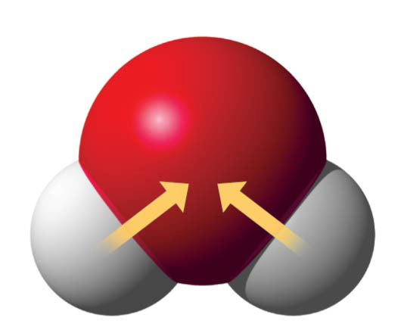
Figure 2.11
δ−
O
H
H
δ+
δ+
H₂O
Polar covalent bond = one atom is more electronegative, atoms DO NOT share the electron equally
Unequal sharing of electrons = partial positive or negative charge for each atom or molecule
Notes:
Figure 2.11 Polar covalent bonds in a water molecule

Slide 30
Notes:
What results from an unequal sharing of electrons between atoms?
https://www.polleverywhere.com/multiple_choice_polls/kPl4EX7Nkpm9poO

Slide 31
Concept 2.3: The formation and function of molecules depend on chemical bonding between atoms
Weak Chemical Bonds
Most of the STRONGEST bonds in organisms are covalent bonds that form a cell’s molecules
WEAK chemical bonds are also indispensable
Ionic bonds
Hydrogen bonds

Slide 32
Concept 2.3: The formation and function of molecules depend on chemical bonding between atoms
Ionic Bonds (“Weak”)
A charged atom (or molecule) = ion
Cation = positively charged ion
Anion = negatively charged ion
Ionic bond = attraction between cation + anion
Atoms sometimes strip electrons from their bonding partners (e.g. Na + Cl) → both atoms now have charges (e.g. Na⁺Cl⁻)

Slide 33
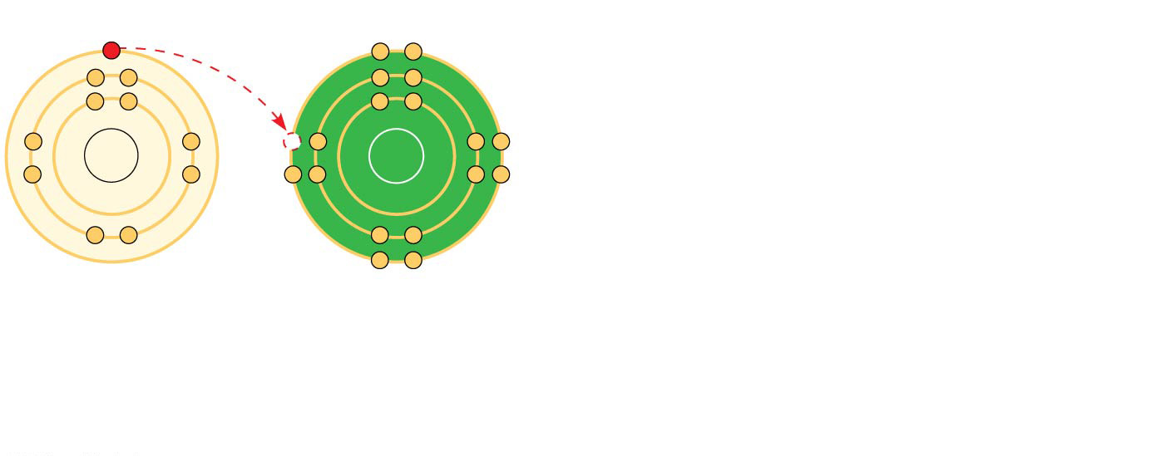
Figure 2.12-1
Na
Cl
Na Sodium atom
Cl
Chlorine atom
Notes:
Figure 2.12-1 Electron transfer and ionic bonding (step 1)

Slide 34
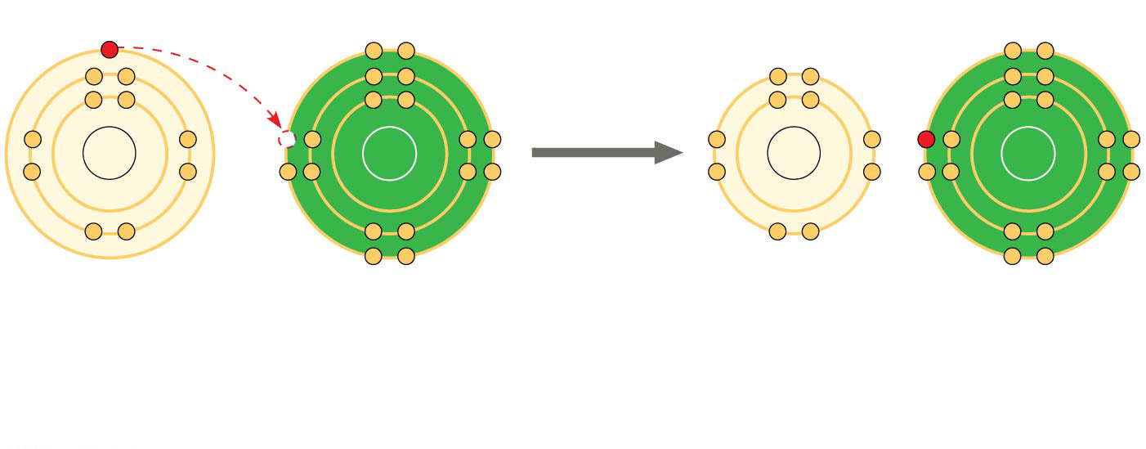
Figure 2.12-2
+
−
Na
Cl
Na
Cl
Na Sodium atom
Cl
Chlorine atom
Na⁺ Sodium ion (a cation)
Cl⁻ Chloride ion (an anion)
Sodium chloride (NaCl)
Compounds formed by ionic bonds are called ionic compounds, or salts
Salts, such as sodium chloride (table salt), are often found in nature as crystals
Notes:
Figure 2.12-2 Electron transfer and ionic bonding (step 2)

Slide 35
Notes:
What is the difference between covalent bonds and ionic bonds?
https://www.polleverywhere.com/multiple_choice_polls/XXJnR6KZGBFL5qT

Slide 36
Concept 2.3: The formation and function of molecules depend on chemical bonding between atoms
Hydrogen Bonds – Weak Chemical Bonds
Hydrogen bond = hydrogen atom covalently bonded to one electronegative atom is also attracted to another electronegative atom
In living cells, the electronegative partners are usually oxygen or nitrogen atoms

Slide 37
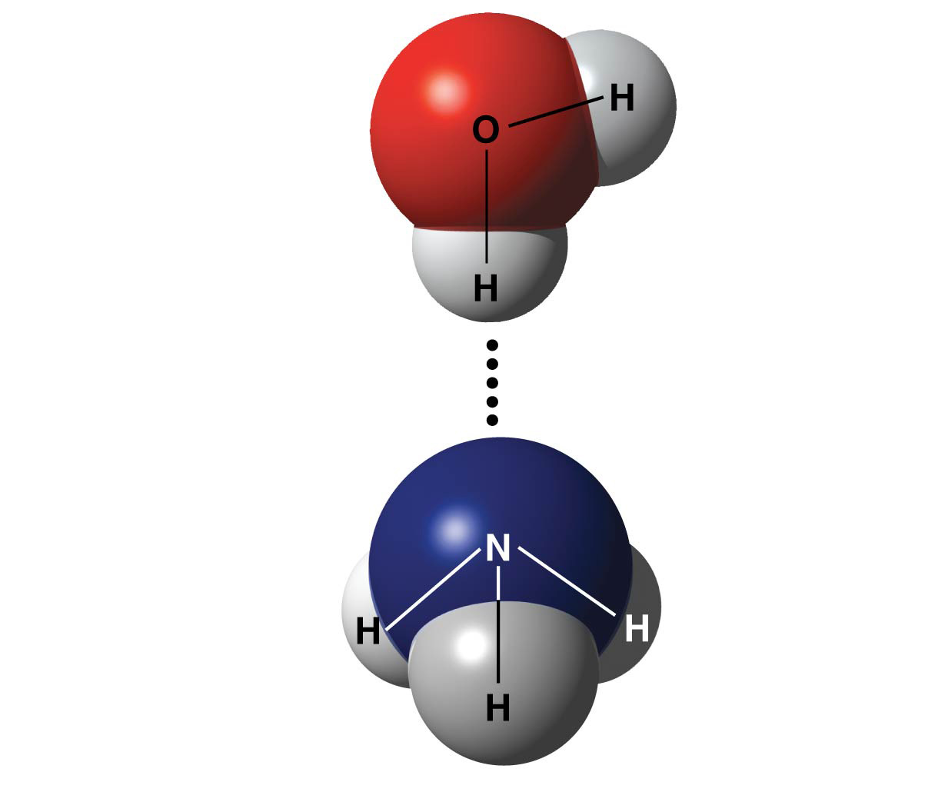
Figure 2.14
δ−
δ+
Water (H₂O)
δ+
Hydrogen bond
δ−
Ammonia (NH₃)
δ+
δ+
δ+
Notes:
Figure 2.14 A hydrogen bond

Slide 38
Notes:
The partial negative charge at one end of a water molecule is attracted to the partial positive charge of another water molecule. What is this attraction called?
https://www.polleverywhere.com/multiple_choice_polls/DlusRHjT4JlSSAG

Slide 39
Notes:
Nitrogen (N) is more electronegative than hydrogen (H). Which of the following is a correct statement about the atoms in ammonia (NH3)?
https://www.polleverywhere.com/multiple_choice_polls/qOdJN6q1N4Ba4Zj

Slide 40
Overview
Concept 2.1: Matter consists of chemical elements in pure form and in combinations called compounds
Concept 2.2: An element’s properties depend on the structure of its atoms
Concept 2.3: The formation and function of molecules depend on chemical bonding between atoms
Concept 2.4: Chemical reactions make and break chemical bonds

Slide 41
Concept 2.4: Chemical reactions make and break chemical bonds
Chemical reactions = making + breaking of chemical bonds
Reactants = starting molecules of a chemical reaction
Products = final molecules of a chemical reaction
Chemical reactions = reversible
Products of the forward reaction become reactants
Chemical equilibrium = forward and reverse reactions occur at the same rate

Slide 42
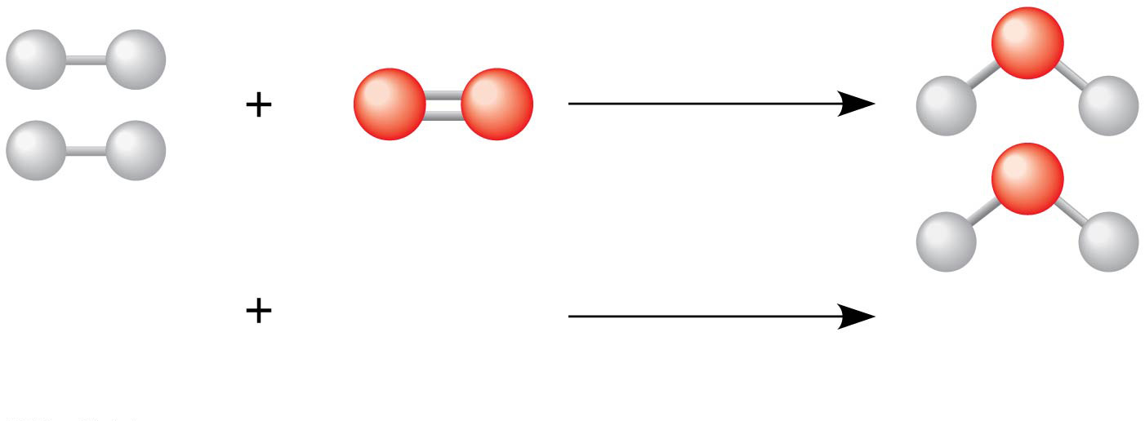
Figure 2.UN03
2 H₂
O₂
2 H₂O
Reactants
Reaction
Products
Notes:
Figure 2.UN03 In-text figure, water formation, p. 40

Slide 43
Notes:
Which of the following correctly describes a reaction that has reached chemical equilibrium?
https://www.polleverywhere.com/multiple_choice_polls/cFkSskT2jIL9JuZ

Slide 44
Overview
Concept 2.1: Matter consists of chemical elements in pure form and in combinations called compounds
Concept 2.2: An element’s properties depend on the structure of its atoms
Concept 2.3: The formation and function of molecules depend on chemical bonding between atoms
Concept 2.4: Chemical reactions make and break chemical bonds

