Slide 1
22
Descent with Modification: A Darwinian View of Life

Slide 2
What comes to mind when you hear…
Charles Darwin?
On the Origin of Species?
Alfred Russell Wallace?
Theory?
Evolution?
Theory of evolution?
Natural selection?
Survival of the fittest?
Unity?
Diversity?

Slide 3
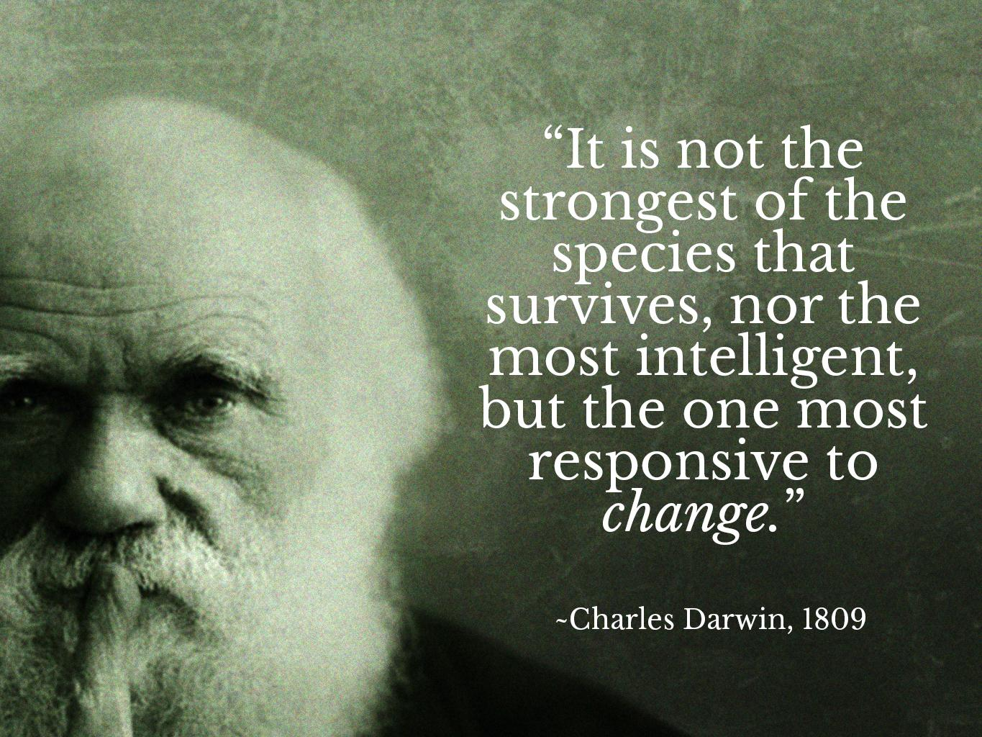

Slide 4
“Endless Forms Most Beautiful”
A new era of biology began in 1859 when Charles Darwin published The Origin of Species
The Origin of Species focused biologists’ attention on the great diversity of organisms
Darwin noted that current species are descendants of ancestral species
Evolution can be defined by Darwin’s phrase…
“descent with modification”

Slide 5
Overview
Concept 22.1: The Darwinian revolution challenged traditional views of a young Earth inhabited by unchanging species
Concept 22.2: Descent with modification by natural selection explains the adaptations of organisms and the unity and diversity of life
Concept 22.3: Evolution is supported by an overwhelming amount of scientific evidence

Slide 6
Overview
Concept 22.1: The Darwinian revolution challenged traditional views of a young Earth inhabited by unchanging species
Concept 22.2: Descent with modification by natural selection explains the adaptations of organisms and the unity and diversity of life
Concept 22.3: Evolution is supported by an overwhelming amount of scientific evidence

Slide 7
Concept 22.1: The Darwinian revolution challenged traditional views of a young Earth inhabited by unchanging species
Traditional views (pre-Darwin):
Earth was YOUNG
Species do NOT change
Evolution does NOT exist
Notes:
Earth = 4.5 byo

Slide 8
Concept 22.1: The Darwinian revolution challenged traditional views of a young Earth inhabited by unchanging species – Pre-Darwinian Ideas
NO EVOLUTION
Aristotle: species = fixed and arranged them on a scala naturae
Old Testament: species = individually designed by God and therefore perfect
Carolus Linnaeus: founder of taxonomy
Developed the binomial format for naming species (ex: Homo sapiens)
Linnaeus ascribed the resemblance among species to the pattern of creation rather than evolution
Notes:
Earth = 4.5 byo

Slide 9
Notes:
What was the prevailing belief prior to the time of Darwin?
https://www.polleverywhere.com/multiple_choice_polls/QpIAaOUJMzr0IUy

Slide 10
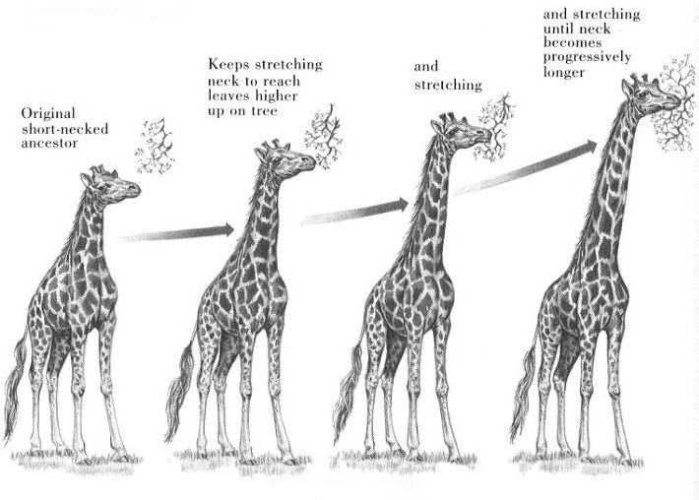
Concept 22.1: The Darwinian revolution challenged traditional views of a young Earth inhabited by unchanging species – Pre-Darwinian Ideas
Lamarck hypothesized that species evolve through use and disuse of body parts and the inheritance of acquired characteristics
The mechanisms he proposed are UNSUPPORTED by evidence
WRONG EVOLUTION
Notes:
10

Slide 11
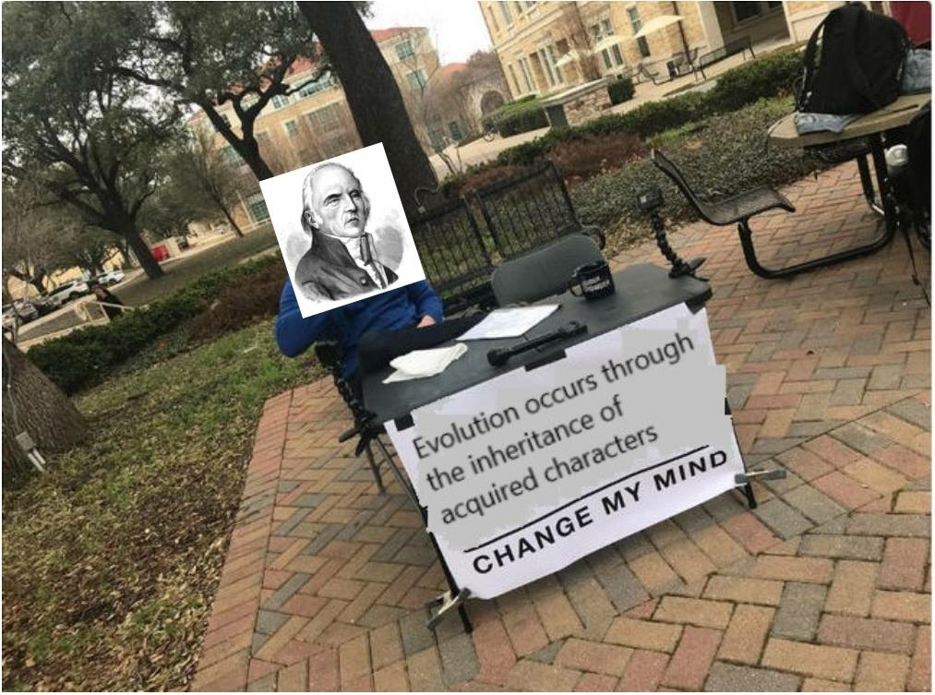
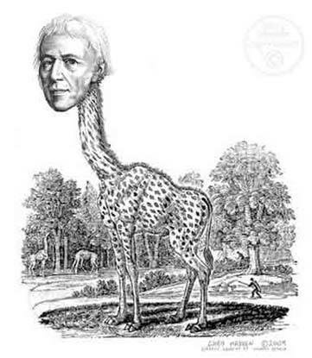
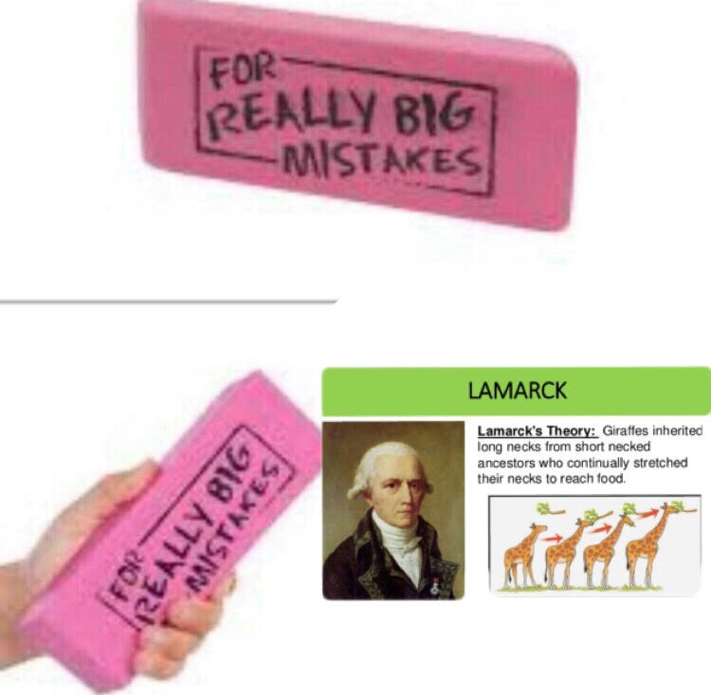

Slide 12
Notes:
During a study session about evolution, one of your fellow students remarks, "The giraffe stretched its neck while reaching for higher leaves; its offspring inherited longer necks as a result." Which statement is most likely to be helpful in correcting this student's misconception?
https://www.polleverywhere.com/multiple_choice_polls/0Z8YnC5dnr0E3d3

Slide 13
Concept 22.1: The Darwinian revolution challenged traditional views of a young Earth inhabited by unchanging species
Darwin’s view: introduced the idea of change over time…SUPPORTED BY INCONTROVERTIBLE EVIDENCE
The study of fossils (paleontology) helped lay the groundwork for Darwin’s ideas
Fossils are remains or traces of organisms from the past, usually found in sedimentary rock, which appears in layers called strata

Slide 14
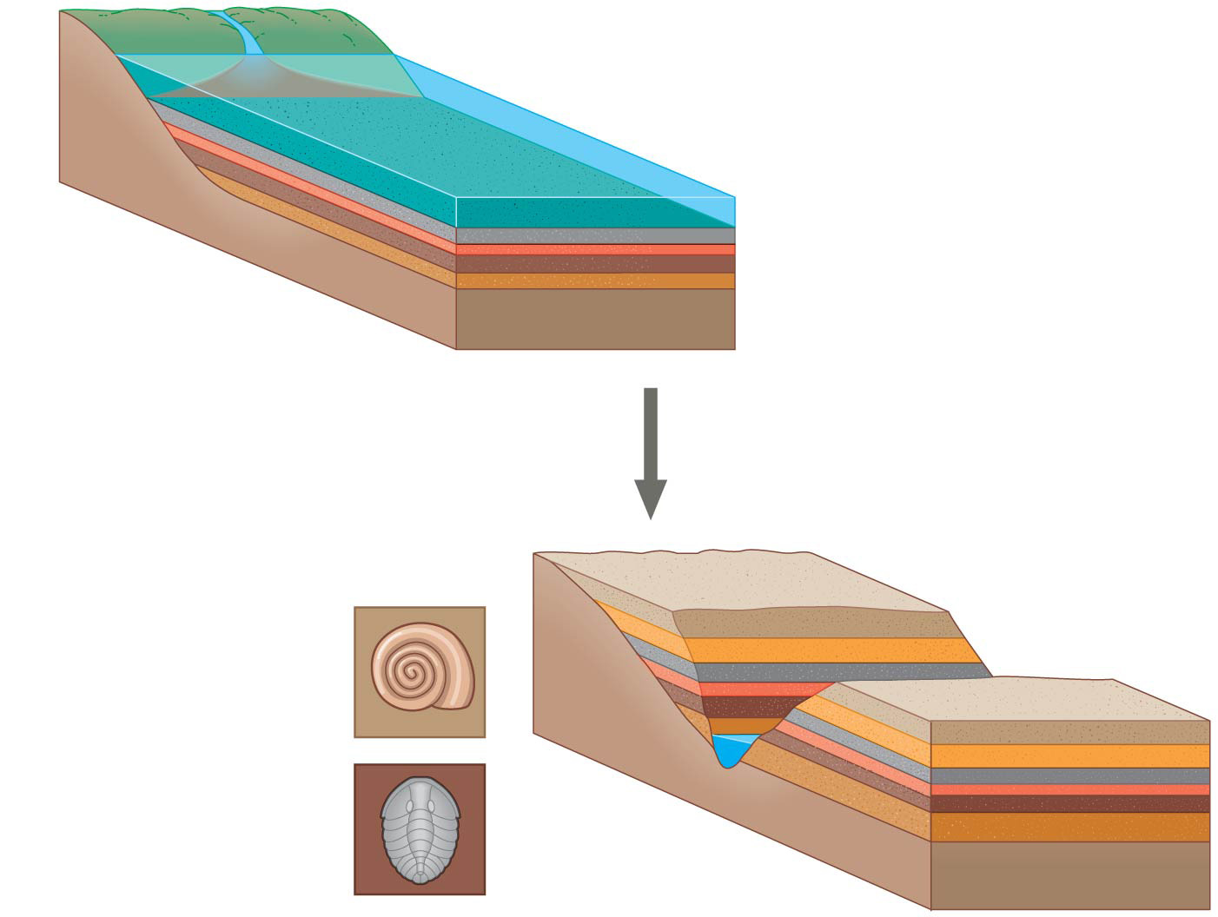
Sedimentary rock
layers (strata)
Younger stratum
with more recent
fossils
Older stratum
with older fossils
Notes:
Figure 22.3 Formation of sedimentary strata with fossils

Slide 15
Notes:
Charles Darwin was the first person to propose
https://www.polleverywhere.com/multiple_choice_polls/TrhjvWLeG2R7Lv9

Slide 16
Overview
Concept 22.1: The Darwinian revolution challenged traditional views of a young Earth inhabited by unchanging species
Concept 22.2: Descent with modification by natural selection explains the adaptations of organisms and the unity and diversity of life
Concept 22.3: Evolution is supported by an overwhelming amount of scientific evidence

Slide 17
Concept 22.2: Descent with modification by natural selection explains the adaptations of organisms and the unity and diversity of life
As a boy and into adulthood, Charles Darwin had a consuming interest in nature
Darwin first studied medicine (unsuccessfully), and then theology at Cambridge University
After graduating, he took an unpaid position as naturalist and companion to Captain FitzRoy for a 5-year around the world voyage on the Beagle
Landed at a biodiversity hotspot → Galapagos Islands

Slide 18
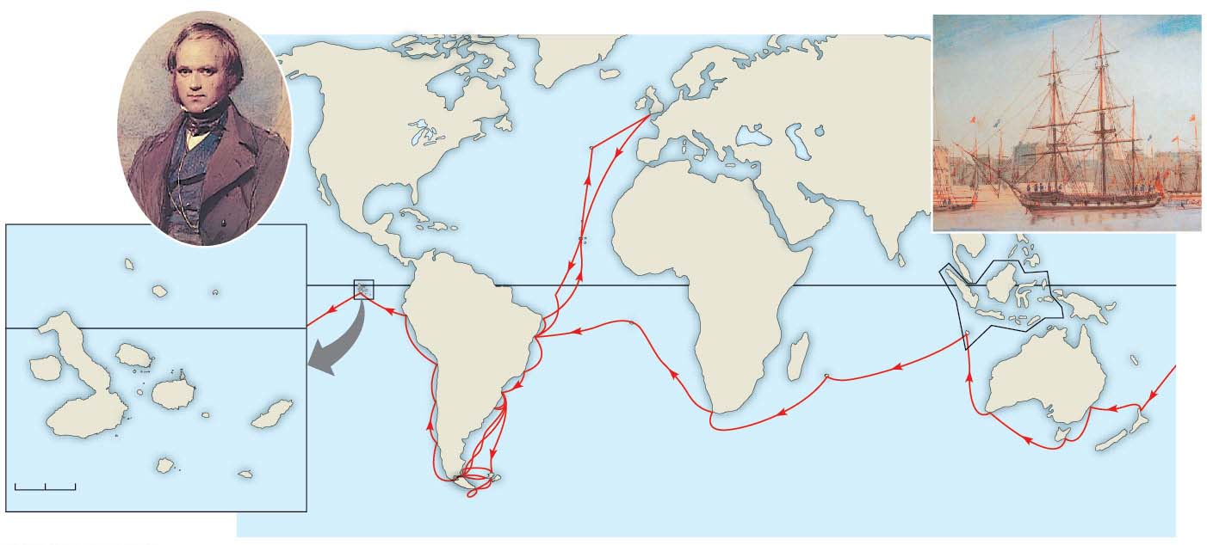
Darwin in
1840, after
his return
from the
voyage
HMS Beagle in port
Great
Britain
EUROPE
NORTH
AMERICA
ATLANTIC
OCEAN
The
Galápagos
Islands
PACIFIC
OCEAN
AFRICA
PACIFIC
OCEAN
Pinta
Marchena
Santiago
Genovesa
Equator
SOUTH
AMERICA
Equator
Malay
Archipelago
Chile
Mtns.
Brazil
AUSTRALIA
Fernandina
PACIFIC
OCEAN
Andes
Cape of
Good Hope
Isabela
Santa
Cruz
Santa
Fe
San
Cristobal
0 20 40
Floreana
Argentina
Tasmania
Kilometers
Española
Cape Horn
New
Zealand
Notes:
Figure 22.5 The voyage of HMS Beagle (December 1831–October 1836)

Slide 19
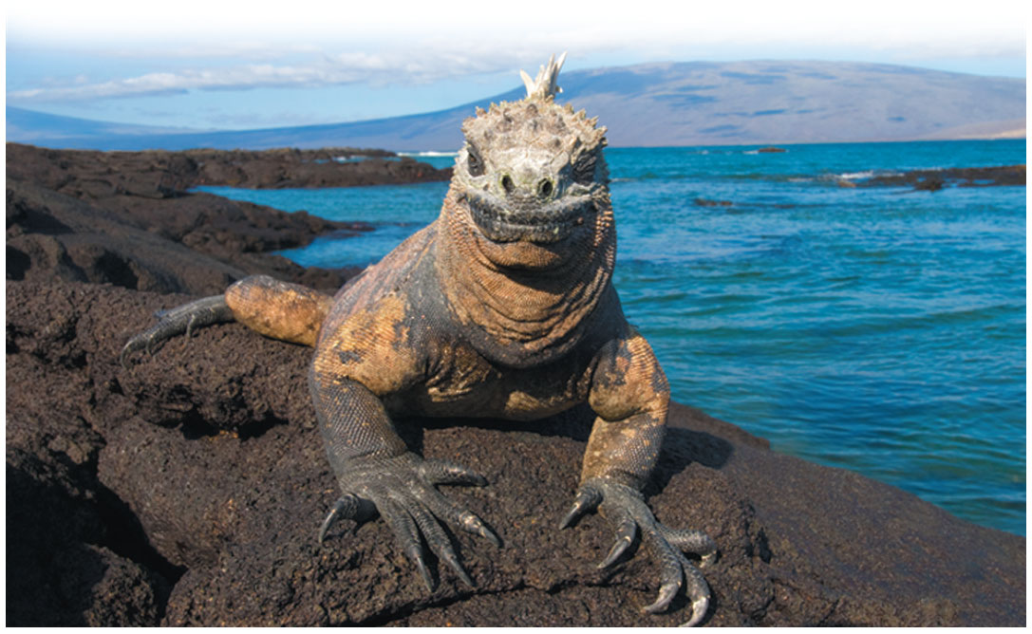
Galapagos Iguana – Unusual species inspired novel ideas
Notes:
Figure 22.2 Unusual species inspired novel ideas.

Slide 20
Concept 22.2: Descent with modification by natural selection explains the adaptations of organisms and the unity and diversity of life
Based on his observations during his journey, Darwin established that:
Adaptation to the environment + the origin of NEW species = closely related processes
Explained the ideas of descent with modification and change over time
Ex: Galapagos finches and their well-ADAPTED beaks

Slide 21
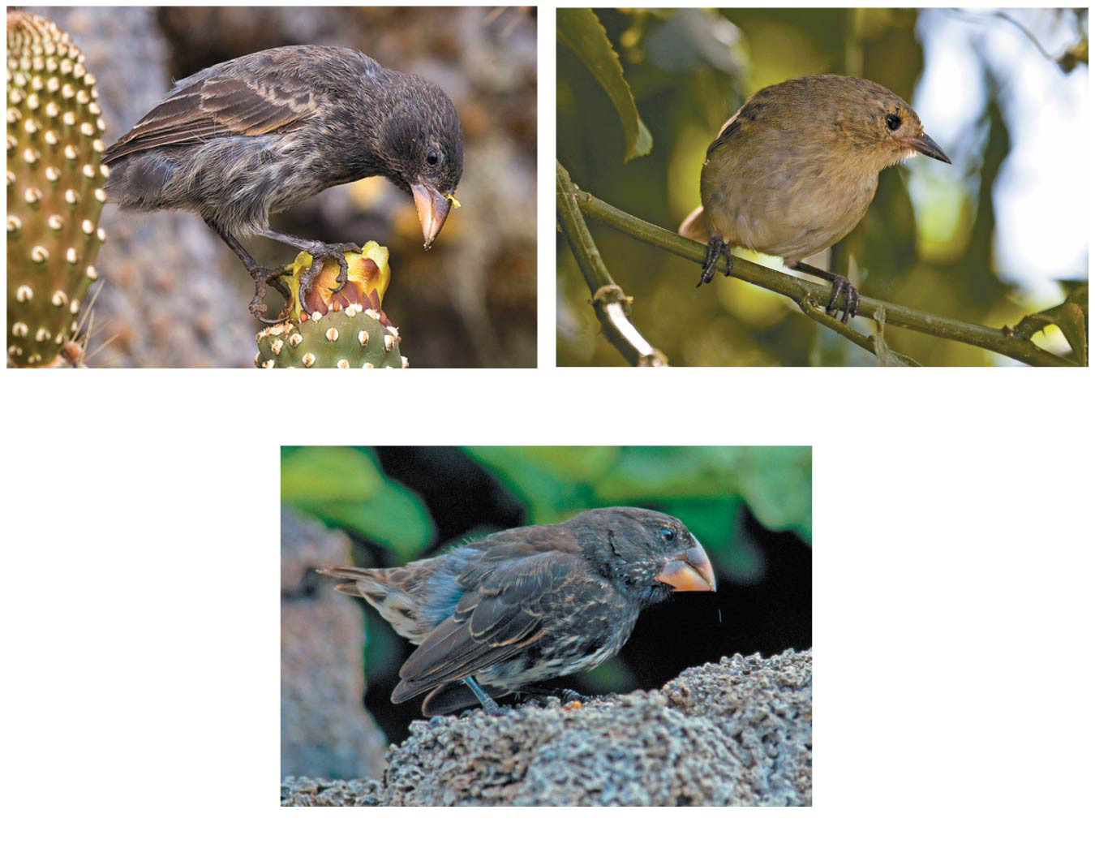
(a) Cactus-eater
(b) Insect-eater
(c) Seed-eater
Notes:
Figure 22.6 Three examples of beak variation in Galápagos finches

Slide 22
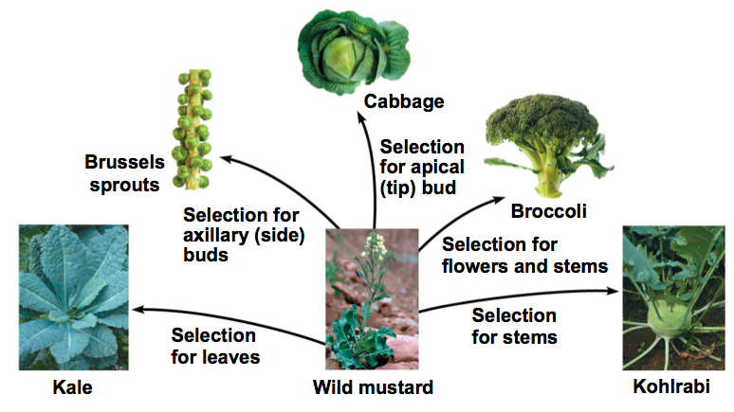
Concept 22.2: Descent with modification by natural selection – Artificial Selection
Darwin also noted that humans have MODIFIED species for their own benefits
Human selection and breeding of individuals with desired traits = artificial selection
Human intervention has lead to the “artificial” selection of many (hated) vegetables…all from the single wild mustard plant

Slide 23
Notes:
Artificial selection is
https://www.polleverywhere.com/multiple_choice_polls/JseRMPRddMrHoj4

Slide 24
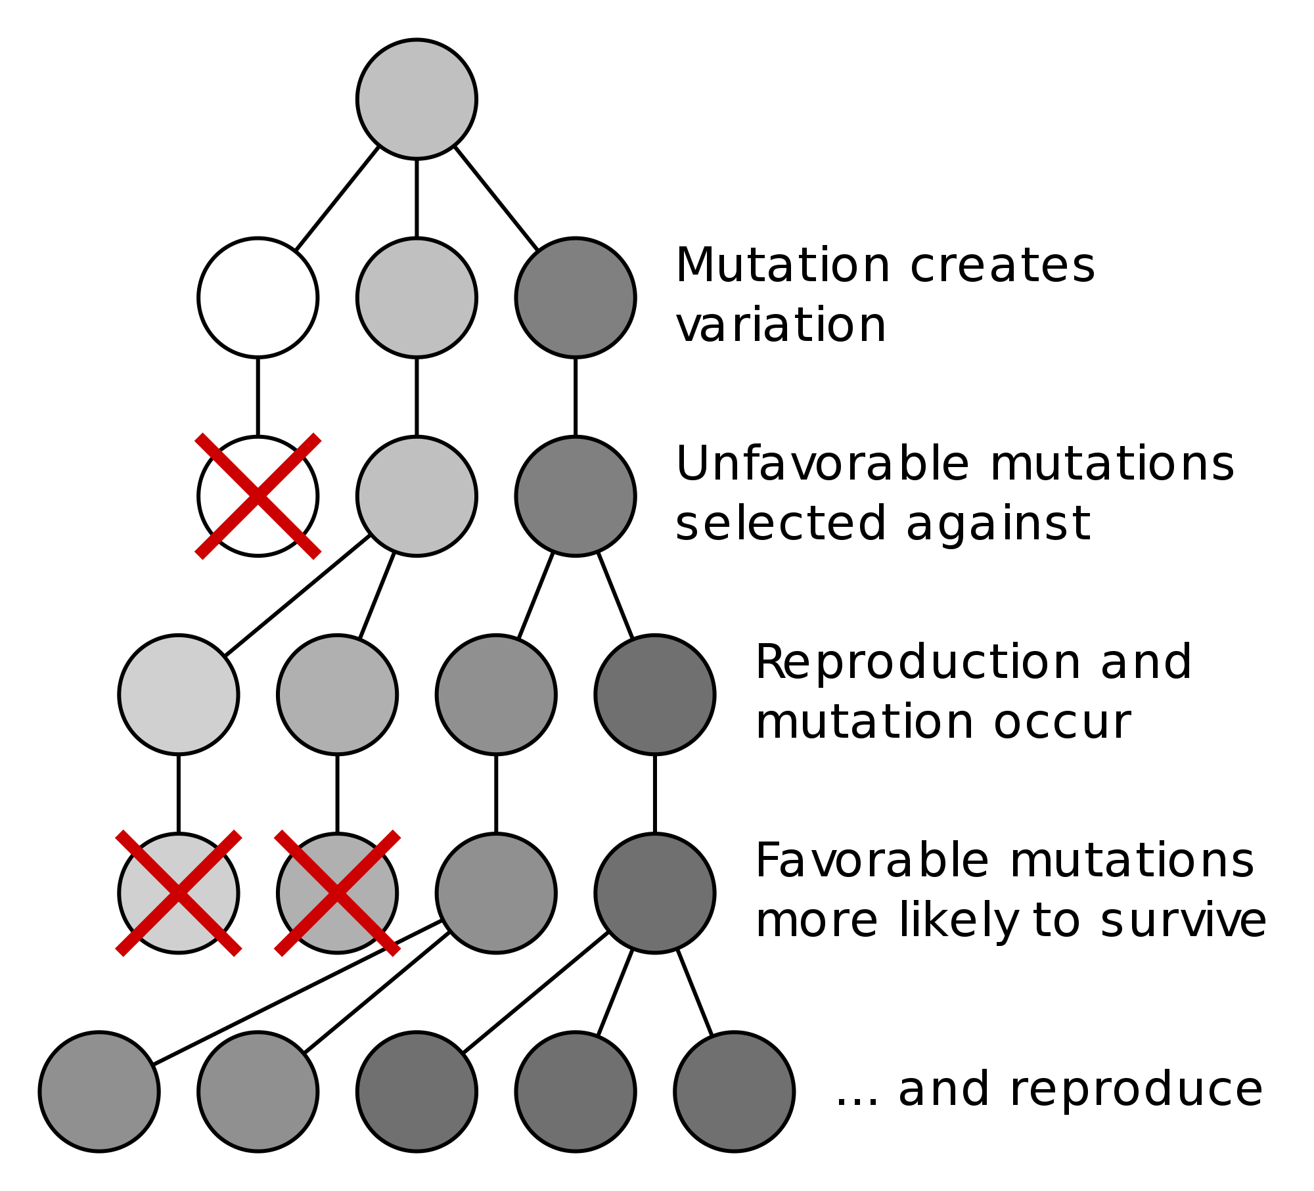
Concept 22.2: Descent with modification by natural selection – Mechanism of Evolution
Darwin established the idea of natural selection as the MECHANISM of evolution
Natural selection is a process in which individuals with favorable + inherited traits are MORE LIKELY to SURVIVE AND REPRODUCE

Slide 25
Concept 22.2: Descent with modification by natural selection – Mechanism of Evolution
Survival + reproduction (S+R) is the ONLY true purpose of LIFE (in biology at least)…anything that IMPROVES S+R is super important in evolution
Evolutionary fitness is measured by reproductive success…NOT just strength, speed, height, weight, smarts, good looks
“Survival of the fittest” = survival of those who can most successfully REPRODUCE…NOT necessarily about who’s the strongest, fastest, smartest, etc.

Slide 26
Concept 22.2: Descent with modification by natural selection – Recap
Quick Recap
Q: What is evolution?
A: Descent with modification (CHANGE over time)
Q: How does evolution happen?
A: Natural selection (MECHANISM of evolution)
Q: What is fitness?
A: Ability to produce viable, fertile offspring (“fecundity”)

Slide 27
Concept 22.2: Descent with modification by natural selection – Observations of Life
Darwin’s work explained THREE (3) broad observations about the living world #nbd
The unity of life
The diversity of life
The match between organisms and their environment

Slide 28
Concept 22.2: Descent with modification by natural selection – Tree-thinking
The phrase descent with modification summarized Darwin’s perception of the unity of life
The phrase refers to the view that ALL organisms are RELATED through descent from a single common ancestor that lived in the remote past
In the Darwinian view, the history of life is like a TREE with branches representing life’s diversity

Slide 29
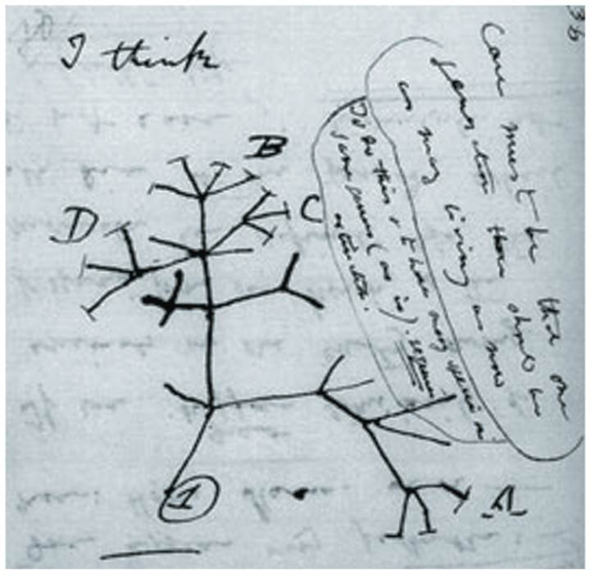
Yet another major understatement in biological history!
Darwin’s own sketch!
Notes:
Figure 22.7 “I think. . . .” In this 1837 sketch, Darwin envisioned the branching pattern of evolution.

Slide 30
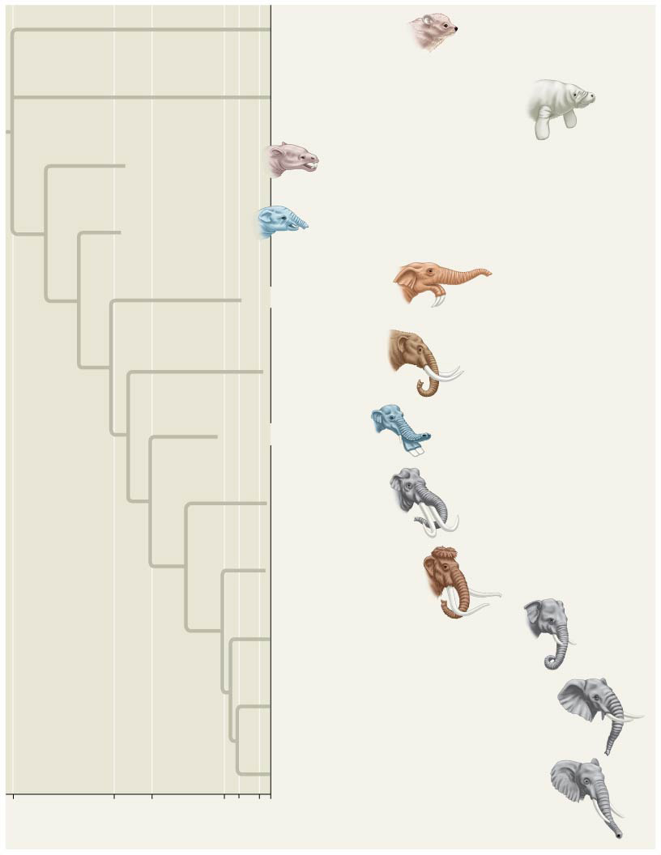
A modern-day branching of elephant-like species matching the very same idea of Darwin’s “I think” sketch!
Hyracoidea
(Hyraxes)
Sirenia
(Manatees and relatives)
†Moeritherium
†Barytherium
†Deinotherium
†Mammut
†Platybelodon
†Stegodon
†Mammuthus
Elephas maximus (Asia)
Loxodonta africana (Africa)
Loxodonta cyclotis (Africa)
60
34
24
2
5.5
10⁴
0
Millions of years ago
Years ago
Notes:
Figure 22.8 Descent with modification.
The dagger symbol (†) denotes extinction.

Slide 31
Concept 22.2: Descent with modification by natural selection – Observations & Inferences
Darwin drew TWO inferences from TWO observations
Observation #1: Members of a population often VARY in their INHERITED traits, thus…
Inference #1: Individuals whose inherited traits give them a HIGHER probability of surviving and reproducing in a given environment tend to leave MORE offspring than other individuals

Slide 32
Concept 22.2: Descent with modification by natural selection – Observations & Inferences
Darwin drew TWO inferences from TWO observations
Observation #2: All species can produce MORE offspring than the environment can support, and many of these offspring FAIL to survive and reproduce
Inference #2: This UNEQUAL ability of individuals to survive and reproduce will lead to the ACCUMULATION of favorable traits in the population over GENERATIONS

Slide 33
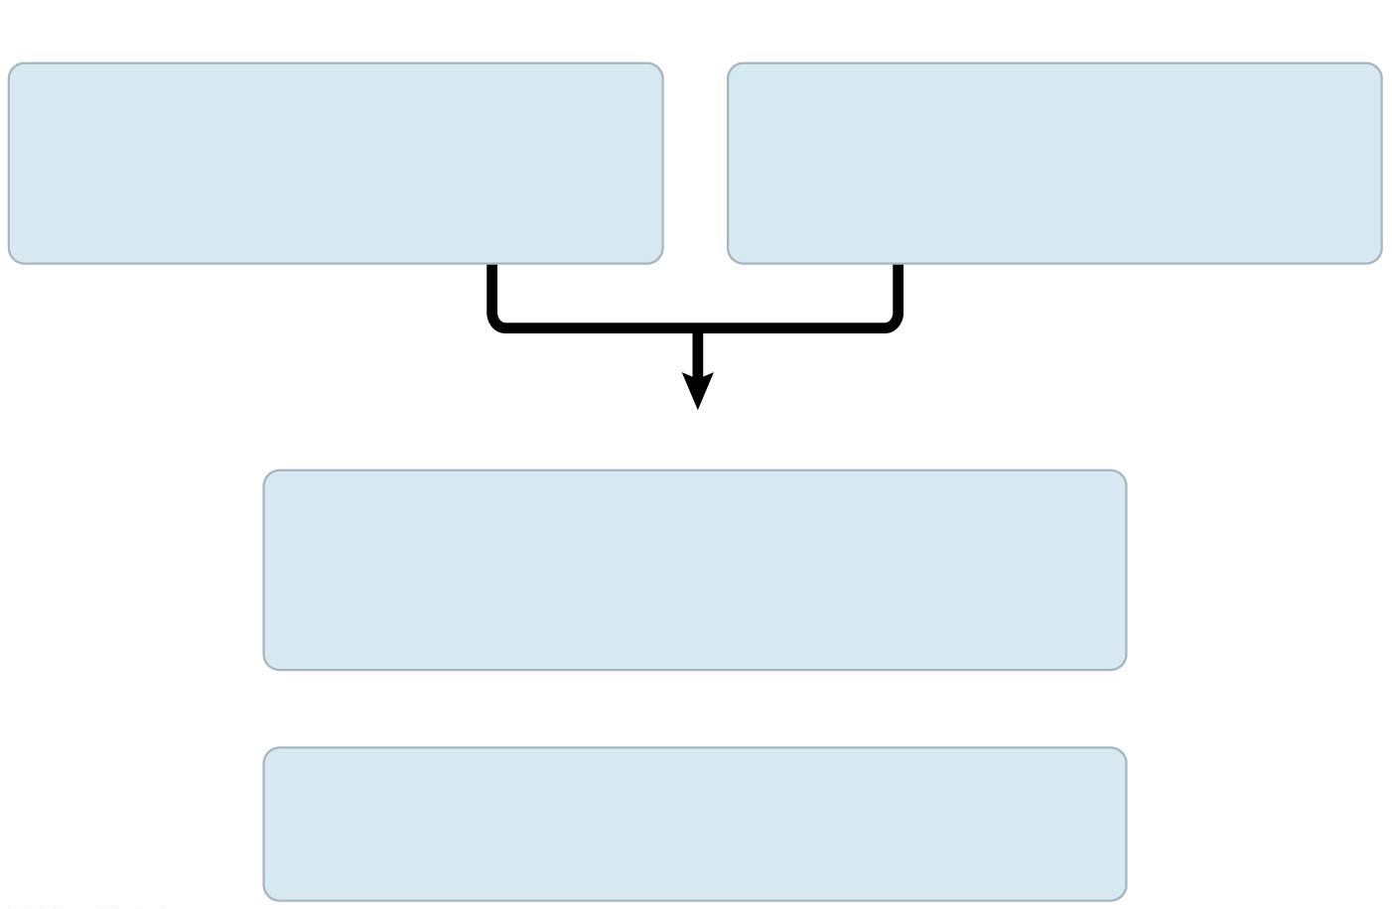
Observations
Individuals in a population
vary in their heritable
characteristics.
Organisms produce more
offspring than the
environment can support.
Inferences
Individuals that are well suited
to their environment tend to leave more
offspring than other individuals.
and
Over time, favorable traits
accumulate in the population.
Notes:
Figure 22.UN03 Summary of key concepts: natural selection

Slide 34
Concept 22.2: Descent with modification by natural selection – Observations & Inferences
If some heritable traits are advantageous, these will ACCUMULATE in a population OVER TIME
Remember change over time
Remember descent with modification
The frequency of individuals with FAVORABLE traits will INCREASE
This process explains the match between organisms and their environment

Slide 35
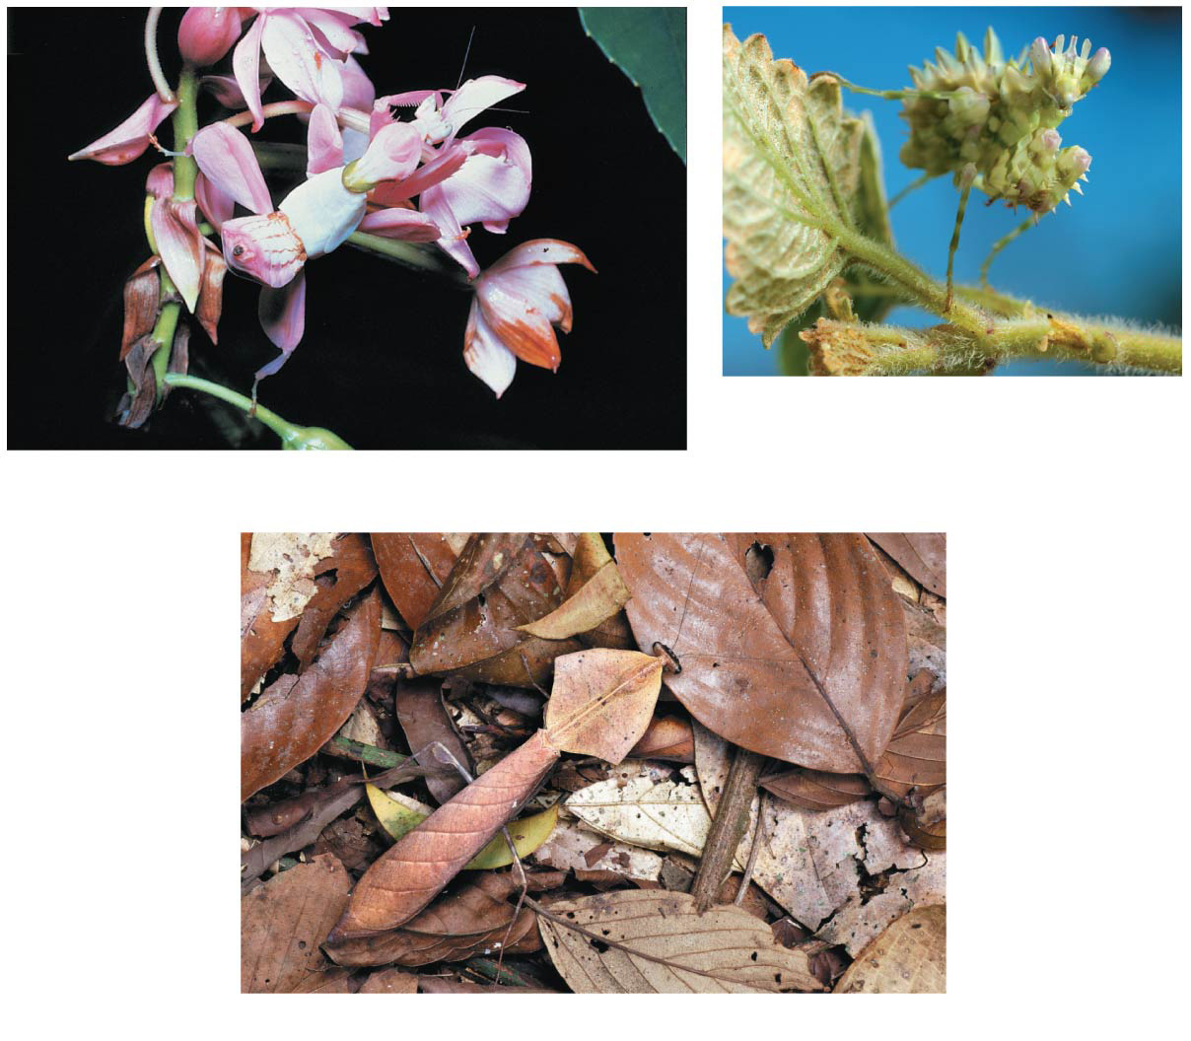
A flower-eyed mantid in South Africa
A flower mantid in Malaysia
A leaf mantid in Borneo
Notes:
Figure 22.12 Camouflage as an example of evolutionary adaptation

Slide 36
Concept 22.2: Descent with modification by natural selection – Summary
Individuals with certain HERITABLE traits survive and reproduce at a HIGHER RATE than other individuals = differential reproductive success
Natural selection = mechanism of evolution
INCREASES the match between organisms and their environment OVER TIME
If an environment changes over time, natural selection may result in adaptation to these new conditions and may give rise to new species

Slide 37
Concept 22.2: Descent with modification by natural selection – Summary
INDIVIDUALS DO NOT EVOLVE
INDIVIDUALS DO NOT EVOLVE
INDIVIDUALS DO NOT EVOLVE
INDIVIDUALS DO NOT EVOLVE
INDIVIDUALS DO NOT EVOLVE
INDIVIDUALS DO NOT EVOLVE
INDIVIDUALS DO NOT EVOLVE

Slide 38
Concept 22.2: Descent with modification by natural selection – Summary
POPULATIONS EVOLVE OVER TIME
POPULATIONS EVOLVE OVER TIME
POPULATIONS EVOLVE OVER TIME

Slide 39
Notes:
Natural selection is based on all of the following except
https://www.polleverywhere.com/multiple_choice_polls/pzZBhEwLnbURWIo

Slide 40
Concept 22.2: Descent with modification by natural selection – Summary
Natural selection can only increase or decrease HERITABLE traits that vary in a population
Natural selection does NOT just “create” new traits!
It edits or selects for traits ALREADY PRESENT in the population!!!
Adaptations VARY with DIFFERENT environments
The current, local environment determines which traits will be selected for or selected against in any specific population

Slide 41
Notes:
What are adaptations?
https://www.polleverywhere.com/multiple_choice_polls/Wfoy7xhkRZI71zy

Slide 42
Notes:
A biologist studied a population of squirrels for 15 years. During that time, the population was never fewer than 30 squirrels and never more than 45. Her data showed that over half of the squirrels born did not survive to reproduce, because of both competition for food and predation. In a single generation, 90% of the squirrels that were born lived to reproduce, and the population increased to 80. Which inference(s) about this population might be true?
https://www.polleverywhere.com/multiple_choice_polls/mQ0tQP7l42IvHc5

Slide 43
Notes:
Which of the following must exist in a population before natural selection can act upon that population?
https://www.polleverywhere.com/multiple_choice_polls/W97XhYYHk6scuOg

Slide 44
Overview
Concept 22.1: The Darwinian revolution challenged traditional views of a young Earth inhabited by unchanging species
Concept 22.2: Descent with modification by natural selection explains the adaptations of organisms and the unity and diversity of life
Concept 22.3: Evolution is supported by an overwhelming amount of scientific evidence

Slide 45
Concept 22.3: Evolution is supported by an overwhelming amount of scientific evidence
There are four types of data that document the pattern of evolution
Direct observations
Homology
The fossil record
Biogeography

Slide 46
Concept 22.3: Evolution is supported by an overwhelming amount of scientific evidence
There are four types of data that document the pattern of evolution
Direct observations
Homology
The fossil record
Biogeography

Slide 47
Concept 22.3: Evolution is supported scientific evidence – Direct Observation
The Evolution of Drug-Resistant Bacteria
The bacterium Staphylococcus aureus is commonly found on people
One strain, methicillin-resistant S. aureus (MRSA) is a dangerous pathogen
Resistance to penicillin evolved in S. aureus by 1945, two years after it was first widely used
Resistance to methicillin evolved in S. aureus by 1961, two years after it was first widely used
MRSA strains are now resistant to many antibiotics

Slide 48
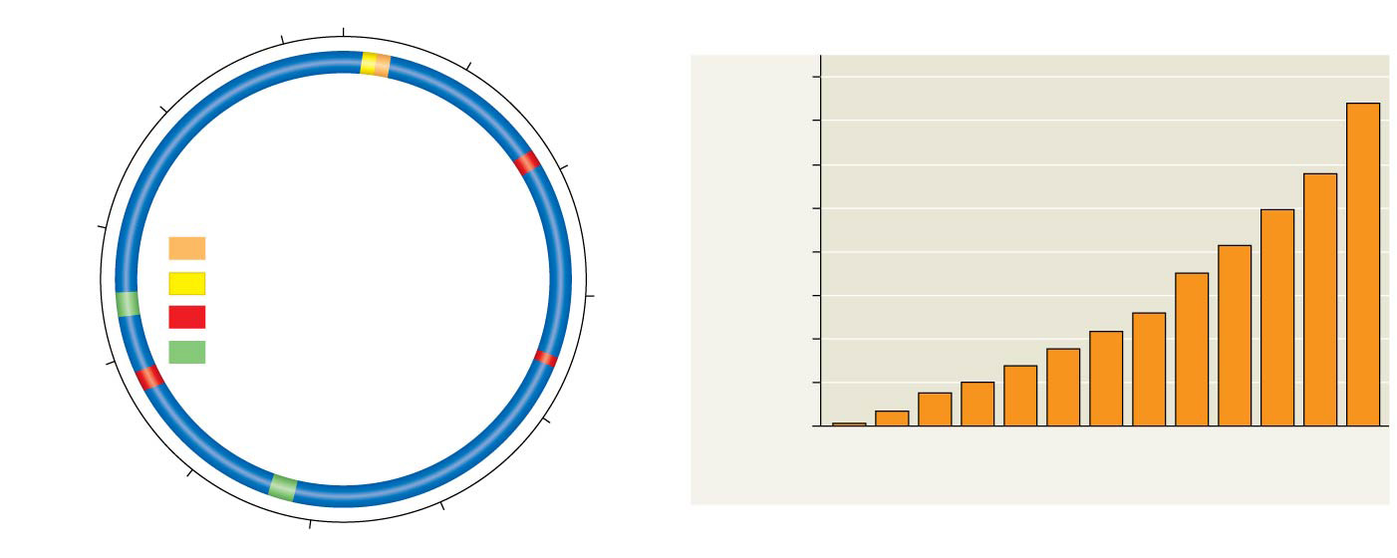
2,750,000
1
250,000 base pairs
400
2,500,000
350
Chromosome map
of S. aureus clone USA300
500,000
300
2,250,000
Key to adaptations
250
Annual hospital admissions
with MRSA (thousands)
Methicillin resistance
200
Ability to colonize hosts
750,000
150
Increased disease severity
100
2,000,000
Increased gene exchange
(within species) and
toxin production
50
1,000,000
0
’93
’94
’95
’96
’97
’98
’99
’00
’01
’02
’03
’04
’05
1,750,000
Year
1,500,000
1,250,000
Notes:
Figure 22.14 The rise of methicillin-resistant Staphylococcus aureus (MRSA)

Slide 49
Notes:
DDT was once considered a "silver bullet" that would permanently eradicate insect pests. Instead, today DDT is largely useless against many insects. Which of the following should have occurred for this pest eradication effort to be successful in the long run?
https://www.polleverywhere.com/multiple_choice_polls/kZ5WEH9M0gdWIGc

Slide 50
Concept 22.3: Evolution is supported by an overwhelming amount of scientific evidence
There are four types of data that document the pattern of evolution
Direct observations
Homology
The fossil record
Biogeography

Slide 51
Concept 22.3: Evolution is supported scientific evidence – Homology
Homology is similarity resulting from COMMON ANCESTRY
Homologous structures are anatomical/structural resemblances that represent variations on a structural theme present in a COMMON ANCESTOR
Ex: Mammalian forelimbs

Slide 52
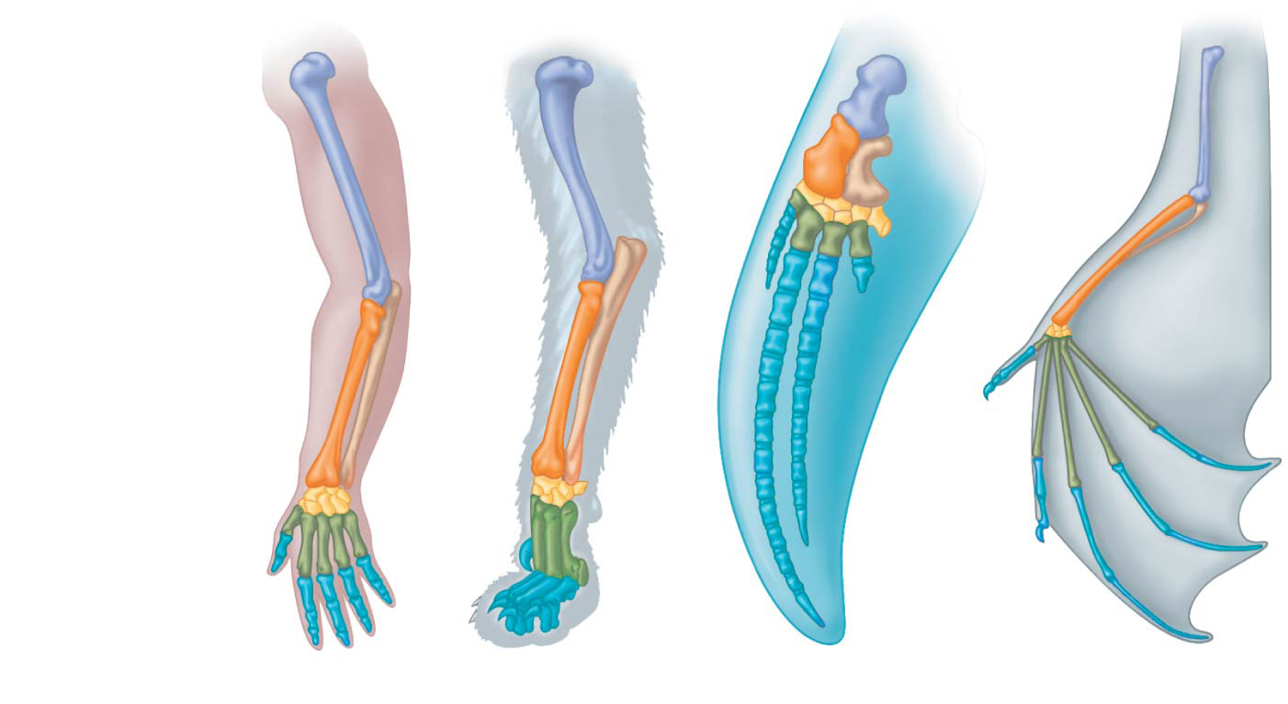
Mammalian forelimbs = most famous homologous structures
Humerus
Radius
Ulna
Carpals
Metacarpals
Phalanges
Human
Cat
Whale
Bat
Unity & Diversity of life, just like Darwin said!
Notes:
Figure 22.15 Mammalian forelimbs: homologous structures

Slide 53
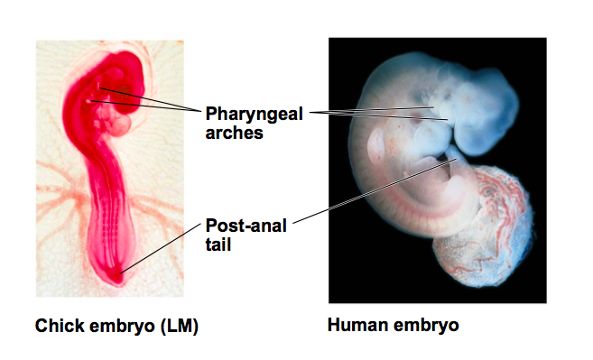
Concept 22.3: Evolution is supported scientific evidence – Homology
Comparative embryology reveals anatomical homologies not visible in adult organisms
Ex: all vertebrate embryos have a post-anal tail and pharyngeal arches
Unity & Diversity of life, just like Darwin said!

Slide 54
Notes:
Of the following anatomical structures, which is homologous to the bones in the wing of a bird?
https://www.polleverywhere.com/multiple_choice_polls/O3Y3rDuBiA1plJg

Slide 55
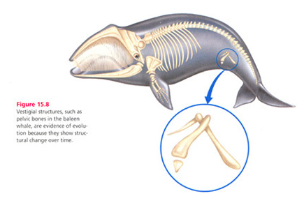
Concept 22.3: Evolution is supported scientific evidence – Homology
Vestigial structures are remnants of features that served important functions in the organism’s ancestors
Pelvic bones are necessary for moving on land…however in the baleen whale, evolution (structural change over time) has led these bones to become vestigial structures

Slide 56
Concept 22.3: Evolution is supported scientific evidence – Homology versus Analogy
Convergent evolution is the evolution of similar, or analogous, features in DISTANTLY related groups
Analogous traits arise when groups INDEPENDENTLY adapt to similar environments in similar ways (similar FUNCTION, not structure)
Convergent evolution does NOT provide information about common ancestry
Ex: Bird wing and insect wing

Slide 57
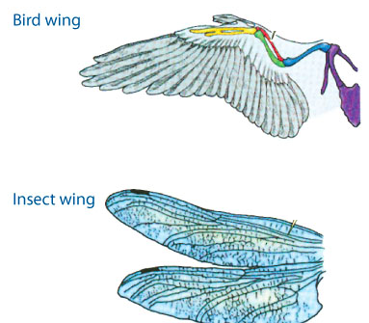
Concept 22.3: Evolution is supported scientific evidence – Analogous Traits
A bird wing and an insect wing both converge on the FUNCTION of flight, but they are NOT homologous!
No recent common ancestor
No structural/bone similarities

Slide 58
Notes:
Analogous features share ________ function but not ________ ancestry.
https://www.polleverywhere.com/multiple_choice_polls/Bs2yVS0lpPMfask

Slide 59
Concept 22.3: Evolution is supported by an overwhelming amount of scientific evidence
There are four types of data that document the pattern of evolution
Direct observations
Homology
The fossil record
Biogeography

Slide 60
Concept 22.3: Evolution is supported scientific evidence – Fossil Record
The fossil record provides evidence of…
Extinction of species
Origin of new groups
Changes within groups over time
Fossils can document important transitions
For example, the transition from land → sea in the ancestors of cetaceans
Change over time, just like Darwin said!

Slide 61
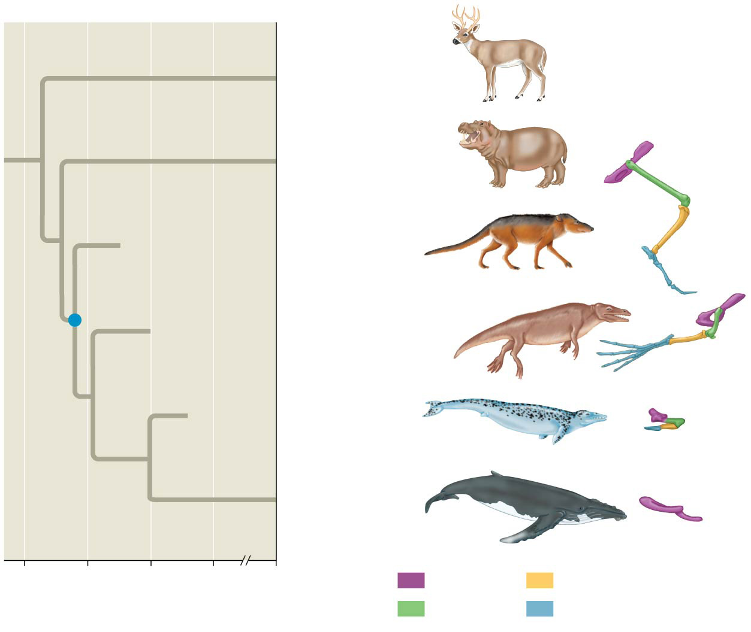
Other even-toed
ungulates
Hippopotamuses
†Pakicetus
†Rodhocetus
†Dorudon
Common
ancestor
of cetaceans
Living
cetaceans
60
50
40
30
0
Key
Pelvis
Tibia
Millions of years ago
Femur
Foot
Notes:
Figure 22.20 The transition to life in the sea
The dagger symbol (†) denotes extinction.

Slide 62
Concept 22.3: Evolution is supported by an overwhelming amount of scientific evidence
There are four types of data that document the pattern of evolution
Direct observations
Homology
The fossil record
Biogeography

Slide 63
Concept 22.3: Evolution is supported scientific evidence – Biogeography
Biogeography, the scientific study of the geographic distribution of species, provides evidence of evolution
Earth’s continents were formerly united in a single large continent called Pangaea, but have since separated by continental drift
An understanding of continent movement and modern distribution of species allows us to predict when and where different groups evolved

Slide 64
Concept 22.3: Evolution is supported scientific evidence – Biogeography
Endemic species are species that are not found anywhere else in the world
Islands have many endemic species that are often closely related to species on the nearest mainland or island
Darwin explained that species from the mainland colonized islands and gave rise to new species as they adapted to new environments

Slide 65
Concept 22.3: Evolution is supported by an overwhelming amount of scientific evidence
There are four types of data that document the pattern of evolution
Direct observations
Homology
The fossil record
Biogeography

Slide 66
Notes:
Which of the following pieces of evidence most strongly supports the common origin of all life on Earth?
https://www.polleverywhere.com/multiple_choice_polls/9xmoTSdp9uVyhqH

Slide 67
Notes:
Over evolutionary time, many cave-dwelling organisms have lost their eyes. Tapeworms have lost their digestive systems. Whales have lost their hind limbs. How can natural selection account for these losses?
https://www.polleverywhere.com/multiple_choice_polls/Wx3GSTC99pUrfVm

Slide 68
Overview
Concept 22.1: The Darwinian revolution challenged traditional views of a young Earth inhabited by unchanging species
Concept 22.2: Descent with modification by natural selection explains the adaptations of organisms and the unity and diversity of life
Concept 22.3: Evolution is supported by an overwhelming amount of scientific evidence

Slide 69
What Is “Theoretical” About Darwin’s View of Life?
In science, a theory accounts for many observations and explains and integrates a great variety of phenomena
The predictions of a scientific theory must stand up to continual testing by experimentation and observation
Darwin’s theory of evolution by natural selection integrates diverse areas of biological study and stimulates many new research questions
Ongoing research adds to our understanding of evolution
Notes:
69

