Slide 1
21
Genomes and Their Evolution

Slide 2
Reading the Leaves from the Tree of Life
Complete genome sequences exist for a human, chimpanzee, E. coli, brewer’s yeast, corn, fruit fly, house mouse, rhesus macaque, and many other organisms
COMPARISONS of genomes among organisms provide insights into evolution and other biological processes
Genomics is the study of whole sets of genes and their interactions
Bioinformatics is the application of computational methods to the storage and analysis of biological data

Slide 3
Overview
Concept 21.1: The Human Genome Project fostered development of faster, less expensive sequencing techniques
Concept 21.2: Scientists use bioinformatics to analyze genomes and their functions
Concept 21.3: Genomes vary in size, number of genes, and gene density
Concept 21.4: Multicellular eukaryotes have much noncoding DNA and many multigene families
Concept 21.5: Duplication, rearrangement, and mutation of DNA contribute to genome evolution
Concept 21.6: Comparing genome sequences provides clues to evolution and development

Slide 4
Overview
Concept 21.2: Scientists use bioinformatics to analyze genomes and their functions
Concept 21.3: Genomes vary in size, number of genes, and gene density
Concept 21.4: Multicellular eukaryotes have much noncoding DNA
Concept 21.5: Duplication, rearrangement, and mutation of DNA contribute to genome evolution
Concept 21.6: Comparing genome sequences provides clues to evolution and development

Slide 5
Concept 21.2: Scientists use bioinformatics to analyze genomes and their functions
Bioinformatics resources are provided by a number of sources
Genbank, the NCBI database of sequences, doubles its data approximately every 18 months…you can find:
A specific DNA sequence
A predicted protein sequence
Common stretches of amino acids in a protein
3-D views of all protein structures that have been determined

Slide 6
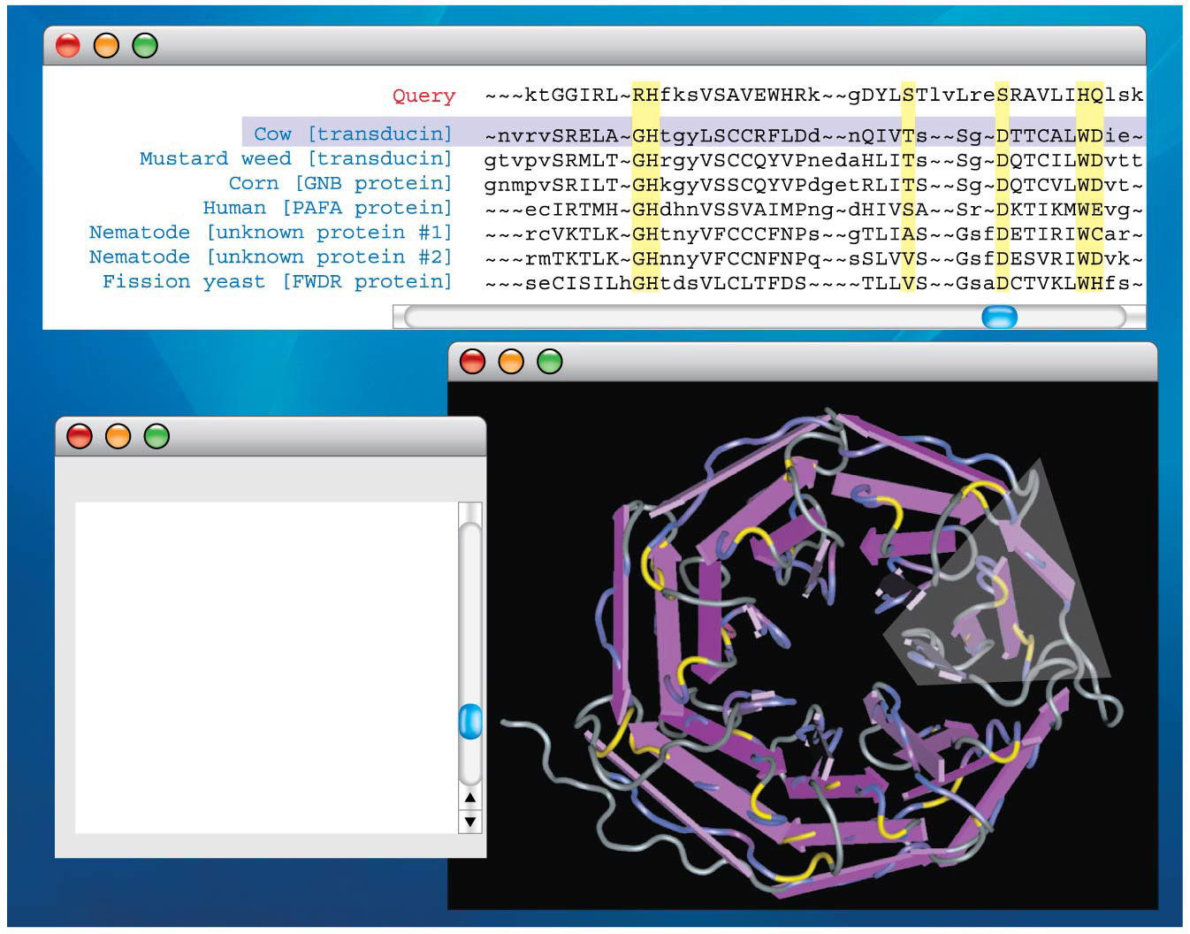
Figure 21.3
WD40 - Sequence Alignment Viewer
WD40 - Cn3D 4.1
CDD Descriptive Items
Name: WD40
WD40 domain, found in a number of eukaryotic proteins that cover a wide variety of functions including adaptor/regulatory modules in signal transduction, pre-mRNA processing and cytoskeleton assembly; typically contains a GH dipeptide 11-24 residues from its N-terminus and the WD dipeptide at its C-terminus and is 40 residues long, hence the name WD40;
Notes:
Figure 21.3 Bioinformatics tools that are available on the Internet

Slide 7
Overview
Concept 21.2: Scientists use bioinformatics to analyze genomes and their functions
Concept 21.3: Genomes vary in size, number of genes, and gene density
Concept 21.4: Multicellular eukaryotes have much noncoding DNA
Concept 21.5: Duplication, rearrangement, and mutation of DNA contribute to genome evolution
Concept 21.6: Comparing genome sequences provides clues to evolution and development

Slide 8
Concept 21.3: Genomes vary in size, number of genes, and gene density – Genome Size
Genomes of most bacteria and archaea range from 1 to 6 million base pairs (Mb); genomes of eukaryotes are usually larger
Most plants and animals have genomes greater than 100 Mb; humans have 3,000 Mb
Within each domain, there is no systematic relationship between genome size and phenotype

Slide 9
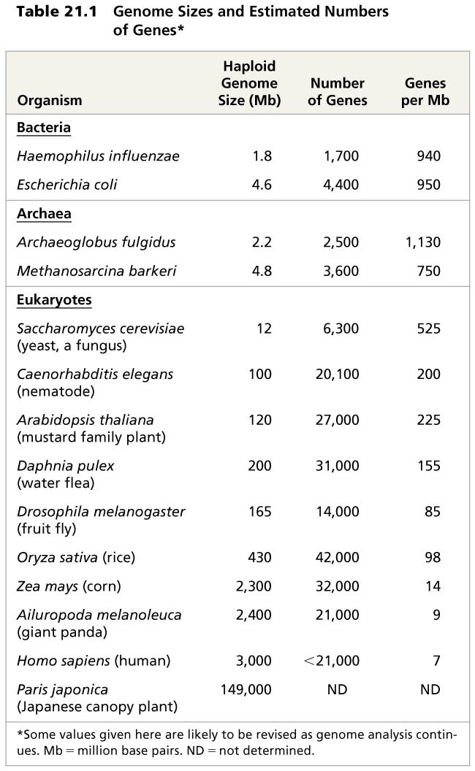
Table 21.1
Notes:
Table 21.1 Genome sizes and estimated numbers of genes

Slide 10
Concept 21.3: Genomes vary in size, number of genes, and gene density – Number of Genes
Number of genes is NOT correlated to genome size
For example, it is estimated that the nematode C. elegans has 100 Mb and 20,100 genes, while Drosophila has 165 Mb and 14,000 genes
Researchers predicted the human genome would contain about 50,000 to 100,000 genes; however the number is around 21,000
Vertebrate genomes can produce more than one polypeptide per gene because of alternative splicing of RNA transcripts

Slide 11
Concept 21.3: Genomes vary in size, number of genes, and gene density – Gene Density
Humans and other mammals have the LOWEST gene density, or number of genes, in a given length of DNA…why?
Multicellular eukaryotes have MANY INTRONS within genes and a large amount of NONCODING DNA between genes
Introns = intervening sequences within a gene that are txned along with exons (expressed) to pre-mRNA
Noncoding DNA = regulatory sequences NOT txned

Slide 12
Notes:
Why might the cricket genome have eleven times as many base pairs as that of Drosophila melanogaster?
https://www.polleverywhere.com/multiple_choice_polls/467yLNwoqVlDkmU

Slide 13
Notes:
The comparison between the number of human genes and those of other animal species has led to many conclusions, including that _____.
https://www.polleverywhere.com/multiple_choice_polls/KulS781ehAw9NBu

Slide 14
Overview
Concept 21.2: Scientists use bioinformatics to analyze genomes and their functions
Concept 21.3: Genomes vary in size, number of genes, and gene density
Concept 21.4: Multicellular eukaryotes have much noncoding DNA
Concept 21.5: Duplication, rearrangement, and mutation of DNA contribute to genome evolution
Concept 21.6: Comparing genome sequences provides clues to evolution and development

Slide 15
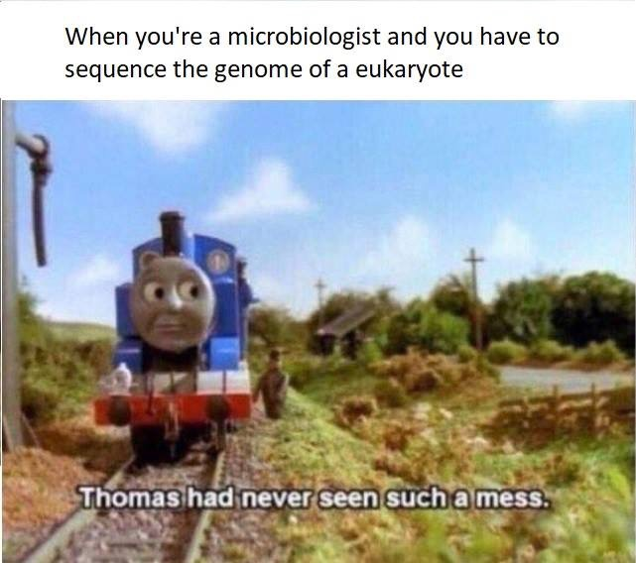

Slide 16
Concept 21.4: Multicellular eukaryotes have much noncoding DNA
Sequencing of the human genome reveals that 98.5% does NOT code for proteins, rRNAs, or tRNAs
Intergenic DNA is noncoding DNA found between genes
Pseudogenes are former genes that have accumulated mutations and are nonfunctional
Repetitive DNA is present in multiple copies in the genome

Slide 17
Concept 21.4: Multicellular eukaryotes have much noncoding DNA
The big question is…why???
Much evidence indicates that noncoding DNA (previously called “junk DNA”) plays important roles in the cell…so don’t ever call it “junk DNA” anymore!
For example, genomes of humans, rats, and mice show high sequence conservation for about 500 noncoding regions

Slide 18
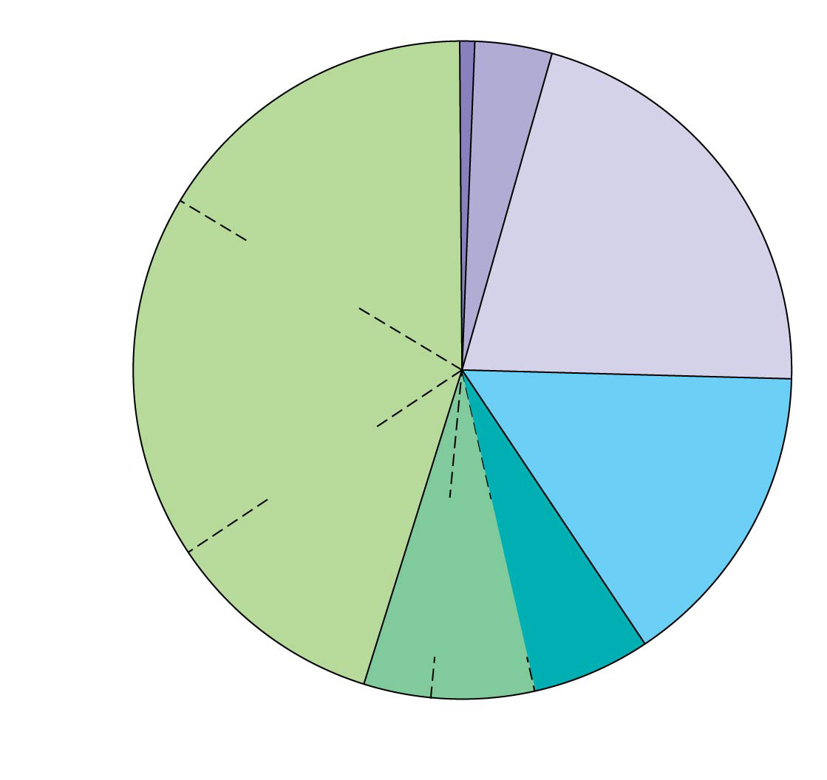
Figure 21.6
Regulatory sequences (5%)
Exons (1.5%)
What is this?
Introns (∼20%)
Repetitive DNA that includes transposable elements and related sequences (44%)
Unique noncoding DNA (15%)
L1 sequences (17%)
Repetitive DNA unrelated to transposable elements (14%)
Alu elements (10%)
Simple sequence DNA (3%)
Large-segment duplications (5–6%)
Notes:
Figure 21.6 Types of DNA sequences in the human genome

Slide 19
Concept 21.4: Multicellular eukaryotes have much noncoding DNA
Transposable elements (aka “jumping genes”) move from one site to another in a cell’s DNA; they are present in both prokaryotes and eukaryotes
The first evidence for mobile DNA segments came from geneticist Barbara McClintock’s breeding experiments with Indian corn (1983 Nobel Prize)
McClintock identified changes in the color of corn kernels that made sense only if some genetic elements move from other genome locations into the genes for kernel color

Slide 20
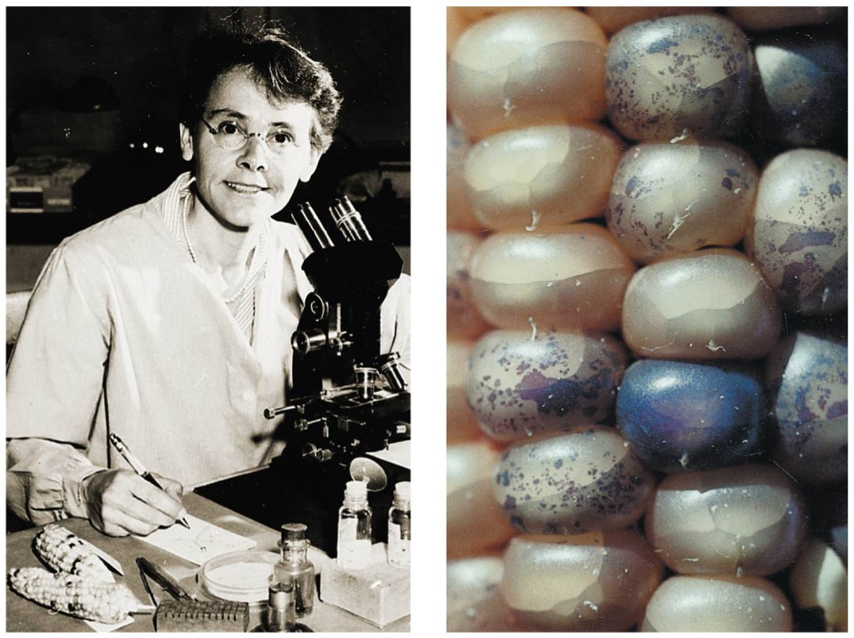
The effect of transposable elements on corn kernel color
Notes:
Figure 21.7 The effect of transposable elements on corn kernel color

Slide 21
Notes:
It is more difficult to identify eukaryotic genes than prokaryotic genes because in eukaryotes _____.
https://www.polleverywhere.com/multiple_choice_polls/LqrJP4i3BzOAWyj

Slide 22
Notes:
Sequencing eukaryotic genomes is more difficult than sequencing genomes of bacteria or archaea because of the _____.
https://www.polleverywhere.com/multiple_choice_polls/07QF7ZqhwzGviR0

Slide 23
Overview
Concept 21.2: Scientists use bioinformatics to analyze genomes and their functions
Concept 21.3: Genomes vary in size, number of genes, and gene density
Concept 21.4: Multicellular eukaryotes have much noncoding DNA
Concept 21.5: Duplication, rearrangement, and mutation of DNA contribute to genome evolution
Concept 21.6: Comparing genome sequences provides clues to evolution and development

Slide 24
Concept 21.5: Duplication, rearrangement, and mutation of DNA contribute to genome evolution
The basis of change at the genomic level is mutation, which underlies much of genome evolution
The earliest forms of life likely had ONLY those genes necessary for survival and reproduction
The size of genomes has increased over evolutionary time, with the extra genetic material providing raw material for gene diversification

Slide 25
Concept 21.5: Duplication, rearrangement, and mutation of DNA contribute to genome evolution – Transposable elements
Functions of Transposons
Multiple copies of similar transposable elements may facilitate RECOMBINATION, or crossing over, between different chromosomes
Insertion of transposable elements within a protein-coding sequence may BLOCK protein production
Insertion of transposable elements within a regulatory sequence may INCREASE OR DECREASE protein production

Slide 26
Concept 21.5: Duplication, rearrangement, and mutation of DNA contribute to genome evolution – Transposable elements
Functions of Transposons
Transposable elements may carry a gene or groups of genes to a NEW POSITION
Transposable elements may also create NEW SITES FOR ALTERNATIVE SPLICING in an RNA transcript
These genomic changes are usually detrimental but may, on occasion, prove advantageous to an organism

Slide 27
Notes:
Which of the following can be duplicated in a genome?
https://www.polleverywhere.com/multiple_choice_polls/TAKLfb8V45qkICL

Slide 28
Overview
Concept 21.2: Scientists use bioinformatics to analyze genomes and their functions
Concept 21.3: Genomes vary in size, number of genes, and gene density
Concept 21.4: Multicellular eukaryotes have much noncoding DNA
Concept 21.5: Duplication, rearrangement, and mutation of DNA contribute to genome evolution
Concept 21.6: Comparing genome sequences provides clues to evolution and development

Slide 29
Concept 21.6: Comparing genome sequences provides clues to evolution and development
Comparisons of genome sequences from different species reveal much about the evolutionary history of life
Genome comparisons of closely related species help us understand recent evolutionary events
Relationships among species can be represented by a tree-shaped diagram

Slide 30
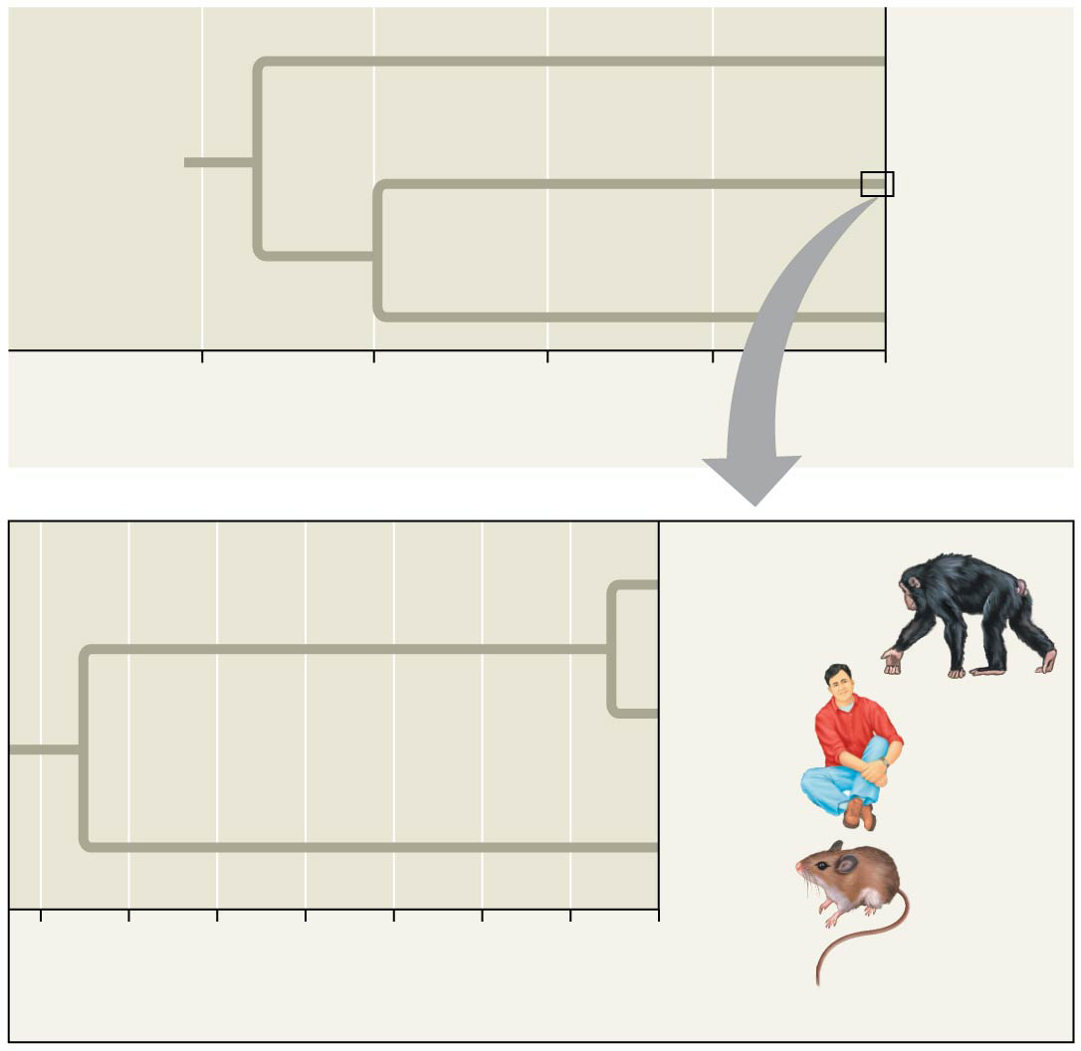
Figure 21.17
Bacteria
Most recent common ancestor of all living things
Eukarya
Archaea
4 3 2 1 0
Billions of years ago
Chimpanzee
Human
Mouse
70 60 50 40 30 20 10 0
Millions of years ago
Notes:
Figure 21.17 Evolutionary relationships of the three domains of life

Slide 31
Concept 21.6: Comparing genome sequences provides clues to evolution and development
Comparing DISTANTLY Related Species
Highly conserved genes have changed very LITTLE over time
These help clarify relationships among species that diverged from each other long ago
Bacteria, archaea, and eukaryotes diverged from each other between 2 and 4 billion years ago
Highly conserved genes can be studied in one model organism, and the results applied to other organisms

Slide 32
Concept 21.6: Comparing genome sequences provides clues to evolution and development
Comparing CLOSELY Related Species
Genomes of closely related species are likely to be organized similarly
For example, using the human genome sequence as a guide, researchers were quickly able to sequence the chimpanzee genome
Analysis of the human and chimpanzee genomes reveals some general differences that underlie the differences between the two organisms

Slide 33
Concept 21.6: Comparing genome sequences provides clues to evolution and development
Comparing Genomes Within a Species
As a species, humans have only been around about 200,000 years*** and have low within-species genetic variation
Variation within humans is due to single nucleotide polymorphisms (SNPs), inversions, deletions, and duplications
Most surprising is the large number of copy-number variants—these variations are useful for studying human evolution and human health

Slide 34
Notes:
Fragments of DNA have been extracted from the remnants of extinct woolly mammoths, amplified, and sequenced. These can now be used to _____.
https://www.polleverywhere.com/multiple_choice_polls/CB5Ozx5epyUWGmL

Slide 35
Notes:
A recent study compared the Homo sapiens genome with that of Neanderthals. The results of the study indicated that there was a mixing of the two genomes at some period in evolutionary history. Additional data consistent with this hypothesis could be the discovery of _____.
https://www.polleverywhere.com/multiple_choice_polls/4rwd1NA92FZEPrz

Slide 36
Overview
Concept 21.2: Scientists use bioinformatics to analyze genomes and their functions
Concept 21.3: Genomes vary in size, number of genes, and gene density
Concept 21.4: Multicellular eukaryotes have much noncoding DNA
Concept 21.5: Duplication, rearrangement, and mutation of DNA contribute to genome evolution
Concept 21.6: Comparing genome sequences provides clues to evolution and development

Slide 37
