Slide 1
0
Mendel and the Gene Idea
14

Slide 2
Drawing from the Deck of Genes
What principles account for the passing of traits from parents to offspring?
The “blending” hypothesis is the idea that genetic material from the two parents blends together (like blue and yellow paint blend to make green)
The “particulate” hypothesis is the idea that parents pass on DISCRETE HERITABLE UNITS (genes)
Mendel documented a PARTICULATE mechanism through his experiments with garden peas

Slide 3
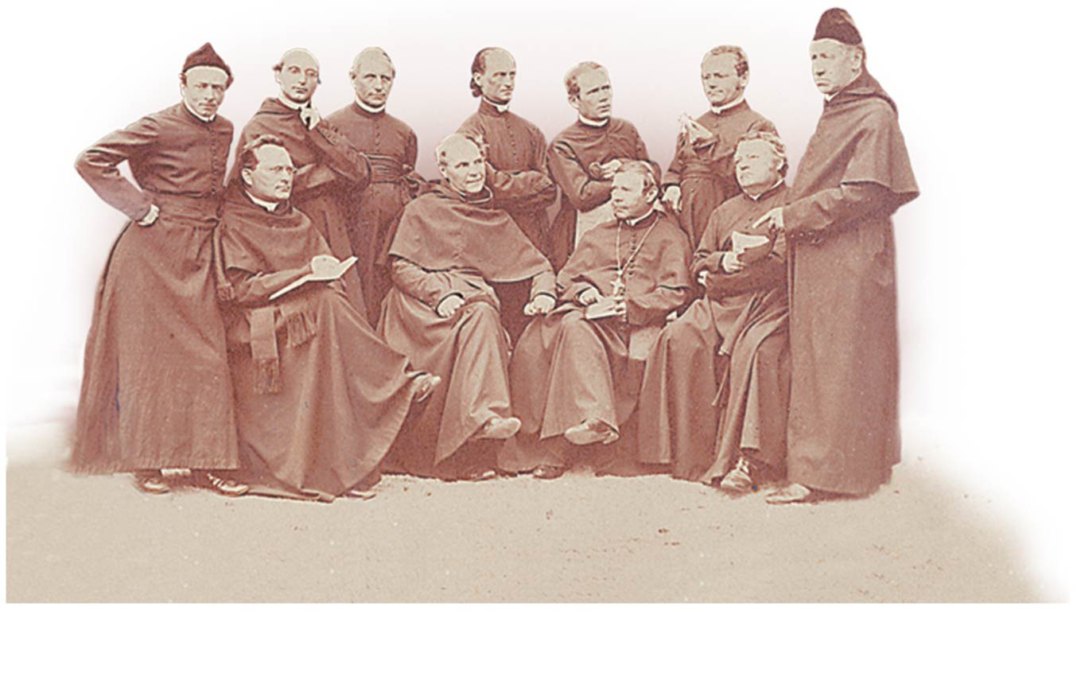
Mendel (third from right, holding a sprig of fuchsia)
with his fellow monks.
Notes:
Figure 14.1a What principles of inheritance did Gregor Mendel discover by breeding garden pea plants? (part 1: Mendel with fellow monks)

Slide 4
#squadgoals
GOAT
Mendel (third from right, holding a sprig of fuchsia)
with his fellow monks.
Notes:
Figure 14.1a What principles of inheritance did Gregor Mendel discover by breeding garden pea plants? (part 1: Mendel with fellow monks)

Slide 5
Overview
Concept 14.1: Mendel used the scientific approach to identify two laws of inheritance
Concept 14.2: Probability laws govern Mendelian inheritance

Slide 6
Overview
Concept 14.1: Mendel used the scientific approach to identify two laws of inheritance
Concept 14.2: Probability laws govern Mendelian inheritance

Slide 7
Concept 14.1: Mendel used the scientific approach to identify two laws of inheritance
Mendel discovered the basic principles of HEREDITY by breeding garden peas in carefully planned experiments (quantitative approach)
A heritable feature that varies among individuals is called a character
Character = flower color
Each variant for a character is called a trait
Trait = purple or white flower color

Slide 8
Concept 14.1: Mendel used the scientific approach to identify two laws of inheritance
Mendel chose to track only those characters that occurred in TWO distinct alternative forms
He also used varieties that were true-breeding
Plants that produce offspring of the same variety when they self-pollinate
In a typical experiment, Mendel mated two contrasting, true-breeding varieties, a process called hybridization

Slide 9
HERE WE GO…MENDEL’S AMAZING, GENIUS EXPERIMENT!
P generation = True-breeding parents
F₁ generation = Hybrid offspring of the P generation
F₂ generation = F₁ individuals self-pollinate or cross- pollinate with other F₁ hybrids

Slide 10
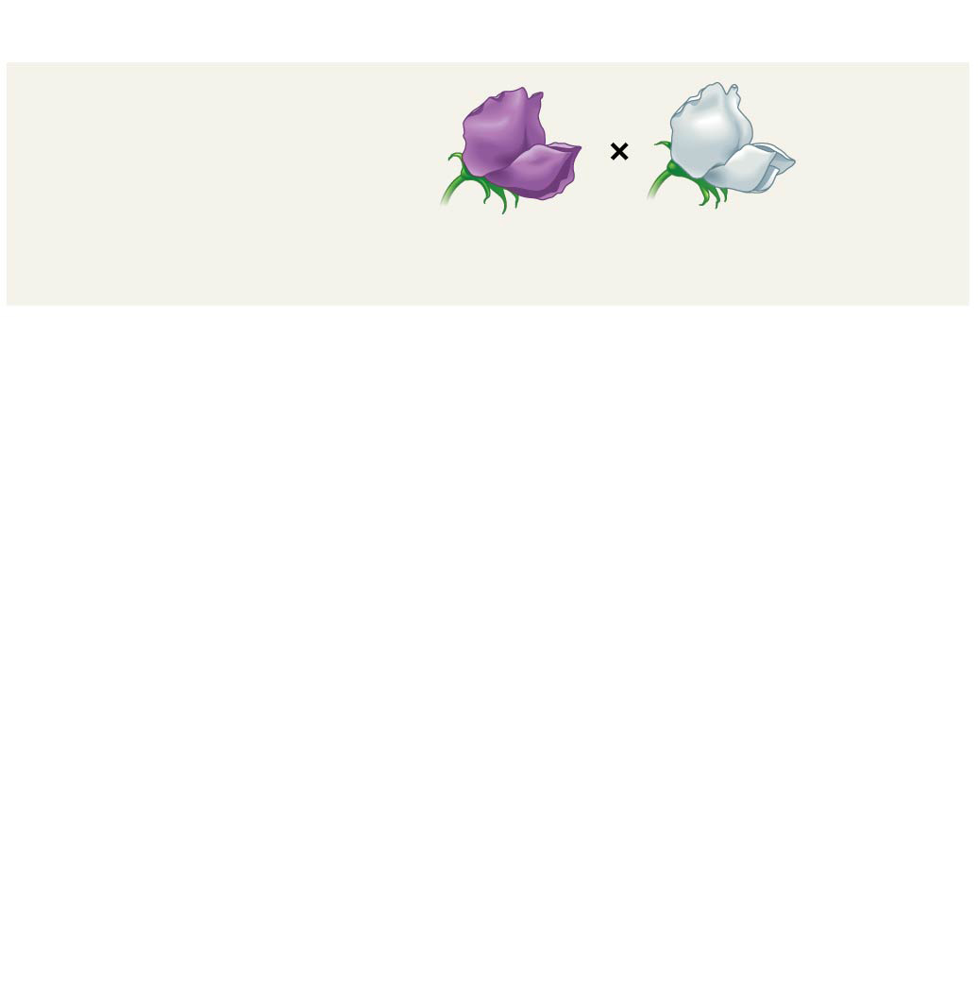
Figure 14.3-1
Experiment
P Generation
(true-breeding
parents)
Purple
flowers
White
flowers
Notes:
Figure 14.3-1 Inquiry: When F₁ hybrid pea plants self- or cross-pollinate, which traits appear in the F₂ generation? (step 1)

Slide 11
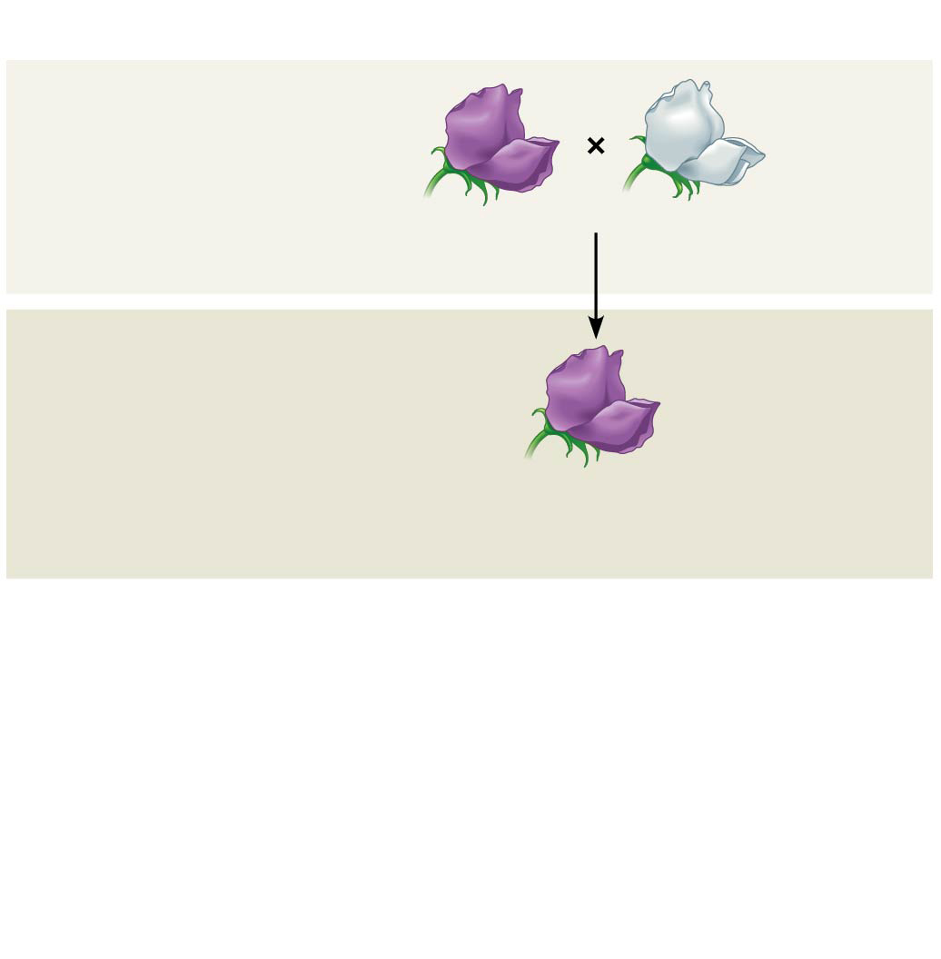
Figure 14.3-2
Experiment
P Generation
(true-breeding
parents)
Purple
flowers
White
flowers
F₁ Generation
(hybrids)
All plants had purple flowers
Self- or cross-pollination
Notes:
Figure 14.3-2 Inquiry: When F₁ hybrid pea plants self- or cross-pollinate, which traits appear in the F₂ generation? (step 2)

Slide 12
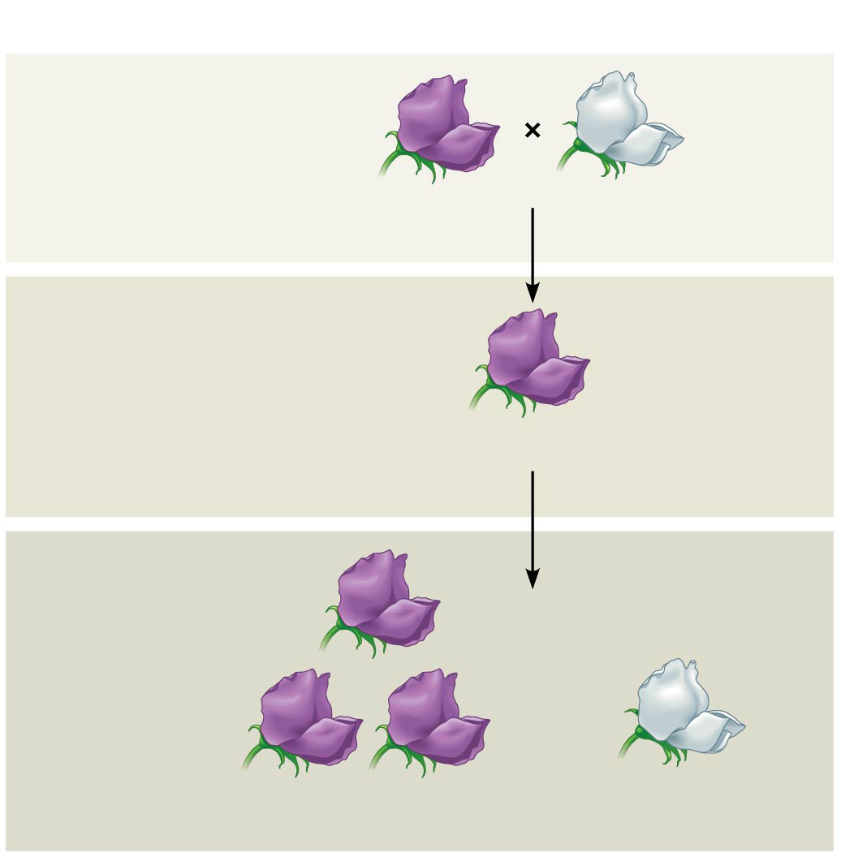
Figure 14.3-3
Experiment
P Generation
(true-breeding
parents)
Purple
flowers
White
flowers
F₁ Generation
(hybrids)
All plants had purple flowers
Self- or cross-pollination
F₂ Generation
705 purple-flowered
plants
224 white-flowered
plants
Notes:
Figure 14.3-3 Inquiry: When F₁ hybrid pea plants self- or cross-pollinate, which traits appear in the F₂ generation? (step 3)

Slide 13
So WHAT just happened…
Cross #1 (P Generation): When Mendel crossed contrasting, true-breeding white- and purple-flowered pea plants, ALL of the F₁ hybrids were purple
Cross #2 (F₁ Generation): When Mendel crossed the F₁ hybrids, many of the F₂ plants had purple flowers, but some had white
F₂ Generation Results: Mendel discovered a ratio of ~3:1, purple to white flowers, in the F₂ generation

Slide 14
So WHY did that just happen…
Mendel reasoned that only the purple flower “factor” was affecting flower color in the F₁ hybrids
Mendel called the purple flower color a DOMINANT trait and the white flower color a RECESSIVE trait
The “factor” for white flowers was not “diluted’ or “destroyed” because it reappeared in the F₂ generation…
What Mendel called a “heritable factor” is what we now call a “gene”!!!

Slide 15
Drawing from the Deck of Genes
What principles account for the passing of traits from parents to offspring?
The “blending” hypothesis is the idea that genetic material from the two parents blends together (like blue and yellow paint blend to make green)
The “particulate” hypothesis is the idea that parents pass on DISCRETE HERITABLE UNITS (genes)
Mendel documented a PARTICULATE mechanism through his experiments with garden peas

Slide 16
Notes:
What was the most significant conclusion that Gregor Mendel drew from his experiments with pea plants?
https://www.polleverywhere.com/multiple_choice_polls/GGt9QvtWtr0Qxb7

Slide 17
Notes:
Mendel continued some of his experiments into the F2 or F3 generation to _____.
https://www.polleverywhere.com/multiple_choice_polls/hoY5YVodolQS2c7

Slide 18
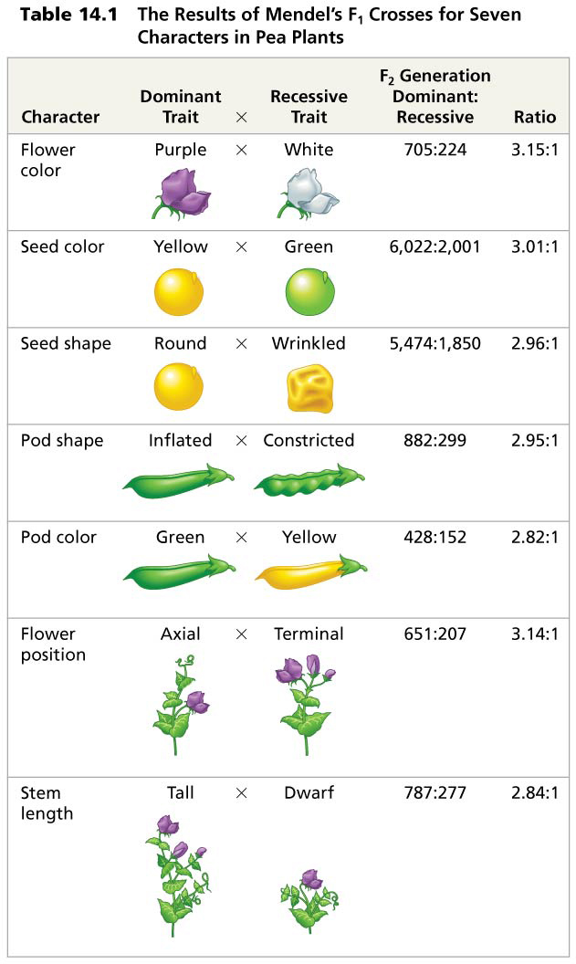
Table 14.1
Notes:
Table 14.1 The results of Mendel’s F₁ crosses for seven characters in pea plants

Slide 19
Mendel’s Model: A Closer Look
Mendel developed a complete hypothesis with 4 key points to explain the 3:1 inheritance pattern he observed in F₂ offspring
Alternative versions of genes account for variations in inherited characters
For each character, an organism inherits two alleles, one from each parent
Dominant/recessive allele relationship
Mendel’s 1st Law: Law of segregation
These concepts can be related to what we now know about genes and chromosomes over 100 years later!!!

Slide 20
Mendel’s Model: A Closer Look
Alternative versions of genes account for variations in inherited characters
For example, the gene for flower color in pea plants exists in two versions, one for purple flowers and the other for white flowers
These alternative versions of a gene are called alleles
Each gene resides at a specific locus on a specific chromosome

Slide 21
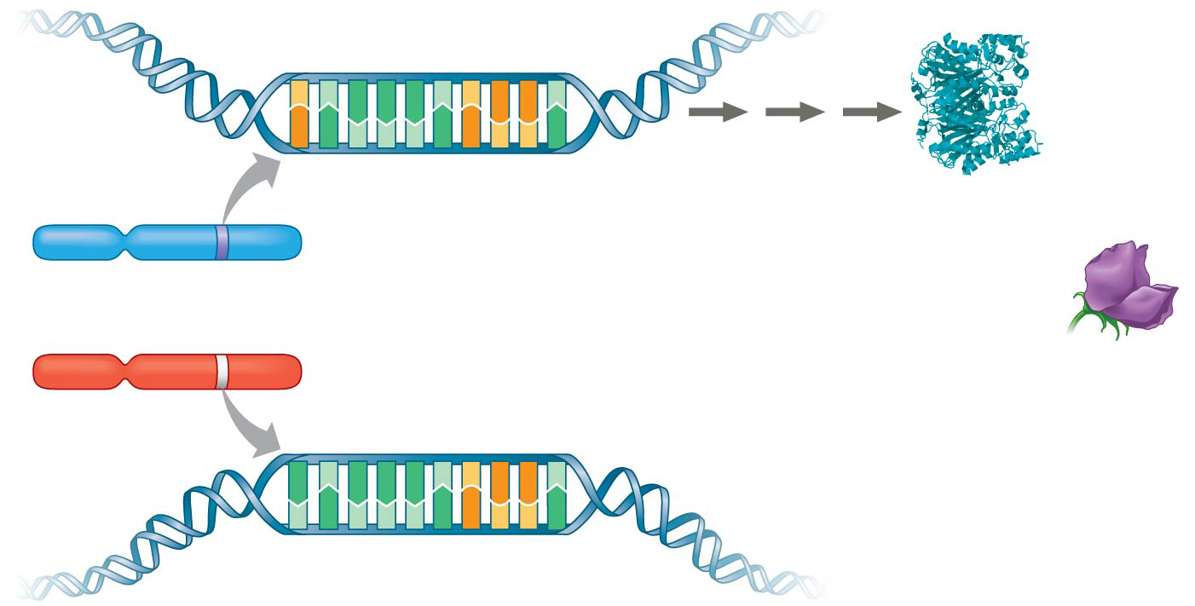
Figure 14.4
Enzyme
C
T
A
A
A
T
C
G
G
T
Allele for
purple flowers
G
A
T
T
T
A
G
C
C
A
CTAAATCGGT
Enzyme that helps
synthesize purple
pigment
Locus for
flower-color gene
Pair of
homologous
chromosomes
One allele
results in
sufficient
pigment
Allele for
white flowers
A
T
A
A
A
T
C
G
G
T
Absence of enzyme
T
A
T
T
T
A
G
C
C
A
ATAAATCGGT
Notes:
Figure 14.4 Alleles, alternative versions of a gene

Slide 22
Mendel’s Model: A Closer Look
For each character, an organism inherits two alleles, one from each parent
Mendel made this deduction without knowing ANYTHING about chromosomes! GENIUS!
The two alleles at a particular locus may be identical, as in the true-breeding plants of Mendel’s P generation
Alternatively, the two alleles at a locus may differ, as in the F₁ hybrids

Slide 23
Mendel’s Model: A Closer Look
Dominant/recessive allele relationship
If the two alleles at a locus differ…
Then one (the dominant allele) determines the organism’s appearance and the other (the recessive allele) has no noticeable effect on appearance
Dominant alleles “mask” recessive alleles
In the flower-color example, the F₁ plants had purple flowers because the allele for that trait is dominant (purple > white)

Slide 24
Notes:
Why did the F1 offspring of Mendel's classic pea cross always look like one of the two parental varieties?
https://www.polleverywhere.com/multiple_choice_polls/96Hs7qTU1cR4gqi

Slide 25
Notes:
Mendel accounted for the observation that traits that had disappeared in the F1 generation reappeared in the F2 generation by proposing that _____.
https://www.polleverywhere.com/multiple_choice_polls/kYITrUTkDsLxzrw

Slide 26
Mendel’s Model: A Closer Look
Mendel’s 1st Law: Law of segregation
The two alleles for a heritable character separate (segregate) during gamete formation and end up in DIFFERENT haploid gametes
Thus, an egg or a sperm gets only ONE of the two alleles that are present in the organism
We’ll look at Mendel’s 2nd law (Law of Independent Assortment) later…

Slide 27
Notes:
Mendel's observation of the segregation of alleles in gamete formation has its basis in which of the following phases of cell division?
https://www.polleverywhere.com/multiple_choice_polls/Xn6daFGjBy0cNfA

Slide 28
Mendel’s Model: A Closer Look
Conclusion: The model accounts for the 3:1 ratio observed in the F₂ generation of Mendel’s crosses
Possible combinations of sperm and egg can be shown using a Punnett square
A capital letter represents a dominant allele, and a lowercase letter represents a recessive allele

Slide 29
Figure 14.5-1
P Generation
Appearance:
Genetic makeup:
Purple flowers
PP
White flowers
pp
Gametes:
P
p
Notes:
Figure 14.5-1 Mendel’s law of segregation (step 1)

Slide 30
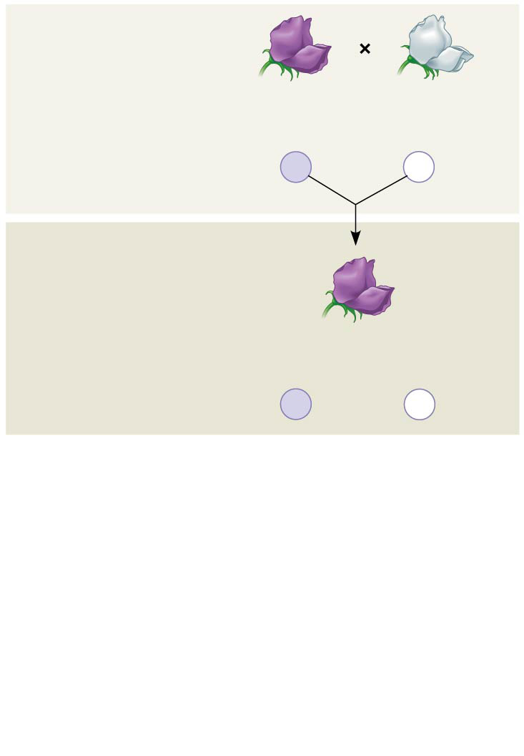
Figure 14.5-2
P Generation
Appearance:
Genetic makeup:
Purple flowers
PP
White flowers
pp
Gametes:
P
p
F₁ Generation
Appearance:
Genetic makeup:
Purple flowers
Pp
Gametes:
1
1
p
2
P
2
Notes:
Figure 14.5-2 Mendel’s law of segregation (step 2)

Slide 31
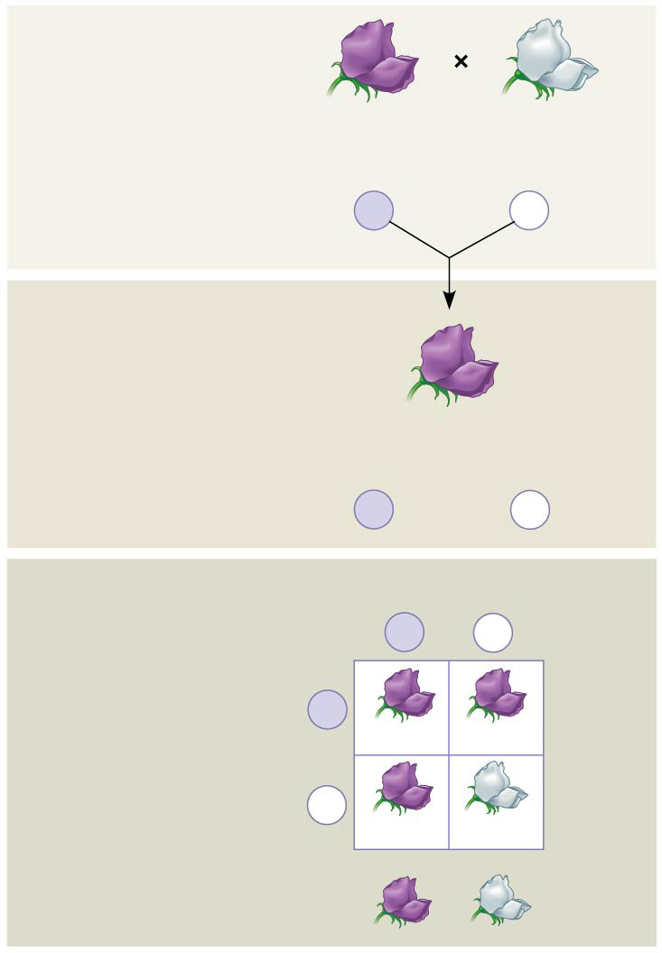
Figure 14.5-3
P Generation
Appearance:
Genetic makeup:
Purple flowers
PP
White flowers
pp
Gametes:
P
p
F₁ Generation
Appearance:
Genetic makeup:
Purple flowers
Pp
Gametes:
1
1
p
2
P
2
Sperm from F₁ (Pp) plant
F₂ Generation
P
p
P
Eggs from
F₁ (Pp) plant
PP
Pp
p
Pp
pp
3
: 1
Notes:
Figure 14.5-3 Mendel’s law of segregation (step 3)

Slide 32
Genetics 101: Useful vocab
An organism with two identical alleles for a character is homozygous for the gene controlling that character
An organism that has two different alleles for a gene is heterozygous for the gene controlling that character
Unlike homozygotes, heterozygotes are NOT true-breeding

Slide 33
Genetics 101: More useful vocab
Because of the different effects of dominant and recessive alleles, an organism’s physical traits do not always reveal its genetic composition
Therefore, we need to distinguish between an organism’s…
Phenotype = physical appearance
Genotype = genetic makeup
In the example of flower color in pea plants…
PP and Pp plants have…
Same phenotype (purple)
Different genotypes (PP and Pp)

Slide 34
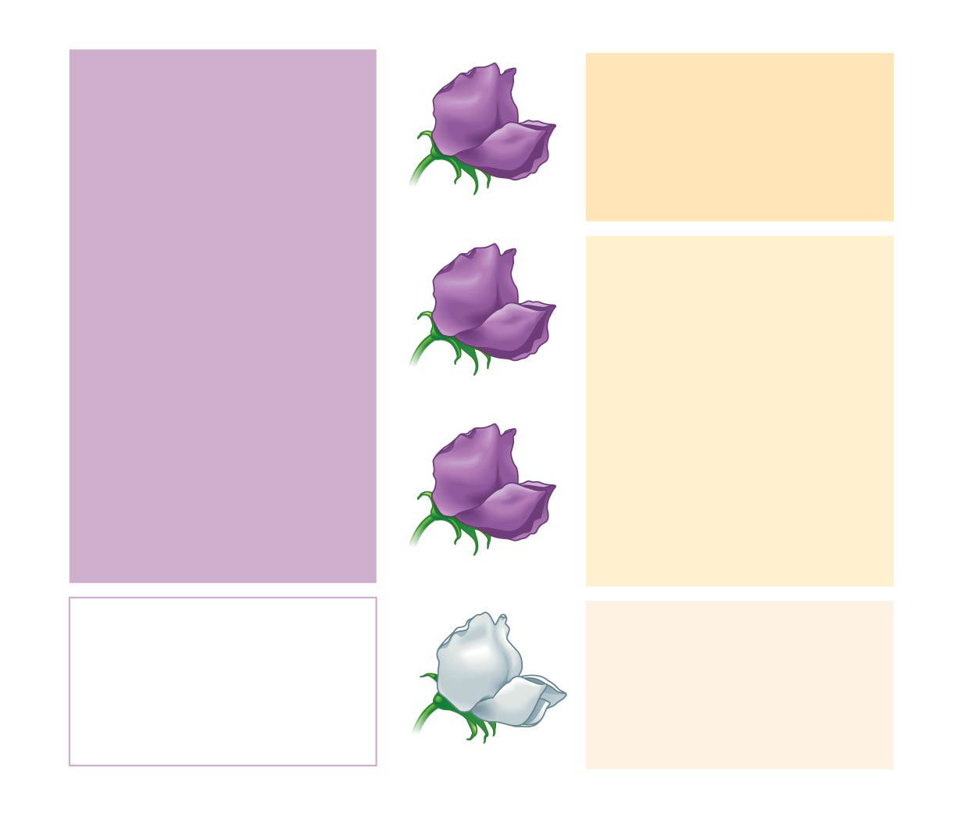
Figure 14.6
Phenotype
Genotype
Purple
PP
(homozygous)
1
3
Purple
Pp
(heterozygous)
2
Purple
Pp
(heterozygous)
White
pp
(homozygous)
1
1
Ratio 3:1
Ratio 1:2:1
Notes:
Figure 14.6 Phenotype versus genotype

Slide 35
Genetics 101: The Testcross
How can you determine the genotype of a dominant phenotype?
How can you determine if a dominant phenotype is either homozygous dominant or heterozygous?
To determine the genotype we can carry out a testcross: breeding the mystery individual with a homozygous recessive individual
If any offspring display the recessive phenotype, the mystery parent MUST be heterozygous

Slide 36
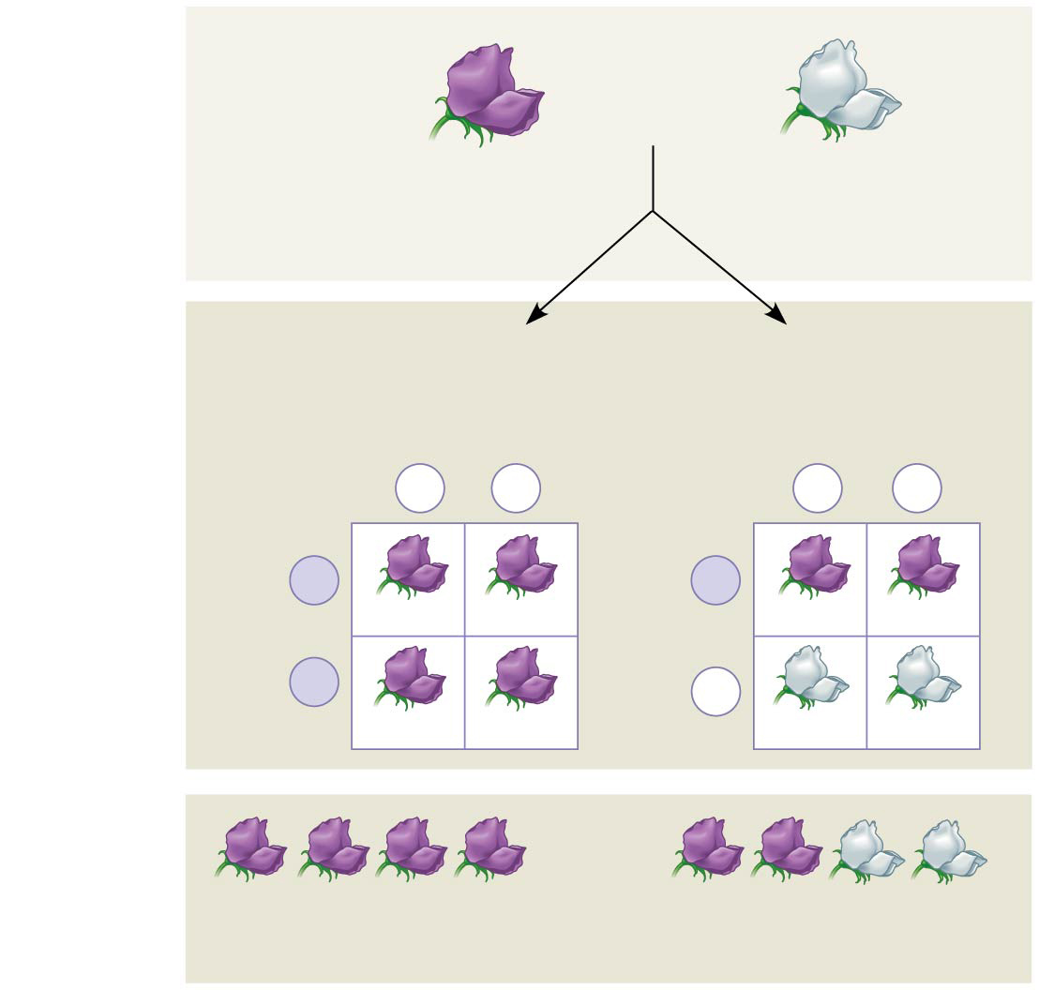
Figure 14.7
Technique
Dominant phenotype,
unknown genotype:
PP or Pp?
Recessive phenotype,
known genotype:
pp
Predictions
If purple-flowered
parent is PP
or
If purple-flowered
parent is Pp
Sperm
Sperm
p
p
p
p
P
P
Eggs
Pp
Pp
Eggs
Pp
Pp
P
p
Pp
Pp
pp
pp
Results
or
All offspring purple
1
offspring purple and
2
1
2
offspring white
Notes:
Figure 14.7 Research method: the testcross

Slide 37
What about Mendel’s 2nd Law?
Mendel derived the law of segregation by following a single character
The F₁ offspring produced in this cross were monohybrids, heterozygous for one character
A cross between such heterozygotes is called a monohybrid cross
What if he followed TWO characters???

Slide 38
Mendel’s 2nd Law: Law of Independent Assortment
Mendel identified his second law of inheritance by following TWO characters at the same time
Crossing two true-breeding parents differing in two characters produces dihybrids in the F₁ generation, heterozygous for both characters
A dihybrid cross, a cross between F₁ dihybrids, can determine whether two characters are transmitted to offspring as a “package” or “independently”

Slide 39
Mendel’s 2nd Law: Law of Independent Assortment
Using a dihybrid cross, Mendel developed the law of independent assortment
It states that each pair of alleles segregates INDEPENDENTLY of each other pair of alleles during gamete formation
This law applies only to genes on different, nonhomologous chromosomes or those far apart on the same chromosome
Genes located near each other on the same chromosome tend to be inherited together (non-Mendelian inheritance, violates this law)

Slide 40
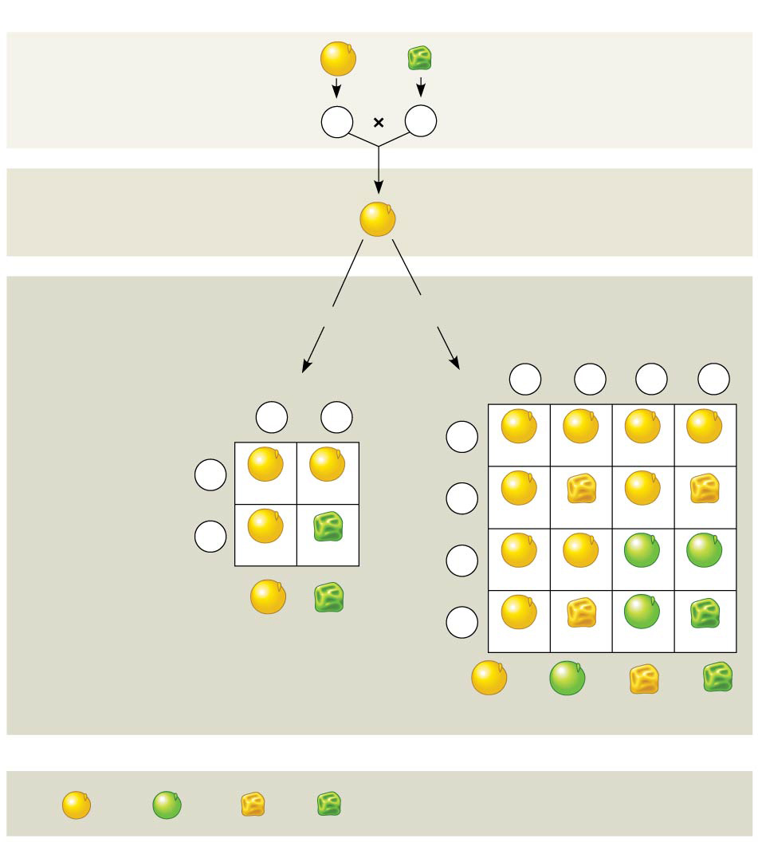
Figure 14.8
Experiment
P Generation
YYRR
yyrr
Gametes
YR
yr
F₁ Generation
YyRr
Predictions
Hypothesis of
dependent assortment
Hypothesis of
independent assortment
or
Sperm
Predicted
offspring of
F₂ generation
1
YR
1
Yr
1
yR
1
yr
Sperm
4
4
4
4
1
YR
1
yr
2
2
1
YR
4
YYRR
YYRr
YyRR
YyRr
1
YR
2
YYRR
YyRr
1
Eggs
4
Yr
YYRr
YYrr
YyRr
Yyrr
1
yr
Eggs
2
YyRr
yyrr
1
4
yR
YyRR
YyRr
yyRR
yyRr
3
1
4
4
1
yr
Phenotypic ratio 3:1
4
YyRr
Yyrr
yyRr
yyrr
9
3
3
1
16
16
16
16
Phenotypic ratio 9:3:3:1
Results
315
108
101
32
Phenotypic ratio approximately 9:3:3:1
Notes:
Figure 14.8 Inquiry: Do the alleles for one character assort into gametes dependently or independently of the alleles for a different character?

Slide 41
Notes:
What do we mean when we use the terms monohybrid cross and dihybrid cross?
https://www.polleverywhere.com/multiple_choice_polls/nF79qo9HE16exjS

Slide 42
Overview
Concept 14.1: Mendel used the scientific approach to identify two laws of inheritance
Concept 14.2: Probability laws govern Mendelian inheritance

Slide 43
Concept 14.2: Probability laws govern Mendelian inheritance
Mendel’s laws of segregation and independent assortment reflect the rules of probability
When tossing a coin, the outcome of one toss has no impact on the outcome of the next toss
In the same way, the alleles of one gene segregate into gametes independently of another gene’s alleles
The rules of probability give us the multiplication and addition rules

Slide 44
The Multiplication and Addition Rules Applied to Monohybrid Crosses
The multiplication rule states that the probability that two or more independent events will occur together is the product of their individual probabilities
Probability in an F₁ monohybrid cross can be determined using the multiplication rule
Segregation in a heterozygous plant is like flipping a coin: Each gamete has a ½ chance of carrying the dominant allele and a ½ chance of carrying the recessive allele

Slide 45
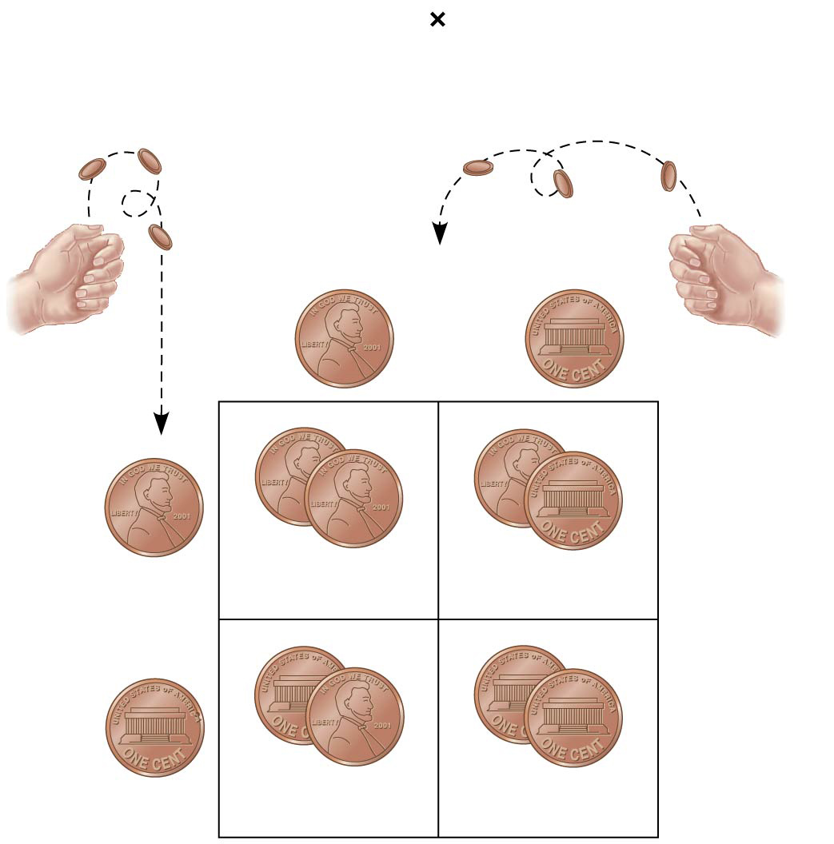
Figure 14.9
Rr
Rr
Segregation of
alleles into eggs
Segregation of
alleles into sperm
Sperm
1
2
R
1
2
r
R
R
1
2
R
R
r
1
4
1
4
Eggs
r
r
1
2
r
R
r
1
4
1
4
Notes:
Figure 14.9 Segregation of alleles and fertilization as chance events

Slide 46
The Multiplication and Addition Rules Applied to Monohybrid Crosses
The addition rule states that the probability that any one of two or more exclusive events will occur is calculated by adding together their individual probabilities
The rule of addition can be used to figure out the probability that an F₂ plant from a monohybrid cross will be heterozygous rather than homozygous

Slide 47
Solving Complex Genetics Problems with the Rules of Probability
We can apply the multiplication and addition rules to predict the outcome of crosses involving multiple characters
A multicharacter cross is equivalent to two or more independent monohybrid crosses occurring simultaneously
In calculating the chances for various genotypes, each character is considered separately, and then the individual probabilities are multiplied

Slide 48
Overview
Concept 14.1: Mendel used the scientific approach to identify two laws of inheritance
Concept 14.2: Probability laws govern Mendelian inheritance
Mendel’s Paper: http://www.bialigy.com/uploads/1/2/7/3/12737194/mendel_-_experiments_in_plant_hybridization.pdf

