Slide 1
Origins of Genetic Variation Among Offspring

Slide 2
Origins of Genetic Variation Among Offspring
1. Independent Assortment of Chromosomes
Homologous pairs of chromosomes orient RANDOMLY at metaphase I of meiosis
In independent assortment, each pair of chromosomes sorts maternal and paternal homologs into daughter cells INDEPENDENTLY of the other pairs

Slide 3
Origins of Genetic Variation Among Offspring
1. Independent Assortment of Chromosomes
The number of combinations possible when chromosomes assort independently into gametes is 2^{n}, where n is the haploid number
For humans (n = 23), there are more than 8 million (!!!) (2²³) possible combinations of chromosomes

Slide 4
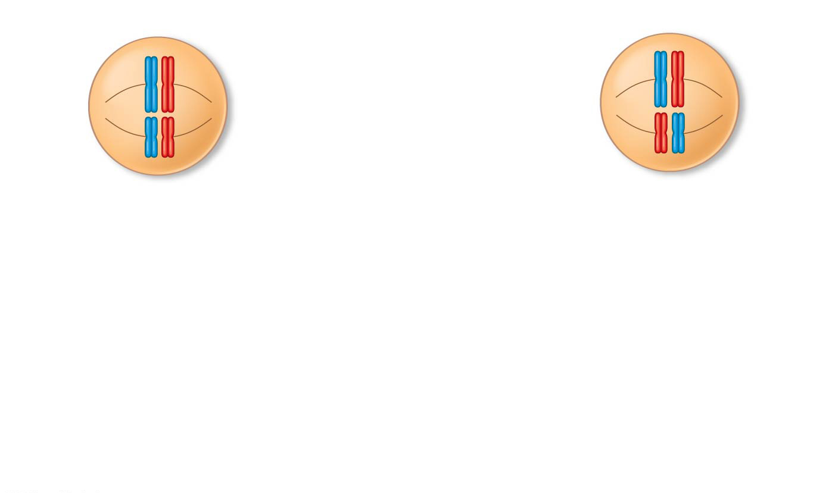
Figure 13.11-1
Possibility 1
Possibility 2
Two equally probable
arrangements of
chromosomes at
metaphase I
Notes:
Figure 13.11-1 The independent assortment of homologous chromosomes in meiosis (step 1)

Slide 5
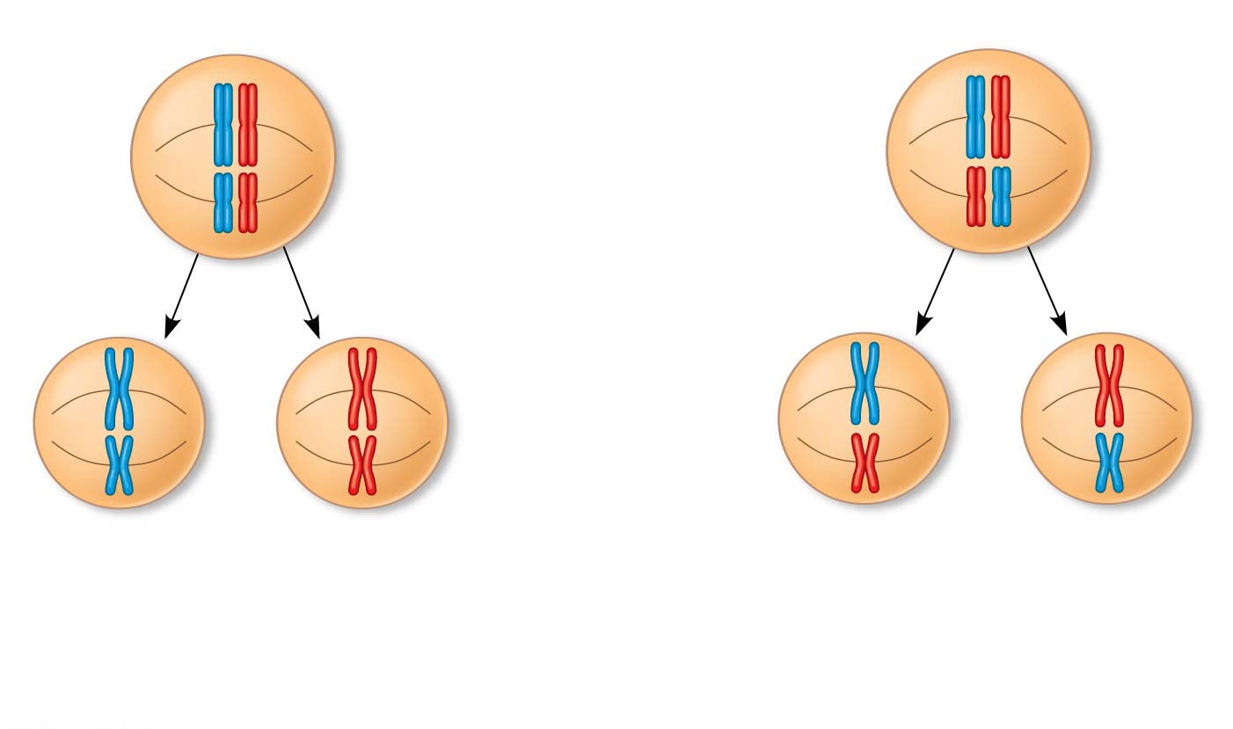
Figure 13.11-2
Possibility 1
Possibility 2
Two equally probable
arrangements of
chromosomes at
metaphase I
Metaphase II
Notes:
Figure 13.11-2 The independent assortment of homologous chromosomes in meiosis (step 2)

Slide 6
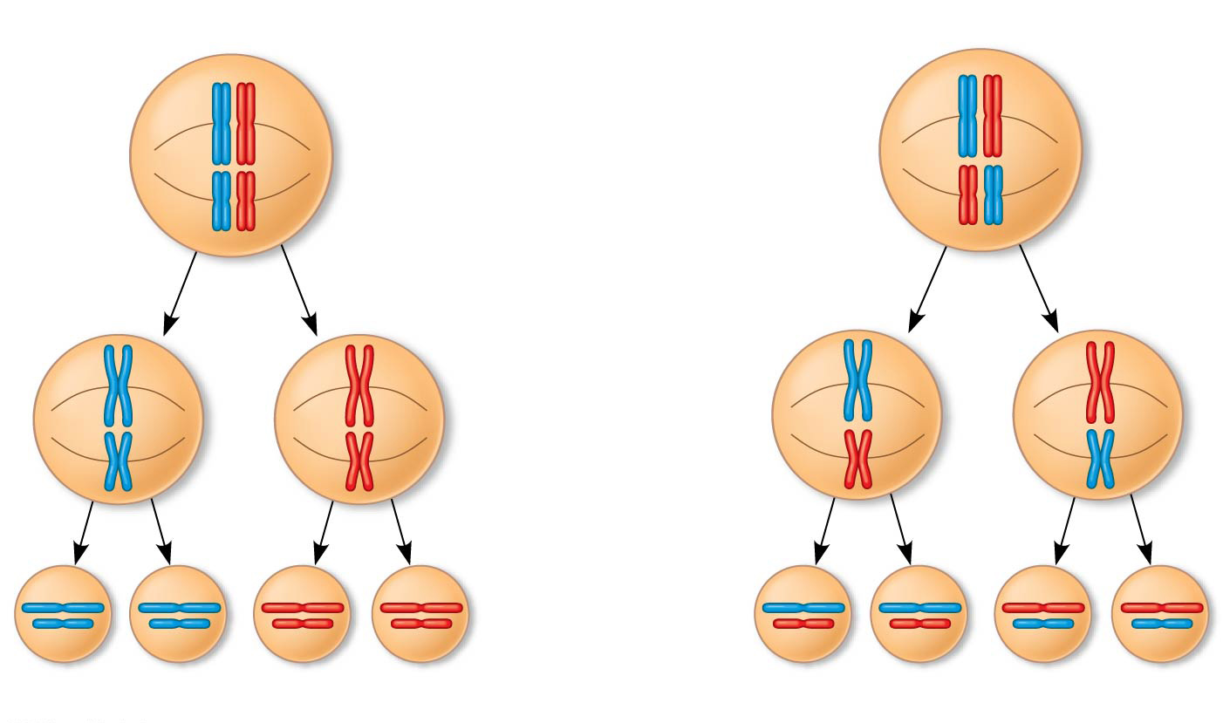
Figure 13.11-3
Possibility 1
Possibility 2
Two equally probable
arrangements of
chromosomes at
metaphase I
Metaphase II
Daughter
cells
Combination 1
Combination 2
Combination 3
Combination 4
Notes:
Figure 13.11-3 The independent assortment of homologous chromosomes in meiosis (step 3)

Slide 7
Origins of Genetic Variation Among Offspring
2. Crossing Over
Crossing over produces recombinant chromosomes, which combine DNA inherited from each parent
Crossing over contributes to genetic variation by COMBINING DNA from two parents into a single chromosome
In humans an average of one to three crossover events occurs per chromosome

Slide 8
Figure 13.12-1
Prophase I
of meiosis
Nonsister chromatids
held together
during synapsis
Pair of
homologs
Notes:
Figure 13.12-1 The results of crossing over during meiosis (step 1)

Slide 9
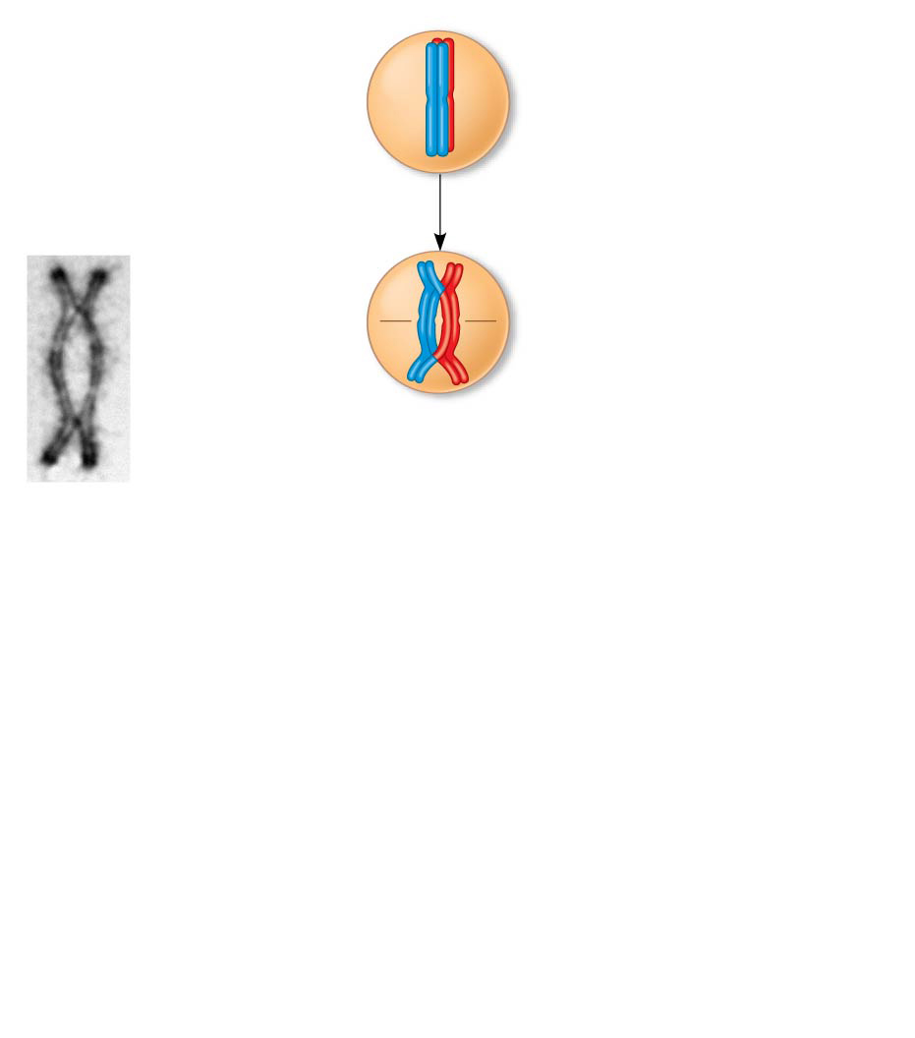
Figure 13.12-2
Prophase I
of meiosis
Nonsister chromatids
held together
during synapsis
Pair of
homologs
1
Synapsis and
crossing over
Chiasma
Centromere
TEM
Notes:
Figure 13.12-2 The results of crossing over during meiosis (step 2)

Slide 10
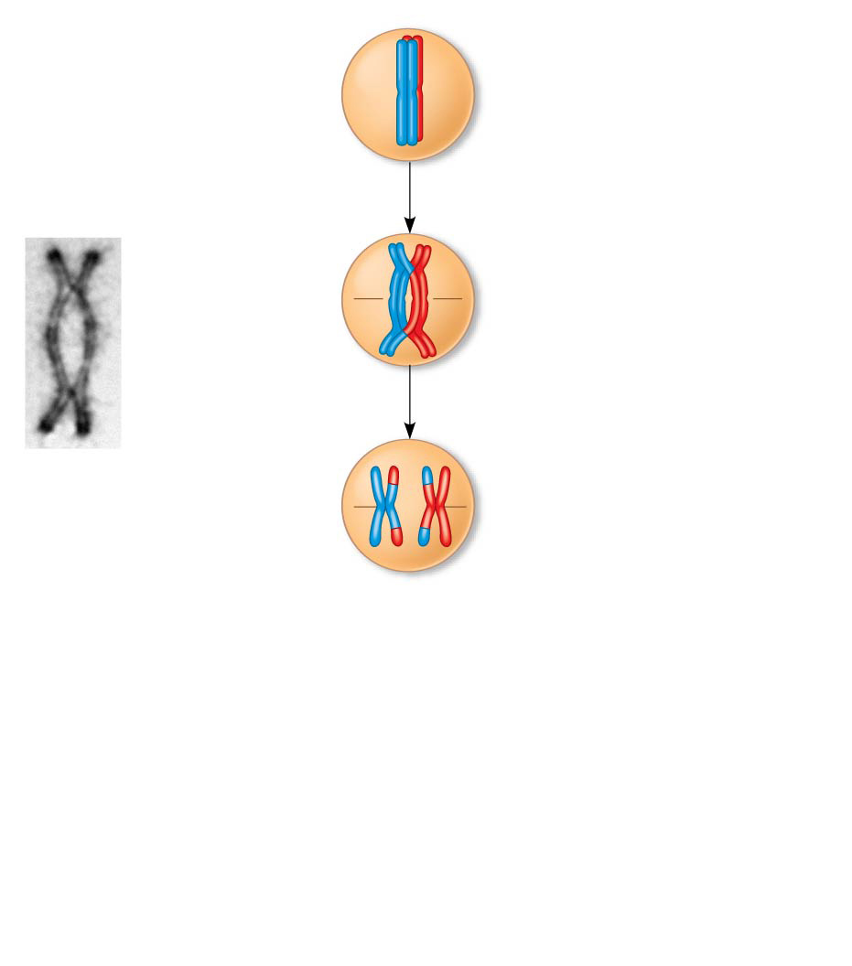
Figure 13.12-3
Prophase I
of meiosis
Nonsister chromatids
held together
during synapsis
Pair of
homologs
1
Synapsis and
crossing over
Chiasma
2
Movement to
the metaphase
I plate
Centromere
TEM
Anaphase I
Notes:
Figure 13.12-3 The results of crossing over during meiosis (step 3)

Slide 11
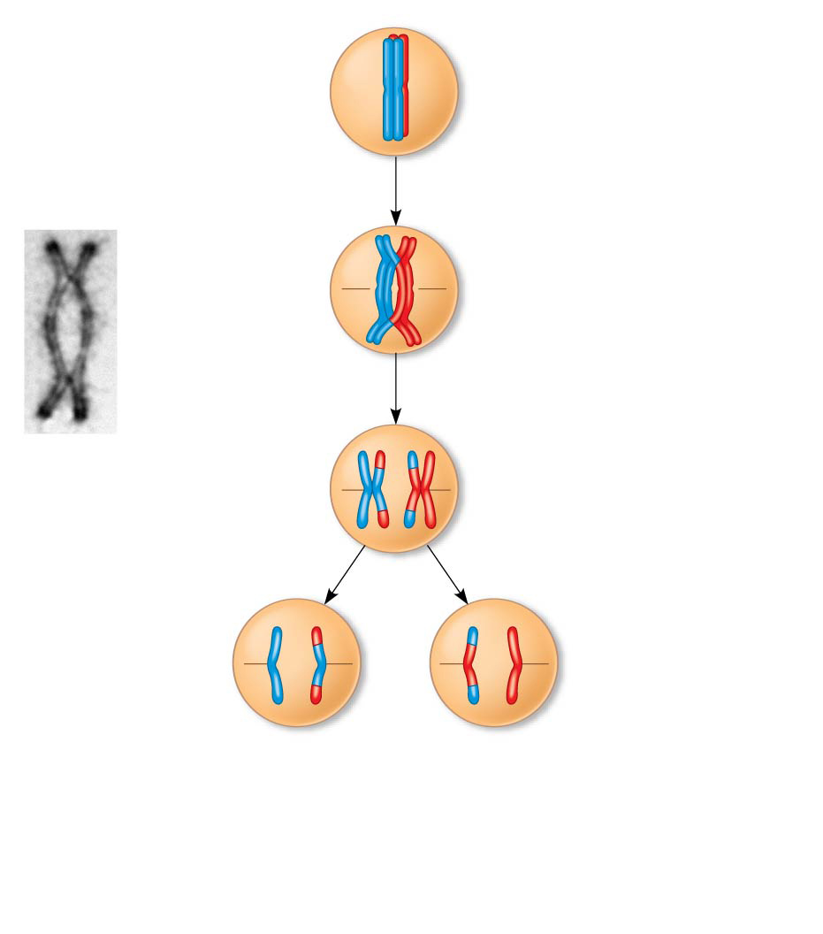
Figure 13.12-4
Prophase I
of meiosis
Nonsister chromatids
held together
during synapsis
Pair of
homologs
1
Synapsis and
crossing over
Chiasma
2
Movement to
the metaphase
I plate
Centromere
3
Breakdown of
proteins holding
sister chromatid
arms together
TEM
Anaphase I
Anaphase II
Notes:
Figure 13.12-4 The results of crossing over during meiosis (step 4)

Slide 12
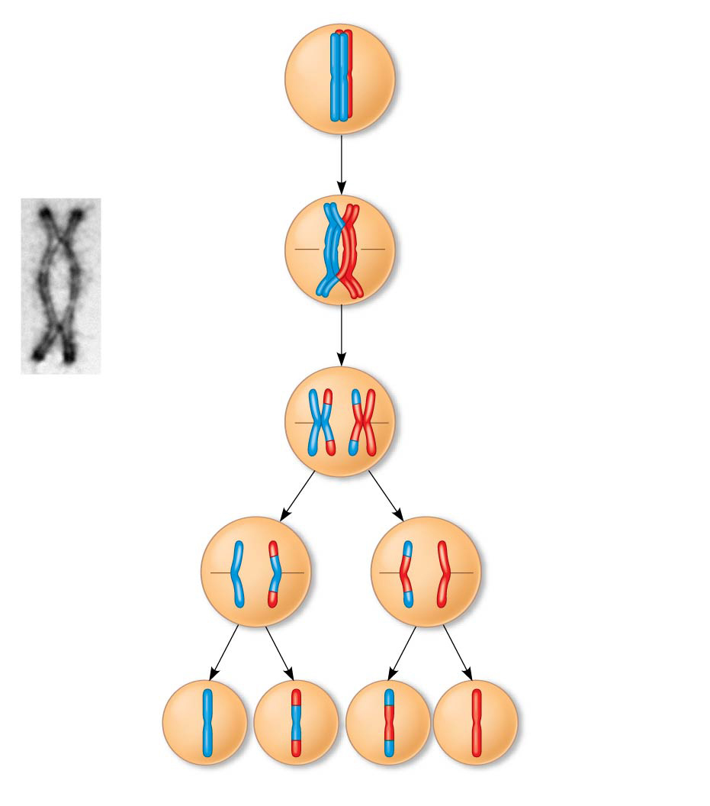
Figure 13.12-5
Prophase I
of meiosis
Nonsister chromatids
held together
during synapsis
Pair of
homologs
1
Synapsis and
crossing over
Chiasma
2
Movement to
the metaphase
I plate
Centromere
3
Breakdown of
proteins holding
sister chromatid
arms together
TEM
Anaphase I
Anaphase II
Daughter
cells
Recombinant chromosomes
Notes:
Figure 13.12-5 The results of crossing over during meiosis (step 5)

Slide 13
Origins of Genetic Variation Among Offspring
3. Random Fertilization
Random fertilization adds to genetic variation because ANY sperm from dad’s meiosis can fuse with ANY ovum (unfertilized egg) from mom’s meiosis
The fusion of two gametes (each with 8.4 million possible chromosome combinations from independent assortment) produces a zygote with any of about 70 TRILLION (!!!) diploid combinations

