Slide 1
AP Biology – Ch. 10 – Photosynthesis
AP Exam Questions

Slide 2
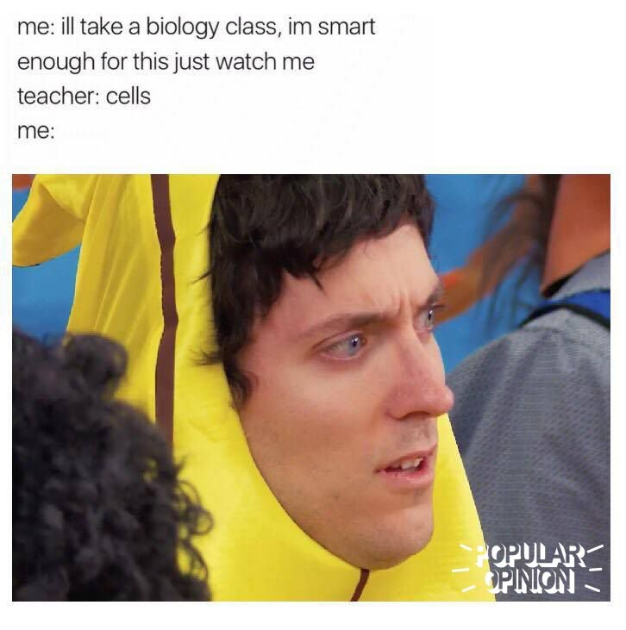
Do Now
Using your notes, EXPLAIN to a partner how photosynthesis and cell respiration are related. Think about…
Inputs (initial reactants)
Outputs (final products)
Redox

Slide 3
Overview
Today, we’ll be answering and analyzing real AP biology multiple choice exam questions on Photosynthesis (Ch. 10.1-10.3).
I will walk us through questions 1-3.
We will complete questions 4-8 as a class in groups.
You will complete questions 9-15 independently using the strategies learned today.

Slide 4
Bloom’s taxonomy
Levels of Questions
Level 1: Knowledge/comprehension
Level 2: Application/analysis
Level 3: Synthesis/evaluation

Slide 5
Question 1
When oxygen is released as a result of photosynthesis, it is a direct by-product of
A) reducing NADP+.
B) splitting water molecules.
C) chemiosmosis.
D) the electron transfer system of photosystem II.
Topic: Concept 10.1
Skill: Knowledge/Comprehension

Slide 6
Question 1
When oxygen is released as a result of photosynthesis, it is a direct by-product of
A) reducing NADP+.
B) splitting water molecules.
C) chemiosmosis.
D) the electron transfer system of photosystem II.
Topic: Concept 10.1
Skill: Knowledge/Comprehension

Slide 7
Question 2
Which of the events listed below occurs in the light reactions of photosynthesis?
A) NADP is produced.
B) NADPH is reduced to NADP+.
C) ATP is phosphorylated to yield ADP.
D) Light is absorbed and funneled to reaction-center chlorophyll a.
Topic: Concept 10.2
Skill: Knowledge/Comprehension

Slide 8
Question 2
Which of the events listed below occurs in the light reactions of photosynthesis?
A) NADP is produced.
B) NADPH is reduced to NADP+.
C) ATP is phosphorylated to yield ADP.
D) Light is absorbed and funneled to reaction-center chlorophyll a.
Topic: Concept 10.2
Skill: Knowledge/Comprehension

Slide 9
Question 3
Some photosynthetic organisms contain chloroplasts that lack photosystem II, yet are able to survive. The best way to detect the lack of photosystem II in these organisms would be
A) to determine if they have thylakoids in the chloroplasts.
B) to test for liberation of O2 in the light.
C) to test for CO2 fixation in the dark.
D) to test for production of either sucrose or starch.
Topic: Concept 10.2
Skill: Application/Analysis

Slide 10
Question 3
Some photosynthetic organisms contain chloroplasts that lack photosystem II, yet are able to survive. The best way to detect the lack of photosystem II in these organisms would be
A) to determine if they have thylakoids in the chloroplasts.
B) to test for liberation of O2 in the light.
C) to test for CO2 fixation in the dark.
D) to test for production of either sucrose or starch.
Topic: Concept 10.2
Skill: Application/Analysis

Slide 11
For the next 5 questions…
Work in your groups to come up with ONE consensus answer
Be prepared to explain your reasoning! (one “volunteer”)

Slide 12
Question 4
Assume a thylakoid is somehow punctured so that the interior of the thylakoid is no longer separated from the stroma. This damage will have the most direct effect on which of the following processes?
A) the splitting of water
B) the absorption of light energy by chlorophyll
C) the flow of electrons from photosystem II to photosystem I
D) the synthesis of ATP
Topic: Concept 10.2
Skill: Application/Analysis

Slide 13
Question 4
Assume a thylakoid is somehow punctured so that the interior of the thylakoid is no longer separated from the stroma. This damage will have the most direct effect on which of the following processes?
A) the splitting of water
B) the absorption of light energy by chlorophyll
C) the flow of electrons from photosystem II to photosystem I
D) the synthesis of ATP
Topic: Concept 10.2
Skill: Application/Analysis

Slide 14
Question 5
P680+ is said to be the strongest biological oxidizing agent. Why?
A) It is the receptor for the most excited electron in either photosystem.
B) It is the molecule that transfers electrons to plastoquinone (Pq) of the electron transfer system.
C) It transfers its electrons to reduce NADP+ to NADPH.
D) This molecule has a stronger attraction for electrons than oxygen, allowing it to obtain electrons from water.
Topic: Concept 10.2
Skill: Synthesis/Evaluation

Slide 15
Question 5
P680+ is said to be the strongest biological oxidizing agent. Why?
A) It is the receptor for the most excited electron in either photosystem.
B) It is the molecule that transfers electrons to plastoquinone (Pq) of the electron transfer system.
C) It transfers its electrons to reduce NADP+ to NADPH.
D) This molecule has a stronger attraction for electrons than oxygen, allowing it to obtain electrons from water.
Topic: Concept 10.2
Skill: Synthesis/Evaluation

Slide 16
Question 6
Some photosynthetic bacteria (e.g., purple sulfur bacteria) have only photosystem I, whereas others (e.g., cyanobacteria) have both photosystem I and photosystem II. Which of the following might this observation imply?
A) Photosynthesis with only photosystem I is more ancestral.
B) Photosystem II may have evolved to be more photoprotective.
C) Linear electron flow is more primitive than cyclic flow of electrons.
D) Cyclic flow is more necessary than linear electron flow.
Topic: Concept 10.2
Skill: Synthesis/Evaluation

Slide 17
Question 6
Some photosynthetic bacteria (e.g., purple sulfur bacteria) have only photosystem I, whereas others (e.g., cyanobacteria) have both photosystem I and photosystem II. Which of the following might this observation imply?
A) Photosynthesis with only photosystem I is more ancestral.
B) Photosystem II may have evolved to be more photoprotective.
C) Linear electron flow is more primitive than cyclic flow of electrons.
D) Cyclic flow is more necessary than linear electron flow.
Topic: Concept 10.2
Skill: Synthesis/Evaluation

Slide 18
Question 7
The pH of the inner thylakoid space has been measured, as have the pH of the stroma and of the cytosol of a particular plant cell. Which, if any, relationship would you expect to find?
A) The pH within the thylakoid is less than that of the stroma.
B) The pH of the stroma is lower than that of the other two measurements.
C) The pH of the stroma is higher than that of the thylakoid space but lower than that of the cytosol.
D) The pH of the thylakoid space is higher than that anywhere else in the cell.
Topic: Concept 10.3
Skill: Application/Analysis

Slide 19
Question 7
The pH of the inner thylakoid space has been measured, as have the pH of the stroma and of the cytosol of a particular plant cell. Which, if any, relationship would you expect to find?
A) The pH within the thylakoid is less than that of the stroma.
B) The pH of the stroma is lower than that of the other two measurements.
C) The pH of the stroma is higher than that of the thylakoid space but lower than that of the cytosol.
D) The pH of the thylakoid space is higher than that anywhere else in the cell.
Topic: Concept 10.3
Skill: Application/Analysis

Slide 20
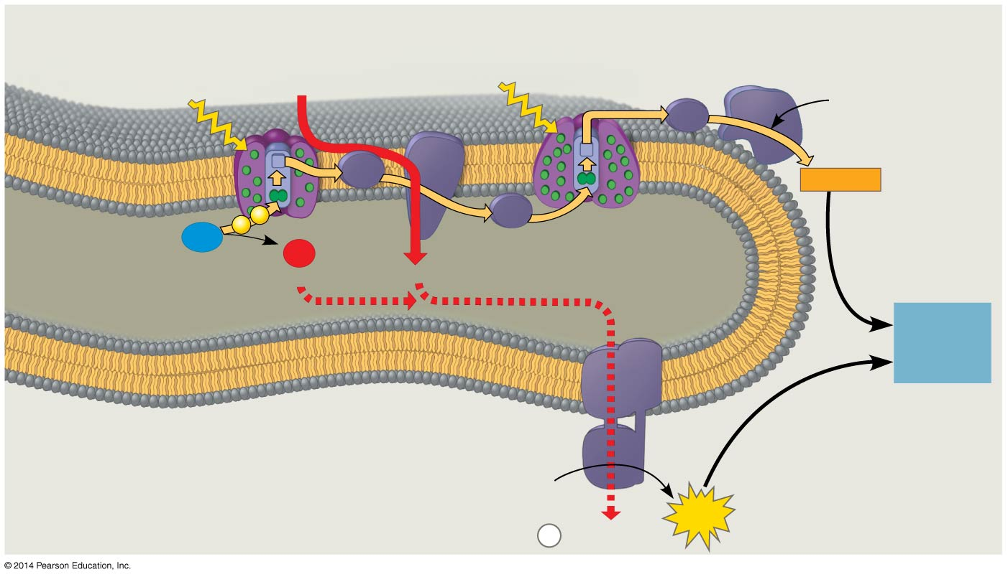
Figure 10.18
Photosystem II
Cytochrome
complex
Photosystem I
NADP⁺
reductase
4 H⁺
Light
3
Light
NADP⁺
+ H⁺
Fd
Pq
NADPH
e⁻
e⁻
2
Pc
H₂O
1
O₂
THYLAKOID SPACE
(high H⁺ concentration)
½
+2 H⁺
4 H⁺
To
Calvin
Cycle
VERSUS
Thylakoid
membrane
ATP
synthase
STROMA
(low H⁺ concentration)
ADP
+
ATP
P
H⁺
i
Notes:
Figure 10.18 The light reactions and chemiosmosis: Current model of the organization of the thylakoid membrane

Slide 21
Question 8
In the process of carbon fixation, RuBP attaches a CO2 to produce a six-carbon molecule, which is then split to produce two molecules of 3-phosphoglycerate. After phosphorylation and reduction produces glyceraldehyde 3-phosphate (G3P), what more needs to happen to complete the Calvin cycle?
A) addition of a pair of electrons from NADPH
B) inactivation of RuBP carboxylase enzyme
C) regeneration of ATP from ADP
D) regeneration of RuBP
Topic: Concept 10.3
Skill: Application/Analysis

Slide 22
Question 8
In the process of carbon fixation, RuBP attaches a CO2 to produce a six-carbon molecule, which is then split to produce two molecules of 3-phosphoglycerate. After phosphorylation and reduction produces glyceraldehyde 3-phosphate (G3P), what more needs to happen to complete the Calvin cycle?
A) addition of a pair of electrons from NADPH
B) inactivation of RuBP carboxylase enzyme
C) regeneration of ATP from ADP
D) regeneration of RuBP
Topic: Concept 10.3
Skill: Application/Analysis

Slide 23
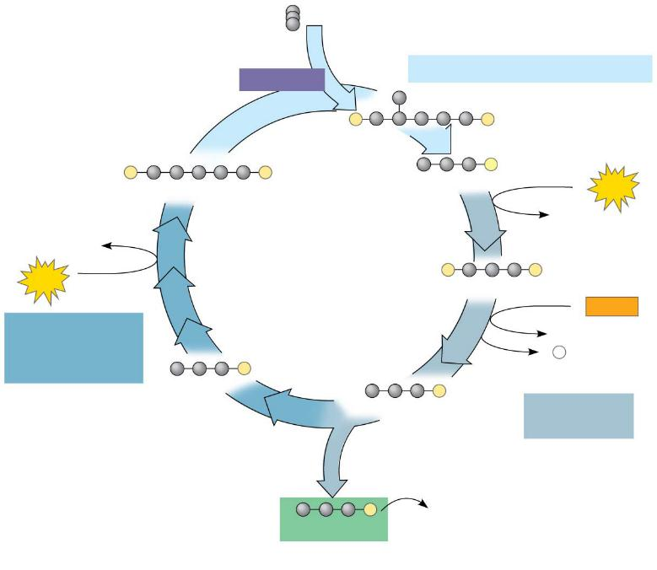
Figure 10.19-3
Input 3 CO₂, entering one per cycle
Phase 1: Carbon fixation
Rubisco
3
P
P
3
P
P
6
P
RuBP
3-Phosphoglycerate
6
ATP
6 ADP
3 ADP
Calvin
Cycle
3
ATP
6
P
P
1,3-Bisphosphoglycerate
6
NADPH
Phase 3:
Regeneration
of RuBP
6 NADP⁺
6
P
5
P
i
G3P
6
P
G3P
Phase 2:
Reduction
1
P
Glucose and
other organic
compounds
G3P
Output
Notes:
Figure 10.19-3 The Calvin cycle (step 3)

Slide 24
Questions 9-15
Independently complete these questions. Be sure to use the strategies we’ve discussed!

Slide 25
Questions 9-15 Answers
9. D
10. C
11. B
12. A
13. D
14. C
15. C

Slide 26
Exit Ticket
In groups, come up with your own multiple choice question/answer from any topic covered thus far.
Be sure to appropriately classify it using Bloom’s taxonomy.
Level 1: Knowledge/comprehension
Level 2: Application/analysis
Level 3: Synthesis/evaluation

