Slide 1
1
Evolution, the Themes of Biology, and Scientific Inquiry

Slide 2
Inquiring About Life
Biology = scientific study of life
Biologists ask questions such as:
How does a single cell develop into an organism?
How does the human mind work?
How do living things interact in communities?
Life defies a simple, one-sentence definition
Life is recognized by what living things do
Notes:
Click to add notes

Slide 3
Overview
Concept 1.1: The study of life reveals common themes
Concept 1.2: The Core Theme: Evolution accounts for the unity and diversity of life
Concept 1.3: In studying nature, scientists make observations and form and test hypotheses
Concept 1.4: Science benefits from a cooperative approach and diverse viewpoints

Slide 4
Overview
Concept 1.1: The study of life reveals common themes
Concept 1.2: The Core Theme: Evolution accounts for the unity and diversity of life
Concept 1.3: In studying nature, scientists make observations and form and test hypotheses

Slide 5
Concept 1.1: The study of life reveals common themes
Biology is a subject of ENORMOUS scope
There are five unifying themes
Organization
Information
Energy and matter
Interactions
Evolution

Slide 6
Concept 1.1: The study of life reveals common themes
The Five Themes:
Organization: New Properties Emerge at Successive Levels of Biological Organization
Information: Life’s Processes Involve the Expression and Transmission of Genetic Information
Energy and matter: Life Requires the Transfer and Transformation of Energy and Matter
Interactions: From Ecosystems to Molecules, Interactions Are Important in Biological Systems
Evolution: The Core Theme of Biology

Slide 7
Side note: AP Biology’s 4 “Big Ideas”
Big Idea 1: The process of evolution drives the diversity and unity of life.
Big Idea 2: Biological systems utilize free energy and molecular building blocks to grow, to reproduce and to maintain dynamic homeostasis.
Big Idea 3: Living systems store, retrieve, transmit and respond to information essential to life processes.
Big Idea 4: Biological systems interact, and these systems and their interactions possess complex properties

Slide 8
Concept 1.1: The study of life reveals common themes
Emergent Properties
Emergent properties result from the arrangement and interaction of parts within a system
Emergent properties characterize non-biological entities as well
For example, a functioning bicycle emerges only when all of the necessary parts connect in the correct way

Slide 9
Notes:
Biology is...
https://www.polleverywhere.com/multiple_choice_polls/g9yDDExlAHDsfXN

Slide 10
Overview
Concept 1.1: The study of life reveals common themes
Concept 1.2: The Core Theme: Evolution accounts for the unity and diversity of life
Concept 1.3: In studying nature, scientists make observations and form and test hypotheses

Slide 11
Concept 1.2: The Core Theme: Evolution accounts for the unity and diversity of life
“Nothing in biology makes sense except in the light of evolution” —Theodosius Dobzhansky
Evolutionary mechanisms account for the unity and diversity of all species on Earth
The Three Domains of Life
Organisms are divided into three domains = Bacteria, Archaea, and Eukarya
Plants + protists + fungi + animals = “eukaryotes”
Bacteria + archaea = “prokaryotes”

Slide 12
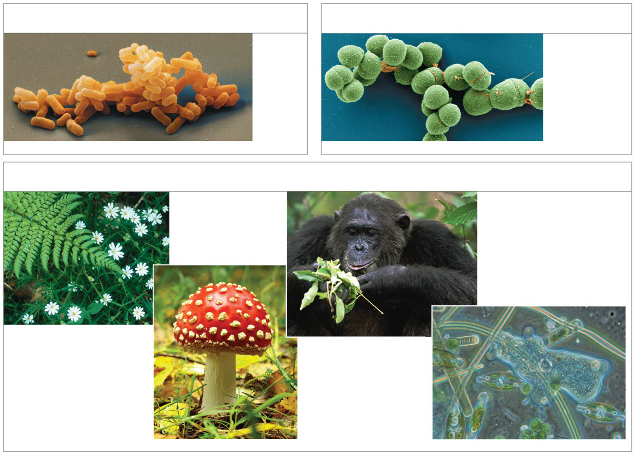
Figure 1.13
(a) Domain Bacteria
(b) Domain Archaea
2 µm
2 µm
(c) Domain Eukarya
Kingdom Animalia
100 µm
Kingdom Plantae
Kingdom Fungi
Protists
Notes:
Figure 1.13 The three domains of life

Slide 13
Notes:
Name the person who said, "Nothing in biology makes sense except in the light of evolution."
https://www.polleverywhere.com/free_text_polls/bDSPmIXncd3zUQp

Slide 14
Overview
Concept 1.1: The study of life reveals common themes
Concept 1.2: The Core Theme: Evolution accounts for the unity and diversity of life
Concept 1.3: In studying nature, scientists make observations and form and test hypotheses

Slide 15
Concept 1.3: In studying nature, scientists make observations and form and test hypotheses
The word science is derived from Latin and literally means “to know” !!!
Inquiry = the search for information and explanations of natural phenomena
The scientific process (eh) includes making observations, forming logical hypotheses, and testing them

Slide 16
Concept 1.3: In studying nature, scientists make observations and form and test hypotheses
Making Observations
Biologists describe NATURAL structures and processes based on observation and the analysis of data
Recorded observations = data
Qualitative data = recorded descriptions
Quantitative data = numerical measurement, organized into tables and graphs

Slide 17
Notes:
Give an example of QUANTITATIVE data.
https://www.polleverywhere.com/free_text_polls/EcjwtUYay3QSSXm

Slide 18
Notes:
Give an example of QUALITATIVE data.
https://www.polleverywhere.com/free_text_polls/iBW4O14EUS2Fnou

Slide 19
Concept 1.3: In studying nature, scientists make observations and form and test hypotheses
Forming and Testing Hypotheses
In science…
Hypothesis = tentative answer to a well-framed scientific question
It is usually a rational accounting for a set of observations
It leads to predictions that CAN BE TESTED by making additional observations or by performing experiments (testable & falsifiable)

Slide 20
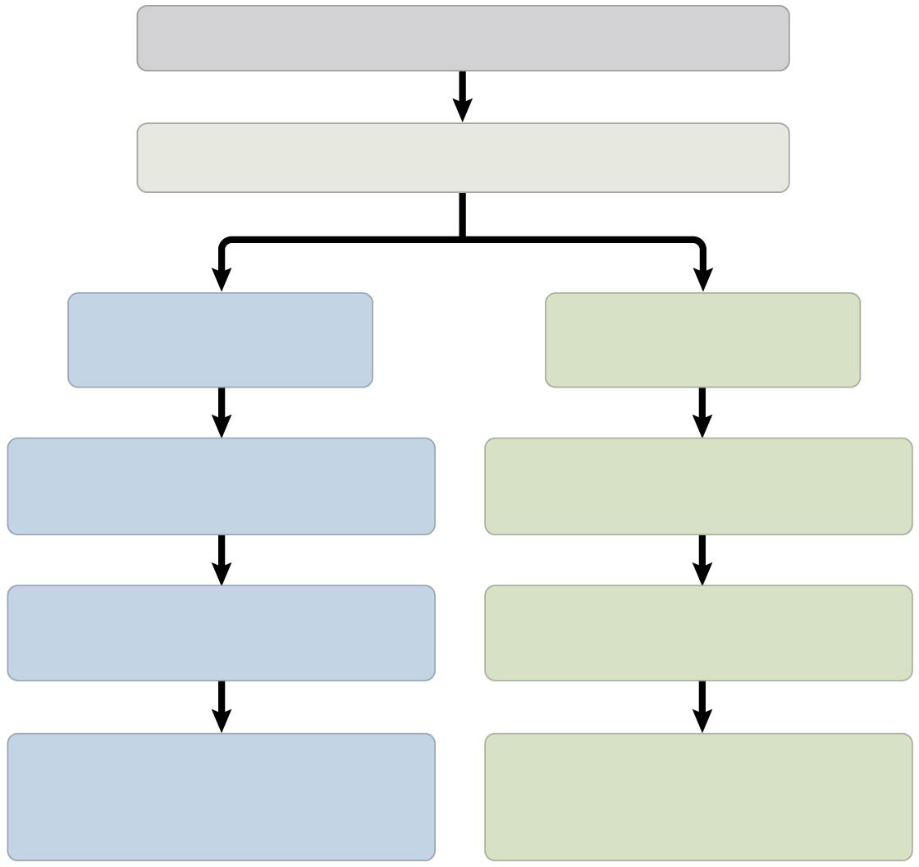
Figure 1.22
Observation: Flashlight doesn’t work.
Question: Why doesn’t the flashlight work?
Hypothesis #1: Batteries are dead.
Hypothesis #2: Bulb is burnt out.
Prediction: Replacing batteries will fix problem.
Prediction: Replacing bulb will fix problem.
Test of prediction: Replace batteries.
Test of prediction: Replace bulb.
Result: Flashlight doesn’t work. Hypothesis is contradicted.
Result: Flashlight works. Hypothesis is supported.
Notes:
Figure 1.22 A simplified view of the scientific process

Slide 21
Notes:
A scientific hypothesis must be…
https://www.polleverywhere.com/multiple_choice_polls/TAInRJjn5u9gP1u

Slide 22
Concept 1.3: In studying nature, scientists make observations and form and test hypotheses
The Flexibility of the Scientific Process
The scientific method is an idealized process of inquiry
Hypothesis-based science is based on the “textbook” scientific method but RARELY follows all the ordered steps
Backtracking and “rethinking” may be necessary part way through the process

Slide 23
Concept 1.3: In studying nature, scientists make observations and form and test hypotheses
Experimental Variables and Controls
In a controlled experiment, an experimental group is COMPARED with a control group
Ideally, experimental and control groups DIFFER in only the ONE FACTOR under investigation

Slide 24
Concept 1.3: In studying nature, scientists make observations and form and test hypotheses
Theories in Science
In the context of science, a theory is:
Broader in scope than a hypothesis
General, and can lead to new testable hypotheses
Supported by a LARGE BODY OF EVIDENCE in comparison to a hypothesis

Slide 25
Overview
Concept 1.1: The study of life reveals common themes
Concept 1.2: The Core Theme: Evolution accounts for the unity and diversity of life
Concept 1.3: In studying nature, scientists make observations and form and test hypotheses

Slide 26
Notes:
I will get a score of _____ on the AP test in May.
https://www.polleverywhere.com/multiple_choice_polls/XZPtGwUaW0N0I2d

